Slide 1
Hygiene Practices From The Past Are So Gross They’re Funny
This illustrates that cultures do change over time, some faster than others; however, they all change.

Slide 2
They were doing the best they could with what the had.
Of course, our ancestors from medieval times and the Renaissance era had slightly different standards than we do. Before the advent of modern plumbing, electricity and the medical expertise we have now, personal hygiene was, um, slightly gross (to put it lightly). No wonder the average life expectancy was a mere 30 years. This was the time of the plague, after all.
Prior to the modern conveniences we have today, people had to resort to some pretty strange practices for cosmetics, dentistry and even feminine care. If you think port-a-potties are gross, wait until you see what we used as toilets back in Victorian times!

Slide 3
Major causes of culture change
Changes in technology
New knowledge and understanding
Exposure to other cultures
These account for the following practices no longer being used in developed countries

Slide 4
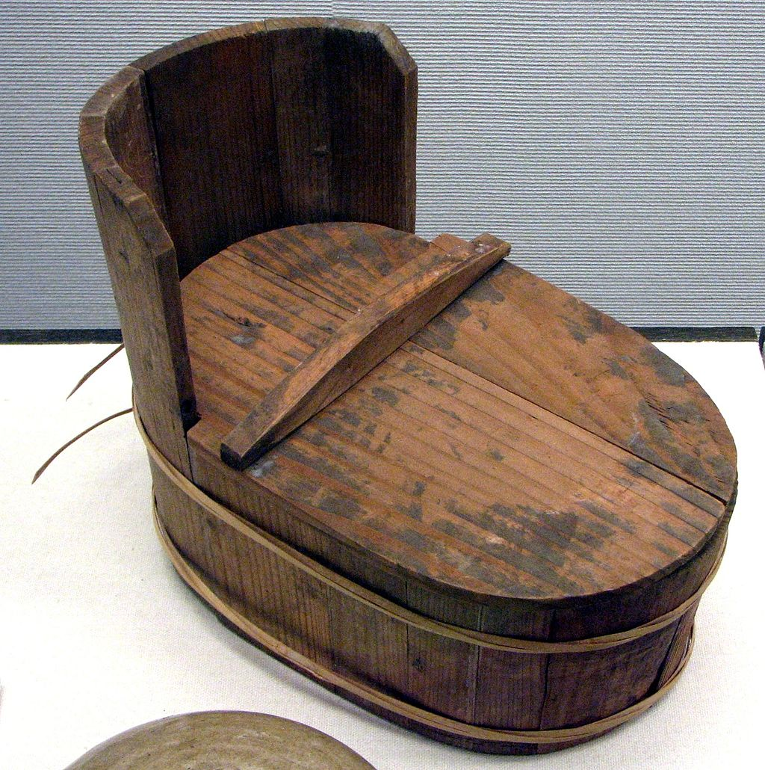
1. People used to pee and poo in pots kept under their beds.
If you were to wake up in the middle of the night realizing that you had too much water before going to bed, you wouldn’t run down the hall to the bathroom. You’d reach right under your bed to pull out the bedpan. When you were finished, you’d just stash the bowl right back where you got it.
In certain cities, the bedpans would be emptied out the window and right onto the street. Blarf!

Slide 5
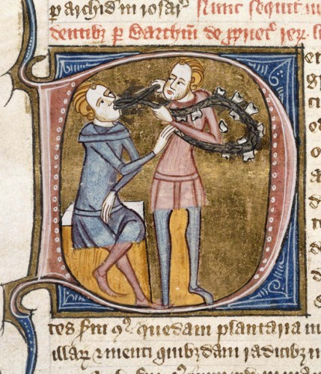
2. If you had a toothache or a cavity, you'd just pull out your tooth.
If you think going to the dentist is a scary proposition in our modern age, imagine visiting one in the era before anesthesiology.
Dentists didn’t even exist in the middle ages; you would have to visit a barber. The barber was responsible not just for cutting hair, but pulling teeth, letting blood and performing some other minor surgeries. If basic, non-invasive treatments of toothaches didn’t fix the problem, there was one solution: that tooth was coming out… without the help of Novocain.

Slide 6
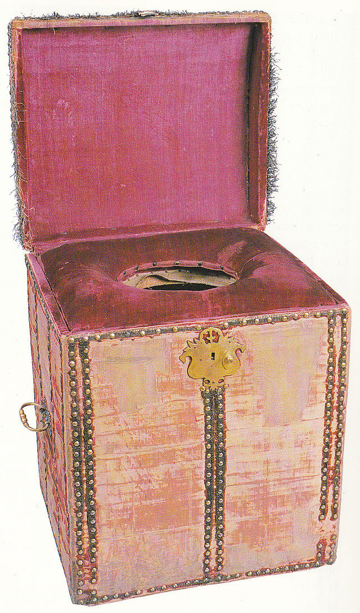
3. Someone was paid to wipe the king's bum.
If you think your job is bad, just be grateful you aren’t the “Groom of the King’s Close Stool.” This position carried the responsibility of following the king around with his portable commode and washing instruments. The groomsman assisted the king with his personal business and the, um, cleaning afterwards.
It may sound like the least respectable position in the court, but it was actually a coveted role given to the sons of nobility. The Groom of the Stool was often one of the king’s most trusted advisors and confidantes due to the nature of his position.

Slide 7
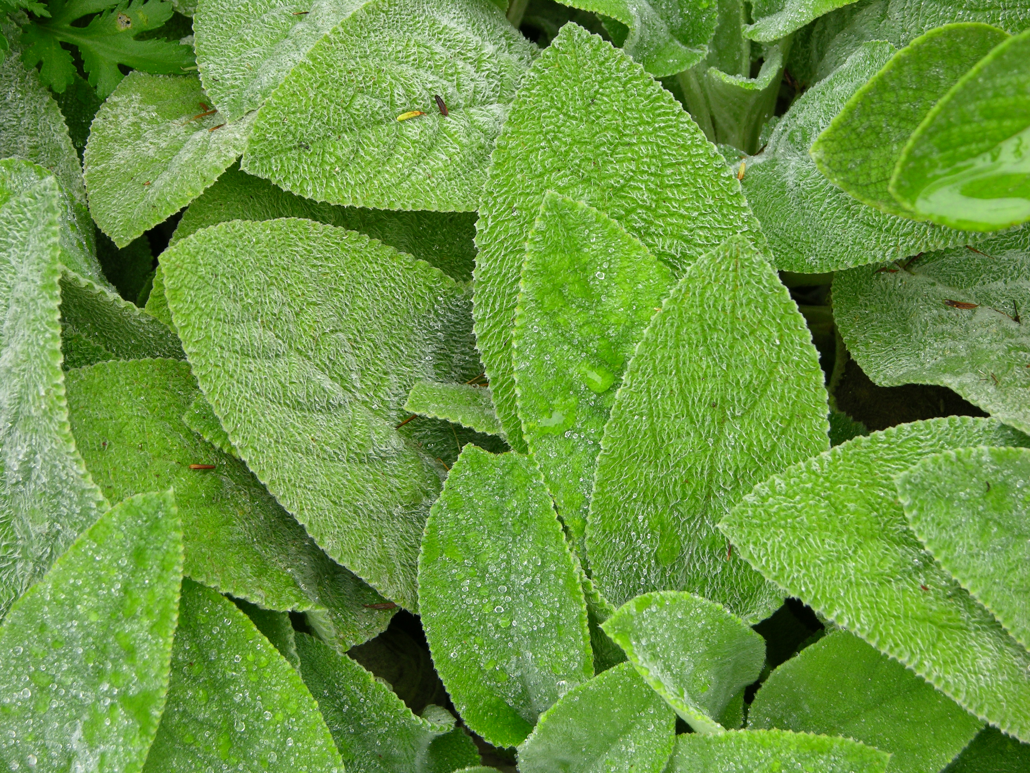
4. Peasants had to use LEAVES for toilet paper.
Peasants obviously didn’t have it as good as the king. Instead, they resorted to using dried leaves as toilet paper.

Slide 8
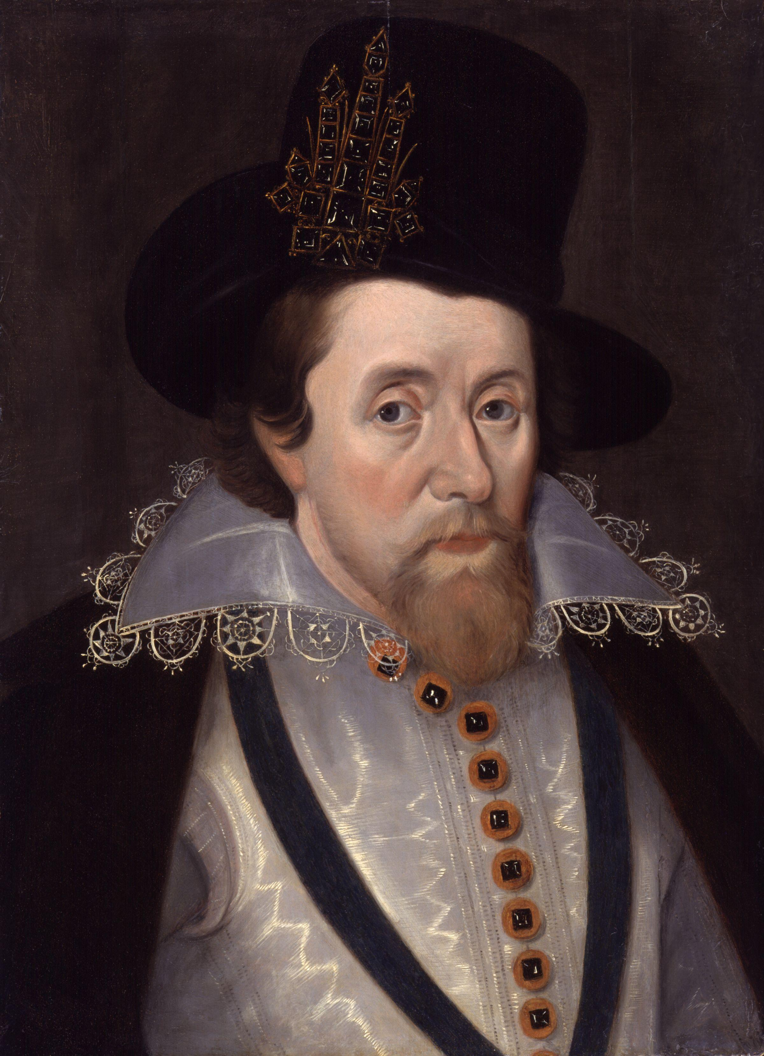
5. People RARELY changed their clothes.
King James VI of Scotland went months at a time without changing his clothes. He even slept in them. Often, people only had four outfits — one for each season. Even a princess might not change her dress for months at a time.

Slide 9
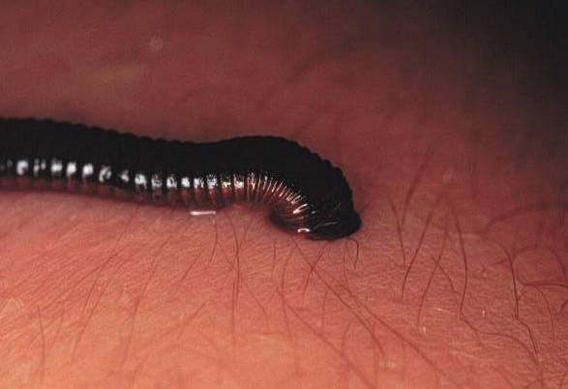
6. If you were feeling sick, you might have a leech drain your blood.
The cure for most ailments during this time was bloodletting through leeches. It was believed that blood was stagnant, not circulating. If you were ill or had a cold, the blood would be fed to a leech. If leeches disgust you, keep in mind that the alternative would be bloodletting with a dirty knife. I’LL HAVE THE LEECH, THANK YOU!

Slide 10
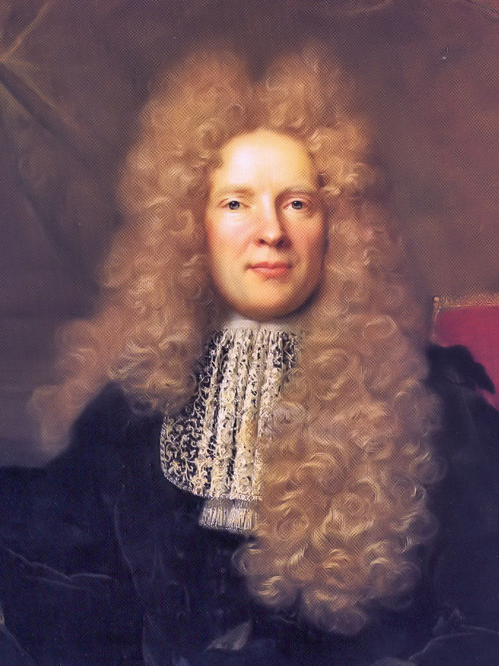
7. Wigs were usually infested with lice.
The periwigs you see in portraits from the 1500s to the 1800s may seem beautiful and grand, but just imagine them covered in hundreds of lice and nits (the eggs of a louse or other parasitic insect also : the insect itself when young). Again… blarf.

Slide 11
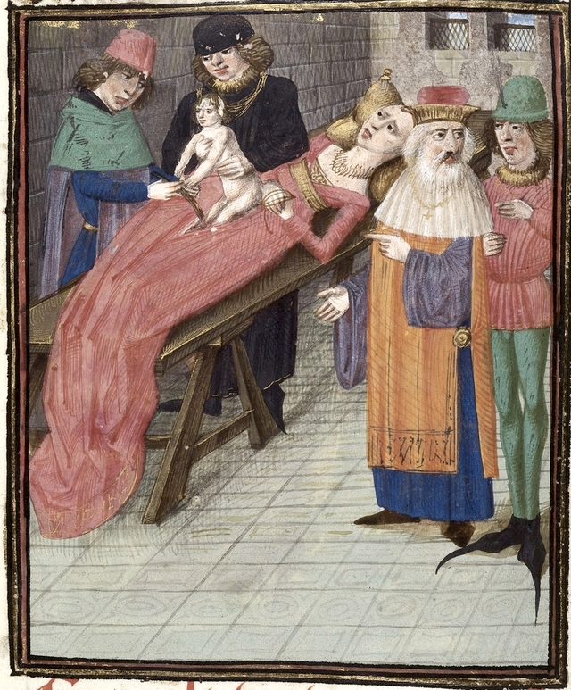
8. Eagle dung was present at most births.
Forget the epidural. When a woman was going through childbirth, she had few comforts. She was given oil and vinegar to drink, and poultices of eagle dung were used to ease her pain.

Slide 12
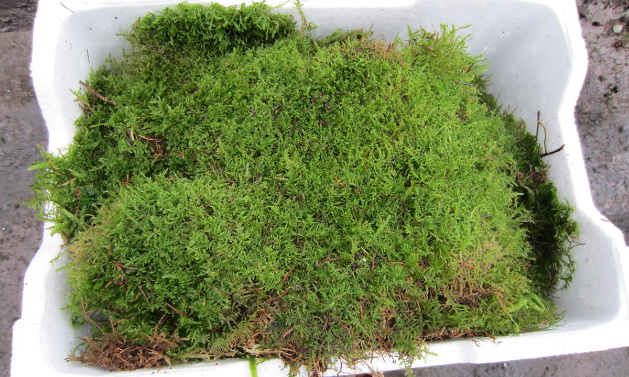
9. Tampons and pads were made of napkins wrapped around moss.
During a woman’s period, tampons and pads were made using the materials folks had within reach. Often, this meant old rags and cloths wrapped around naturally absorbent moss.

Slide 13

10. Urine was used for washing faces.
Especially amongst nobility, a woman took excellent care of the skin on her face. It was washed nearly every day… with urine. It probably seems disgusting, but they firmly believed in urine’s antiseptic ability.
Shockingly, there are some scientists today who still recommend urine as a cure for acne!

Slide 14
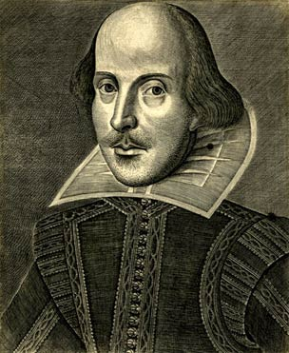
11. A mixture of potassium and chicken droppings were used to "cure" baldness.
Even back then, baldness could was considered embarrassing for a man. In some eras, they just covered the baldness with wigs. Those wanting a permanent cure resorted to rubbing a concoction made of potassium and chicken droppings into the scalp. How lovely!

Slide 15
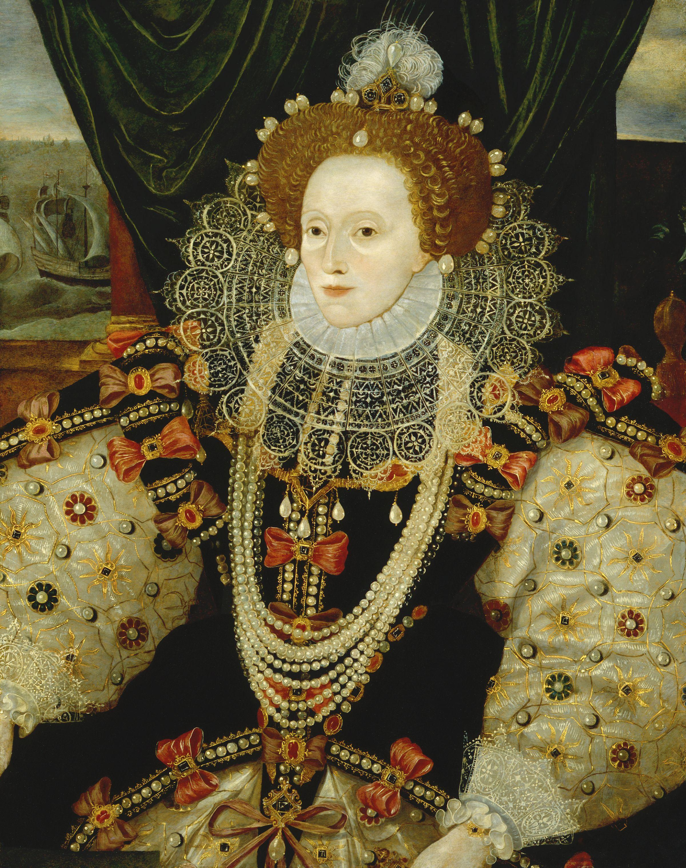
12. Women used Ceruse lead powder for cosmetics.
Women in the Elizabethan era were very particular with their appearances and the most popular cosmetic foundation was Ceruse lead powder. Obviously, the lead was poisonous but it gave them that enviable creamy white complexion.
Queen Elizabeth I would not wash her face, but instead pile new layers of Ceruse lead upon the previous layer upon waking. It’s said that eventually her own skin was dyed gray from all the lead.

Slide 16
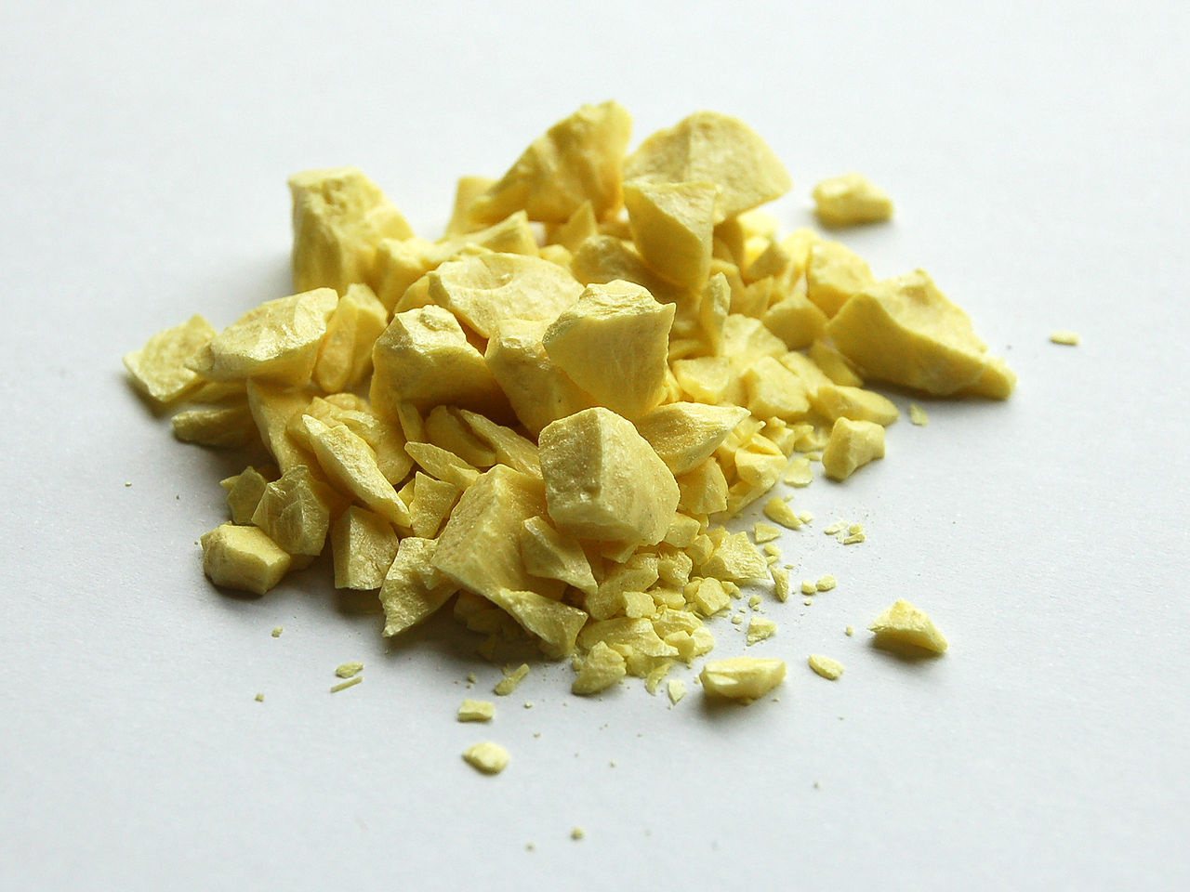
13. Sulphur was used to get rid of freckles.
Freckles were considered a disgusting, unsightly blemish. Sulphur would be vigorously rubbed into the skin daily to minimize their appearance.

Slide 17
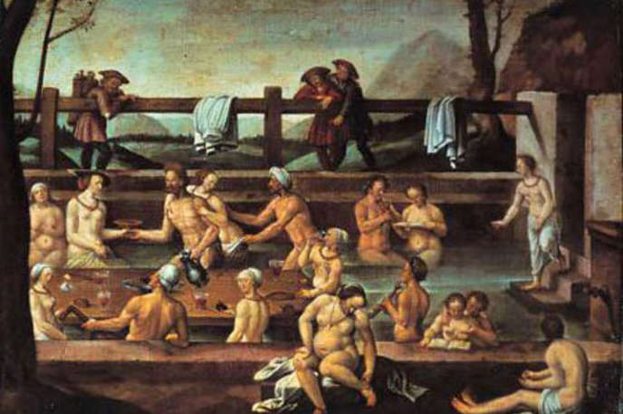
14. Everyone bathed in the same water.
Showers and tubs were rarely found in the home. When people did bathe, it was usually in a common area where hundreds of others had bathed.

Slide 18
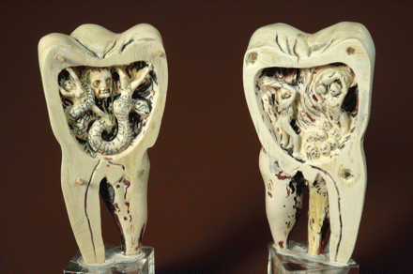
15. Maybe your tooth hurts because of a tooth worm?
Physicians in the 15th century prescribed a remedy for toothaches that involved lighting a candle and letting the smoke fill your mouth. Then, you would lean your head over a warm bowl of water so the pain-causing tooth worms would fall into the water.

Slide 19
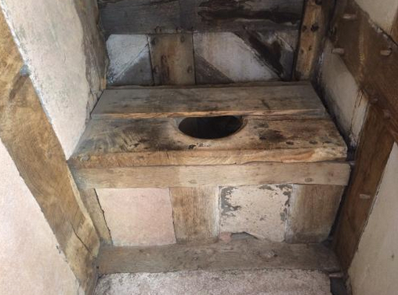
16. The Tudor House toilets were a breeding ground for disease.
Tudor house toilets, like the one pictured here, were rarely cleaned or emptied. They became a breeding ground for infection and disease.

Slide 20
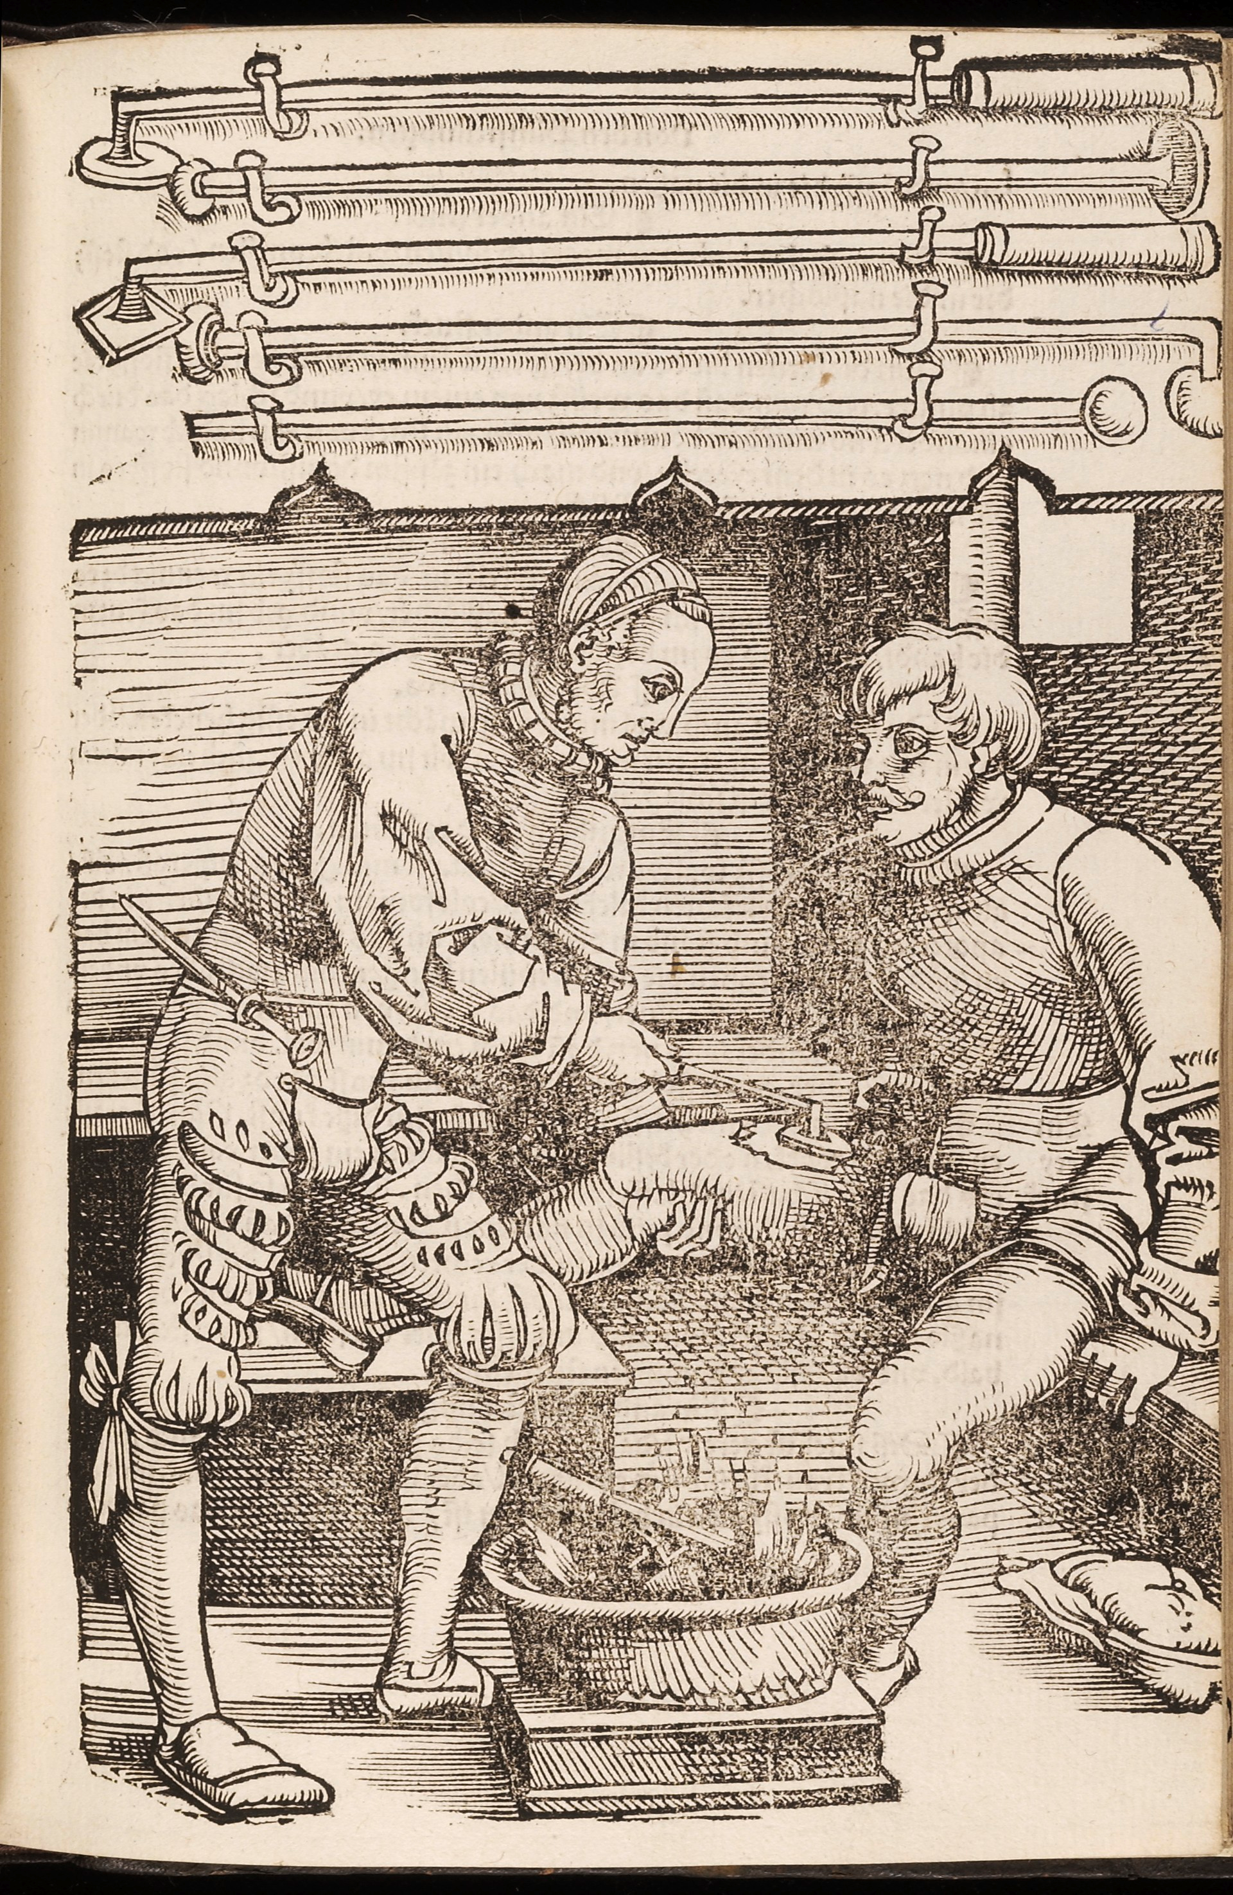
17. Painfully hot pokers were used on ailing body parts.
To protect wounds and cuts from infections, red-hot pokers were used to cauterize the flesh. This was probably just as painful as the initial injuries.

Slide 21
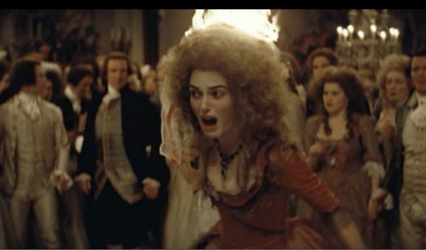
18. Wigs were shaped with animal fat and were highly flammable.
If you look at portraits of Marie Antoinette and other women of the period, their wigs may seem glamorous, but they probably smelled terrible. Wigmakers shaped the wigs with animal fat, making them smelly and prone to catching fire.

Slide 22
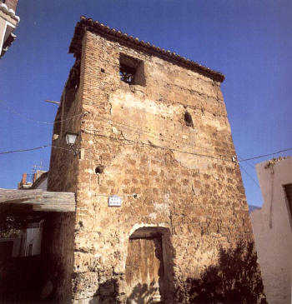
19. Water tanks were lined with lead.
Clean water was a rarity in the past. Unfortunately, it was often stored in tanks lined with lead which caused frequent cases of lead poisoning.

Slide 23
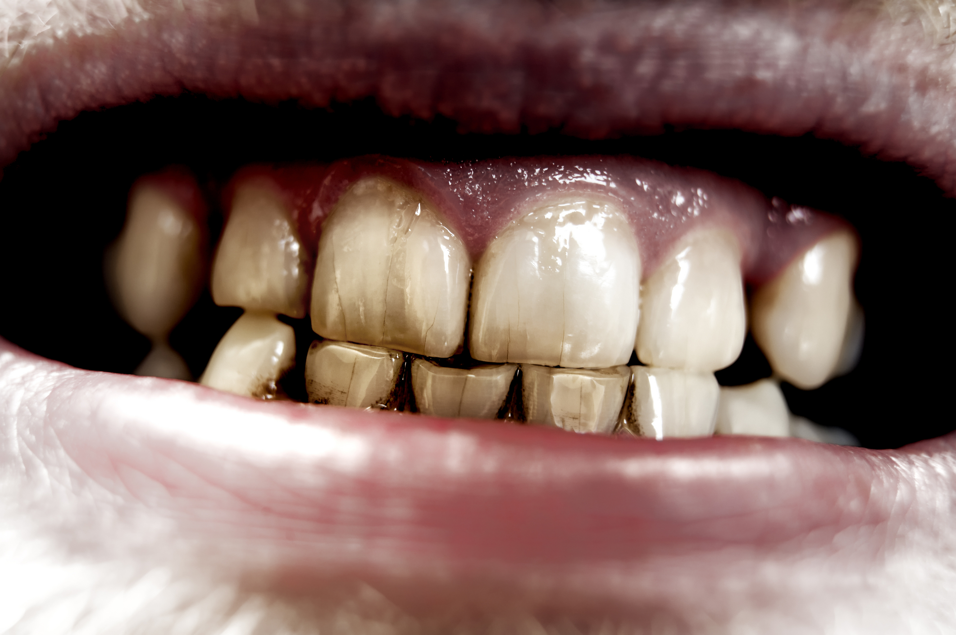
20. Teeth were brushed with a paste of burnt herbs.
Teeth whitening? Not exactly. You were lucky if you made it to adulthood with a full smile.
Toothpastes were made of burnt herbs like rosemary and mint, while wine was a common mouthwash. (Talk about starting your morning out right!)

Slide 24
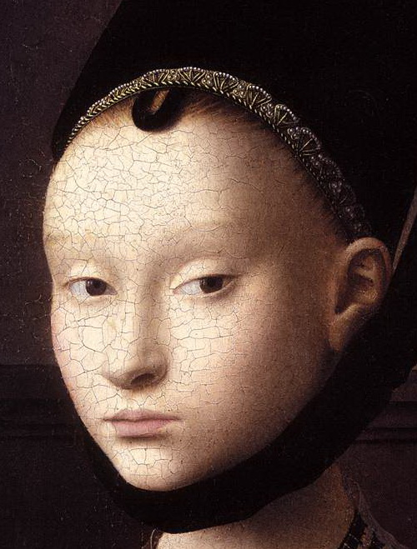
21. Mouse skin was placed on the eyebrows for shaping purposes
A woman’s brow was a very important attribute to her appearance. Women would shape the perfect brow with delicately placed mouse skin.

Slide 25
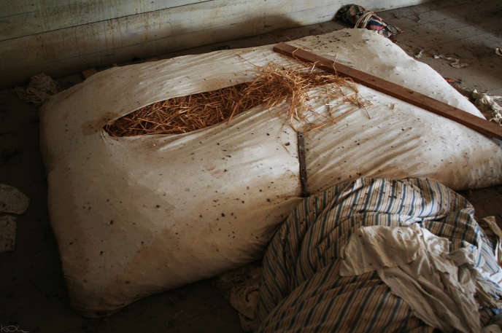
22. Rush floors made people vulnerable to infection and disease.
The rushes in the floors of homes, if not properly maintained, were a breeding ground for a vast array of diseases and infections. They were home to mice, fleas, ticks and several other disease-carrying vermin.
Erasmus (1466-1536) wrote this horrifying first-hand description of rushes and what Medieval floors were like: “Rushes [are] occasionally renewed, but so imperfectly that the bottom layer is left undisturbed, sometimes for twenty years, harboring expectoration, vomiting, the leakage of dogs and men, ale droppings, scraps of fish, and other abominations not fit to be mentioned.”
I don’t want to know about the abominations not fit to be mentioned.

Slide 26
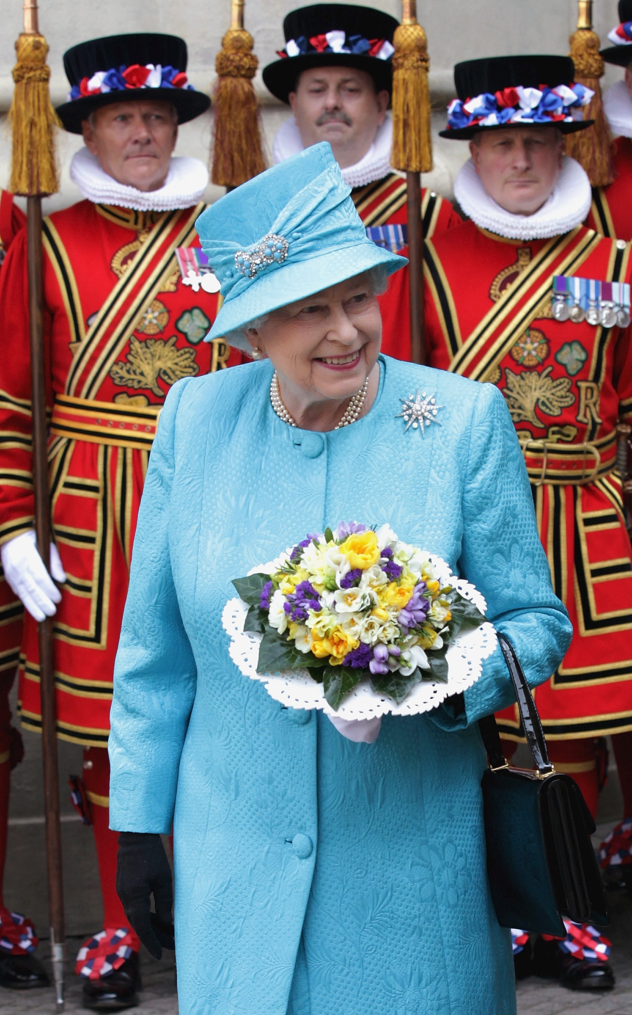
23. Nosegays were used instead of deodorant.
Obviously, deodorants weren’t invented for many centuries later. Bouquets of nosegays were carried to mask the malodorous smell of body odor, although pretty much everyone smelled funky, so nobody really noticed.

Slide 27
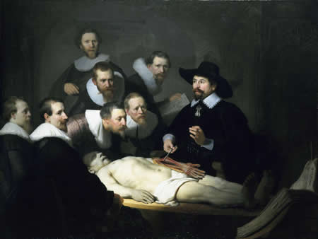
24. Urine was used as an antiseptic.
The most common antiseptic during Victorian times was wine (well, it does contain alcohol) or urine. (Actually, urine leaves the body as a sterile liquid - it was probably more healthful than a lot of other things they might have used.)

Slide 28
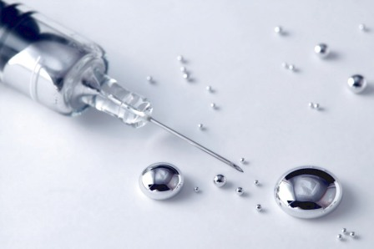
25. Poisonous mercury was used to treat STDs.
Before people realized that it was poisonous, mercury was a common “remedy” for several diseases… Especially STDs. Talk about making a bad thing worse!

Slide 29
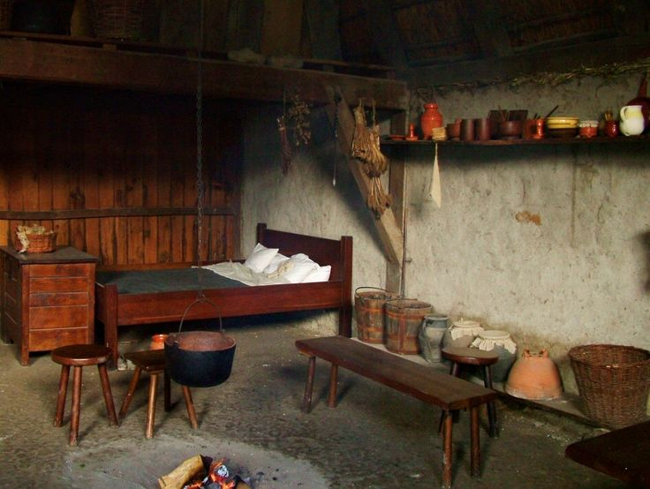
26. Beds were covered in pests and even bird droppings.
Just as the floors of a peasant’s house could make them vulnerable to infection and disease, roofs were often thread-bare and could hardly protect beds from bird droppings. Ugh!

Slide 30
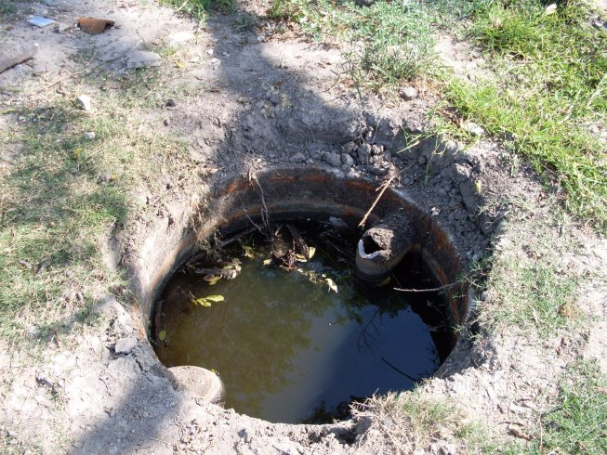
27. Waste was just thrown into cess pits.
So what do you do with those chamber pots when you’re ready to empty them? Just throw it into a hole in the backyard, of course!
The stench would be unbelievably putrid, and the cesspits served as a breeding ground for fatal diseases.

Slide 31
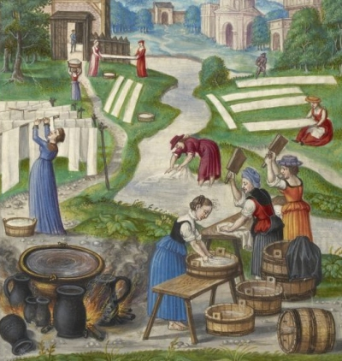
28. Laundry was washed with a mix of lye and urine.
Just to give you a sense of how people must have smelled, remember that people rarely washed their clothes or bathed. To make that worse, when they did, they washed their clothes in a mixture of urine and lye.

Slide 32
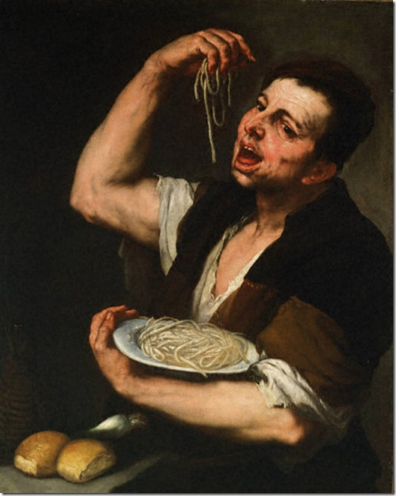
29. Fingers were used instead of forks.
Let’s hope people washed their hands before eating! Forks were not a common utensil at meals, especially for poor families.

Slide 33
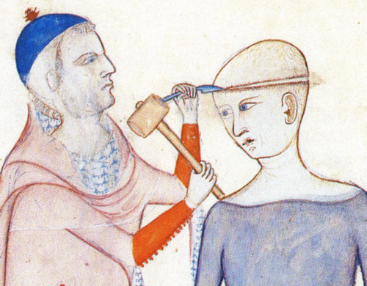
30. There was no such thing as a "clean" surgical instrument.
We’ve already established that urine was one of the most popular disinfectants of the time, so imagine the infection after an operation with a urine drenched scalpel…
Please SHARE with someone who might be interested in the bizarre medical practices of the past.

Slide 34
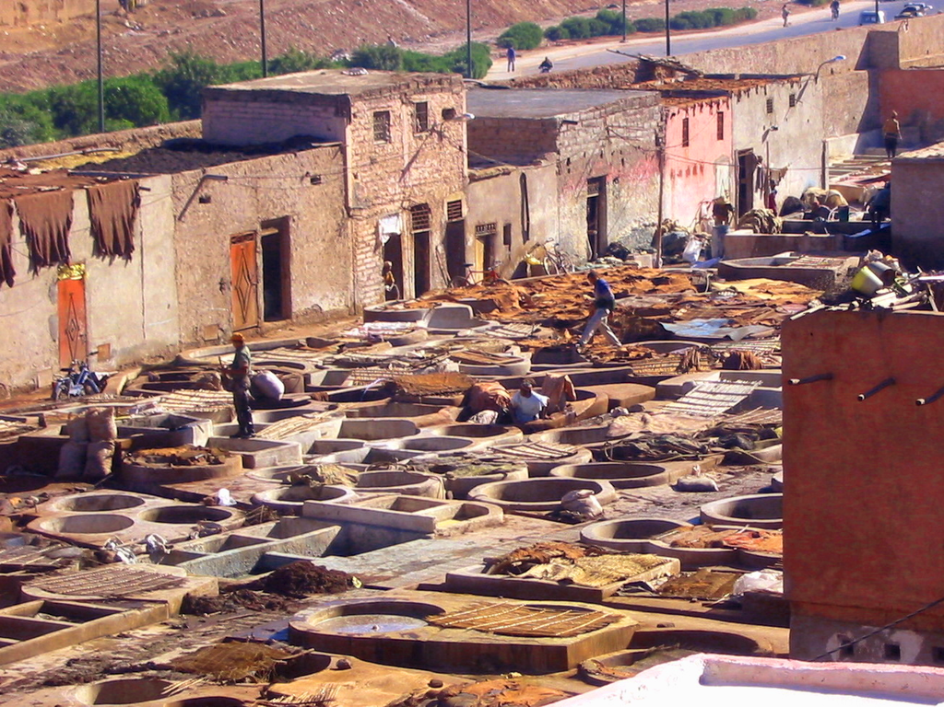
31. Even in the 20th century, urine was used in the tanning of leather, particularly in North Africa
The tanner needed to remove the hair from the skin. This was done by soaking the skin in urine. Sometimes, the dung was mixed with water in a large vat, and the prepared skins were kneaded in the dung water until they became supple from bacterial enzyme action, but not too soft. The ancient tanner might use his bare feet to knead the skins in the dung water, and the kneading could last two or three hours. This combination of urine, animal feces, and decaying flesh made tanneries malodorous.

