Slide 1
Here's What Weddings Looked Like

Slide 2
​Let's embark on a 100-year journey through the history of nuptials, shall we?​

Slide 3
Probably between 1910 and 1914 – My poor, immigrant grandparents from Sicily were married in St. Louis, MO.

Slide 4
1916 Britain

Slide 5
1917 The tradition of bridesmaids wearing matching dresses dates back to ancient Rome, when bridesmaids not only wore the same dresses as each other, but also the same dress as the bride in order to act as decoys against evil spirits (and the bride's exes). Matching striped frocks and fancy hats were worn by these bridesmaids in 1917.

Slide 6
1918

Slide 7
1919

Slide 8
1920 What better way to usher in the Jazz Age than with the wedding of the era's most iconic couple? F. Scott Fitzgerald and Zelda Sayre exchanged vows in front of just eight guests on April 3, 1920 at St. Patrick's Cathedral in New York City.

Slide 9
1921 Silent film actress Natalie Talmadge married Hollywood great Buster Keaton in 1921, carrying a bouquet of roses intertwined with long ribbon streamers, a popular bouquet style in the U.S. at the time.

Slide 12
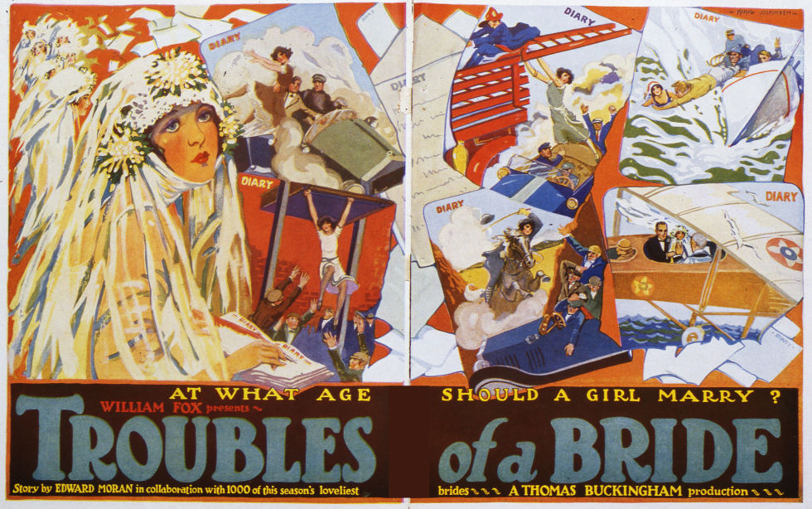

Slide 14
1926 In December 1926, guests showered legendary director Alfred Hitchcock and Alma Reville after the two got "hitch"-ed.

Slide 16
1928

Slide 18
1930 Wedding cakes were initially thought of as a luxury item, as the refined sugars needed to make pure white frosting were very expensive. In fact, the term "royal icing" came about thanks to Queen Victoria and her extravagant, multitiered white-frosted wedding cake. Pictured here is a wedding cake from 1930.

Slide 19
1931 Las Vegas County issued its first gambling license in 1931—and weddings have been a mainstay of Sin City ever since, luring lovebirds with tax licensing laws that meant no blood tests and no waiting periods. Among the earliest celebrities to wed in Las Vegas were the actors Clara Bow and Rex Bell, who tied the knot there in 1931.

Slide 20
1932 – There have always been “kooks”

Slide 21
1933 – legal to have booze at any occasion.

Slide 22
1934 The first issue of BRIDES magazine hit newsstands in 1934 under the title So You're Going to Be Married, before being renamed.

Slide 23
1935 The Bride of Frankenstein

Slide 24
1936 Famed English tennis player Eileen Bennett wed racehorse trainer Marcus Marsh on September 28, 1936. She often wore headbands on the court and chose to walk down the aisle in a headpiece and long veil, which were in fashion at the time.

Slide 25
1937 King Edward VIII gave up his crown to marry Wallis Simpson, a twice-divorced American, on June 1937. At just 326 days, Edward's reign was one of the shortest in British history.

Slide 26
Special for 1938
The picture is of my parent’s wedding. They were a poor couple and had to keep costs down – the country wasn’t fully recovered from the Great Depression.
My father’s mother sewed the bride’s dress and the suits of the 3 men and 1 boy – my father’s only nephew at the time (no nieces yet). I was the second grandchild of my father’s parents – born in 1941.
Considering their financial condition (dad made about $15-$20 a week - it increased to $25 by the time I was born – they made a beautiful bridal party.

Slide 27
1938

Slide 28
1939

Slide 29
940 Prior to World War II, male wedding bands were not as common as they are today. American men chose to wear these rings while fighting overseas to remind themselves of their wives and families back home. It worked for some, not all.

Slide 30
1941

Slide 31
1942 Sixteen-year-old Marilyn Monroe (then known as Norma Jean Baker) married her 21-year-old neighbor, James Dougherty, on June 19, 1942.

Slide 32
1943

Slide 33
1944 Wartime weddings at city hall

Slide 34
1945 War is over

Slide 35
1946 on the carousel where they met

Slide 36
1947 Engagement rings haven't always held sparkly rocks. The trend took off in the late '40s, when a copywriter working for De Beers wrote the famous slogan, "A Diamond is Forever," dramatically shifting public view of diamonds, from tokens of individual relationships to family heirlooms.

Slide 37
1948 Jazz singers Nat King Cole and Maria Ellington wed on Easter Sunday in Harlem, New York.

Slide 38
1949 Necklines plunged during 1949, and wedding gowns were no exception. Shoulder-length, curled hair was also in style, and veils became shorter and simpler.

Slide 39
1950 Eighteen-year-old Elizabeth Taylor wed the first of her seven spouses, Conrad "Nicky" Hilton, 23, on May 6, 1950. Their Bel-Air Country Club reception was Hollywood's social event of the year. Liz wore a gown by designer Helen Rose, who created both Taylor's wardrobe in Father of the Bride (released in 1950) and Grace Kelly's wedding dress.

Slide 40
1951

Slide 41
1952 Future president Ronald Reagan wed actress Nancy Davis on March 4, 1952. The couple, who said their vows at Little Brown Church of the Valley in Los Angeles, had a marriage that lasted 52 years, until Reagan's death in 2004.

Slide 42
1953 In September 1953, the media turned its spotlight to John Kennedy and Jackie Bouvier, as the famous couple wed in Rhode Island. Jackie's Battenburg lace dress was made from 50 yards of material, and she donned a veil that was originally worn by her grandmother.

Slide 43
1954

Slide 44
1955 Actress Olivia de Havilland donned a Christian Dior wedding dress with a high neck and long sleeves while filming the romantic comedy The Ambassador's Daughter, which was released the following year.

Slide 45
1956 A wedding for the history books, Grace Kelly wed the Prince of Monaco in 1956, making the Hollywood starlet a real-life princess. Her wedding dress, designed by Helen Rode of MGM, is known as one of the most iconic wedding dresses and of all time— it's now on display at the Philadelphia Museum of Art.

Slide 46
1957 Robert Wagner and Natalie Wood celebrated their first wedding on December 28, 1957 in Arizona. The couple divorced in 1962, only to rekindle their relationship and marry again in 1972.

Slide 47
1958 Though her divorce from Paul Mansfield had only been finalized days before, actress Jayne Mansfield wed Mickey Hargitay on January 13, 1958. The Mr. Universe winner had proposed to her with 10-carat diamond ring just two months prior.

Slide 48
1959

Slide 49
1960 Etta James recorded her version of Mack Gordon and Harry Warren's 1941 tune "At Last," changing wedding playlists forevermore.

Slide 50
1961 The Berlin Wall was built in 1961, effectively dividing the German city in half. This photo, taken during the first year of the wall's existence, shows the bride with her parents, who resided in East Berlin and were unable to get permission to take part in their daughter's wedding in West Berlin.

Slide 52
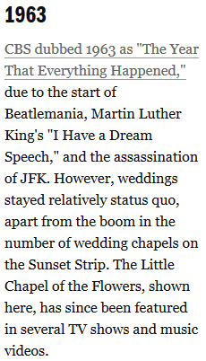

Slide 53
1964 For her first wedding to Richard Burton Elizabeth Taylor wore a bold yellow dress and extravagant floral headdress. The couple divorced in 1974, but married again in1975.

Slide 54
1965 Popular singer and actor Annette Funicello married her agent, Jack Gilardi, on January 9, 1965.

Slide 55
1966
My favorite year – I got married on June 11. In a few months after this was put together we will celebrate 50 years together. We tried to keep the costs modest because my father-in-law’s youngest daughter was to be married 9 months later. Interesting note:
My parents 58 years
My ln-laws 54 years
My wife’s brother 50+
My wife’s sister 50+
My wife and I will soon have 50
My wife’s younger sister will have 50 nine months after us
My sister will have 50 two years after us

Slide 56
1966

Slide 57
1967 Elvis marries

Slide 58
1968

Slide 59
1969 The popular '60s trend of brides wearing short wedding dresses was still going strong at the end of the decade, and some brides opted for a hat as opposed to a veil. Audrey Hepburn went for both trends, wearing a short dress and a head-covering.

Slide 60
1970 In the1970s, wedding trends were all over the map, with brides wearing everything from traditional gowns to pantsuits. This was the decade when men started sporting colored tuxedos, too.

Slide 61
1971 In 1971, Bianca Jagger nixed the fairy tale dress in favor of an Yves St. Laurent Le Smoking jacket.

Slide 62
1972

Slide 63
1973 Princess Anne U.K.

Slide 64
1974

Slide 65
1975

Slide 66
1976 Royal wedding in Germany

Slide 67
1977 Colorful and floppy hats

Slide 68
1978 The 1970s was a big decade for tech inventions, which, of course, would eventually come to transform the way weddings were planned. The VCR was invented in 1970, and email arrived in 1971; the inkjet printer and Apple were both born in 1976.

Slide 69
1979 For her wedding to Rod Stewart in April 1979, Alana Hamilton wore an off-the-shoulder dress and a crown of baby's breath.

Slide 70
1980 Welcome to the1980s—the decade of poofy shoulders, taffeta, lace frills, and cathedral trains.

Slide 71
1981 The 1981 wedding of Lady Diana Spencer and Prince Charles was an absolute game changer in the wedding world. An estimated 750 million people watched the ceremony on television—and soon brides everywhere were demanding a fairytale wedding.

Slide 72
1982 After Princess Diana's wedding, everyone began channeling their inner royal. Extra lace accents, longer veils, and bigger bouquets abounded. Figure skater Dorothy Hamill married Dean Paul Martin in 1982, complete with—you guessed it—a big bouquet and lace details.

Slide 73
1983 and the video camera – memories are made of this

Slide 74
1984 After the recession ended in 1983, wedding receptions became more and more extravagant. Elaborate multi-tiered wedding cakes—like this one featured on an episode of Knight Rider—were a must-have, with some towering as tall as eight tiers high.

Slide 75
1985 After taking a look at the getup actress Kristian-Joy Alfonso wore for her character Hope's (first!) wedding to Peter Reckell's Bo Brady on the soap opera Days of Our Lives in 1985, there's no question as to why the '80s were known as "The Decade of Excess."

Slide 76
1986 Sarah Ferguson and Prince Andrew U.K.

Slide 77
1987 Dirty Dancing premiered in 1987 and the film's hit song "(I've Had) The Time of My Life" became an instant wedding classic.

Slide 78
1988 Tom Hanks and Rita Wilson tied the knot in 1988—and they're still going strong 28 years later.

Slide 79
1989

Slide 80
1990 Vera Wang collection

Slide 81
1991 The 90s saw a new obsession with wedding movies, ushered in by the release of Father of the Bride starring Steve Martin. The decade would also see the release of Four Weddings and a Funeral (1994), Muriel's Wedding (1994), My Best Friend's Wedding (1997), and Runaway Bride (1999).

Slide 82
1992

Slide 83
1993 Bridal gowns of the '90s were more sleek and simple than the styles popular in the 1980s, but brides still loved a small touch of poof and drama, which is evident in this photo from the wedding of Marla Maples and Donald Trump.

Slide 84
1994

Slide 85
1995 Target becomes one of the first retailers to offer an online gift registry, with the introduction of Club Wedd. Within the first year, more than 125,000 couples registered with Target.

Slide 86
1996

Slide 87
1997 Thanks to Carolyn Bessette, minimal and simplistic bridal styles defined the latter part of the decade—spaghetti straps were a hot trend.

Slide 88
1998 Precious Moments cake toppers are popular

Slide 89
1999 disposable cameras provided for guests

Slide 90
2000 Golden couple Brad Pitt and Jennifer Aniston married in Malibu on July 29th, 2000. The now-divorced couple reportedly recited quirky vows, that included Brad pledging to "split the difference on the thermostat" and Jennifer promising to always make his "favorite banana milk shake.“

Slide 91
21st Century
Less emphasis on the wedding and more on the reception. After all, many couples had been living together for several years before the wedding – some had already had children before the wedding.
Also popular – Exotic locations like beach weddings in Jamaica
More emphasis on the honeymoon than on the wedding.
Parents going in debt for $10,000 - $40,000 extravaganzas – particularly the receptions
I don’t know that this results in marriages that make the 50+ year mark.

Slide 92
2001 Monica & Chandler on Friends

Slide 93
2002 Bachelor TV Show

Slide 94
2003 Military loved ones miss weddings

Slide 95
2004 strapless

Slide 98
2007 Weddings are no longer just an intimate family affair. Couples are publicizing their ceremonies through media outlets, like when Jessica Mapel and Cody Heleson wed on "Today Throws a Martha Stewart Wedding" (the first televised wedding on the Today show happened in 2000). Millions of viewers voted on every detail of their big day, including which wedding cake they would cut into. Say Yes to the Dress also premiered in 2007, providing an intimate peek into the dress buying process.

Slide 99
2008 Sex in the City fashion

Slide 100
2009 the "JK Wedding Dance" video went viral, brides everywhere were inspired to turn their ceremonies into entertainment, with flash mob-style dances down the aisle.

Slide 101
2010 launches and engaged women begin using the social network to find inspiration for the wedding of their dreams, spawning the term "Pinterest bride."

Slide 102
2011

Slide 103
2012 Style Me Pretty launched in 2007, A Practical Wedding launched in 2008, 100 Layer Cake launched in 2009—and by 2012, brides everywhere were turning to wedding blogs as a way to plan their big day.

Slide 104
2013 Kelly Clarkson married Brandon Blackstock in a scenic ceremony at Blackberry Farm, a pastoral Tennessee resort. Kelly's romantic dress with lace sleeves is a nod towards the vintage wedding style that's come back in vogue in recent years.

Slide 105
2014 The social media obsession has officially infiltrated weddings, with couples inventing wedding hashtags to encourage guests to post photos to platforms like Instagram and Twitter.

Slide 107
2016 - Prince William and Kate Middleton celebrated their fifth wedding anniversary on April 29, as the world takes a look back at their fairytale nuptials.

