Slide 1
Beautiful Women Around the World
"No matter how plain a woman may be, if truth and honesty are written across her face, she will be beautiful." Eleanor Roosevelt

Slide 2
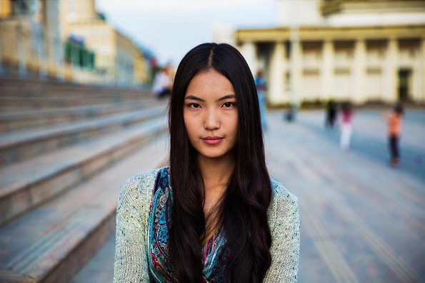
Photographed in Ulaanbaatar, Mongolia

Slide 3
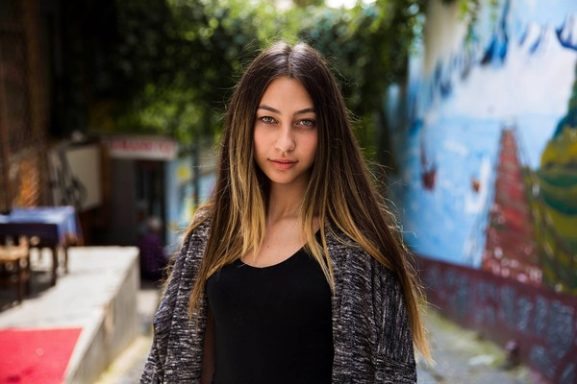
Turkish Cypriot in Istanbul, Turkey

Slide 4
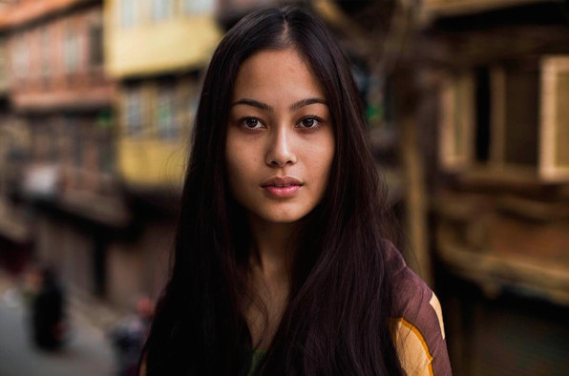
Photographed in Kathmandu, Nepal

Slide 5
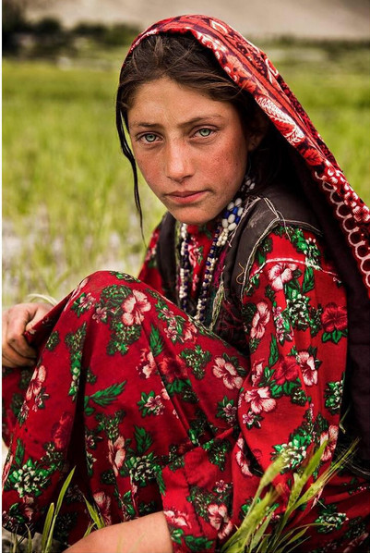
Photographed in Afghanistan

Slide 6
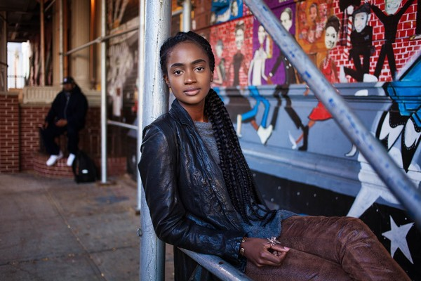
Photographed in Harlem, NY, United States

Slide 7
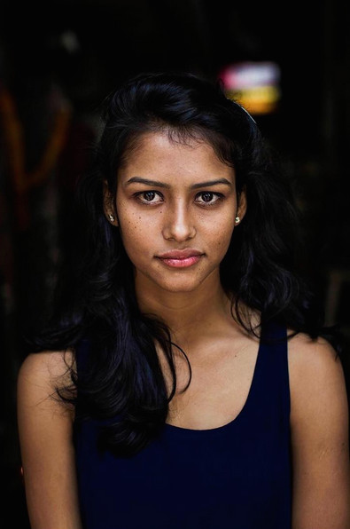
Photographed in Delhi, India

Slide 8
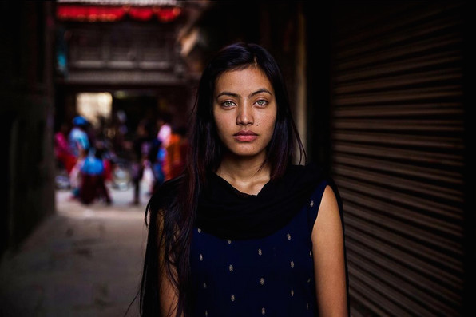
Photographed in Kathmandu, Nepal

Slide 9
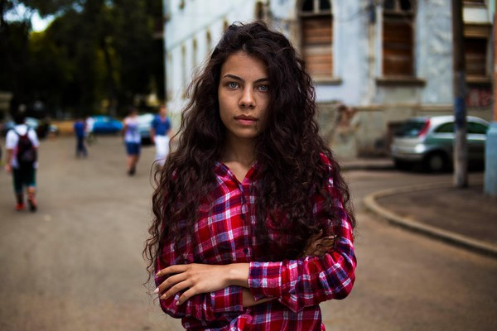
Photographed in Bucharest, Romania

Slide 10
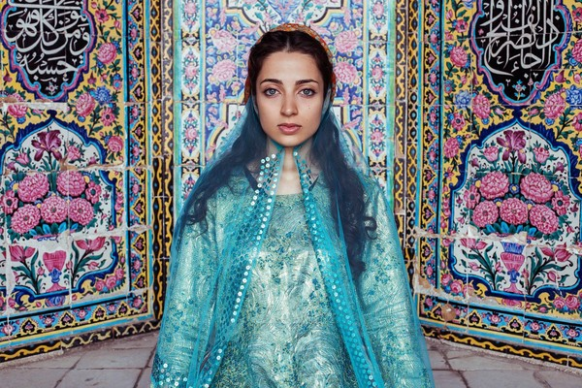
Photographed in Shiraz, Iran

Slide 11
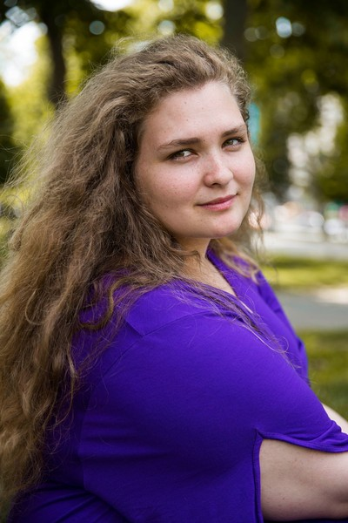
Photographed in Istanbul, Turkey

Slide 12
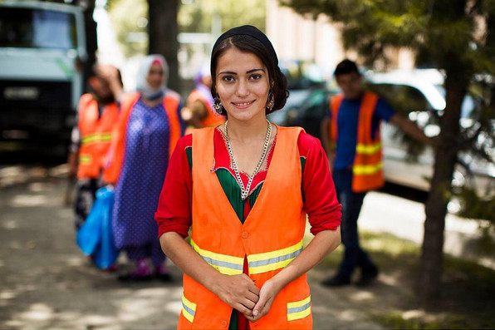
Photographed in Dushanbe, Tajikistan

Slide 13
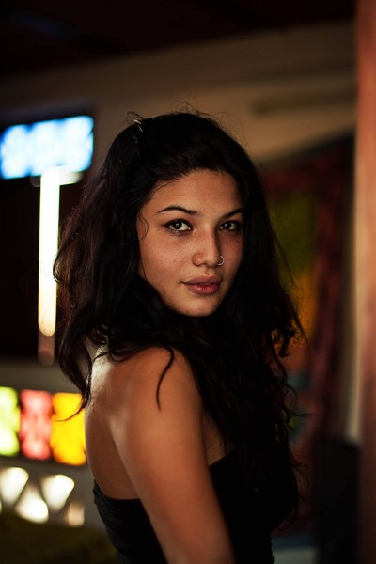
Photographed in Cali, Colombia

Slide 14
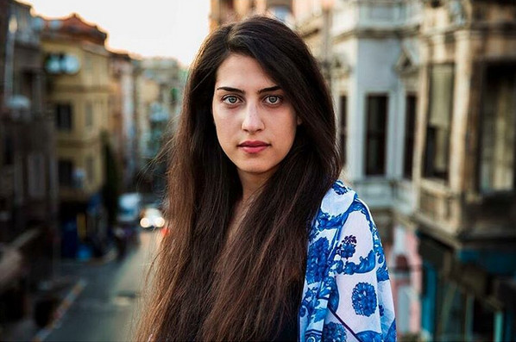
Photographed in Istanbul, Turkey

Slide 15
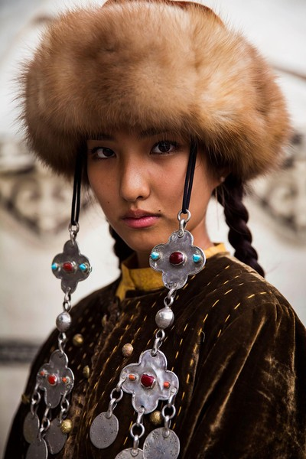
Photographed in Bishkek, Kyrgyzstan

Slide 16
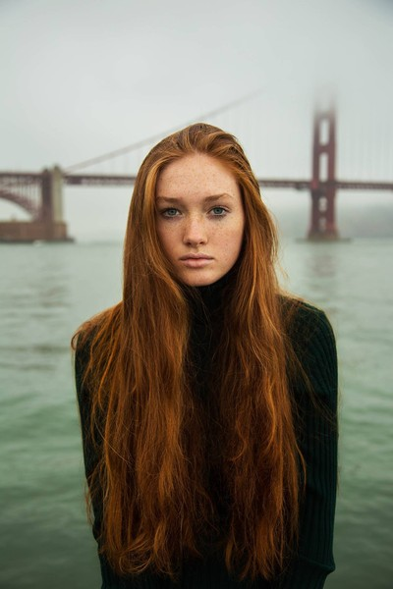
Photographed in San Francisco, CA, United States

Slide 17
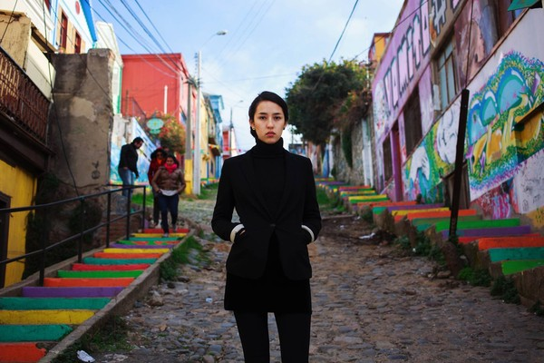
Photographed in Valparaiso, Chile

Slide 18
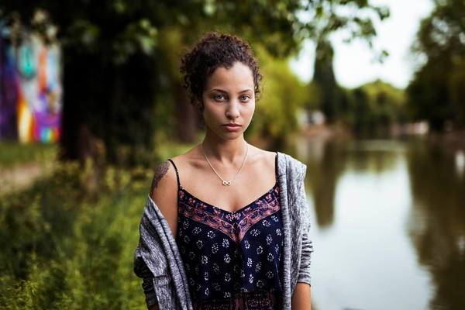
Photographed in Timisoara, Romania

Slide 19
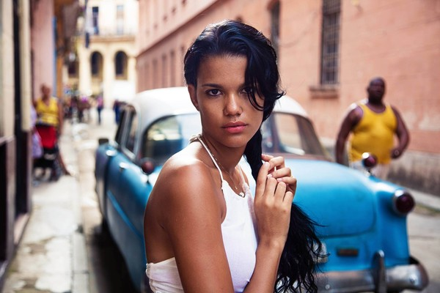
Photographed in Havana, Cuba

Slide 20
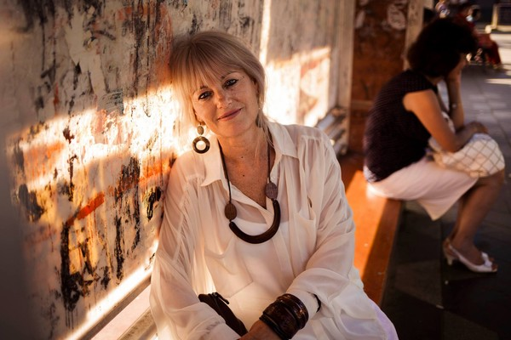
Photographed in Bucharest, Romania

Slide 21
Photographer had too narrow of a selection
Additions selected by Joe Naumann, UMSL

Slide 22
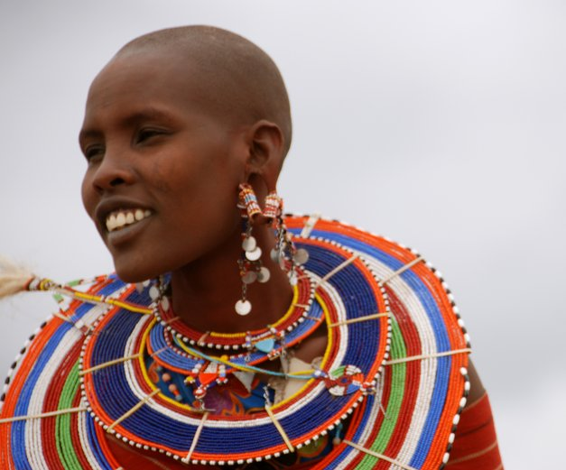
Beautiful Masai Woman

Slide 23
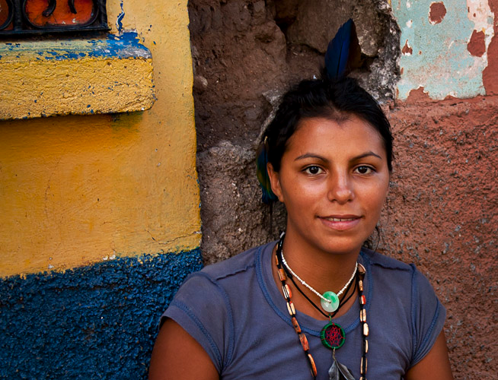
Mayan woman

Slide 24
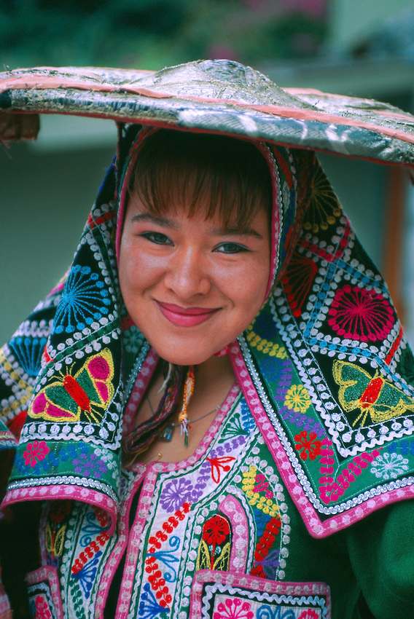
Indigenous Peruvian woman

Slide 25
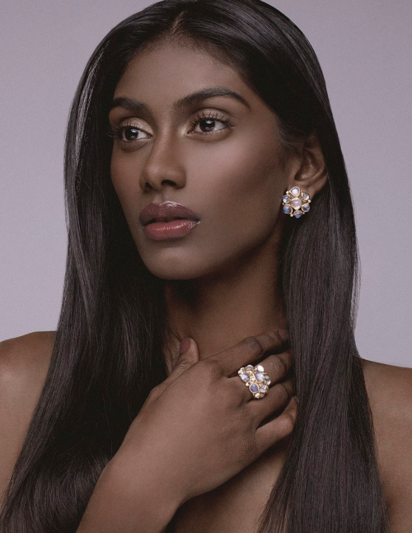
Indus/Dravidian Beauty

Slide 26
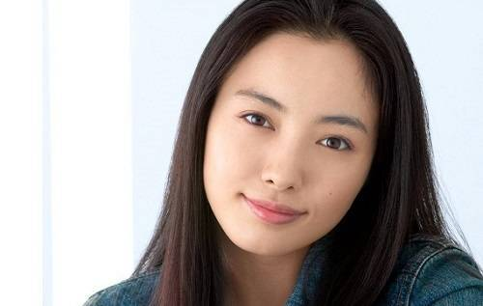
Beautiful Japanese woman

Slide 27
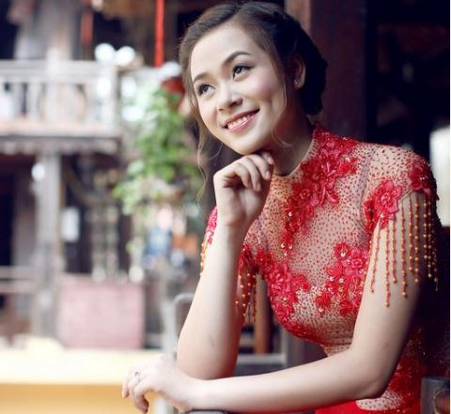
Vietnamese woman

Slide 28
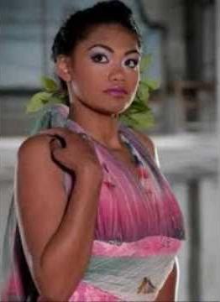
Samoan woman

Slide 29
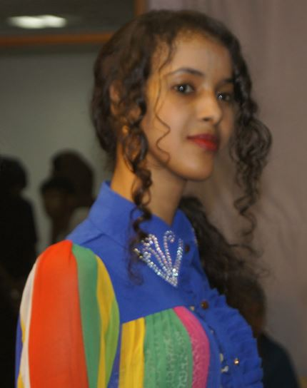
Somali woman

Slide 30
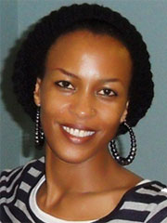
Tutsi woman in Rwanda

Slide 31
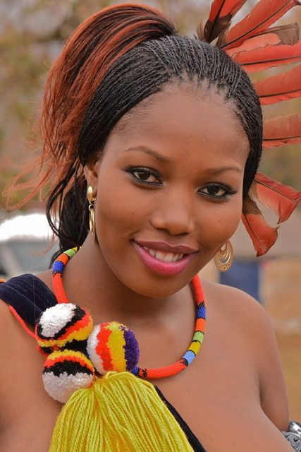
Woman in Swaziland

Slide 32
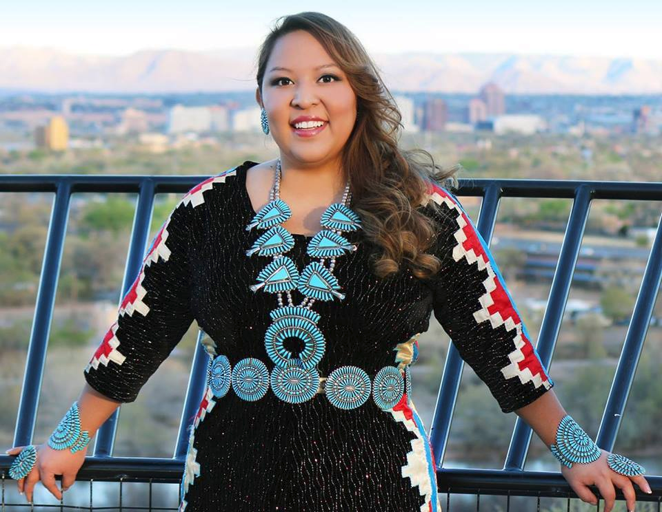
Navajo woman

