Slide 1
Beautiful Stained Glass Windows

Slide 2
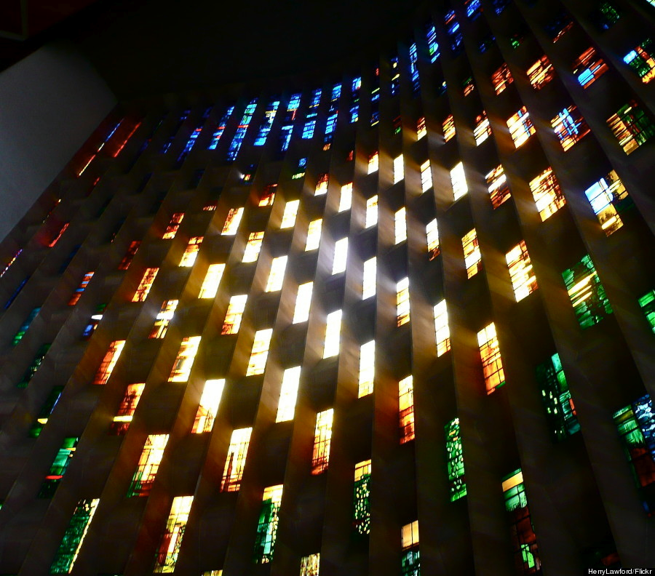
Coventry Cathedral, U.K.

Slide 3
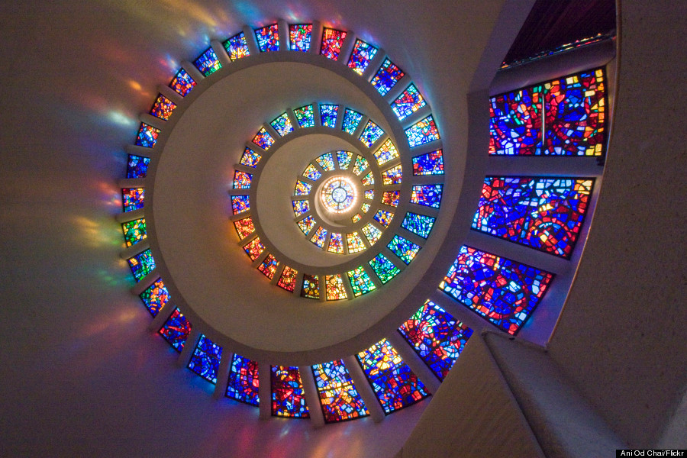
Thanksgiving Chapel Dallas, Texas, USA

Slide 4
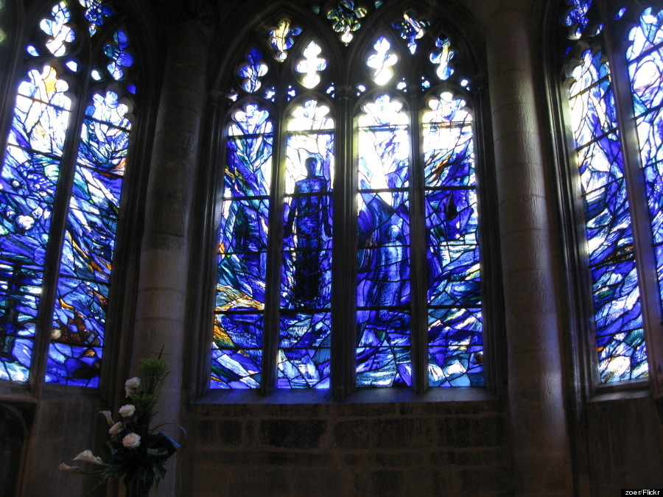
Gloucester Cathedral, UK

Slide 5
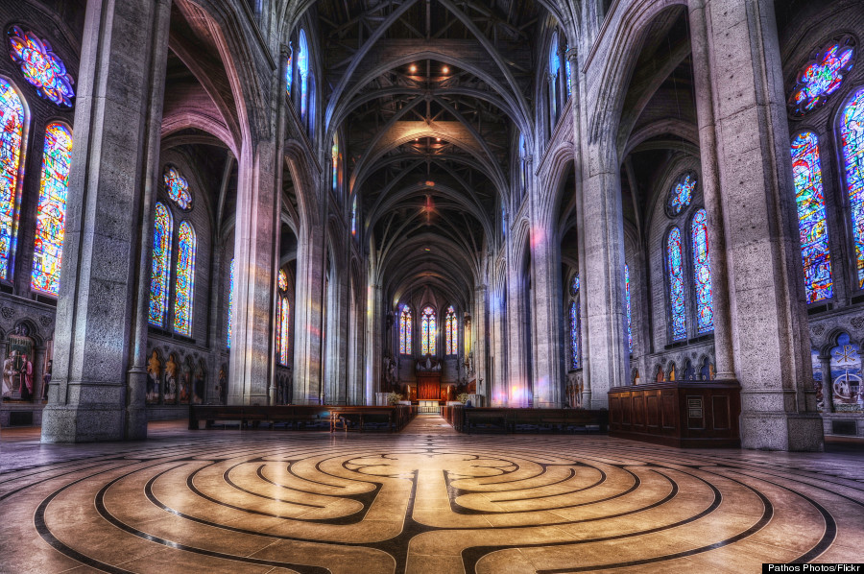
Grace Cathedral San Francisco, USA

Slide 6
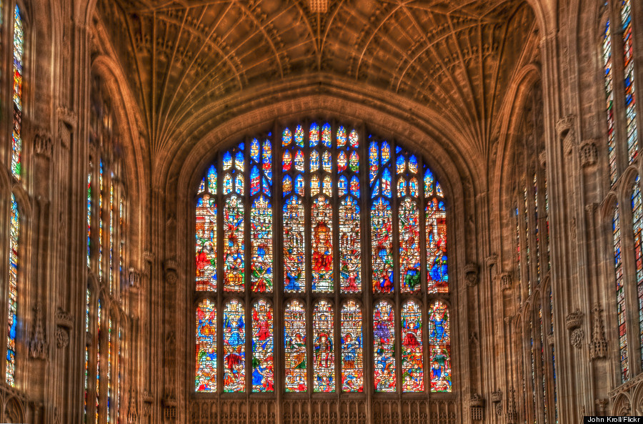
King's College Chapel, UK

Slide 7
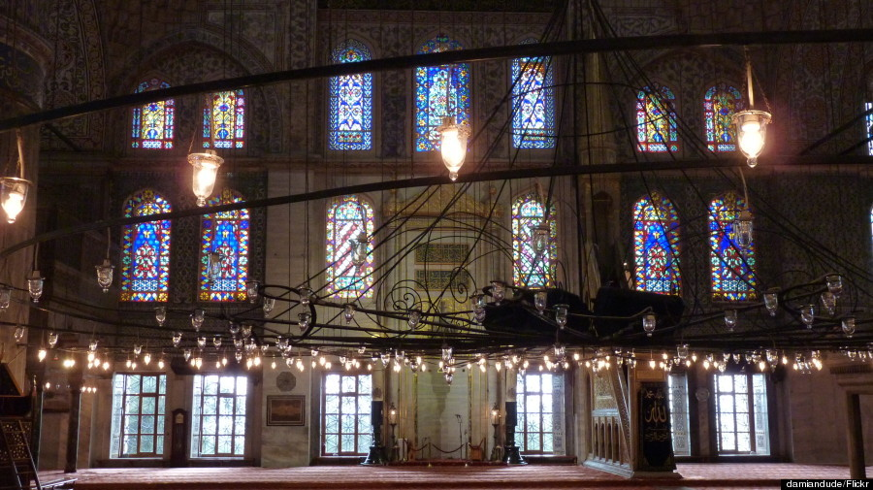
The Blue Mosque, Istanbul, Turkey

Slide 8
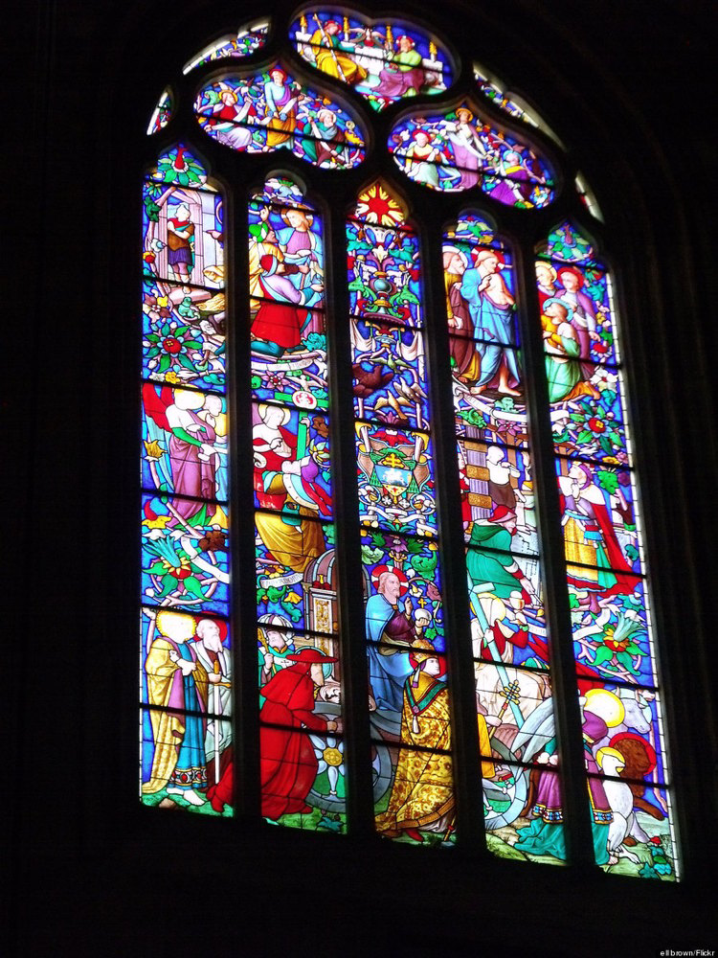
Cathédrale d'Aix
France

Slide 9
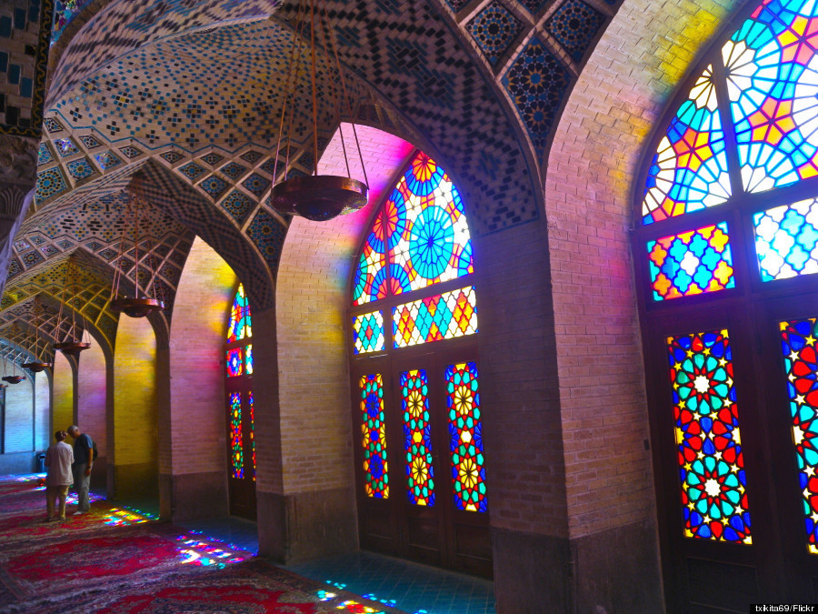
Nasir-al-Mulk Mosque
Iran

Slide 10
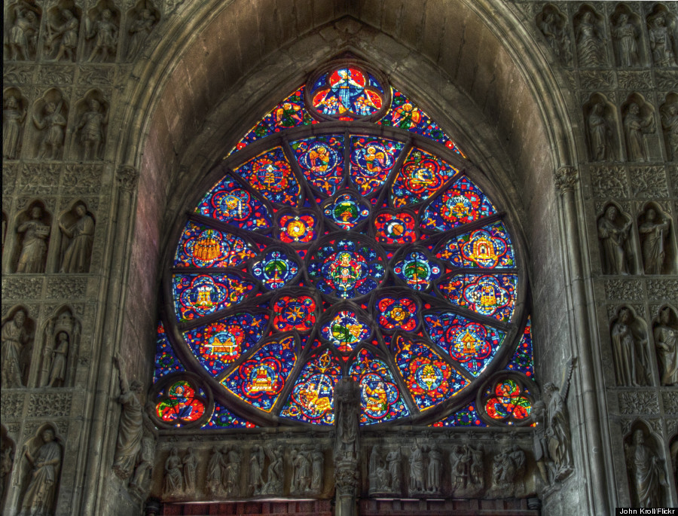
Reims Cathedral
France

Slide 11
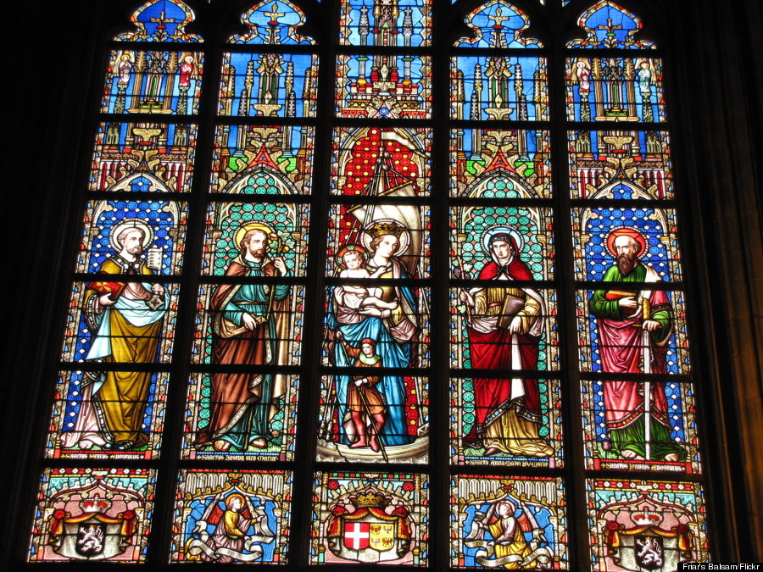
Notre-Dame au Sablon, Belgium

Slide 12
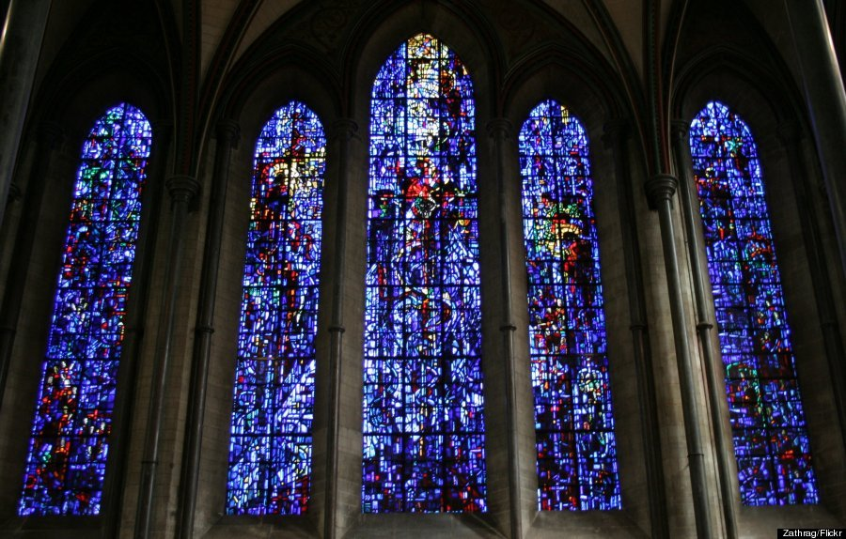
Salisbury Cathedral, UK

Slide 13
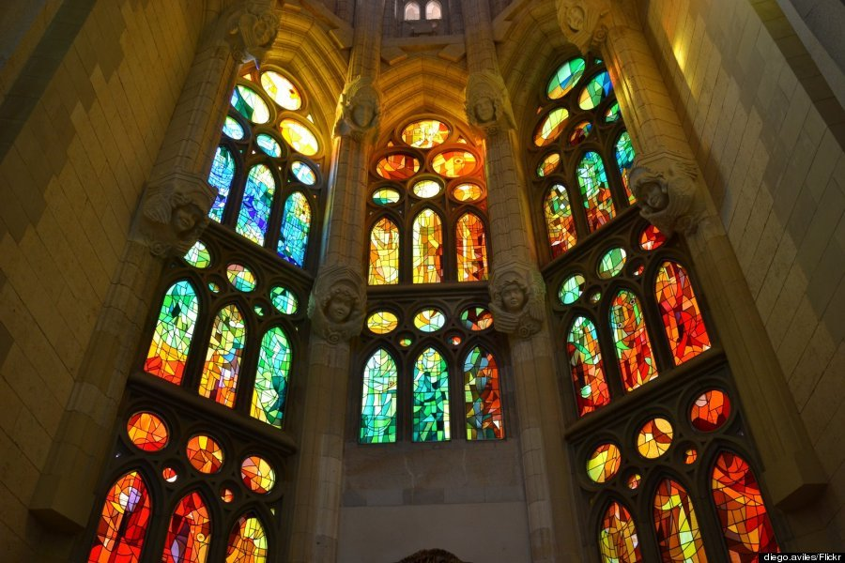
La Sagrada Familia, Spain

Slide 14
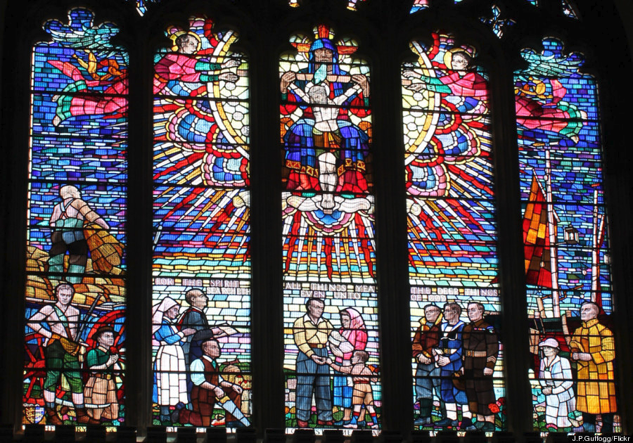
St. Clements Church, UK

Slide 15
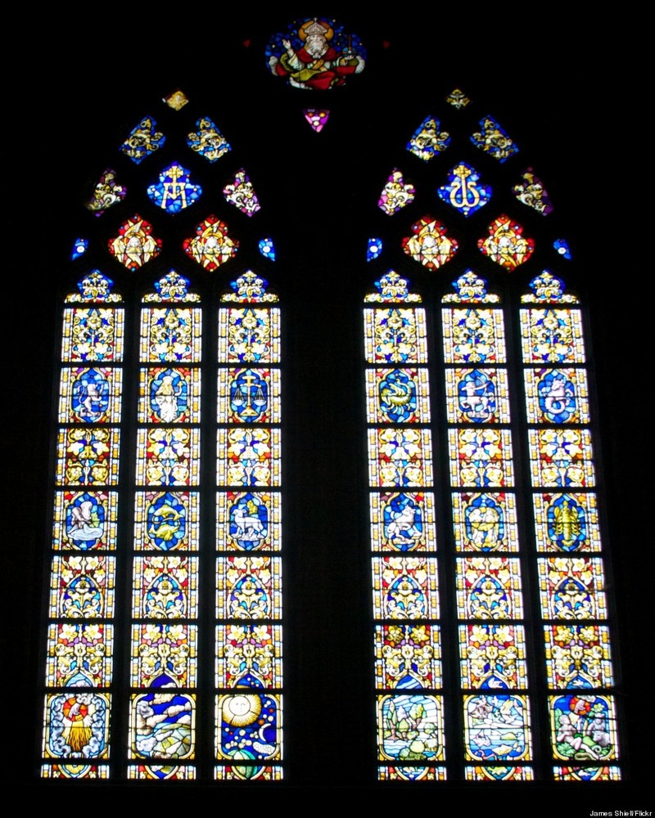
Cathédrale St Martin
Ypres, Belgique

Slide 16
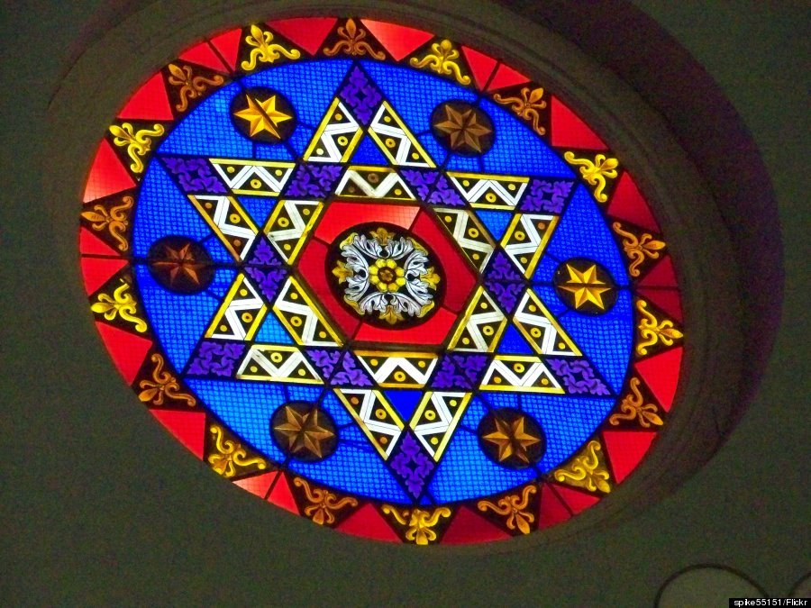
Lloyd Street Synagogue, Baltimore, Maryland, USA

Slide 17
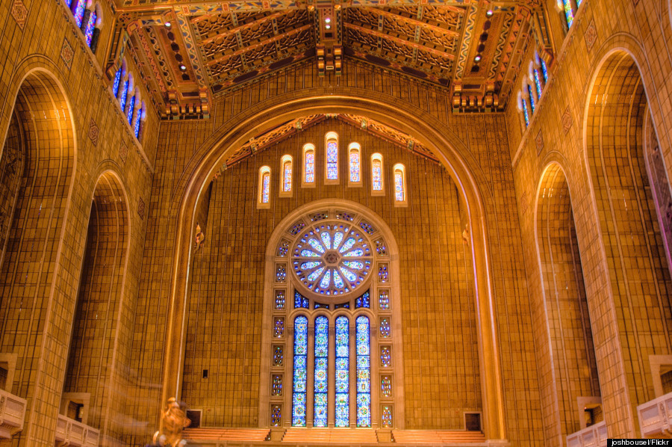
Temple Emanu-El, New York City,

Slide 18
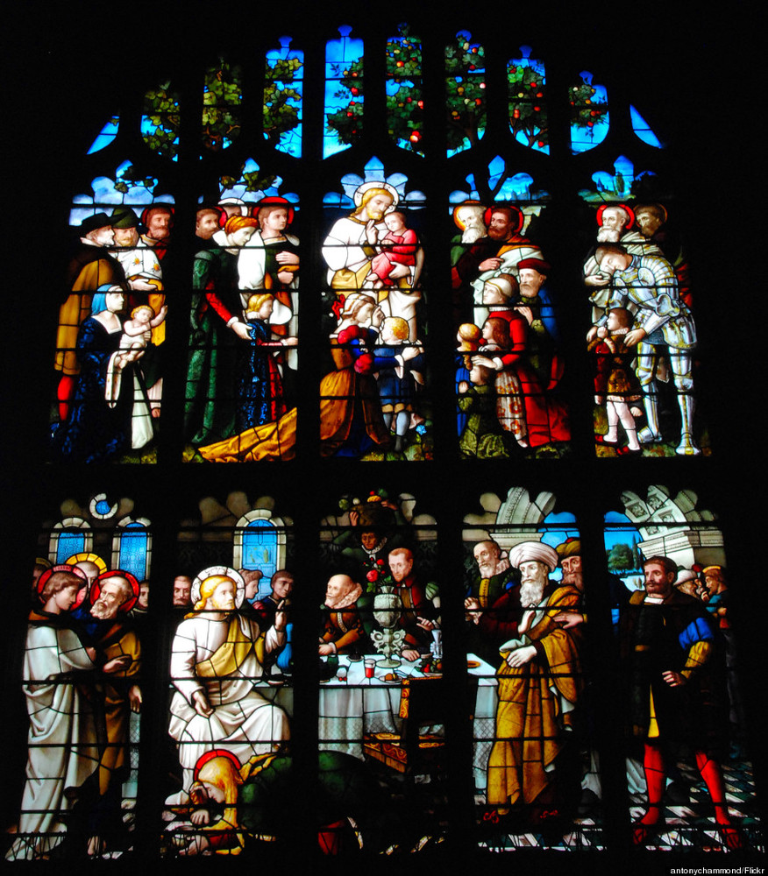
St Peter and St Paul's Church, UK

Slide 19
St. Stephen’s Episcopal Church, Ferguson, MO, USA

Slide 20
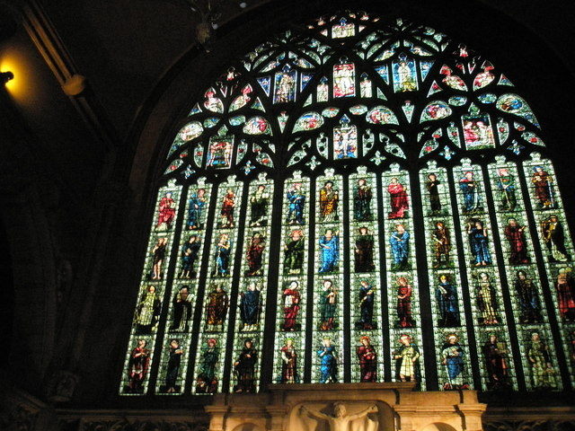
Holy Trinity, Sloane Square, UK

Slide 21
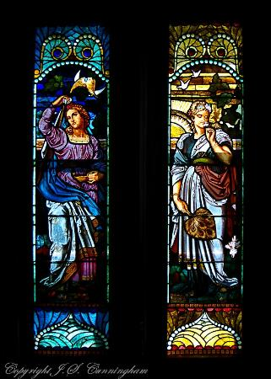
St. Joseph, MO, USA

Slide 22
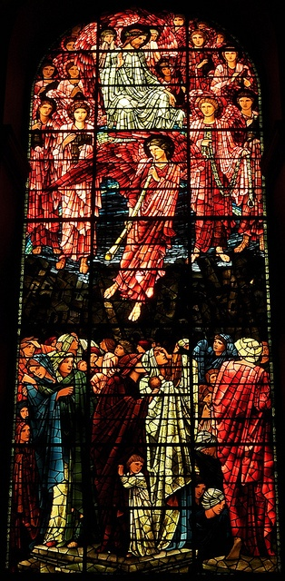
Birmingham Cathedral, Burne-Jones west window, UK

Slide 23
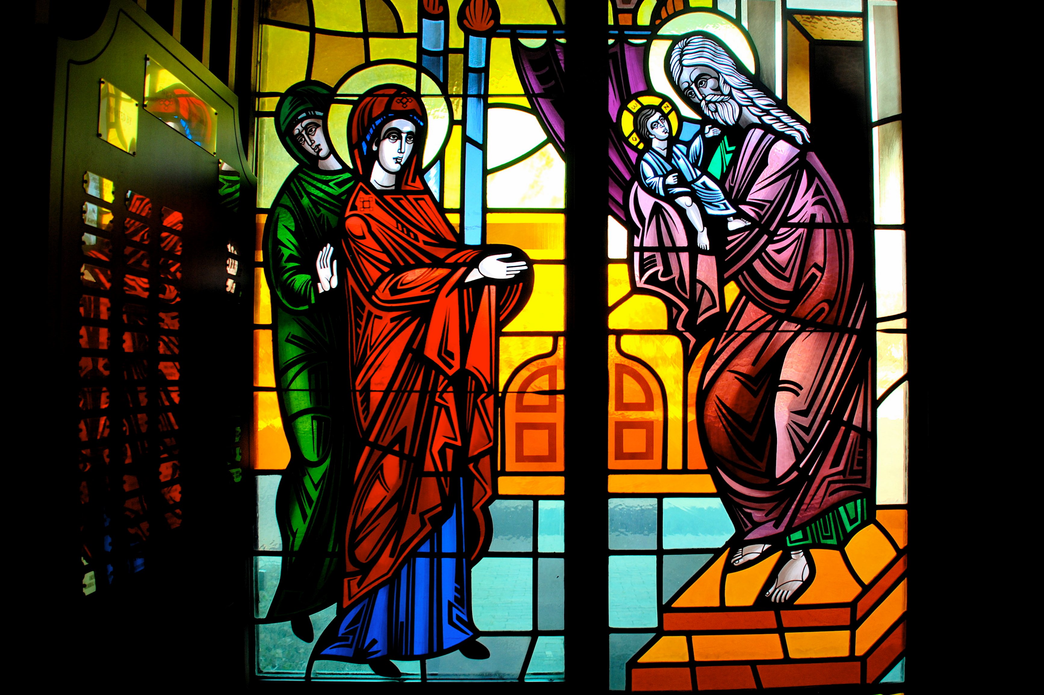
Window at Greek Orthodox Church

Slide 24
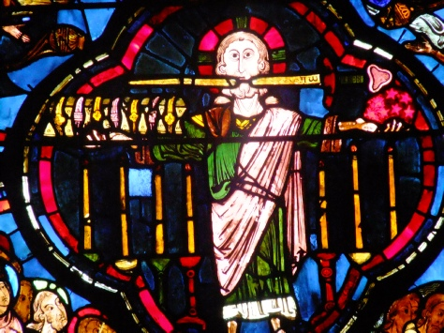
13th century stained glass windows at Bourges Cathedral, Bourges,

Slide 25
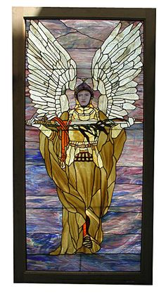
Made by Tiffany

Slide 26
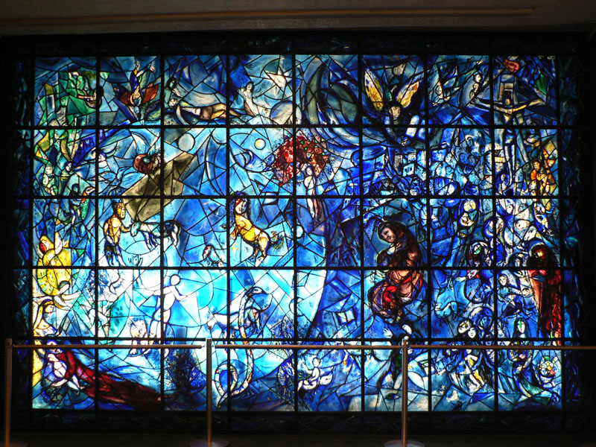
Retro Chagall Stained Glass Window

Slide 27
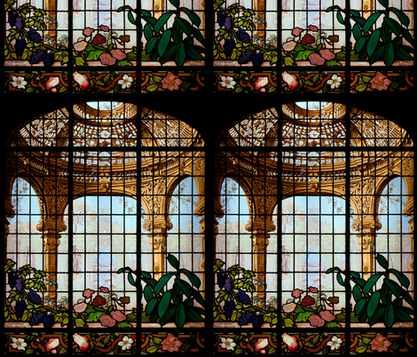
Henry G. Marquand House Conservatory

