Slide 1
Artist and Africa
Judy Scotch

Slide 2
Judy Scotch
Judy Scotch began to paint in 1985 and since then, has been busy developing an individual approach to her art that combines traditional methods with her own painting techniques. Prior to 1997, the emphasis of her work was on indigenous Australian wildlife painted in oils, but her first trip to Africa that year had a huge inspirational impact, and the focus of her work changed to African subjects - people as well as wildlife. Her artistic horizons have continued to expand, and now Judy paints a wide spectrum of subjects and portraits in mixed media. The current subjects of her paintings are often a reflection of the cultural diversity of the various parts of the world to which Judy has been fortunate enough to travel. Her detailed paintings display a love of design, color and strong tonal contrasts, and she has devised a unique way to portray the personalities of people. Subtle use of mixed media gives her paintings a 'trompe l'oeil' or three dimensional effects.

Slide 3
Children

Slide 4
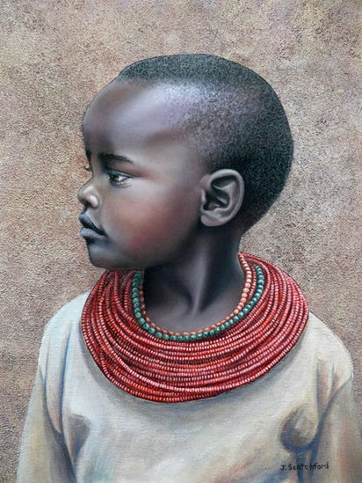

Slide 5
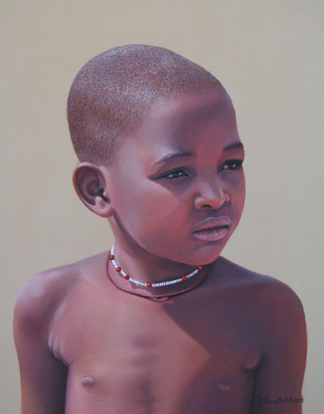

Slide 6
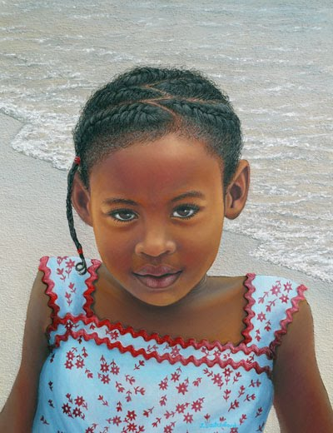

Slide 7
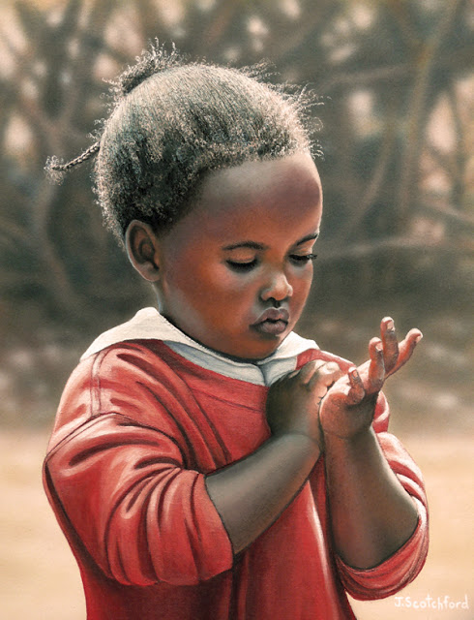

Slide 8
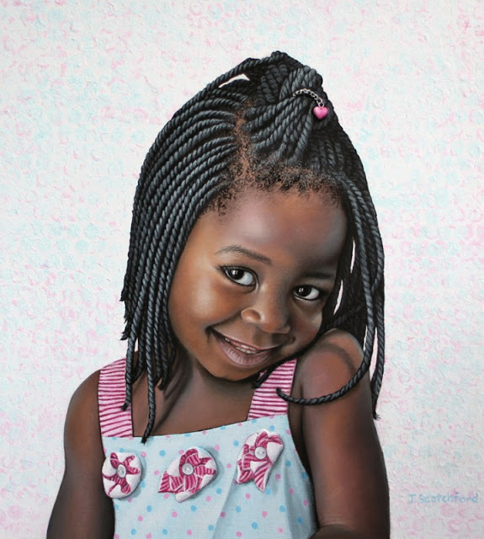

Slide 9
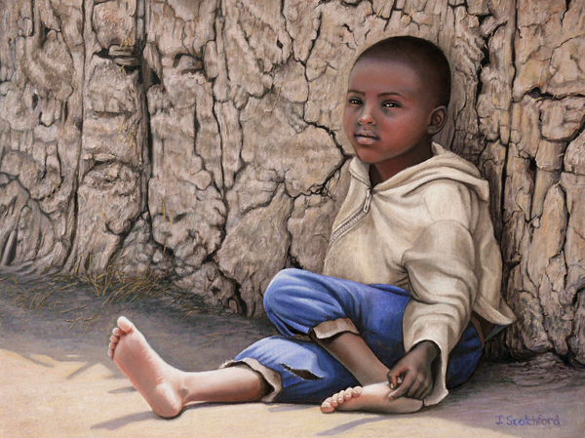

Slide 10
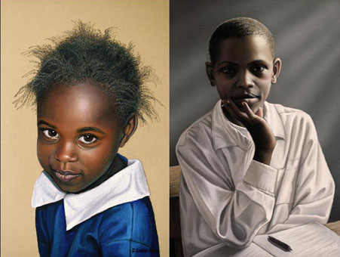

Slide 11
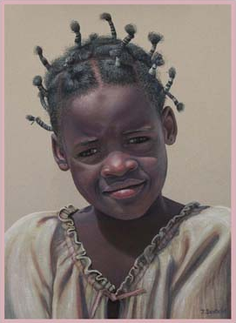

Slide 12
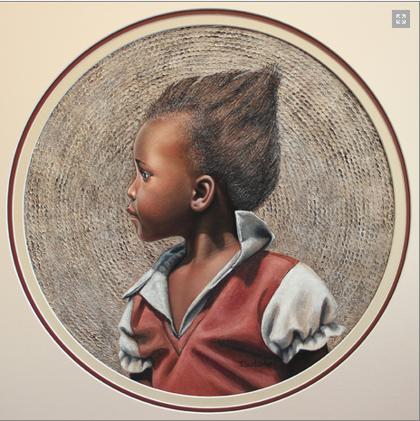

Slide 13
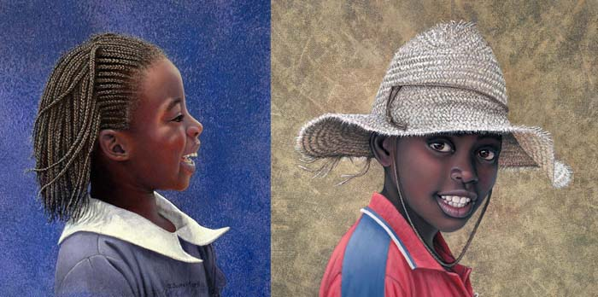

Slide 14
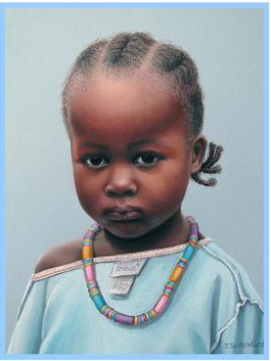

Slide 15
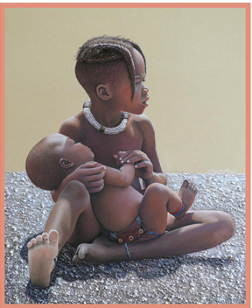

Slide 16
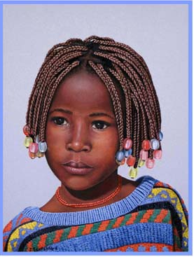

Slide 17
adults

Slide 18
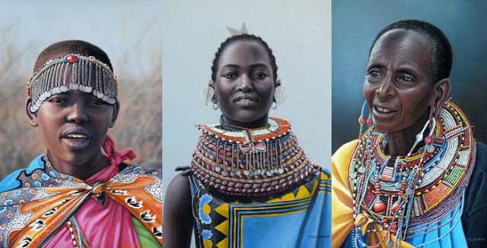

Slide 19
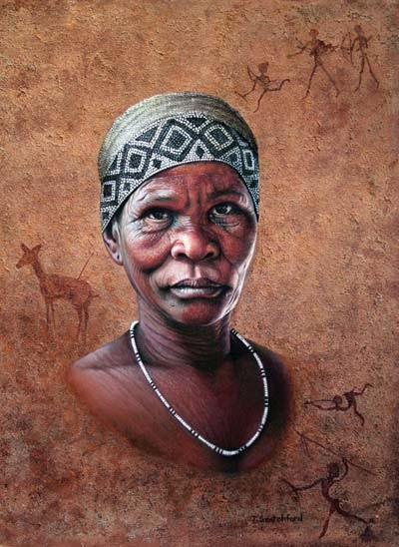

Slide 20
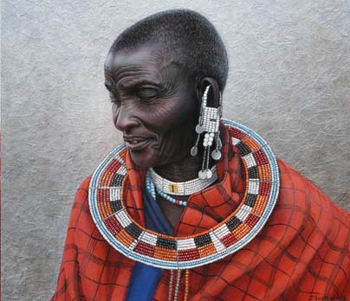

Slide 21
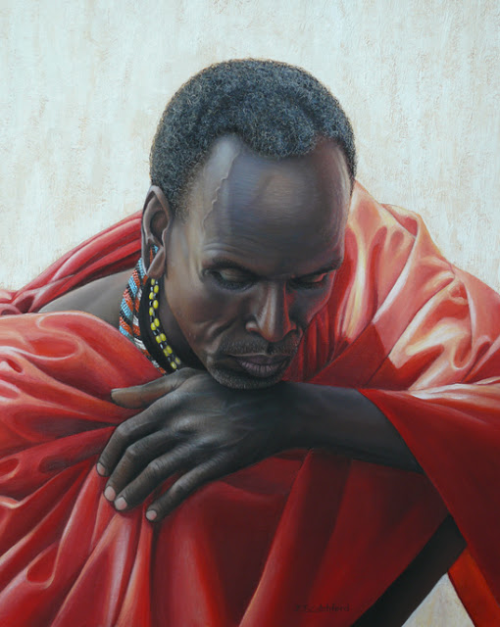

Slide 22
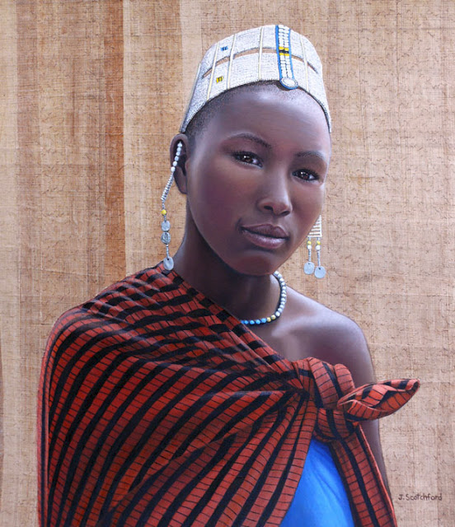

Slide 23
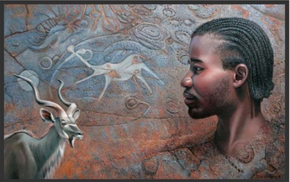

Slide 24
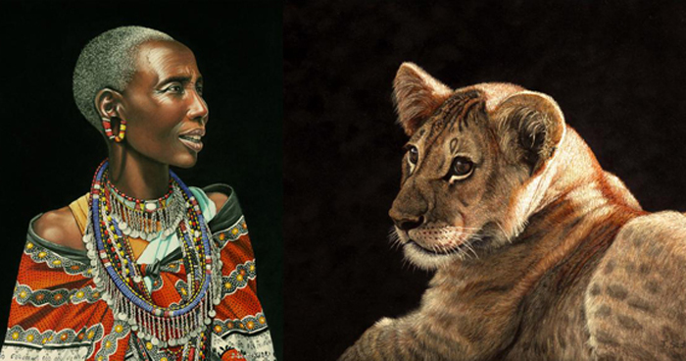

Slide 25
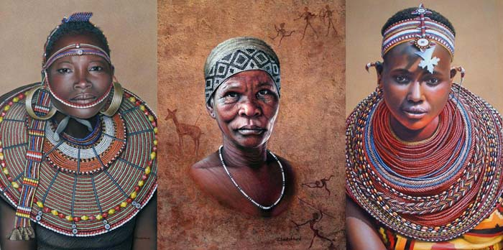

Slide 27
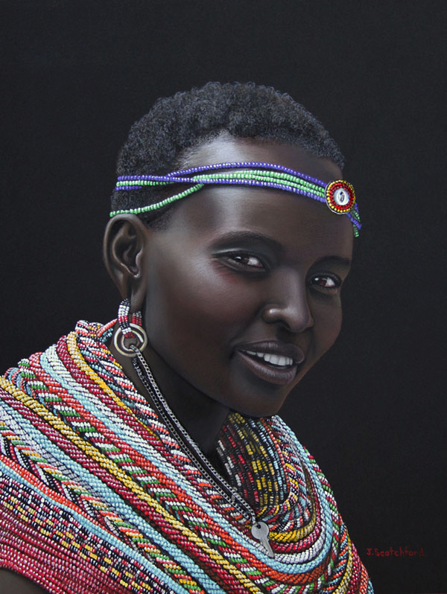

Slide 28
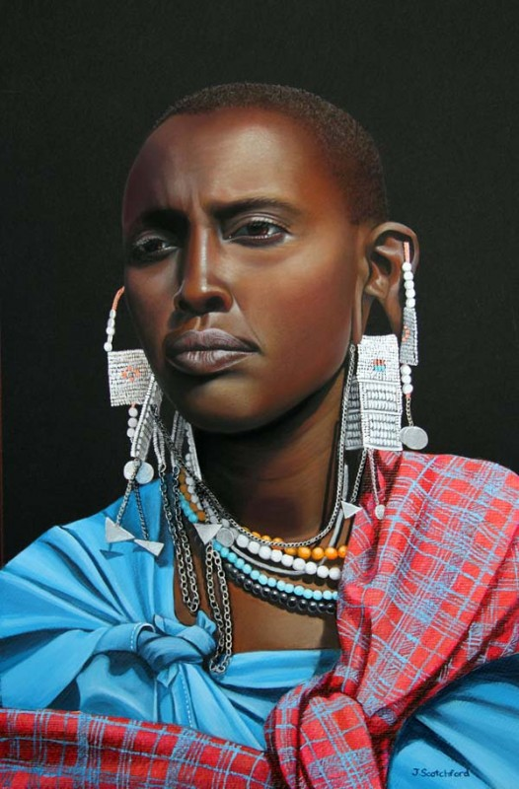

Slide 29
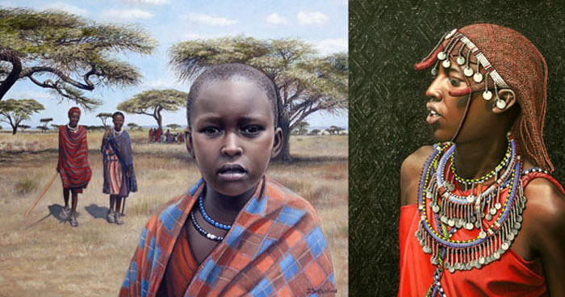

Slide 30
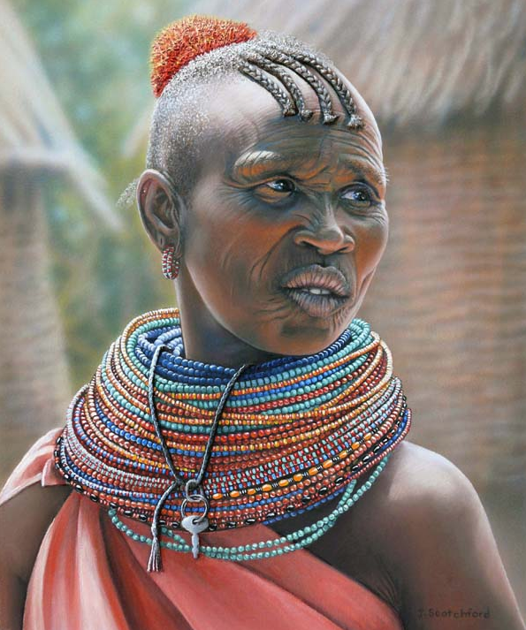

Slide 31
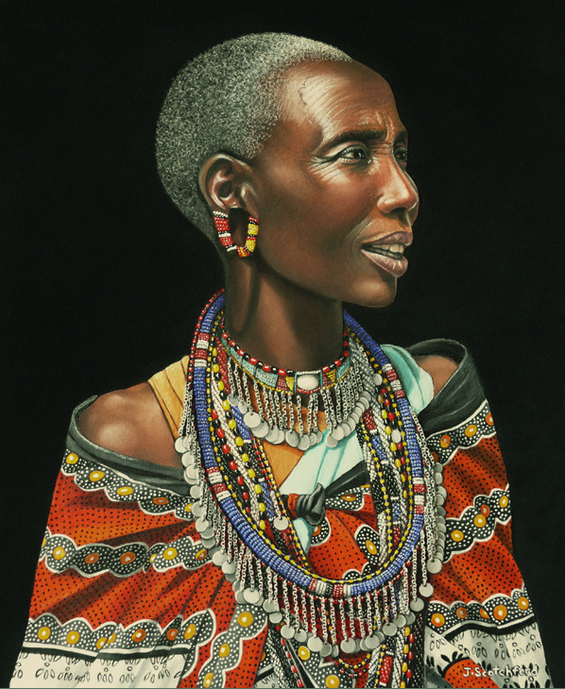

Slide 32
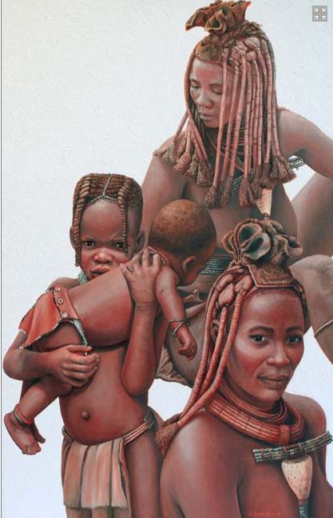

Slide 33
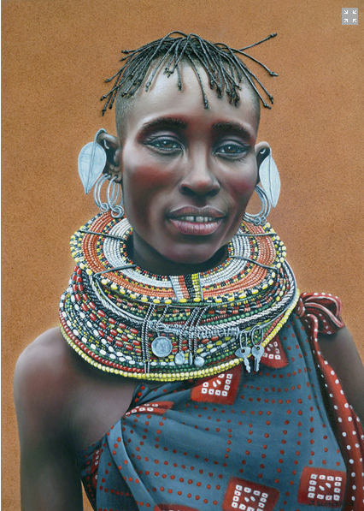

Slide 34
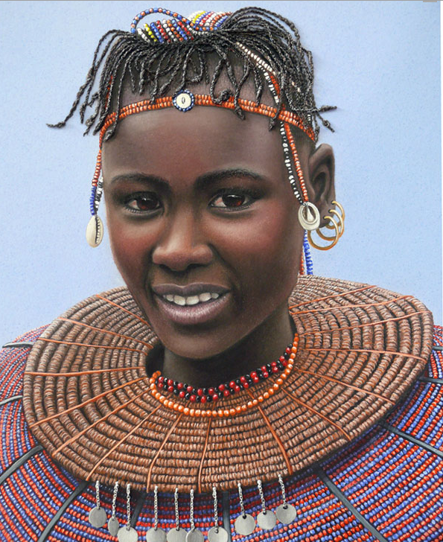

Slide 35
wildlife

Slide 36
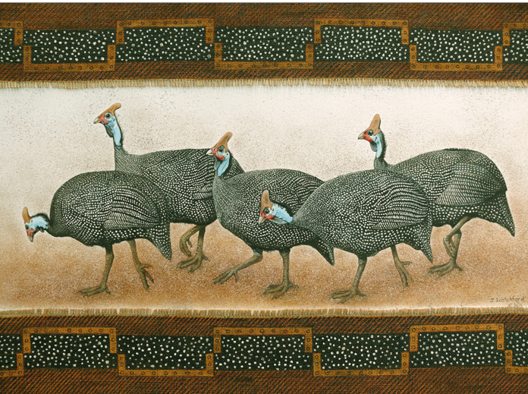

Slide 37
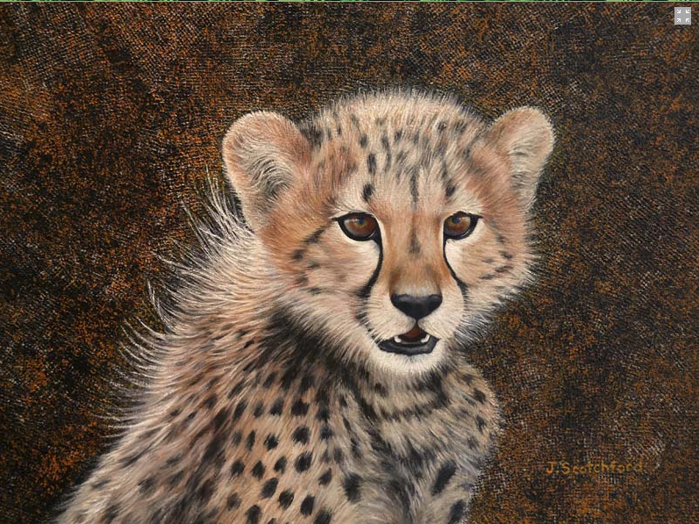

Slide 38
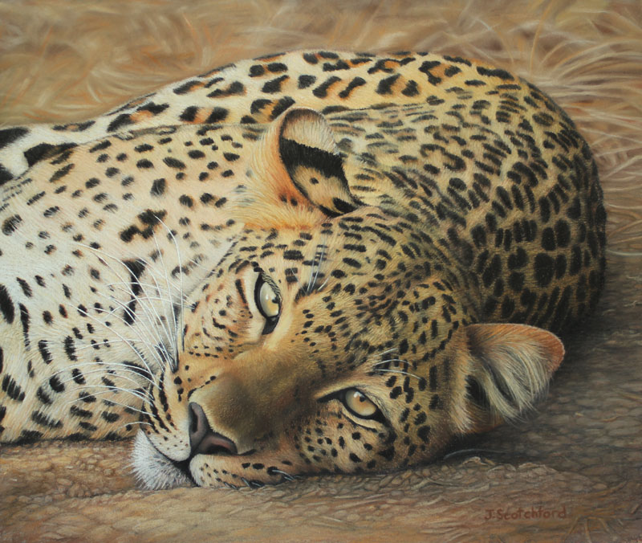

Slide 39
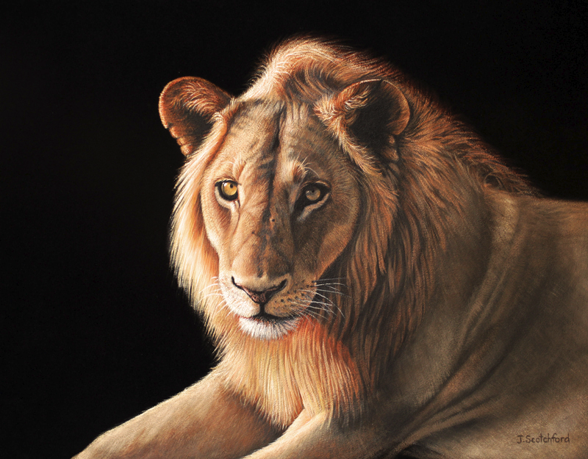

Slide 40
