Slide 1
12 Disgusting Foods Your Grandparents Loved
I’m lucky that neither my wife, my mother, nor my mother-in-law ever tried to make any of these.

Slide 2
We've come a long way since our grandparent's were kids. While we have made advancements in technology, medicine, and many other facets of life, we've also made strides in the culinary world.
A few of these have possibilities with a few alterations, like leaving tuna out of Jello.

Slide 3
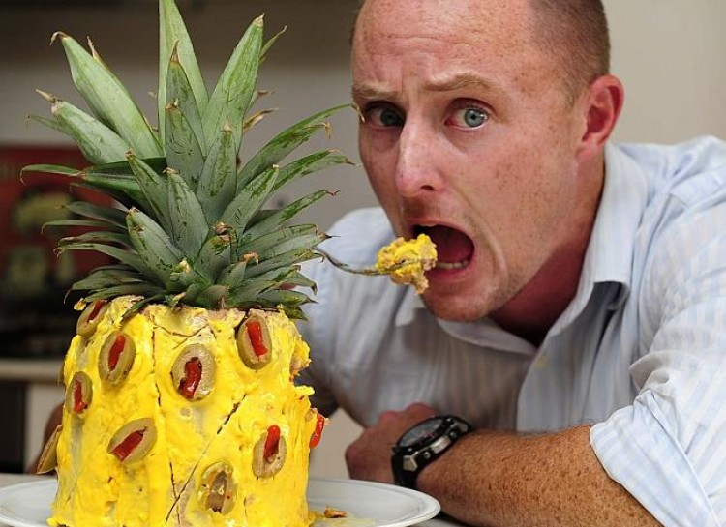
Liver Sausage Pineapple
You take a liver sausage and turn it into a pineapple using things like mayo and mustard. The disgusting concoction was featured in cookbooks of the early 1950's, but we don't see how anyone could've stomached it.

Slide 4
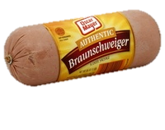
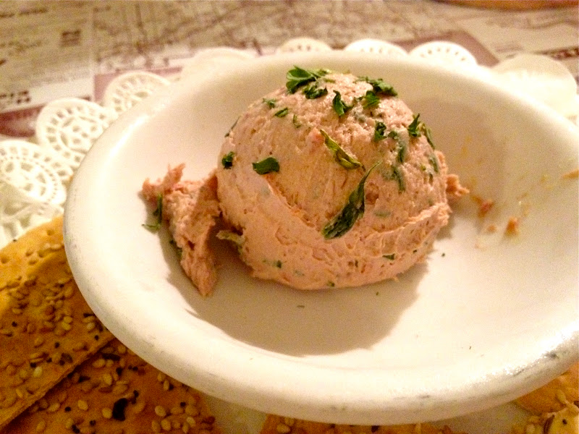
It has possibilities
One could use this as a cracker spread, but don’t try to make it look like a pineapple. I think the “pineapple” might look much worse than it would taste.

Slide 5
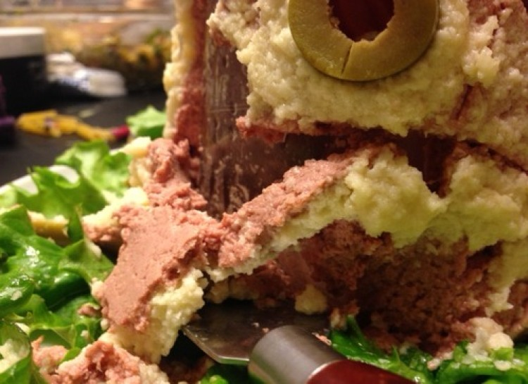
Close up of Liver Sausage Pineapple

Slide 6
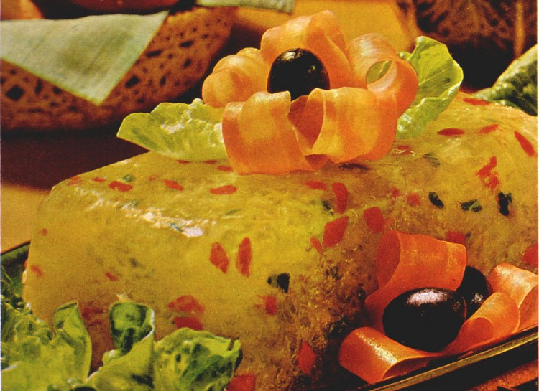
Perfection Salad
Um, this does not look like any salad I've ever seen. You basically take any sort of vegetable and vegetable juice you want, and add in gelatin. Then chill.

Slide 7
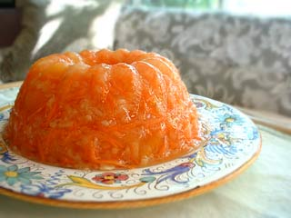
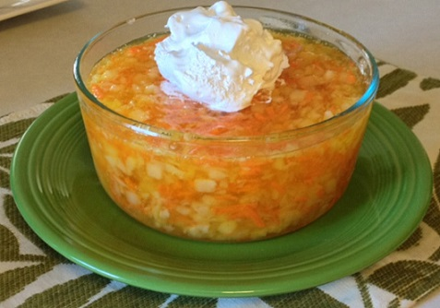
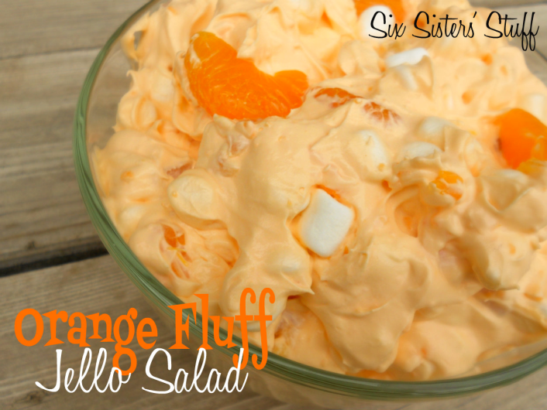
Possibility
Shred carrots and mix them in with orange Jello
Or add drained tropical fruit salad (canned) to orange Jello. Possibly mix in something like a whipped topping to make it more “fluffy.”

Slide 8
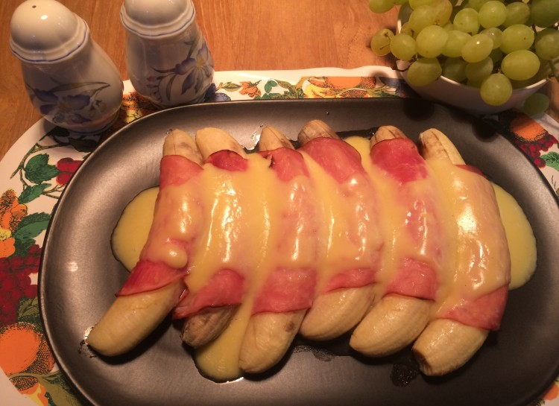
Ham and Banana Hollandaise
You sprinkle the bananas with lemon juice and roll in ham. Add some mustard and bake for ten minutes. Yes, this was actually a thing. I know it sounds horrible to think about, but it did exist.

Slide 9
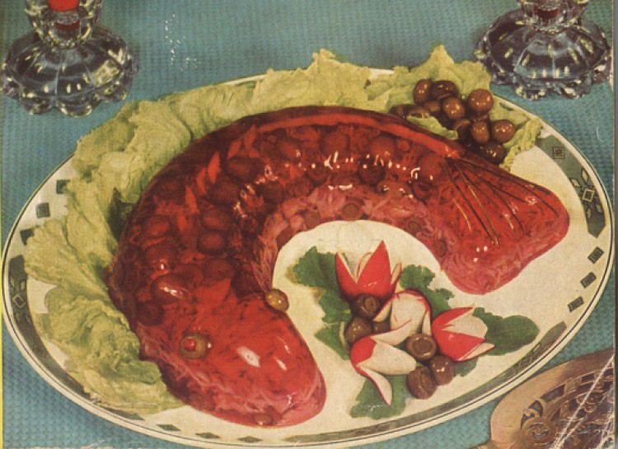
Glace Fish Mold
Prepare the jello and add in all the tuna, pimento and olives. Chill it and make it into a fish mold. It's basically combining a tuna fish mold and gelatin mold into one.

Slide 10
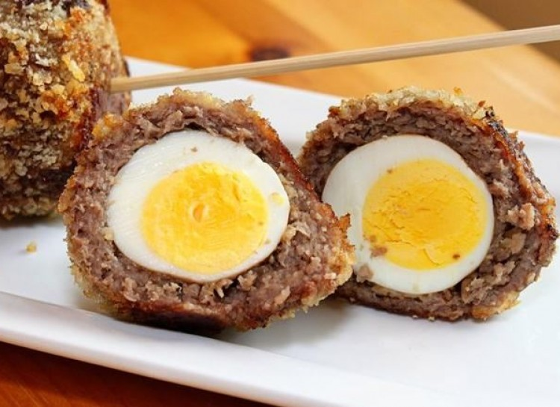
Scotch Eggs
Okay, this one takes the cake. You basically stick eggs inside a mystery meat. You also put a little scotch in there for good luck. This looks disgusting and is disgusting.

Slide 11
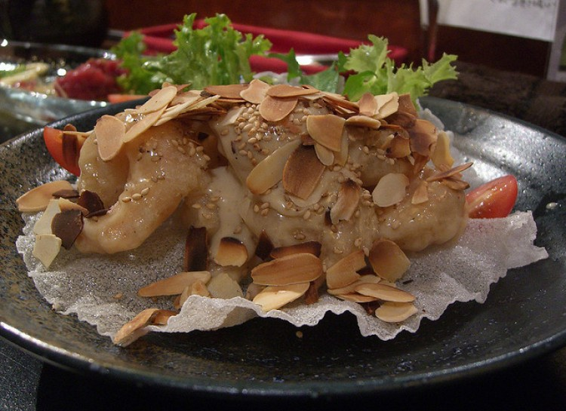
Deep Fried Prawns in Sesame Mayonnaise
It just looks like a deep fried stew with vegetables all rolled into one. People in the 70's used to eat this, but you'd be hard-pressed to find anyone who would order this today.

Slide 12
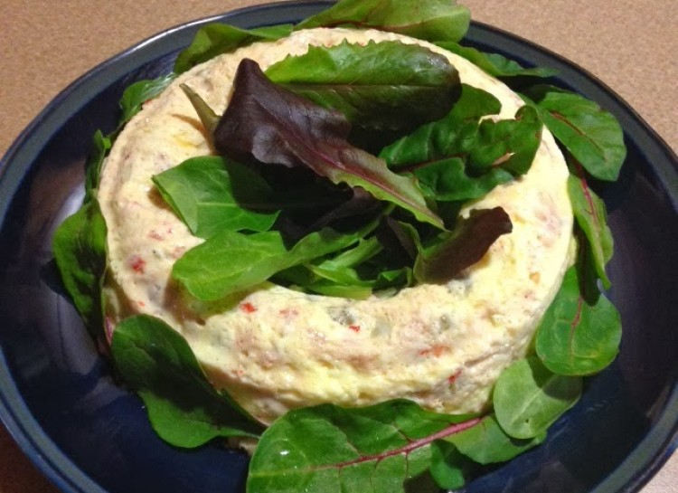
Monterey Souffle Salad
All you do is take some jello, add some mayo and lemon juice and freeze. After 15 minutes add in some tuna, olives and pimento. Sounds yummy, I know. Again, this did actually exist; we try not to think about it though.

Slide 13
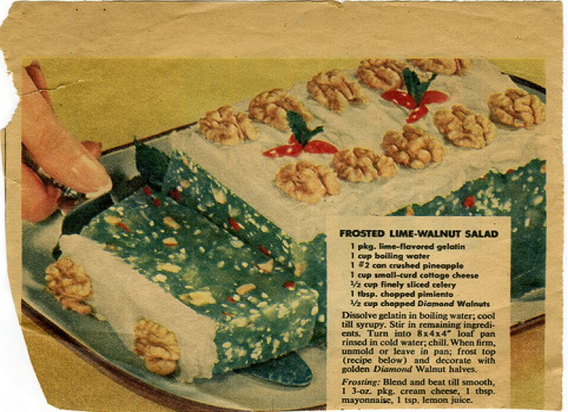
Frosted Lime Walnut
Are they running out of ideas here or what! You mix pimento, cottage cheese, lime jello, celery and walnuts. Frost with cream cheese. I know this came from the 60's, but come on!

Slide 14
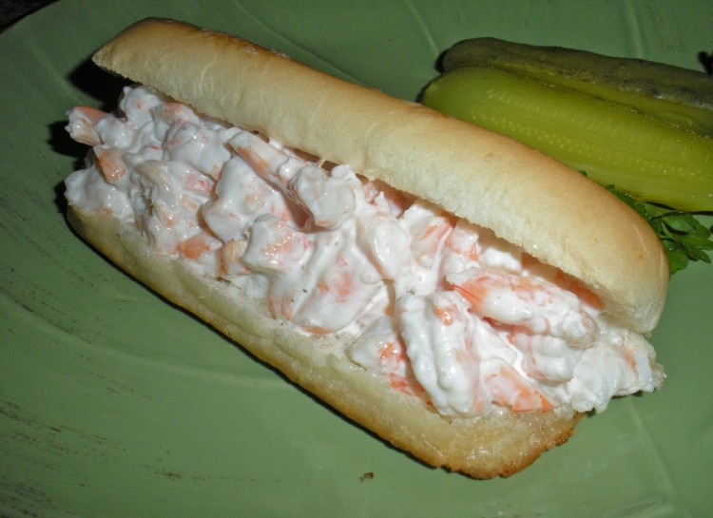
Shrimp Sandwich Roll
A sandwich with shrimp spread might taste pretty good, but turning it into this pink frosted log is upsetting. I'll just have my sandwich with the contents between two slices of bread, please!

Slide 15
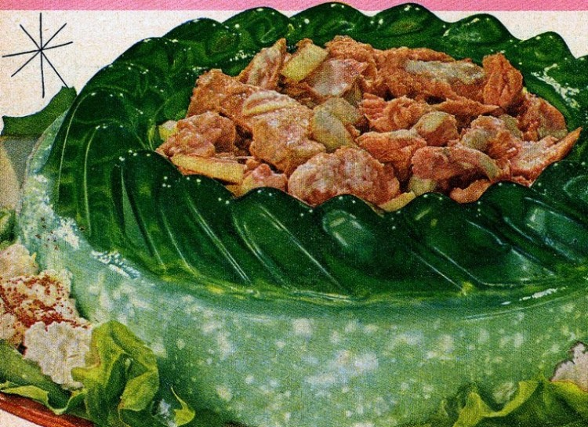
Lime Cheese Salad
Okay, what's with all these "salads" made from gelatin? This one includes the disgusting combination of cottage cheese, mayonnaise, onions, and lime Jello. Not ready to barf yet? Well you also fill the center with seafood salad.

Slide 16
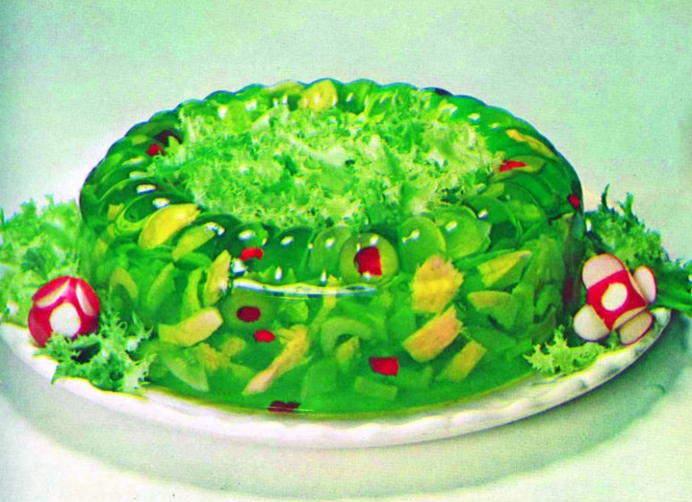
Ring-Around-The-Tuna
All you do is take some tuna and add in some gelatin, pimento, olives, vinegar and onion. Chill it and set in a mold. This just whets the appetite, doesn't it?

Slide 17
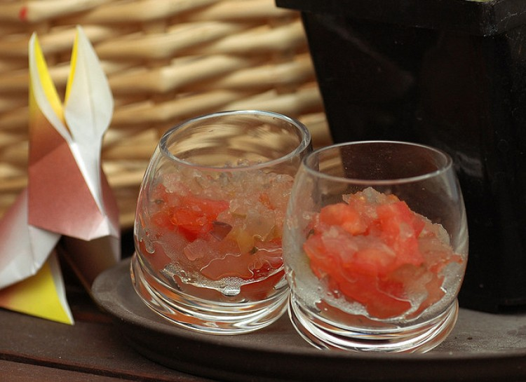
Jellied Tomato Refresher
I definitely wouldn't call this goopy concoction refreshing. Apparently, this is supposed to be a drink made from tomato sauce, green pepper flakes, broth, and garlic salt.

