Slide 1
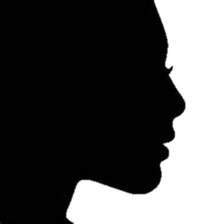
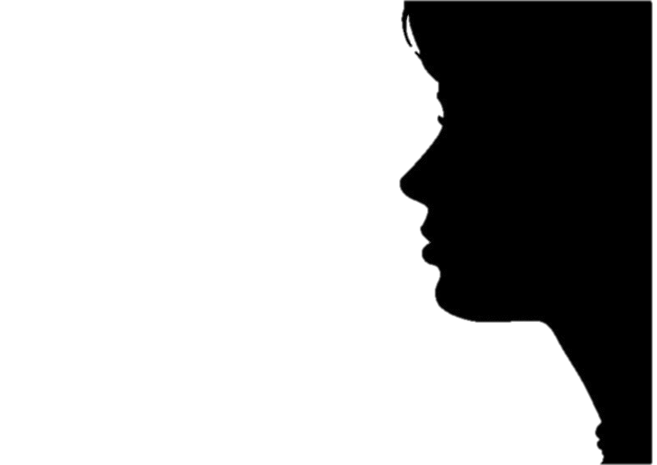
10 women trailblazers you may not have heard of
From trailblazing photojournalist Margaret Bourke-White to America’s first female doctor, Elizabeth Blackwell, take a look back at 10 female historical pioneers you should know about.

Slide 2
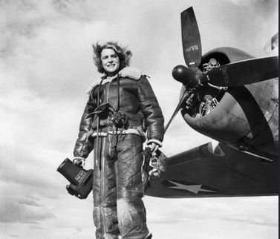
Margaret Bourke-White,
Margaret Bourke-White, fully dressed in a leather, fleece-lined flight suit — camera in hand — stands at the ready by an airplane propeller in this 1943 photo. Bourke-White was the first female photojournalist for LIFE magazine, making some of the most memorable images of the 20th century. She had an amazing career of many firsts and fearless assignments in a traditionally male-dominated line of work. (Photo: Bettmann/Getty Images)

Slide 3
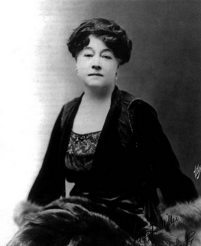
Alice Guy-Blache
Alice Guy-Blache (1873-1968), French pioneer filmmaker, was the first female director in the motion picture industry. (Photo: Apic/Getty Images)

Slide 4
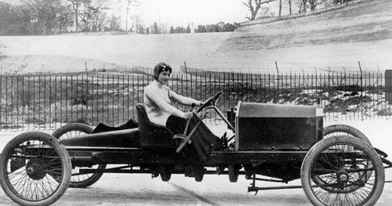
Miss Dorothy Levitt
Miss Dorothy Levitt is shown in a 26-horsepower Napier, at Brooklands in 1908. In 1903, she won her class at the Southport Speed Trials. In 1906, she broke the women’s world speed record, recording a speed of 96 mph. (Photo: National Motor Museum/Heritage Images/Getty Images)

Slide 5
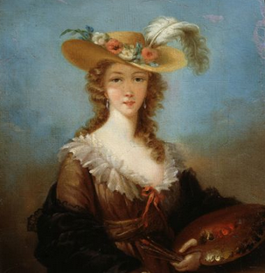
Elisabeth Vigée Le Brun
Elisabeth Vigée Le Brun was the most successful and celebrated portrait painter of her age, with the best known figures in late 18th-century Paris sitting for her, before the French Revolution forced her to flee France. (Photo: Fine Art Images/Heritage Images/Getty Images)

Slide 6
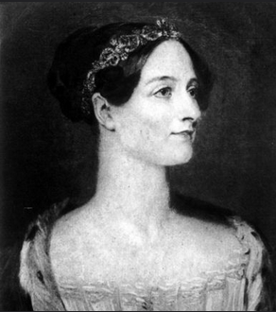
Augusta Ada King-Noel
Augusta Ada King-Noel, Countess of Lovelace, the daughter of the poet Lord Byron, was an English mathematician. Her code is now considered by many to be the world’s first computer program, with the United States Department of Defense naming its own computer language ADA after her. (Photo: Hulton Archive/Getty Images)

Slide 7
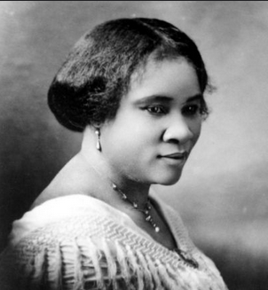
Madam C.J. Walker (Sarah Breedlove)
The most successful female entrepreneur of her time, Madam C.J. Walker (Sarah Breedlove), created a line of beauty and hair care products for African-American women, became the first female self-made millionaire in America. (Photo: Michael Ochs Archives/Getty Images)

Slide 8
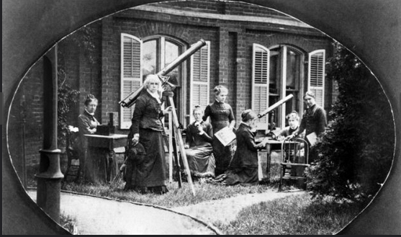
Maria Mitchell
Astronomer Maria Mitchell (1818-1889), standing second from left, next to a telescope, is shown with her astronomy class outside the observatory, at Vassar College, Poughkeepsie, N.Y., circa 1870. (Photo: Interim Archives/Getty Images)

Slide 9
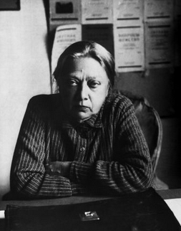
Nadezhda Krupskaya
One of the most significant exponents of Marxism, Nadezhda Krupskaya ran an international newspaper and became a key figure in the Bolshevik Party, helping to kick-start the October Revolution. (Photo: Hulton-Deutsch Collection/Corbis via Getty Images)

Slide 10
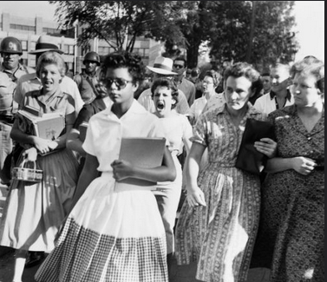
Elizabeth Eckford
Students of Central High School in Little Rock, Ark., shout insults at Elizabeth Eckford as she marches down to a line of National Guardsmen, who blocked the main entrance and would not let her enter, on Sept. 4, 1957. She was one of the nine African-American students whose integration into Central High School was ordered by a Federal Court following legal action by NAACP. (Photo: Bettmann/Getty Images)

Slide 11
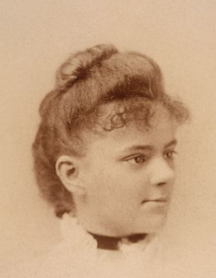
Elizabeth Blackwell
Elizabeth Blackwell was the first female doctor in the United States, and the first recorded woman to graduate from medical school. (Photo: Museum of the City of New York/Getty Images)

