Slide 1
10 things no one is allowed to do in front of the Queen
From Country Living UK
From Country Living UK

Slide 2
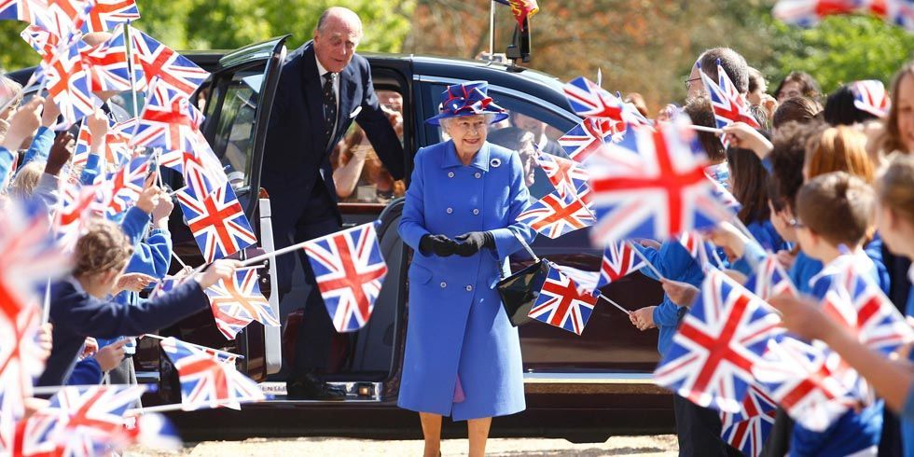
Queen Elizabeth has met hundreds of thousands, if not millions, of people in her lifetime. But one must remember when meeting Her Majesty, there are just certain things you shouldn't do in order to avoid looking rude or offending her.

Slide 3
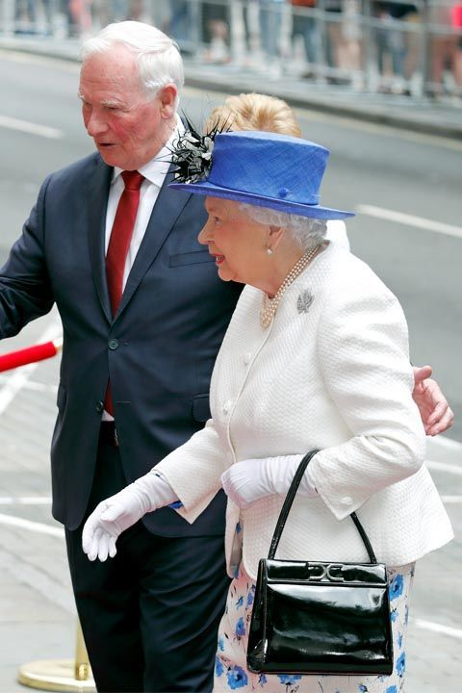
You shouldn't touch her
Protocol says anyone meeting Queen Elizabeth for the first time should wait for her to extend her hand first. And even afterwards, contact should be kept to a minimum. That means hugs and kisses are a major no no.

Slide 4
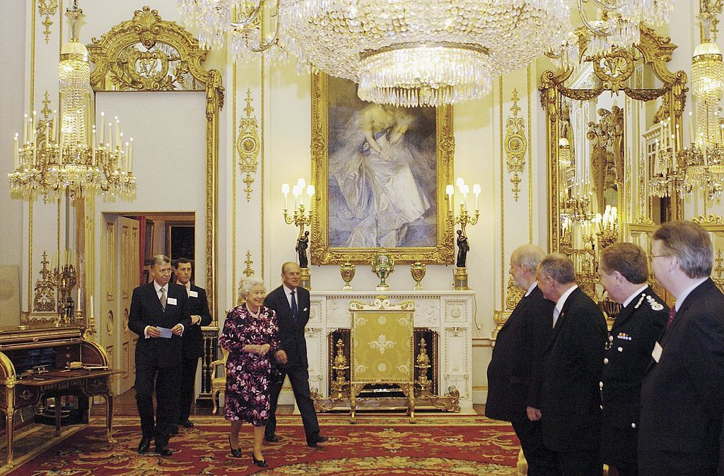
You shouldn't be sitting
As soon as the Queen enters the room, everyone must stand to greet her and should not sit down until she does. Only then is it polite to take a rest.

Slide 5
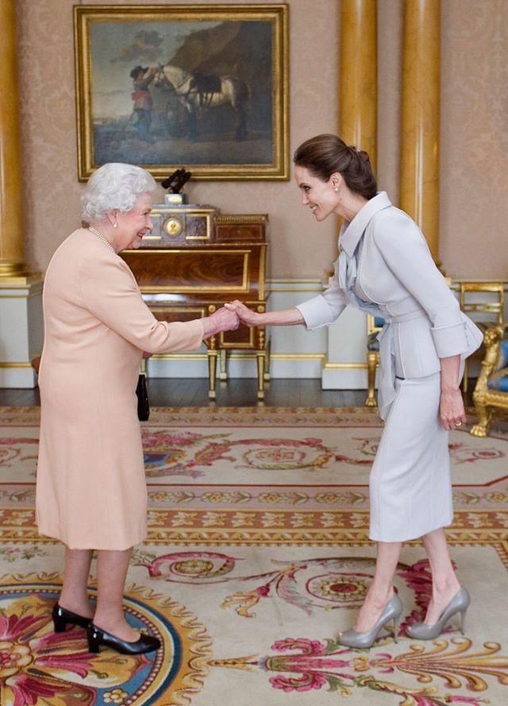
You shouldn't just stand there
If you're a citizen of the United States, you can simply shake hands, but in Great Britain, men and women must bow or curtsy. When Angelina Jolie, who is a US citizen met the Queen, you see she did a little of all three...

Slide 6
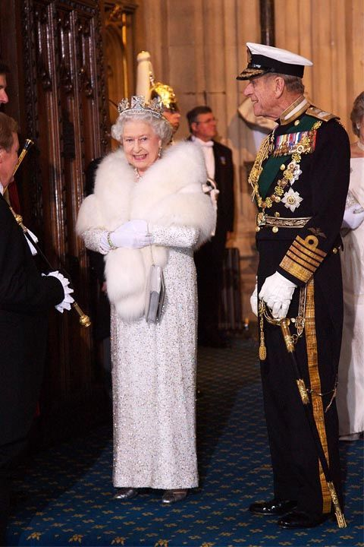
You shouldn't show up casual.
Dress to impress. If there's a dress code, follow it.

Slide 7
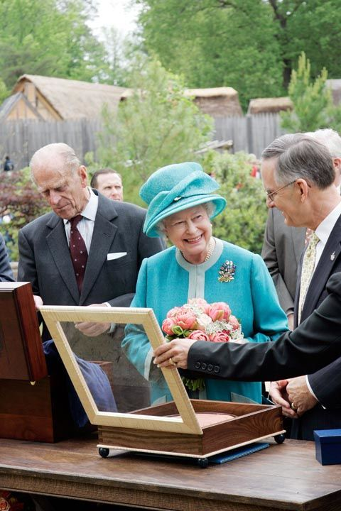
You shouldn't show up without a gift
Bringing a gift is a must, but it should always be appropriate for the occasion. For instance, if the Queen visits your hometown, it's common to give her something that is from there and indicative of your culture.

Slide 8
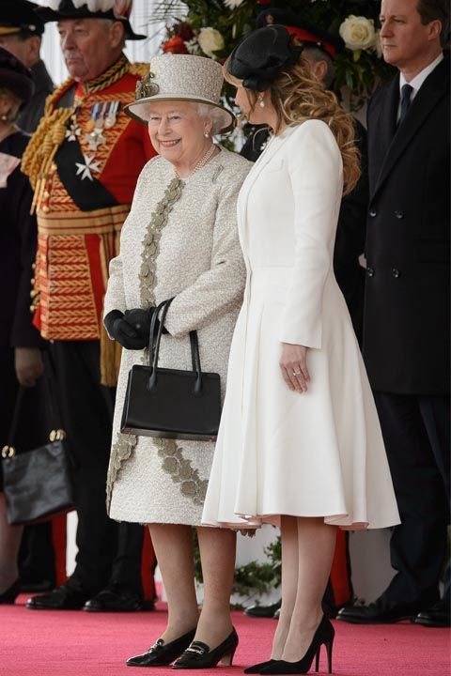
You shouldn't use nicknames
Even though you might feel like you've known the Queen your whole life, remember: she doesn't know you. When you first meet her, address her as "Your Majesty." Use "Ma'am" the rest of the time, except when you say farewell, which should be "Your Majesty" once again.

Slide 9
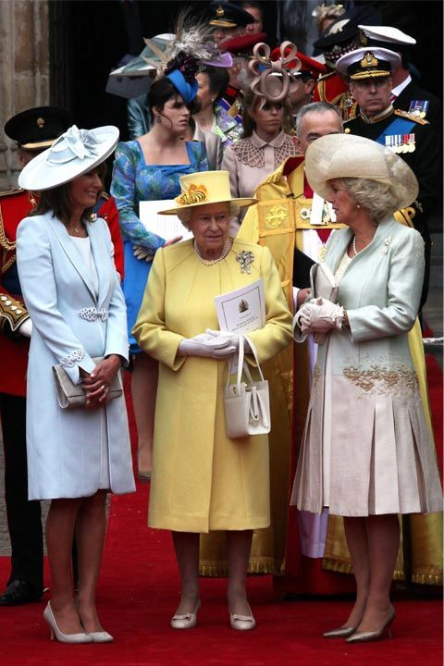
You shouldn't speak unless spoken to
When around the Queen, you should follow the same rule some people use for kids, which is "little children should be seen and not heard." This allows for the Queen to carry the conversation - or put it to a stop, if she so desires.

Slide 10
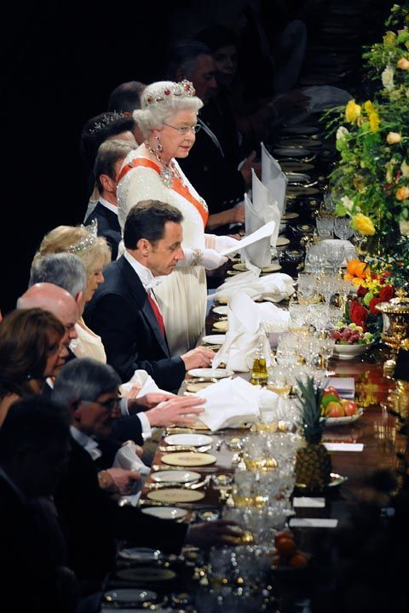
You shouldn't eat first
It's customary that the Queen should take the first bite at the table and when she's done eating, you should be too

Slide 11
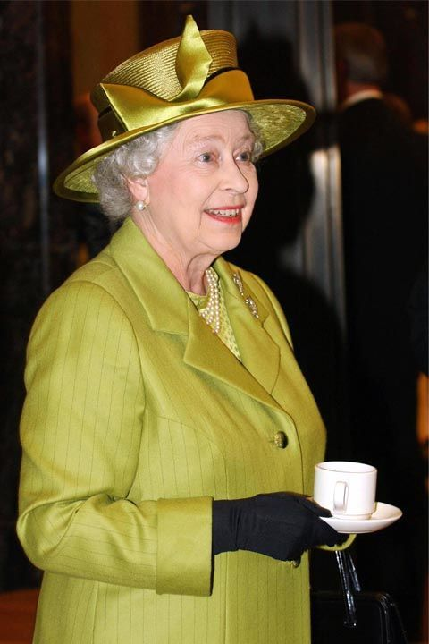
You shouldn't slurp your tea
Since tea is huge part of the British culture, you should drink it as the Queen does. Hold the tea cup, not the cup and saucer, when at the table, and never, ever slurp as you drink.

