Slide 1
Sea Level Rise Could Look Much Worse by 2100
New research doubles previous predictions if greenhouse gas emissions go unchecked.

Slide 2
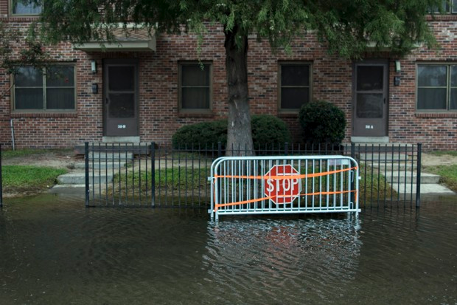
Some areas already affected by high tide flooding

Slide 3
Sea level rise can be difficult to imagine concretely. It’s often discussed as a gradual phenomenon, a threat whose effects will only really be felt by far-distant generations. But new research has made it impossible to continue in this line of thought. In an article published recently in the journal Nature, the scientists Robert DeConto and David Pollard double the prediction for sea level rise expected by the year 2100 from three feet to six feet, if the current rate of greenhouse gas emissions holds steady. By the year 2500, it could hit 50 feet.

Slide 4
How some cities could be affected . . .
First map shows today, and the second map shows what could be in 2100 if greenhouse gasses are not reduced.

Slide 5
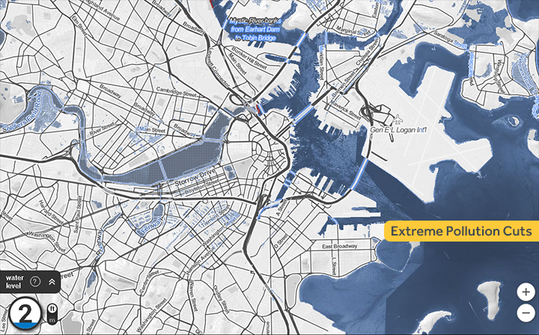
Boston

Slide 6
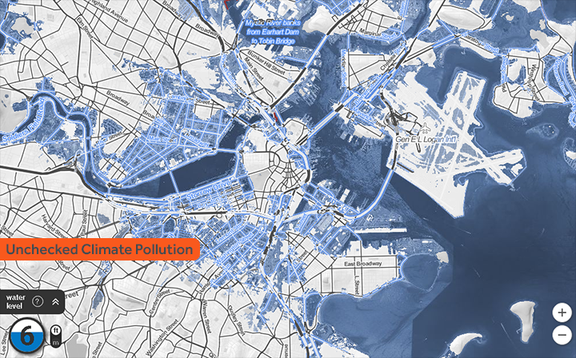
Boston 2100

Slide 7
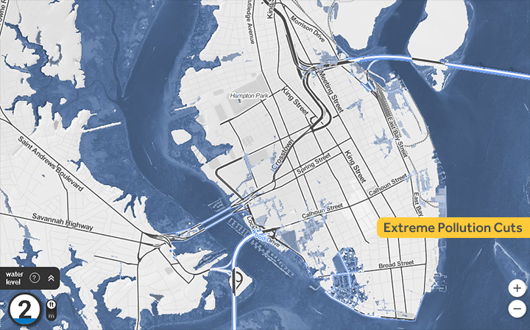
Charleston

Slide 8
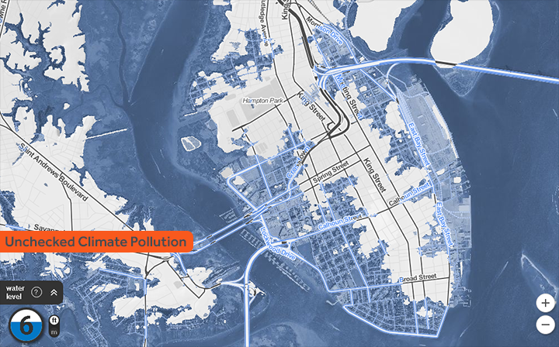
Charleston 2100

Slide 9
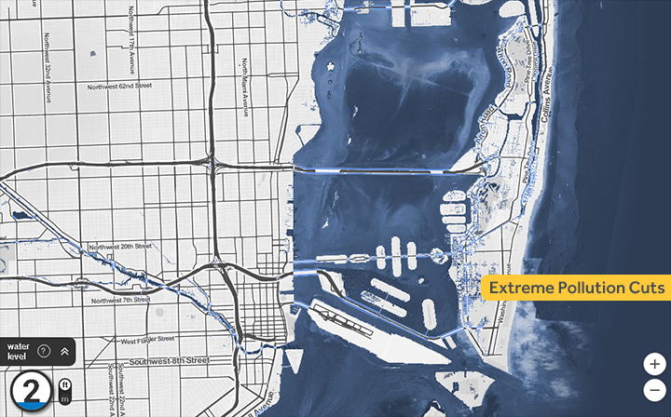
MIAMI

Slide 10
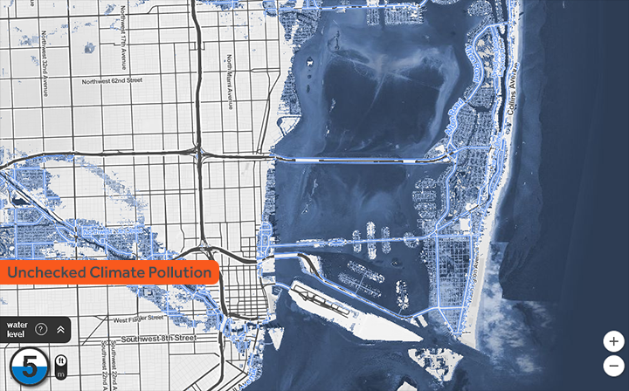
MIAMI in 2100

Slide 11
These findings are especially crucial now, Pollard says, because some of the consequences are preventable. The precipitous rise, he adds, occurs in their model “only if business continues as usual, and the CO2 levels keep going up.” But if warming is limited to the levels recommended in the Paris Agreement—well below 2°C (3.6°F)—the model shows a much less drastic increase.

