Slide 1
Coastlines and Climate Change
Louisiana Example

Slide 2
1922 to the present
Over the last 80 or more years, Louisiana has lost nearly 2,000 square miles of coastland — land that has simply vanished into the Gulf of Mexico. And much, much more land is likely to disappear in the years ahead unless major changes are made. That's the subject of a terrific 2014 investigation from Bob Marshall of The Lens and Brian Jacobs and Al Shaw of ProPublica. You should absolutely go read their entire piece (and check out all of their excellent visuals), but I've made two images of two key maps to highlight the very basic change at play here:

Slide 3
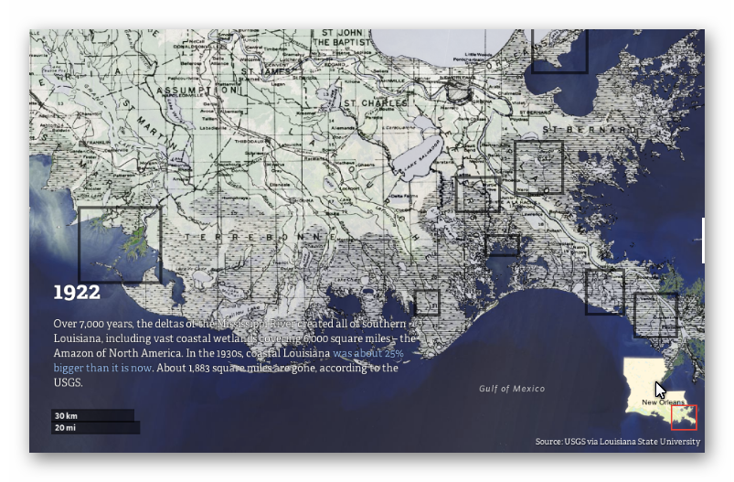
Baseline for this comparison

Slide 4
And over the past century, various human activities have disrupted this ecosystem.
Great Mississippi Flood of 1927
Army Corps of Engineers built dams, blocking sediment from reaching the delta
Discovery of Gulf oil deposits
Energy companies dredged thousands of miles of canals through the wetlands to transport equipment through — and those canals allowed shoreline to crumble and saltwater to seep in, killing off plants.
scientists argue that the land itself has sunk after companies extracted oil and gas from underground wells.
The nutria, an invasive rodent species, is also helping destroy the wetlands.

Slide 5
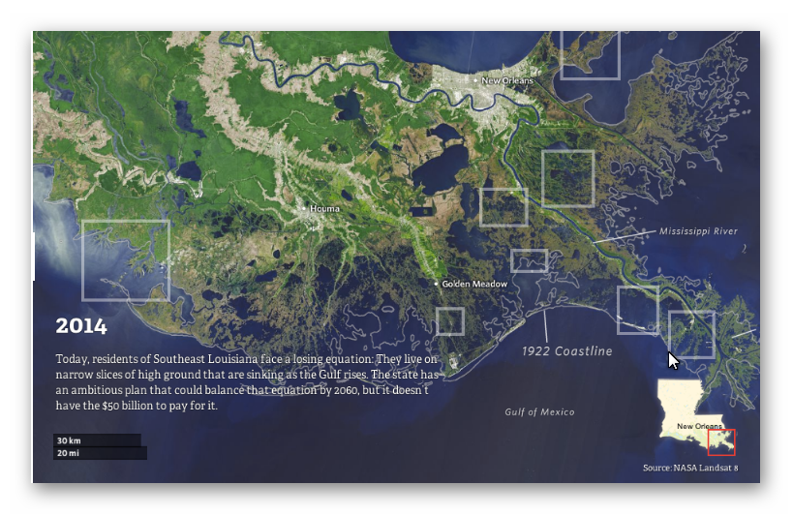
Compare to 1922 Coastline

Slide 6
Global sea levels are currently rising 3.2 millimeters per year, on average. But the pace has been much faster in parts of Louisiana, because the activities mentioned above that are causing to land to sink — sea levels are rising 9.2 millimeters per year near Grand Isle, La.
And if sea level rise accelerates in the decades ahead, as many scientists expect it will, then southeast Louisiana could end up one of the hardest-hit areas. Next is a map by Louisiana State University's Mike Blum showing what the state's coastline could look like in 2100 in the worst-case scenarios:

Slide 7
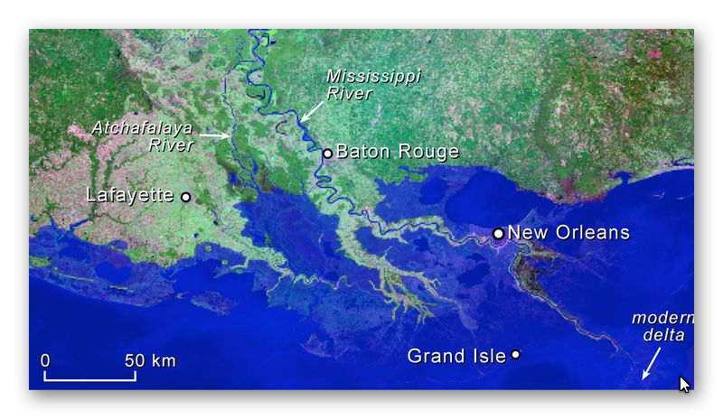
2100 – Worst Case Scenario

Slide 8
Now, the scenario in this map isn't inevitable. There's still a range of projections for future sea-level rise — this is just one of them, albeit one that dramatically underscores how vulnerable the region is. So is there anything the state can do? Back in 2012, Louisiana policymakers unveiled a master plan for storm protection and coastal restoration that would, among other things, revamp the system of levees and allow controlled flooding to replenish the delta. That could at least help slow the sinking. The hitch: this plan is estimated to cost more than $90 billion in all and is still far from fully funded — a study last November by Tulane Law School's Mark Davis estimated that the state was still $71 billion short.

Slide 9
World-Wide
Rising sea levels will have an impact on all coastlines around the world, more or less. River delta lands like the Louisiana coastline will be more affected than other areas, particularly where rivers have had dams built along their course like the Mississippi River. Here are a few such rivers:
Columbia River
Nile River
Chang Jiang (Yangtze R.)
Parana-Paraguay drainage basin

