Slide 1
Climate change speeding up the spread of Lyme disease
Katharine Walter is a graduate student in the Department of Epidemiology of Microbial Diseases at Yale University.

Slide 2
A deer tick resting on a blade of grass.

Slide 3
Immature deer ticks are called questing nymphs. They now inhabit a wide swath of North American forests, but they didn’t always. During early summer, their quest is for blood. The season now starts earlier and lasts longer than it did in the past, which is good for the ticks. But it’s bad for humans, because these ticks carry the bacteria, viruses, and parasites that cause Lyme disease, anaplasmosis, deer tick encephalitis, and babesiosis.

Slide 4
Deer tick invasion
Encounters with ticks didn’t always cast a dark shadow over North American summers. Cases of Lyme disease first appeared in 1976 in the woodsy suburb of Lyme, Connecticut. At that time, deer ticks were found only in a hotbed encircling Long Island Sound, along with a small area in Wisconsin.
Since the 1970s, deer ticks have rapidly extended their reach north, west, and south. The most recent map shows that deer ticks now roam throughout the eastern coastal states, from Maine to Florida, and across the Midwest. They are now established in 45 percent of US counties. That means the deer tick has more than doubled its reach in the 20 years since the previous map was published.

Slide 5
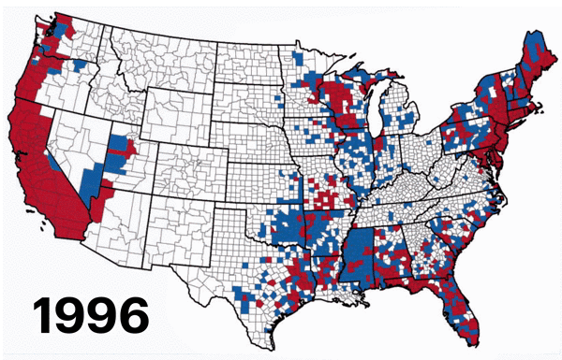

Slide 6
n part, ticks are following the spread of one of their favorite sources of blood: deer. As deer populations exploded over the last sixty years, thanks to strict hunting laws and the largely predator-free and deer-friendly landscapes in New England and the Midwest, deer ticks followed. However, the steady crawl of ticks north into Canada can’t be explained by deer alone.
Ticks spend the majority of their lives on the forest floor. They are vulnerable to changing local climates and death by freezing, drowning, or desiccation. Warmer winters and longer summers let more ticks survive and thrive further north each year. Warmer temperatures quicken the tick life cycle, too. Tick eggs hatch sooner and ticks spend more time questing for blood, and so are increasingly likely to feast on a human and pass on a disease-causing pathogen. Because more ticks survive and mature more quickly, diseases can be transmitted faster.

Slide 7
Species that thrive under climate change
The barriers we have created — the heated, cooled, and (somewhat) bug-free spaces we inhabit — give us an artificial sense of immunity to the disturbances shaking our fragile ecosystems. Nymphs don’t respect the barriers of urbanization and wealth that protect many Americans from vector-borne diseases. Window screens, socks, and our skin don’t stop the invasion of nymphs, reminding us of our vulnerability to ecological changes brought about by climate change, habitat fragmentation, and deforestation.
As we worry about the ability of some species to run from climate change and escape extinction, ticks, mosquitoes, kissing bugs, and the parasites they carry may thrive under climate change. Where will these crawling and flying disease carriers move? And who will be at risk for what were once called tropical diseases?

Slide 8
The consequences of climate change will vary dramatically across the globe and are difficult to predict. The yellow fever mosquito (which also carries dengue, Zika, and chikungunya viruses), for instance, is predicted to spread rapidly in some areas, including eastern North America and large parts of southeast Asia, and become less common in others areas, like much of Australia.
A changing climate will affect mosquito-borne diseases in subtler ways, too. In a warmer climate, the dengue virus matures more quickly (up to a certain temperature). That means an infected mosquito can more swiftly spread the virus.

Slide 9
The consequences of climate change will be felt most profoundly by people living in or near areas where diseases carried by mosquitoes and other vectors are already common, and where poverty makes it difficult to stamp out these diseases.
A forest nymph brushing against a hiker doesn’t begin to drink blood immediately. She crawls across the skin, searching for a comfortable dinner spot. She grips her prey with spindly legs and uses knife-like mouthparts to slice into human skin. She secretes cement around the wound, binding herself to her host, and then begins to imbibe. Once attached, this offspring of a changing climate can’t be simply brushed off.

Slide 11
Results of Lyme Disease May Linger On . . .
Patients suffering from persistent symptoms they believe to be caused by a past episode of Lyme disease aren’t helped by long courses of antibiotics, according to a new study.
Why it matters: Of the tens of thousands of Lyme infections worldwide every year, some 4 to 20 percent of people continue to suffer symptoms they attribute to the disease — such as arthritis, neuropsychological disorders, or fatigue — for years. But it’s an unsettled question whether these patients’ symptoms are connected to Lyme disease and what to do about them.
Doctors sometimes prescribe long courses of antibiotics, but the research on the effectiveness of this practice is patchy. According to the Centers for Disease Control and Prevention, studies have not shown antibiotics to be effective in treating these long-term symptoms.

