Slide 1
Australia - Third of coral 'dead or dying' in parts of Barrier Reef

Slide 2
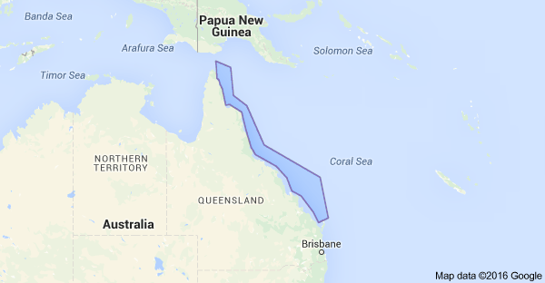

Slide 4
Importance of Coral Reefs
Functions of Coral Reefs: Coral reefs are important for many different reasons aside from supposedly containing the most diverse ecosystems on the planet. They: protect coastlines from the damaging effects of wave action and tropical storms. provide habitats and shelter for many marine organisms.
Coral reefs are important for many reasons. Most importantly, they provide protection and shelter for many different species of fish. Without coral reefs, these fish are left homeless with nowhere to live and no where to have their babies. Coral reefs support more species per unit area than any other marine environment, including about 4,000 species of fish, 800 species of hard corals and hundreds of other species.
Coral reefs are an important food source for the people who live near reefs, and, as nurseries, are vital to the world's fisheries. Many of the compounds now being used in human medicines, including some that treat cancer, are found on coral reefs, with probably many more yet to be discovered.

Slide 5
Dead and dying staghorn coral on the central Great Barrier Reef

Slide 6
Coral bleaching is the loss of intracellular endosymbionts (Symbiodinium, also known as zooxanthellae) through either expulsion or loss of algal pigmentation. The corals that form the structure of the great reef ecosystems of tropical seas depend upon a symbiotic relationship with algae-like unicellular flagellate protozoa that are photosynthetic and live within their tissues. Zooxanthellae give coral its coloration, with the specific color depending on the particular clade. Some scientists consider bleaching a poorly-understood type of "stress" related to high irradiance; environmental factors like sediments, harmful chemicals and freshwater; and high or low water temperatures. This "stress" causes corals to expel their zooxanthellae, which leads to a lighter or completely white appearance, hence the term "bleached". Bleaching has been attributed to a defense mechanism in corals; this is called the "adaptive bleaching hyp

Slide 7
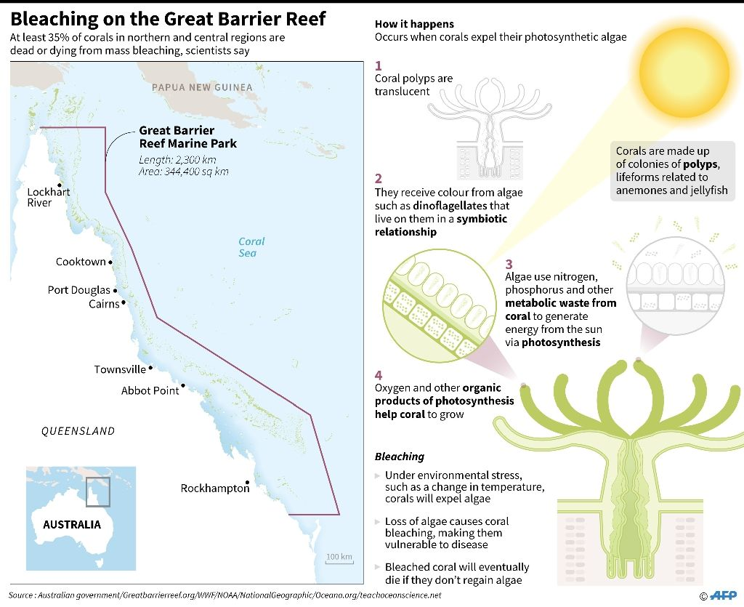

Slide 8
The Great Barrier Reef is already under pressure from farming run-off, development, the coral-eating crown-of-thorns starfish, along with climate change

Slide 9
4 / 9 Related Search Result Australia's Great Barrier Reef could be beyond saving in five years without "now or never" funding to improve water quality as climate change ravages the World Heritage-listed site, scientists warn.

Slide 12
A section that has not totally died, yet . . . .

Slide 13
6 / 9 Related Search Result Without government funding of Aus$10 billion (US$7.2 billion) over the next decade to improve water quality, "the Great Barrier Reef will be in a terminal condition within five years", say scientist

Slide 14
This is how it should be . . . . .

Slide 16
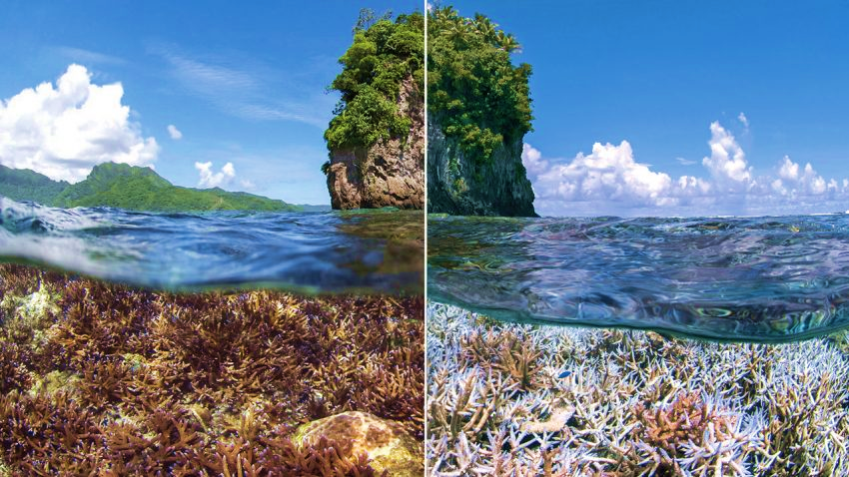
El Niño’s warmth devastating reefs worldwide
Images from December 2014 (left) and February 2015 show coral bleaching in the Pacific waters around American Samoa.

Slide 17
It shouldn’t be like this

Slide 18
Coral growth is forced into interesting elongated and stunted (not normal) shapes in the surge and surf zone

Slide 21
Threats to Pacific corals and consequences
Ocean water is becoming slightly more acidic – increased levels of carbon dioxide in the water plus some agricultural and/or industrial pollutants. Corals are sensitive to increased acidity in a negative way.
Climate change has raised the temperature of the ocean water a little, but that little bit is enough to get a negative reaction from coral.
The crown of thorns starfish spreading in the Pacific – they prey on coral, destroying it.
The accumulated “stresses” on coral reefs causes the little animals to self-destruct.
They are part of the world ecosystem – remember that “everything is connected.” We may live far from any coral reefs, but harm to them can and will affect you and me in some way.

Slide 22
Can they do it, or is it too late?
In the face of global warming and after decades of increasingly devastating coral reef destruction, the world's top marine scientists are struggling to find the political and financial wherewithal to tackle the loss of these globally important ecosystems.
Don’t forget the four laws of ecology
Everything is connected
Everything goes somewhere
Nature knows best
There’s no such thing as a free lunch

