Slide 1
Thanksgiving Storm Moves East, Could Snarl Holiday Travel for Millions
November 25, 2013

Slide 2
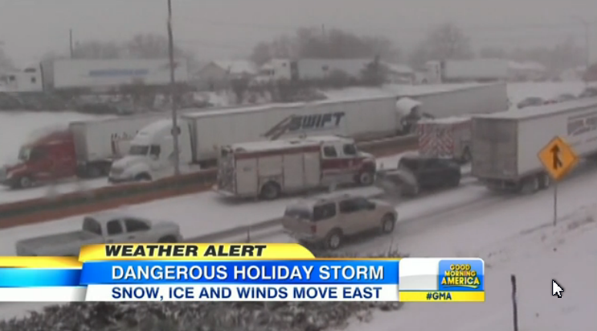

Slide 3
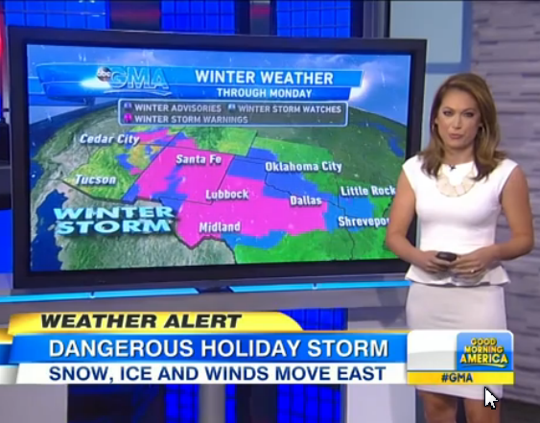

Slide 4
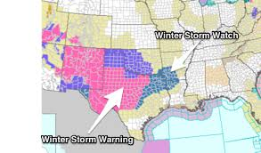

Slide 5
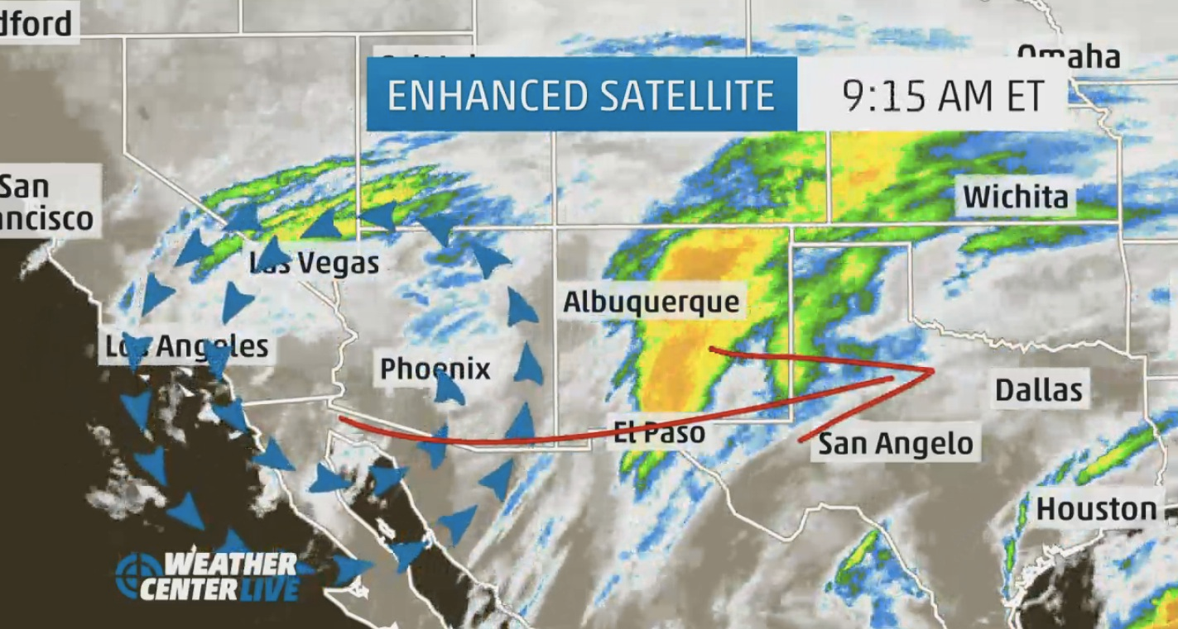

Slide 7
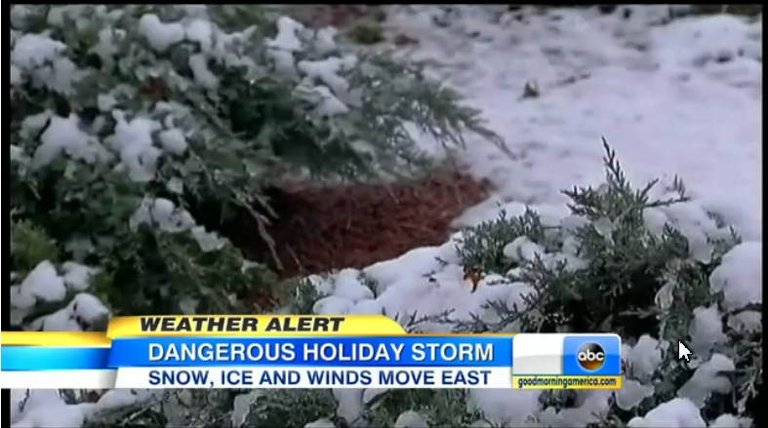

Slide 8
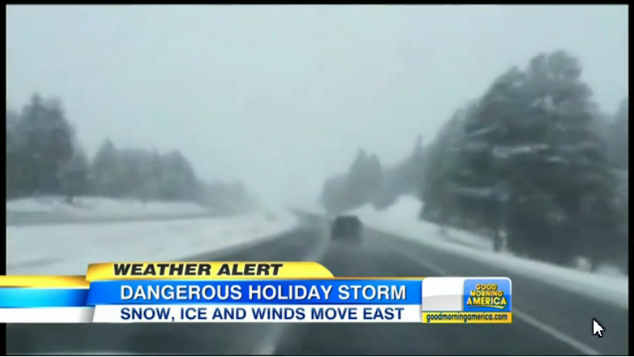

Slide 9
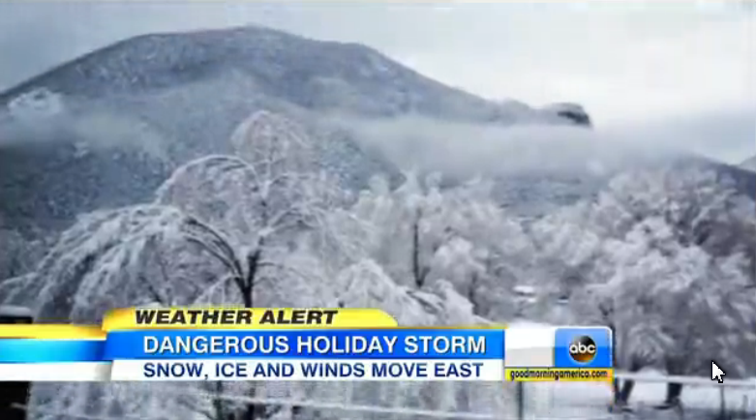

Slide 10
A powerful winter-like storm that is being blamed for at least eight deaths is marching eastward and could wreak havoc as millions of Americans are preparing to travel for Thanksgiving. The front, which began Thursday in California, is now pummeling most of North Texas with a mix of rain, light freezing rain and light sleet. The west got walloped with up to three feet of snow from California to Texas. Meteorologists said they expected the Arctic mass to head south and east and threaten plans for Tuesday and Wednesday as people hit the roads and airports for some of the busiest travel days of the year.

Slide 11
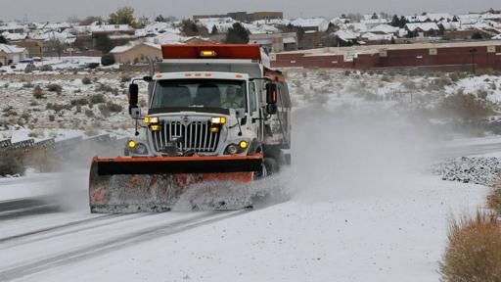
New Mexico

Slide 12
In Arizona, firefighters recovered the body of a man who was swept away by high waters Friday in the Santa Cruz River in the southern part of the state. Flagstaff, Ariz., was socked with 11 inches of snow by early Sunday and was expecting at least another inch overnight. Metro Phoenix and other parts of central Arizona received between 1½ to 2½ inches of rain over the course of the storm. The storm is also affecting animals and casing migrating ducks to fall from the sky in Noble, Okla. Rondi Large, director at Wildcare Foundation in Noble, is caring for a group of confused ducks who thought they were landing in water when they crashed into glistening, ice covered asphalt roads. "The edges of their beaks had got very bad bruising and bleeding on the end of the beaks so they must have nose-dived," Large said.

Slide 13
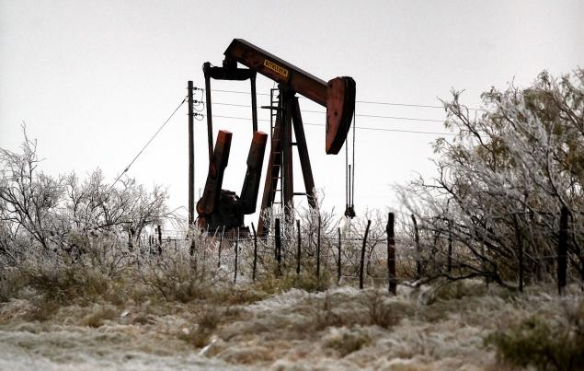
A pumpjack can be seen through branches covered in ice in a cold Saturday, Nov. 23, 2013 in Odessa, Texas.

Slide 14
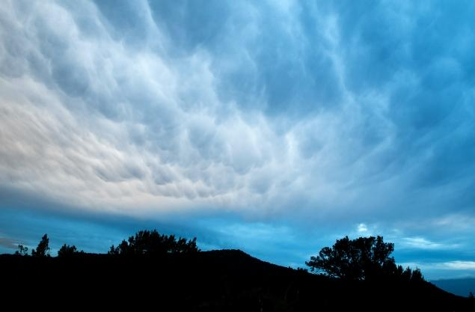
Nov. 21, photo shows a winter storm moving into Flagstaff, Ariz.

Slide 15
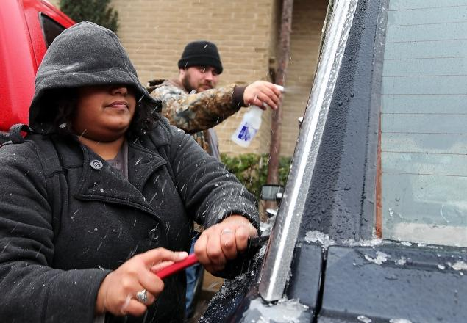
Samantha Hernandez scrapes ice off of the windows on Saturday, Nov. 23, 2013, in Odessa, Texas

Slide 16
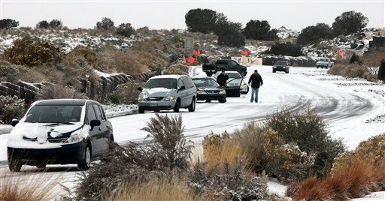
New Mexico

Slide 17
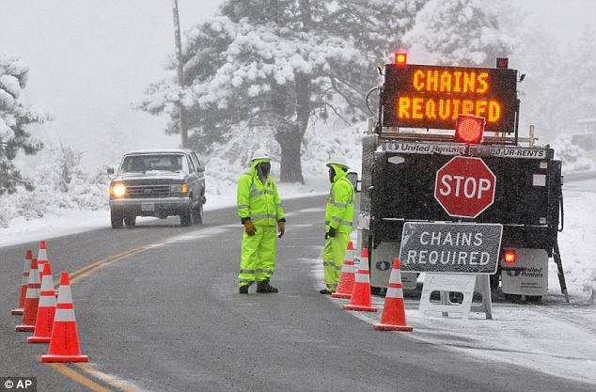
Mountain High Resort in Wrightwood, California

Slide 18
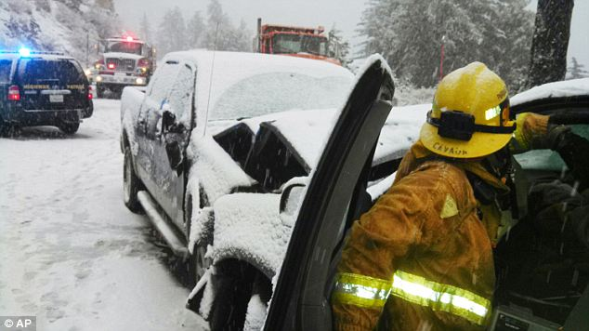

Slide 19
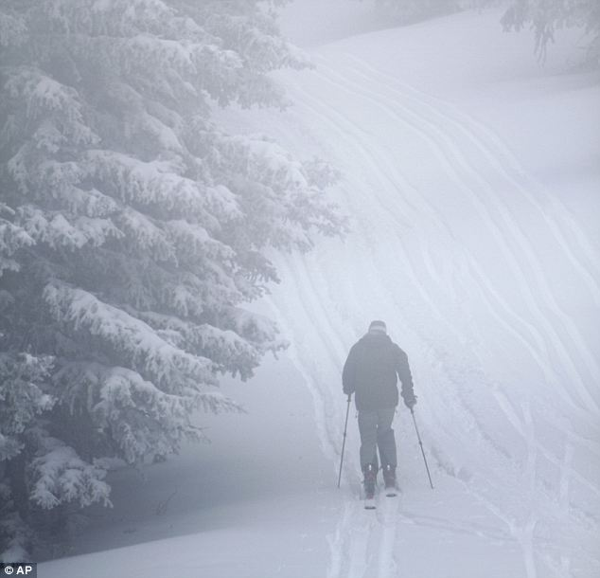
Santa Fe, New Mexico

Slide 20
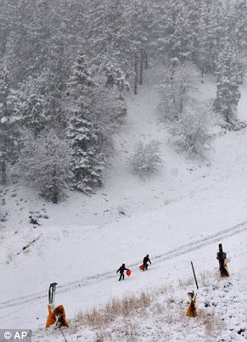
New Mexico

Slide 21
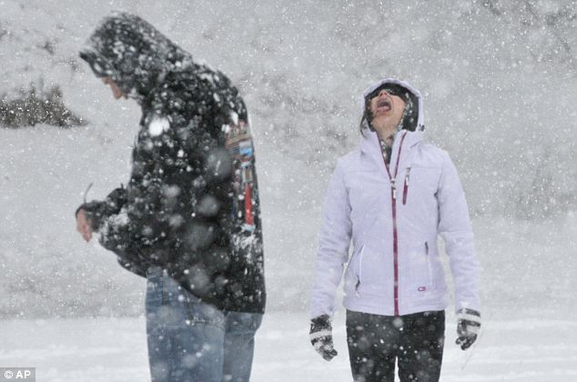
Nevada

Slide 22
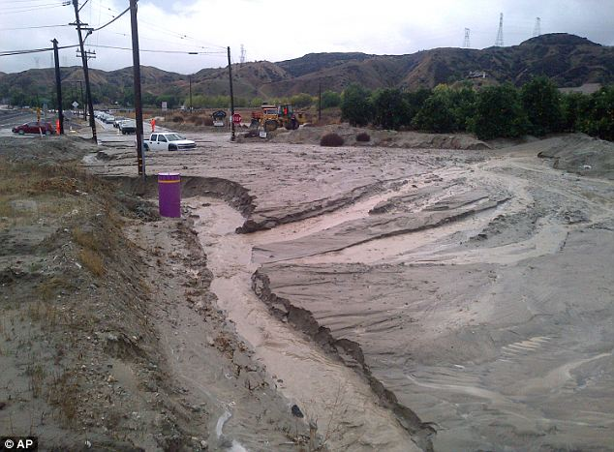
Flooding, mud and debris in Redlands, California

