Slide 1
Why study geography?
To function as a good citizen, one must have some geographic knowledge.

Slide 2
Geography studies:
How humans live on, use, and abuse the earth – the only home they have.
Some causes of change that humans need to know about since our government will decide to get involved in some of them
Climate change and its impacts around the world and within the U.S.A.
Wars and human rights violations, particularly in strategic places
Economic inequality in the world and within the U.S.A.

Slide 3
Your governments will make decisions regarding these concerns
If you live in a rather democratic country like the U.S.A., you can influence the decisions by what and for whom you vote!
To vote intelligently, people need knowledge of geography, history, and economics
You will need to decide:
Which candidates positions seem to make sense
Which issues you need to support or oppose
Remember if you don’t vote, you don’t have the right to complain!

Slide 4
Consider this presentation

Slide 5
Pictures Of The Human Race That Are Simply Stunning
The world is a “mixed bag:” The beautiful, the ugly, the tragic, the brave, the courageous, the horrible, the touching, the inspiring.
By Michaela Mazur | November 10, 2015

Slide 6
Each one is a human being with inalienable rights. (check the Declaration of Independence

Slide 7
The world is full of amazing people, each with their own story of love, family, or hope. Some are inspiring; some tragically sad. These heartwarming and heartbreaking photos are a reminder of the vast spectrum of emotion coursing every day through the body of the entire human race.

Slide 8
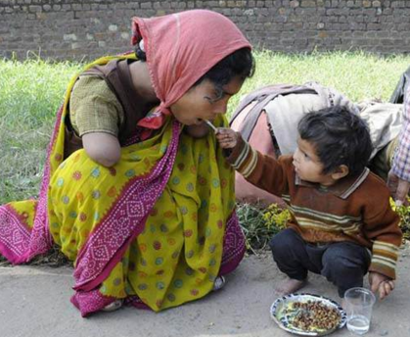
Young Boy Feeds His Mother
A young boy helps feed his mother, who has tragically lost both of her arms.

Slide 9
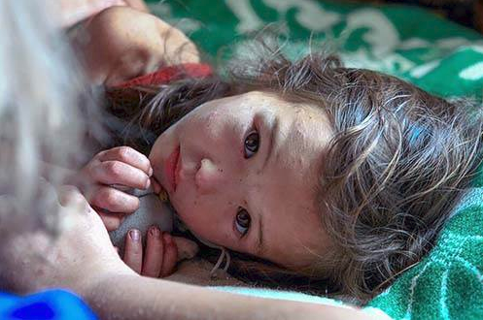
A Weary Survivor
A girl is comforted after spending 11 days alone in a Siberian forest. She suffered only a handful of scratches and insect bites.

Slide 10
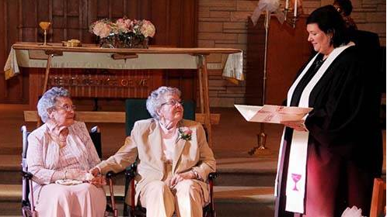
Love Is Timeless
A same-sex couple finally gets married in Iowa – at the tender age of 72 years young.

Slide 11
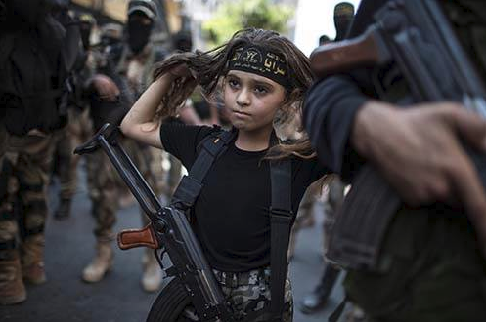
Child Militants
A young Palestinian girl strapped with a Kalashnikov rifle attends an Islamic jihad rally in Gaza City.

Slide 12
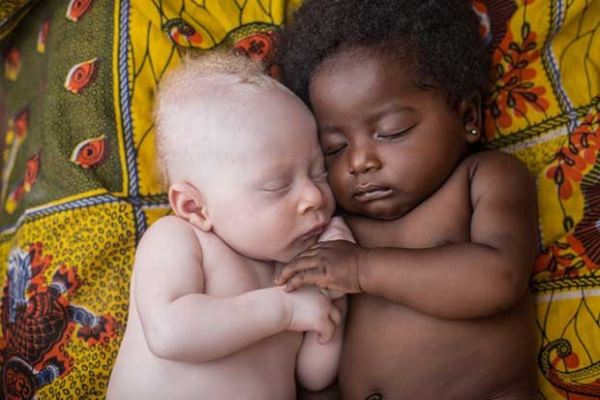
Sleeping Cousins
A 3-week old newborn with albinism sleeps beside his cousin in Kinshasa, the capital of the Democratic Republic of the Congo.

Slide 13
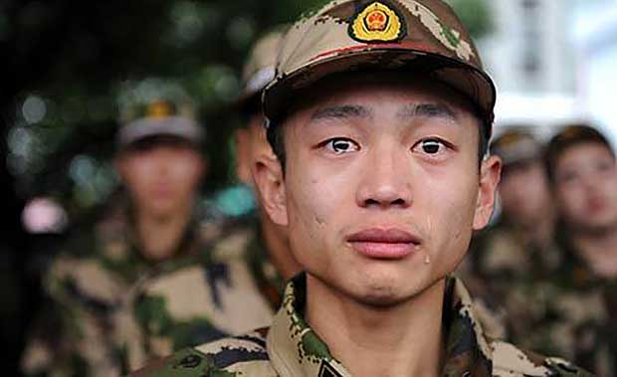
"Dreaming Up Wars...“
“I’m fed up to the ears with old men dreaming up wars for young men to die in.” ~ George S. McGovern

Slide 14
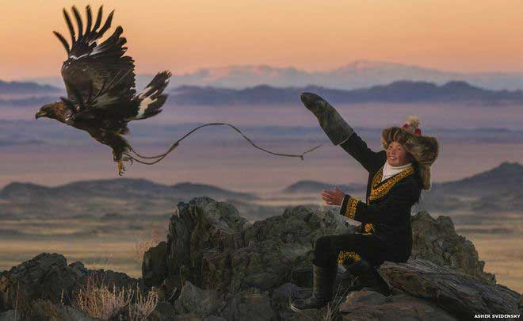
Eagle Huntress of Mongolia
Ashol-Pan is a 13-year-old eagle huntress, part of a group of young hunters – the only female of the group – who one photographer recalled, “To see her with the eagle was amazing. She was a lot more comfortable with it, a lot more powerful with it and a lot more at ease with it.”

Slide 15
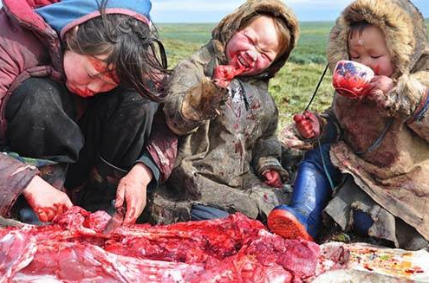
A Typical Siberian Meal
Dig in, we guess?

Slide 16
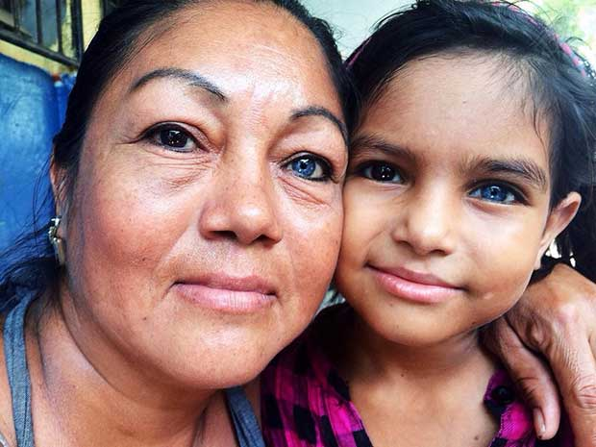
Mother and Daughter Have Similar Unusual Eyes
One dark eye and one blue runs through the generations.

Slide 17
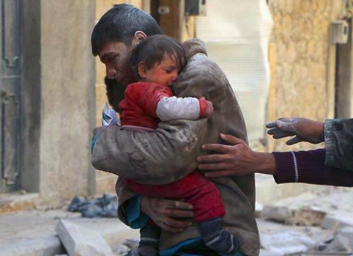
Save From Destroyed Home
A man risked his life to save his baby sister from their crumbling home in Syria.

Slide 18
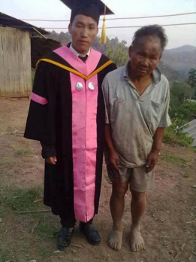
Proud Father
He has no money, but this father did everything he could to make sure his son made it through college.

Slide 19
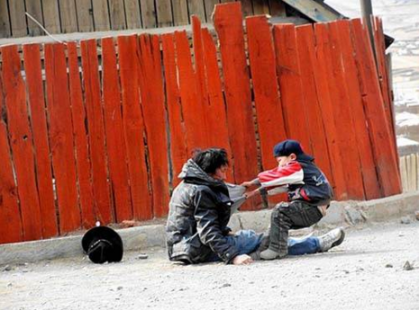
Child Dragging Home His Alcoholic Father
Heart-wrenching to witness.

Slide 20
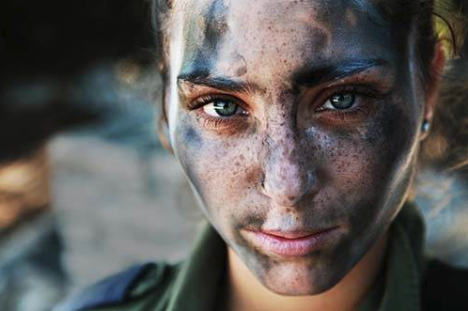
IDF Soldier Pauses After Training
Striking image of a young, 18-year-old woman in the Israeli Defense Forces.

Slide 21
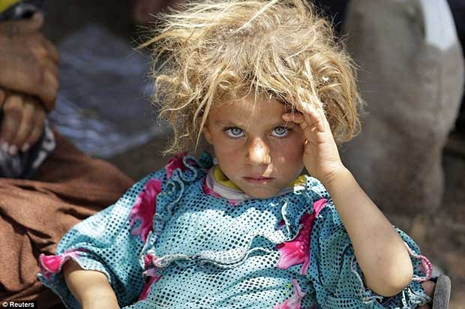
A Young Iraqi Girl
A minority girl from the Yazidi sect in Iraq watches the cameraman.

Slide 22
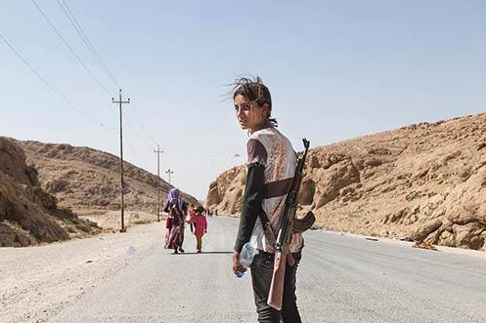
Protect Your Family
To protect her family from ISIS militants, a young Yezidi woman arms herself with an AK-47.

Slide 23
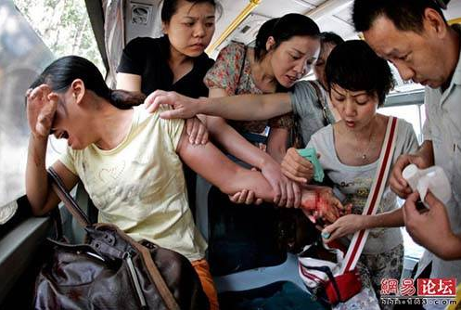
Attempted Suicide
Strangers rally to aide a woman who attempted to commit suicide on a public bus.

Slide 24
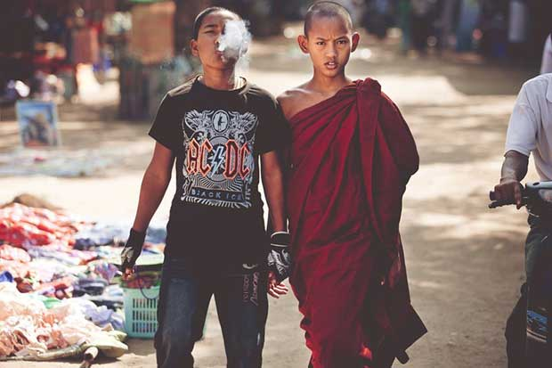
Brothers
A monk and his brother link hands.

Slide 25
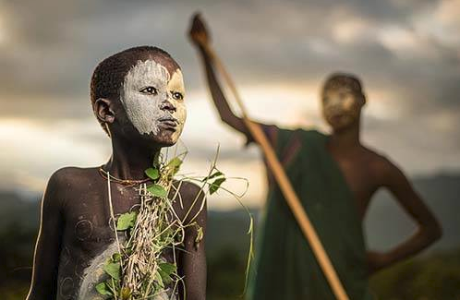
Boy From Nomadic Suri Tribe of Ethiopia
He’s dressed in traditional body paint and natural attire.

Slide 26
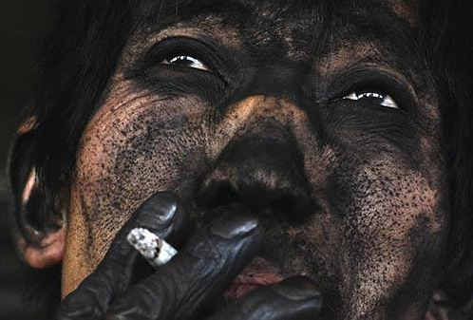
Chinese Coal Miner
There isn’t a smidge of skin on his hands that isn’t black. Crazy!

Slide 27
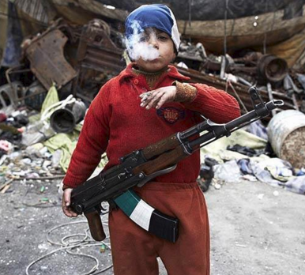
7-Year-Old Syrian Rebel
For some, they have little choice in the life they are taught.

Slide 28
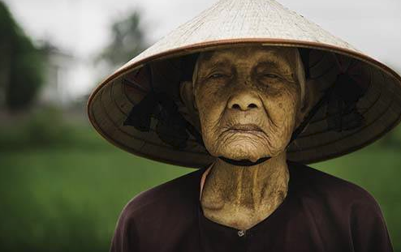
Old Rice Farmer from a Small Village in Vietnam

Slide 29
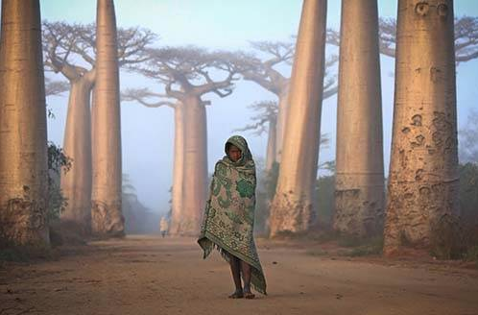
Girl Walks Between Villages Among Baobab Trees

Slide 30
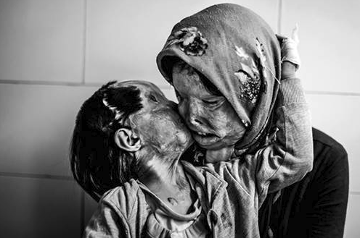
Acid Attack Victims
A 3-year-old kisses her mother. They survived an attack by the father/husband.

Slide 31
Ethiopian Girl from the Hamer Tribe

Slide 32
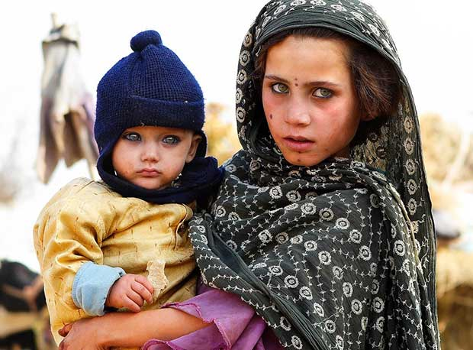
Mother & Son
The eyes are the window to the soul.

Slide 33
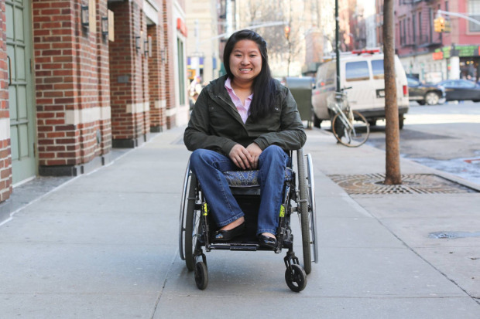
Additional ones

Slide 44
The Human Cost of Agrotoxins

Slide 46
The Roma People (Gypsies)

Slide 57
Indigenous People

Slide 58
Hasn’t let his medical condition hamper his brilliance.

Slide 59
Asks people to respect the environment

Slide 60
2015 concerns continuing on past 2015
U.S. has troops in:
Bosnia, Kosovo, Afghanistan, Iraq, - will military “advisors” be sent to Syria?
Will a genocidal civil war break out in Burundi?
The “Godzilla” El Niῆo was more powerful because of climate change
African areas subject to malaria and sleeping sickness increased due to climate change
Area of Marshall islands and Maldive islands shrinking due to sea level rising (climate change).

