Slide 1
U.S. Urban Segregation

Slide 2
It Can’t be Created by Law . . .
Processes & Conditions that support segregation
Self selection – choosing to live where people are mostly like you
Channeling – Real estate agents tend to show homes in certain areas to people who fit certain categories – example: white home buyers may have to specifically ask to see houses in north county, otherwise they will be shown homes in St. Charles county, West County, or South County
Socio-economic levels may discourage some buyers form looking in areas that are beyond their means.

Slide 3
Maps reveal segregation
Socio-economic levels
Racial groupings
Ethnic Background
Religious affiliation

Slide 4
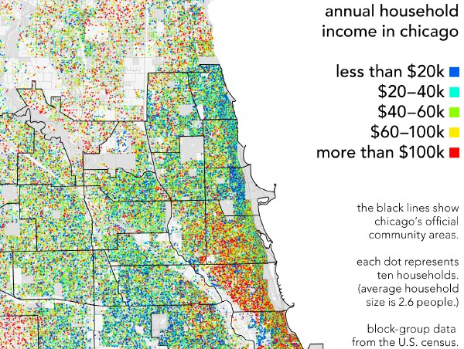

Slide 5
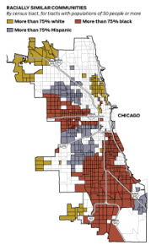
Chicago

Slide 6
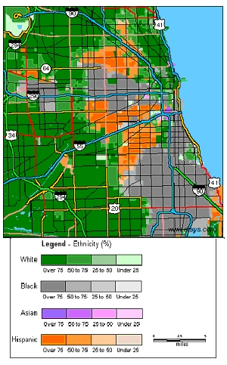
Chicago

Slide 7
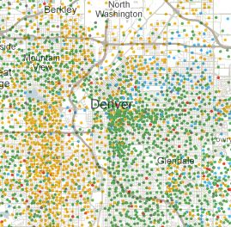
Denver
Yellow – Hispanic (mostly west of I-25)
Green - “White” (mostly east of I-25)

Slide 8
On the following Maps, the darker the green, the higher the percentage of African- American Residents (2000 census data) Interactive map can show asian, hispanic, white, and income (default is black):
http://www.umich.edu/~lawrace/seg.htm

Slide 9
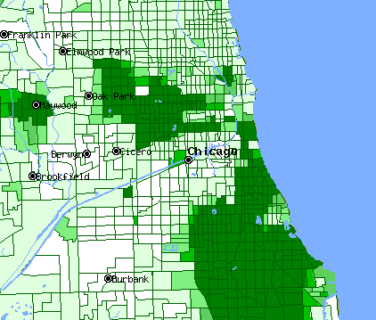
Chicago, IL.
Compare with the socio- economic map above.

Slide 10
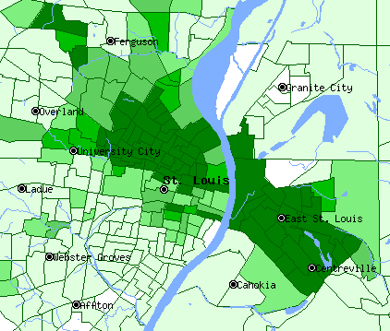
St. Louis

Slide 11
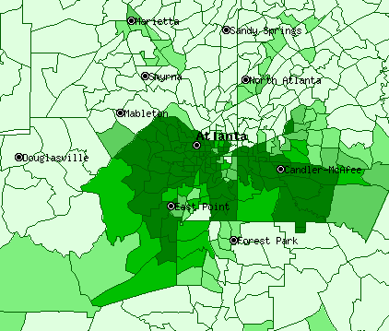
Atlanta, Georgia

Slide 12
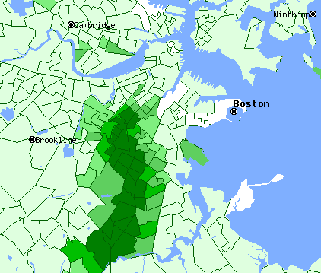
Boston, Mass.

Slide 13
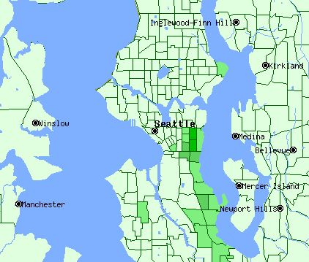
Seattle, Wash.

Slide 14
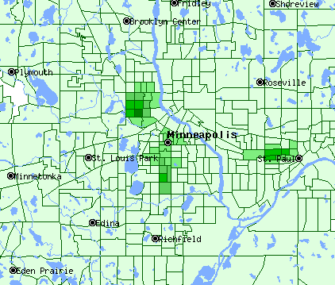
Minneapolis, Min.

Slide 15
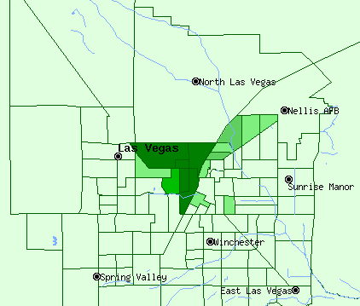
Las Vegas, Nevada

Slide 16
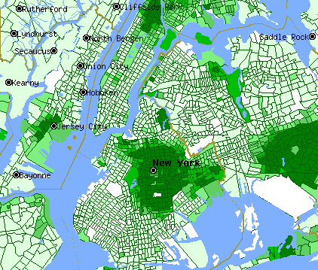
New York

Slide 17
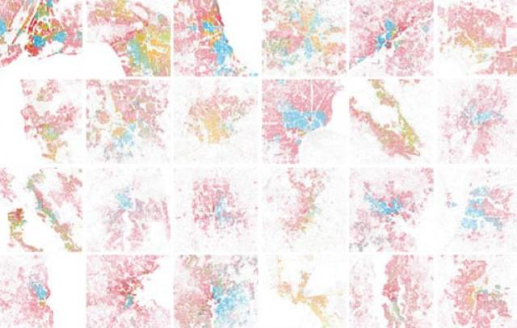
In the following maps, White areas are pink, Black ones are blue, Hispanic orange, and Asian green.

Slide 18
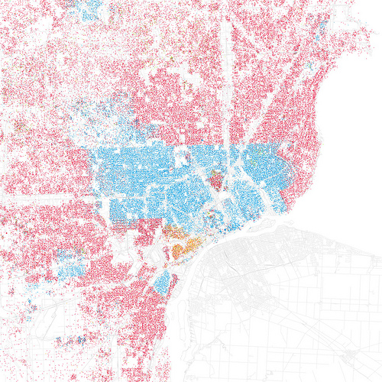
Detroit, Michigan

Slide 19
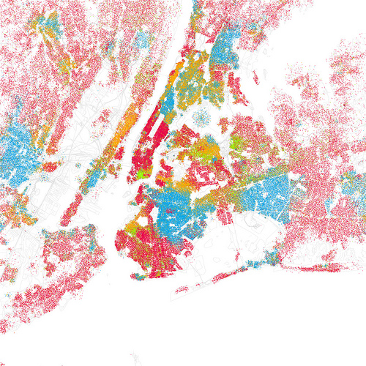
New York

Slide 20
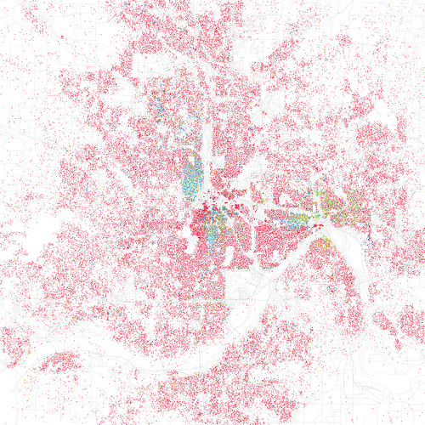
Minneapolis, Min.

Slide 21
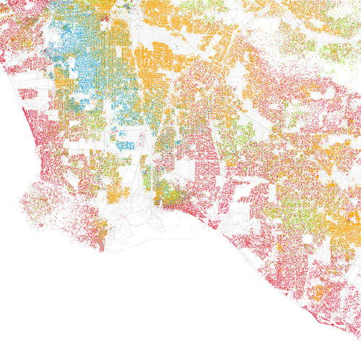
Long Beach, Calif.

Slide 22
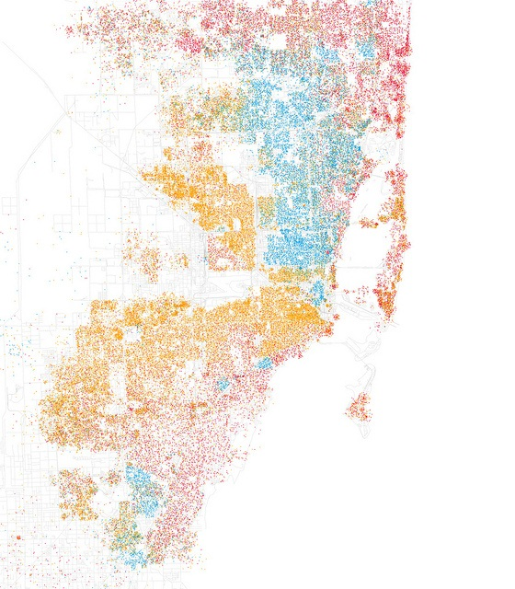
Miami, Fl.

Slide 23
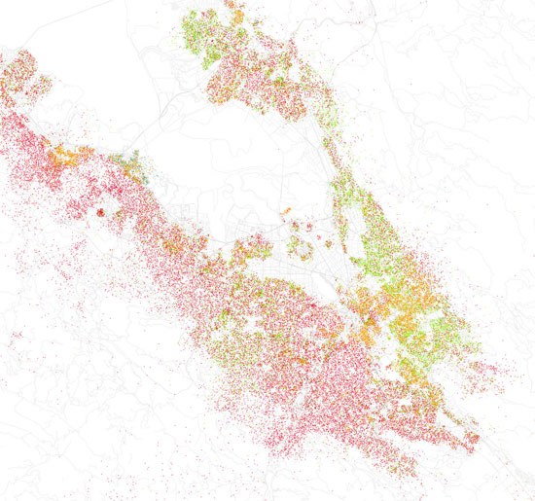
San Jose, Calif.

Slide 24
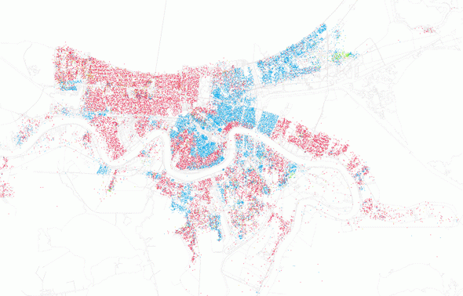
New Orleans, Louisiana

Slide 25
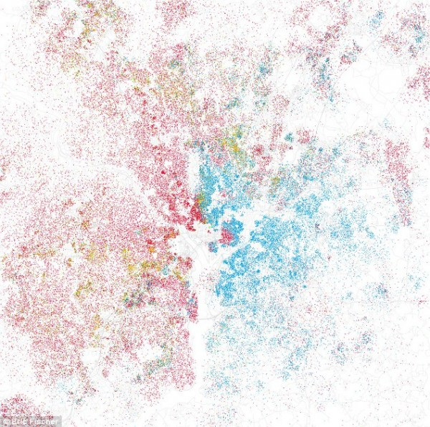
Washington, D.C.

Slide 26
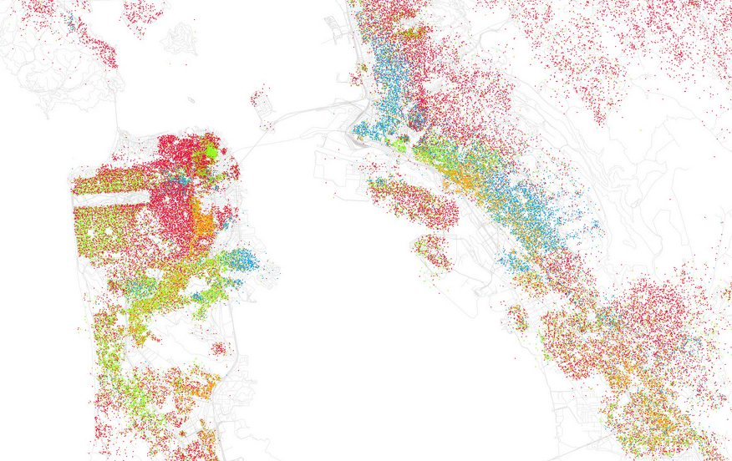
San Francisco

Slide 27
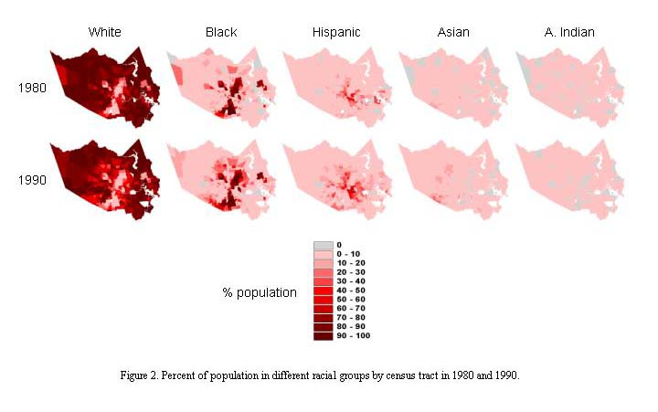
Houston, Texas

Slide 28
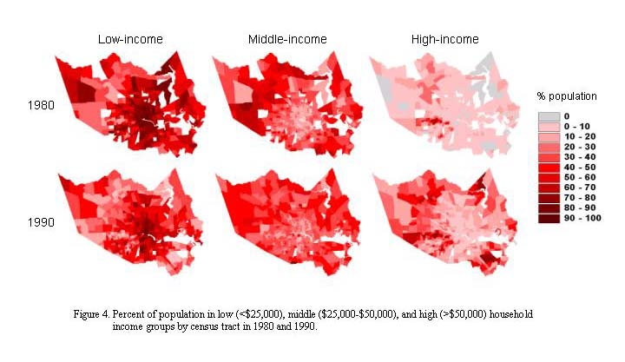
Houston, Texas Income Levels

Slide 29
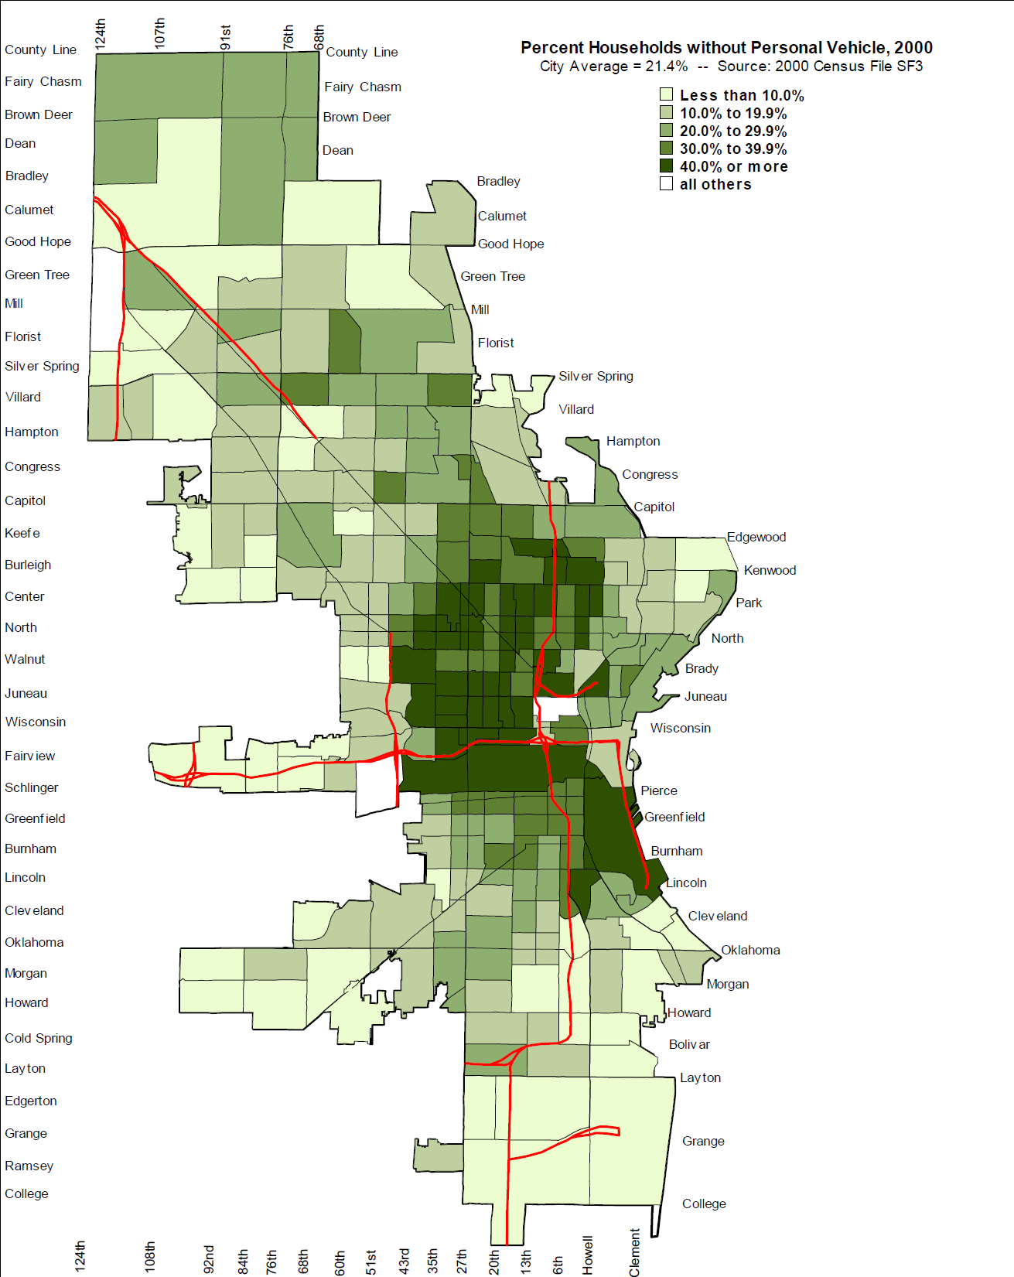
Minneapolis
Compare with maps of racial/ethnic segregation.

Slide 30
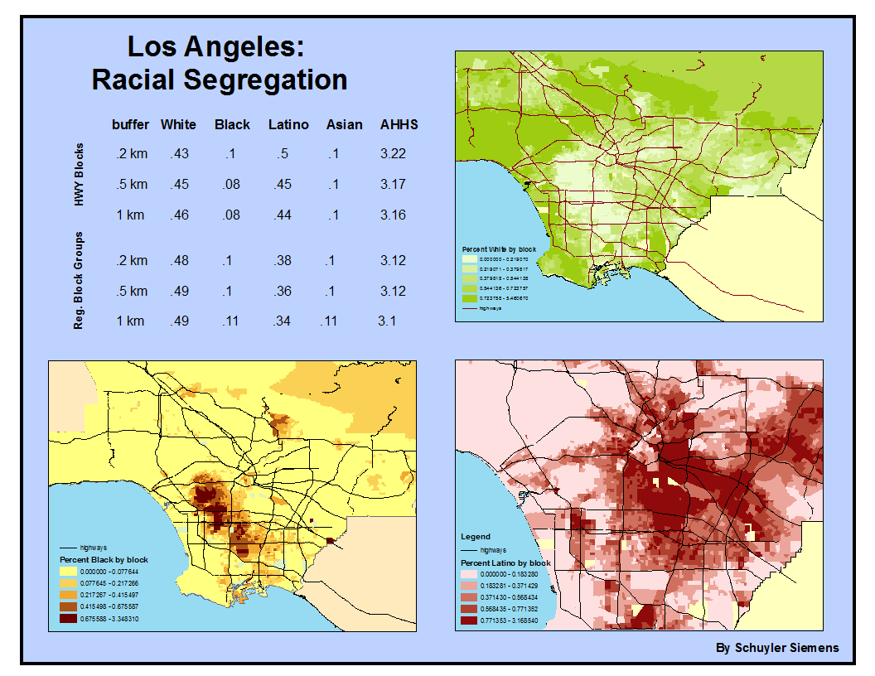

Slide 31
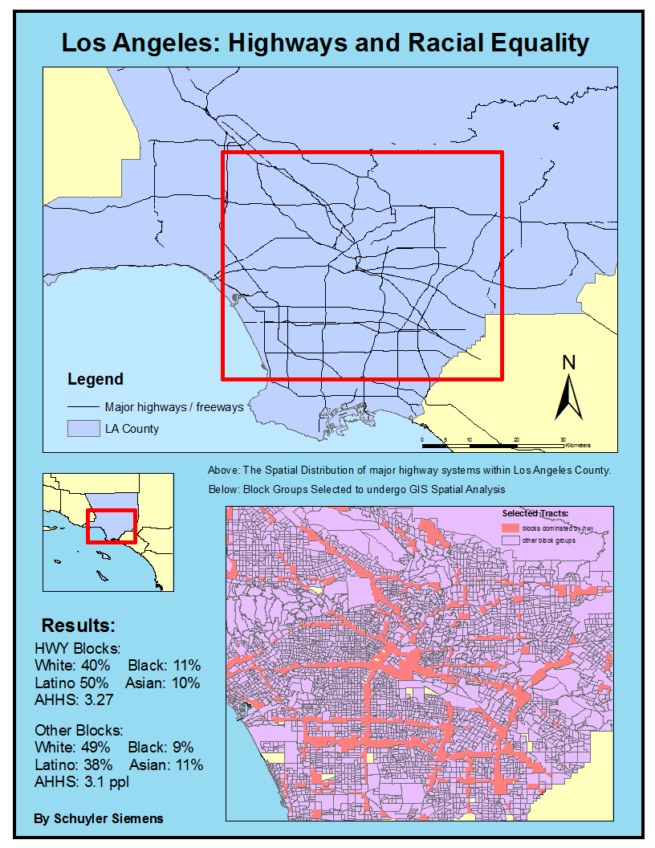

Slide 32
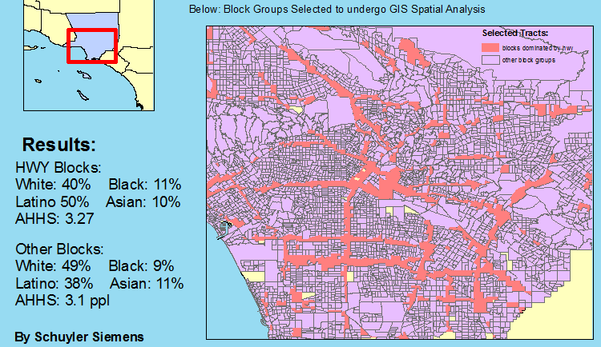
L.A. Highway impact enlarged

Slide 33
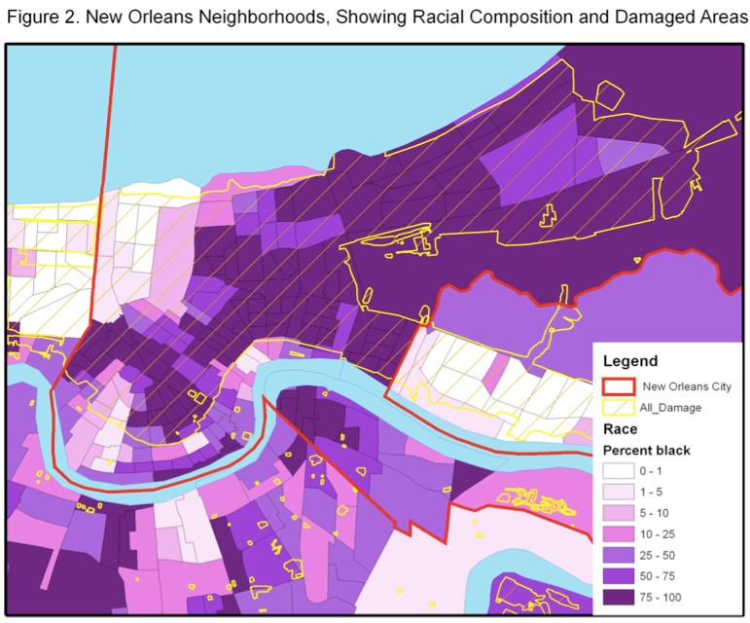

Slide 34
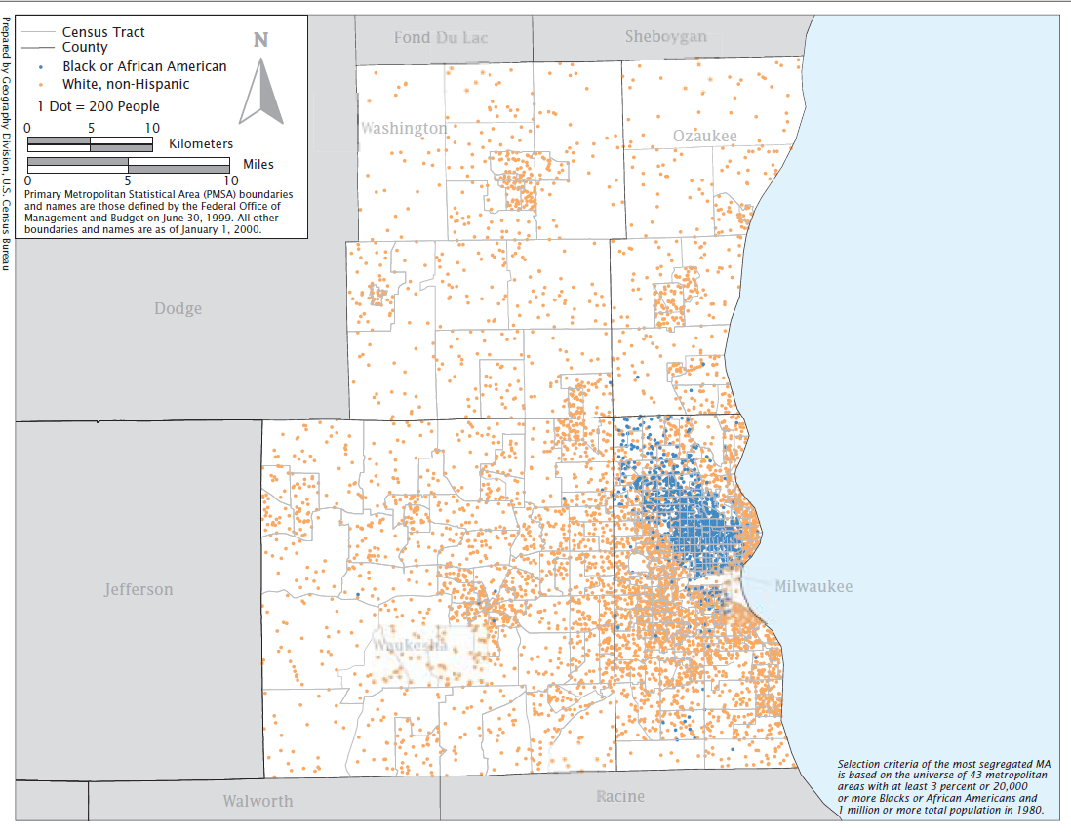
Milwaukee, Wisconsin

Slide 35
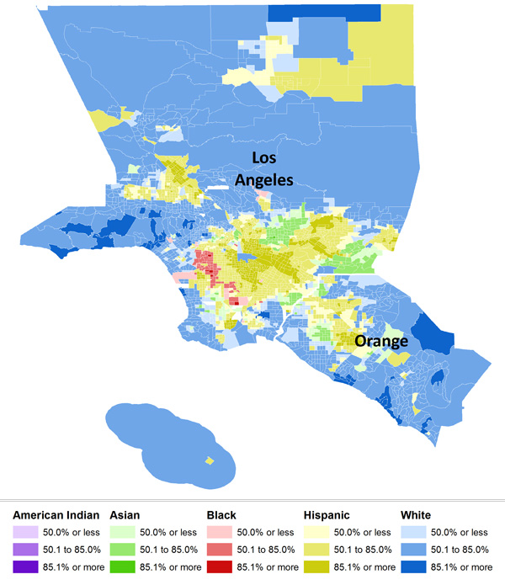

Slide 36
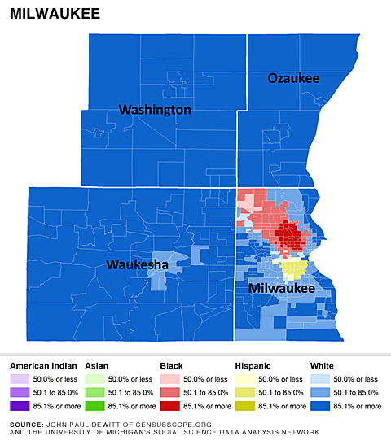

Slide 37
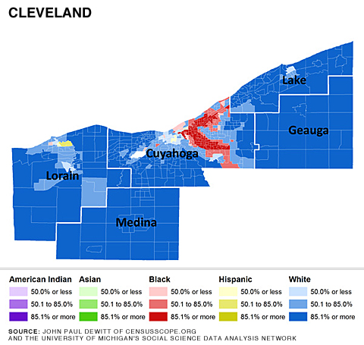

Slide 38
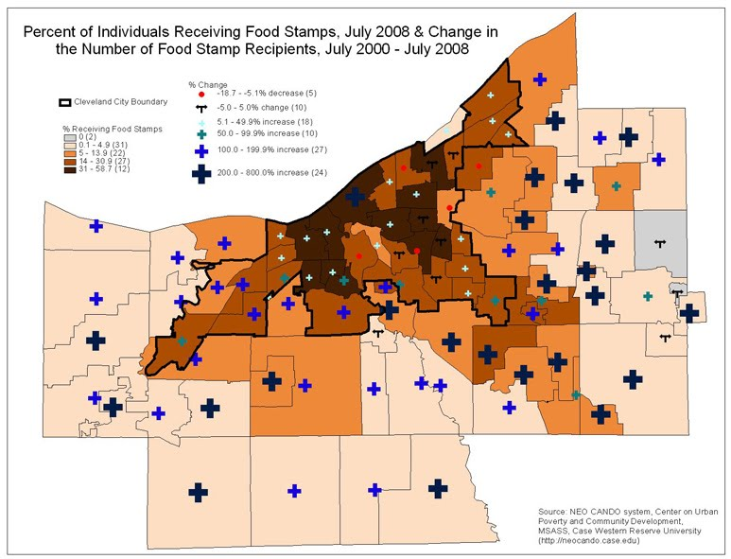
Cleveland

Slide 39
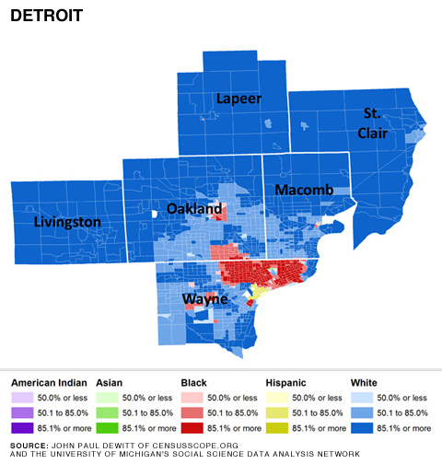

Slide 40
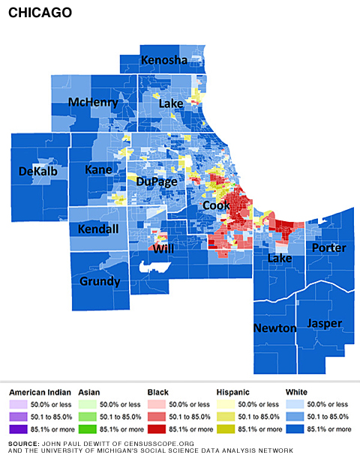

Slide 41
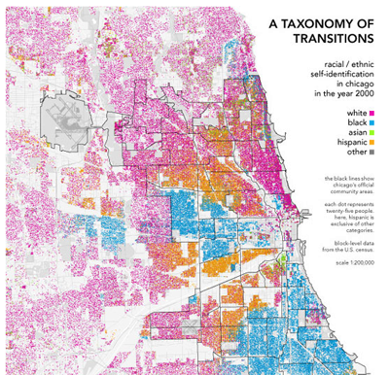

Slide 42
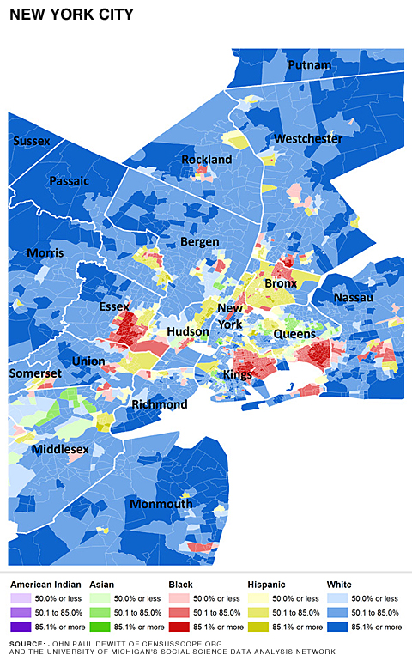

Slide 43
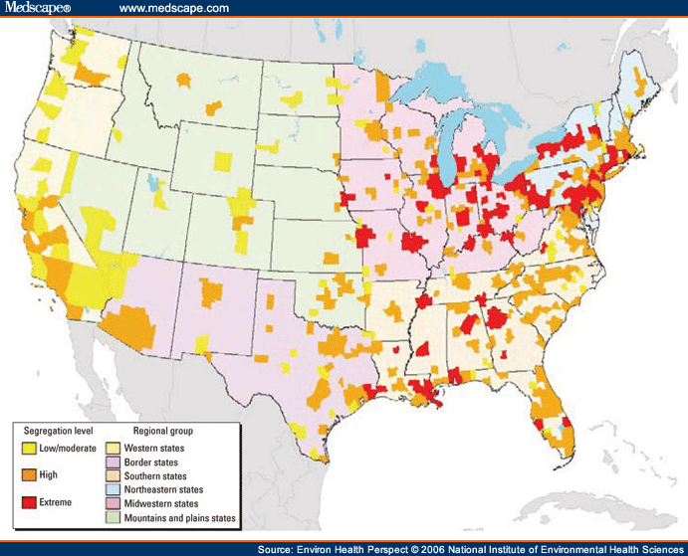

Slide 44
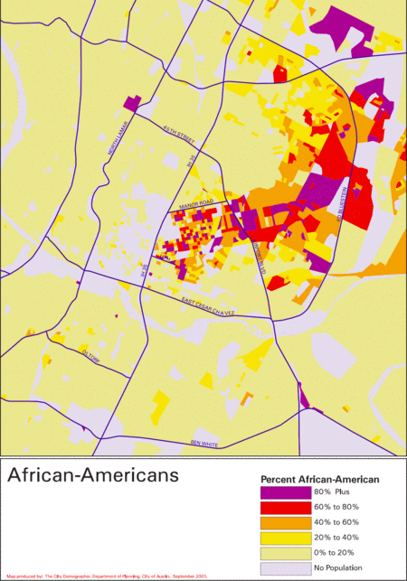
Austin, TX

Slide 45
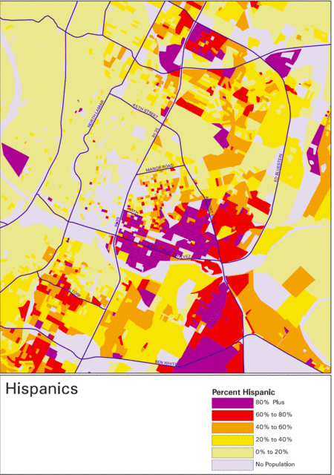
Austin, TX

