Slide 1
Barnstable County, Massachusetts
Emily Menendez

Slide 2
About
Barnstable County is a county located in the U.S. state of Massachusetts, consisting of Cape Cod and associated islands. Barnstable County was formed as part of the Plymouth Colony on 2 June 1685, including the towns of Falmouth, Sandwich and others lying to the east and north on Cape Cod. These postcards cost 1¢ to mail.

Slide 3
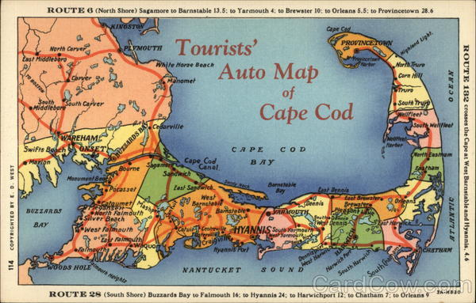

Slide 4
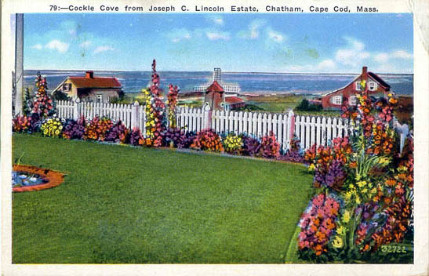

Slide 5
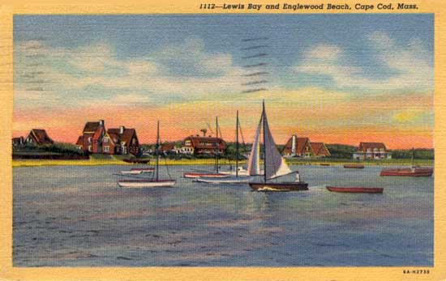

Slide 6
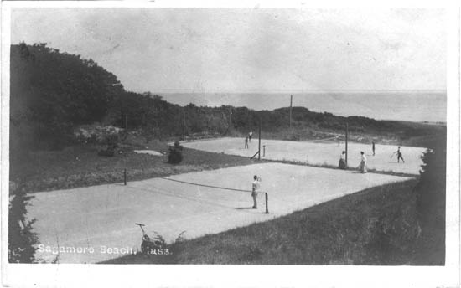

Slide 7
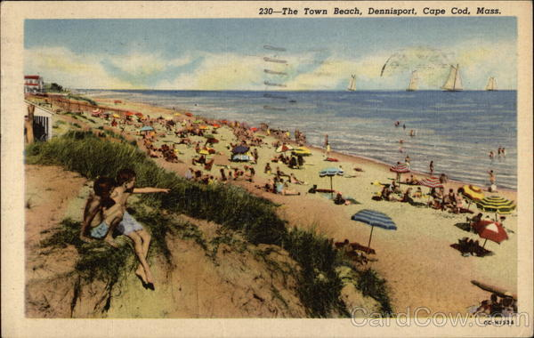

Slide 8
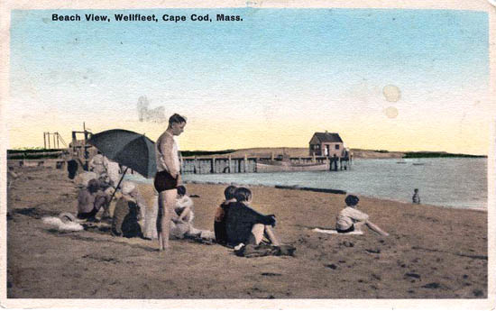

Slide 9
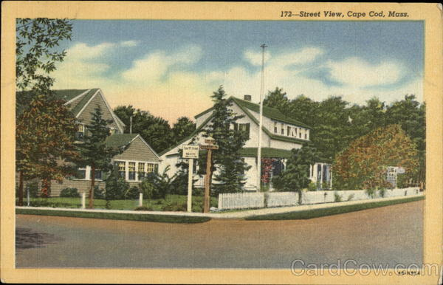

Slide 11
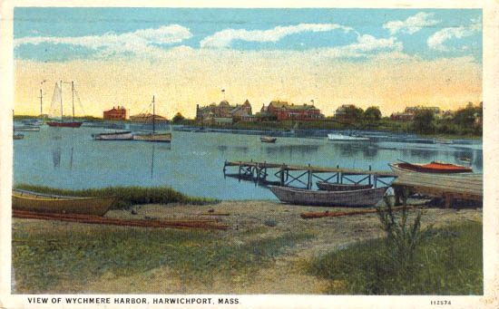

Slide 12
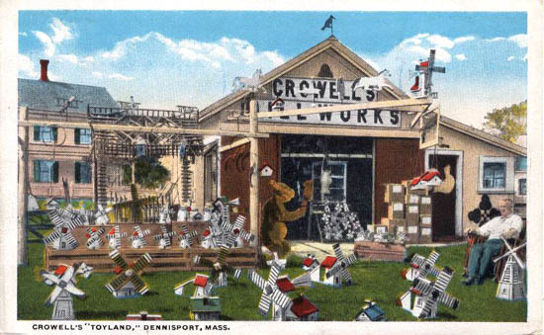

Slide 13
Businesses

Slide 14
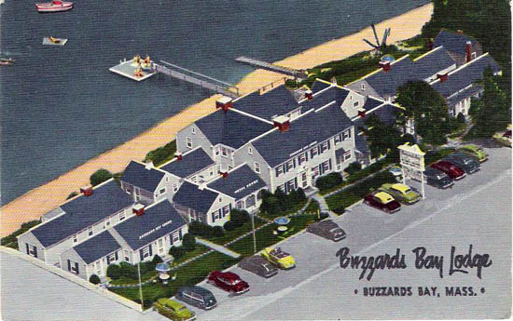
Buzzards Bay Lodge, Buzzards Bay

Slide 15
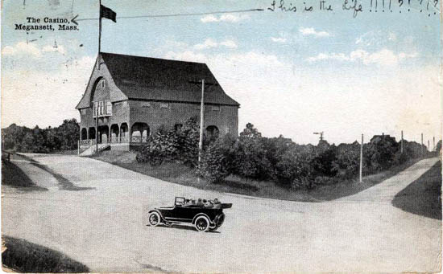
The Casino

Slide 16
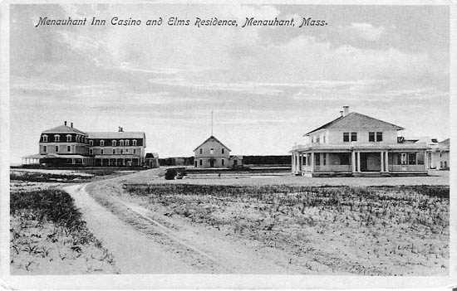

Slide 18
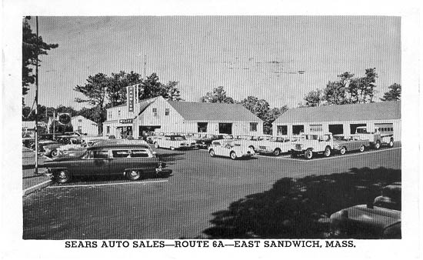
Sears Auto Sales, Route 6A, East Sandwich

Slide 19
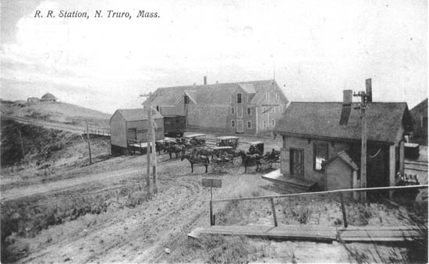
Railroads

Slide 20
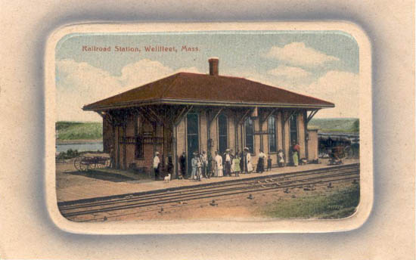

Slide 21
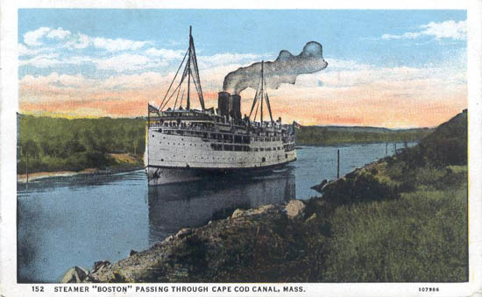
Transportation

Slide 22
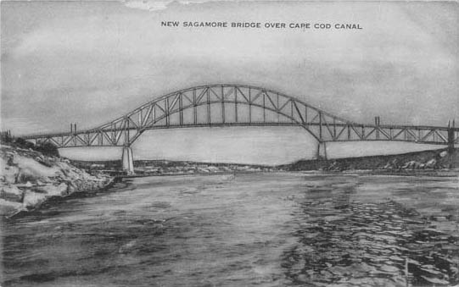
1911-New Sagamore Bridge Construction

Slide 23
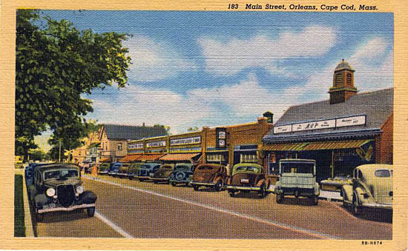

Slide 24
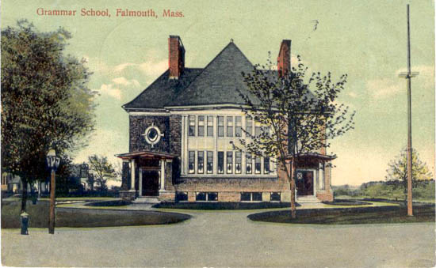

Slide 25
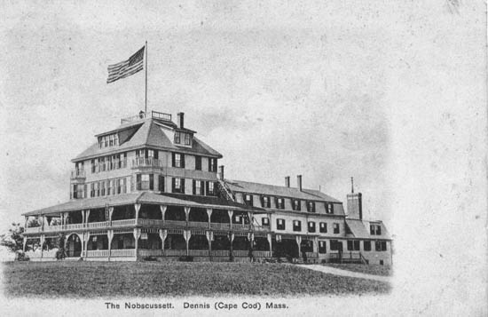
The Nobscussett
Named after Rev. Josiah Dennis who previously had been the faithful pastor of its principal church for thirty-seven consecutive years. The town extends across the Cape, having Cape Cod bay for its northern boundary and the Vineyard sound for its southern.

Slide 26
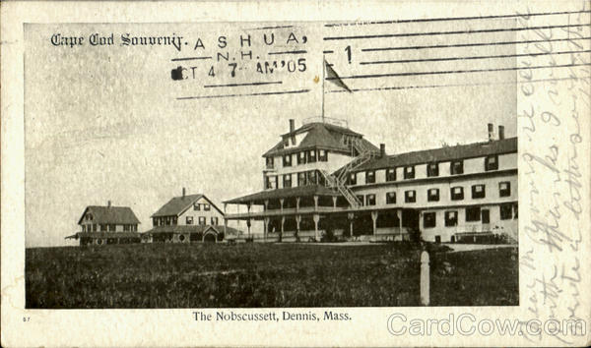

Slide 27
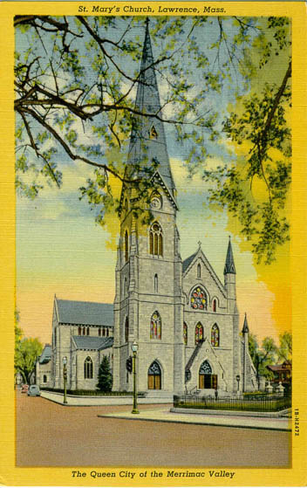
Lawrence, Massachusetts
In 1922, Father O’Reilly helped to bring about a settlement of the textile strike in Lawrence. When over 20,000 unhappy workers were on strike, the city’s major industries were crippled for six months. In spite of all this civic participation, he never forgot his parish. In 1914, he had installed a new organ. In 1923, he remodeled and renovated the interior and exterior of St. Mary Church.

Slide 28
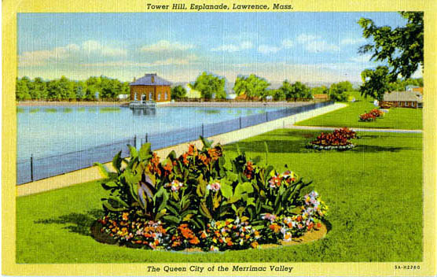

Slide 29
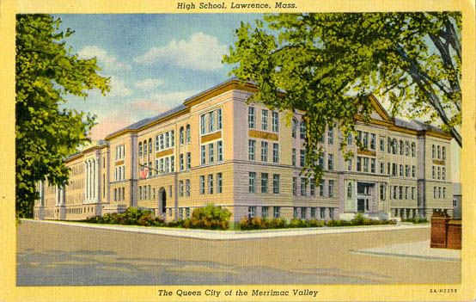
Lawrence High School

Slide 30
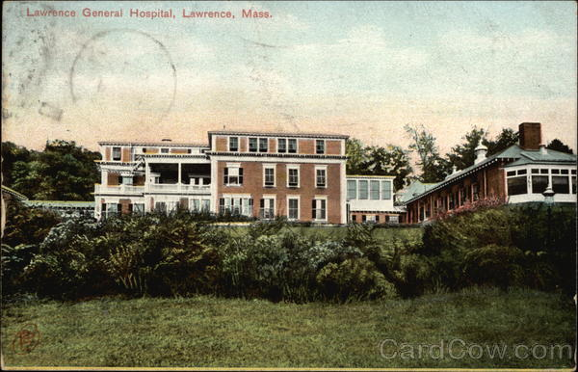
General Hospital

Slide 31
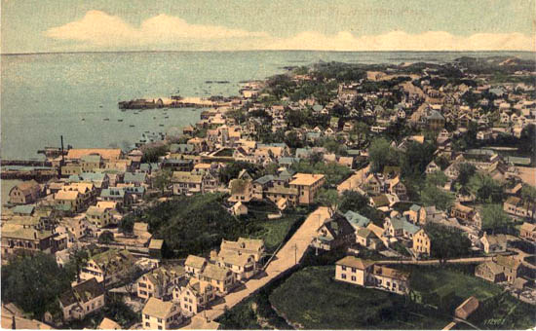
Provincetown, Massachusetts

Slide 32
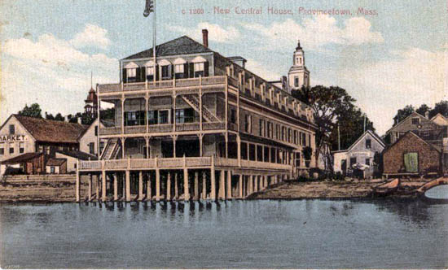
New Central House
Built sometime before 1868 by Timothy F. Johnson, it was the largest hotel in town, with rooms for 75 guests, an auditorium, a bowling alley and a saloon. There was a billiard hall, ladies' parlors and gentlemen's reading and smoking rooms. The Customs House occupied the third floor. It boasted cabanas on the beach for bathers and porches on the first and second floors where patrons rocked and exchanged greetings with passerby. Its first name was Ocean House. Since then it has been known as the Central House, New Central House, Towne House and the Sea Horse Inn.

Slide 33
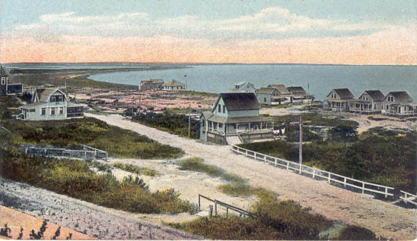

Slide 34
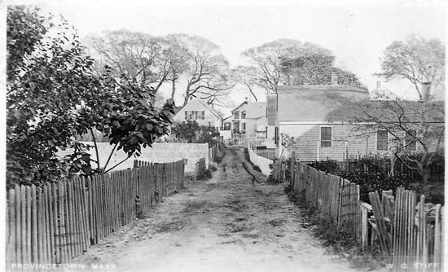

Slide 35
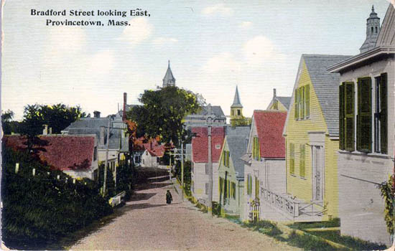

Slide 36
Resources
http://usgwarchives.org/ma/barnstable/postcards/ppcs-bar.html
http://www.cardcow.com/350611/lawrence-general-hospital-massachusetts/

