Slide 1
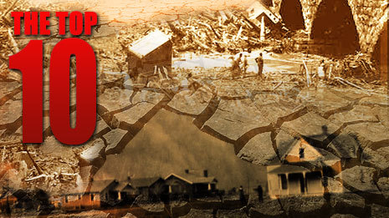
Worst U.S. Natural Disasters

Slide 2
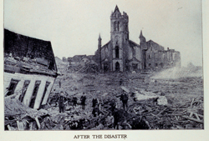
Hurricane Galveston - Sept. 8, 1900

Slide 3
Galveston was known at the end of the 19th Century as the "Jewel of Texas" until the single deadliest natural disaster in U.S. history wiped away much of what had been a booming future. The bustling island community had been the hub of the cotton trade and Texas' largest city. Progress bred complacency though, which became apparent when city officials and residents decided against building a seawall to protect the city. When the category 4 hurricane with estimated 135 mph winds made landfall in the early morning, buildings crumbled under the force of 15-foot-high waves. By late afternoon, the entire island was submerged. An estimated 8,000 people perished. Although the city was successfully rebuilt, it never regained the prosperity that earned it a reputation as the "New York of the south."
Credit: NOAA

Slide 4
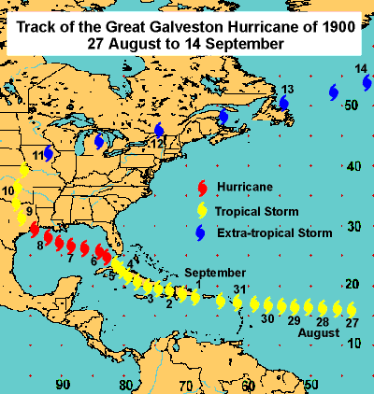

Slide 5
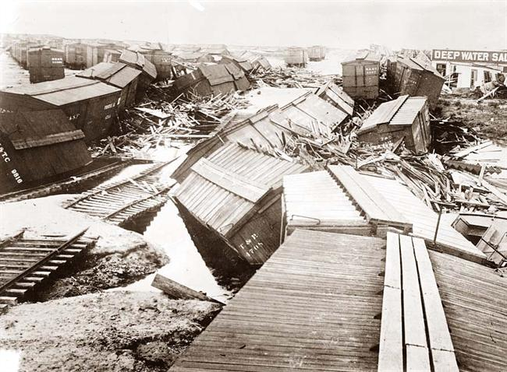

Slide 6
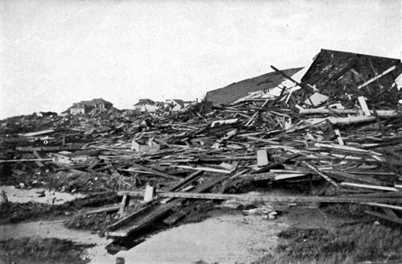

Slide 7
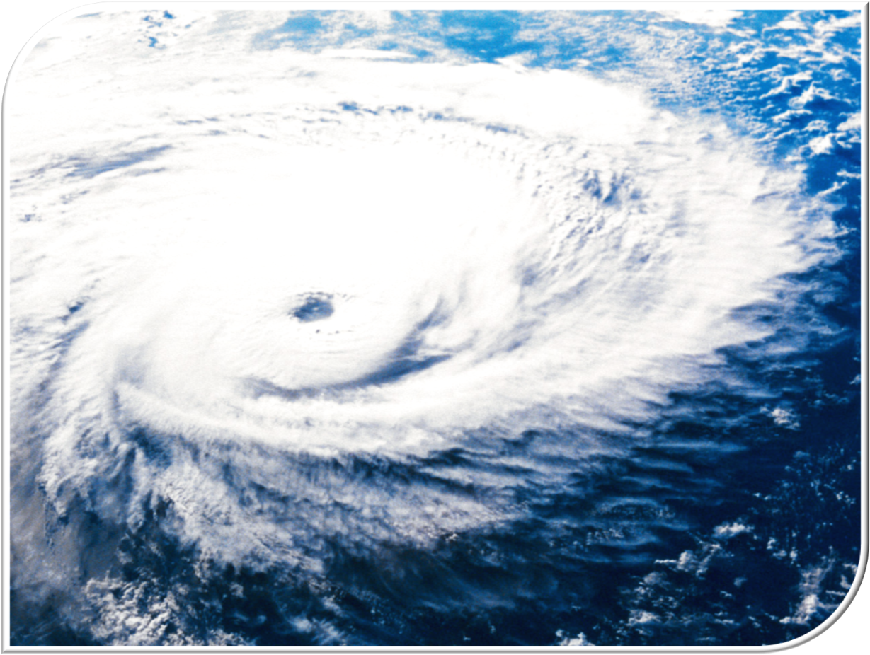
Hurricane Katrina - Aug. 29, 2005

Slide 8
The Atlantic storm that began as a category 1 hurricane as it blew across southern Florida wound up being the country's costliest tragedy. Katrina roared into the Louisiana coast with 125 mph sustained winds, causing a storm surge that broke levees that shielded New Orleans from surrounding, higher coastal waters, and leaving 80 percent of the city under water. Katrina killed at least 1,836 people and inflicted damages estimated at around $125 billion.
Credit: NOAA

Slide 9
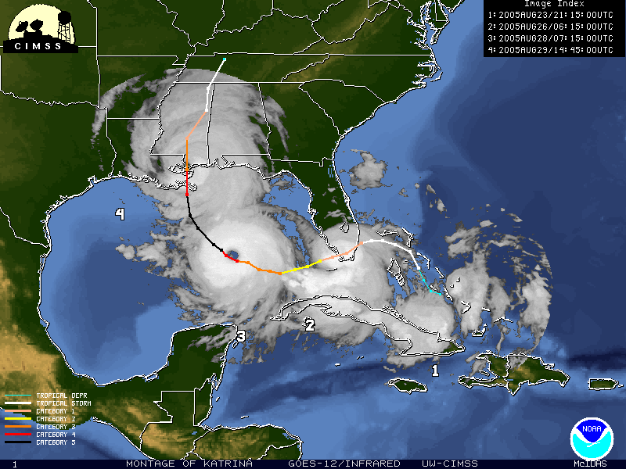

Slide 10
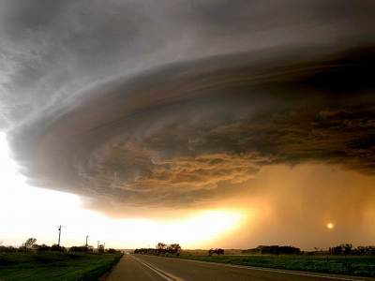

Slide 11
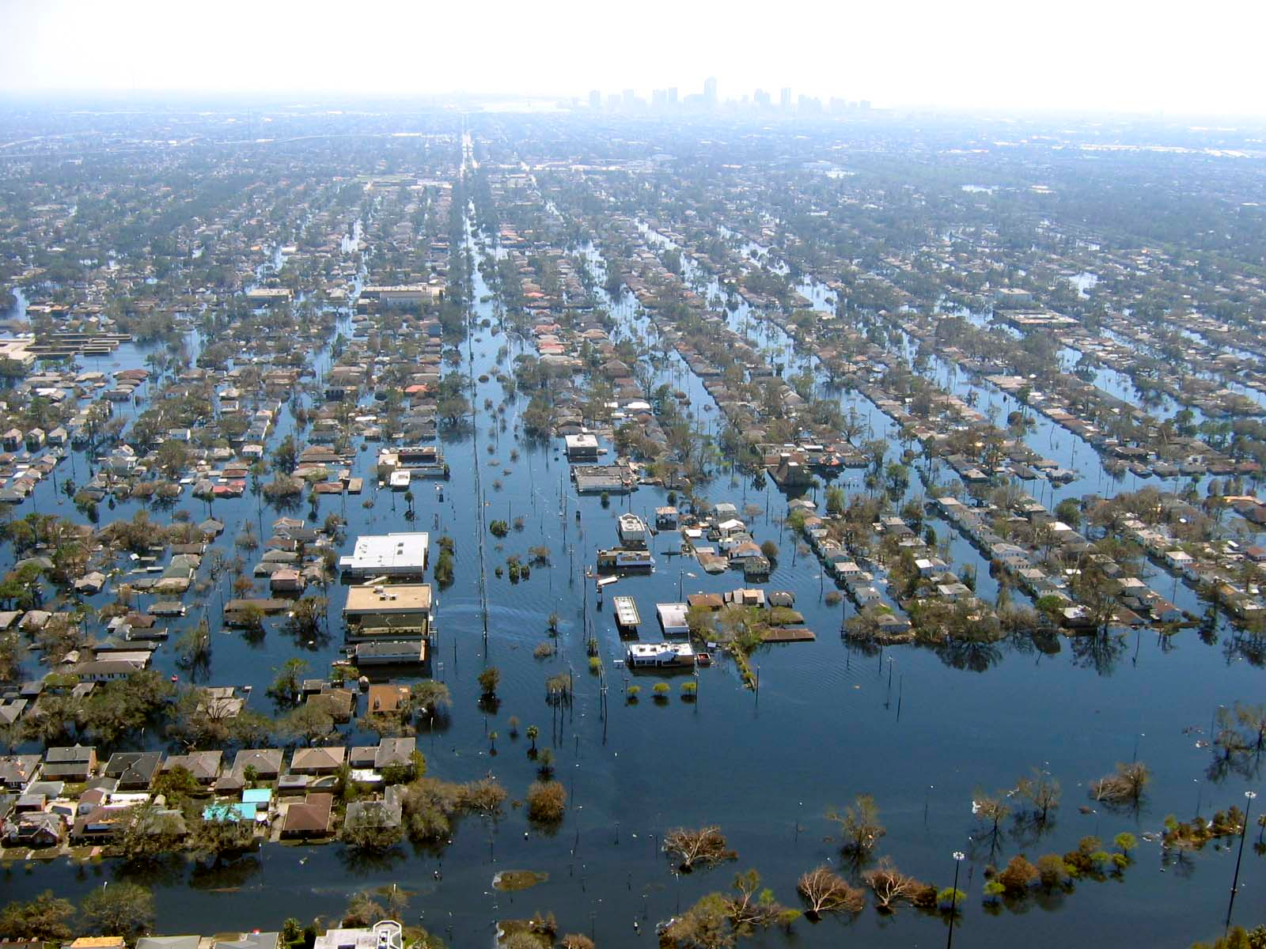

Slide 12
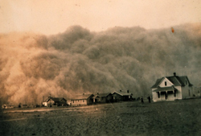
Dust Bowl - Early 1930's

Slide 13
Prior to the early 1930's, the Great Plains was a farmer's paradise. Rising demands for wheat spurred settlers to plow much of the southern plains' grassy soil to meet this need. The land was eventually exposed to erosion, since grass and tree roots that had held the moist soil in place during dry times were replaced by cash crops. A decade-long drought transformed the loose topsoil into dust, which windstorms swept up and blew eastward, darkening skies as far away as the Atlantic Coast. With most of the areaâ€™s crops decimated, a third of the farmers turned to government aid, while around half a million Americans were left homeless.
Credit: NOAA

Slide 14
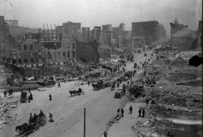
Great San Francisco Fire and Earthquake - April 18, 1906

Slide 15
San Francisco residents were abruptly awakened one spring morning by an earthquake that lasted no more than a minute, but set off a chain of events that caused the city to burn for four straight days. The estimated 7.7- to 7.9-magnitude temblor not only broke natural gas mains, which sparked the fires, but also damaged water mains, leaving the fire department with limited resources to battle the blaze. By the time the fires were doused, flames had devoured more than 500 city blocks, and 3,000 lives were lost. Of those who survived, approximately 225,000 people found themselves without a home.
Credit: Records of the Office of the Chief Skinal Officer

Slide 16
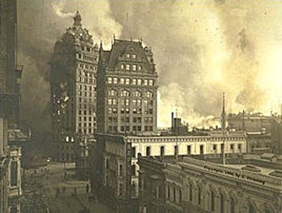

Slide 17
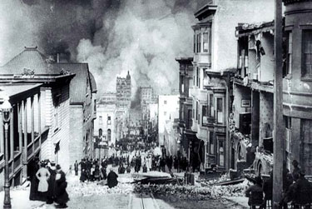

Slide 18
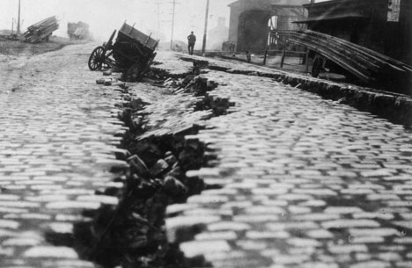

Slide 19
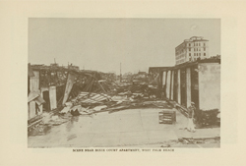
Okeechobee Hurricane - September 16, 1928

Slide 20
When the evacuated residents of Lake Okeechobee learned that a hurricane hadn't arrived on schedule, many returned home thinking that they had been spared. The storm, however, slammed ashore later on the evening of September 16th with sustained 140 mph winds. Such intensity broke a small dike at the lake's south end, resulting in weeks of heavy flooding that claimed at least 2,500 lives.
Credit: NOAA

Slide 21
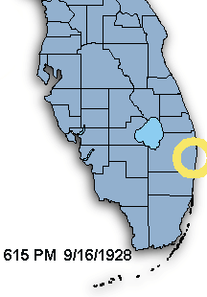
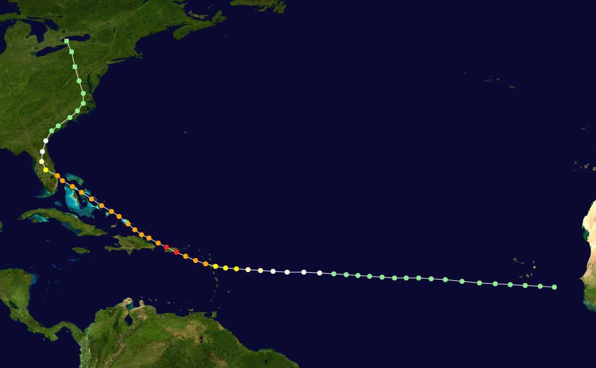
Initial U.S. Landfall in Florida

Slide 22
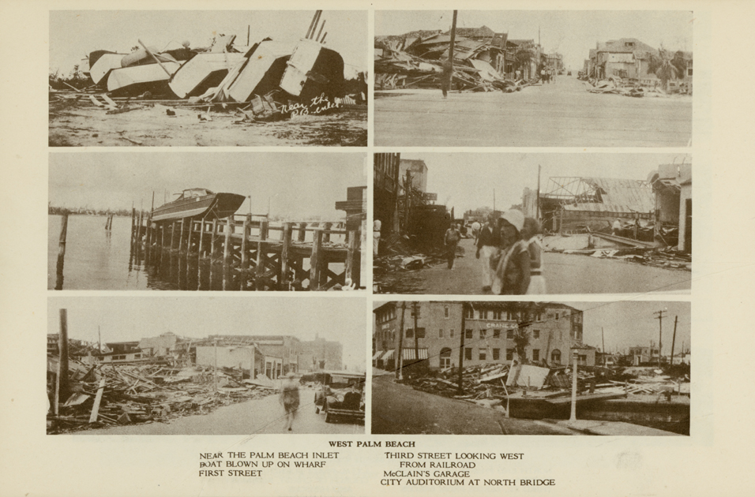

Slide 23
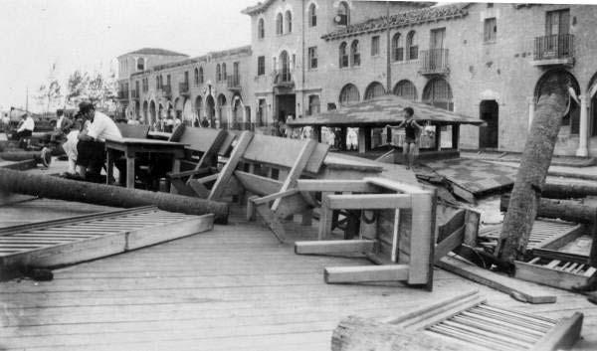

Slide 24
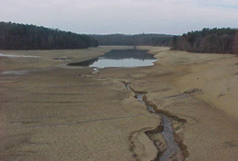
Heat Wave of 1980 - Summer of 1980

Slide 25
The heat wave of 1980 proved to be one of the nation's most catastrophic prolonged weather events. A high-pressure ridge pushed temperatures across the central and southern United States above 90 degrees Fahrenheit for most of the summer. Agricultural damage tallied an estimated $48 billion due to a massive drought, and 10,000 people died from heat and heat stress-related ailments.
Credit: NASA

Slide 26
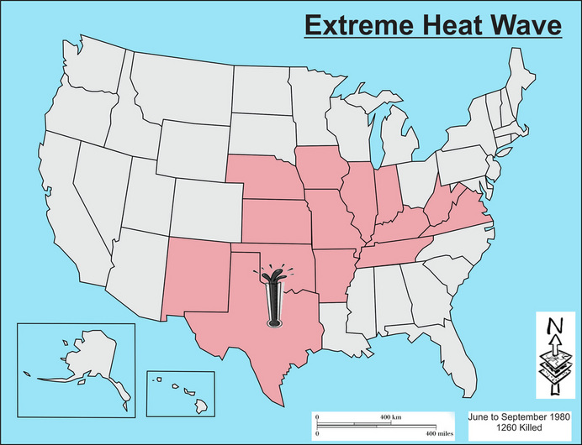

Slide 27
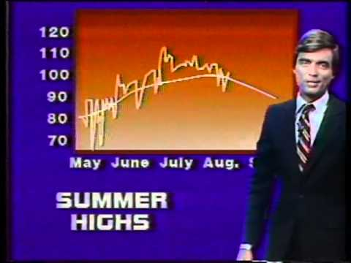

Slide 29
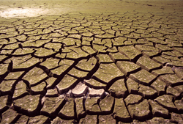
Heat Wave of 1988 - Summer of 1988

Slide 30
A year-long drought that had ravaged the agricultural economy was further exacerbated by the heat wave of 1988. Damage to the agricultural economy surpassed $61 billion, as total rainfall along the Great Plains region from April through June was even lower than during the Dust Bowl years. Drought conditions seeded wildfires that raged across Yellowstone National Park and Mount Rushmore that summer. Between 5,000 and 10,000 people succumbed to health complications stemming from the sweltering heat.
Credit: Dreamstime

Slide 31
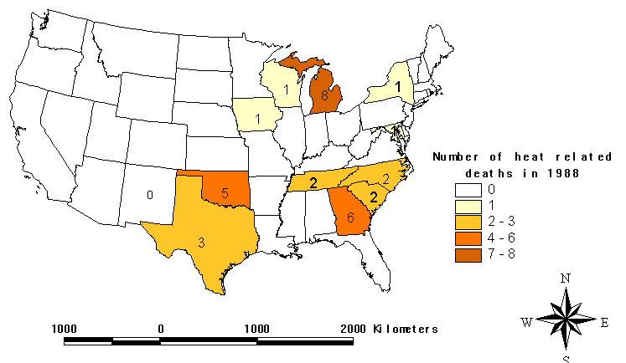

Slide 32
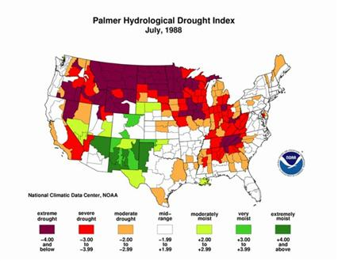

Slide 33
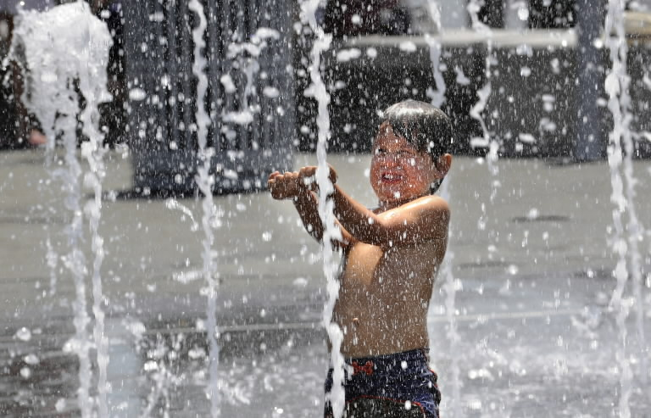

Slide 34
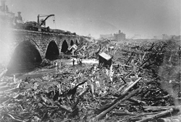
Johnstown Flood - May 31, 1889

Slide 35
During the late 19th Century, the small industrial community of Johnstown in Pennsylvania earned a reputation as a producer of high-quality steel. All that progress was flushed away when the poorly maintained South Fork dam that stood high up in the mountains, 14 miles from the city, failed. Days of torrential downpour caused the dam to burst, unleashing more than 20 million tons of water and debris to crash down on the city with the force of Niagara Falls. The flood leveled 1,600 homes and killed 2,209 people.
Credit: National Park Service

Slide 36
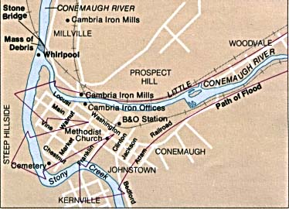

Slide 37
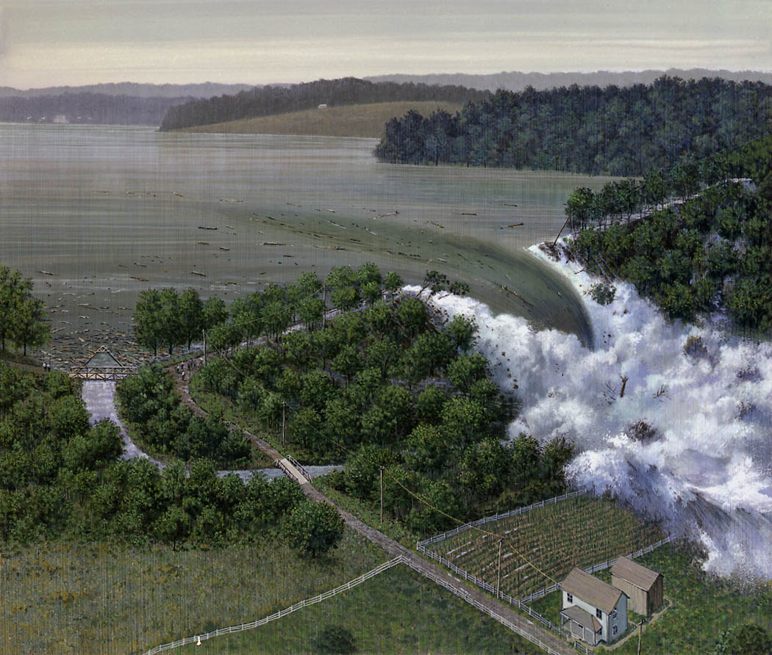

Slide 38
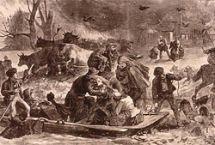
Peshtigo Fire - October 8, 1871

Slide 39
A lesser-known fire in Wisconsin that burned on the same day as the Great Chicago Fire of 1871 turned out to be the nation's deadliest. The drought-stricken city of Peshtigo was set afire when a strong windstorm fueled the spread of a small group of prairie fires by fanning the blaze out over a million acres of forest land. The wildfire even jumped across the Peshtigo River, trapping both sides of the town in flames. By the time the inferno subsided, it had scorched 12 towns and left roughly 1,200 dead.
Credit: Wisconsin Historical Society

Slide 40
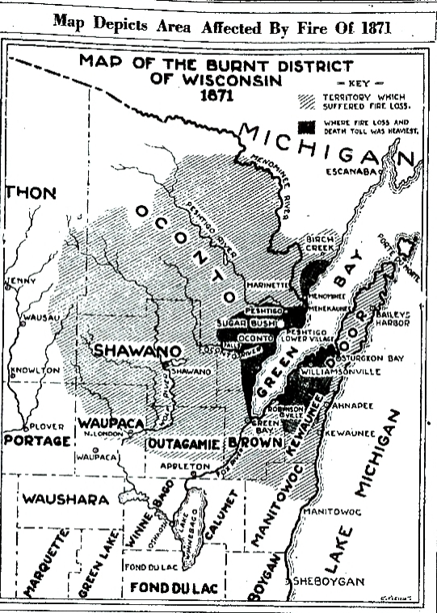

Slide 41
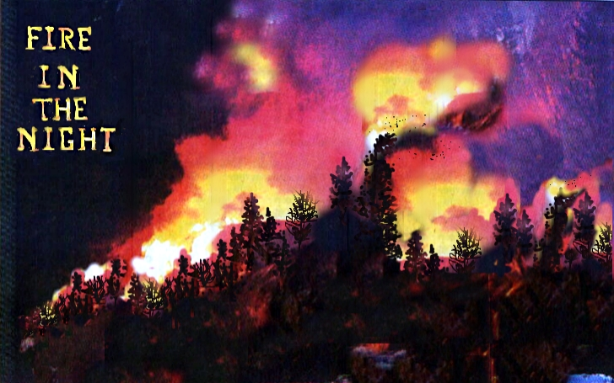

Slide 42
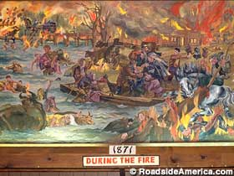
From the Great Peshtigo Fire Museum

Slide 43
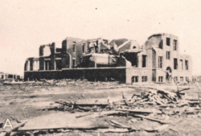
Tri-State Tornado - March 18, 1925

Slide 44
Over the span of three-and-a-half destructive hours, the Tri-State Tornado became the deadliest twister to rip through the heartland. Along its path â€” which included Illinois, Indiana, Missouri â€” the tornado demolished more than 15,000 homes. Of the nearly 700 people killed, 613 were from Illinois. In the aftermath, forecasters started to look into developing a tornado warning system that would have spared many lives at the time.
Credit: NOAA

Slide 45
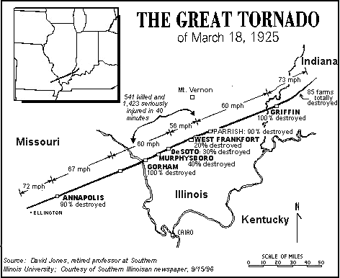

Slide 46
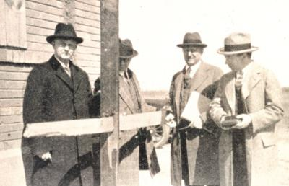
Engineering committee examining a 1X5 inch board which was driven through a 2X6 plank in southern Illinois.

Slide 47
Great Resource
Natural Disaster Atlas of the United States
http://naturaldisasteratlas.weebly.com/index.html

