Slide 1
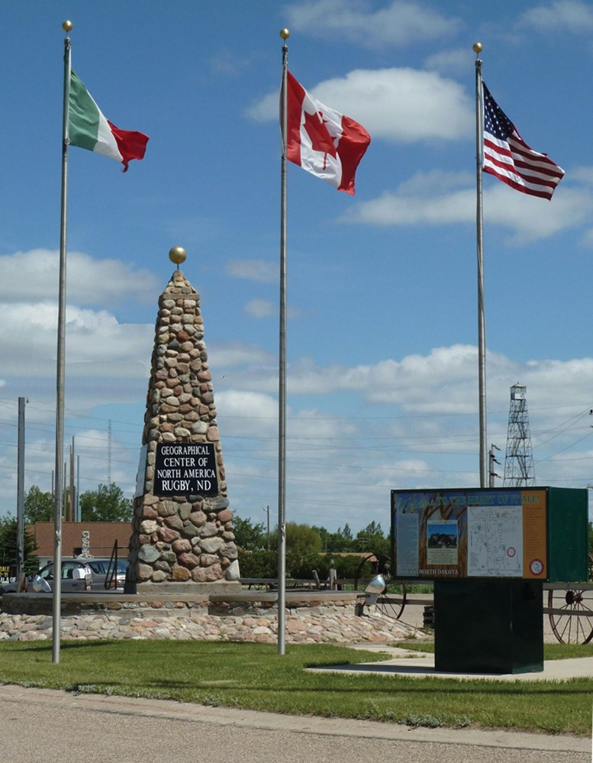
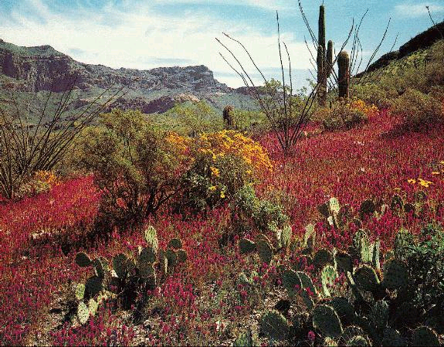
Chapter 4: North America
as modified by
Joe Naumann, UMSL

Slide 2
North America
Learning Objectives
  Your first opportunity to apply introductory concepts to a region
  Apply concepts of globalization to a familiar region
  Understand the following concepts and models:
Acid rain
Concentric zone model
Counterurbanization
Digital divide
-Ethnicity
-Gentrification
-Megalopolis
-Urban realms model

Slide 3
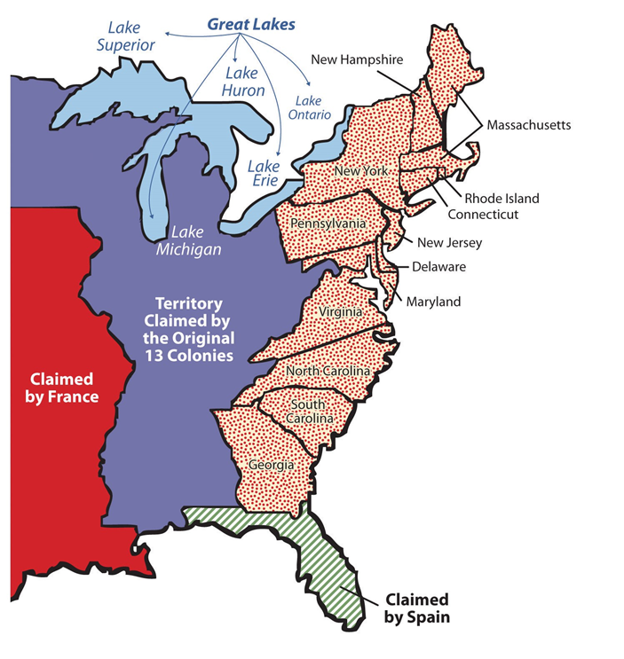
In the beginning

Slide 4
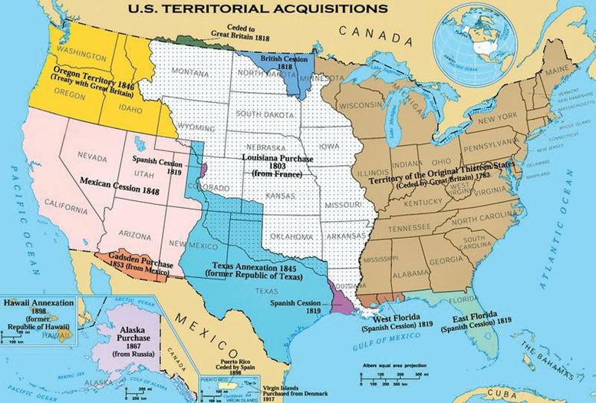
Growth

Slide 5
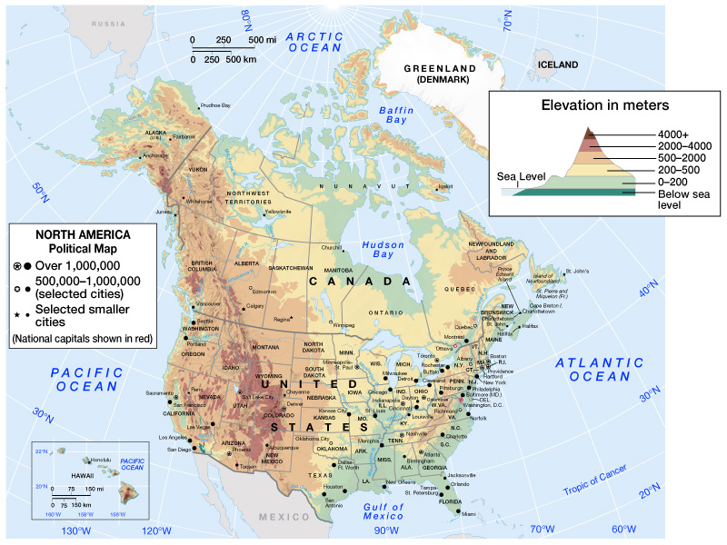

Slide 6
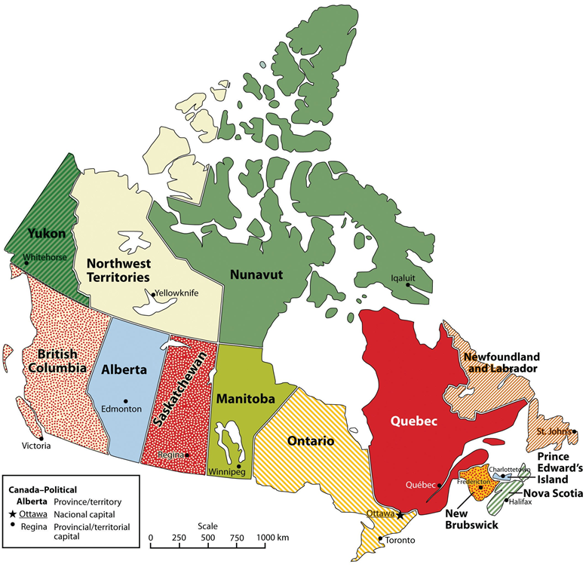

Slide 7
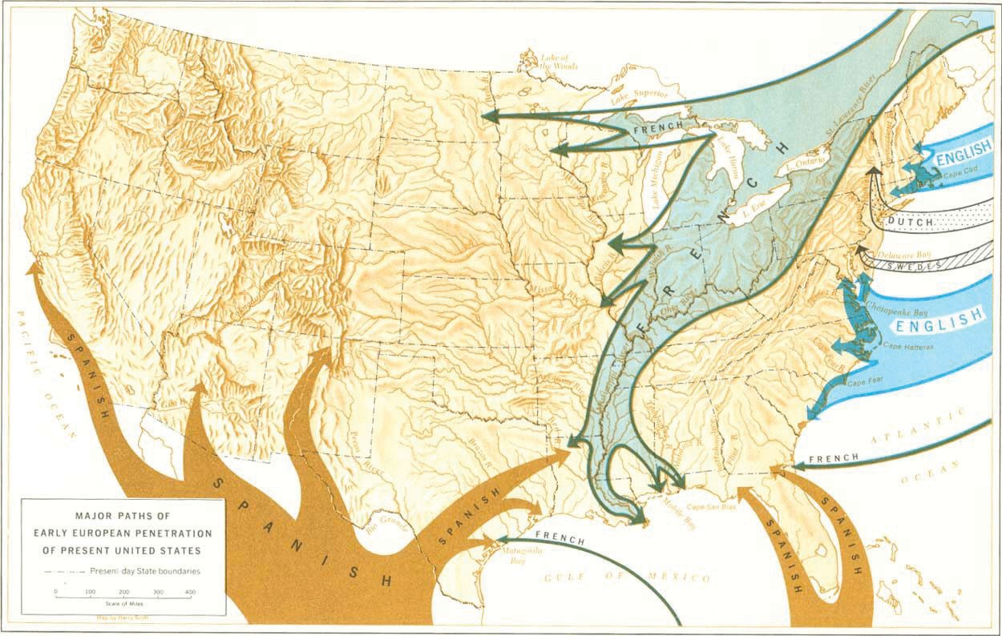
Early European Invasion of North America

Slide 8
Introduction
North America includes the U.S. and Canada
  Culturally defined region, not continentally defined
  Both countries are in the final stage of the demographic transition (low birth rate, low death rate)
  Postindustrial economy with modern technology, innovative financial and information services, and popular culture
  355 million residents (U.S. – 324 million (2016}; Canada – 31million)
Environmental Geography: Threatened Life of Plenty
  North America has a diverse physical setting, rich in resources, that has been heavily modified by human activities

Slide 9
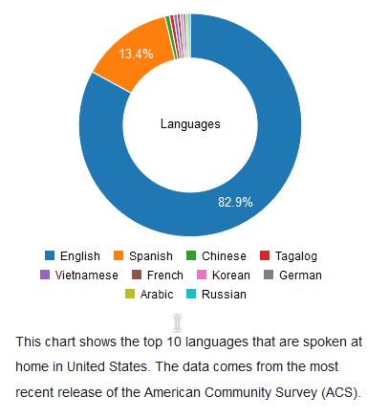
U.S. Population
Estimates
2013 – 316.5 Million
2014 – 318.9 Million
2015 – 320 Million
2016 – 324 Million
Language Spoken in the Home

Slide 10
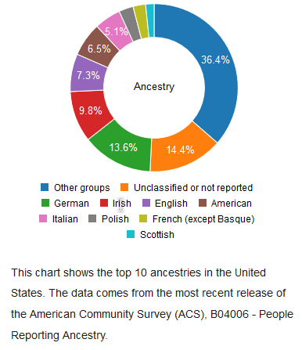
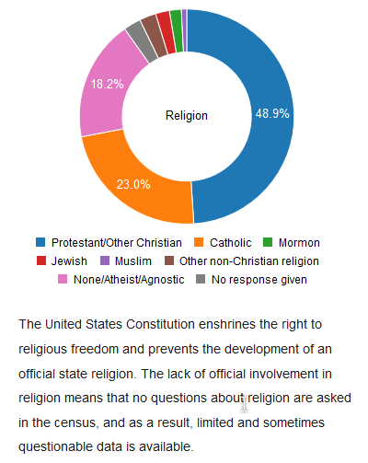
Diversity
Ancestry
Religious Affiliation

Slide 11
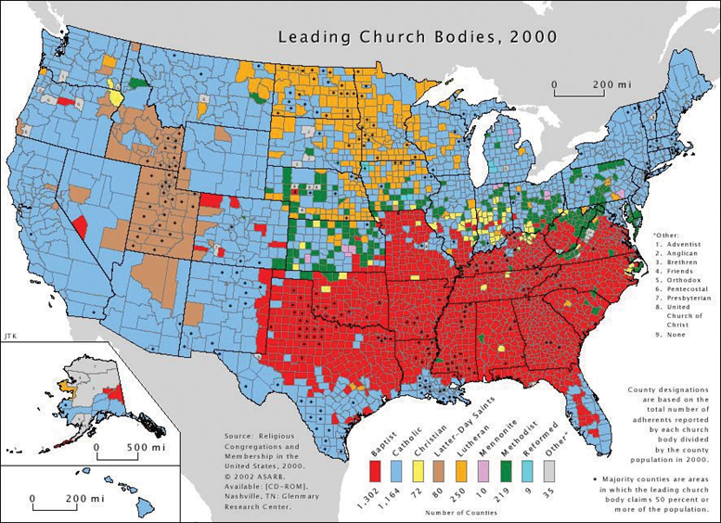
Diversity

Slide 12
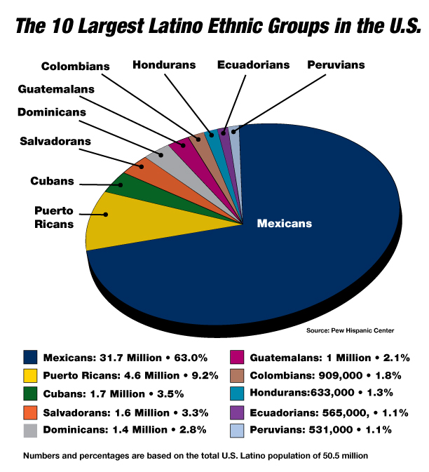
Diversity
Puerto Rico:
Is a U.S. Commonwealth – Status is higher than a territory, but it is lower than a state. People born in Puerto Rico are American citizens by birth

Slide 13
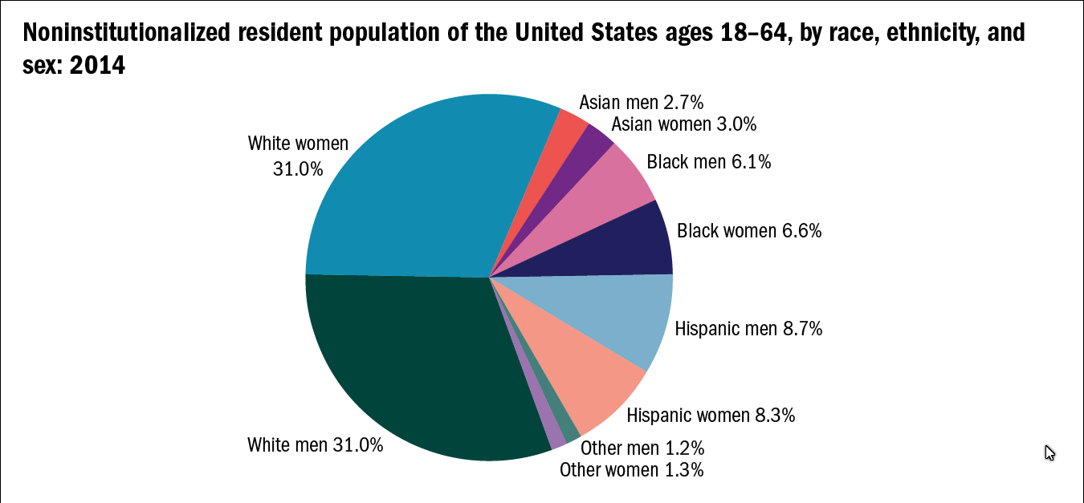
White population is headed toward being the largest minority rather than the majority group
Low birth rate so the percentage is shrinking. TFR below 2.1
High birth rate so percentages are increasing. TFR above 2.1

Slide 14
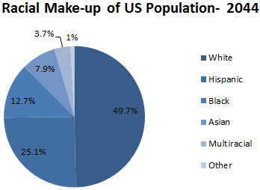
Assuming demographic conditions or trends do not change.
It might be a good idea to learn Spaniah naqs a second language.
The largest minority

Slide 15
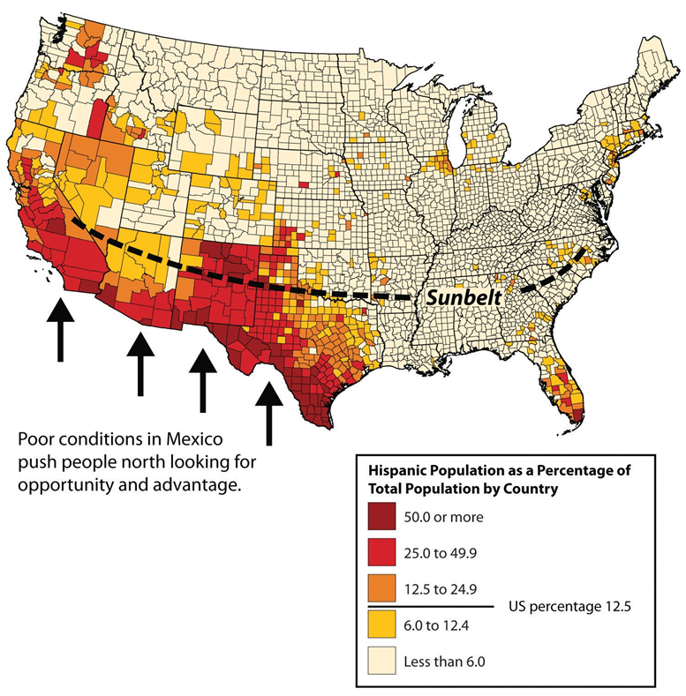
Hispanic population

Slide 16
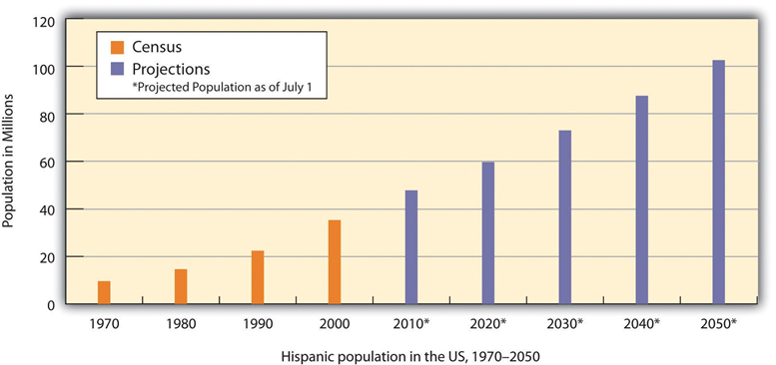

Slide 17
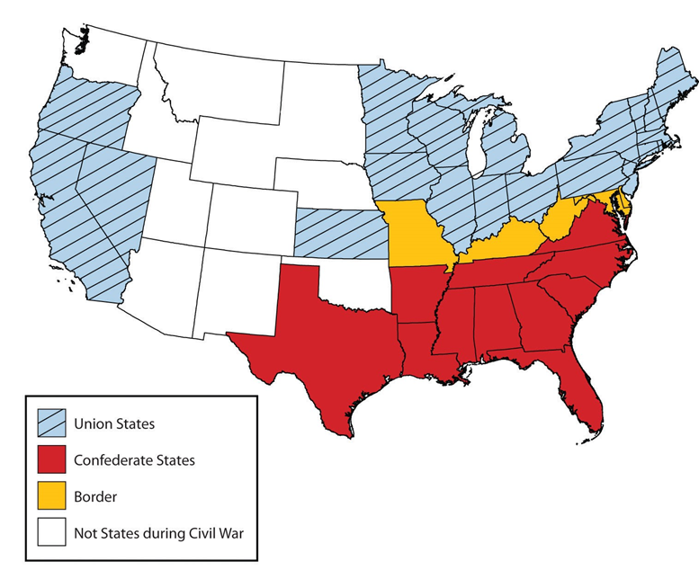
USA still hasn’t fully recovered from the Civil War and Reconstruction

Slide 18
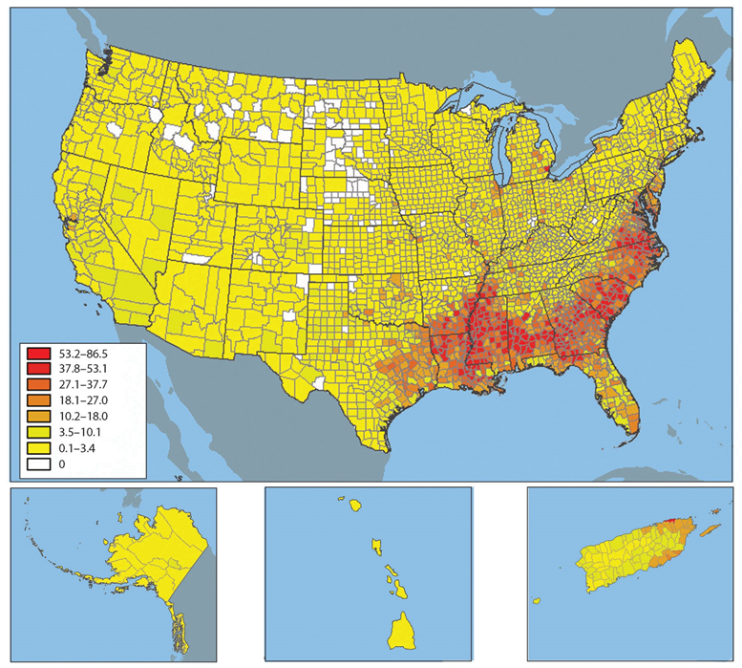
African-American population

Slide 19
Migration
Push Factors – drive people away from home
  Undesirable conditions in the homeland that make emigrating seem desirable
  Depressed economy, famine, persecution, war, etc.
Pull Factors – attract people to leave home
  Desirable conditions in the receiving country which attract immigrants
  Freedom from persecution & repression, economic opportunities, etc.

Slide 20
More Migration
  Rural to Urban Migration
    Today, more than 75% of North Americans live in cities (2,500 or more people)
  Growth of the Sun Belt South
    Fastest growing region since 1970, with some states growing by 20% (GA, FL, TX, NC)
  The Counterurbanization Trend
    Since 1970, some people have moved to smaller cities and rural areas
    Lifestyle migrants: seeking amenities
  Settlement Geographies: The Decentralized Metropolis
    Urban decentralization: when metropolitan areas sprawl in all directions and suburbs take on the characteristics of downtown

Slide 21
Occupying the Land
Three settlement stages for Europeans
  Stage 1: 1600 - 1750: European colonial footholds on East Coast (French, English, Dutch, Spanish, enslaved Africans)
  Stage 2: 1750 - 1850: Infilling better eastern farmland, including Upper Ohio & Tennessee Valleys, Interior Lowlands, Midwest, Interior South; Canadian settlement slower
  Stage 3: 1850 - 1910: Westward movement (immigrants & American-born Europeans) heading west for gold rushes and other opportunities

Slide 22
North America on the Move
Westward-Moving Populations
  By 1990, more than half of U.S. population west of Mississippi River
Black Exodus from the South
  After emancipation, most African-Americans stayed in the South
  Movement north for jobs
  1900: more than 90% of African-Americans lived in the south; today, only 50% live there
  Some Blacks returning to the South

Slide 23
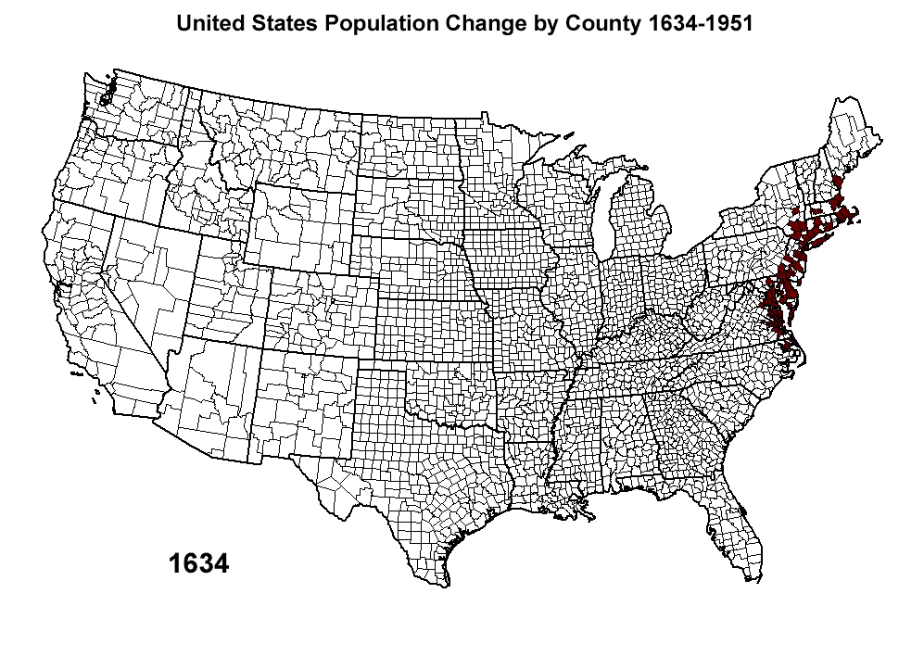

Slide 24
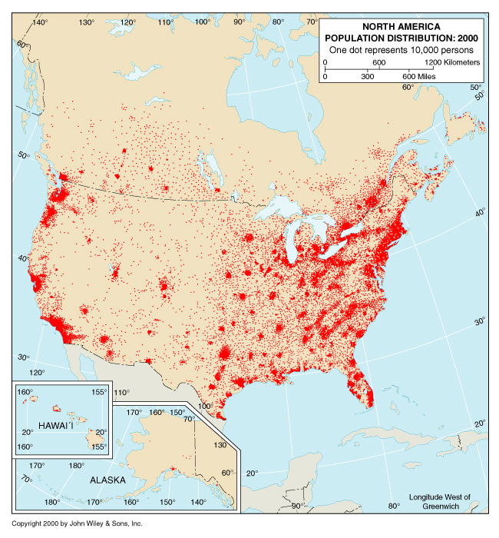
Population Distribution
Mountainous or too cold
Most of Canada’s population lives within 200 miles of the US border
Mountainous or arid

Slide 25
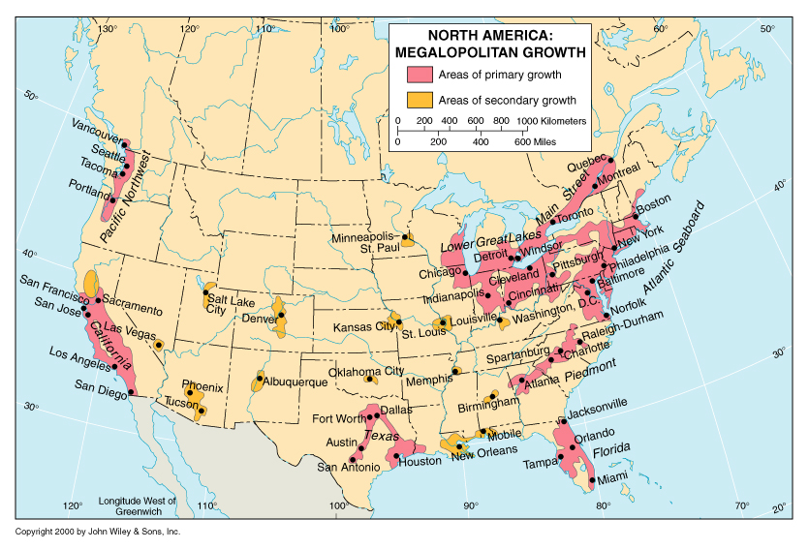
MEGALOPOLITAN POP. DISTRIBUTION

Slide 26
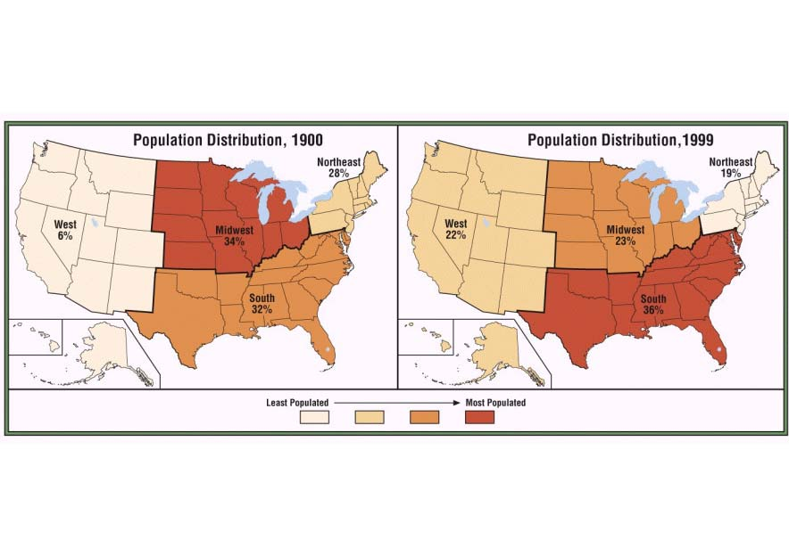
Population Shifts
SUNBELT

Slide 27
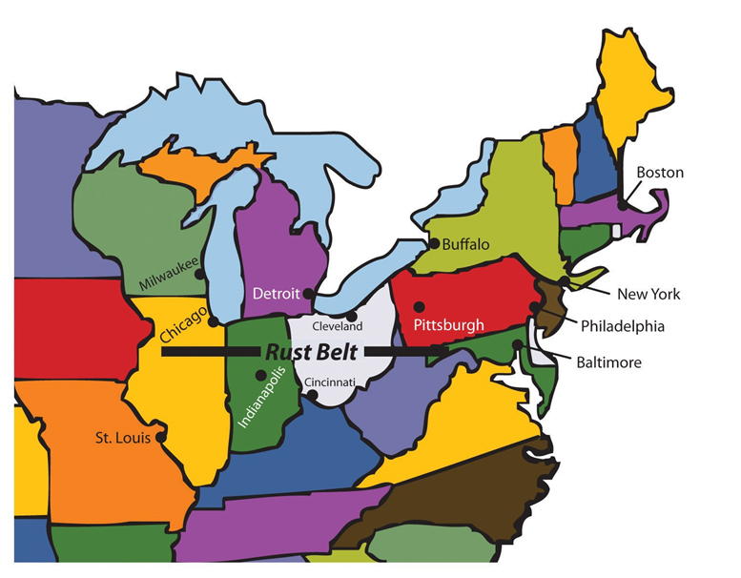
Pop. Movement in US
The Sun Belt attracted light industry and high technology industries And grew in population technology industry and gained population
Rust Belt (old heavy industry core of USA) is losing population as heavy industry declines in economic importance.
SUN BELT

Slide 28
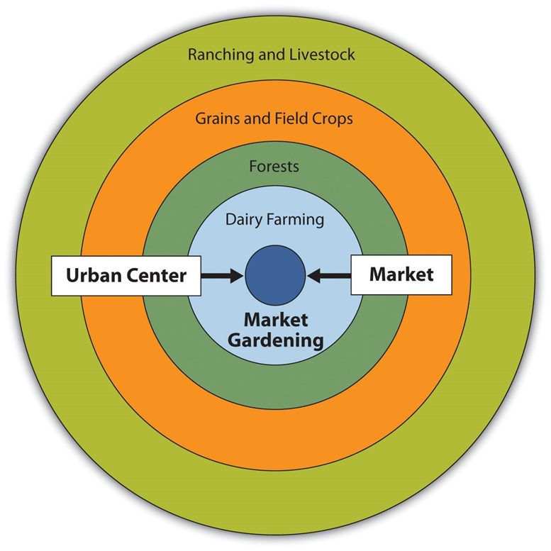
Urbanization of America
An Idealized model: Real cities deviate from the ideal due to differences in topography, rivers, state boundaries, etc.

Slide 29
Urban Models
Concentric Zone Model: Urban land uses organized in rings around the Central Business District
Urban realms model or Edge Cities:
  New suburbs with a mix of retail, office complexes & entertainment like Clayton

Slide 30
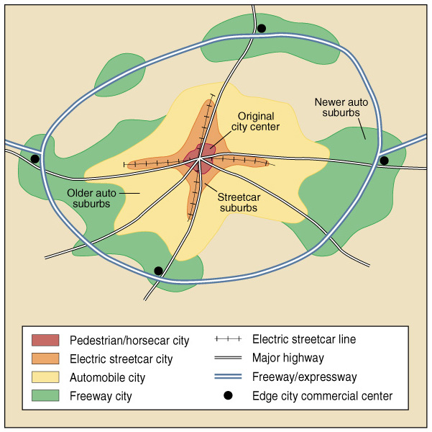
Growth of the
American
City
(Fig. 3.13)
Historical Evolution of the City in the USA
1. Walking/Horsecar
(before 1888)
2. Electric Streetcar
(1888-1920)
3. Recreational
Automobile (1920-45)
4. Freeway (1945-present)
Result of technolgical change.

Slide 31
Changing Urban Patterns
Consequences of Sprawl:
  People and investment flee city for suburbs
  Poverty, crime, racial tension in cities
Gentrification:
  Movement of wealthier people to deteriorated inner-city areas; may displace low income residents
Suburban downtowns:
  Similar to edge cities; suburbs becoming full-service urban centers with retail, business, education, jobs, etc.

Slide 32
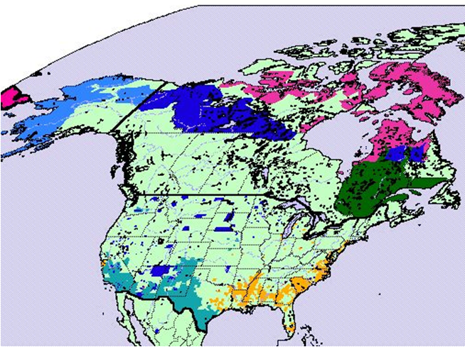
Ethnic Differences

Slide 33
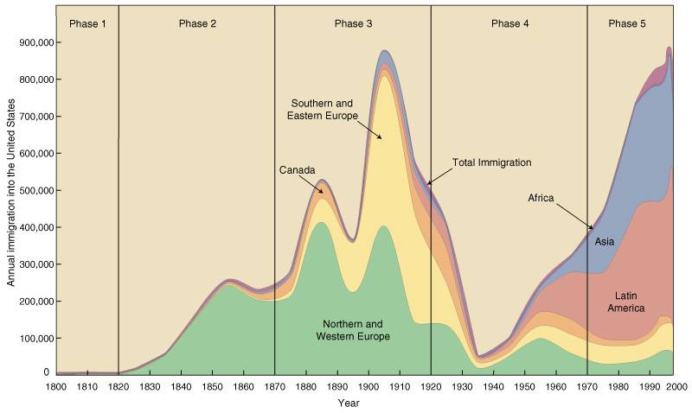
U.S. Immigration, By Year and Group (Fig. 3.17)

Slide 34
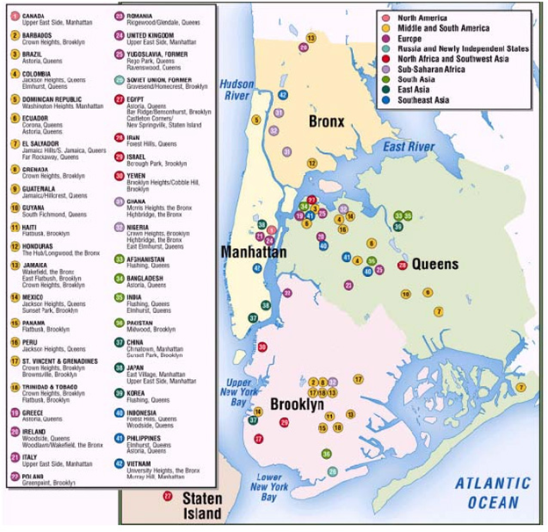
Urban Ethnic Regions

Slide 35
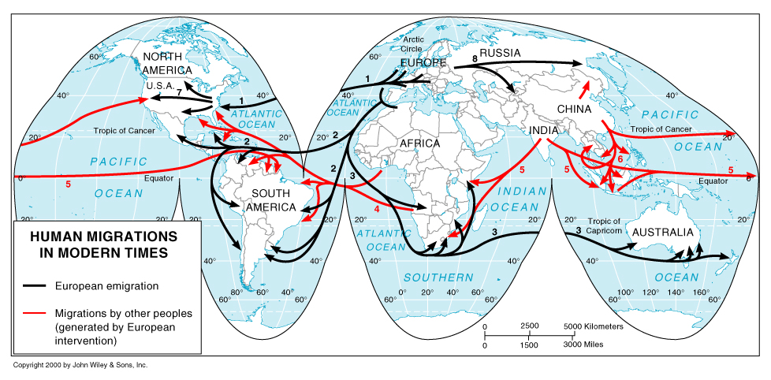
In modern times, many immigrants are the result of wars and terrorism.

Slide 36
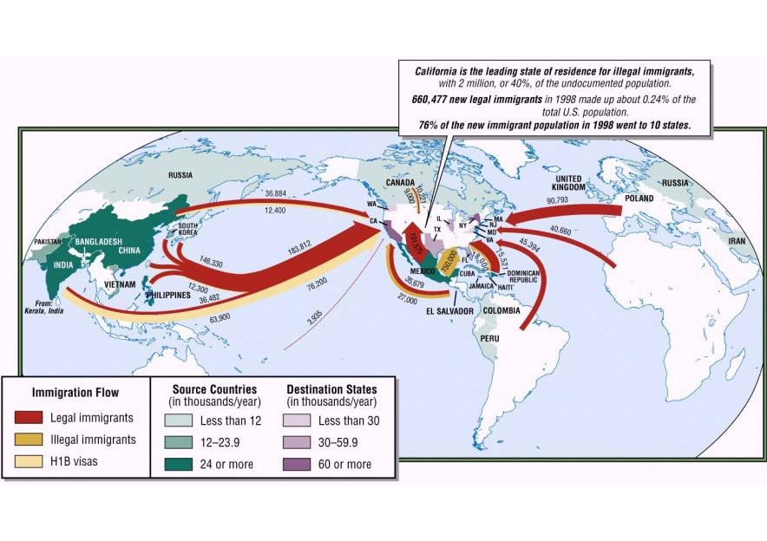
Recent Immigration
America continues to appear to be the pot of gold at the end of the rainbow for many people around the world.

Slide 37
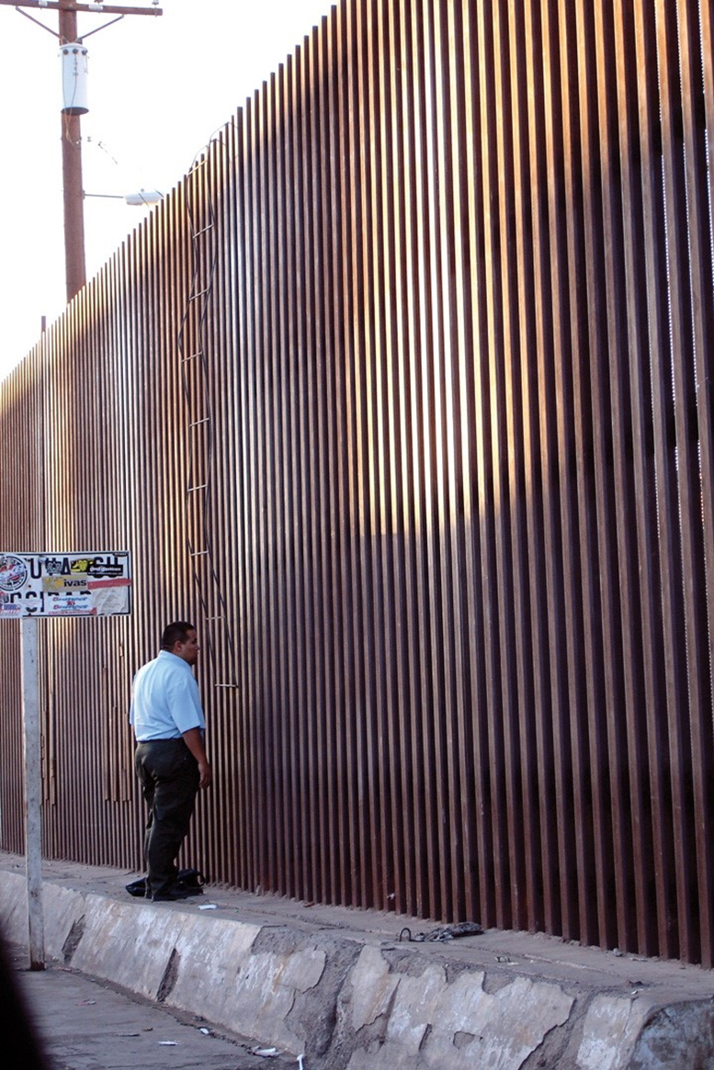
Increased visibility of racism and prejudice
1908-2019 population polarization and political gridlock
  Ethics of political campaigns reaches an all-time low
  The concept of a loyal oppositionis no longer evident
Anti-immigrant proposals
  Presidential insistence on a wall on the Mexican border
  Arresting Hispanics, deporting, separating parents and children
What lies ahead for the USA?

Slide 38
Environmental Geography
A Diverse Physical Setting
  Eastern mountains (Appalachians, Piedmont) from 3,000-5,000 ft.
  Western mountains include earthquakes, volcanoes, alpine glaciers, and erosion; Rockies reach more than 10,000 ft.
  Great Plains in the center
Patterns of Climate and Vegetation
  Great variation in climate and vegetation because of latitudinal range, varied terrain (altitude) and oceans
  Maritime climates in coastal zones (moderated temperatures)
  Continental climate in the interior (great temperature range)
    Frequent winds, including tornadoes
    Natural vegetation often replaced by farm

Slide 39
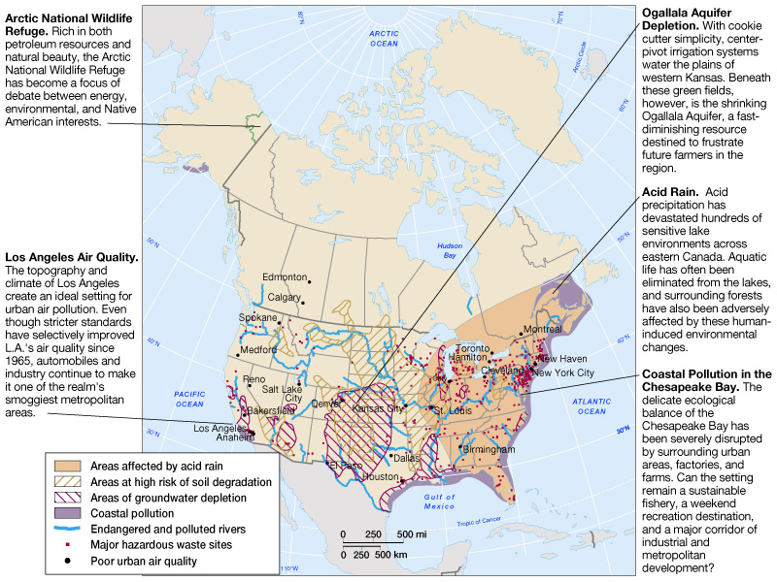
Environmental Issues in North America

Slide 40
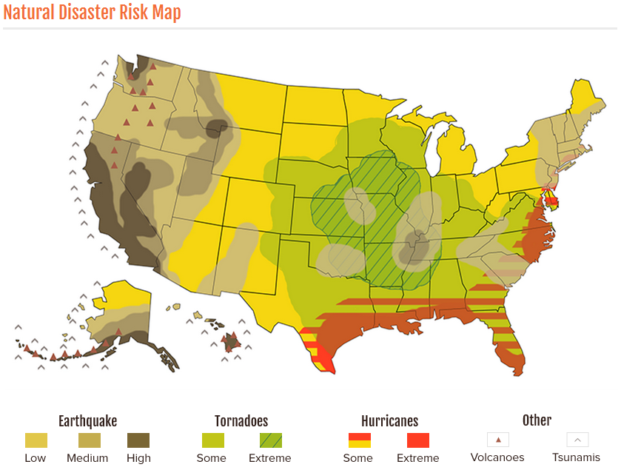
Climate change seems to be shifting “Tornado Alley” to the southeast

Slide 41
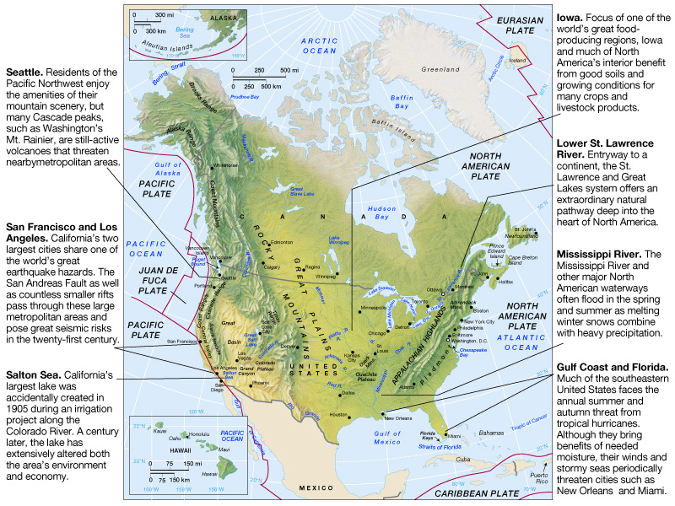
Physical Geography of North American

Slide 42
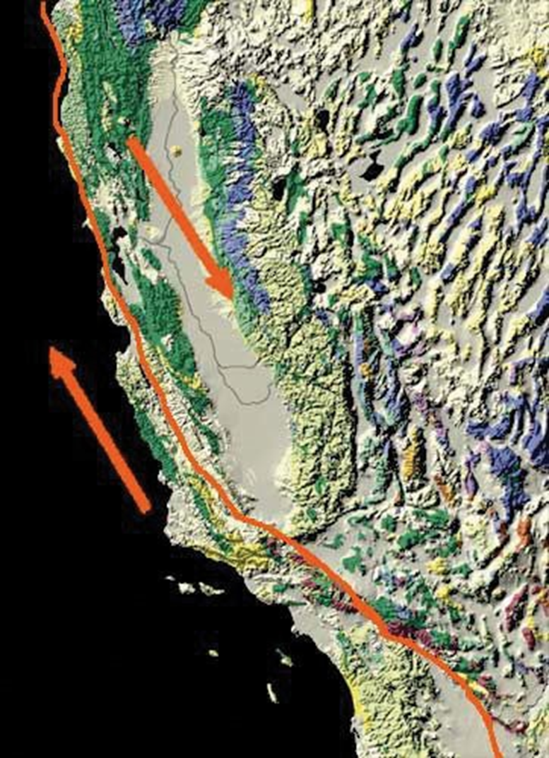
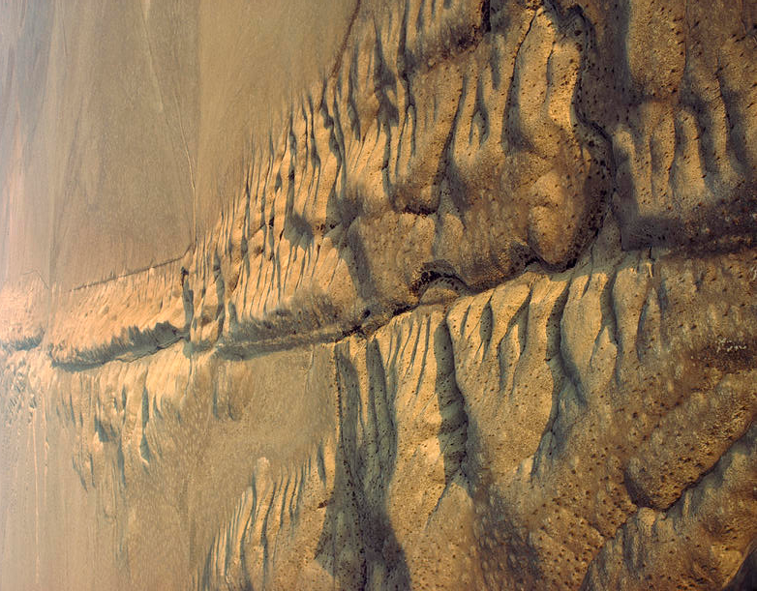
San Andreas Transverse Fault
The fault can be seen in arid areas

Slide 43
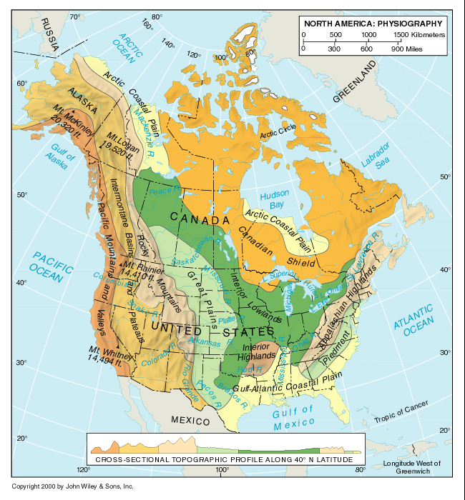
Physical Geography
Physiographic provinces
  North to South orientation of mountain ranges has a pronounced effect on climates and has influenced east-west movement.

Slide 44
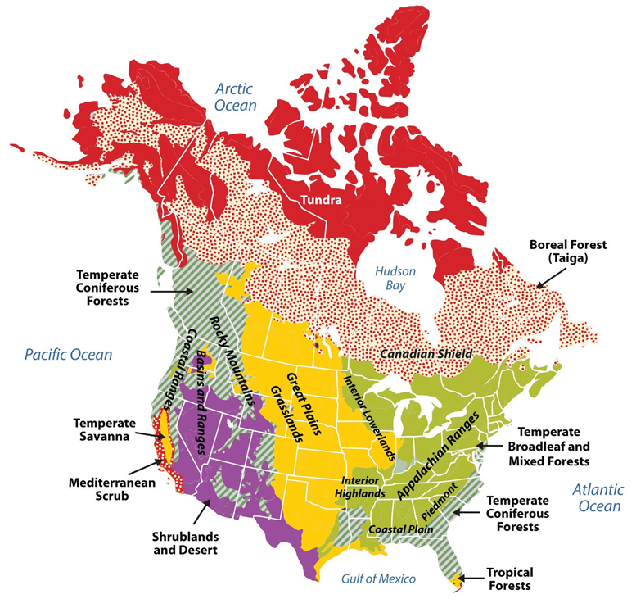
Variation of Previous Map
  Original vegetation added

Slide 45
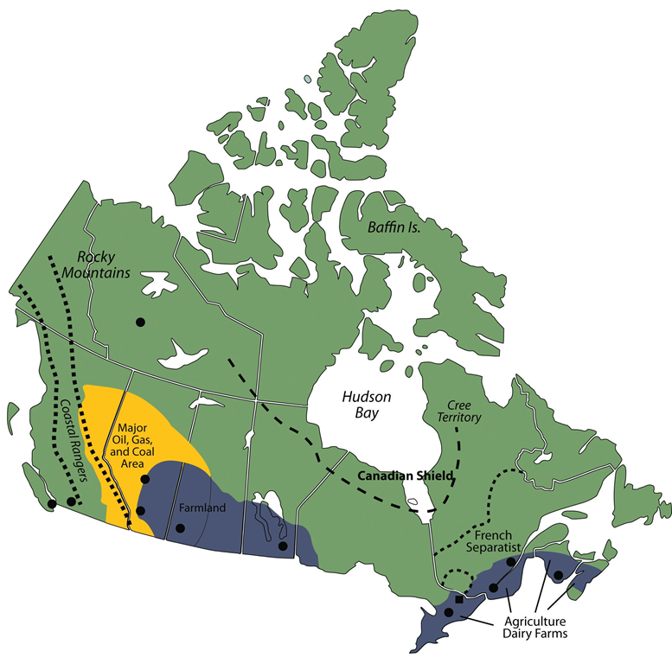

Slide 46
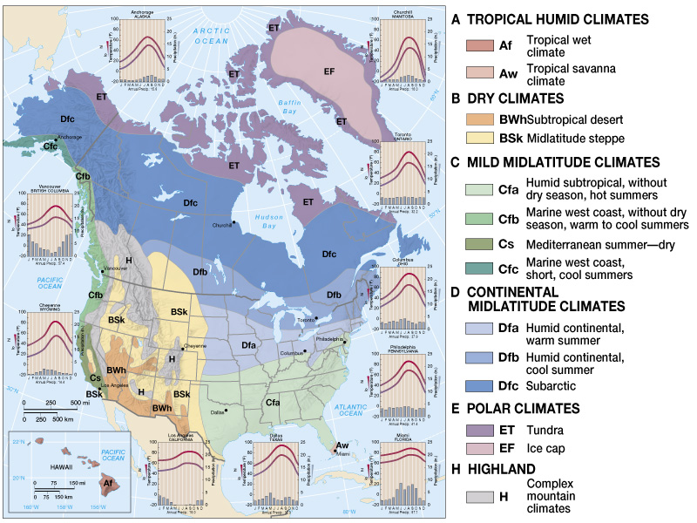
Climate Map of North America

Slide 47
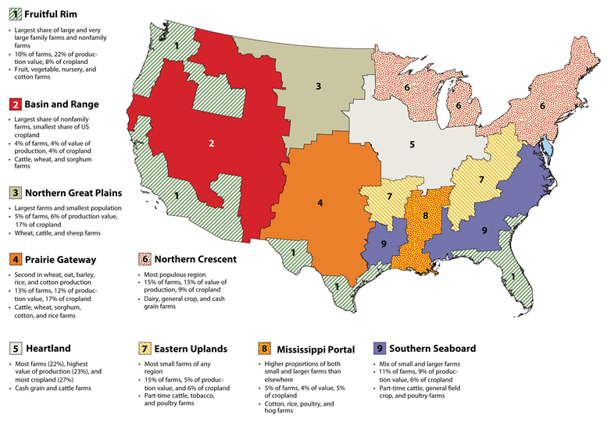
Agriculture

Slide 48
Climate Factors
Continentality – Large landmasses at high latitudes – Temperature extremes in the interior
Rain shadow effect - Precipitation in Eastern North America declines toward the west
  Westerlies are intercepted by the coastal ranges
  Winds from the Gulf of Mexico lose their moisture as they penetrate the continent
  The 20 inch isohyet is an important division – particularly agriculturally

Slide 49
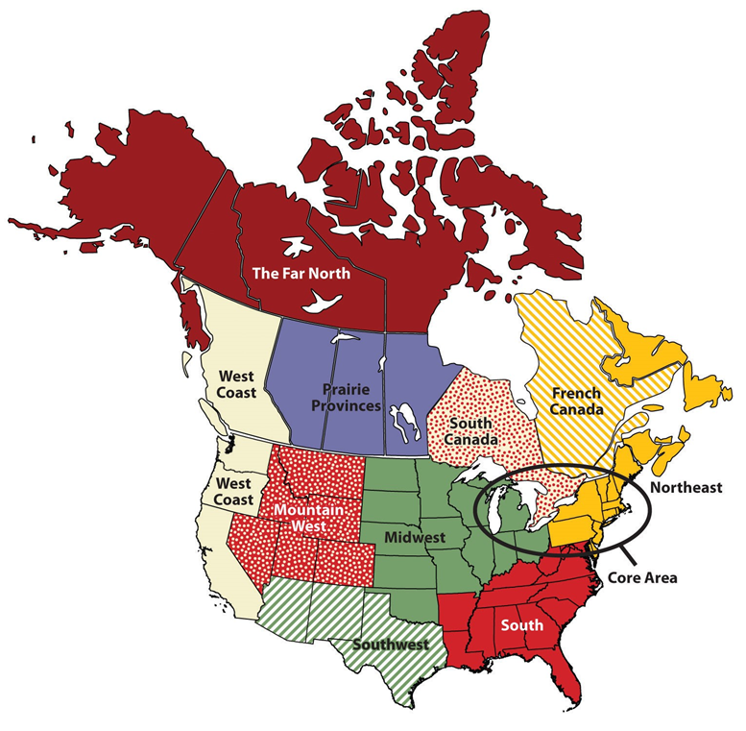
Regions from the Textbook
Determining factors
  Economic base
  Culture
  Climate & physiography
Core Area Characteristics
  Contains political capitals
  Contains Heavy Industrial base of both countries
  Contains the major financial center (New York) of North America & the world
  Contains an excellent water &
  Transportation systems of North America

Slide 50
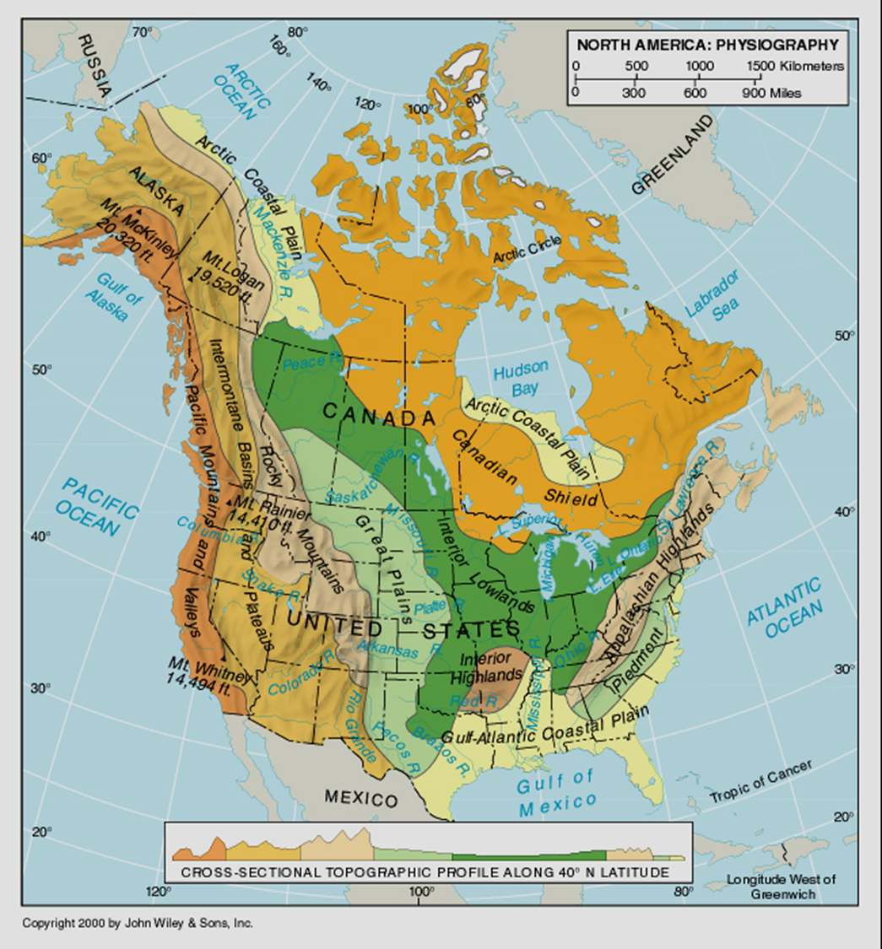
Physical Regions within the north American realm
Brief descriptions and illustrations follow

Slide 51
Gulf-Atlantic Coastal Plain & Piedmont
Gulf-Atlantic Coastal Plain
  Drained by many short rivers which flow from the interior to the coast
  Would be most affected by rising sea levels from global warming
Piedmont
  Foothills to the east of the Appalachian highlands
  Early settlements often were made at the fall line to take advantage of water power & because it was a break-in-bulk point

Slide 52
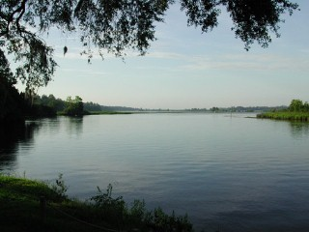



Gulf Coast & Piedmont

Slide 53
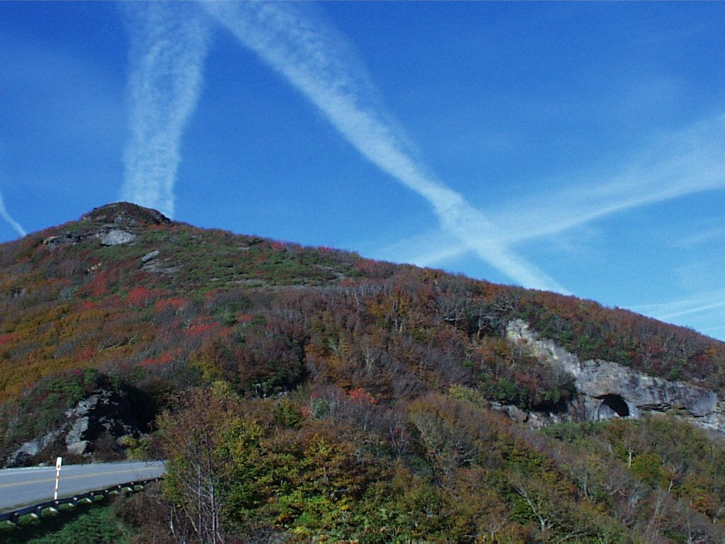
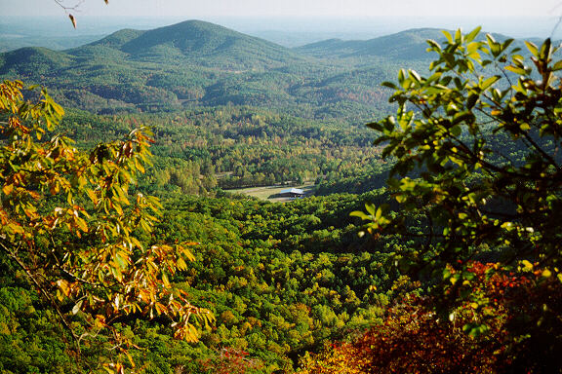
Appalachian & Interior Highlands
Appalachian Highlands
  Low, old mountain range
  No major impediment to transportation
  Resource area – coal, iron ore etc.
Interior Highlands
  A dissected plateau known as the Ozarks

Slide 54
Interior Lowlands &
Canadian Shield & Arctic Coastal Plain
Interior Lowlands
  Much of the best agricultural land
  Parent material for the soil for much of the area is glacial till
Canadian Shield (encircles Hudson Bay)
  The oldest rocks in North America
  The “core” of the North American continent
  Very thin soil – developed after the last glacial advance
Arctic coastal Plain (south coast Hudson Bay)
  Cold area – difficult to develop
  Permafrost

Slide 55
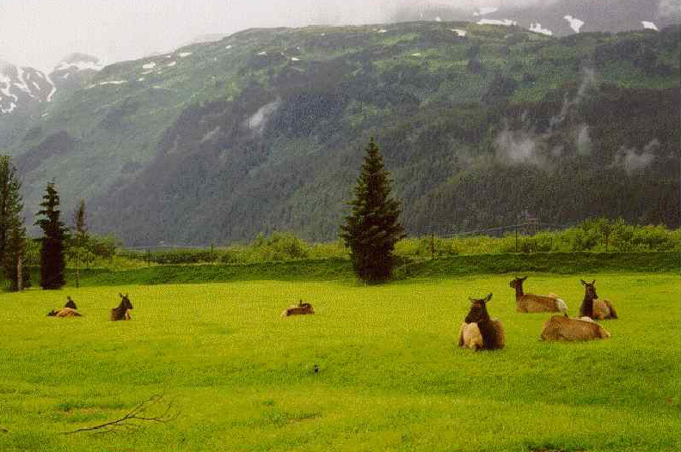
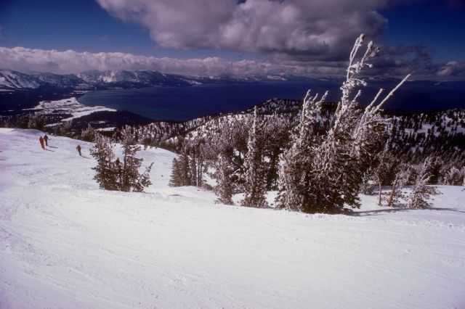
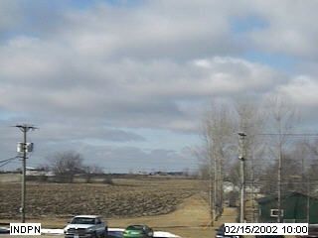
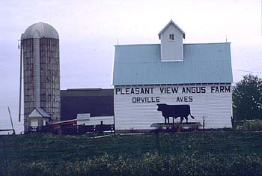
Interior Lowlands

Slide 56
Great Plains & Rocky Mountains
Great Plains
  Semi-arid area – gets drier from east to west
  Wheat growing areas of U.S. and Canada
Rocky Mountains
  North-South orientation affects climate
  Storehouse of many minerals
  Lumbering & winter-sport tourism
  Younger mountains than Appalachians, therefore more of an impediment to transportation.

Slide 57



Rockies & Great Plains

Slide 58
Intermontane Basins –
Plateaus &Pacific Mountains and Valleys
Intermontane Basins & Plateaus
  Rather dry area
  North/south oriented – Between the Rockies and Sierra Nevada/Cascade ranges
Pacific Mountains and Valleys
  First interruption of westerly winds (orographic precipitation) – north-south orientation
  Three large, useful valleys
    California’s Central Valley
    Cowlitz-Puget Sound lowland of Washington and Oregon
    Lower Fraser Valley in British Columbia

Slide 59




Intermontane

Slide 60
A Threatened Life of Plenty
The Costs of Human Modification
    Increasing population and expanding agriculture are changing North America
  Transforming Soils and Vegetation
    Europeans brought new species (ex.: wheat, cattle, horses – one side of the Columbian Exchange)
    Settlers cut millions of acres of forest, replaced grasslands with non-native grain and forage crops
    Soil erosion is a result of unsustainable farming practices in the Great Plains and the South

Slide 61
USA
– A Special Distinction
The blessings of climatic diversity
  The only country in the world that has every kind of climate type.
    Every kind of plant can be grown somewhere in the USA
    The whole USA – 48 states, Alaska, Hawaii, & Puerto Rico
  Of all the countries in the world, the USA is the country most nearly able to be self-sufficient in food production

Slide 62
Managing Water
City dwellers use 170 gal/person/day
Agriculture/industrial users average 1,500 gal/person/day
Allocation
  45% manufacturing & energy production
  40% agriculture
  15% home and business
Quality and quantity of water are both problems
  Clean Water Act in U.S.
  Green Plan in Canada

Slide 63


Slide 64
Human Modification
Altering the Atmosphere
    Activity in cities raises the temperatures above nearby rural temperatures
    Air pollution from factories, utilities, and vehicles
    Acid rain occurs when airborne pollutants (sulfur & nitrogen) mix in chemical reaction to make acidic precipitation; originates in industrial areas, comes down far away
    Global warming & rising sea levels
The Price of Affluence
    North Americans use almost twice as much energy per capita as the Japanese and more than 16 times that of people in India
    Toxic waste, poor air quality, wild lands lost to development, excellent farmland lost to “development”
    Increased medical costs – asthma, emphysema, skin cancers (from ozone depletion) etc.

Slide 65
Population and
Settlement:
Reshaping a Continental Landscape
Modern Spatial and Demographic Patterns
    Settlement is uneven in the region
    N. America has 315.5 million (284.5-U.S.; 31-Canada)
    Megalopolis: largest settlement cluster in the U.S. (Boston-Washington, DC)
Occupying the Land
    Indigenous people occupied N.A. at least 12,000 years
    Europeans came to N.A. 400 years ago
    European diseases and disruptions reduced Native American populations by 90% in some areas.

Slide 66

W. Hemisphere Cartogram
Size is based on population size, not on land area size (Actually, USA and Canada are approximately the same size in land area, but not in population.

Slide 67
Good Hydrography (water)
Two major drainage systems
  Great Lakes-St. Lawrence River
  Missouri-Mississippi Rivers
Best inland water transportation system in the world
  Canals connect the two major systems – Illinois River to Lake Michigan
  Canal around Niagra Falls – St. Lawrence Seaway made Chicago a seaport
Western rivers – no comparable roles for transportation – Hydroelectricity, Drinking and irrigation water sources

Slide 68
Rural North America
North Americans historically have favored a dispersed rural settlement pattern
    Township-and-range survey system: Rectangular survey system introduced in 1785 in U.S. for unincorporated areas; similar system in Canada
  Railroads opened interior to settlement
  Today, many rural areas are experiencing population declines, as family farms are replaced by corporate farms

Slide 69
Cultural Coherence
& Diversity: Shifting Patterns of Pluralism
The Roots of a Cultural Identity
    Early dominance of British culture, then Consumer Culture after 1920 provided common experience
    Ethnicity – group of people with a common background & history identify with one another (sometimes as a minority group in larger society); both Canada & U.S. have many minorities – can be the basis of nationalism
Peopling North America
    Cultural assimilation – the process in which immigrants are absorbed by the larger host society

Slide 70
Peopling North America
Migration to the U.S.
  Five distinct phases determined by immigrants’ number and source regions
    Phase 1: before 1820: English and Africans
    Phase 2: 1820-1870: Irish and Germans
    Phase 3: 1870-1920: Southern and Eastern Europeans
    Phase 4: 1920-1970: Canada, Latin America, but overall numbers of immigrants drops
    Phase 5: 1970-present: Latin America, Asia, and overall numbers rise again
The Canadian Pattern
  Similar to U.S., but with larger French presence
  Today, 16% in Canada are foreign-born

Slide 71

Culture & Place
North America’s cultural diversity expressed two ways geographically
  People with similar characteristics often congregate and derive meaning from their territory
  Distinctive cultures leave their mark on the landscape
“The Hill” in
St. Louis

Slide 72
Ethnicity
Persisting Cultural Homelands
  French-Canadian Quebec
  Hispanic Borderlands
  African-Americans in the “Black Belt”
  Cajuns in Southern Louisiana
  Native American Reservations
Persisting urban ethnic neighborhoods
  The Hill (Italian neighborhood) in St. Louis

Slide 73

Selected
Cultural
Regions of
North
America

Slide 74
Culture & Place
  A Mosaic of Ethnic Neighborhoods
    Smaller scale ethnic signatures can shape both rural and urban landscapes
    Can have political impacts
Patterns of North American Religion
    Dominance of Protestantism in the U.S. (60%)
    Regional concentration of American Catholics, Jews
      Catholics are the largest single denomination in USA
    Millions with religious or secular traditions apart from Christianity
    Canada: 40% Protestant; 25% Roman Catholic
    Increasing diversity: Hindus, Buddhists, Muslims, etc.

Slide 75
Globalization of
American Culture
North Americans: Living Globally
  Many international tourists, students in North America
  Globalization of culture (international restaurants, imports, music, etc.)
The Global Diffusion of U.S. Culture
  U.S. culture has impact on billions since WWII
    Global corporate culture, advertising, consumption
    Other countries challenge U.S. influence

Slide 76
Cultural Pluralism
Definition: Society with 2 or more population groups, each practicing its own culture, live adjacent to one another without mixing inside a single state – can be centrifugal force
Strongly geographical in Canada
  French Canadians concentrated in Quebec
  Quebec independence movement near majority
U.S.A. not so geographically pronounced
  Some groups are somewhat more concentrated geographically, but they are still quite mixed
  English remains the language of all people though not officially – English language movement

Slide 77

French Canadians

Slide 78
Multi-National State
A Nation is a culture group, not really a country
Nations of Canada
  French Canadians – Majority in Quebec
  Native American/Inuit – in the cold northern areas
  Asians – strong presence in the West Coast
  Anglo-Canadians – the majority in Canada
Quebec referendum many years ago: to separate.
  The province-wide referendum took place on Tuesday, May 20, 1980, and the proposal to pursue secession was defeated by a 59.56 percent to 40.44 percent margin. A second referendum on sovereignty, in 1995, also failed, albeit (50.58% to 49.42%).

Slide 79
Efforts to placate the French
Quebec granted greater autonomy than other provinces
French elevated to national langrage status all over Canada
At least two Prime Ministers have been French Canadians
  Pierre Trudeau (father)
  Justin Trudeau (son) – current Prime Minister - 2019
As of 2006, about 58 percent of Canadians spoke English as their primary language, French was the mother tongue of 22 percent, and another one-fifth of the population (20 percent) spoke a mother tongue other than English or French

Slide 80

No Ethnic Minority
Has a Majority

Slide 81
Patterns of
Dominance & Division
Creating Political Space
  U.S. broke cleanly, violently from Great Britain; Canada separated peacefully
    U.S. purchased and conquered new lands
    Provinces of Great Britain joined Canada
Continental Neighborhoods
    Long boundary between U.S. and Canada
      Many cross-boundary issues
      Water resources, transportation, environmental quality
    North American Free Trade Agreement (NAFTA)
      Brings Mexico int to the picture.

Slide 82

Geopolitical Issues in North America

Slide 83
Historical Framework
The Legacy of Federalism
    Federal states: those that allocate considerable power below the national level
    Unitary states: those with centralized power at national level
  Quebec’s Challenge
    French-speakers consider secession from Canada
  Native Peoples and National Politics
    In the U.S., Indian Self-Determination and Education Assistance Act of 1975 and the Indian Gaming Regulatory Act (1988)
    In Canada, Native Claims Office (1975) (Canada) and Nunavut Territory (1999)

Slide 84
A Global Reach
U.S.’s geopolitical reach is beyond our borders
  Monroe Doctrine (1824) asserted U.S. rights in Western Hemisphere
  WWII and Truman Doctrine gave U.S. wider world role
  North Atlantic Treaty Organization (NATO), Organization of American States (OAS)
  Other international involvement: Korea (1950–1953); Vietnam (1961–1973); Afghanistan and Iraq

Slide 85
Economic & Social
Development
    North America has the world’s most powerful economy and its wealthiest population
An Abundant Resource Base
    Direct extraction of natural resources makes up 3% of U.S. economy, and 6% of Canadian economy
  Opportunities for Agriculture
    Highly mechanized and productive
    Good land being lost to “development.”
    Agriculture employs 2.6% of U.S., and 3.7% of Canadian labor force
    Geography of farming in North America determined by (1)diverse environments; (2)continental & global markets for food; (3)historical patterns of settlement & agriculture

Slide 86
Economic
Development
An Abundant Resource Base (cont.)
  Industrial Raw Materials
    North America has abundant resources, but still imports raw materials
    U.S. produces 12% of world’s oil, consumes 25%
Creating a Continental Economy
  Connectivity and Economic Growth
    Connectivity fosters economic growth
      Connectivity: how well regions are linked together by transportation and communication

Slide 87

Major Economic Activities of North America (Fig. 3.23)

Slide 88

Growth of the
Manufacturing Belt – sometimes called the “Rust Belt” today
Canada’s “Main Street”
SUNBELT

Slide 89
Creating a Continental Economy
The Sectoral Transformation
  Changes in employment structure signaled modernization
  Sectoral transformation: the evolution of the nation’s labor force from primary sector activities to secondary, tertiary and quaternary activities
    Primary: natural resource extraction
    Secondary: manufacturing/industrial
    Tertiary: services
    Quaternary: information processing
    Today, tertiary and quaternary activities employ more than 70% of the U.S. and Canadian labor force

Slide 90
Regional Economic Patterns
Location factors: the varied influences that explain why an economic activity is located where it is
  Factors include proximity to natural resources, connectivity, productive labor, market demand, capital investment
  Major manufacturing regions: megalopolis and Midwest, Sunbelt areas, West Coast locations
  Other influences on economic activities: government spending, access to innovation and research, agglomeration economies

Slide 91
Commercial Canges
Decline of competition and small, local businesses
  Whirlpool owns Maytag, Amana, Kitchen Aid,
  Emerson Electric makes most of the motors in home appliances regardless of brand name.
  “Big Box” stores like Walmart, Sam’s Club, Costco, Office Depot-Max, etc. force smaller businesses to close.
  Online sales like Amazon, have reduced trade at brick & mortar stores.
  St. Louis inn 1940 had many grocery stores: Kroger, A&P, National, Tomboy, IGA, Bi-Rite, Bettendorfs, Rapps, Schnucks, Dierbergs Plus some independents
  Today, Schnucks and Dierbergs plus Aldi, Save-a-Lot, and Shop and Save and very few independents.

Slide 92
The Economy
North America & the Global Economy
  North America plays ivotal role in global economy
  Spurred the creation of the International Monetary Fund (IMF), the World Bank, & the World Trade Organization (WTO)
  U.S. & Canada members of Group of Seven (G-7)
    A collection of powerful countries that regularly confer on world political and economic issues
Patterns of Trade
  North America is prominent in both the sale and purchase of goods and services in international economy

Slide 93
Investments
North America and the Global Economy (cont.)
  Patterns of Investment in North America
    Foreign capital comes to North America as investments in North American stocks and bonds and as foreign direct investment (FDI)
  Doing Business Globally
    Many U.S. firms have established businesses abroad
    U.S. pension dollars invested in Japan, Europe

Slide 94
canADA

Slide 95
Provinces

Slide 96
Physical Features

Slide 97
Persisting Social Issues
Wealth and Poverty
  Strong contrasts among communities and ethnicities
    Black household incomes are 64% of the national average and Hispanic incomes are 72% of the national average
  Regional contrasts
    In U.S., Northeast and West are richest regions
    In Canada, Ontario and B.C. are wealthiest
  North American poverty rates have fallen
    Problems still remain in rural and inner city areas
    Digital divide: region’s poor and underprivileged have less access to Internet connections

Slide 98
Persisting Social Issues (cont.)
Twenty-First Century Challenges
  U.S. and Canada’s social indicators compare favorably, but concerns persist
    Jobs, education
    Health care, chronic disease & aging
    Gender gap
Conclusions
  North America enjoys abundance, but must work with diverse populations to address challenges

Slide 99

Aging Population
Growing Problem
  The sandwich generation
Growing Expense
  Funding Social Security & Medicare

Slide 100
Similarities
ANGLO-AMERICAN LABEL – not completely descriptive
ENGLISH OFFICIAL LANGUAGE (with 2nd languages)
    Canada – de jure English & French
    USA – de facto English
JUDEO-CHRISTIAN FOUNDATION – ethics and mores
EUROPEAN NORMS – Western culture foundation in government, architecture, art, diet, etc.
HIGHLY URBANIZED & MOBILE POPULATIONS
HIGHLY EDUCATED POPULATIONS
HIGH INCOMES (large spread between rich and poor)
MANUFACTURING OUTPUT – CORNERSTONE OF DEVELOPMENT (Declining in importance)
FEDERAL STATES WITH PLURAL SOCIETIES

Slide 101
More Similarities
Well-developed infrastructure
Increasing multiculturalism
Changing population distribution (more USA)
  Settlement by immigrants
Somewhat similar landscapes
  Western mountains & central plains
  Urbanization – city structure
Highly involved in the global economy
Growing relationship with Latin America
  NAFTA & possible expansion
International involvement – UN, NATO, GATT

Slide 102
Differences
Climatically, Canada is colder – much smaller area for productive agriculture
Canadian population is highly concentrated along the U.S. border – 11% of US population
Canada still has non-binding ties to Britain
Canada has a dissatisfied ethnic minority which has a geographic base which could lead to devolution – Quebec – two official national languages
Native Americans (Inuit) have gained a more significant role in their affairs
End of Chapter 3: North America

