Slide 1
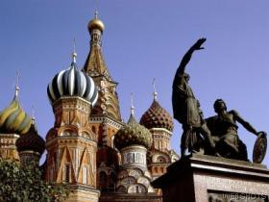
Russia – Chapter 3
Modified by Joe Naumann, UMSL

Slide 2
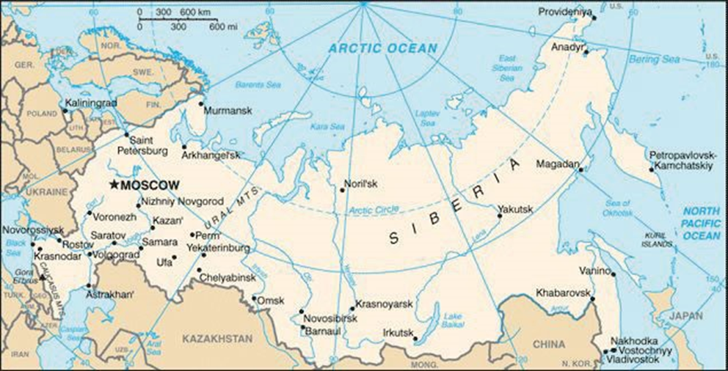
Chapter 3: The Russian Realm

Slide 3
Learning Objectives
Understand the challenges of cold, northern climate that affects this region
Learn about the cold war between the U.S. and U.S.S.R./Russia (1945-1990)
Know the difference between a political system and an economic system
Students should become familiar with the physical, demographic, cultural, political, and economic characteristics of the Russian Domain
Understand these concepts and models:
-Centralized economic planning
-Cold War
-Permafrost
-Autonomous areas
-Glasnost and Perestroika
-Russification
-Denuclearization

Slide 4
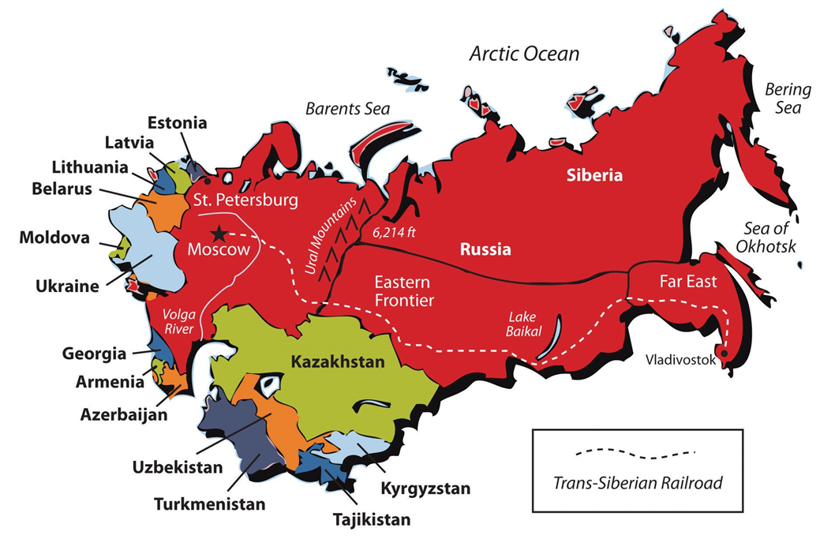
Former Soviet Union

Slide 5
Introduction
Russian Realm includes Russia
Russia is the largest country (in land area) on Earth; it spans 10 time zones
  Rich in resources, but has one of the harshest climates
The Russian Realm has had extremely rapid political and economic change since 1990
  From centrally planned economy to capitalism
  From authoritarian dictatorship to democracy
    Under Putin, Russia seems tp be moving back to dictatorship
  Region’s economy is weak; commitment to democracy uncertain, nationalist movements threaten stability
  Russia was allowed to annex Crimea (part of Ukraine)
    Russia supported and assisted the separation of eastern Ukraine from Ukraine
    Ukraine had been flirting with the European Union which was anathema to Russia

Slide 6
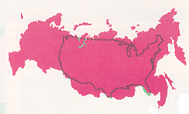
RUSSIA-US SIZE COMPARISON

Slide 7
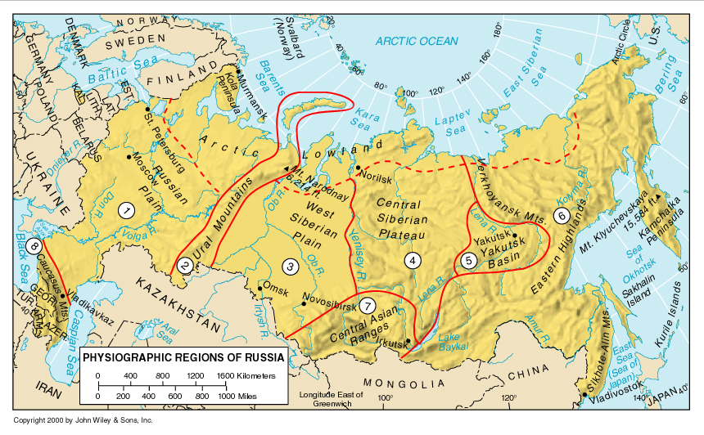
Physiographic Regions – mountains & deserts & poor coasts on margins

Slide 8
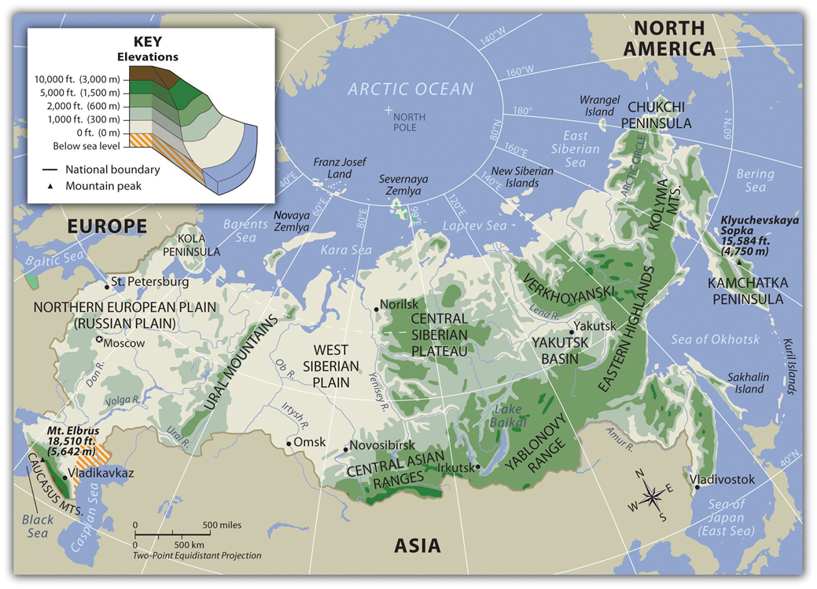

Slide 9
Environmental Geography: Vast & Challenging Land
Russian Domain has “good farmlands,” metal, petroleum, natural gas, and coal resources
High latitude, continental climate, temperature extremes
Cold climate and rugged terrain limit human settlement and agriculture
Sturgeon (caviar-producing fish) nearly gone
  Few domestic regulations to protect them
  Poaching adds to the problem

Slide 10
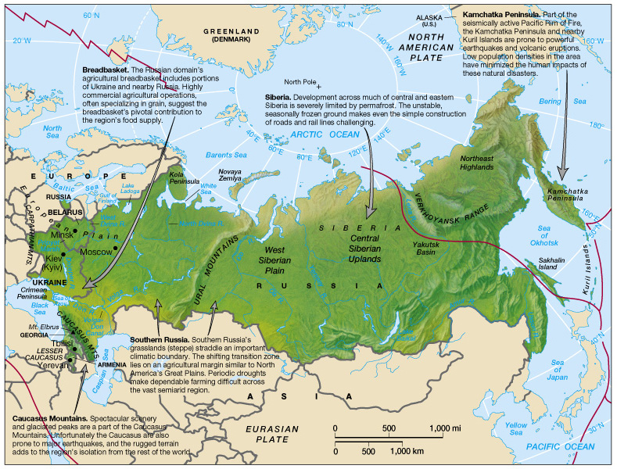
Physical Geography of the Russian Domain

Slide 11
The European West (the “heart” and core of Russia)
  European Russia, on eastern European Plain
    3 environments influence agriculture in this region
      Poor soils, cold temps, forests N. of Moscow & St. Petersburg
      Belarus and central European Russia have longer growing season, but acidic podzol soils limit farm output
      South of 50 N Latitude, grassland and fertile soils support commercial wheat, corn, sugar, beets, meat production
  Ukraine and Belarus: some place one or both with Russia, while others place them in Europe
    Current textbook places them in Europe

Slide 12
The Ural Mountains and Siberia
  Urals separate European Russia from Siberia: low mountains with cold, dry climates
  Siberia extends thousands of miles, cold climate, little precipitation
    Lake Baikal (largest freshwater reserve in the world – 400 miles long, nearly a mile deep, with unique species)
    Tundra (mosses, lichens) north; Taiga (coniferous forest zone) south
    Farming possible only in southwest Siberia
    Permafrost in Eastern Siberia – cold climate with unstable, seasonally frozen ground limiting farming and construction

Slide 13
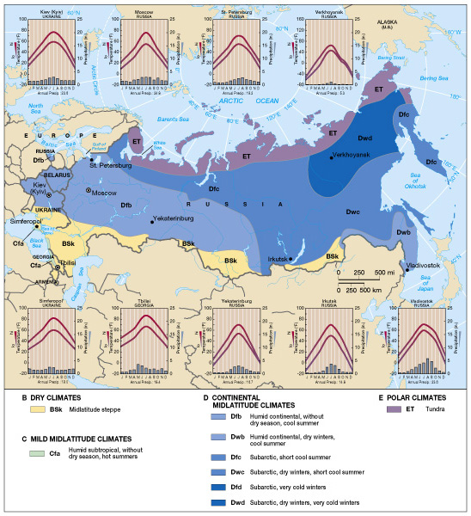
Climate
Map of the
Russian
Domain
Developed Area Triangle

Slide 14
USA compared to Soviet Union
80º
Arctic Circle
Alaska
60º
Russia
40º
Latitudinal
Impact
Hawaii

Slide 15
RUSSIAN CLIMATE
Affected by 3 natural conditions:
    Latitudinal Position – northern latitudes
    Continental Position – far removed from moderating influence of water bodies particularly warm ocean currants
    Location of major mountains – the south blocking warm air masses

Slide 16
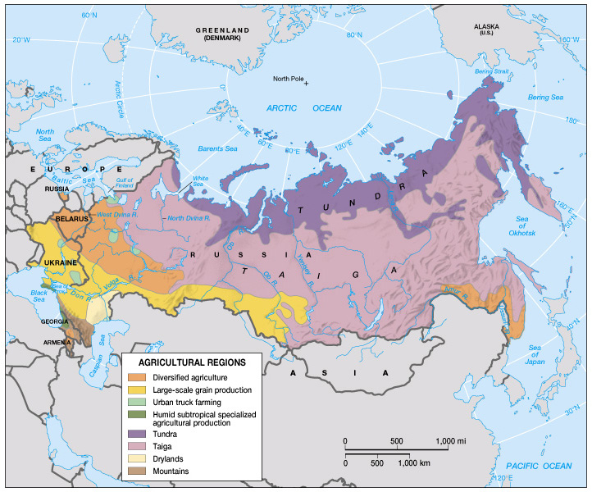
Agricultural Regions (Fig. 9.5)
Agricultural Triangle
(Developed Triangle)

Slide 17
Environmental Geography: A Vast and Challenging Land (cont.)
The Russian Far East
  Near Vladivostok, about same latitude as New England (in N. America)
  Longer growing seasons and milder climates than Siberia, seismically active
  Ussuri and Amur River Valleys have mixed crop and livestock farming
  Vegetation includes conifers, taiga, Asian hardwoods
The Caucasus and Transcaucasia
  In extreme south of European Russia, forms Russia’s southern boundary, between the Black and Caspian seas
  Highest peak is Mt. Elbrus (18,000 feet)
  Georgia and Armenia are in Transcaucasia; Lesser Caucasus Mountains form border between Armenia and Azerbaijan
  Climate: high rainfall in west, arid or semi-arid in east; good soils and farming

Slide 18
A Devastated Environment (cont.)
  Air and Water Pollution
    Extreme environmental pollution, from industrialization, urbanization, careless mining, nuclear energy production; legacy of U.S.S.R.
    Air pollution caused by clustered factories, few environmental controls, reliance on low quality coal
    Water pollution caused by industrial waste, raw sewage, oil spills; pulp and paper factories polluted Lake Baikal (1950s-60s)
  The Nuclear Threat
    Former U.S.S.R. nuclear weapons, energy production caused pollution
      Above-ground testing made radioactive fallout; nuclear waste dumped
      Nuclear weapons used for seismic experiments, oil exploration, dam building
      Russia has many old nuclear reactors; major nuclear accidents: 1986 meltdown in Chernobyl (Ukraine); another in 1956
    Construction of new nuclear plants
    Possibility of warehousing of international nuclear wastes

Slide 19
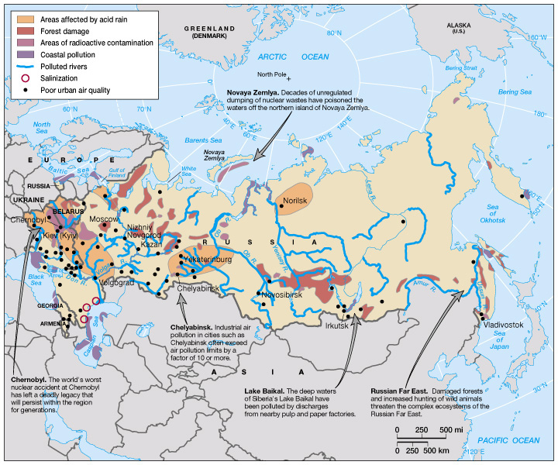
Environmental Issues in Russia

Slide 20
Population & Settlement: An Urban Realm
Overview of the Russian Realm
  Approximately150 million residents, most in cities
Population Distribution
  Most people in best farmlands
    European Russia; 110 mil.; Siberia: 35 mil.
  The European Core (Western Russia)
    Contains the Russian Realm’s largest cities, biggest industrial complexes, most productive farms, higher population densities
  Siberian Hinterlands
    Relatively sparse settlement, with two zones influenced by transportation
      Industrial cities along Trans-Siberian Railroad (1904)
      Thinner settlement along the Baikal-Amur Mainline (BAM) Railroad -- newer (1984)

Slide 21
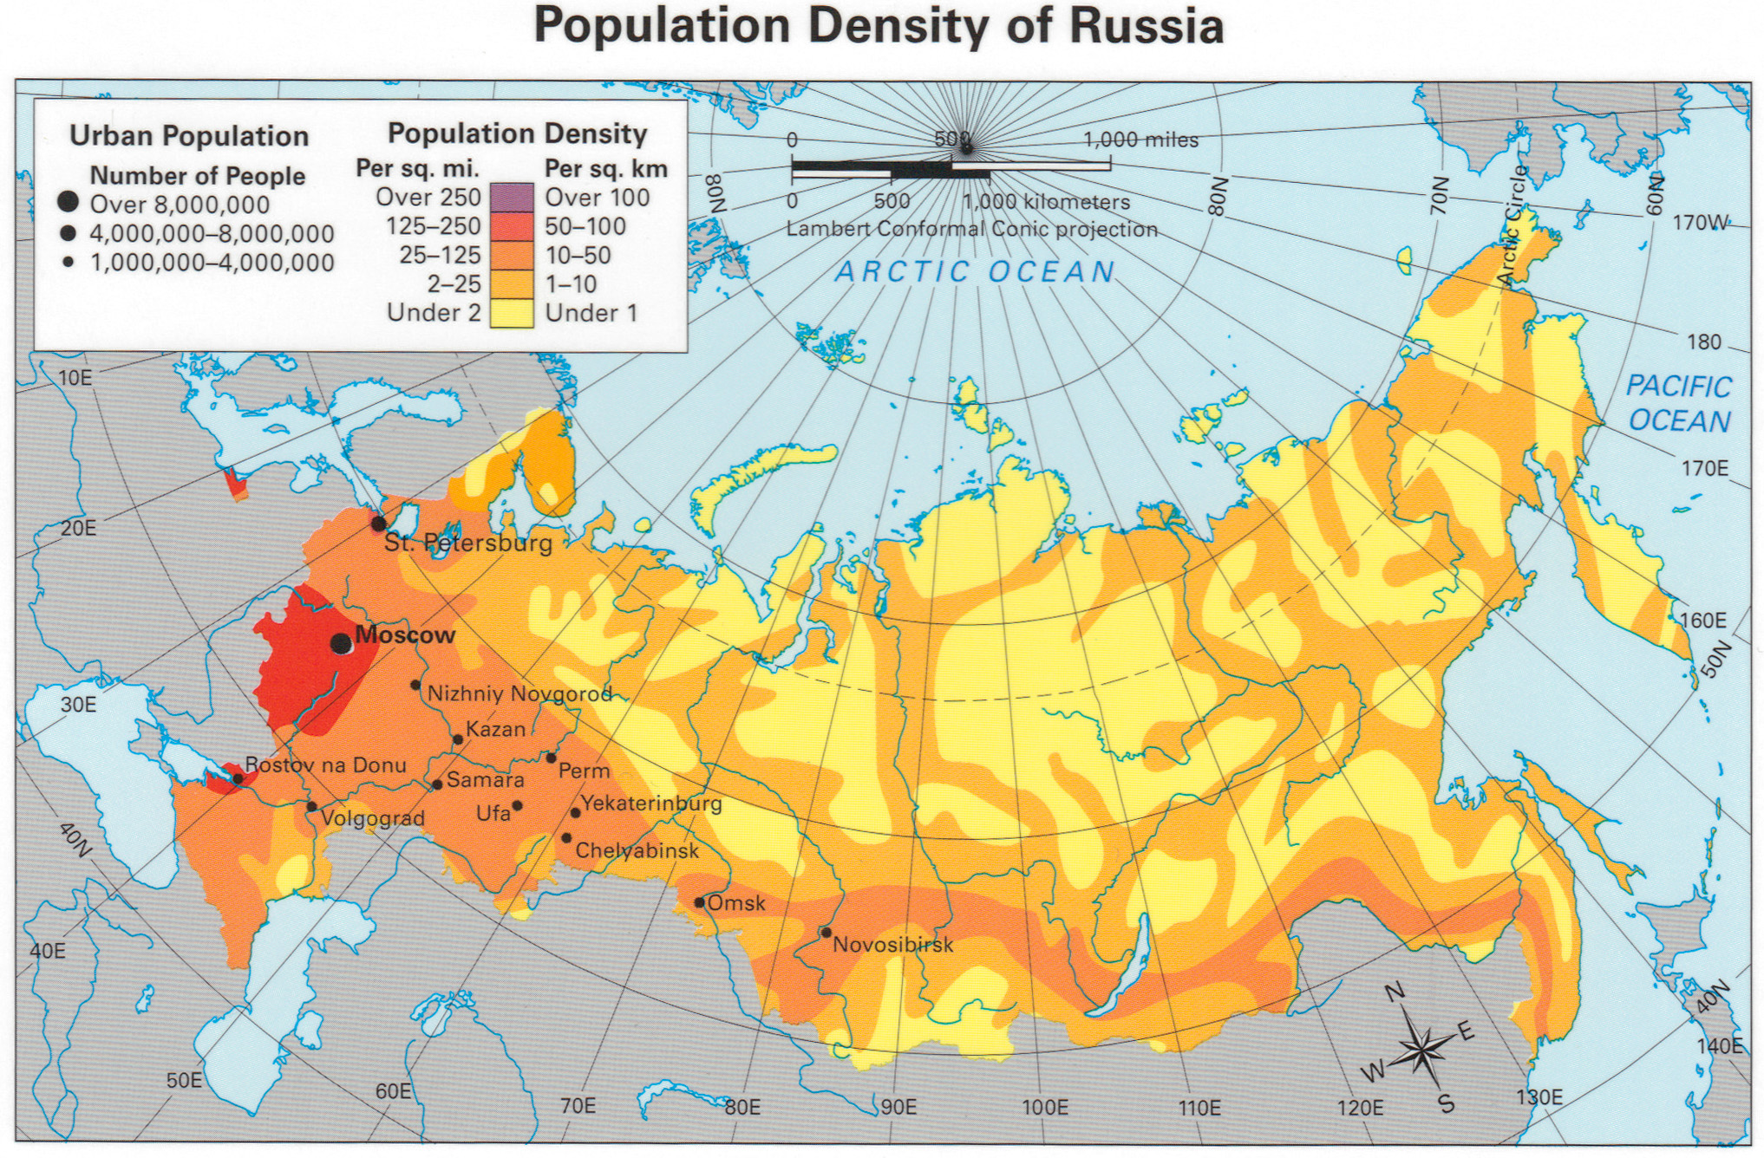
Population Map of the Russian Realm

Slide 22
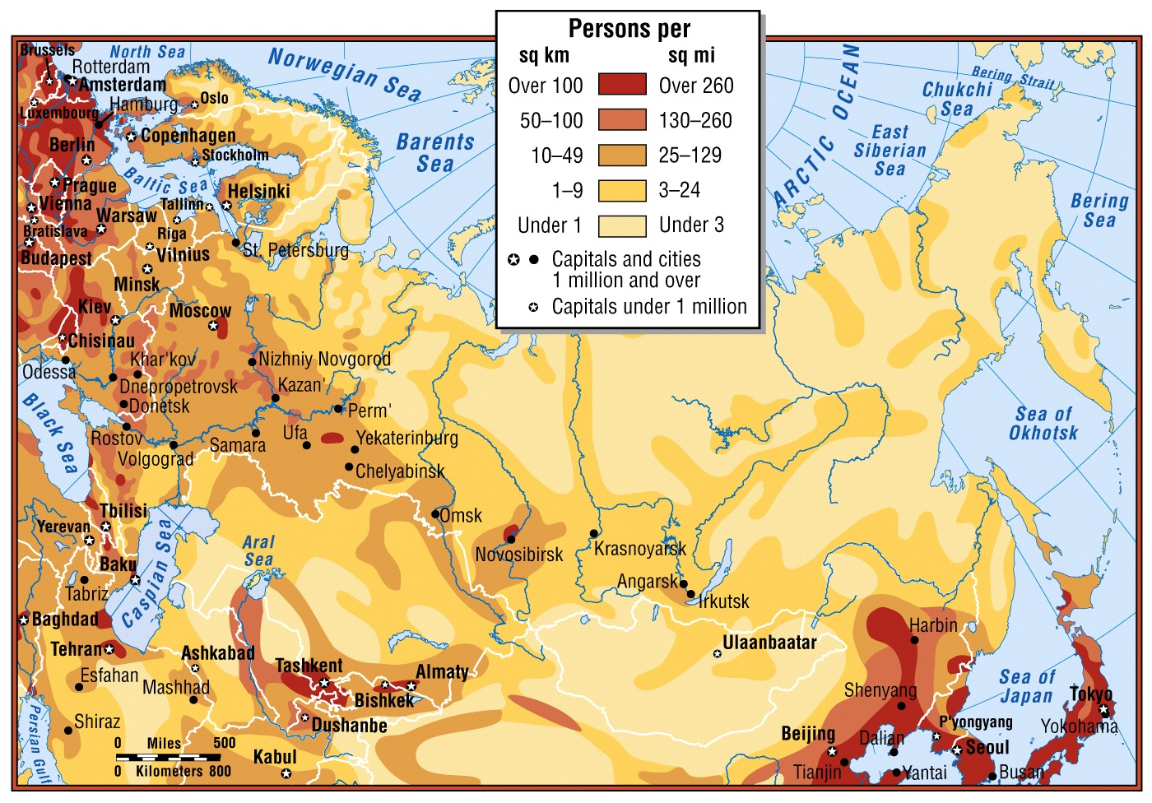
Population Density

Slide 23
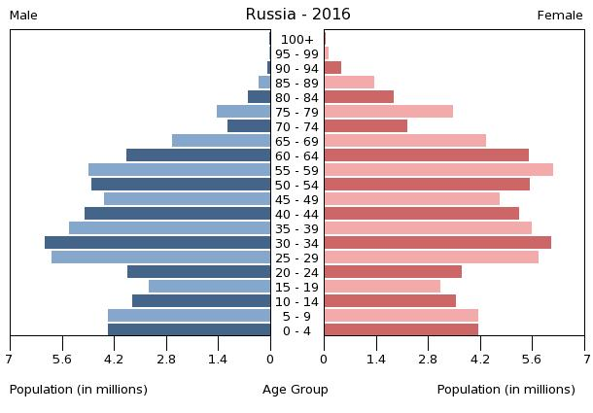
Demographics
Fertility rate 1.62 (2017)
Infant mortality rate 5.6 deaths/1,000 live births (2017)
Net migration rate 1.69 migrant(s)/1,000 population (2014)
Population 144,438,554 (excluding Crimea), 146.8 million (including Crimea)
  Decrease 146,793,744 as of January 1, 2019
Birth rate 12.05 births/1,000 population (2017)
Death rate 12.0 deaths/1,000 population (2017)
Life expectancy 72.70 years (2017)
  male 67.51 years
  female 77.64 years

Slide 24
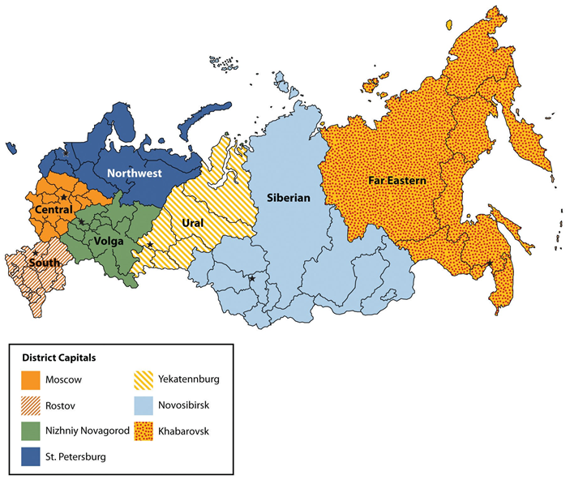
Russian Federal Districts

Slide 25
Regional Migration Patterns
  Eastward Movement (1860-1914)
    Trans-Siberian Railroad speeded eastward movement
    Almost 1 mil. settlers lured by farming opportunities in southern Siberia, more political freedom away from Tsars
        Tsars – czars; authoritarian leaders who dominated politics of pre-1917 Russian Empire (comes from “Caesar”)
  Political Motives
    Infill in Siberia has economic and political benefits
    Political dissidents sent to Siberia (Gulags Archipelago)
    Russification: Soviet policy moved Russians into non-Russian portions of U.S.S.R to increase Russian dominance in those areas; Russians are a significant minority in former Soviet republics

Slide 26
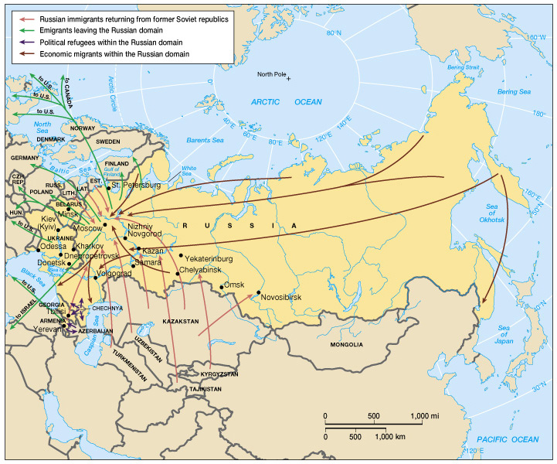
Recent Migration Flows in the Russian Realm
INFLUX
Russians to western Russia from less desirable locations
Russians who were minorities in the newly independent states return to western Russia
OUTFLOW
Jews and others escaping persecution or seeking greater opportunities outside Russia

Slide 27
Regional Migration Patterns (cont.)
  New International Movements
    Russification often reversed in post-Soviet era
      Citizenship, language requirements encourage Russians to go
    Movement to other regions
      “Brain drain” to other countries
      Jewish Russians move to Israel or U.S.
      Mail-order Ukrainian brides to the U.S.
  The Urban Attraction
    Soviet planners’ encouraged migration to cities
    Soviets planned cities, limited population levels and regulated migration
    Post-Soviet era, citizens have greater freedom to move; many older industrial areas are now losing population

Slide 28
Inside the Russian City
    Russian cities carefully in planned form and function, with circular land-use zones
      Core has superior transportation, best stores and housing
        Core predates Soviets era
        Sotzgorods: work-linked housing (including dorms)
        Chermoyuski: apartment blocks from 1950s/60s
        Mikrorayons: Self-contained housing projects of 1970s/80s
        Dachas: country houses available only to the elite

Slide 29
The Demographic Crisis
    General population decline caused by low birth rates and rising death (mortality) rates, especially among middle-aged males
      Causes
        fraying social fabric
        economic uncertainty
        declining health among women of child-bearing age
        stress-related diseases
        rising murder and suicide
        toxic environments
    Russia’s population could fall by 3 million by 25 million by 2030

Slide 30
The Legacy of Slavic Dominance
The Heritage of the Russian Empire
  Growth of the Russian Empire
    Slavic “Rus” in power from 900AD around Kiev
    Eastern Orthodox Christianity came in 1000AD
    By 1400s, new and expanding Russian state after Tatar and Mongol rule
    Expansion eastward in 16th & 17th centuries; westward expansion slow
    Final expansion of Russian Empire in 19th Century in Central Asia
  The Significance of Empire
    1900, Russians ruled from St. Petersburg to Vladivostok

Slide 31
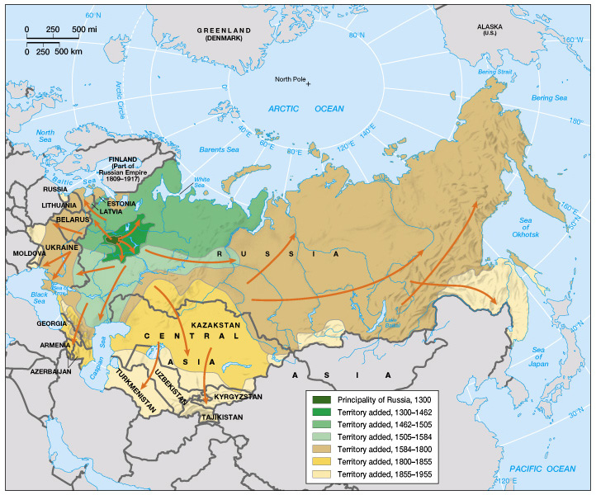
Growth of the Russian Empire

Slide 32
Geographies of Language
  Slavic languages dominate in the Russian Domain
    80% of Russia’s people are ethnic Russians
    There are other language groups – 100 or more
      Finno-Ugric (Finnish) in the north
      Altaic (Tatars & Turkic peoples) middle Volga
      Transcaucasia has many languages
      Yakut (Turkic) in Siberia; Buryats near Lake Baikal
        Similar treatment to indigenous in U.S., Canada, Australia

Slide 33
Geographies of Religion
  Soviets prohibited religion, religious revival underway now
    Bible became a best selling book
  Eastern Orthodox Christianity most common
    Other forms of Western Christianity practiced
  Non-Christian religions
    20-25 million Sunni Muslims live in the North Caucasus
      Quran became a best selling book
    Over 1 million Jews, mostly in larger western cities

Slide 34
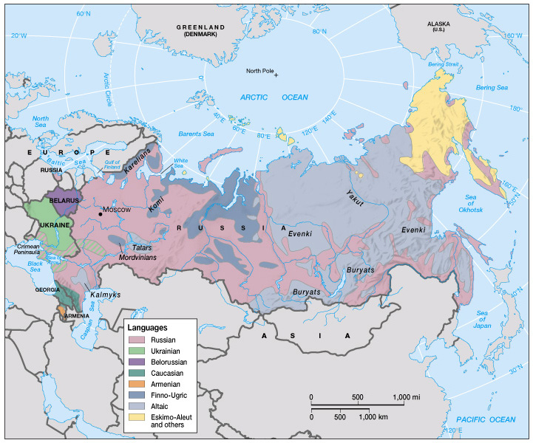
Languages of the Russian Realm
More than 100 languages spoken

Slide 35
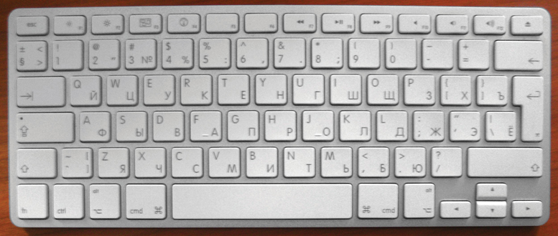
form of Cyrillic alphabet

Slide 36
Russian Culture in Global Context
  Strong traditions, influenced by Western Europe
  Soviet Days
    Soviets promoted social realism: a style devoted to the realistic depiction of workers harnessing the forces of nature or struggling against capitalism
  Turn to the West
    Young Russians adopted consumer culture in 1980s
    In post-Soviet era, globalism and consumerism came to Russia from the West and elsewhere (India, Hong Kong, Latin America)
  The Music Scene
    American and European popular music gaining fans
    Home-grown music industry is evolving

Slide 37
The Remnants of a Global Superpower
Geopolitical Structure of Former Soviet Union
  Russian Empire collapsed abruptly in 1917
    Briefly, a broad-based coalition of business people, workers, and peasants replaced tsars
    Soon, Bolsheviks (faction of Russian Communists representing the interests of the industrial workers), led by Lenin, centralized power and introduced communism The Soviet Republics and Autonomous Areas
    Soviet leaders designed a geopolitical solution to maintain the country’s territorial boundaries, and theoretically acknowledged the rights of non-Russian citizens by creating Union Republics
      Autonomous areas: minor political sub-units designed to recognize special status of minority groups within existing republics

Slide 38
Geopolitical Framework: The Remnants of a Global Superpower
  Centralization and Expansion of the Soviet State
    Communism did not eliminate ethnic differences
    In 1930, Soviet leader Stalin centralized power in Moscow, limiting national autonomy
    Land added
      Sakhalin, Kuril Islands from Japan; Baltic republics
      Occupation of Poland, Romania, Czechoslovakia
      Exclave (outside Russia’s contiguous land) added from Germany
  End of the Soviet System
    Union republics encouraged ethnic identification
    Glasnost: greater openness; Perestroika: economic restructuring
    1991: all 15 Union Republics gained independence

Slide 39
Geopolitical Framework: The Remnants of a Global Superpower
Current Geopolitical Setting (1992-present) (Fig. 9.30)
  Russia and the Former Soviet Republics
    Formed Commonwealth of Independent States (CIS) – a looser political union that included all but three of the former republics; has no power, and is mostly a forum for discussion
    Denuclearization (the return and partial dismantling of nuclear weapons from outlying republics to Russian control completed in 1990s; tactical nuclear weapons moved to Kaliningrad exclave
    Military, political and ethnic tensions remain in parts of the region
  Devolution and the Russian Federation
    Devolution: more localized political control in Russia
    Russian leaders fear other areas will secede

Slide 41
  Regional Tensions
    Chechnyan Republic seeking independence
      Russians sent military
      Chechnya has metals and oil
  The Shifting Global Setting
    Boundary issues between Russia and China
    Dispute with Japan over Kuril Islands
    Expansion of NATO concerns Russian leaders
    Russia recently joined the “Group of Seven” (G-7)
      Other members: U.S., Canada, Japan, Germany, Great Britain, France, Italy)

Slide 42
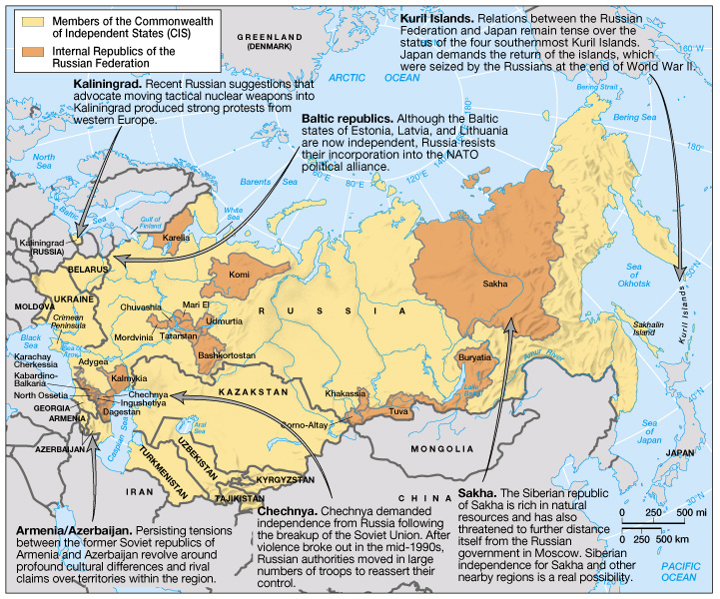
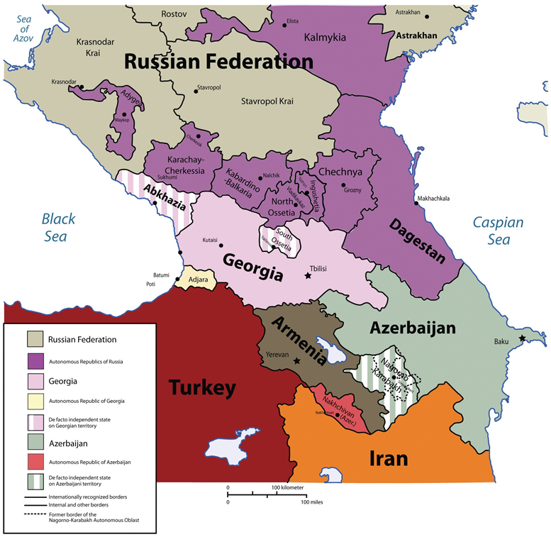
Geopolitical Issues in the Russian Realm

Slide 43
An Era of Ongoing Adjustment
After economic decline of 40% in the 1990s, Russia’s economy stabilized in 2000 and 2004
The Legacy of the Soviet Economy
  Communists came to power in 1917, and instituted centralized economic planning: a situation in which the state controls production targets and industrial output
  Soviets nationalized agriculture, but it was inefficient
  Soviets expanded industrialization and transportation
    Industrialization more successful than collectivized agriculture
    Trans-Siberian Railroad, canal system
  Improvements in housing and education after WWII
    Literacy near 100%
  But economic and social problems increased in 1970s-’80s

Slide 44
  Soviet industry more successful than agriculture
    Soviets added major industrial zones, many near energy sources and metals
    Moscow had fewer raw materials, but had some of Russia’s best infrastructure, large pool of skilled labor, and demand for industrial products
  Soviets developed a good transportation and communication infrastructure
  Soviets had a massive housing campaign in the 1960s
    Below Western standards of adequate housing
  Soviets made literacy virtually universal, and health care readily available; eliminated the worst of the poverty

Slide 45
The Post-Soviet Economy
    The region has replaced its communist system with a mix of state-run operations and private enterprise
  Redefining Regional Economic Ties
    Independent republics negotiate for needed resources with Russia and each other rather than accept centralized control
    Russia continues to dominate the region’s economy
  Privatization and Economic Uncertainty
    Russia removed price controls in 1992; sold state-owned business to private investors in 1993
      Higher prices, lack of legal safeguards created problems
    Agriculture still struggles, in part due to harsh climate, landforms
    Many people see little economic gain from changes

Slide 46
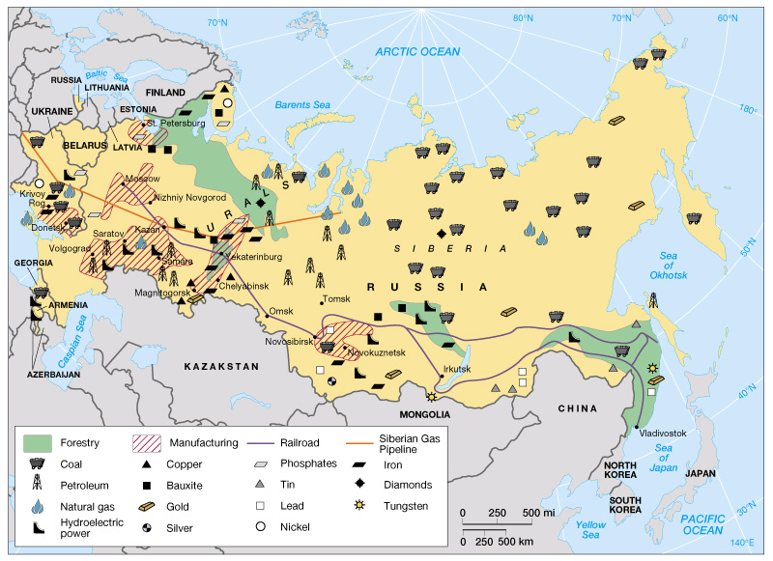
Major Natural Resources and Industrial Zones (Fig. 9.30)

Slide 47
  The Russian Mafia
    Russia Interior Ministry estimates that Russian mafia controls 40% of the private economy & 60% of the state-run enterprises; 80% of banks in Russia may be under mafia influence
      Protection money, corruption result
    Russian mafia has gone global
      Money laundering (Russia, U.K., U.S.);
      gambling (Sri Lanka);
      drugs (Colombia);
      legitimate Israeli high tech companies

Slide 48
Social Problems
  High unemployment,
  rising housing costs;
  lower welfare spending
  Divorce and domestic violence increasing;
  prostitution increasing
  Health care spending dropping
    Vaccine shortages allow disease to return
    Chronic and stress-related illnesses on the rise anxiety & uncertainty

Slide 49
Growing Economic Globalization
  Starting in 1970s, Soviets exported fossil fuels, imported food; ties now stronger
  A New Day for the Consumer
    Western consumer goods available (e.g., McDonald’s, Calvin Klein; even some luxury items)
  Attracting Foreign Investment
    Region struggles to attract foreign investment
    Most investment from U.S., western Europe (esp. Germany, U.K.)
      Fossil fuels, food, telecommunications, consumer goods
      Foreign investment growing by more than 14% annually

Slide 50
  Globalization and Russia’s Petroleum Economy
    Russia has 35% of the world’s natural gas reserves
      Mostly in Siberia
      World’s largest gas exporter
    Primary destination for Russian petroleum products is western Europe
      Former U.S.S.R. republics depend on Russia’s energy
      Foreign investment in new pipelines, other technology
  Local impacts of globalization
    Vary from place to place
      Investment in Moscow, Siberia (oil)
      Pro-business Nizhny Novgorod and Samara attract investment
      Local economic declines in older, uncompetitive industrial areas

Slide 51
OUTLINE OF HISTOTRICAL
GEOGRAPHY

Slide 52
The Region’s Early Heritage
  Vikings created fortified trading towns called gorods
  Genghis Khan’s Mongol Empire invaded (1240 CE)
  Feudal states arose around dominant trading centers
Czarist Russia, 1547–1917
  Czars unified empire by internal colonialism
  Forward capital of St. Petersburg created
  Pioneers pushed eastward to Siberia and North America
Bolshevik Revolution, 1917–22
  Czar Nicholas II and his family executed
  Russian Civil War fought
  Vladimir Lenin created Communist imperial state
  Capital moved to Moscow; republics broke away
The Soviet Union (USSR), 1922–91
  Czarist Empire became the Soviet Union
  Central planning, collectivization, and the Cold War began

Slide 53
  Satellite republics in Eastern Europe kept together by military force
  External interaction of glasnost initiated (1980s)
  Economic restructuring and reforms of perestroika introduced (1980s)
The Russian Republic, 1991–Present
  Independent republics lost with internal unrest
  Economics privatized
  Democracy introduced (1990s)
  Central state strengthened (twenty-first century)
    Putin dictatorship
Russian experience with democracy
  1916-17
  1991-2014
Russian culture shaped during centuries of autocratic rule
  Not enough experience with democracy to appreciate it

Slide 54
Short Peek at Regions

Slide 55
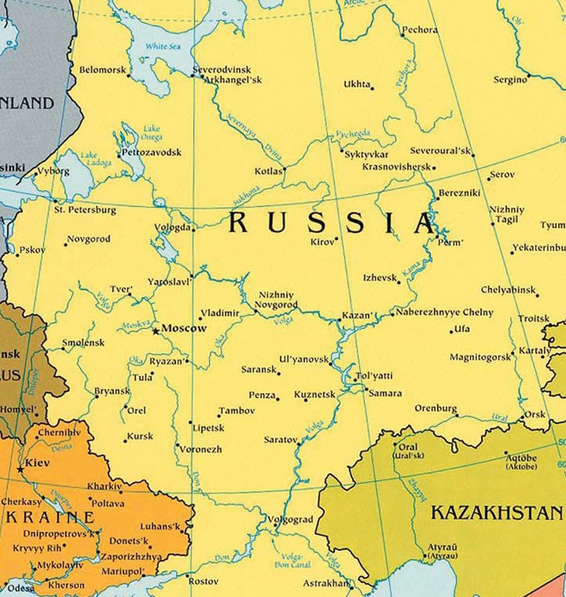
The Core Region
Contains largest population
Best infrastructure
The largest and most important cities
Major industrial centers
Access to Baltic and Black Seas
The Volga-Don River system is to Russia as the Mississippi is to thwe USA
Highest % of ethnic Russians

Slide 56
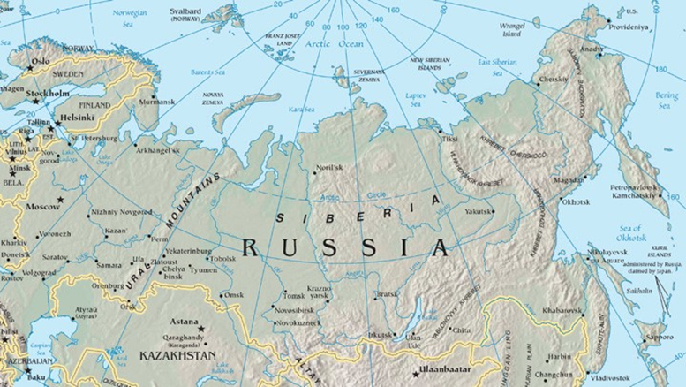
The Eastern Frontier
Permafrost complicates extraction of many natural resources
Thawing permafrost adds to global warming
Most development is along the Trans-Siberian railroad
  Kuzbas
  Lake Baikal (Irkutsk)

Slide 57
Siberia
word Siberia conjures up visions of a cold and isolated place
Type D (continental) climates dominate the southern portion of this region, and the territory consists mainly of coniferous forests in a biome called the taiga. This is one of the world’s largest taiga regions. Type E (polar) climates can be found north of the taiga along the coast of the Arctic Sea, where the tundra is the main physical landscape.
Problems with permafrost
Kamchatka Peninsula has twenty active volcanoes and more than one hundred inactive volcanoes (on the “Ring of Fire”)

Slide 58
The Far East
the port of Vladivostok – home of navy’s Pacific Fleet – ice free port
  . Before 1991, Vladivostok was closed to outsiders
  Manufacturing center
  Near fairly decent agricultural la d
Sakhalin Island – oil deposits have been discovered
Today, the Far East is finding itself on the periphery of Russia’s hierarchy of productivity. However, it has the potential to emerge again as an important link to the Pacific Rim markets.
Feeling of being neglected by Moscow
  Around 2000 Japanese offered to help develop the Far East but Moscow refused

Slide 59
Southern Russia
Greatly fragmented ethnically
  Since the collapse of the Soviet Union, the Caucasus region has been the main location of unrest within Russia. Wars between Russia and groups in the Caucasus have claimed thousands of lives. Some of the non-Russian territories of the Caucasus would like to become independent, but Russia fears an unraveling of its country if their secession is allowed to proceed.

Slide 60
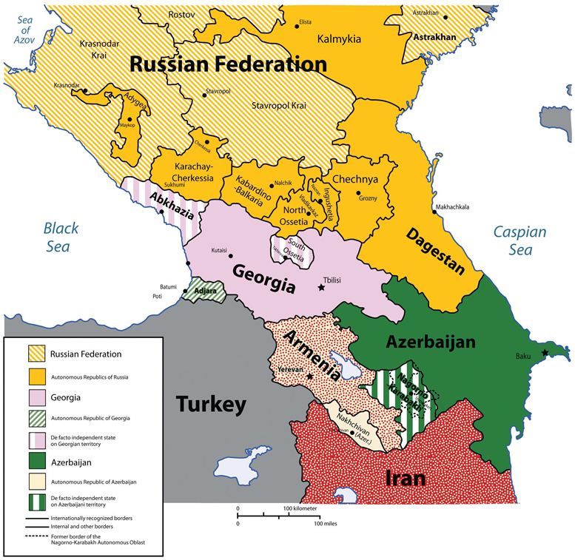
Transcaucasia (mountainous)
Independent states
  Armenia, Azerbaijan, and Georgia
Post-Independence problems
  Fights over borders: Azerbaijan & Armenia
  Russia assisted Abkhazia and South Ossetia separate from Georgia
Azerbaijan has oil deposits
Azerbaijan has a Muslim majority

Slide 61
Conclusions
Russian Realm has seen great change, from empire, through revolution and break-up
Ethnic & cultural differences continue to shape the region
Russian Domain is rich in natural resources, but has limited agricultural potential and lingering economic difficulties
Massive readjustments growing from the political and economic upheavals of the 1990s continue to affect the area
  Government sliding towards dictatorship
Environmental devastation in the region and its effects continue to cause social and health problems
More uncertainty lies ahead for the people of the Russian Domain.
End of Chapter 3: The Russian Realm

