Slide 1
Nomadic Herding
A declining lifestyle – many have become semi-nomadic

Slide 2
Nomadic Herding – the wandering, but controlled movement of livestock, solely dependent on natural forage – is the most extensive type of land use system.
Sheep and goats are the most common with cattle, horses and yaks locally important. The common characteristics are hardiness, mobility and ability to subsist on sparse forage. These animals provide milk, cheese, meat, hair, wool and skins and dung for fuel.
Declining in numbers (Russia and The Sahel and remote, undeveloped, semi-arid areas)

Slide 3
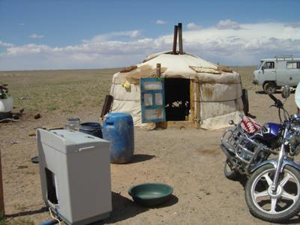
Mongolia – somewhat less nomadic

Slide 4
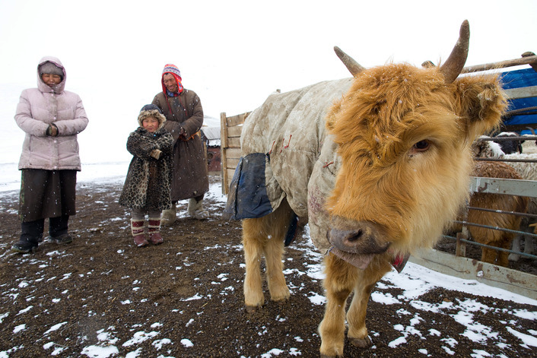
Mongolia

Slide 5
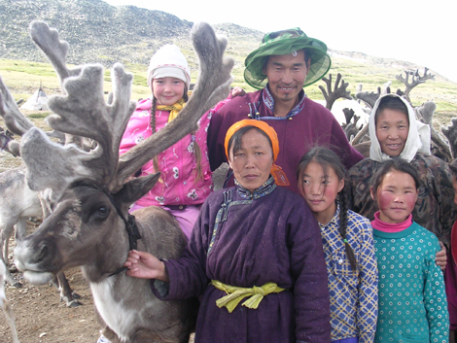
Northern Mongolia

Slide 6
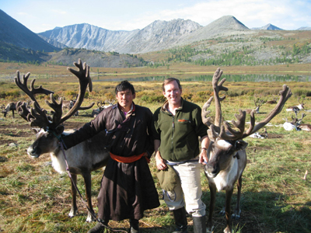
Western Mongolia

Slide 7
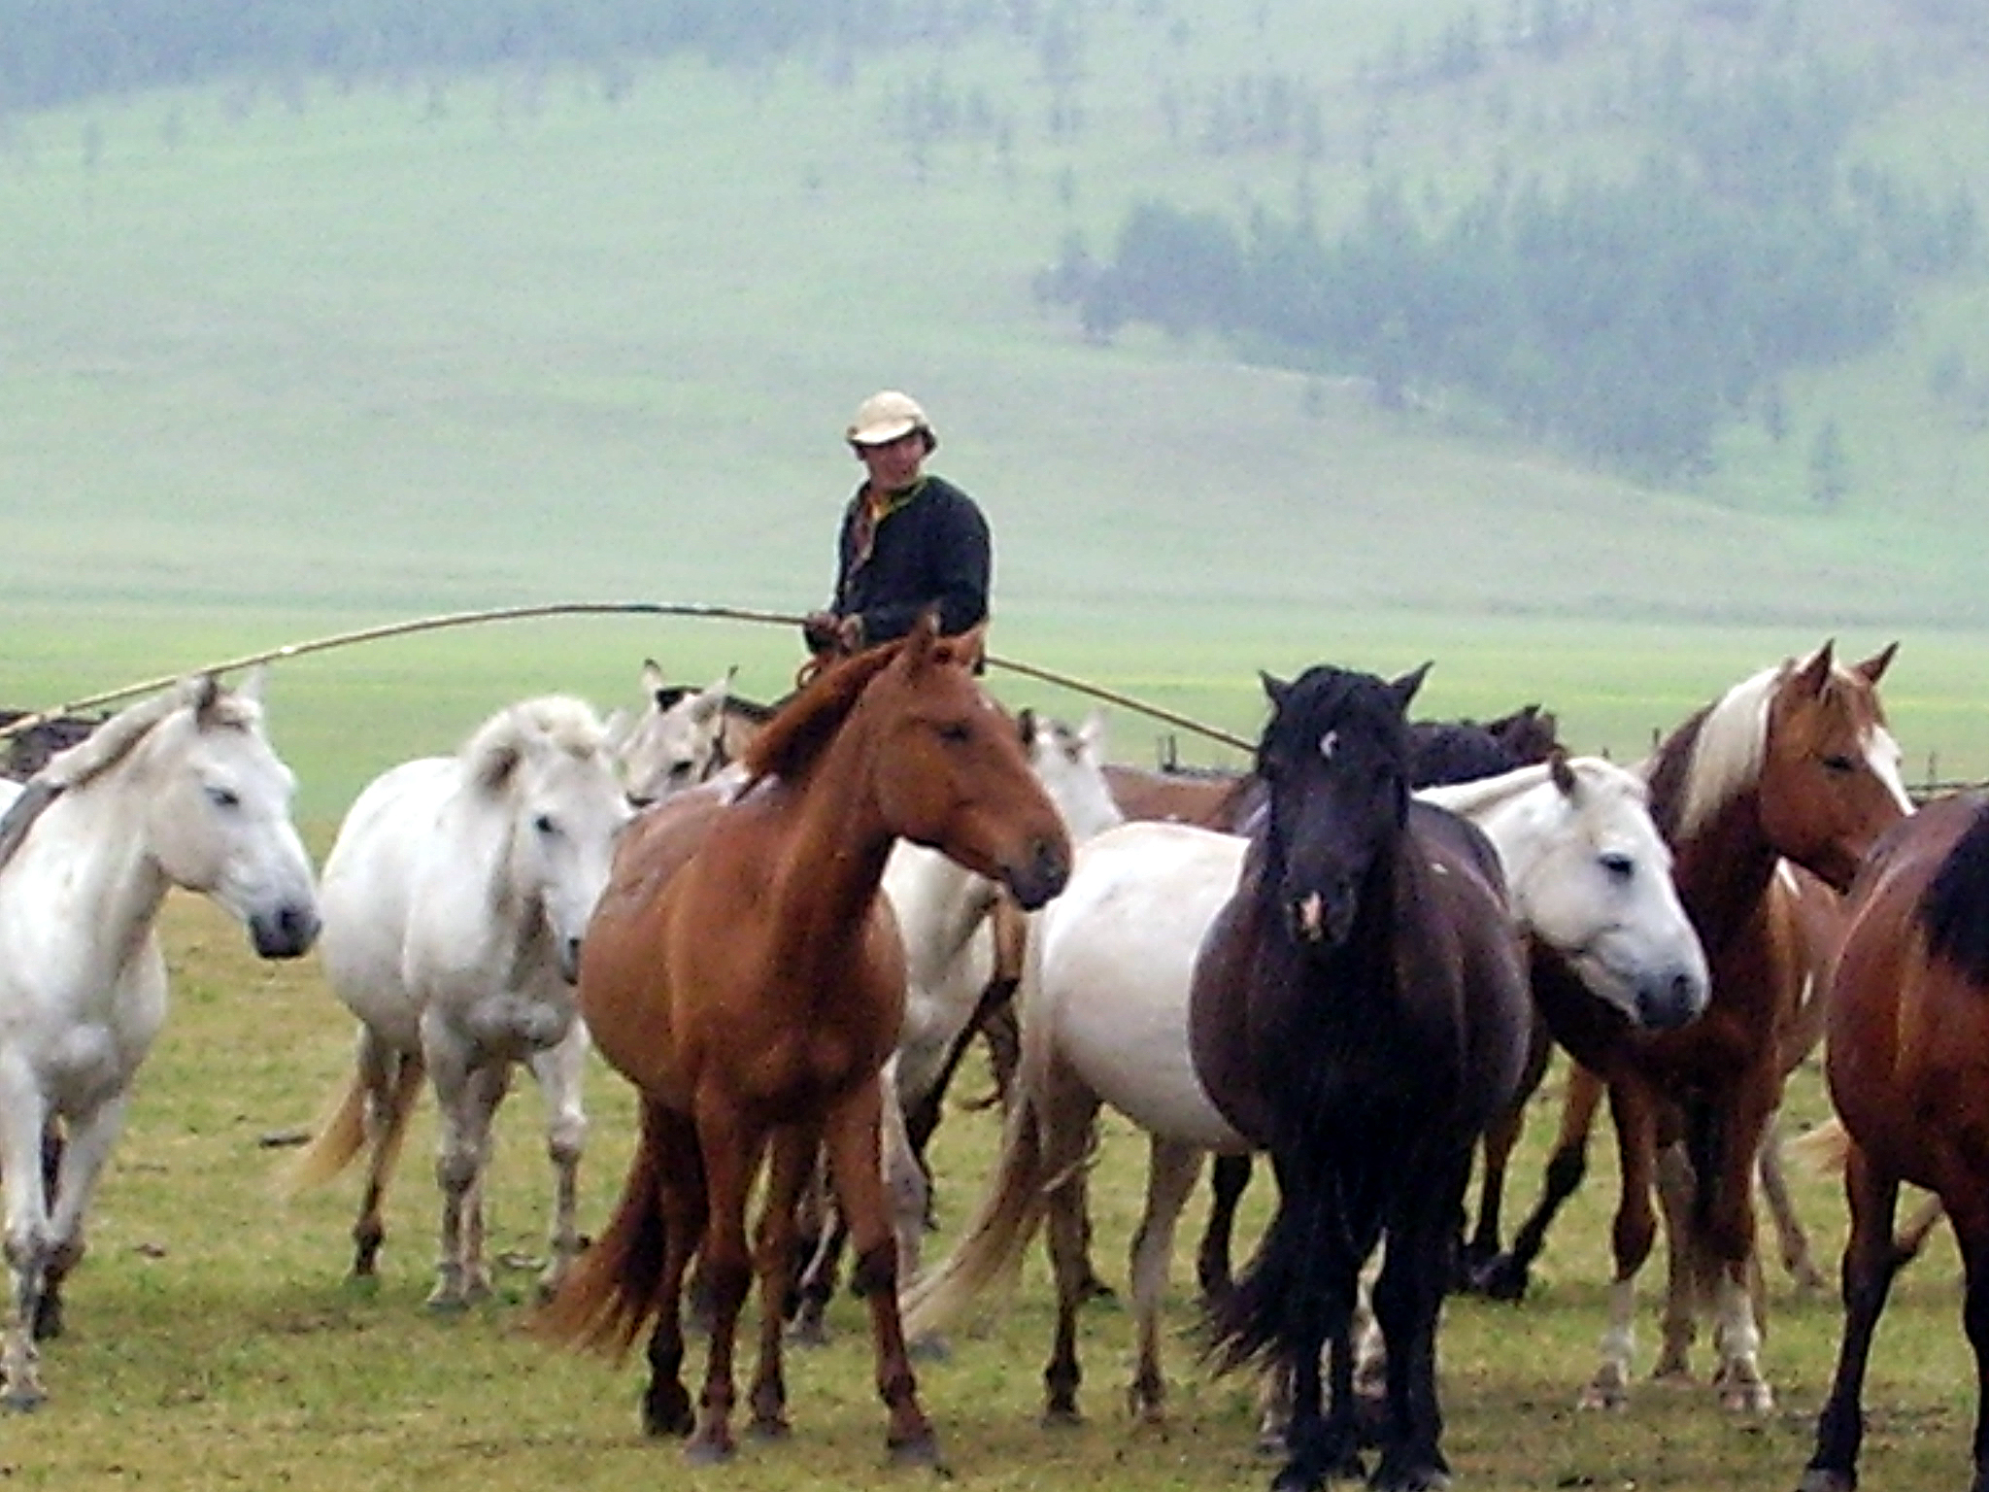
Mongolia

Slide 8
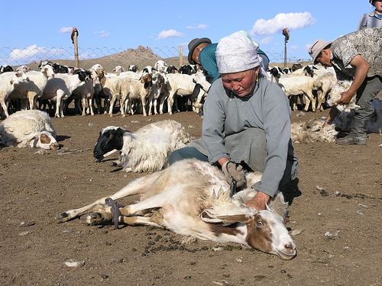
Mongolia

Slide 9
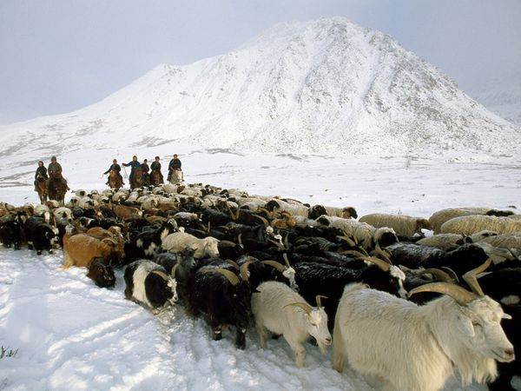
Mongolia

Slide 10
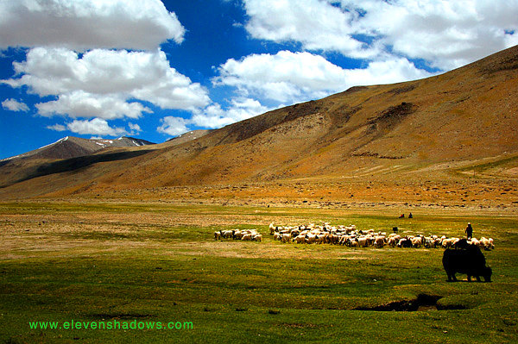
Tibet

Slide 11
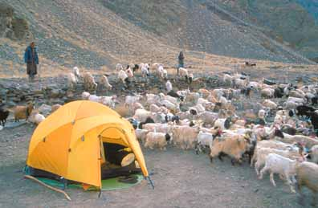
Tibet

Slide 12
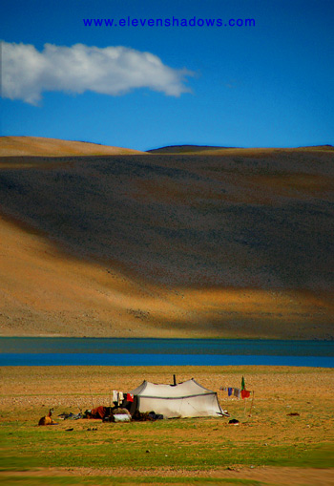
Tibet

Slide 13
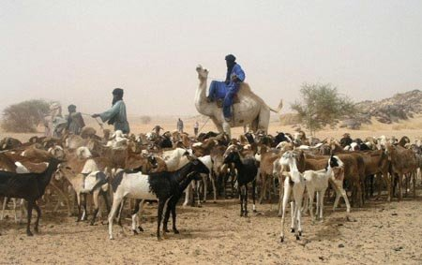
African Sahel

Slide 14
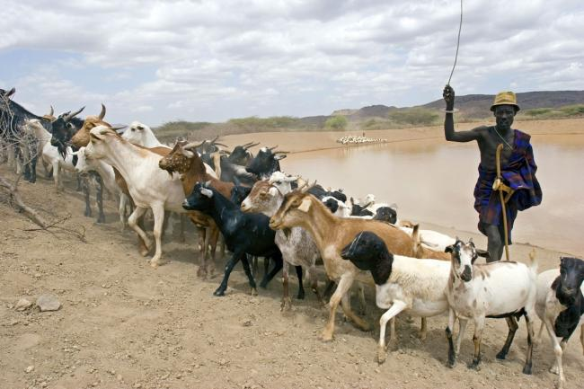
African Sahel

Slide 15
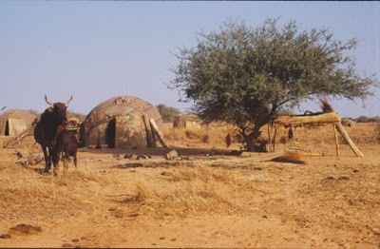
African Sahel

Slide 16
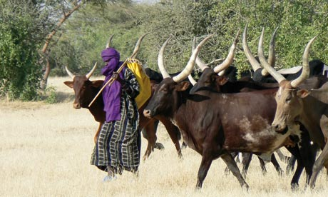
African Sahel

Slide 17
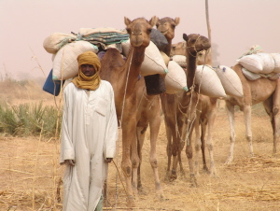
Nigeria (African Sahel)

Slide 18
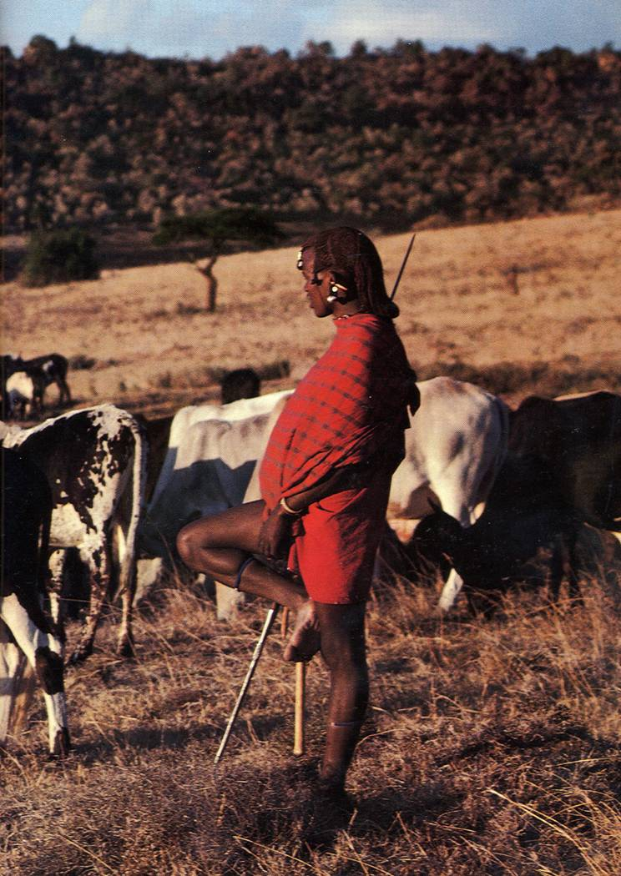
Kenya/Tanzania

Slide 19
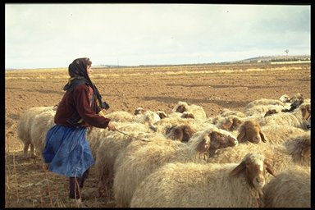
Syria

Slide 20
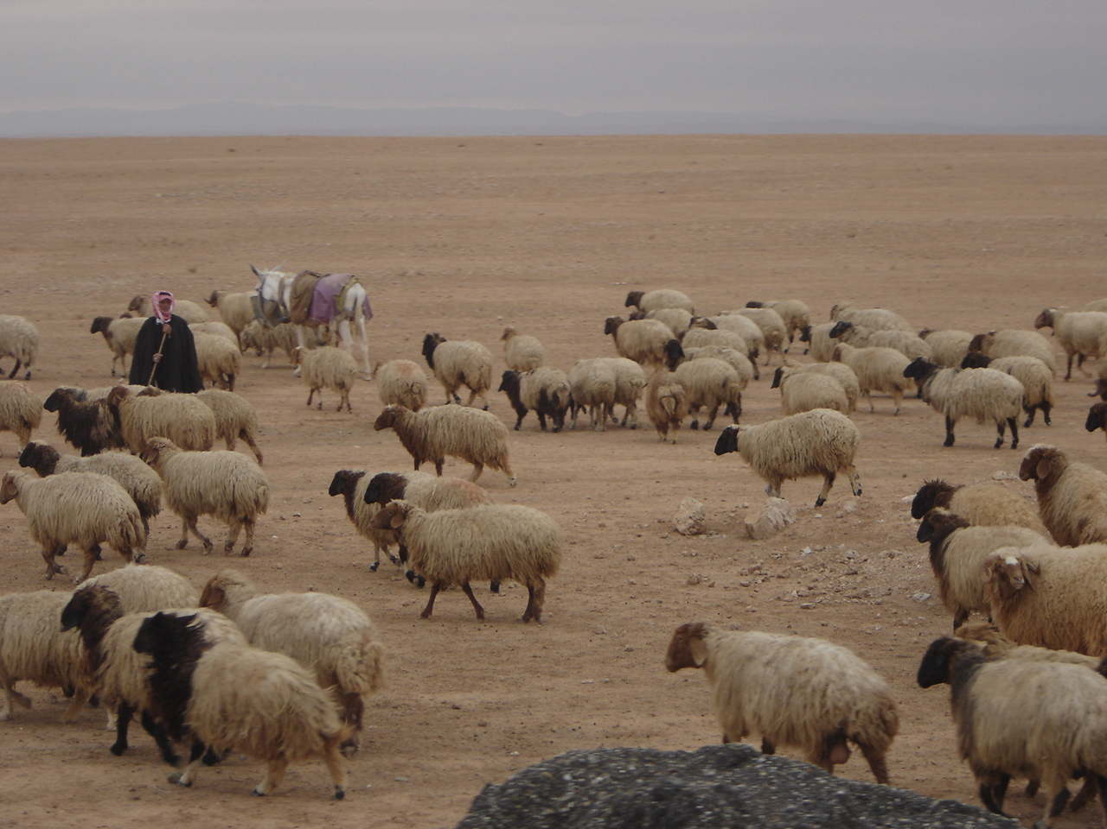
Syria

Slide 21
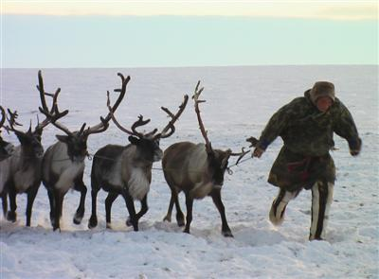
Russia - Siberia

Slide 22
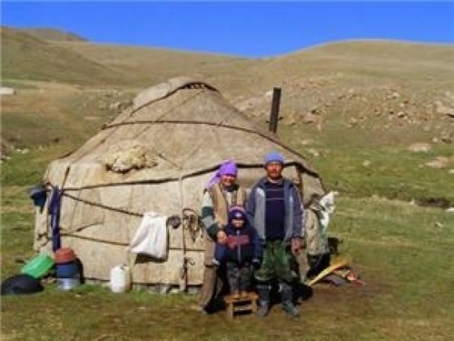
Semi-nomadic herders with their yurt in central Kyrgyzstan

Slide 23
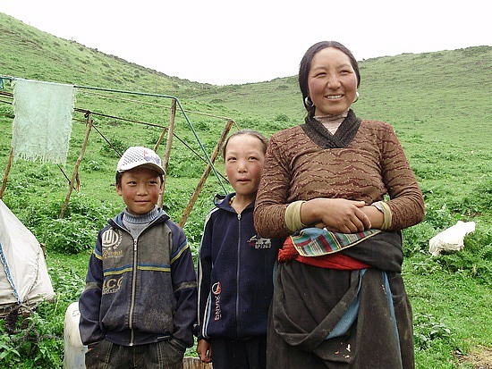
Xunhua, China

Slide 24
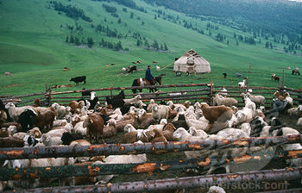
Xinjiang, China

Slide 25
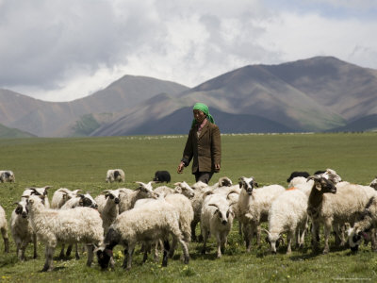
Qinghai, China

Slide 26
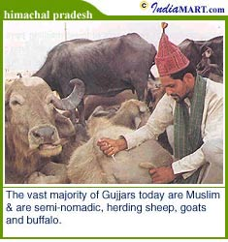
India

Slide 27
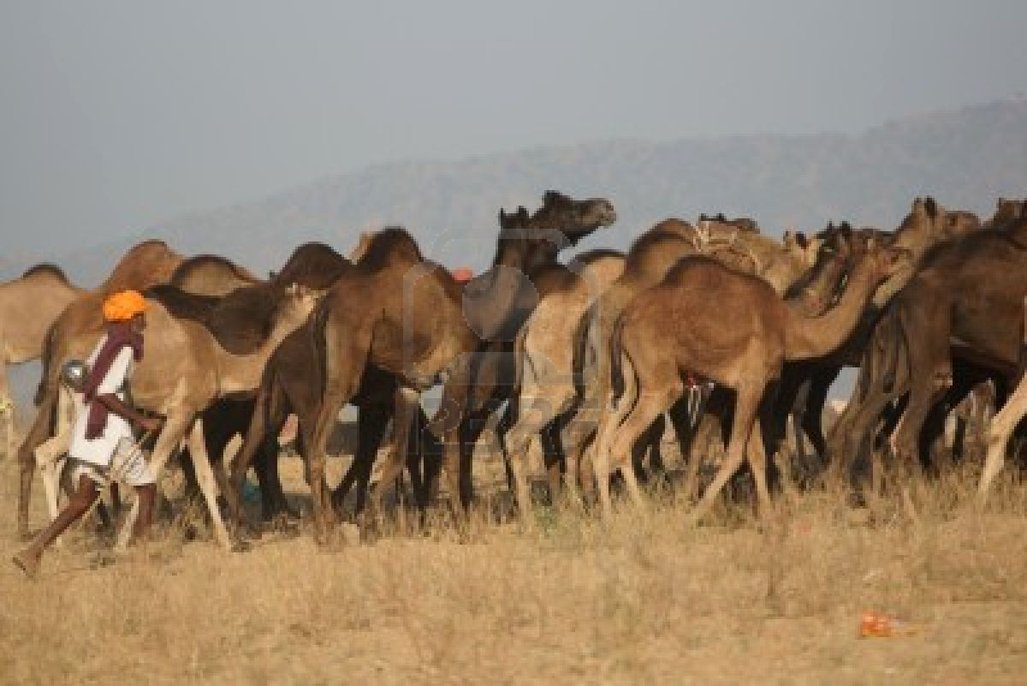
India

Slide 28
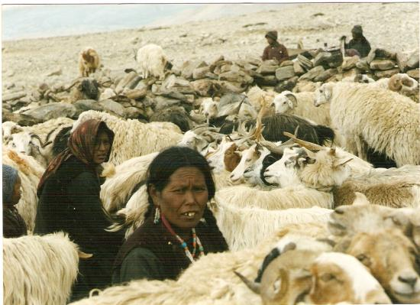
India

Slide 29
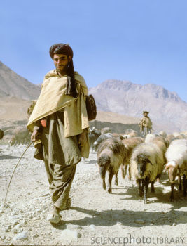
Afghanistan

Slide 30
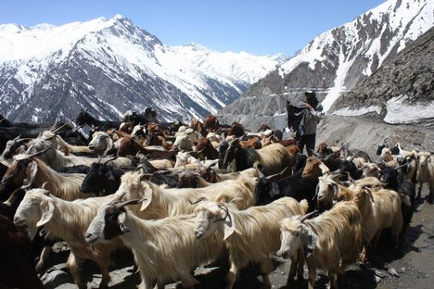
Kashmir

