Slide 1
The Amazing Banyan Tree –
The Great Banyan Tree of India
Free Powerpoint Templates

Slide 2
A banyan (also banian) is a fig that starts its life as an epiphyte when its seeds germinate in the cracks and crevices on a host tree (or on structures like buildings and bridges). "Banyan" often refers specifically to the Indian Banyan or Ficus benghalensis, the National tree of India, though the term has been generalized to include all figs that share a unique life cycle, and systematically to refer to the subgenus Urostigma. The seeds of banyans are dispersed by fruit-eating birds. The seeds germinate and send down roots towards the ground, and may envelop part of the host tree or building structure with their roots, giving them the casual name of "strangler fig." The "strangling" growth habit is found in a number of tropical forest species, particularly of the genus Ficus, that compete for light. Any Ficus species showing this habit may be termed a strangler fig.

Slide 3
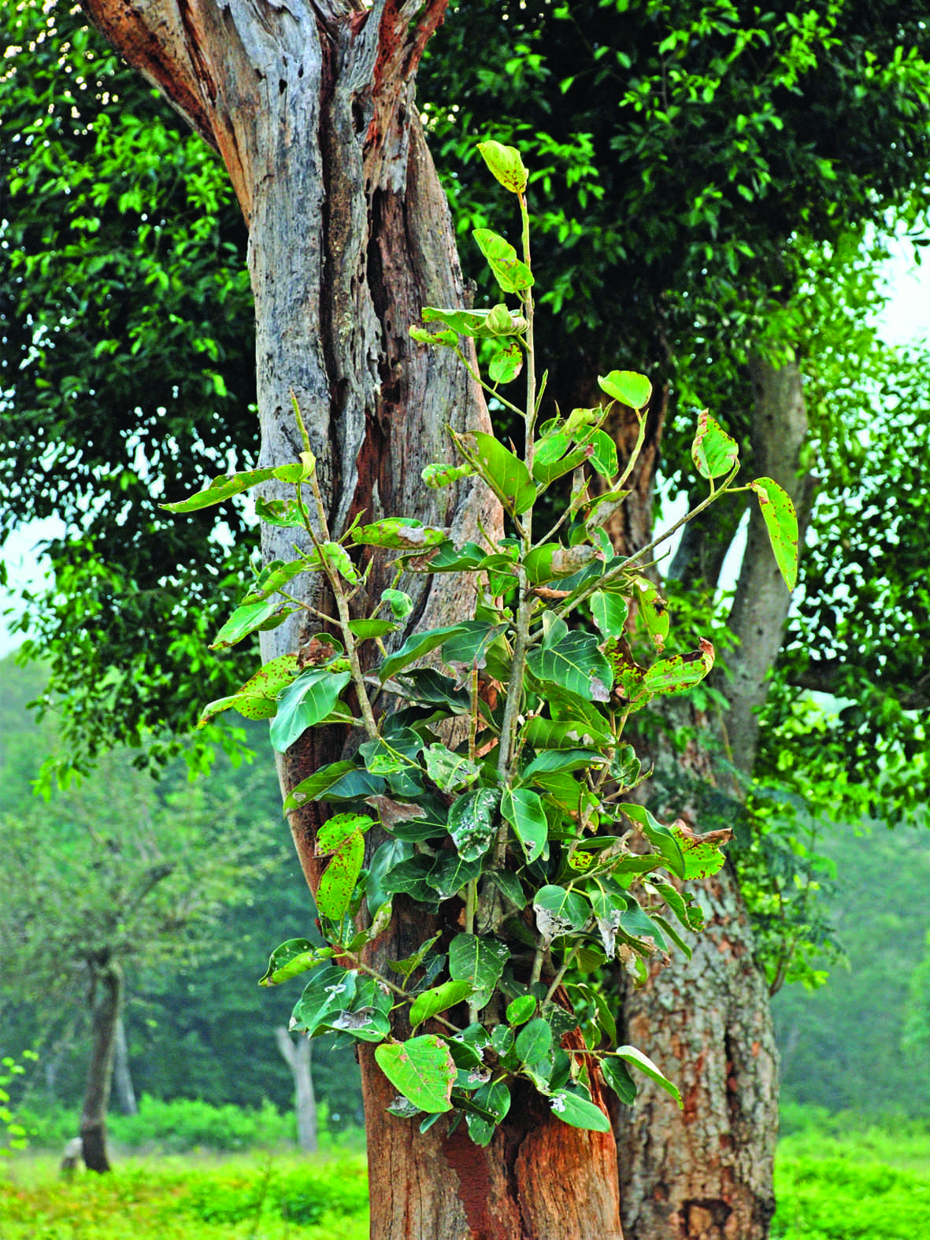
Epiphyte stage

Slide 4
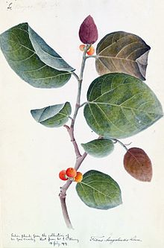
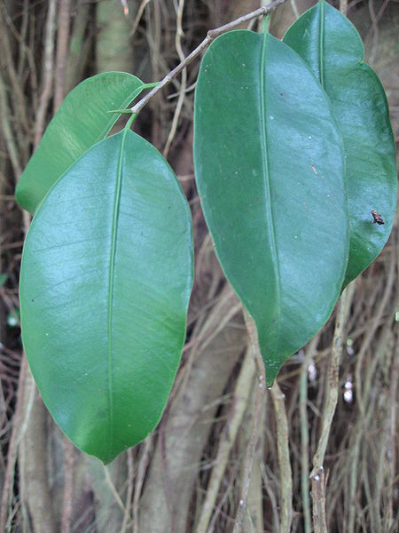
The leaves of Banyan tree are large, leathery, glossy green and elliptical in shape. Like most of the fig-trees, leaf bud is covered by two large scales. As the leaf develops the scales fall. Young leaves have an attractive reddish tinge

Slide 5
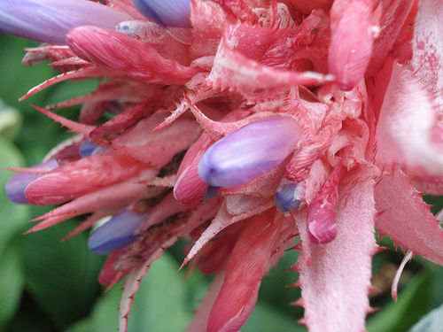
Flower

Slide 6
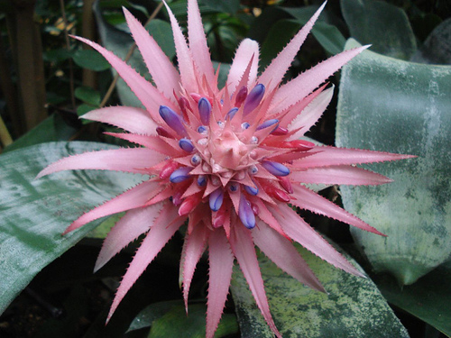

Slide 7
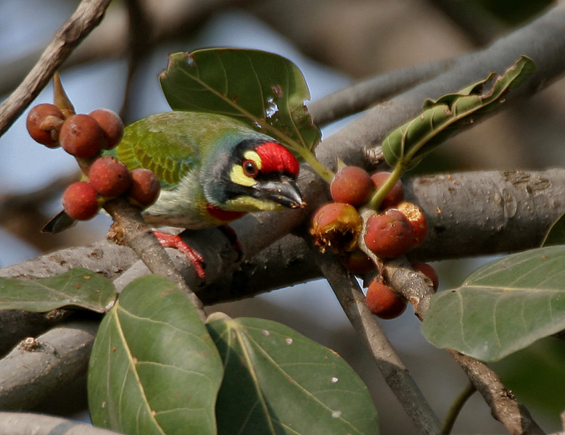

Slide 8
Older banyan trees are characterized by their Aerial prop roots that grow into thick woody trunks which, with age, can become indistinguishable from the main trunk. Old trees can spread out laterally using these prop roots to cover a wide area. Like other Fig species (which includes the common edible fig Ficus carica), banyans have unique fruit structures and are dependent on fig wasps for reproduction.

Slide 9
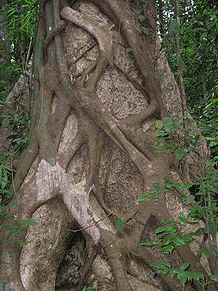
Early stages of a strangler fig on a host tree in the Western Ghats, India.

Slide 10
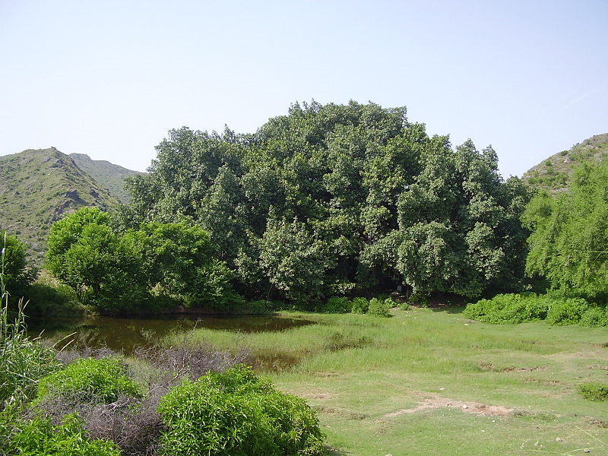
Large banyan tree in Punjab, Pakistan.

Slide 11
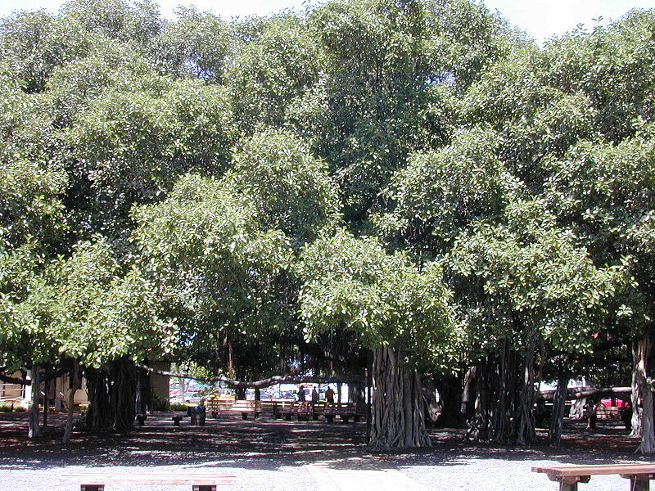

Slide 12
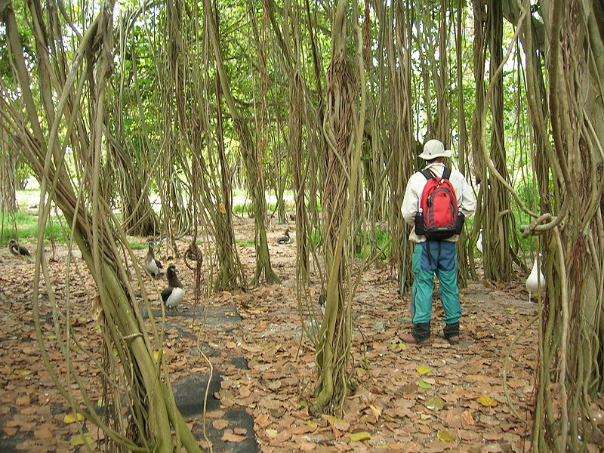

Slide 13
The Great Banyan of India
The Great Banyan is a banyan tree (Ficus benghalensis) located in Acharya Jagadish Chandra Bose Indian Botanic Garden, Howrah, near Kolkata, India. It was the widest tree in the world in terms of the area of the canopy and is estimated to be about 200 to 250 years old. It became diseased after it was struck by lightning, so in 1925 the middle of the tree was excised to keep the remainder healthy; this has left it as a clonal colony, rather than a single tree. A 330 m long road was built around its circumference, but the tree continues to spread beyond it.

Slide 14
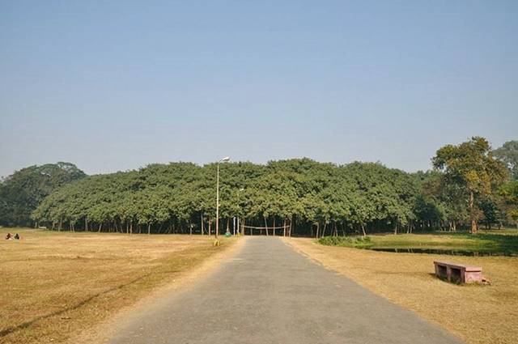

Slide 15
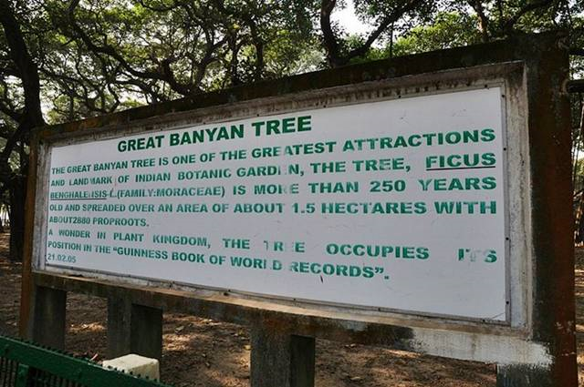

Slide 16
History
The tree is over 250 years old and in spread it is the largest known in India, perhaps in Asia. There is no clear history, but it is mentioned in some travel books of the 19th century. It was damaged by two great cyclones in 1884 and 1886, when some of its main branches were broken and exposed to the attack of a hard fungus. With its large number of aerial roots, It looks more like a forest than an individual tree. It now lives without its main trunk, which decayed and was removed in 1925. The circumference of the original trunk was 1.7 m and it was 15.7 m. tall. The area occupied by the tree is about 14500 square m. (or 4 acres). The circumference of its crown is about 1 kilometre and the highest branch rises to about 25 m; it has at present 2880 aerial roots reaching down to the ground.

Slide 17
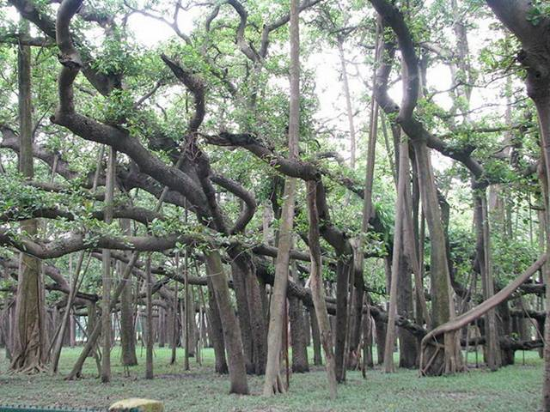

Slide 18
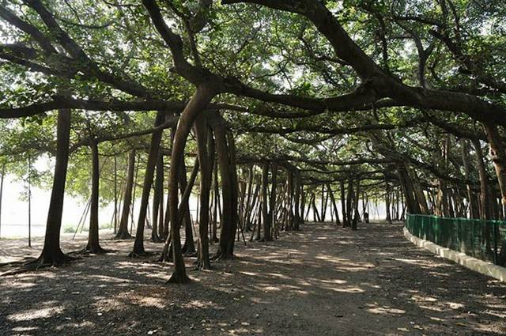

Slide 19
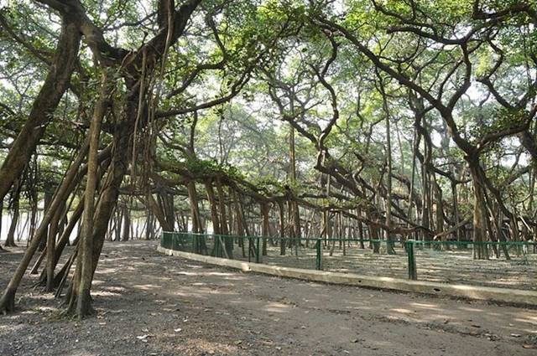

Slide 20
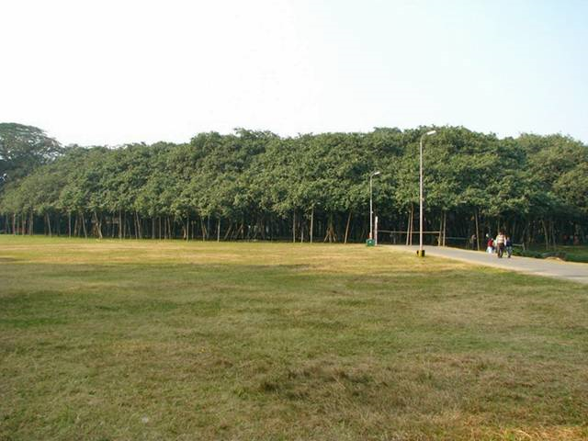

Slide 21
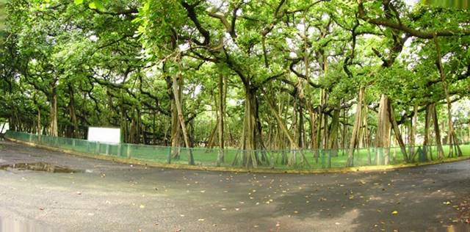

Slide 22
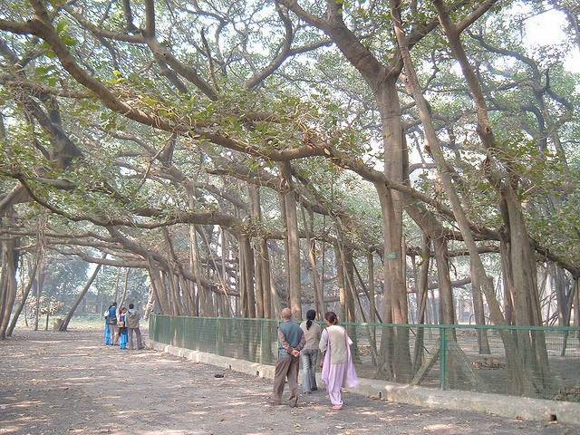

Slide 23
