Slide 1
household plants that remove indoor toxins

Slide 2
NASA has been studying the effects of plants on air quality for about 20 years and their research confirms: Common houseplants are natural air purifiers.
While the original research was aimed at finding ways to purify the air for extended stays in orbiting space stations, the findings are important for us on Earth as well. The following plants are documented as being especially good at improving indoor air quality:

Slide 3
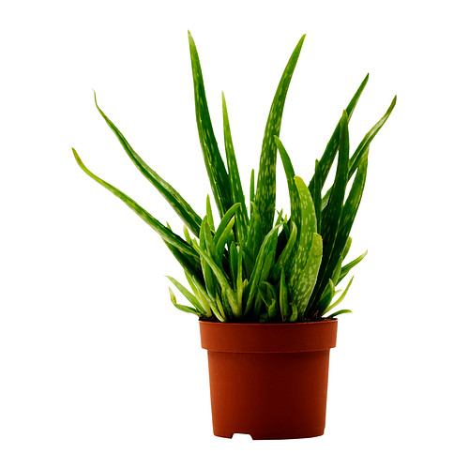
Aloe vera
It's one of the best ways to help treat sunburn, but aloe vera will also help rid your home of formaldehyde.

Slide 4
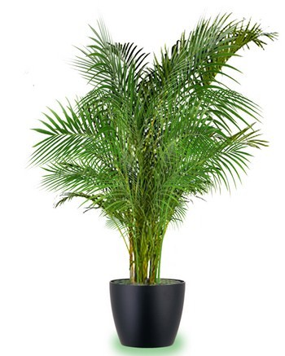
Areca palm
This universal air quality superstar will help remove all indoor air toxins.

Slide 5
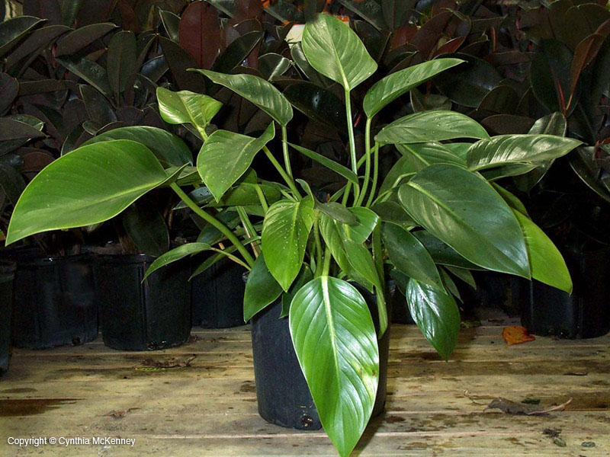
Elephant ear philodendron
Just like aloe vera, elephant ear philodendron will cut traces of formaldehyde from your space.

Slide 6
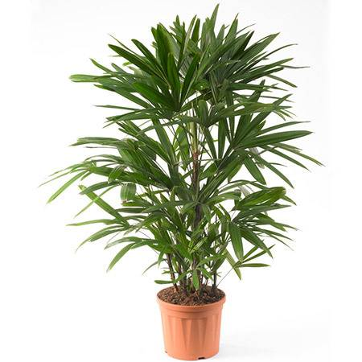
Lady palm
The lady palm plant will eliminate all indoor air toxins, and has been especially powerful in ridding your home of cancer causers.

Slide 7
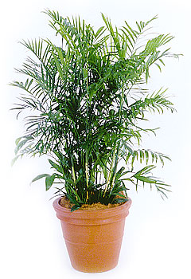
Bamboo or reed palm
These two varieties will work to get out benzene, trichloroethylene, and formaldehyde.

Slide 8
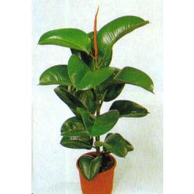
Rubber plant
One of the best plants for new plant owners (read: difficult to kill), the rubber plant has been shown to kill formaldehyde.

Slide 9
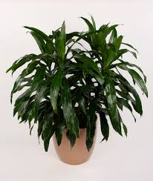
Dracaena 'Janet Craig' (corn plant)
Clear your home of benzene and cigarette smoke by placing corn plants throughout the space.

Slide 10
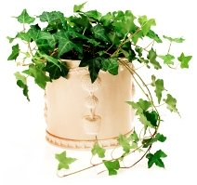
English ivy
Benzene and formaldehyde are no match for English ivy, which can also be grown indoors in water.

Slide 11
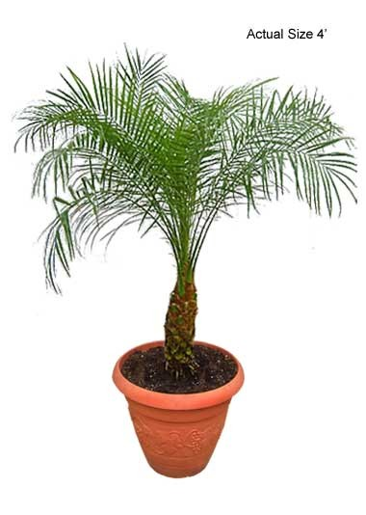
Dwarf date palm
The dwarf date plant, one of the best all-natural air fresheners, helps to remove xylene (found in paints, solvents and adhesives).

Slide 12
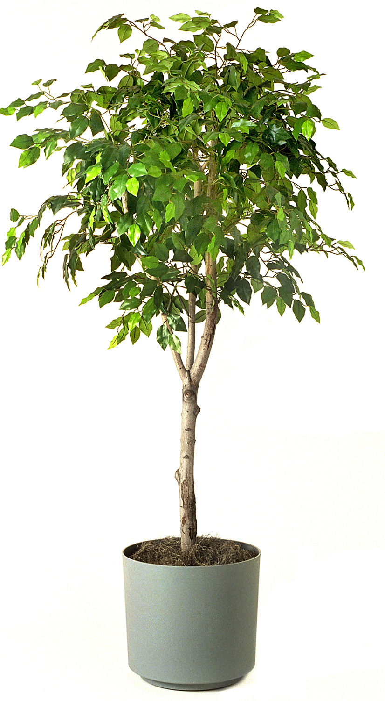
Ficus
Also known as the weeping fig, the ficus plant will cut formaldehyde from your house, but there is a catch. The common houseplant has also been shown to trigger allergies for sensitive people.

Slide 13
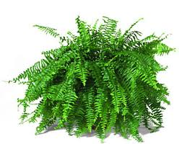
Boston fern
Formaldehyde has been shown to exist in many home furnitures and building materials, but the Boston fern plant can help to eliminate those emissions.

Slide 14
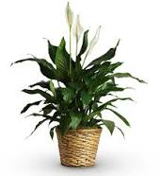
Peace lily
Though the peace lily can get rid of traces of acetone, trichloroethylene, benzene, and formaldehyde, cat lovers should not use this plant. The peace lily has been shown to be poisonous to cats.

Slide 15
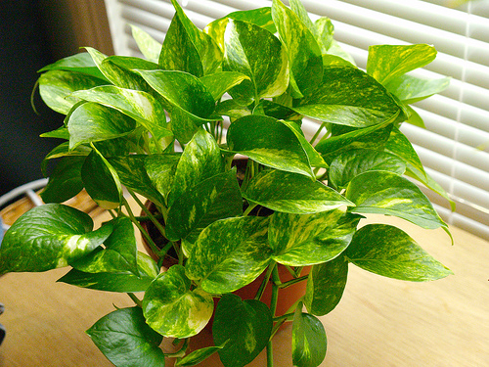
Golden pothos
For improved lung health, reach for the ozone-cleaning golden pothos plant. It can remove carbon monoxide, benzene, and formaldehyde from the indoor air.

Slide 16
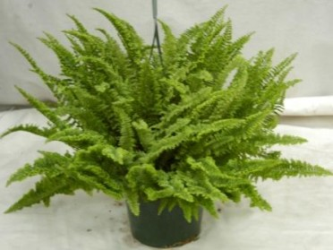
Kimberley Queen fern
The Kimberly Queen fern removes formaldehyde form your home, and pros have called it one of the best humidifiers you can use.

Slide 17
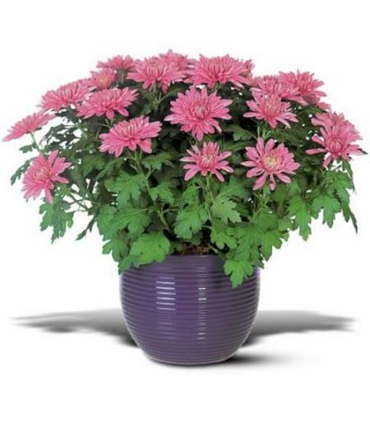
Florist’s mums
Otherwise known as the chrysanthemum—one of the universal "get well" flowers— florist's mums are great for cutting formaldehyde, benzene, and ammonia from your air.

Slide 18
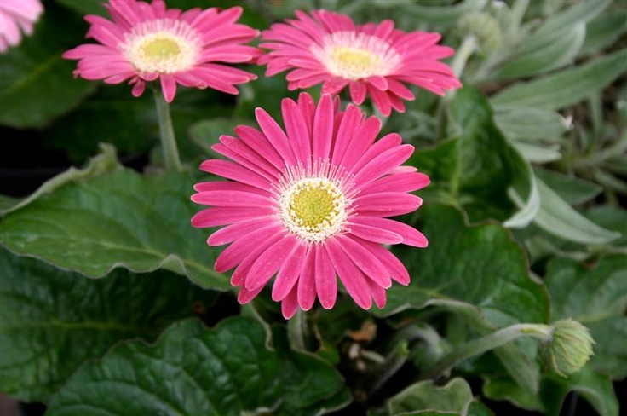
Gerbera daisy
You can count on this powerhouse plant to help remove all indoor toxins. Yes, all.

Slide 19
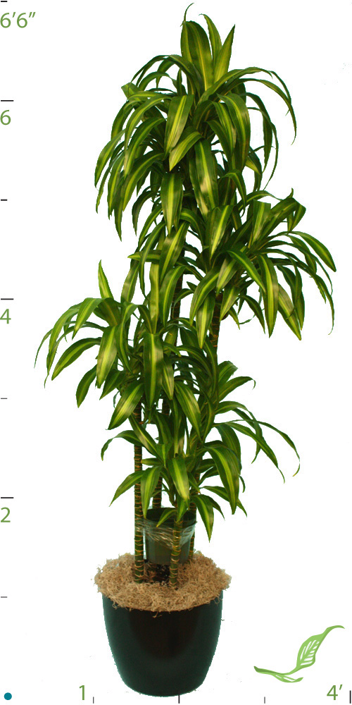
Dragon tree
The dragon tree, while being one of the easiest plants to maintain in your home, cut xylene and trichloroethylene, which have been proven causers of breast cancer.

Slide 20
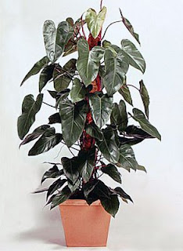
Red emerald philodendron
Just like the gerbera daisy, the red emerald philodendron is your go-to plant for erasing all indoor air toxins.

Slide 21
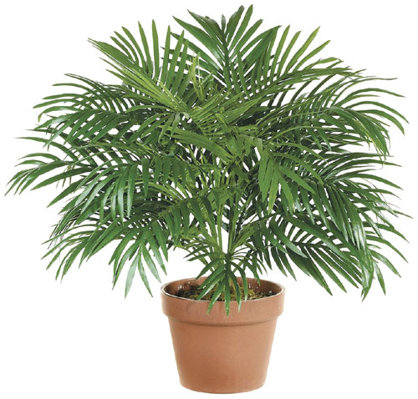
Parlor palm
The parlor palm is an air freshener, a cancer-causer remover, and a plant that can help with all indoor air toxins.

Slide 22
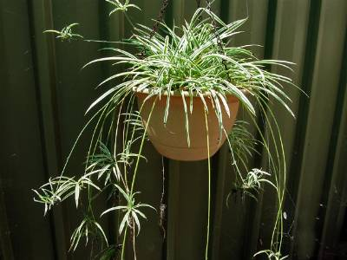
Spider plant
Known for its distinctive long striped leaves, the spider plant is also a carbon monoxide eliminator.

