Slide 1
These People Live In Houses Smaller Than Your Bedroom
by Jenna Spesard

Slide 2
We interview and photograph real people who live in tiny homes, most being less than 200 square feet. That’s smaller than the average master bedroom in the United States – a country where 2,600 square foot homes are commonplace.
These customized handcrafted tiny dwellings grant their owners financial freedom with a minimalist lifestyle and a small footprint. Armed with tiny kitchens, minuscule bathrooms, lofted bedrooms and multi-purpose furniture, tiny houses are redefining the American Dream and questioning what material objects you really need to be happy. You can check our tiny house here.
More info: tinyhousegiantjourney.com

Slide 3
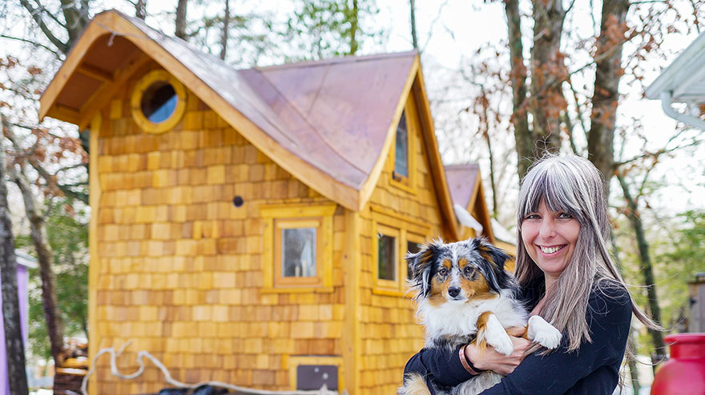
Bernadette downsized to a whimsical 172 sq ft tiny home in Maryland

Slide 4
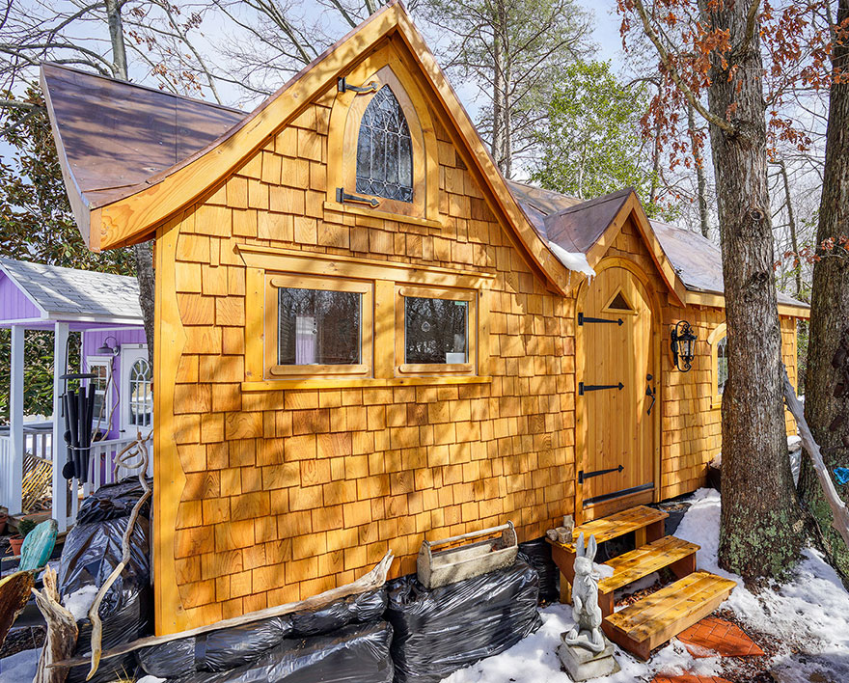

Slide 5
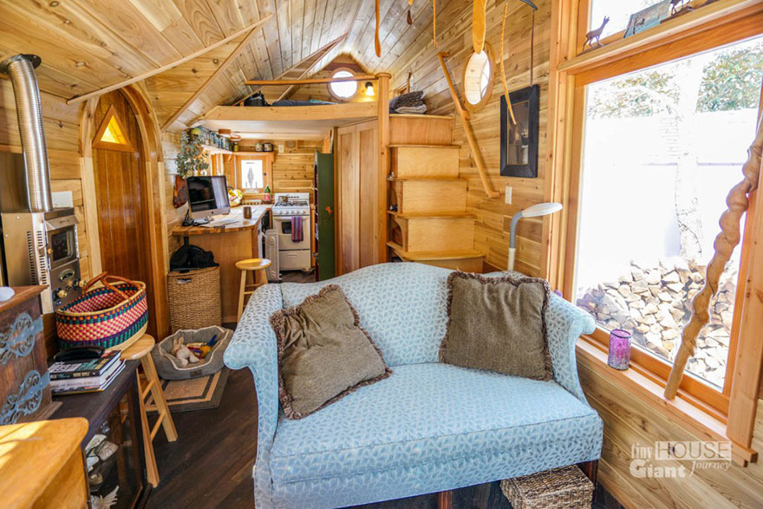

Slide 6
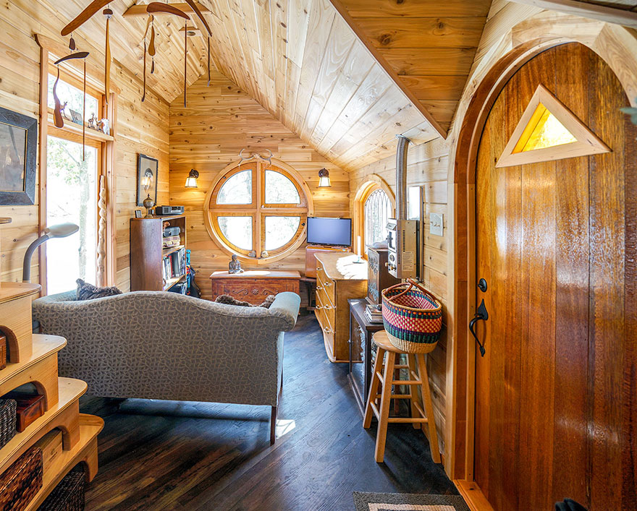

Slide 7
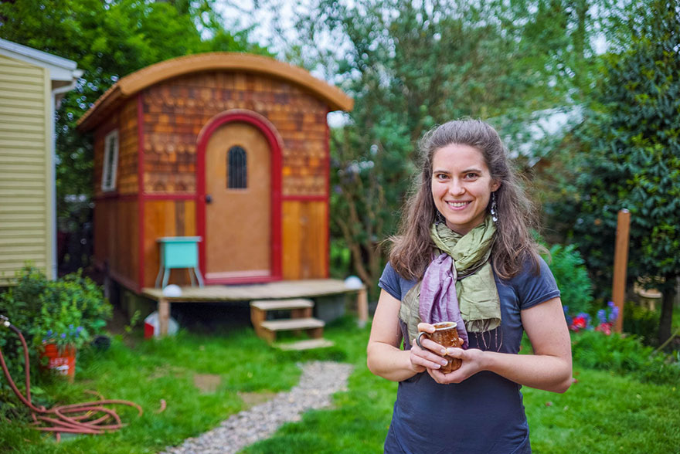
Lina’s Oregon tiny home is only 100 sq ft

Slide 8
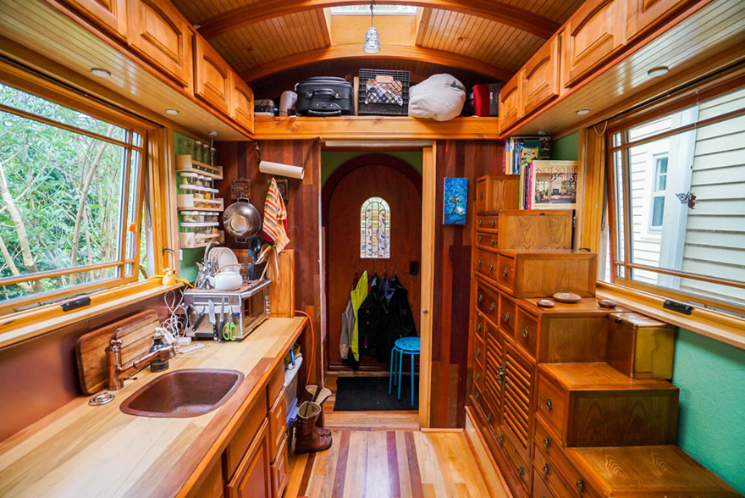

Slide 9
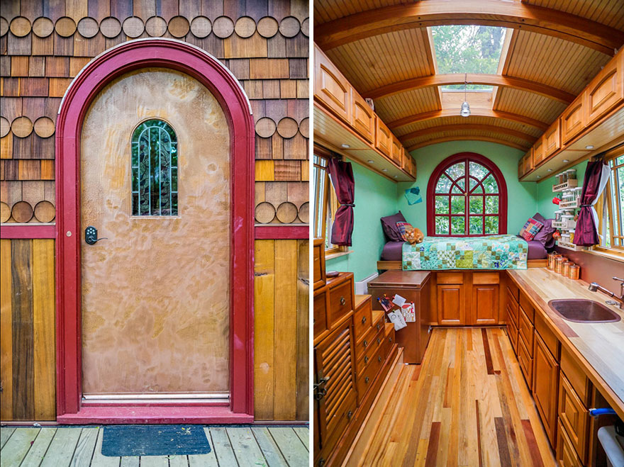

Slide 10
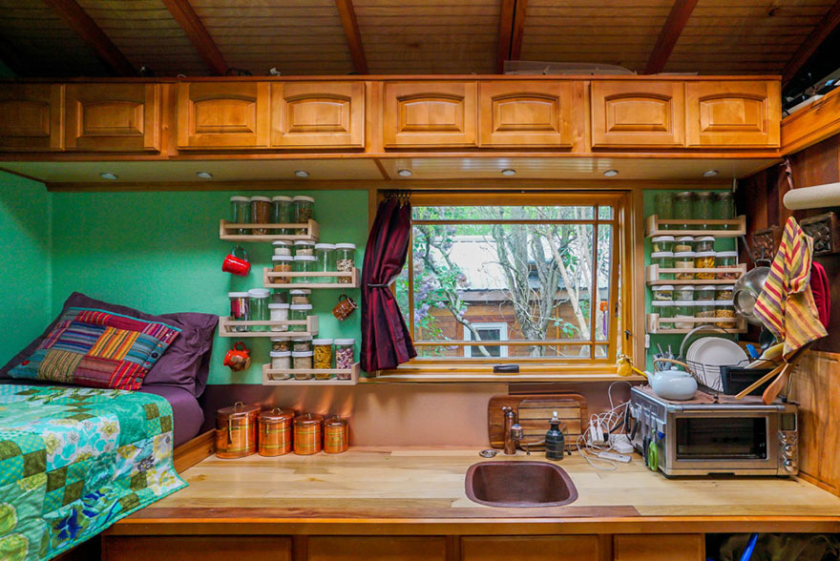

Slide 11
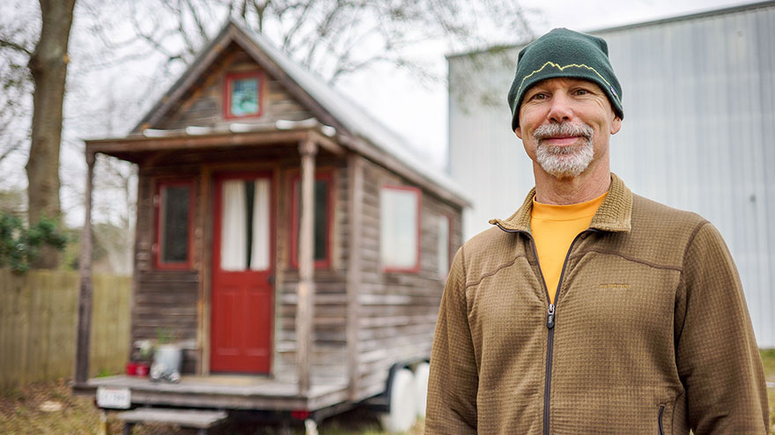
Art parks his 117 sq ft tiny home behind his rock climbing gym in Louisiana

Slide 12
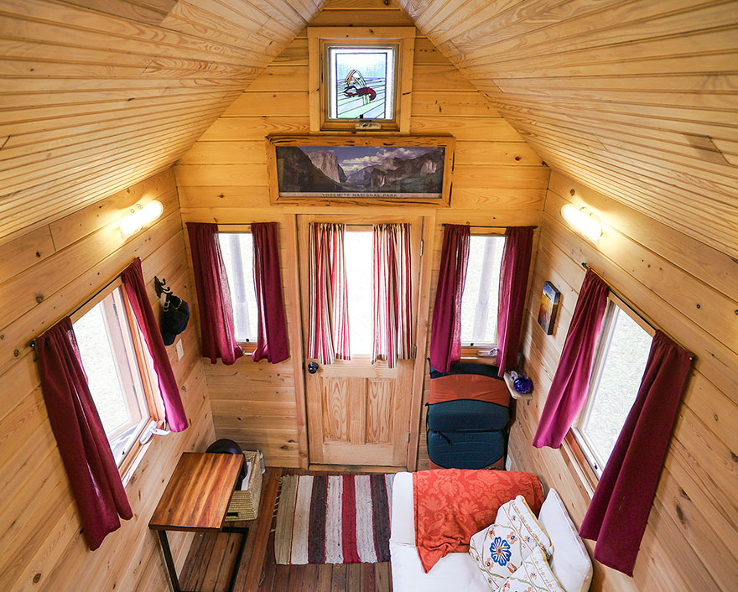

Slide 13
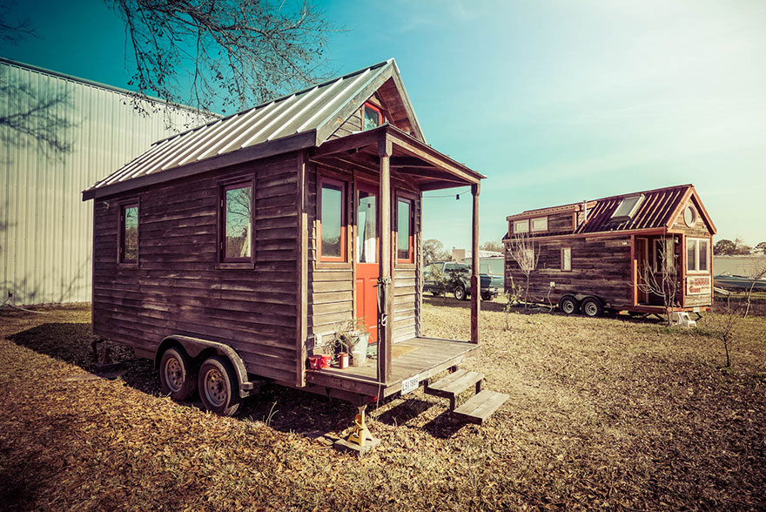

Slide 14
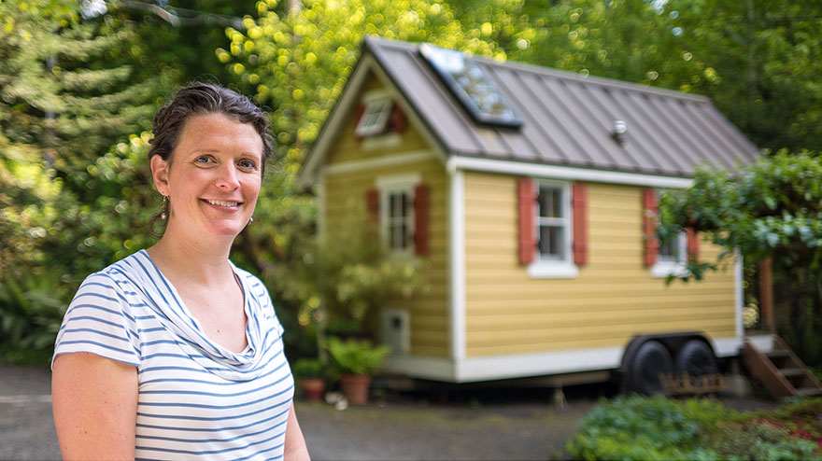
Brittany built her charming 130 sq ft tiny home in Washington after seeing small homes overseas

Slide 15
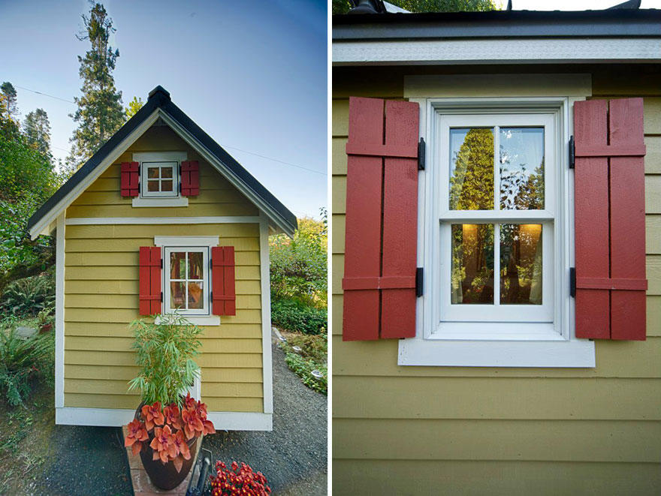

Slide 16
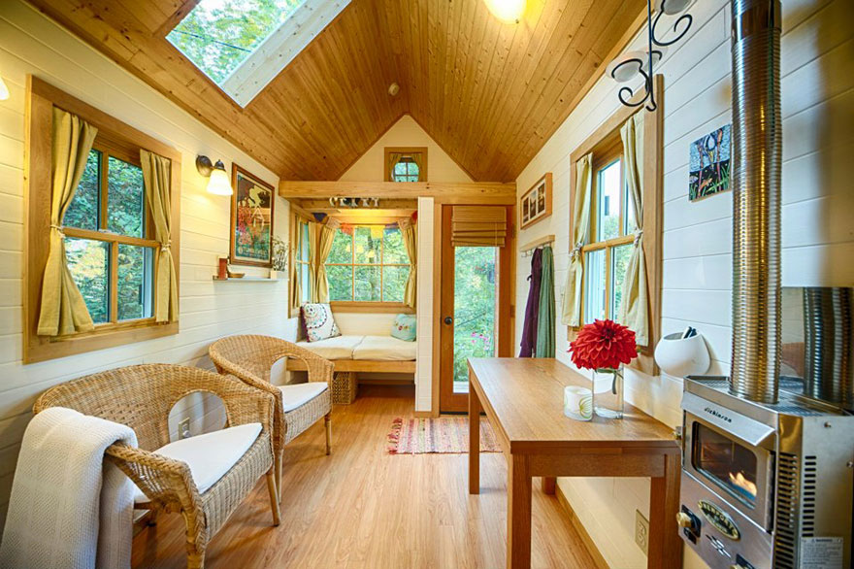

Slide 17
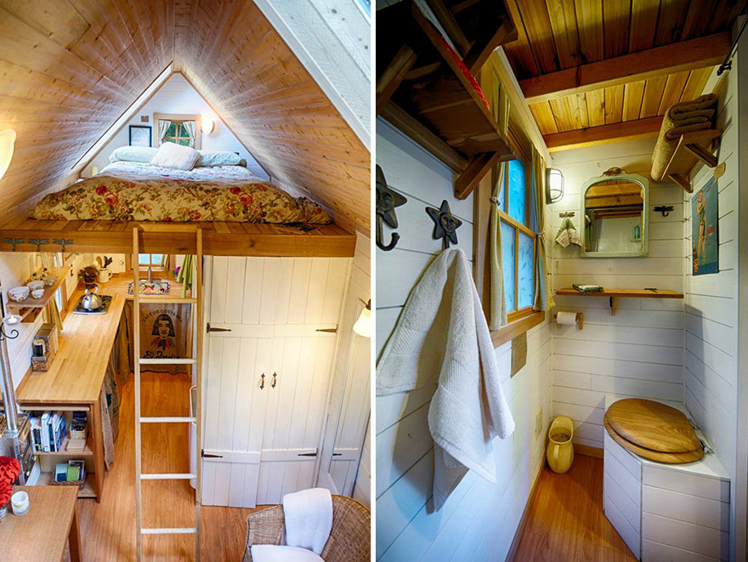

Slide 18
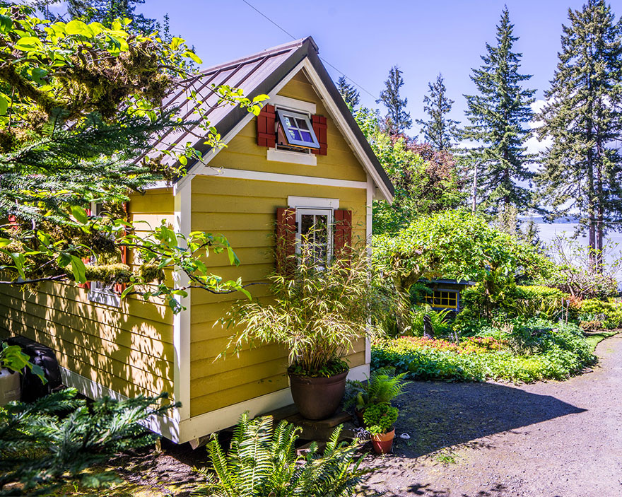

Slide 19
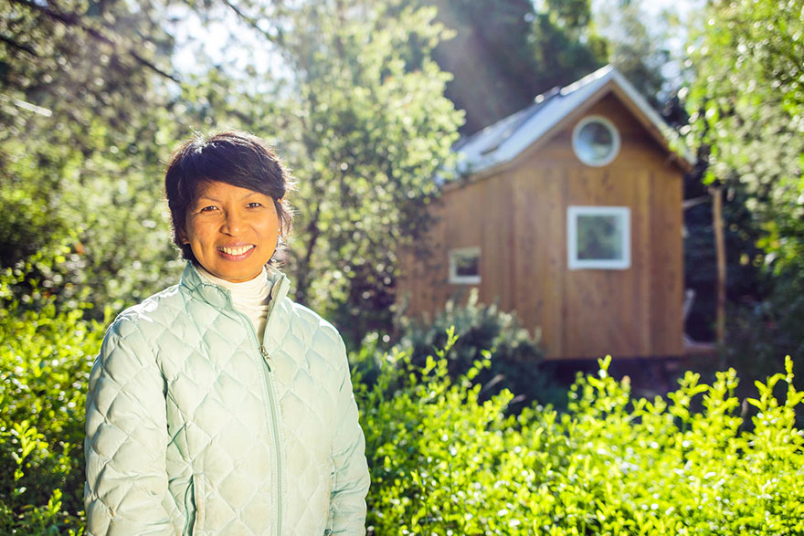
Vina’s 140 sq ft Califrornia home is completely off-grid

Slide 20
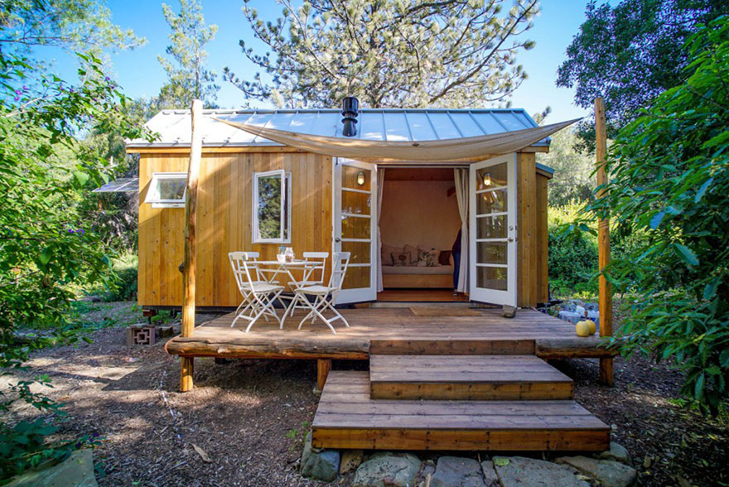

Slide 21
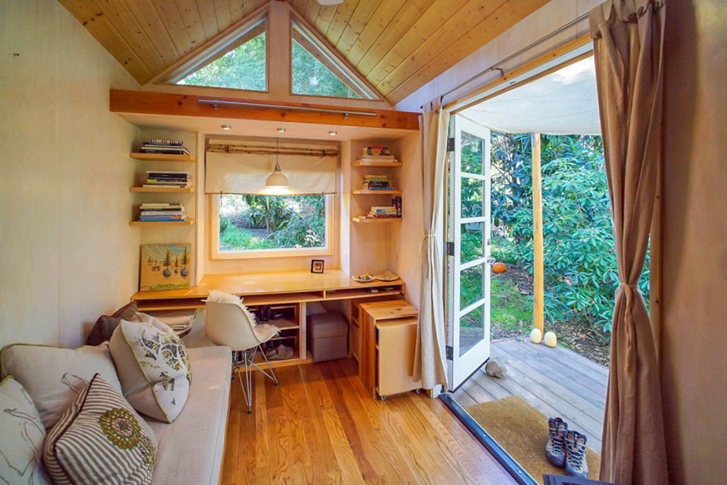

Slide 22
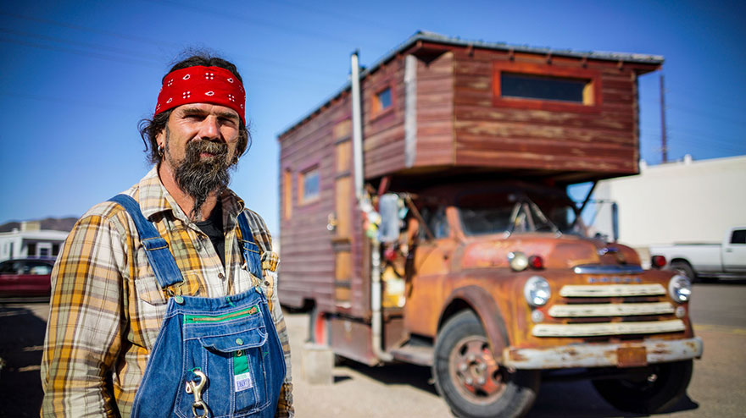
Nomadic John built his house on top of an antique firetruck

Slide 23
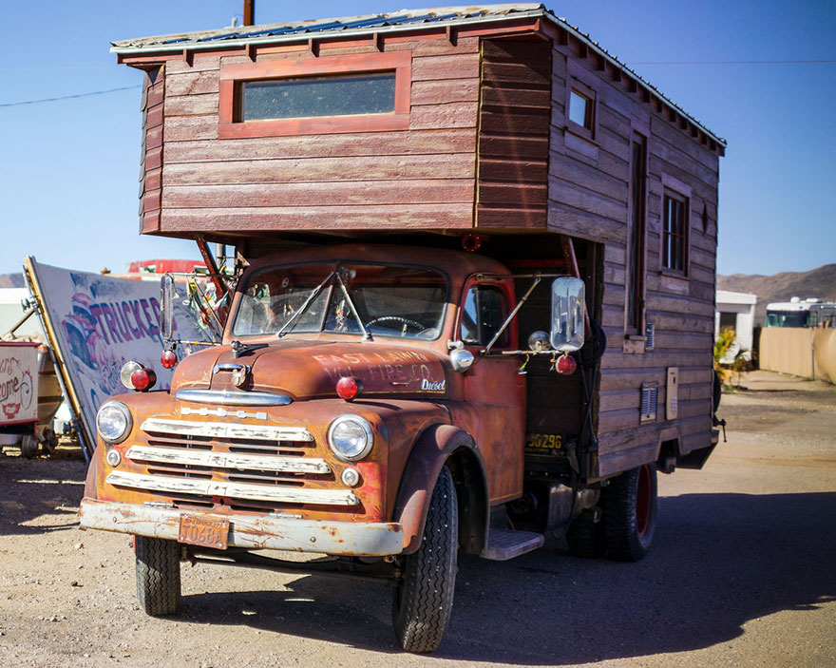

Slide 24
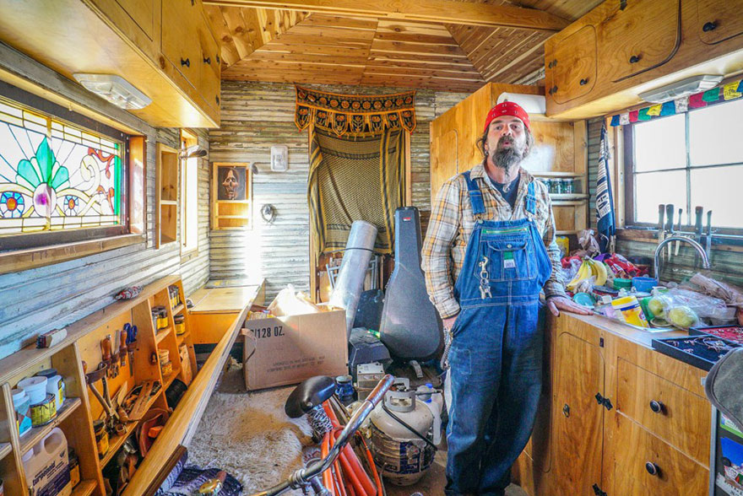

Slide 25
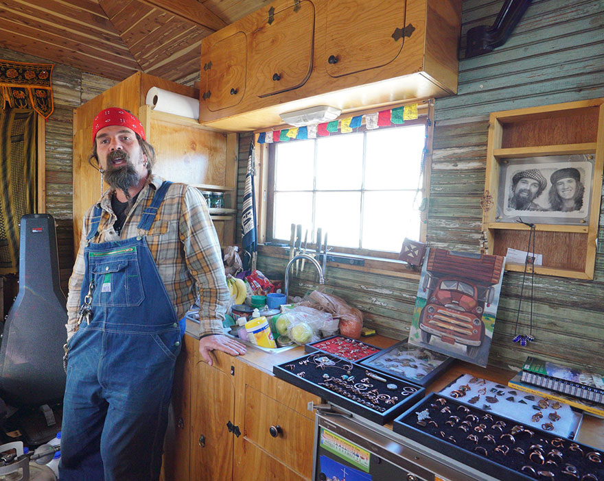

Slide 26
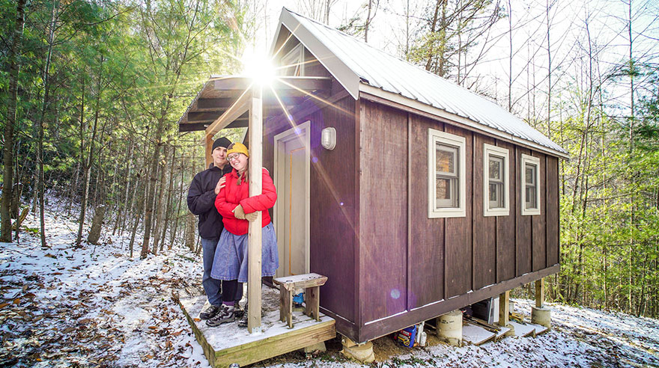
Laura & Matt’s 120 sq ft tiny house sits on a mountain in North Carolina

Slide 27
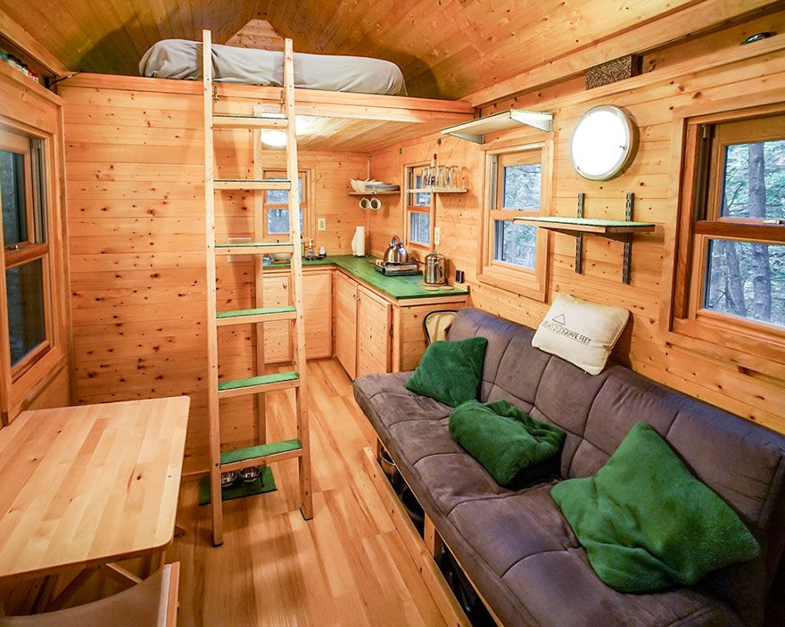

Slide 28
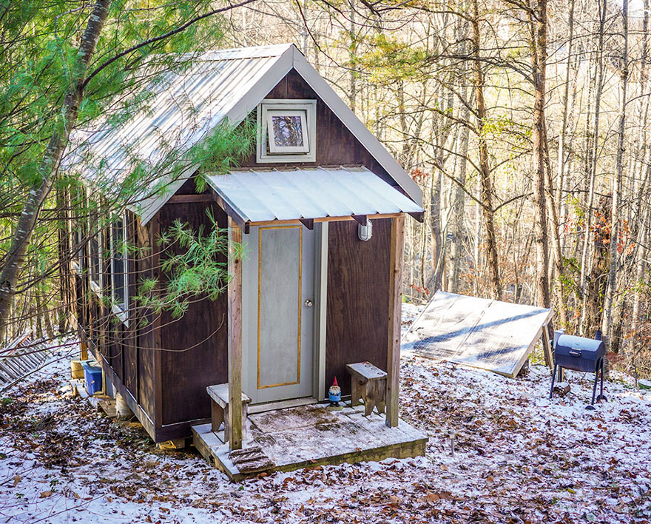

Slide 29
How much space do we really need? Notice that most were single individuals Notice there were no children But do we really need 5,000 square feet of living space for a family with two or three children?

