Slide 1
The Underground City - Derinkuyu
Turkey

Slide 2
Imagine this: You are doing some renovations in your house, and you decide to demolish one of the walls. Only instead of dirt and soil, there is space beyond that wall. And as you start exploring this strange room beyond, you realize it's not just one room, it's an entire city, built underground by the ancients. This is exactly what happened to this person, and this is the story of what we've learned about the amazing underground city of Derinkuyu since that amazing moment of discovery.

Slide 3
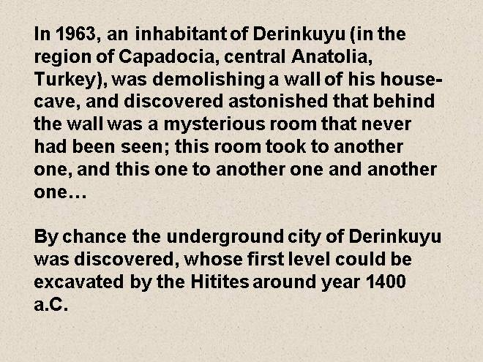

Slide 4
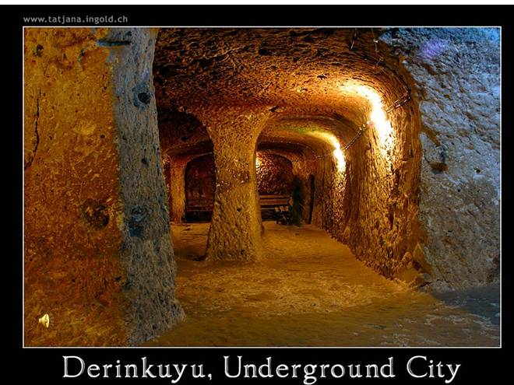

Slide 5
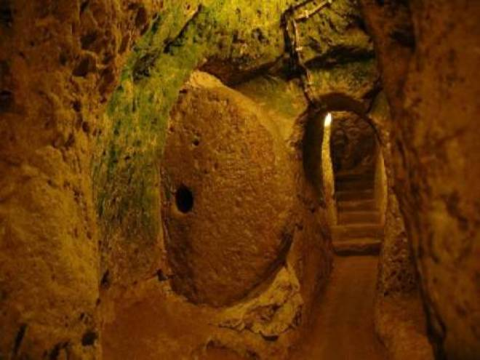

Slide 6
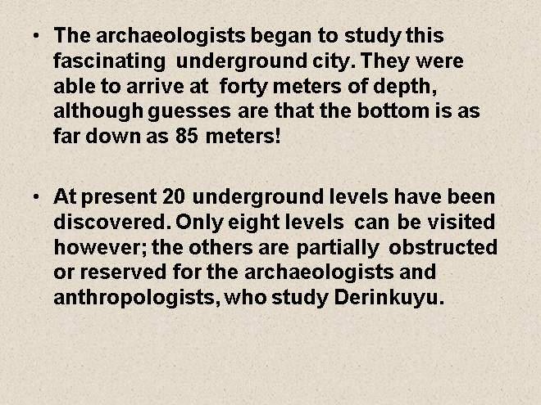

Slide 7
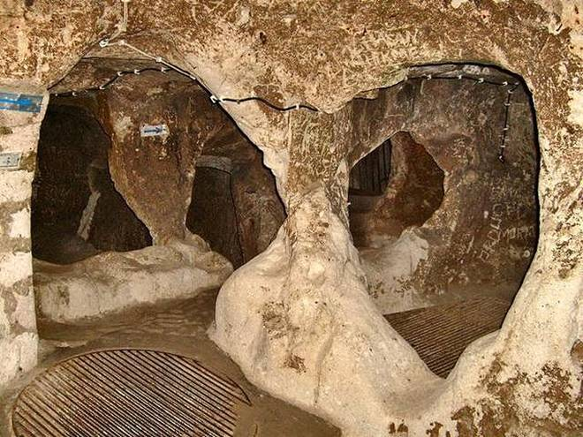

Slide 8
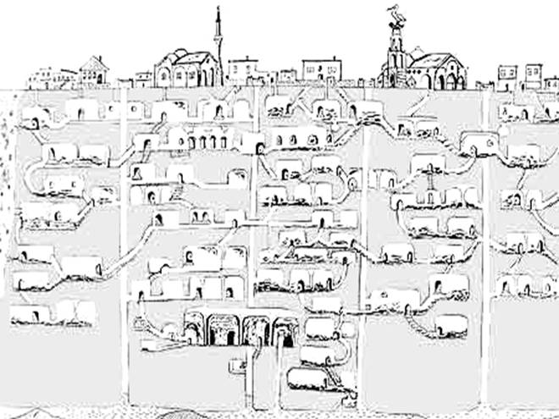

Slide 9
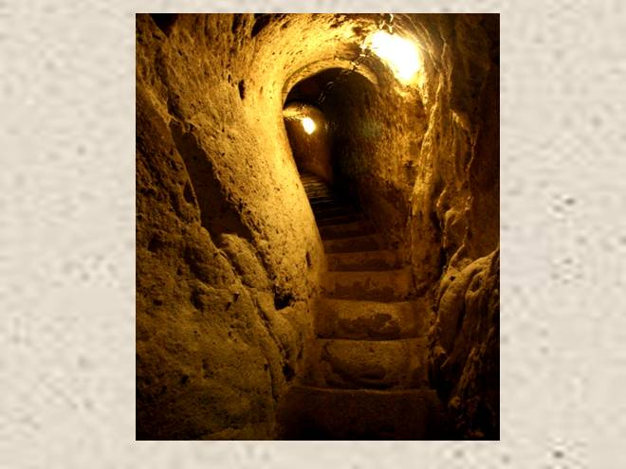

Slide 10
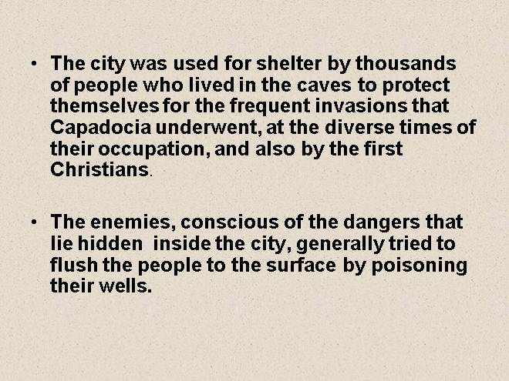

Slide 11
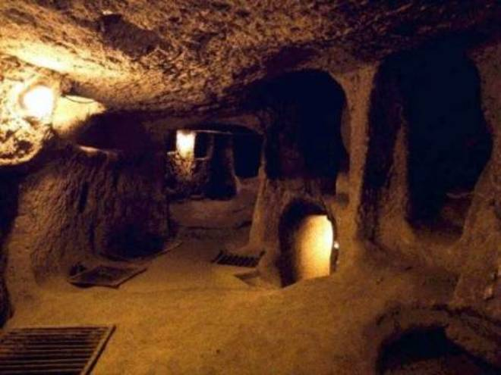

Slide 12
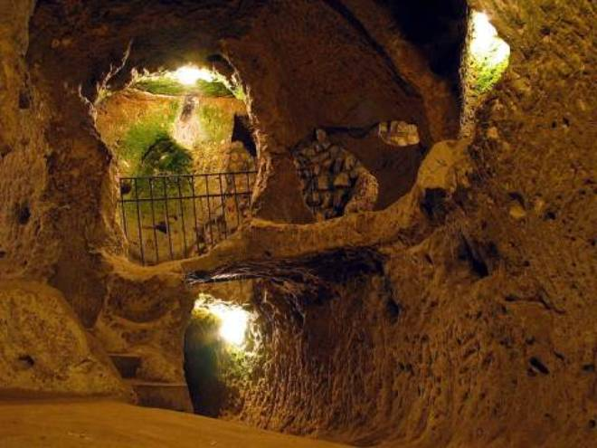

Slide 13
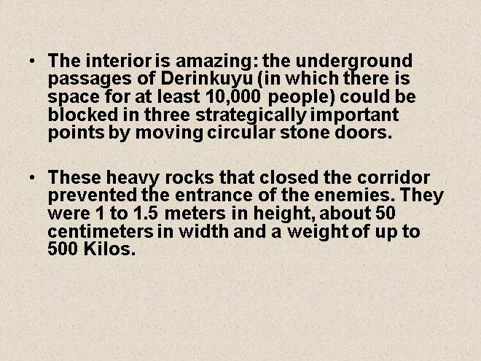

Slide 14
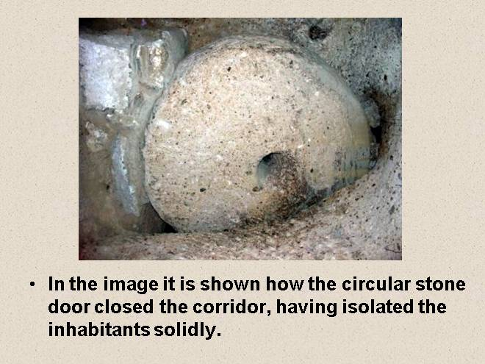

Slide 15
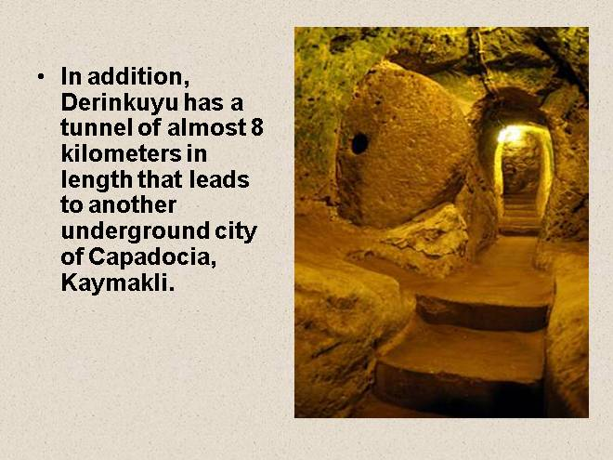

Slide 16
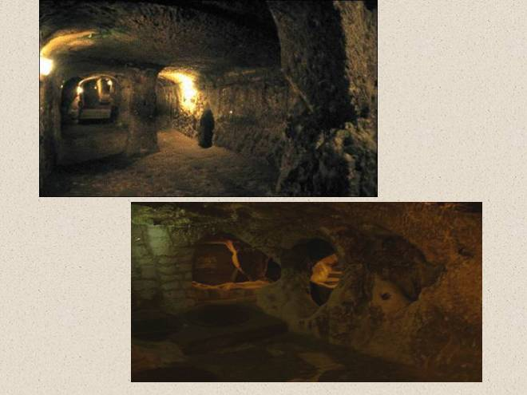

Slide 17
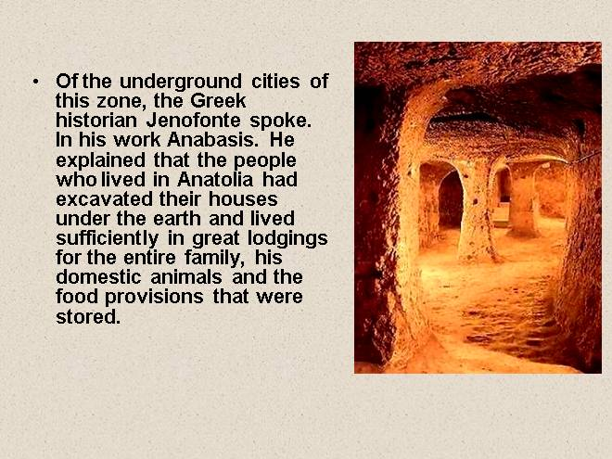

Slide 18
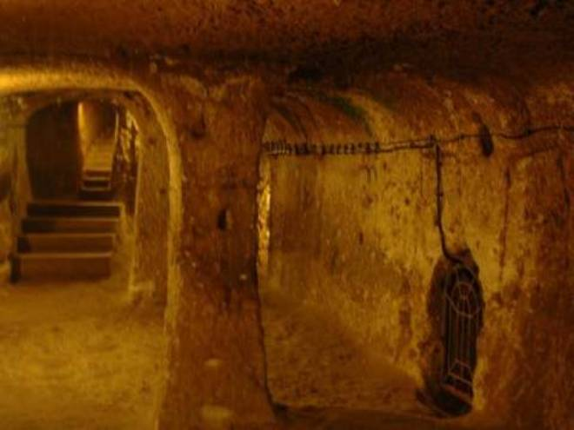

Slide 19
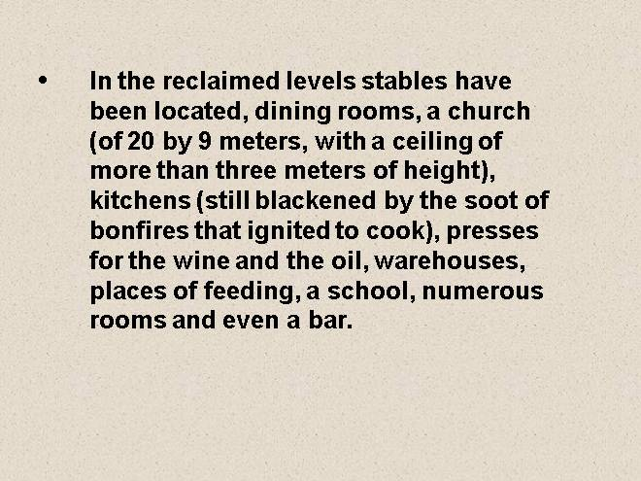

Slide 20
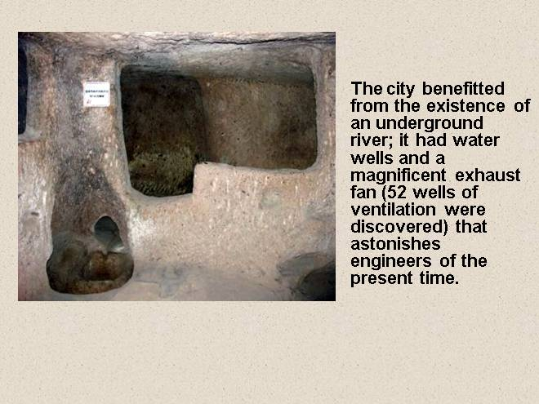

Slide 21
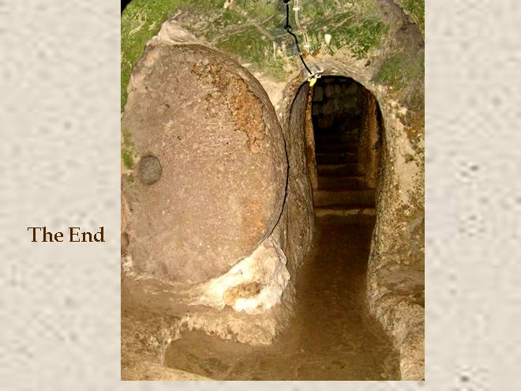

Slide 22
It is a shame that we often underestimate what the people who lived before us could accomplish. We might even get some good ideas from them.

