Slide 1
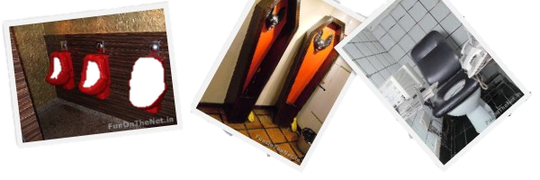
Strangest Toilets and Urinals

Slide 2
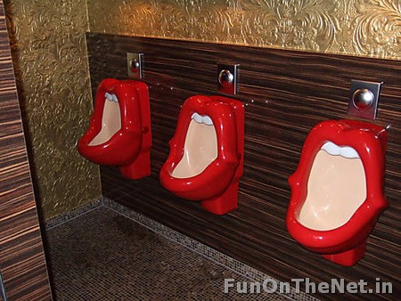
If the big red mouth wasn’t enough, it even has teeth!

Slide 3
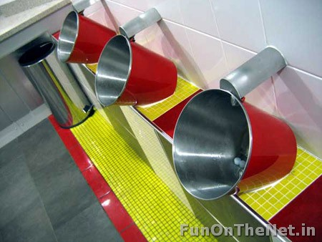
This bathroom is located in London. It has a “firehouse” theme and has fire-buckets as urinals.

Slide 4
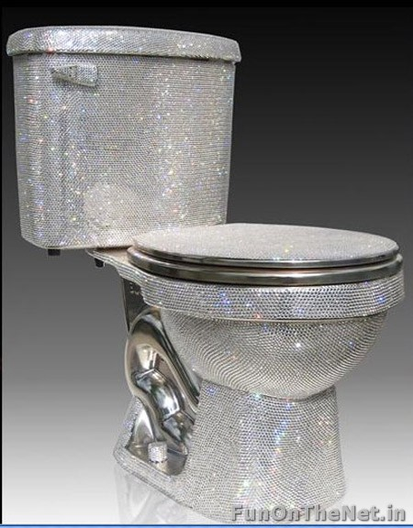
This one of a kind Swarovski toilet has been designed by Jemal Wright. It is from the “Isis” range of bathroom fittings and is either partially or fully studded with Swarovski crystals. It costs a smooth $75,000.

Slide 5
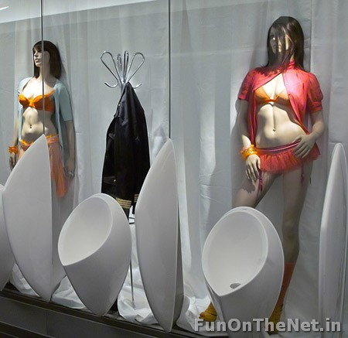
This unique men restroom’s can be found in a shopping centre in Weiterstadt, Germany.

Slide 6
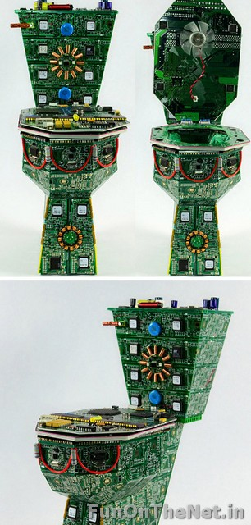
Known as The Royal Data Throne, this is a place where data is disposed. This exceptional piece is full of detail; it has guts in the thanks and a secret hiding place for your..data under the lid.

Slide 7
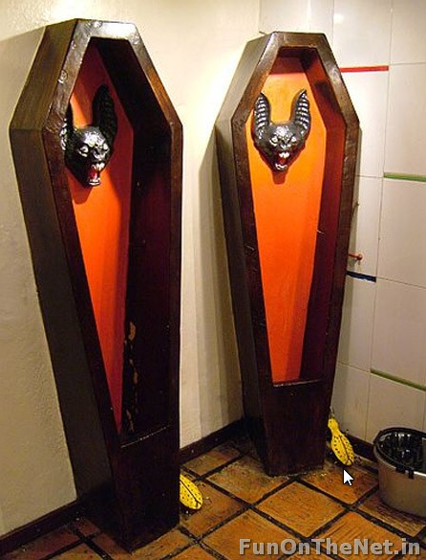
These are the urinals in the bathroom of the restaurant/bar La Jugueteria, in La Macarena district of Bogotá, Colombia.

Slide 8
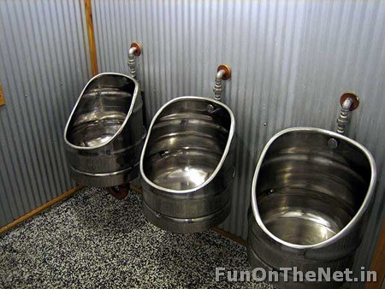
This is taking the art of recycling to a whole new level. Old beer kegs are being used as urinals at Monteith’s Brewery, New Zealand.

Slide 9
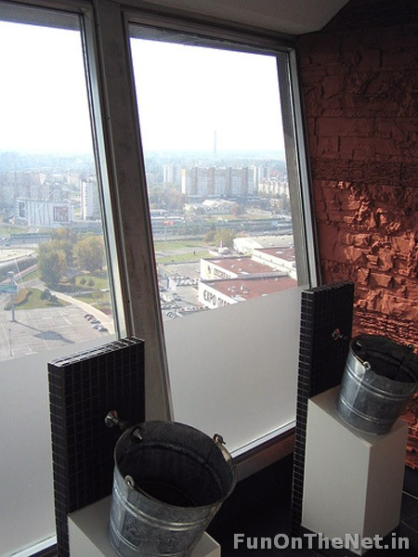
These are the bucket urinals in Bratislava’s wobbly UFO Bar! Why one needs such a beautiful view while doing one’s business in another story.

Slide 10
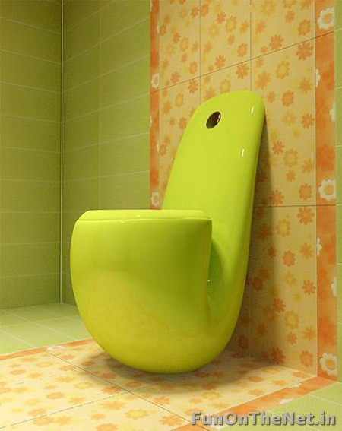
They’ve somehow managed to make a pipe look cute.

Slide 11
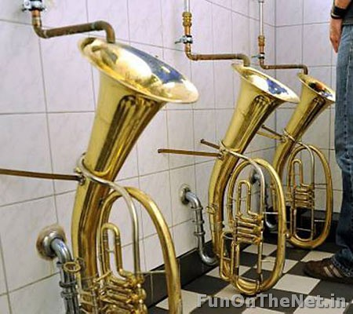
These unusual urinals at a pub in Freiburg, South Germany, were put in by landlord Martin Hartmann.

Slide 12
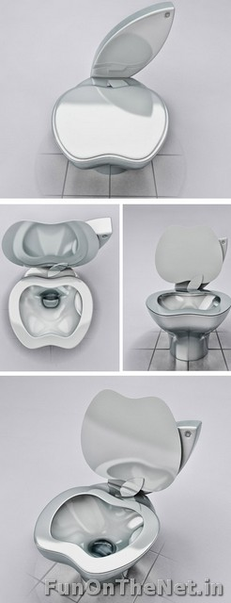
This toilet is a must-have for all the apple fans out there. Designed by Milos Paripovic this iPoo toilet is a prestigious designer toilet which will provide you with the most technologically advanced bathroom experience you’ve ever had. The material used is also the same as those of iProducts.

Slide 13
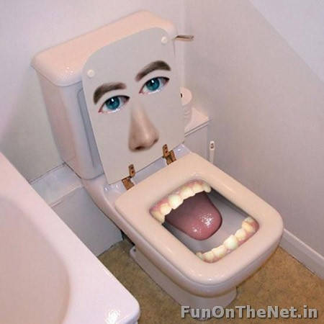
There really are no words to describe this one. Weird mouth. Check. Spooky eyes. Check. Inappropriate for a toilet. Check.

Slide 14
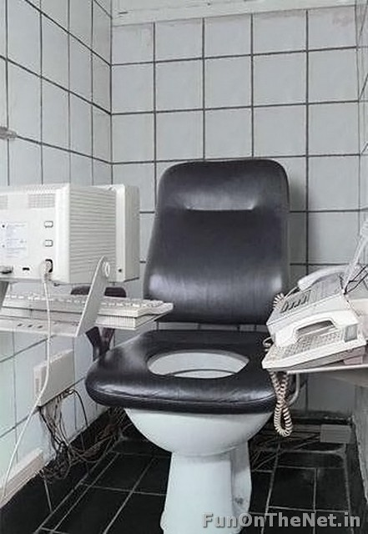
This toilet is a workaholic’s dream come true!

Slide 15
These creepy/funny (you decide) urinals are located in The Las Vegas Hotel.

Slide 16
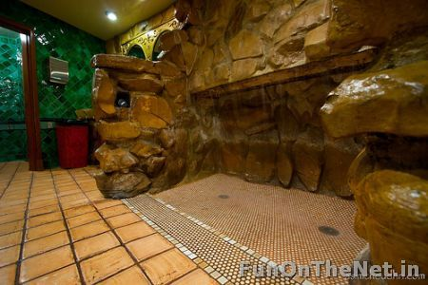
This Waterfall urinal is located in the Madonna Inn in San Luis Obispo, Ca. For some reason it can fit two users, and it's activated by motion control when you get close to the line.

Slide 17
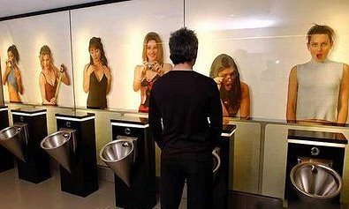

Slide 18
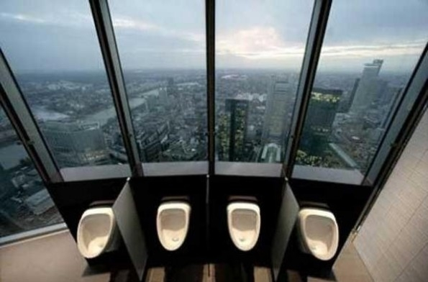

Slide 19
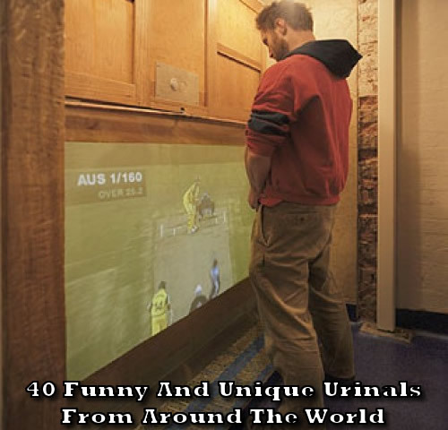

Slide 20
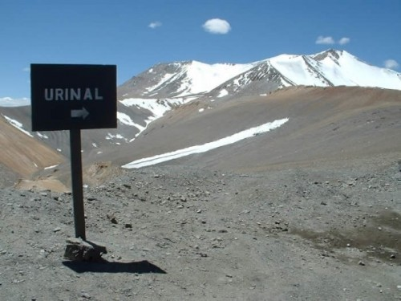

Slide 21
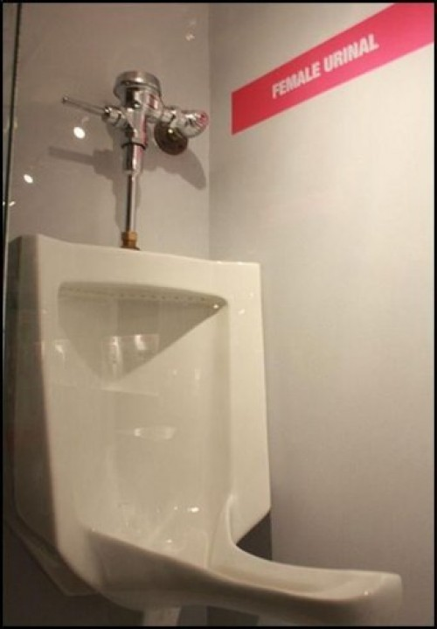
Female Urinal

Slide 22
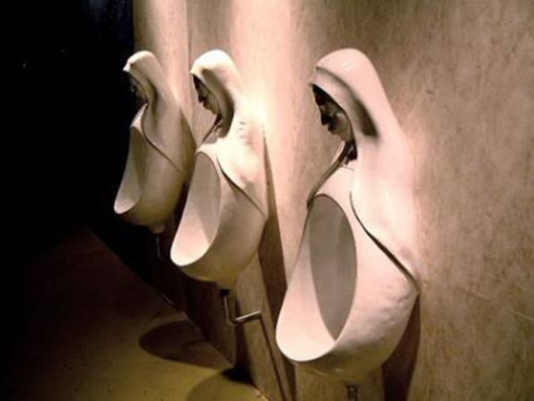
This would not be cool for a church bathroom.

Slide 23
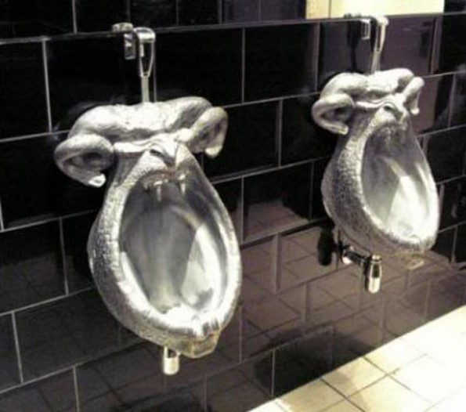
Demon mouth – suitable for a church?

Slide 24
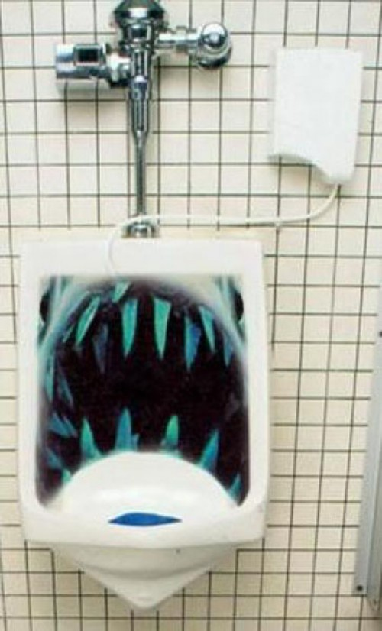
Shark Mouth

Slide 25
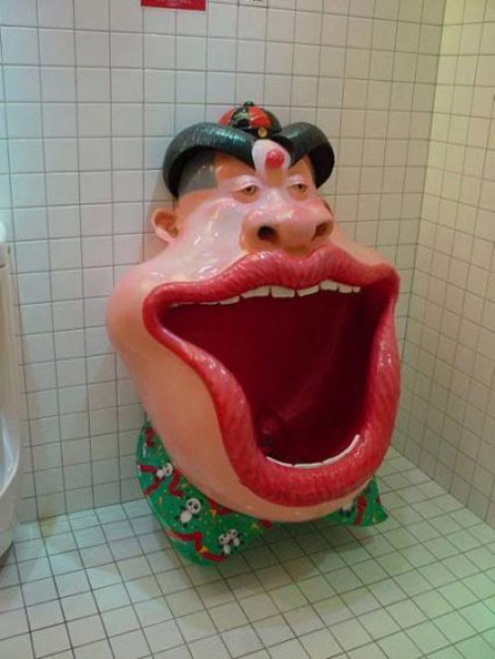
Man’s Mouth

Slide 26
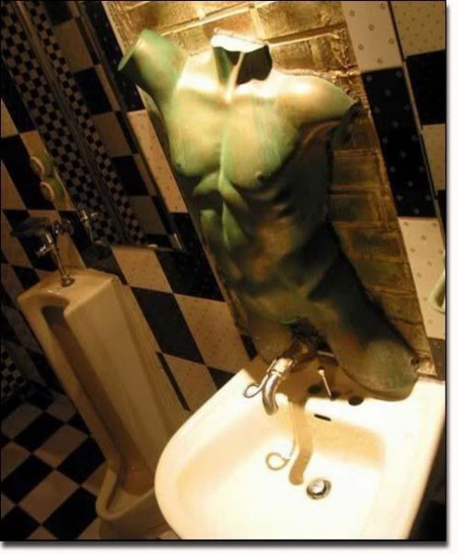
Reverse Urinal
OK, it’s a sink, not a urinal, but I’m including it anyway cause it’s awesome.

Slide 27
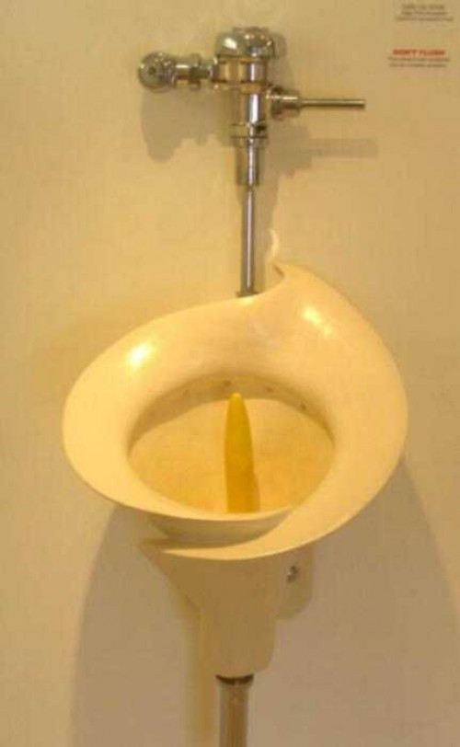
Calla Lily Urinal
Don’t get drunk and mistake this one for a toilet.

Slide 28
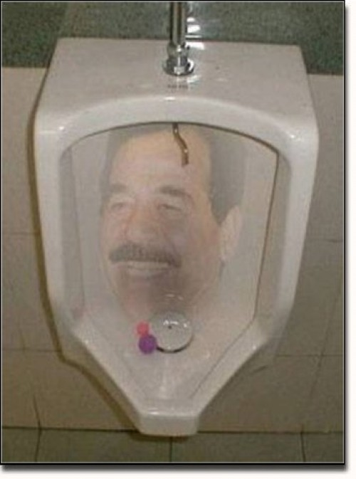
Saddam Hussein Urinal -- This one is very popular in Kurdish regions.

Slide 29
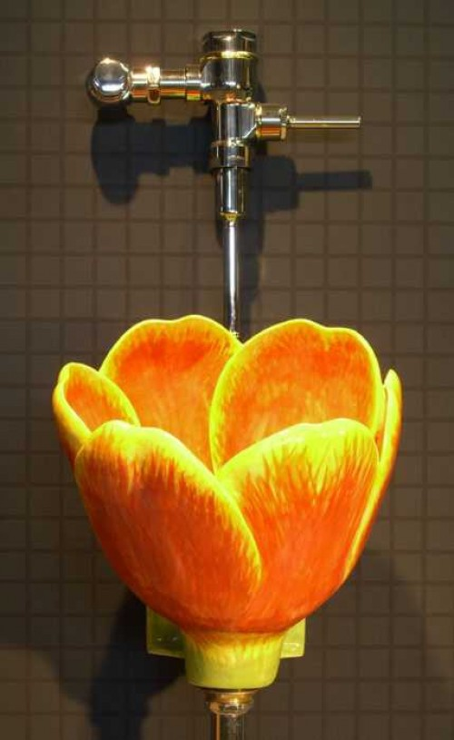
Flower Urinal #3 - This orange flower is much better, because honestly, who wants to pee in a pink flower?

Slide 30
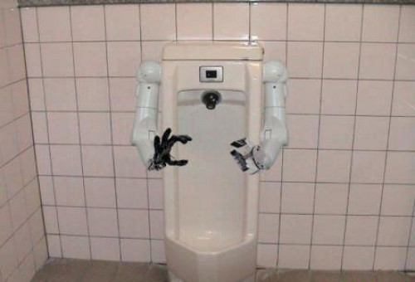
Robot arms urinal – do you need help?

Slide 31
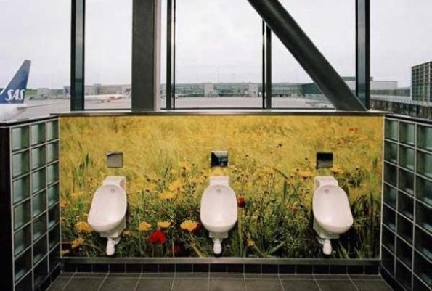
Nature at the airport

Slide 32
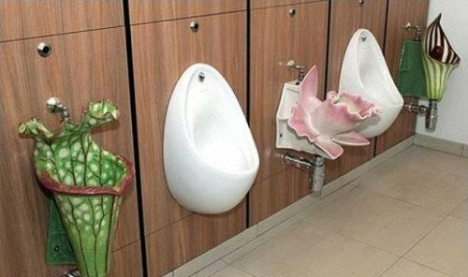
Flower Urnil #2 – You can skip the flowers

Slide 33
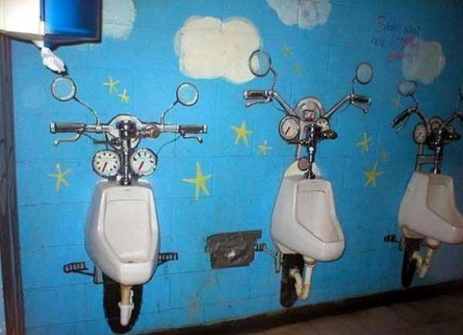
Motorcycle Urinal

Slide 34
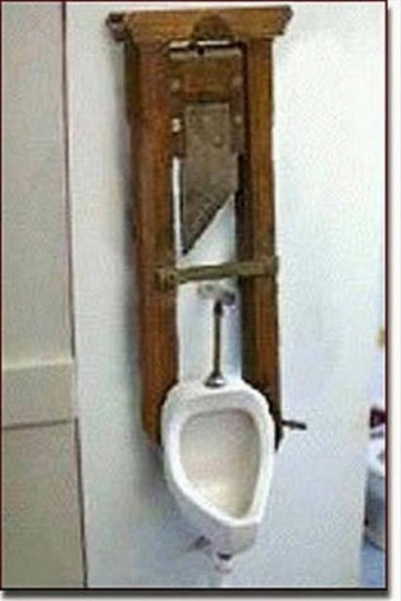
Guillotine Urinal

Slide 35
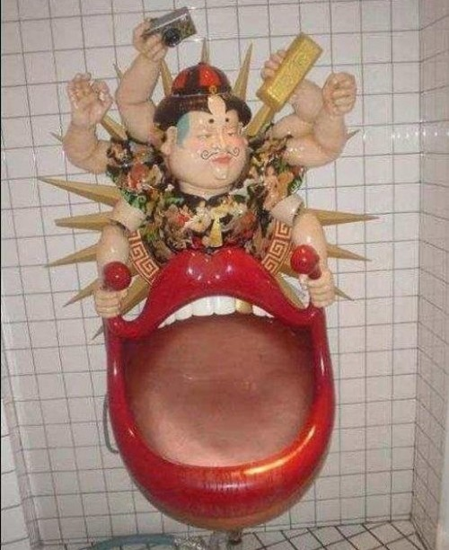
Because sometimes, peeing in an open mouth just isn’t weird enough.

Slide 36
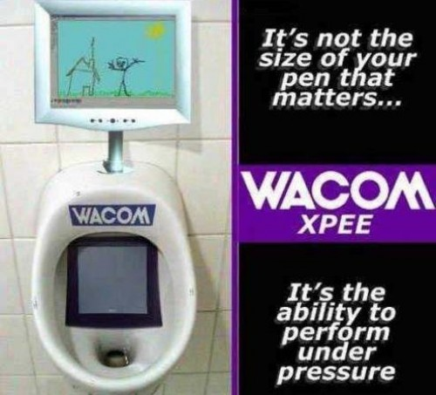
Draw While You Pee Urinal

Slide 37
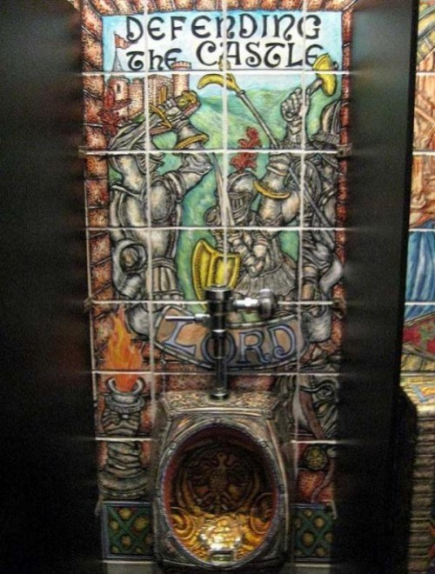
Medieval Urinal

Slide 38
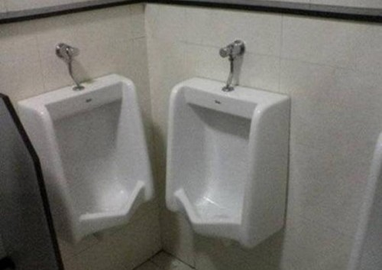
Too Close For Comfort Urinals

Slide 39
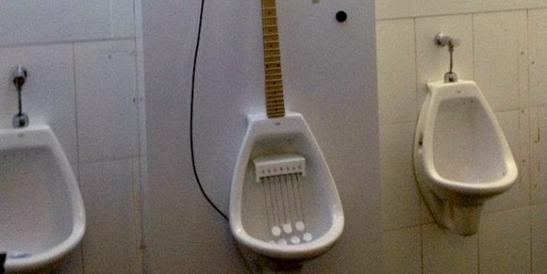
Electric guitar urinal – for the musically inclined

Slide 40
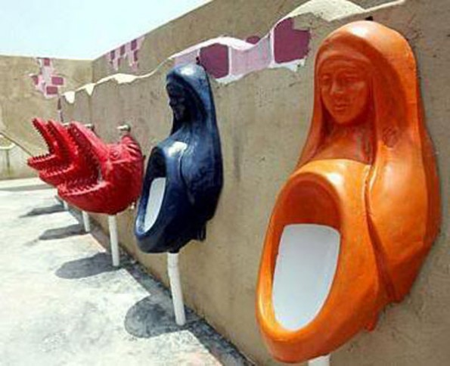
Virgin Mary and Dragon Urinals

Slide 41
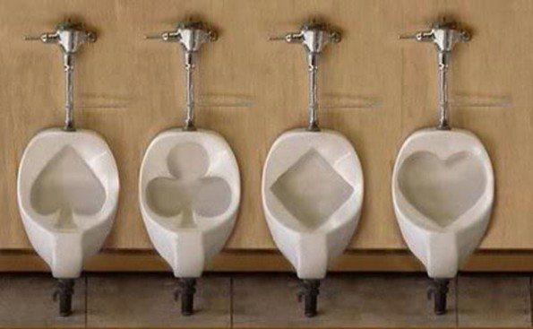
Card suits

Slide 42
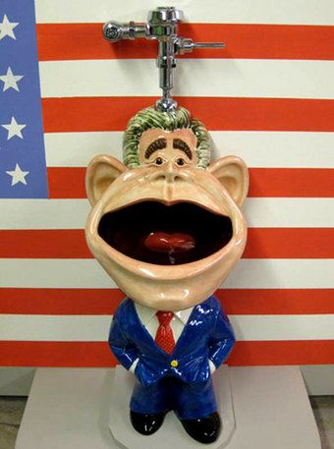
Political Comment

Slide 43
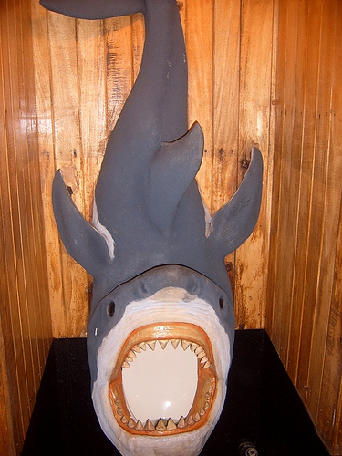

Slide 44
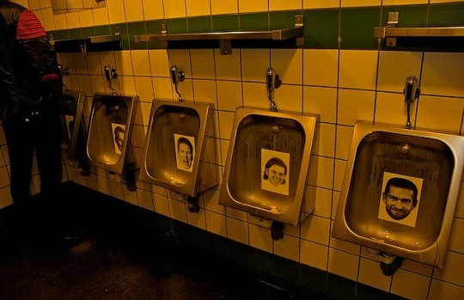

Slide 45
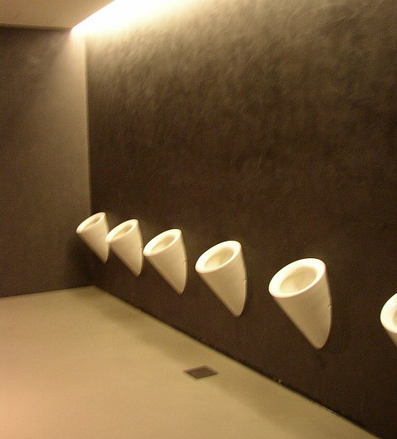

Slide 46
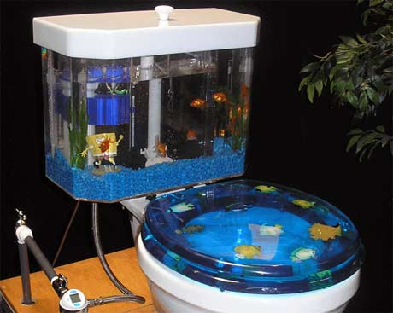

Slide 47
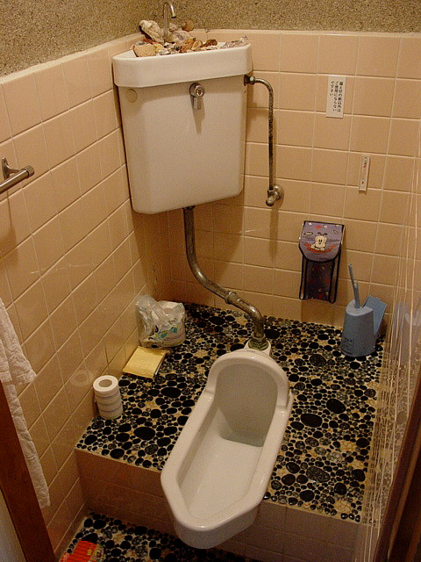
Trench Toilet
You have to squat over it. Common in Asia.

Slide 48
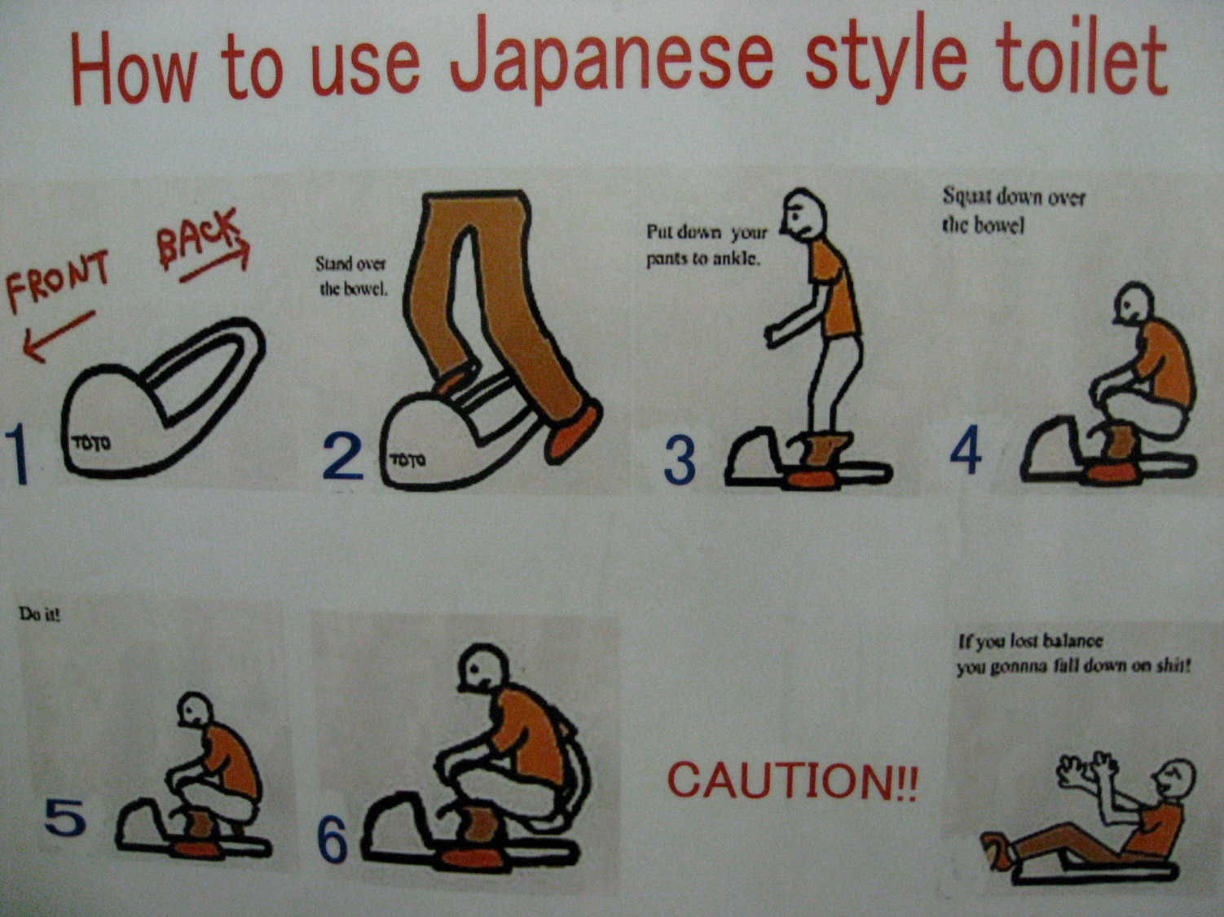

Slide 49
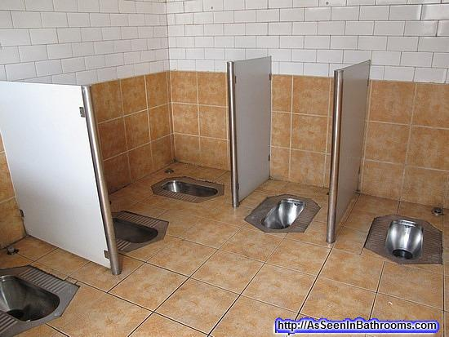

Slide 50
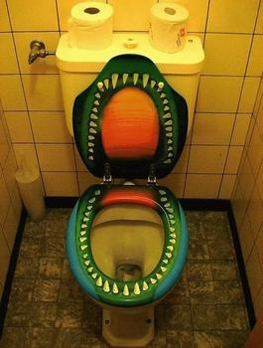

Slide 51
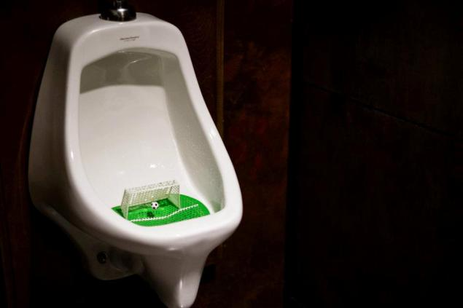

Slide 52
Outside?

Slide 55
Outside? No way!

Slide 56
Australia to discourage public urination

Slide 57
Amsterdam

Slide 58
Canada

