Slide 1
Inside an Amazing Home Made of Shipping Containers
Unusual, but practical, large-scale recycling

Slide 2
Slide title
The first floor of Mooney’s shipping container home is very industrial chic. "The idea is that if you go into the house it's very elemental," says Mooney. Polished cement floors — and accent walls that contrast with the grey — contribute to that "elemental look," as do other touches. "The handrails are made out of steel rebar," Mooney says.

Slide 4
Mooney made sure to include little tributes to the childhood memories that inspired him to build his home. Look closely at the center of the photo. "There are iron frames that we built for the kitchens that have big rivets on them," says Mooney. The rivets are an homage to the rivets on the submarine in Jules Verne's classic, "20,000 Leagues Under the Sea."

Slide 6
No matter how luxurious the house may appear, Mooney never wants visitors to forget they are in shipping containers. For one, he left the exposed corrugated ceilings intact. "The whole idea was that when you came in I wanted you to be able to see what the house was made out of," he says.

Slide 8
The decor and fixtures in the shipping container house reflect Mooney's simple industrial approach. "If I couldn't find it at Home Depot, I didn't want it," he says. "There are no Belgian chandeliers in here or anything like that."

Slide 10
Floor to ceiling windows can be a problem in Texas, where it's been known to get a little hot in the summer. The second-floor balconies are wide and deep enough to allow in natural light without greenhousing the interior with direct sunlight.

Slide 12
"There are seven 40-foot containers and seven 20-foot containers," Mooney says. "They're all 'high cube' containers, 9-and-a-half feet tall." Getting them, Mooney says, was the hardest part of the project. He struck out with the local firms he approached; they were reluctant to sell him new containers that weren't "beat to hell" after years of duty on freighters and trains.

Slide 14
Mooney had better luck with "one trip" shipping containers, where he bought brand new containers from a manufacturer in China. That manufacturer connected with a third party to haul a load of U.S.-bound products. Once the containers arrived in the U.S. and the products off-loaded, they were then trucked to Mooney.

Slide 16
While waiting for the containers, contractors from Texas-based firm Herman Darden ("They did a fantastic job, says Mooney") built the frame: wood with steel beams and a concrete floor.

Slide 18
The containers finally arrived. Despite a few nicks and scars from the overseas trip, they were in great condition. "They're beautiful pieces of equipment," he says. A crane helped lift the containers into place.

Slide 20
One big impediment you might run into while building a shipping container house: local construction laws, which can be a bit fuzzy when it comes to homes of this type. Fortunately, spending 30 years as a commercial architect in Dallas helped Mooney dot all the i's and cross all the t's when it came to local codes and zoning rules. "I was very careful to do it the right way," he says.

Slide 22
While some praise shipping container homes for being inexpensive, Mooney wouldn't exactly call his a bargain. "We got a little bit of a price break," he admits. However, "we took the money that we saved and put it into maple floors and some nicer appointments."

Slide 24
Another of those "nicer appointments": a 1,400-square-foot roof deck with views of Dallas. There's also a 40-foot swimming pool. "This is clearly kind of a cut above the shipping container houses you'll see out in the wild, so to speak," Mooney says.

Slide 26
Mooney says a visitor once asked him, "Why don't you write a book called 'Shipping Container Houses for Dummies?'" Mooney's response: "Because 'dummies' shouldn't build shipping container houses." He says unless you’re a highly experienced commercial architect like he is, the potential construction and legal pitfalls of such a project are too great for first-timers and do-it-yourselfers to take on. "It's more sophisticated than you think," he says.

Slide 27
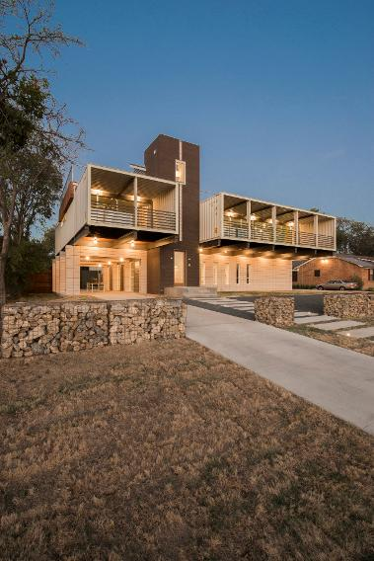

Slide 28
Now that he and his wife are moving in, Mooney has no regrets — even though the whole project took 22 months. "It was way too long," Mooney says about the time frame, "but I was enjoying the process too much."

Slide 30
The don’t have to be this big or expensive

Slide 31
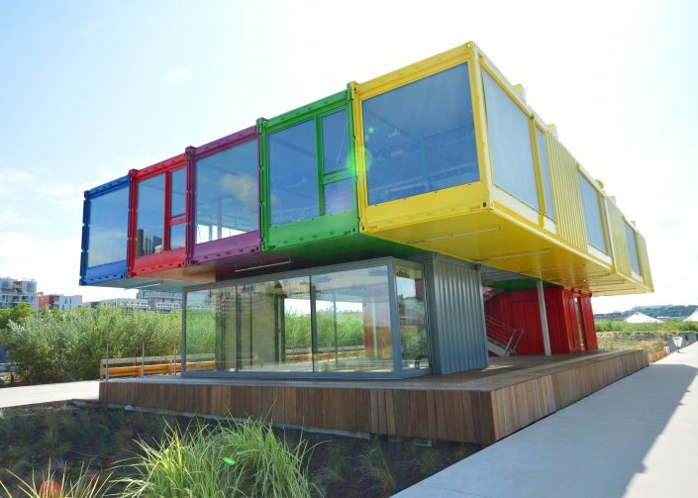

Slide 33
A business

Slide 34
Apartment House

Slide 35
Simplicity

Slide 38
Retail Store

Slide 40
Offices

Slide 41
Starbucks

Slide 52
Endless possibilities

