Slide 1
Animal Camouflage – Survival of the Fittest
The advantages of blending in with one’s habitat.

Slide 2
Advantages to Prey & Predators
Animals that are preyed upon have a greater chance of surviving if they don’t stand out against their habitat.
Likewise, predators that blend in with the habitat have a greater chance of being successful in getting food for themselves and their offspring.

Slide 3
White Animals in white habitats

Slide 17
Other examples of camouflage

Slide 20
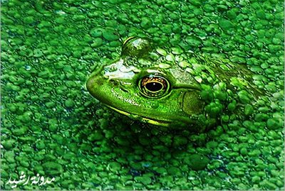
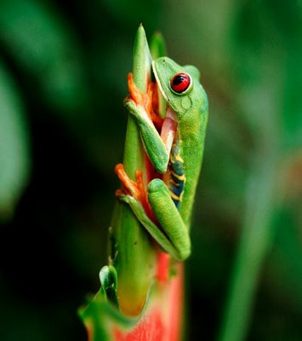
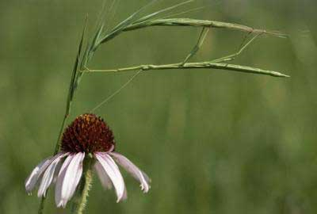

Slide 31
Can you find the camouflaged animals in these photos?

