Slide 1
The Law of the Wild
Botswans: Survival of the fittest, the food chain, etc.

Slide 2
Three lionesses pounced on a crocodile in an extraordinary scene after the reptile tried to attack one of the pride’s cubs. The protective females instinctively leapt into action to fend off the aggressive predator. With organised precision, the lionesses surrounded the croc and launched a ferocious volley of blows.

Slide 3
During the encounter the crocodile managed to bite one of the big cats but was soon killed by the pride. The rare scenes were captured by Tony Goldman while on a safari trip to the Duba Plains, in Botswana, with his son. Tony, 58, a cardiologist, said: ‘The lionesses had just killed a buffalo and suddenly a crocodile ventured about 100 yards out of the water towards them to snack on the meat.

Slide 4
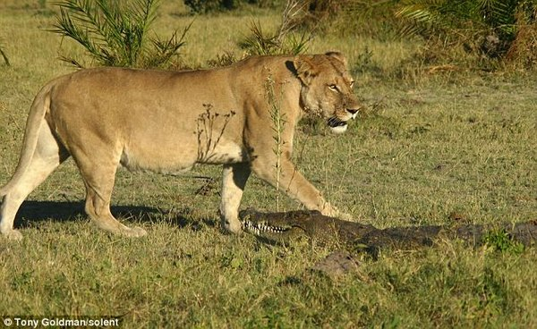

Slide 5
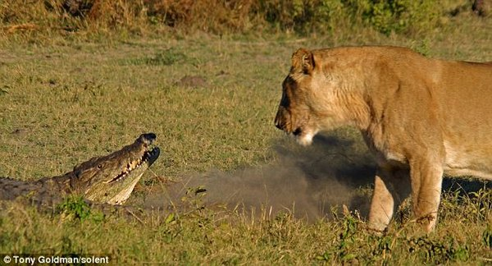

Slide 6
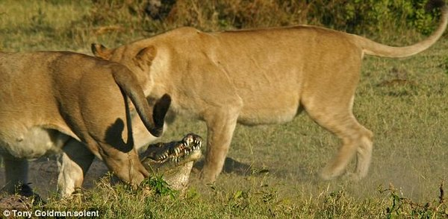

Slide 7
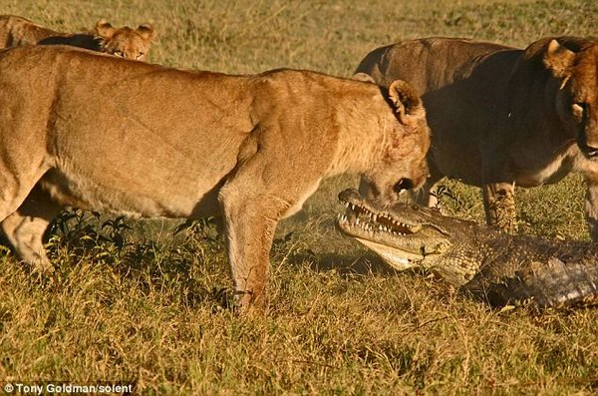

Slide 8
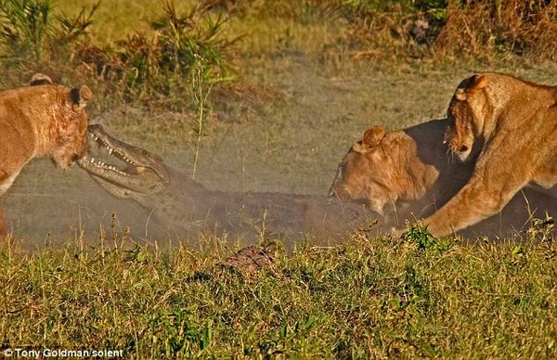

Slide 9
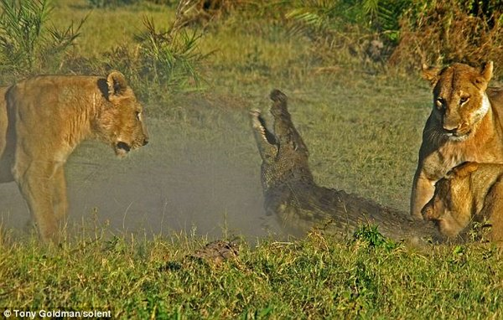

Slide 10
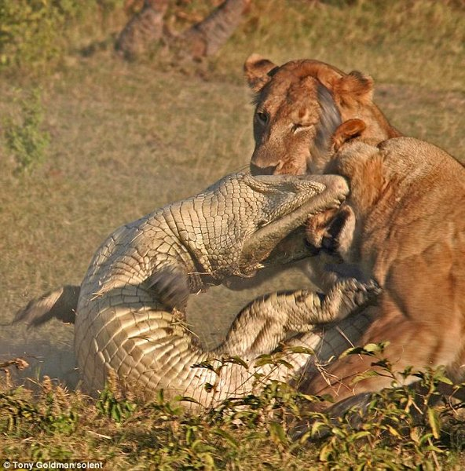

Slide 11
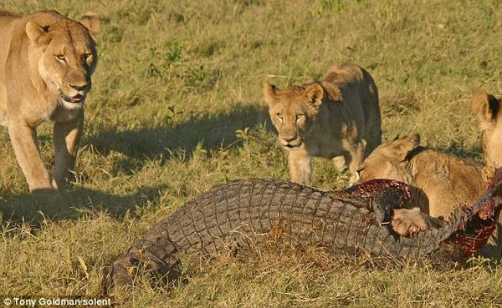

Slide 12
