Slide 1
Newly Discovered Animal Species
Just when you thought you’d seen it all, a load of bizarre new animals get discovered..

Slide 2
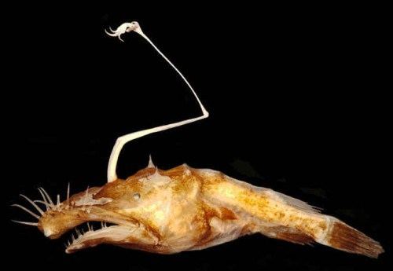
Lasiognathus Dinema
Discovered in 2016, this species of anglerfish is probably the ugliest on the list. Nevertheless, it isn’t the least interesting as the Lasiognathus Dinema was found while assessing damage from the Deepwater Horizon oil spill in the Gulf of Mexico. Is there any relationship to the two? Guess we’ll have to find out very soon.

Slide 3
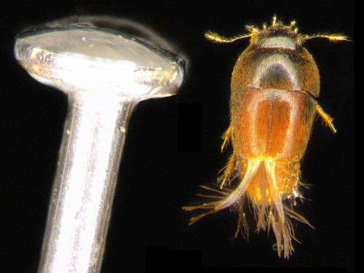
Phytotelmatrichis Osopaddington
Also recently discovered in 2016, this species of beetle is named after Paddington Bear. Why? Guess scientists hoped that when kids open their book about the lovable bear, they would also look after this tiny beetle.

Slide 4
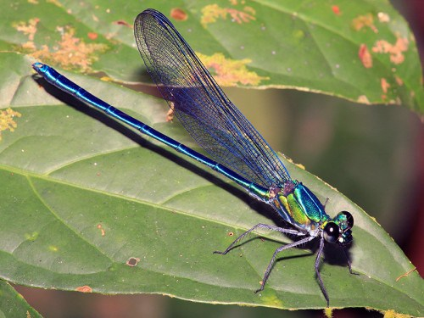
Umma Gumma
There are a number of newly discovered dragonflies and damselflies every year, however, the Umma Gumma caught our attention for its incredible color. This new damselfly was named after Pink Floyd’s 1969 double album Ummagumma.

Slide 5
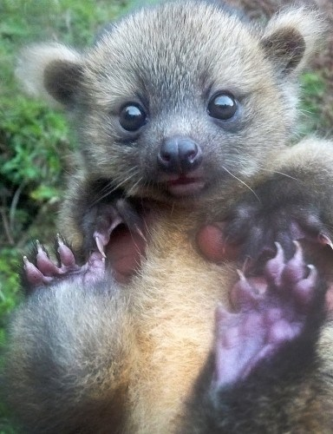
Olinguito
This little guy is the recently discovered Olinguito, a close relative to the racoon which inhabits the tall trees of the Andes forests. They’re notoriously secretive and very few have been spotted in the wild, so the harsh truth is that you’re probably never going to get a cuddle from this adorable creature.

Slide 6
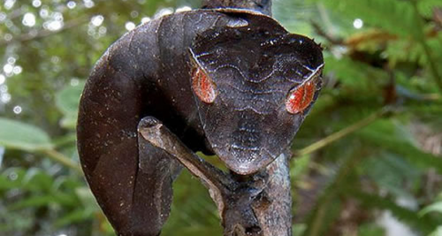
Satanic Leaf Tailed Gecko
This fella definitely has the looks to go with his sinister-sounding name! This gecko species has extremely effective camouflage abilities and can only be found in undisturbed forest in Madagascar.

Slide 7
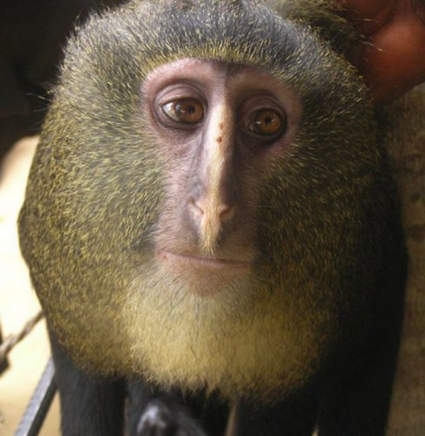
Lesula Monke
This “interesting”-looking monkey was first discovered by scientists in 2007, though he doesn’t look too happy about being found..

Slide 8
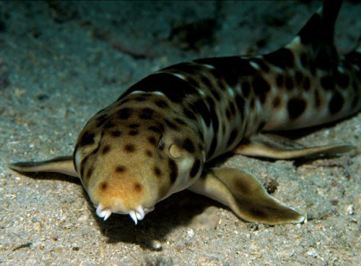
Walking Shark
Not much is known about this newly discovered and rare shark, though despite its name it can actually swim. It is thought to live on a diet of shrimp, crabs and molluscs – presumably caught after a full days hiking.

Slide 9
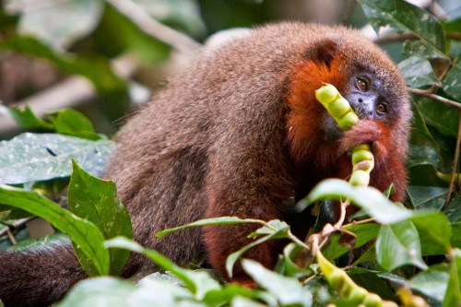
Caqueta Monkey
These cute little monkeys were discovered by a group of scientists in 2010. They are one of the few monkey species who mate for life, but the weirdest thing about them is the way they purr like a cat! Sadly there’s thought to be less than 250 left in the wild.

Slide 10
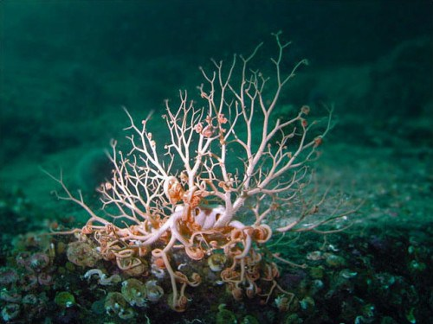
Gorgon Head Starfish
Also known as the basket star, the gorgon head is related to the starfish and was discovered by scientists in the Mid-Atlantic Ridge.

Slide 11
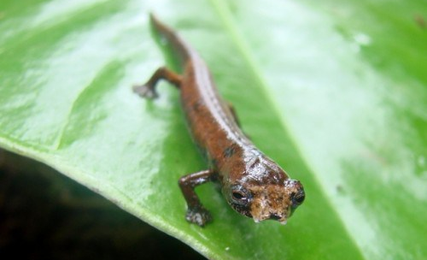
ET Salamander
One look at this little creature’s face and you can probably guess where the name came from! This newly found species of salamander was discovered in the Ecuadorian rainforest.

Slide 12
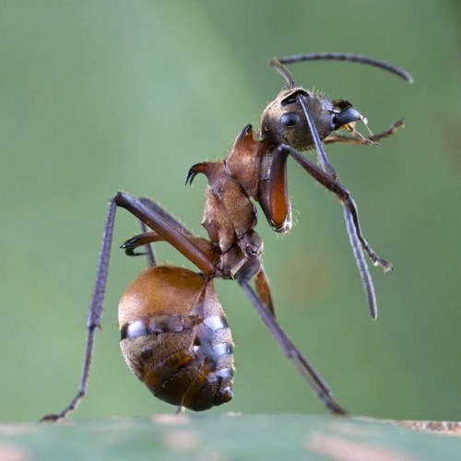
Fish-Hook Ant
These creepy-looking ants have a powerful defence mechanism – a large curved spine (or hook) on their back that can even slice through skin..yowch.

Slide 13
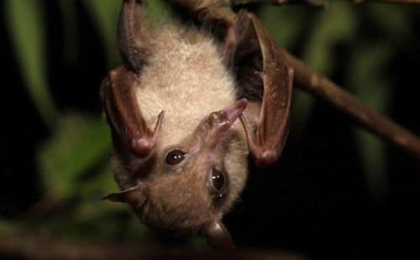
Blossom Bat
Discovered in the mountains of Indonesia, this cute little bat is also known as ‘the hummingbirdof the bat world’ due to the way it uses its long tongue to feed on nectar from trees.

Slide 14
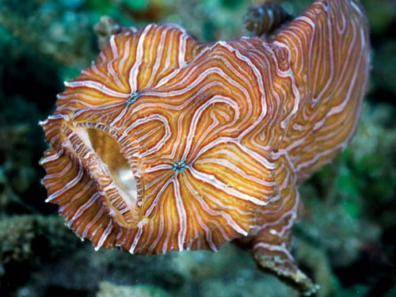
Psychedelic frogfish
This frog’s trippy patterns are unique to each fish – similar to fingerprints in humans. They only grow to six inches long and can be found in the Indonesian sea.

Slide 15
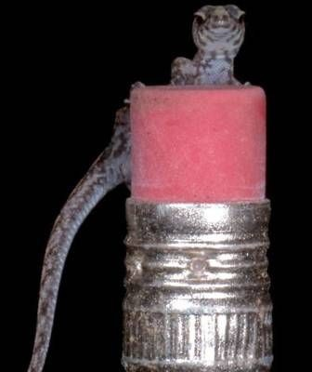
Scaly-Eyed Gecko
This tiny little gecko species was recently discovered in the rainforests of Ecuador, and is so small it can fit on top of a pencil eraser. How did the scientists spot it in the first place?!

Slide 16
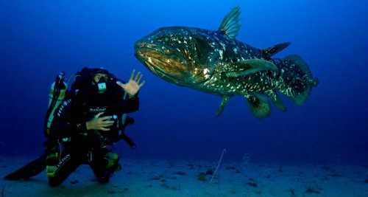
Coelacanth
This strange looking fish was actually thought to have gone extinct along with the dinosaurs 65 million years ago, so scientists got quite the shock when the species was discovered alive and well!

Slide 17
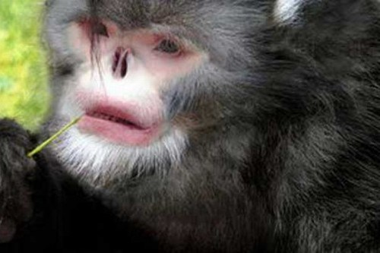
Sneezing Monkey of Burma
These eery looking monkeys get their name from their bizarre upturned noses which cause them to break into sneezing fits when the rain gets into the sinuses. They can be found in the Maw River region, where sadly there are thought to be less than 300 in the wild due to hunting and the destruction of their habitat.

Slide 18
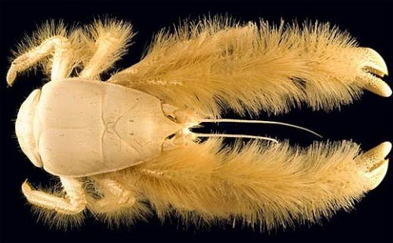
Yeti Crab
This white hairy crab is the latest addition to the yeti crab species which can be found in Antarctica. Because there’s no food source readily available for them here, they’ve come up with a clever way round it – they ‘farm’ their own food by using the hair on their arms to attract bacteria which they then gobble up. Clever!

Slide 19
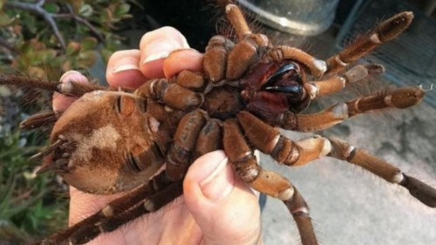
Goliath Bird Eating Spider
This newly discovered species is the largest spider in the world, and can weigh up to a quarter of a pound! Despite its name their main diet is actually lizards, mammals and snakes – although they probably wouldn’t turn down a small bird either…

Slide 20
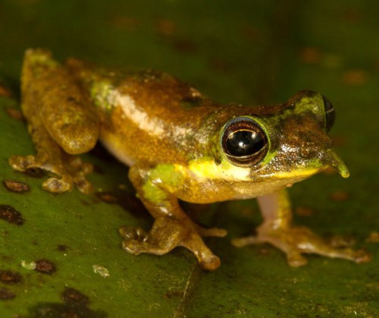
Pinocchio Frog
This cute little frog got its name due to its long pointed nose which turns upwards when making a mating call. Its discovery was a matter of pure chance – a scientist just happened to notice it sitting on a bag in his camp! Maybe he was looking for fame and fortune!

Slide 21
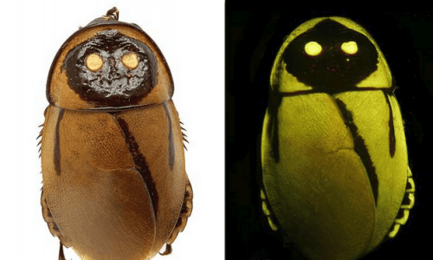
Night-Light Cockroach
This amazing glowing roach was recently mentioned in a scientific paper based on a specimen found seventy years ago. The cockroaches have an ingenious form of self defence – they mimic the glow of the poisonous click beetle in order to warn off possible predators… sneaky!

Slide 22
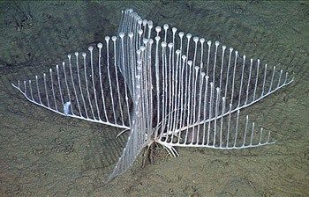
Lyre Sponge
This recently discovered sponge was first spotted deep in the ocean off Monterey Bay in California. It’s also known as the ‘harp sponge’ due to its beautiful shape and design, but don’t be fooled by its harmless appearance – it’s actually a meat-loving carnivore.

Slide 23
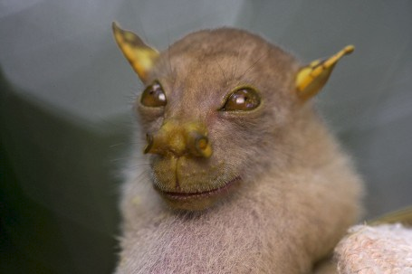
Tube-nosed Fruit Bat
This totally bonkers looking bat looks a lot like a certain Star Wars character – can you spot the resemblance?! They are thought to live only in the forests of Papua New Guinea, and not much else is known about them… yet.

Slide 24
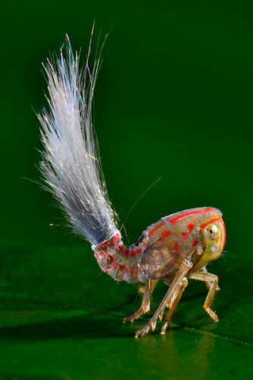
Juvenile Planthopper
Just 5 millimetres long, these freaky looking creatures have a nifty defence strategy. Those long waxy strands break off, distracting a confused predator while the planthopper dashes off to safety.

Slide 25
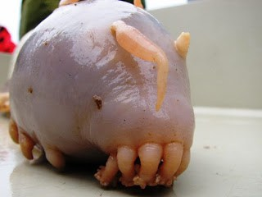
Sea Pigs
Let’s be honest – these scary sea creatures definitely aren’t as cute as their land-living namesakes. They can be found in the ice cold waters of the Southern Ocean, and despite their otherworldly appearance scientists say they are actually one of the most common creatures found in the sea off Antarctica.

Slide 26
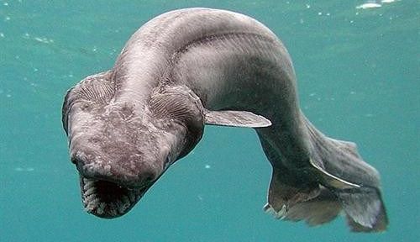
Frilled Shark
Wouldn’t want to come across this terrifying shark whilst getting your PADI would you?! Well thankfully the frilled shark is rarely encountered by humans, instead living deep underwater which they have adapted extremely well to. Their strange ee-like body and scary appearance has caused many to believe that they are the cause of sea-serpent sightings.

Slide 27
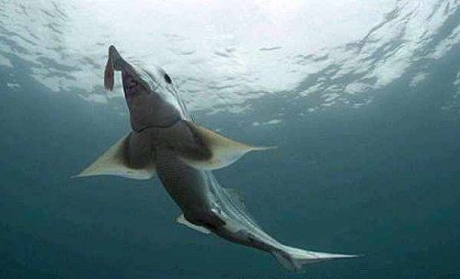
Eastern Pacific Black Ghost Shark
This mythical looking creature was spotted deep in the sea off California in 2009, and uses its fins to glide gracefully through the water. So far very little is known about them, for example there are various theories regarding what the strange organ protrusing from their head is actually used for…

