Slide 1
Hungary
One of the “brighter” spots in Eastern Europe

Slide 2
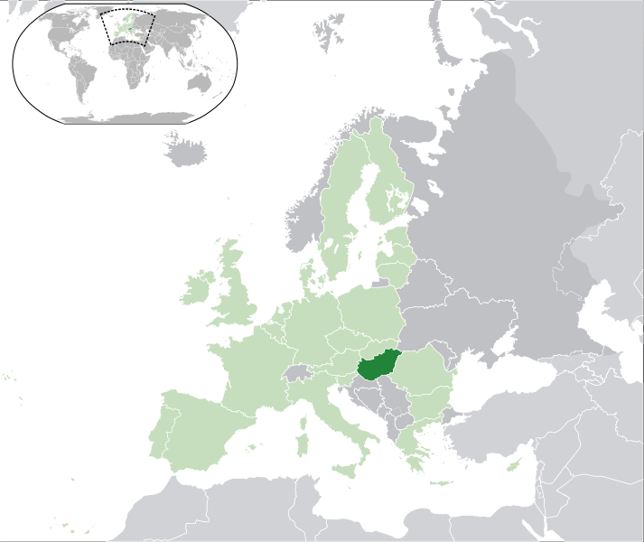

Slide 3
Geographic – General Information
Location: Central Europe, northwest of Romania
Area: 93,028 sq km
Comparative: slightly smaller than Indiana
Land boundaries:
total: 2,185 km
border countries: Austria 366 km, Croatia 329 km, Romania 443 km, Serbia 166 km, Slovakia 676 km, Slovenia 102 km, Ukraine 103 km
Natural resources: bauxite, coal, natural gas, fertile soils, arable land
Land use:
arable land: 49.58%
permanent crops: 2.06%
other: 48.36% (2005)
Climate: temperate; cold, cloudy, humid winters; warm summers
Terrain: mostly flat to rolling plains; hills and low mountains on the Slovakian border
Coastline: none Hungary is a landlocked country
Major River: Danube R.

Slide 4
Demographics
Population: 9,880,059 (July 2010 est.)
Age structure:
0-14 years: 14.8%
65 years and over: 16%
Population growth rate: -0.26% (2010 est.)
Infant mortality rate: 7.7 deaths/1,000 live births
Life expectancy at birth: 73.69 years
Total fertility rate: 1.36
Literacy: age 15 and over can read and write 99.4%
Urban population: 68%
Ethnic groups: Hungarian 92.3%, Roma 1.9%, other or unknown 5.8% (2001 census)
Religions: Roman Catholic 51.9%, Calvinist 15.9%, Lutheran 3%, Greek Catholic 2.6%, other Christian 1%, other or unspecified 11.1%, unaffiliated 14.5% (2001)
Languages: Hungarian 93.6%,

Slide 5
Economy
GDP - per capita (PPP):
$18,600 (2009 est.)
$20,000 (2008 est.)
$19,800 (2007 est.)
GDP - real growth rate:
-6.7% (2009 est.)
0.6% (2008 est.)
1.2% (2007 est.)
GDP - share by sector:
agriculture: 2.8%
industry: 34.7%
services: 62.5% (2009 est.)
Unemployment rate:
10.8% (2009 est.)
7.8% (2008 est.)
Labor force - by occupation:
agriculture: 4.5%
industry: 32.1%
services: 63.4% (2008)
Population below poverty line: 12% (2010 est.)
Agriculture - products: wheat, corn, sunflower seed, potatoes, sugar beets; pigs, cattle, poultry, dairy products
Industries: mining, metallurgy, construction materials, processed foods, textiles, chemicals, motor vehicles

Slide 6
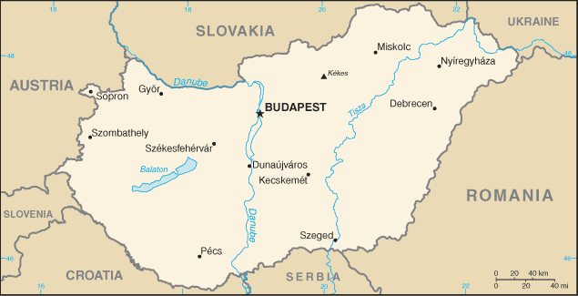

Slide 7
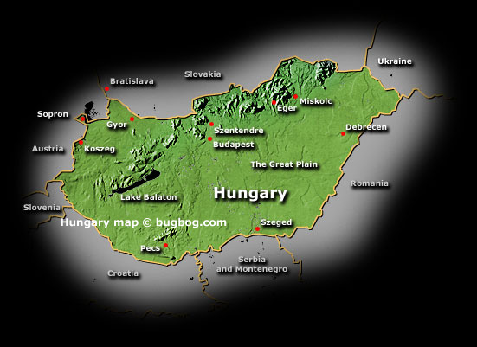

Slide 8
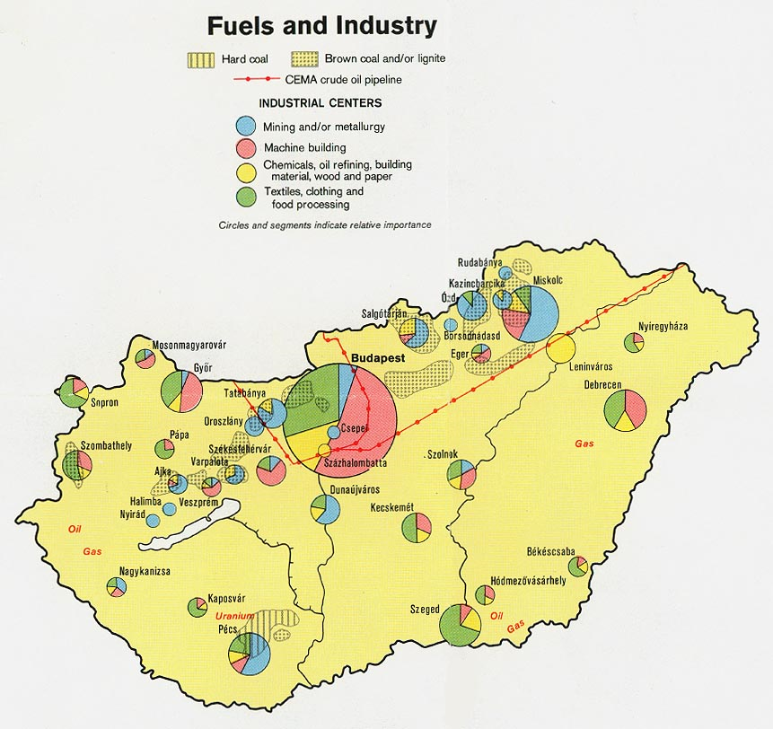

Slide 9
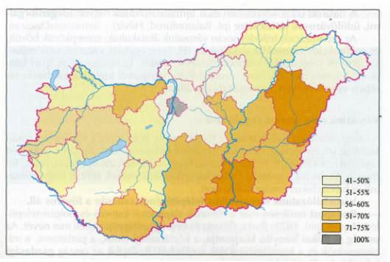
The proportion of urban population by counties (%), 1998

Slide 10
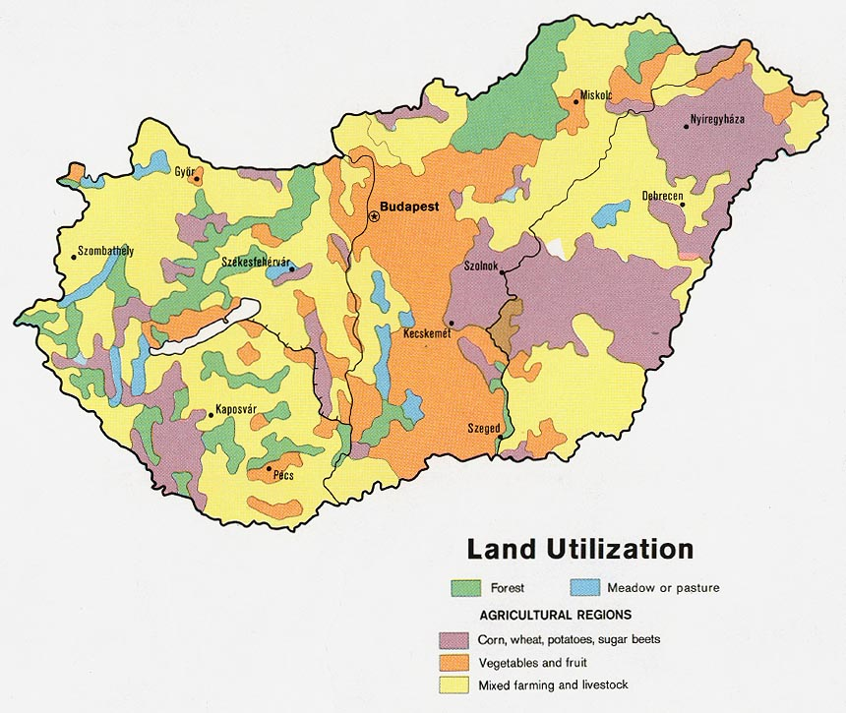

Slide 11
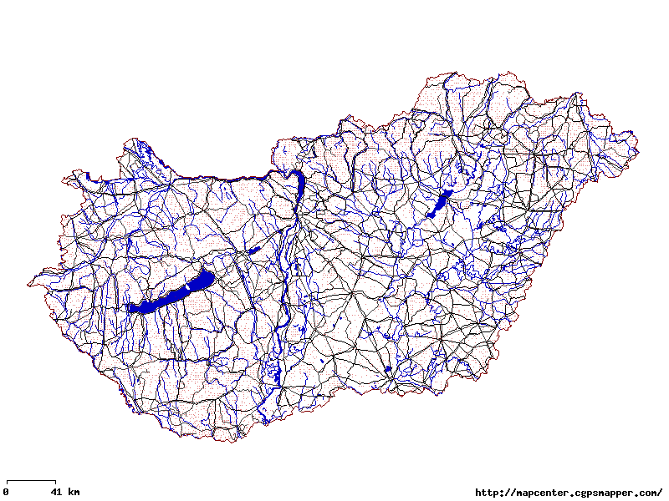
Road Network

Slide 12
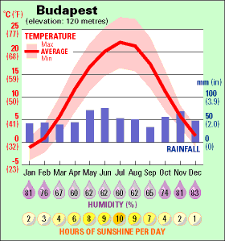
Climograph

Slide 13
Budapest (capital)

Slide 14
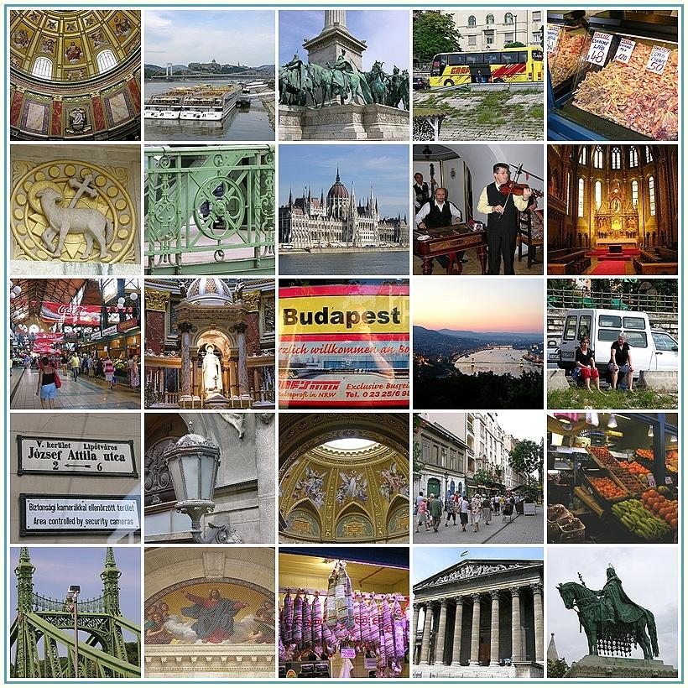

Slide 15
Heroes Square

Slide 16
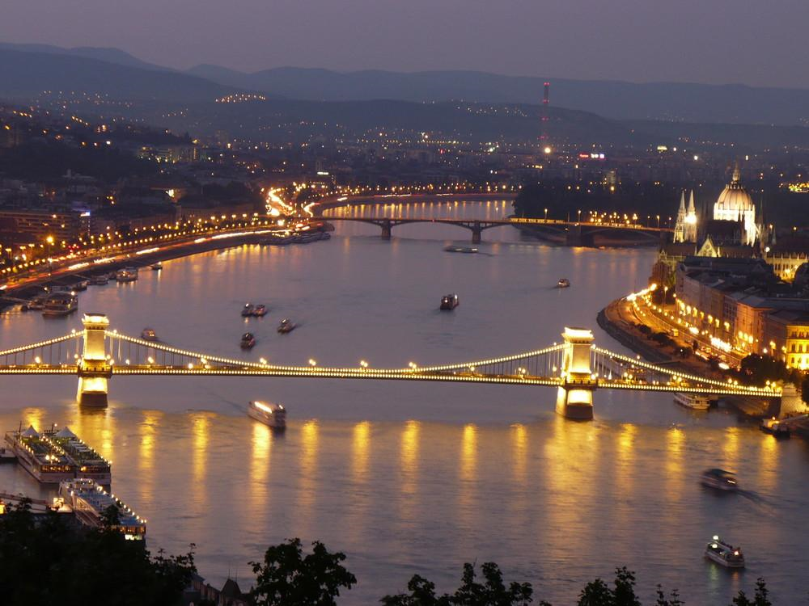

Slide 17
King’s Palace

Slide 18
Parliament on the Danube

Slide 19
Parliament in daylight

Slide 20
Rotunda of the Parliament Building

Slide 23
Saint Stephen's basilica

Slide 24
Saint Stephen's basilica

Slide 25
Matthias church

Slide 26
Matthias church

Slide 27
THE BORY CASTLE

Slide 28
Episcopal Palace

Slide 29
City Hall

Slide 32
Vaci Street

Slide 33
Central Market, Budapest

Slide 34
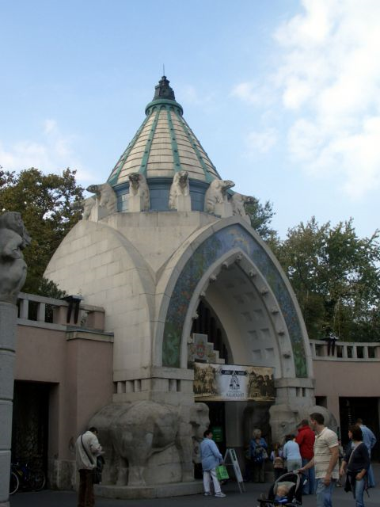
Budapest Zoo

Slide 35
Vörösmarty Square

Slide 40
Hungarian National Museum

Slide 41
Museum of Fine Arts

Slide 42
Palace of Arts

Slide 43
Hungarian National Gallery

Slide 44
Szechenyi Thermal Bath

Slide 45
The Chain Bridge is one of Budapest's most famous landmarks. The magnificent suspension bridge was built in the 19th century across the River Danube between Pest and Buda, at the time still separate cities.

Slide 51
Castle Palace

Slide 52
Fishermen's bastion by night.

Slide 53
Fisherman’s Bastion

Slide 54
Globalization in Budapest

Slide 55
Vajda Hunyadi Castle

Slide 57
Budapest Synagogue

Slide 59
Margaret Island, Budapest

Slide 60
Other Towns & Cities

Slide 61
Debrecen

Slide 62
Debrecen – Kossuth Square

Slide 63
Debrecen – Town Square

Slide 64
Szeged

Slide 65
Szeged - Klauzál Square

Slide 66
Szeged

Slide 67
Pecs, Hungary

Slide 68
Holloko, Hungary

Slide 69
Gyula, hungary
It is one of the most important arts centres of the south of the Large Plain, because it is rich in monuments and the relics of the historical past.

Slide 81
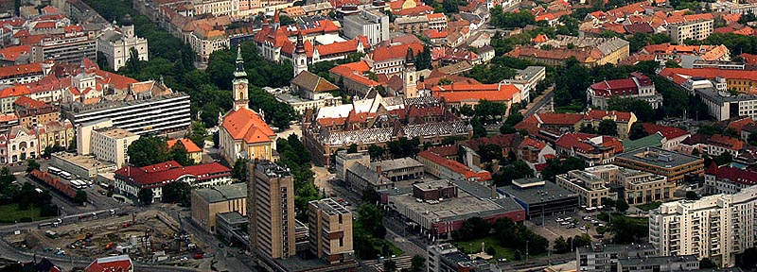
Aerial Photos - Hungarian towns & Cities

Slide 82
Tokaj

Slide 83
Tiszatarján

Slide 84
Abádszalók

Slide 85
City Miskolc

Slide 86
Pilis (town)

Slide 87
Tápiószentmárton (Town)

Slide 88
Dunabogdány

Slide 89
Jászdózsa

Slide 90
TIHANY is a village on the northern shore of Lake Balaton on the Tihany Peninsula

Slide 91
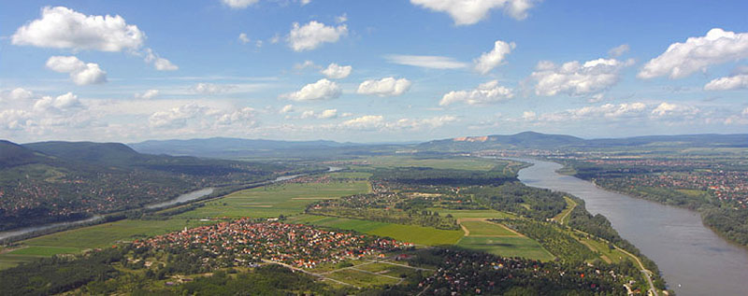
Scenic Tourism

Slide 92
Operencias Family Resort in the beautiful and scenic Zala Valley

Slide 93
Rural Scene

Slide 94
Biking through the Hungarian forests

Slide 95
The Aggtelek Karst is located in the north-eastern corner of Hungary.

Slide 96
Cathedral of Kalocsa (Episcopalian)

Slide 97
The wine region of Tokaj-Hegyalja in Hungary

Slide 98
The scenic Wachau Valley

Slide 103
Shoppe with thatched roof

Slide 107
Pilis Mountains

Slide 108
Ox-bow lake at River Tisza

Slide 109
Nyékládháza-lakes

Slide 110
The Lake Balaton

Slide 127
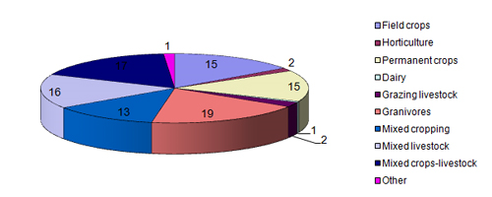
Agriculture

Slide 128
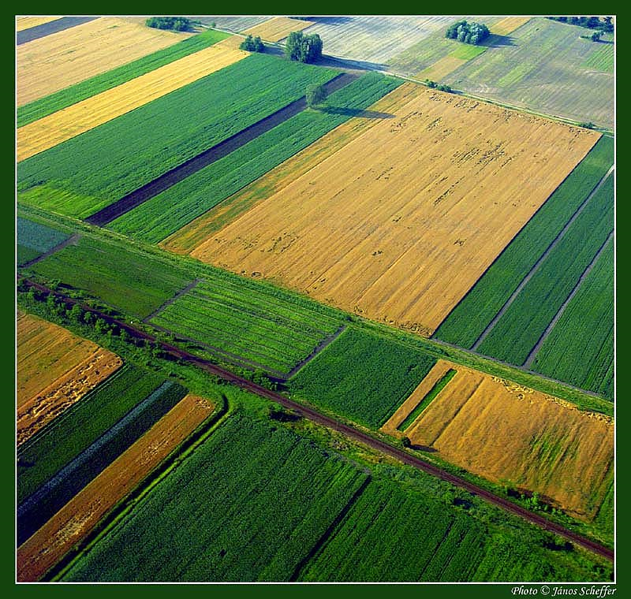

Slide 131
Along the “Blue” Danube

Slide 132
Raising Chickens

Slide 133
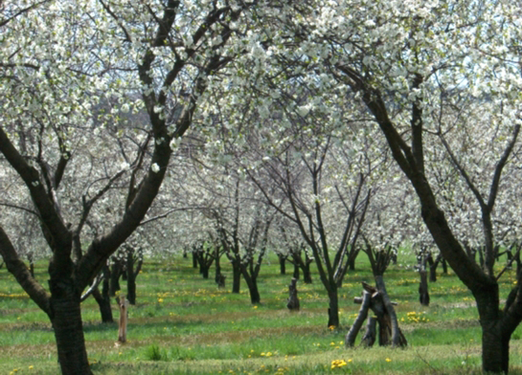
Fruit Orchards

Slide 134
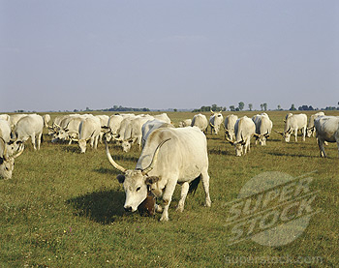
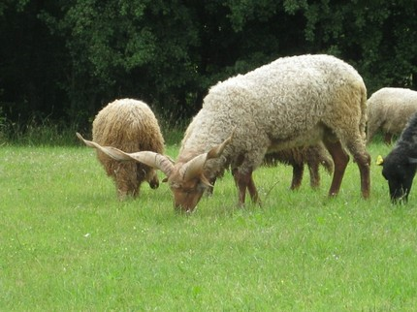
Livestock

Slide 135
Grain

Slide 136
Resources & Industry

Slide 137
Coal, crude oil and natural gas fields in Hungary

Slide 138
Strip-mined Hillside

Slide 139
Stone Mine

Slide 140
Százhalombatta, oil refinery

Slide 141
Nuclear Power Generation

