Slide 1
Meaning Associated with Rose Colors

Slide 2
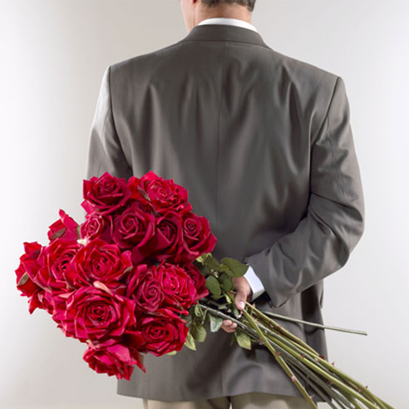

Slide 3
Red: Love and Romance
One of the most universal of all symbols, the red rose represents true love. It has also appeared throughout history and across cultures as both a political and religious symbol.

Slide 4
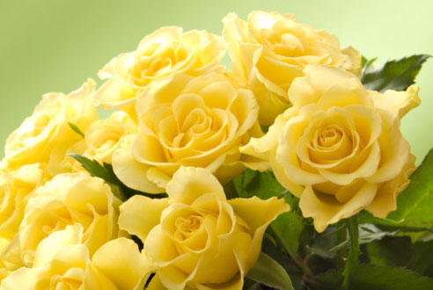

Slide 5
Yellow: Friendship, Joy, Get Well
Throughout history, yellow has been closely associated with the sun, making these roses excellent for cheering people up. Yellow roses send a message of appreciation and platonic love without the romantic subtext of other colors. The color represents feelings of joy and delight.

Slide 6
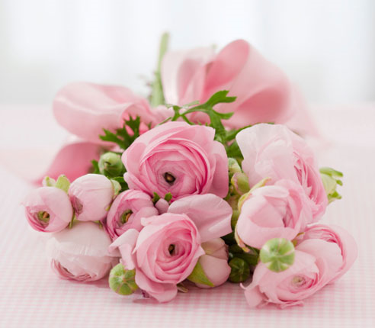

Slide 7
Pink: Love, Gratitude, Appreciation
Pink carries with it the connotation of grace and elegance, as well as sweetness and poetic romance.
Dark pink roses are symbolic of gratitude and appreciation, and are a traditional way to say thanks.
Light pink roses are associated with gentleness and admiration, and can also be used as an expression of sympathy.

Slide 8
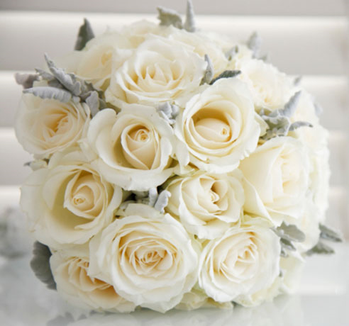

Slide 9
White: Purity, Innocence, Sympathy, Spirituality
Early tradition used white roses as a symbol for true love, an association which would later become the hallmark of the red rose. Known as the bridal rose, the white rose is a traditional wedding flower. So, white represents unity, virtue, and the pureness of a new love. They’re also associated with honor and reverence, making them a fitting memorial for a departed loved one.

Slide 10
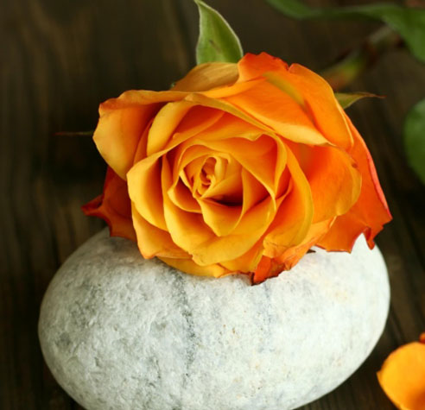

Slide 11
Orange: Desire, Enthusiasm and Passion
A literal mixture of yellow and red, orange roses were seen as a bridge between friendship symbolized by yellow roses and love represented by red roses. They can be an expression of fascination, or a gift to say 'I'm proud of you.'

Slide 12
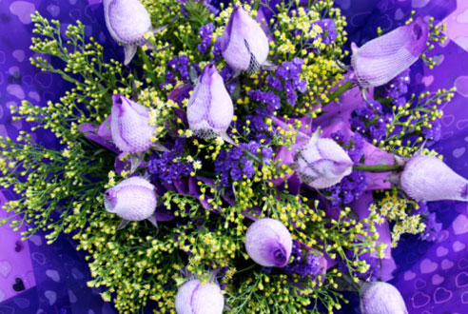

Slide 13
Lavender: Enchantment, Majesty, Love at First Sight
The color purple has a traditional association with royalty. In this regard, shades of lavender roses suggest an air of regal majesty and splendor.

