Slide 1
Northern England & the Scottish border
Selected Scenes

Slide 2
Newcastle- upon-Tyne

Slide 6
Berwick-upon-Tweed

Slide 10
The Castle Inn, Edge Hill

Slide 11
Edge Hill University

Slide 12
Edge Hill

Slide 13
Liverpool: The Liverbirds !

Slide 16
Liverpool' s Chinatown gate, at night

Slide 17
Downtown Manchester

Slide 20
University of Manchester 's iconic building

Slide 21
Sheffield

Slide 25
University of Sheffield

Slide 26
Amusing welcome sign (own it!)

Slide 27
Rural & Coastal Scenes

Slide 28
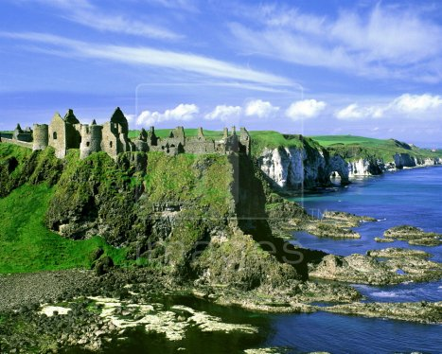

Slide 29
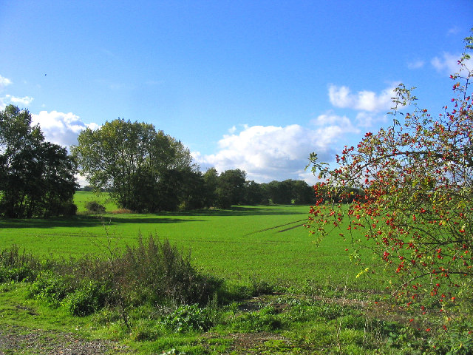

Slide 30
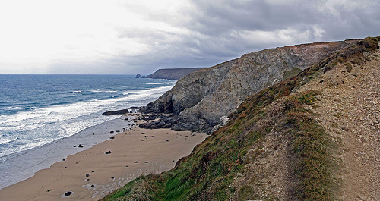

Slide 31
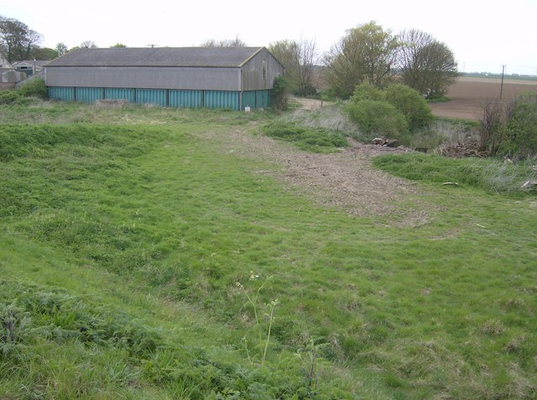

Slide 32
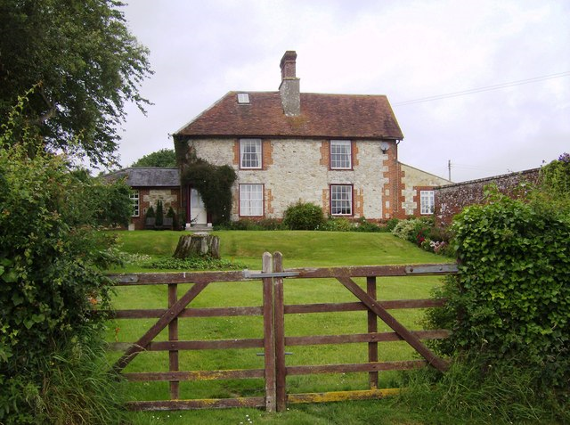

Slide 33
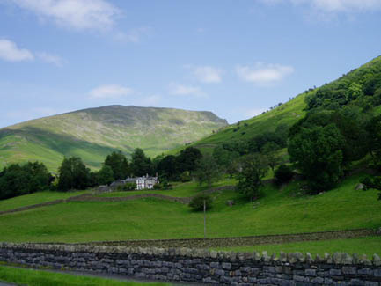

Slide 34
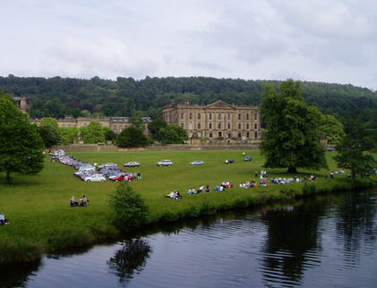

Slide 35
