Slide 1
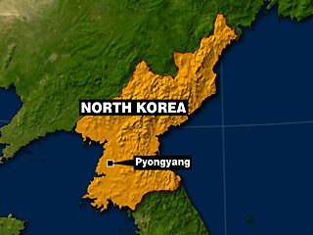
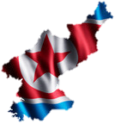
Special glimpse inside North Korea

Slide 2
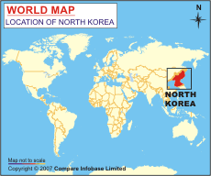
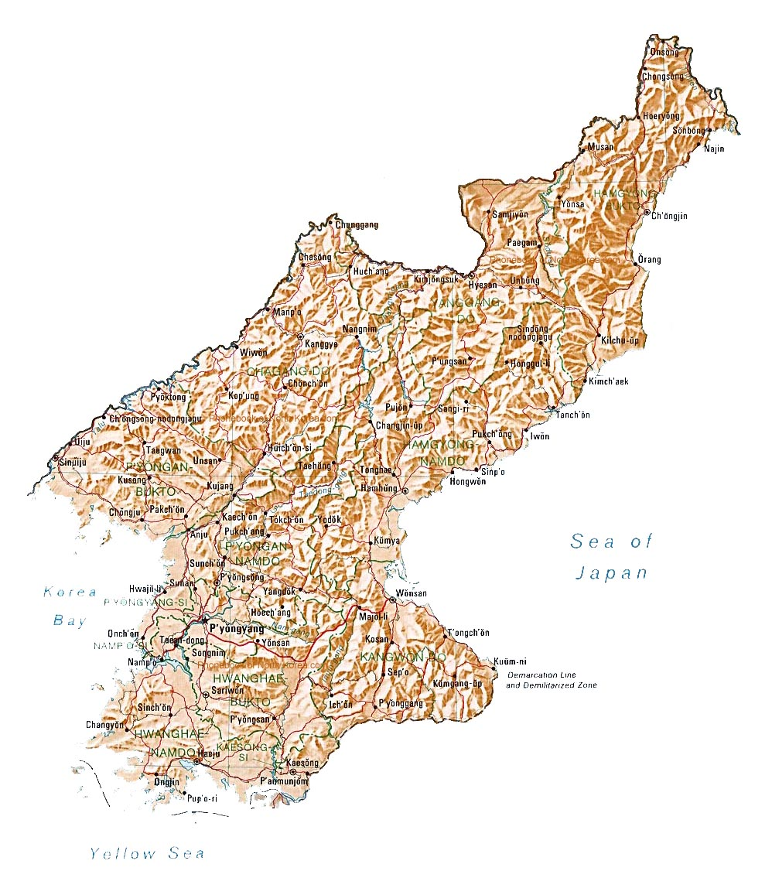

Slide 3
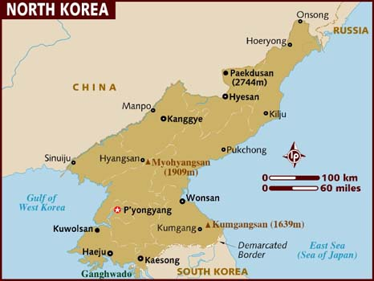

Slide 4
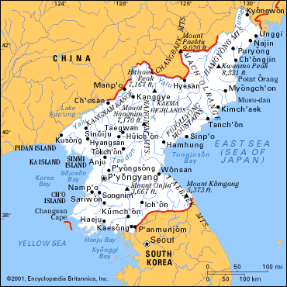

Slide 5
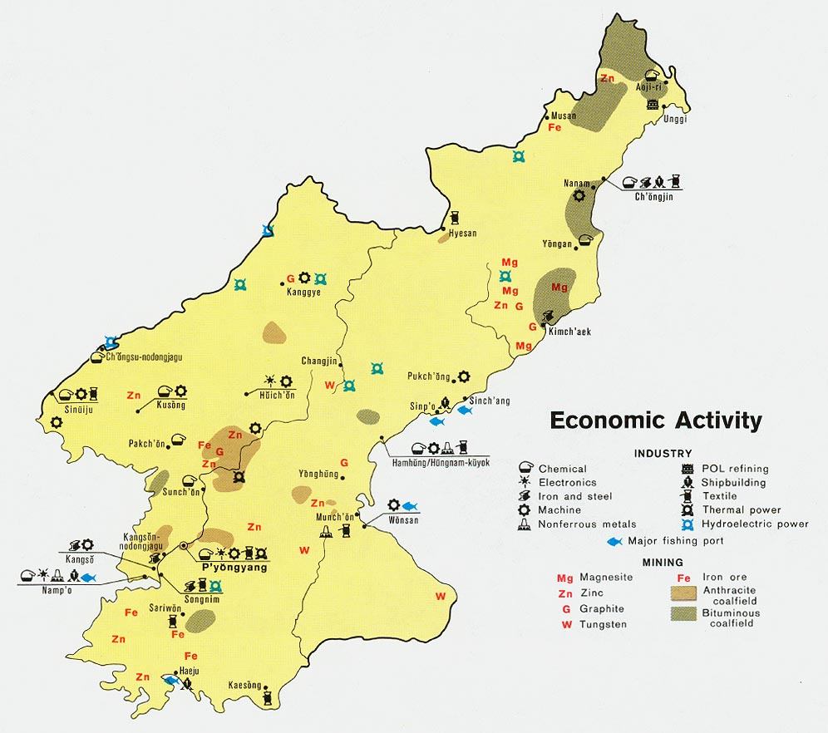

Slide 6
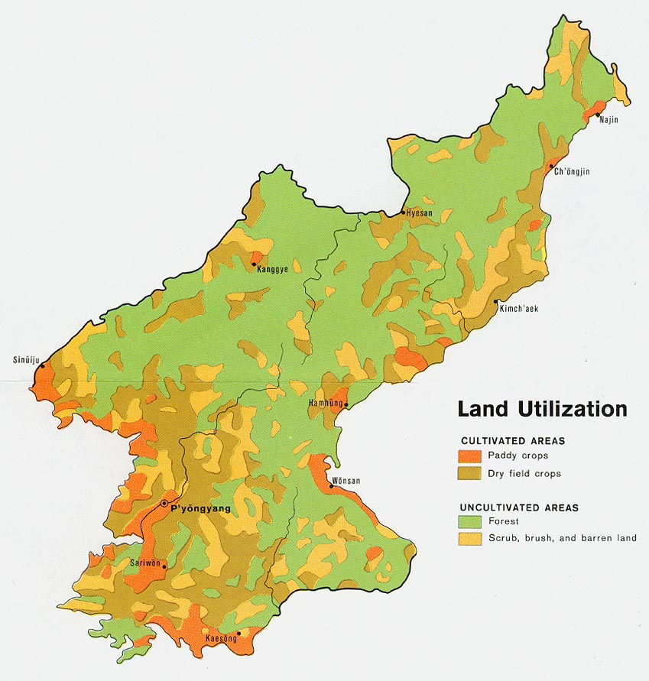

Slide 7
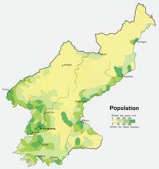

Slide 8
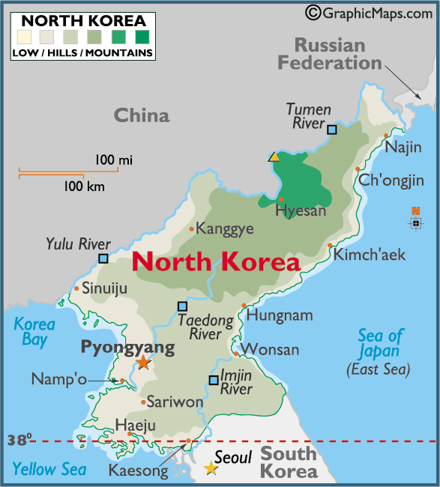

Slide 9
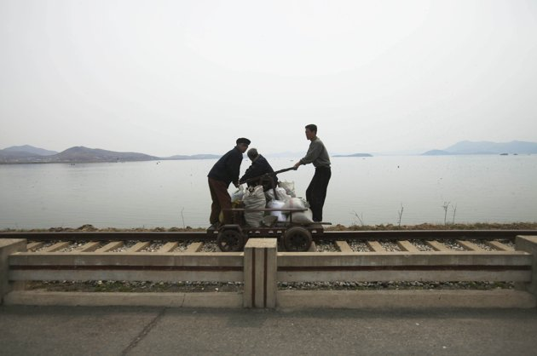
Men operate a manual rail car on tracks running along the West Sea barrage near Nampho

Slide 10
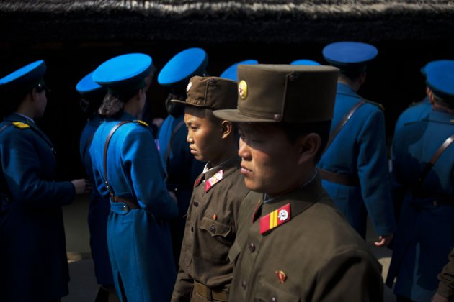
North Korean soldiers, foreground, and North Korean traffic police, background, tour the birthplace of Kim Il Sung

Slide 11
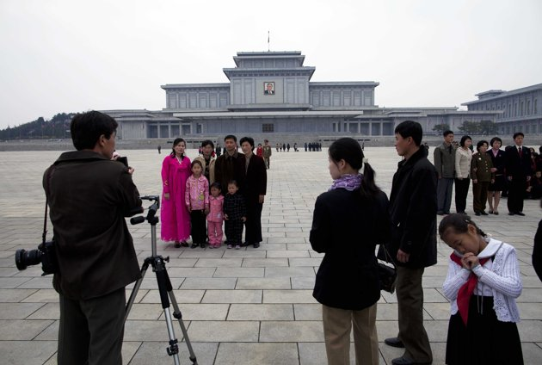
In this April 15, 2011 photo, families have their photographs taken in front of the Kumsusan Memorial Palace in Pyongyang, North Korea. The palace, which was the official residence of Kim Il Sung until his death in 1994, is now a mausoleum where his embalmed body lies in state

Slide 12
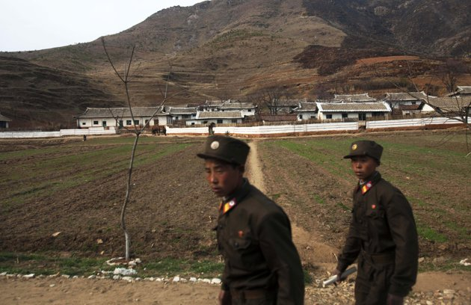
Two North Korean soldiers walk along a road and past a small village near the demilitarized zone

Slide 13
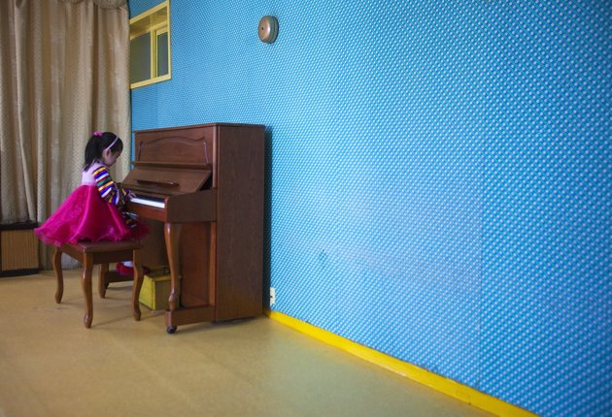
a girl plays the piano inside the Changgwang Elementary School

Slide 14
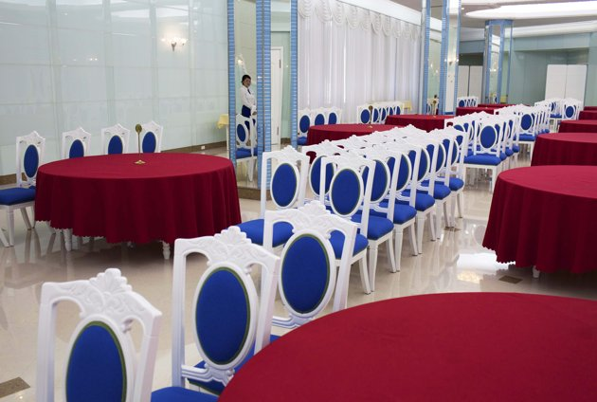
a waitress is reflected in a mirror inside a hotel restaurant in Mount Myohyang

Slide 15
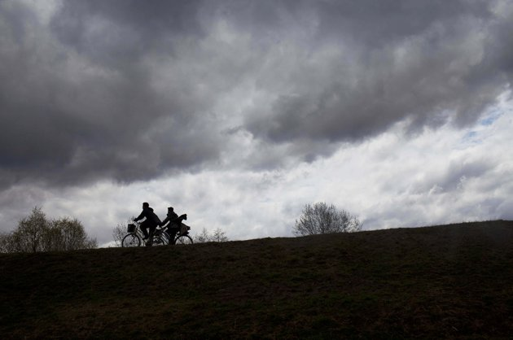
men ride bicycles at the end of a work day in Pyongyang

Slide 16
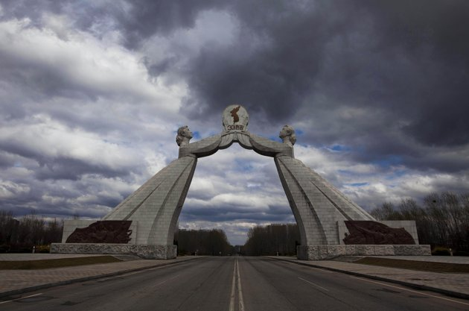
Monument to the Three Charters for National Reunification, which symbolizes the hope for eventual reunification of the two Koreas,

Slide 17
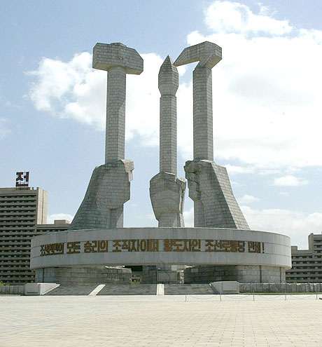
North Korean monument of the three revolutions in Pyongyang. Pyongyang was obliterated by American bombing raids and rebuilt. As a model city, the sick, elderly are moved out of the capital .

Slide 18
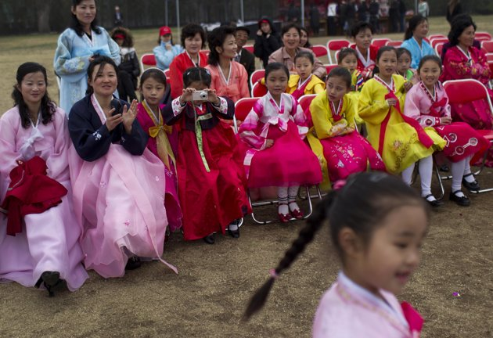
Taking photo of friends dancing on the birthday of Kim Il Sung

Slide 19
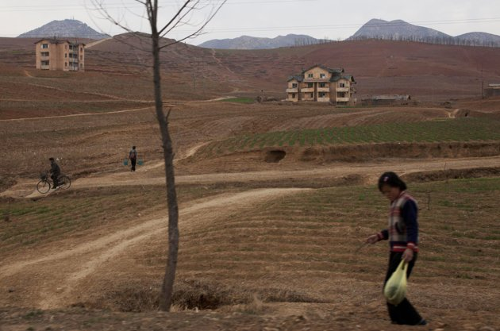
people go about their daily routines south of Pyongyang along the highway

Slide 20
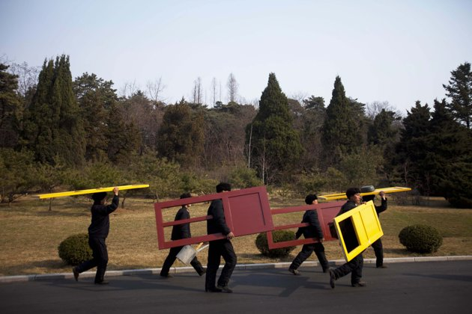
workers carry painted doors along a road in Mangyongdae

Slide 21
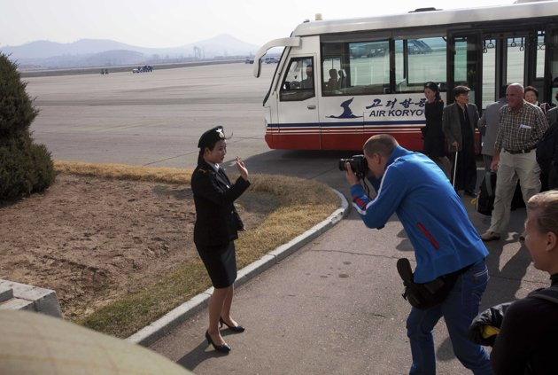
European tourist photographs a North Korean woman working at the airport

Slide 22
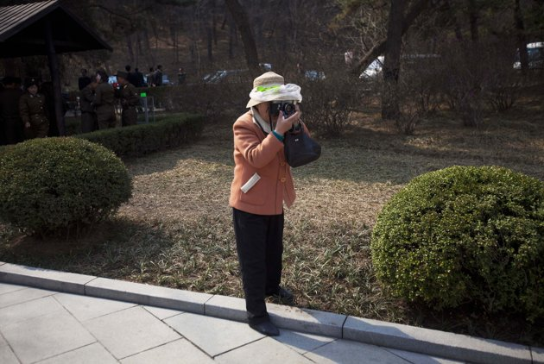
Professional photographer takes a souvenir picture for visitors to the birthplace of Kim Il Sung

Slide 23
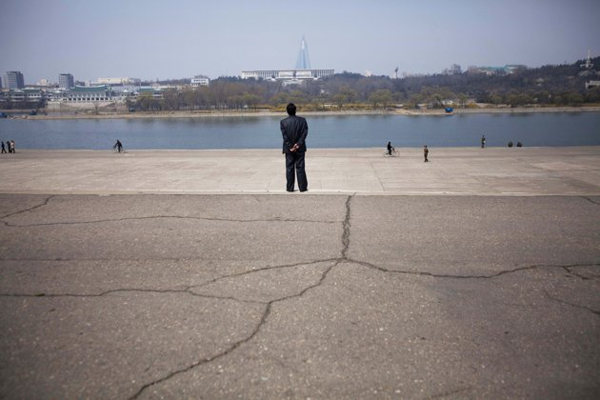
People stroll along the Taedong River in Pyongyang,

Slide 24
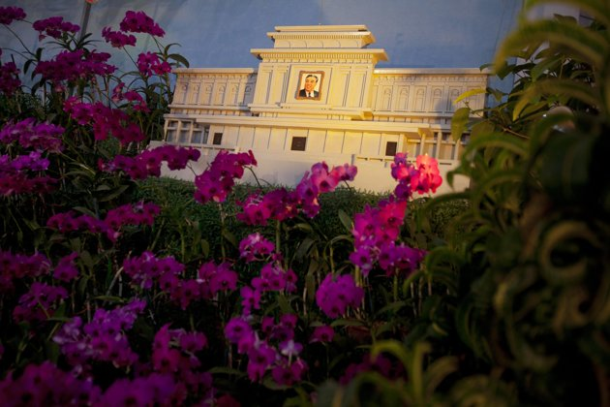
flowers known in North Korea as "Kimilsungia" are displayed next to a small replica of the Kim Il Sung mausoleum

Slide 25
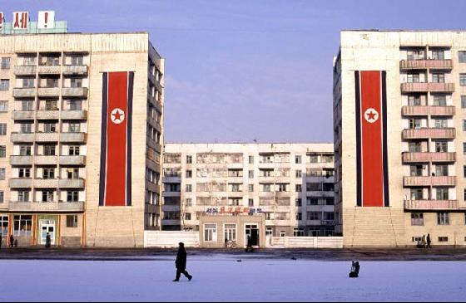

Slide 26
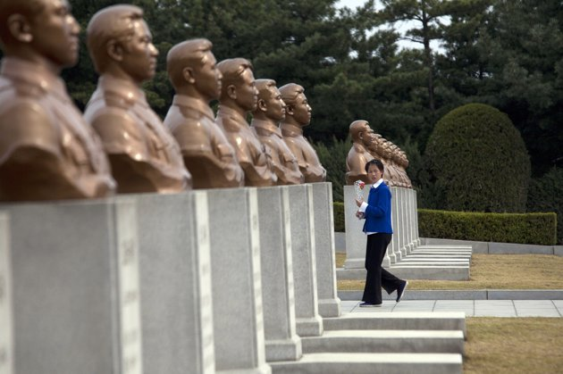
Girl carries flower through memorial cemetery in Pyongyang for men & women who died fighting against the Japanese

Slide 27
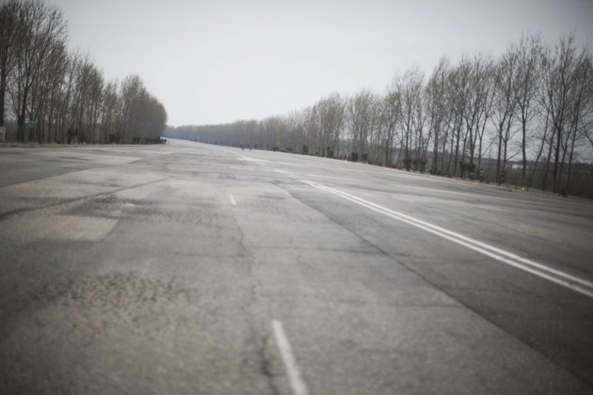
a multi-lane highway empty of vehicles near Pyongyang

Slide 28
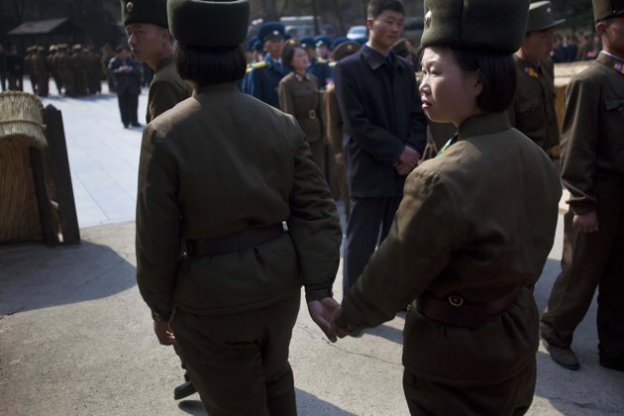
two female North Korean soldiers hold hands as they tour the birthplace of Kim Il Sung

Slide 29
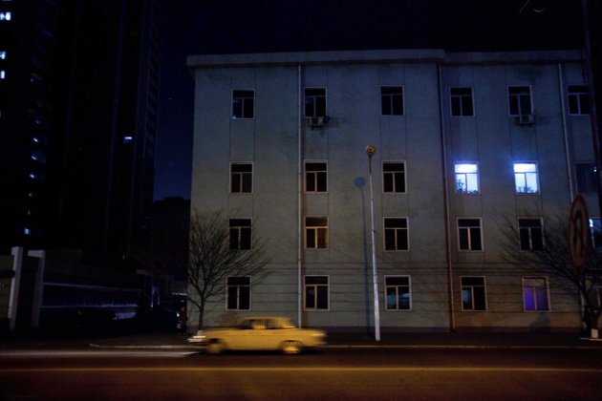
a car drives along a street at night in central Pyongyang

Slide 30
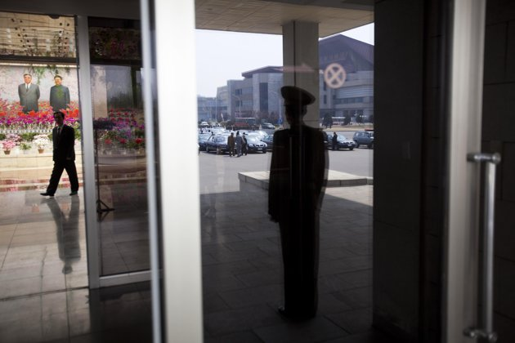
guard reflected in a window stands by the entrance to a hall where organizers held an exhibition of the flowers known in North Korea as Kimjongilia and Kimilsungia

Slide 31
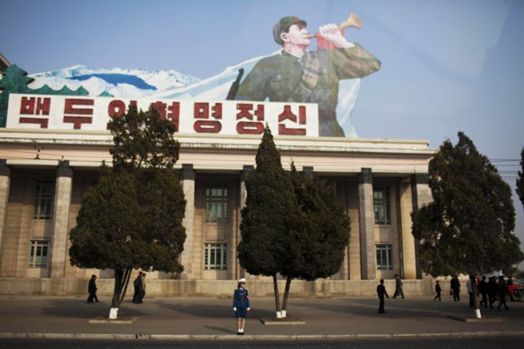
traffic police woman stands on the side of the street in Pyongyang

Slide 32
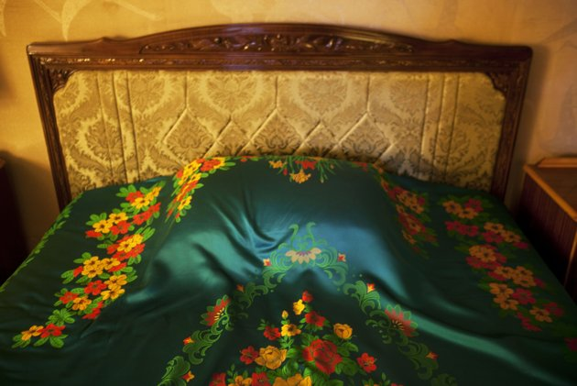
Colorful, decorated sheet covers a bed inside the Koryo Hotel in Pyongyang

Slide 33
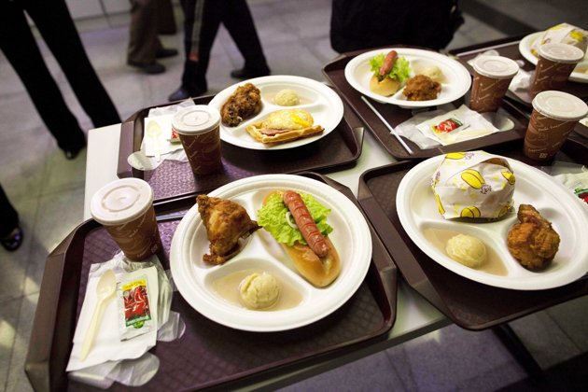
plates of food sit on a customer's table at a fast food restaurant inside an amusement park in Pyongyang

Slide 34
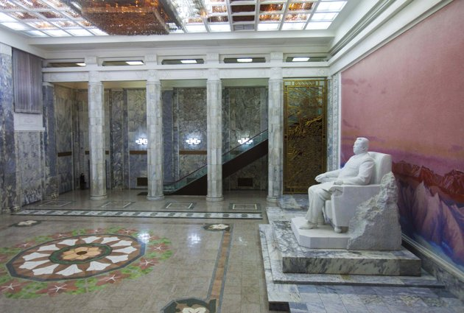
Statue of Kim Il Sung sits in the entrance to the Grand People's Study House

Slide 35
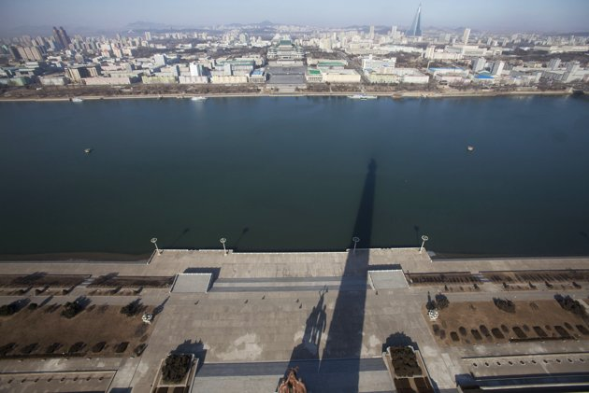
Shadow of the 560-foot Juche Tower is cast over the Taedong River

Slide 36
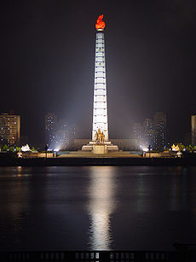
The Juche Tower in Pyongyang, taller than the Washington monument.

Slide 37
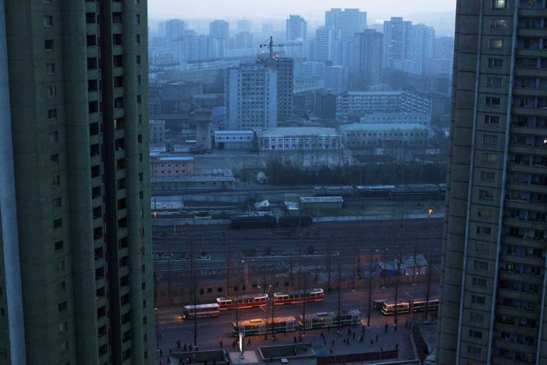
Central Pyongyang, North Korea at dusk

Slide 38
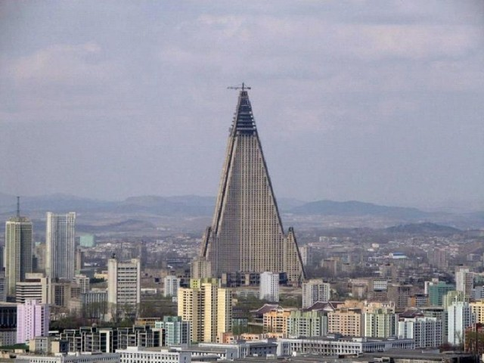

Slide 39
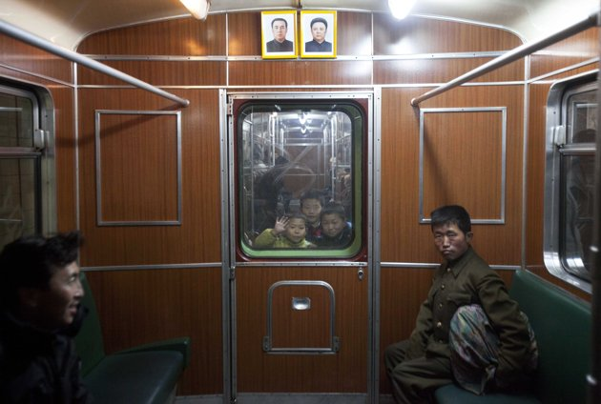
Children look through a subway car window in Pyongyang

Slide 40
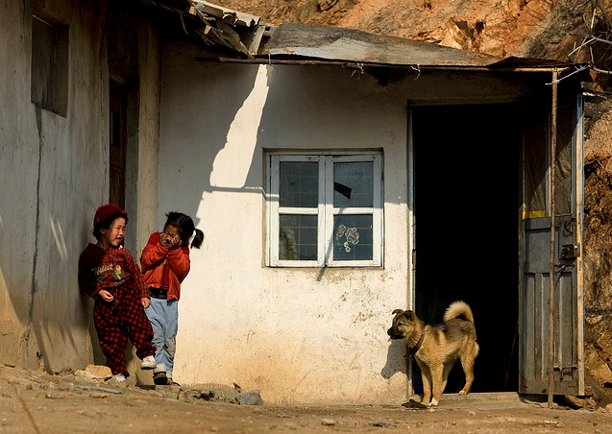

Slide 41
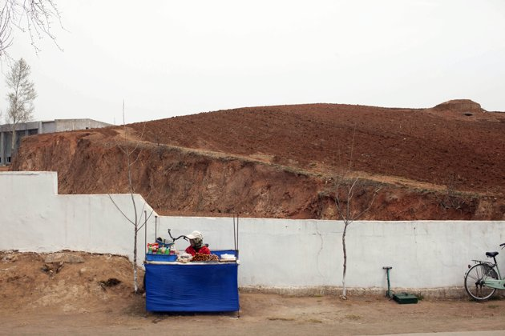
woman sits at a small table selling snacks on the roadside along the West Sea Barrage near Nampho

Slide 42
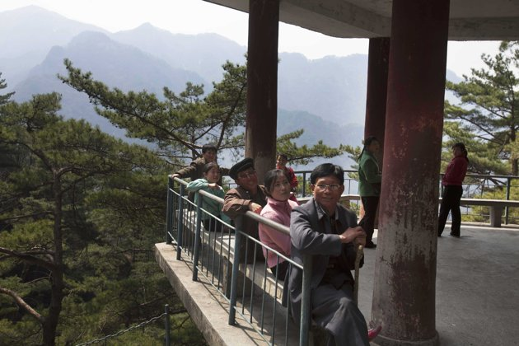
Hikers rest at a small pagoda along a trail on Mount Myohyang

Slide 43
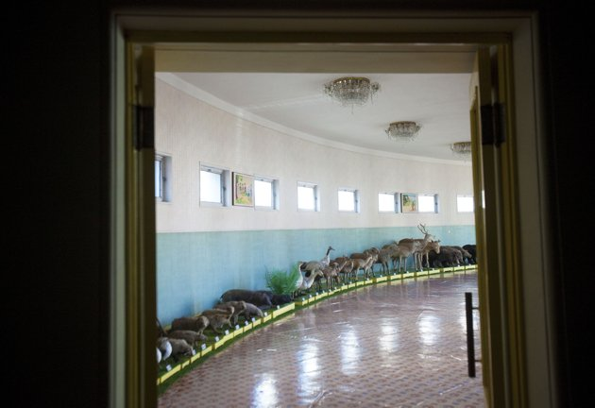
Stuffed animals are on display at Changgwang Elementary School where they are used for biology classes

Slide 44
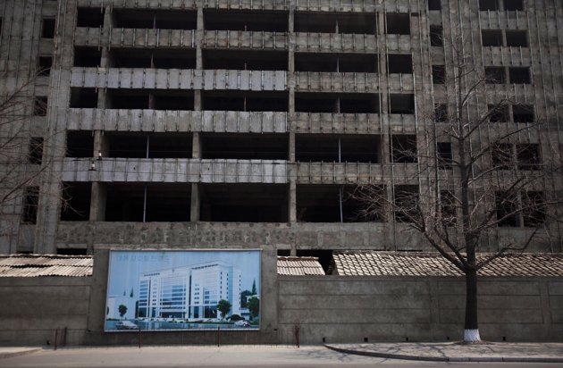
Illustration of a building project hangs in front of the construction project in progress

Slide 45
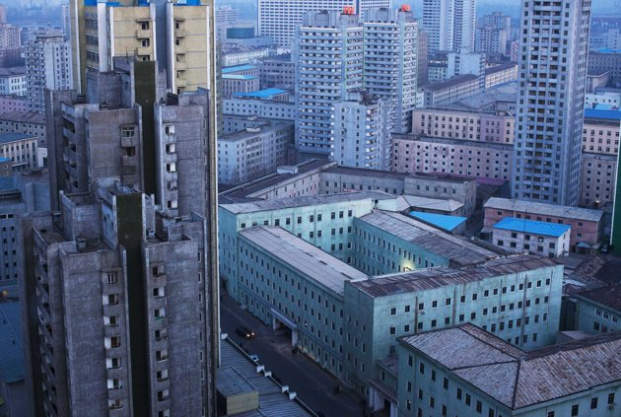
Central Pyongyang, North Korea at dusk

Slide 46
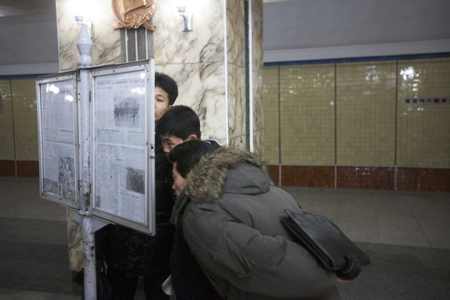
Men read a newspaper on public display inside a subway station

Slide 47
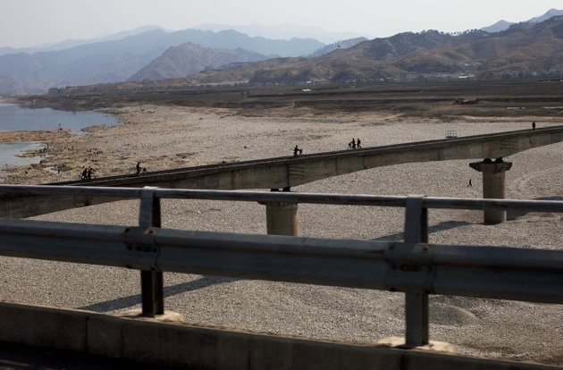
People walk and use bicycles to cross a railroad bridge over a riverbed

Slide 48
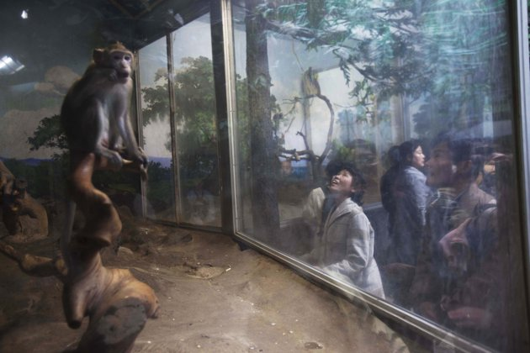
Woman looks at monkeys behind a glass enclosure at the central zoo

Slide 49
Children's choir performs in Pyongyang

Slide 50
Shadow is cast across a parking lot as a man walks by a row of imported cars in central Pyongyang

Slide 51
People react on a ride at an amusement park in Pyongyang,

Slide 52
Workers rebuild the roof of a structure at the Pohyon Temple at the foot of Mount Myohyang,

Slide 54
People work on library computers at the Grand People's Study House

Slide 55
North Korea is undergoing a digital revolution of sorts, even as it holds some of the strictest cyberspace policies in the world

Slide 56
People work on library computers at Kim Il Sung University in Pyongyang

Slide 57
Workers at a brewery operate their section of the facility from computers

Slide 58
man works on a computer at a museum

Slide 59
Woman works on a library computer at the Grand People's Study House

Slide 60
A city tram carries passengers in Pyongyang

Slide 61
Bowl of traditional North Korean cold noodles, known as Naengmyeon

Slide 62
Less than rational leadership

Slide 65
Anti-USA Poster

