Slide 1
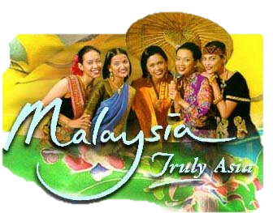
Malaysia
RELIGIONS
Flora & Fauna
Ethnic Groups

Slide 2
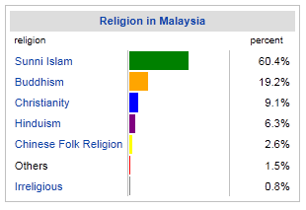

Slide 3
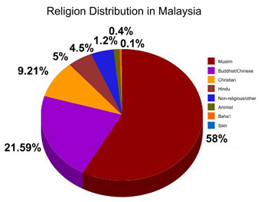

Slide 4
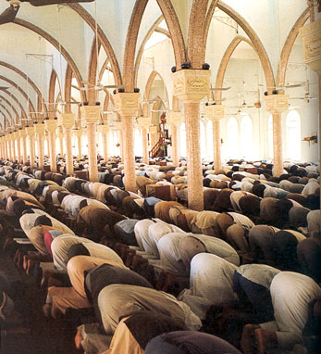
Islam in Malaysia

Slide 5
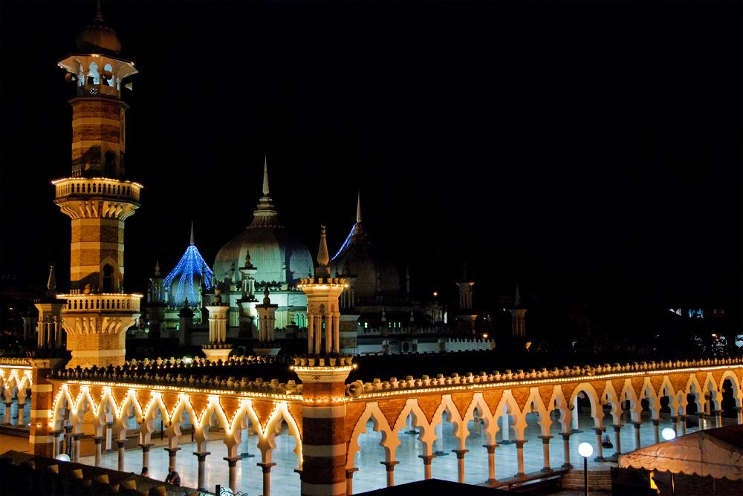
Jamek Mosque-Kuala Lumpur

Slide 6
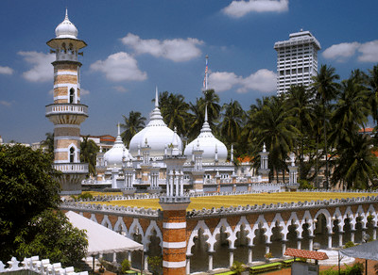

Slide 7
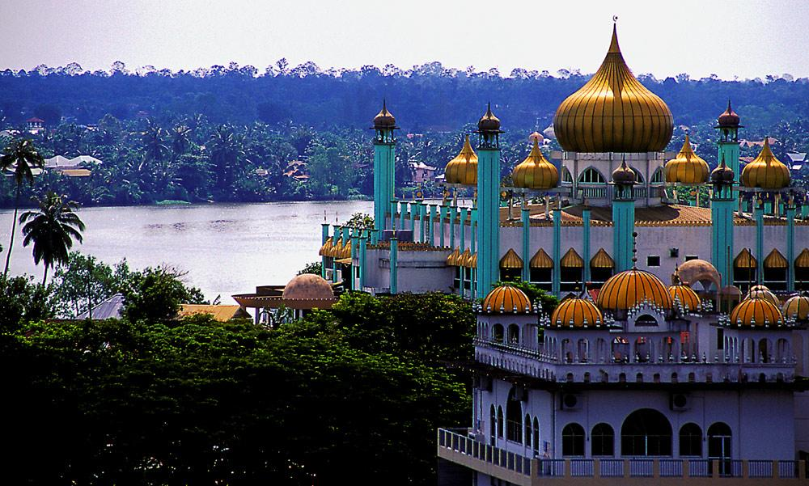
Masjid Bahagian Mosque-Kuching- Sarawak in the background

Slide 8
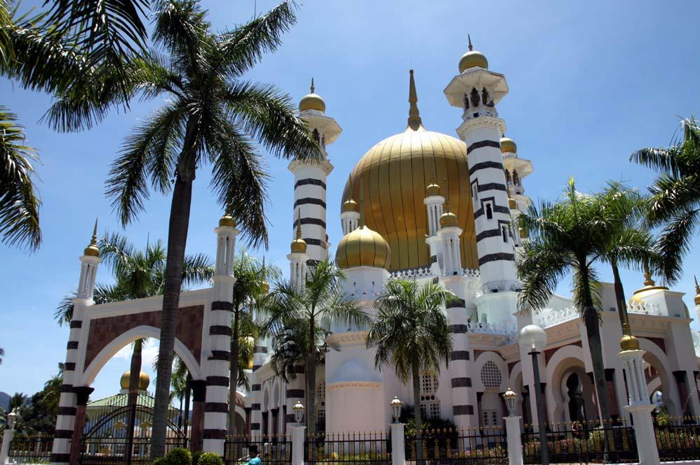
Ubudiah Mosque -Perak

Slide 9
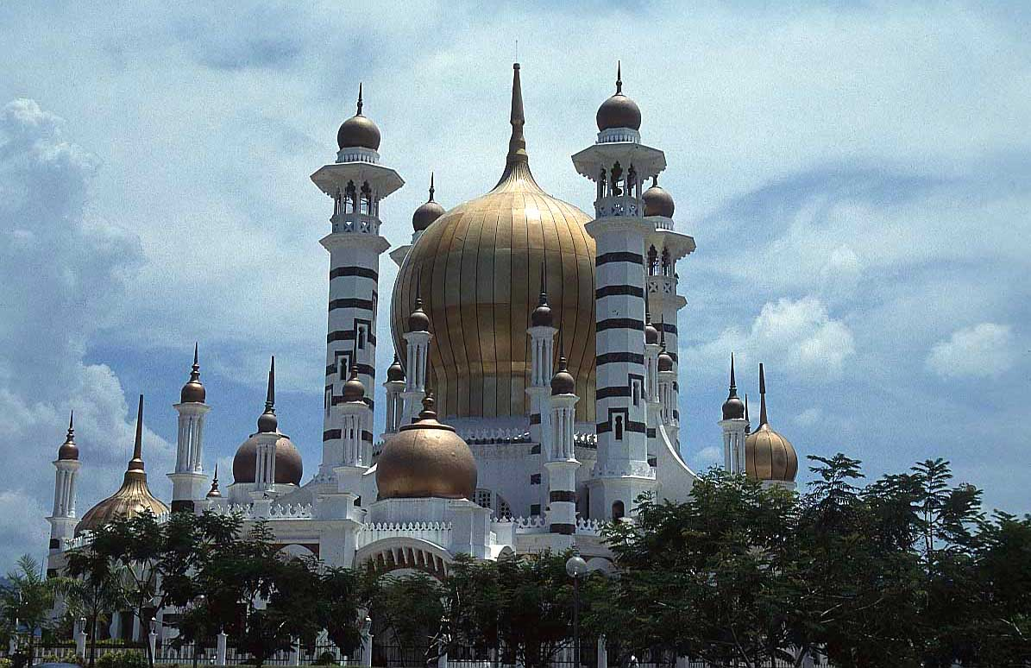

Slide 10
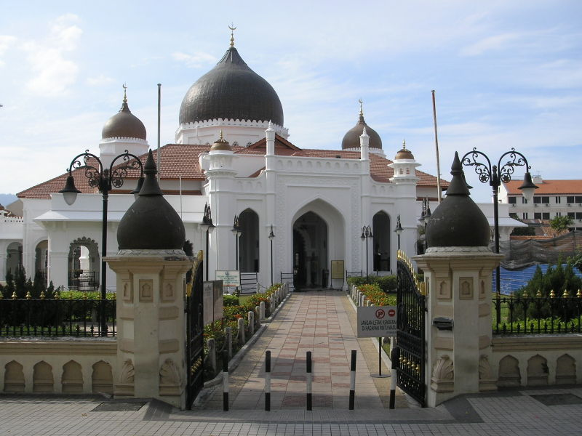
Kapitan Keling Mosque, Penang

Slide 11
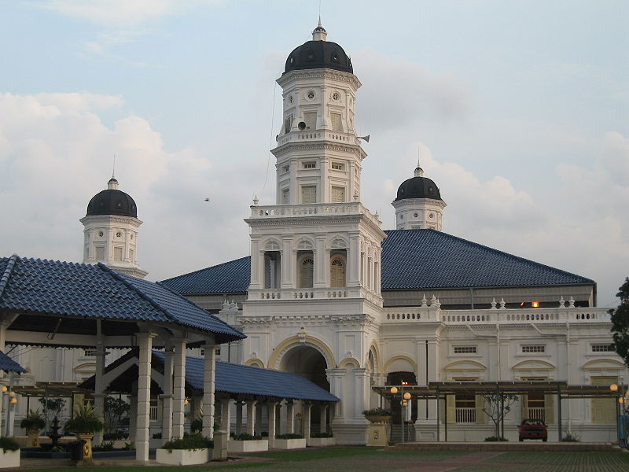
Masjid Negeri Sultan Abu Bakar-Johor Bahru

Slide 12
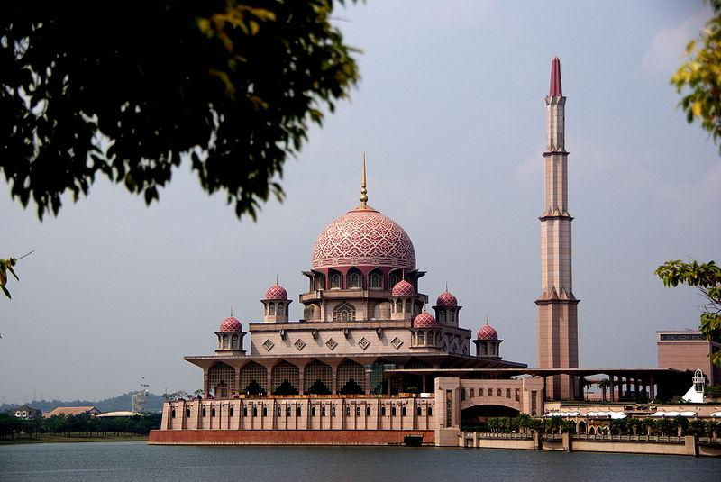
Putrajaya Mosque

Slide 13
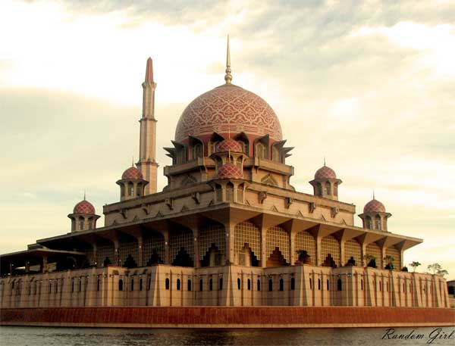

Slide 14
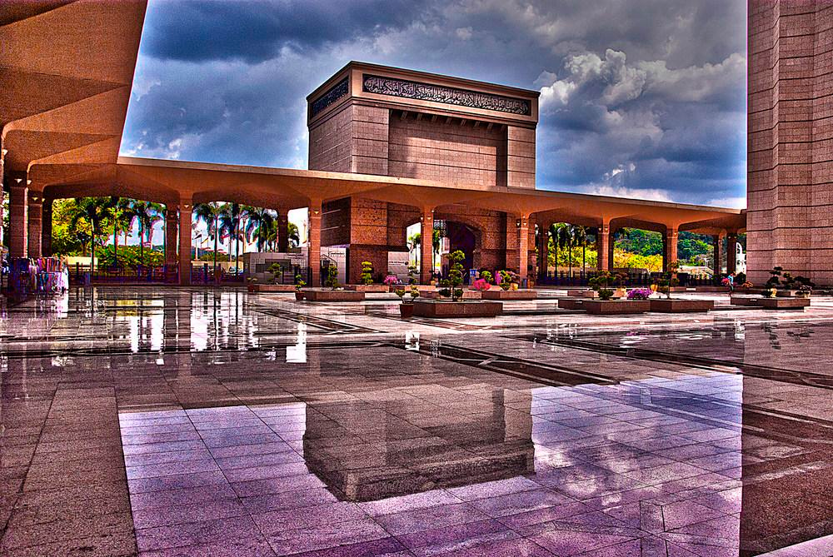

Slide 15
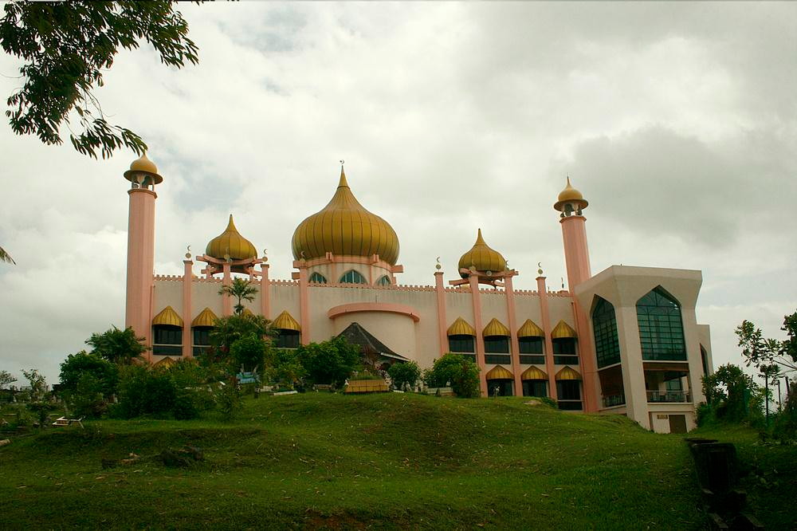
Masjid Bahagian Mosque-Kuching

Slide 16
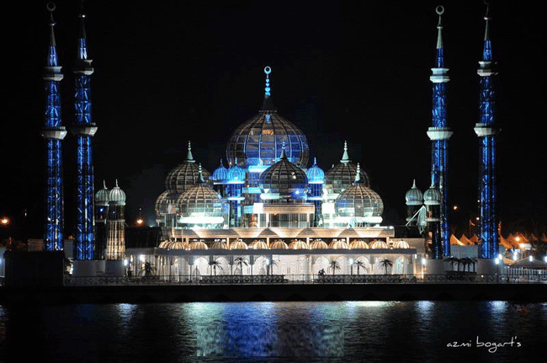
The Crystal Mosque

Slide 17
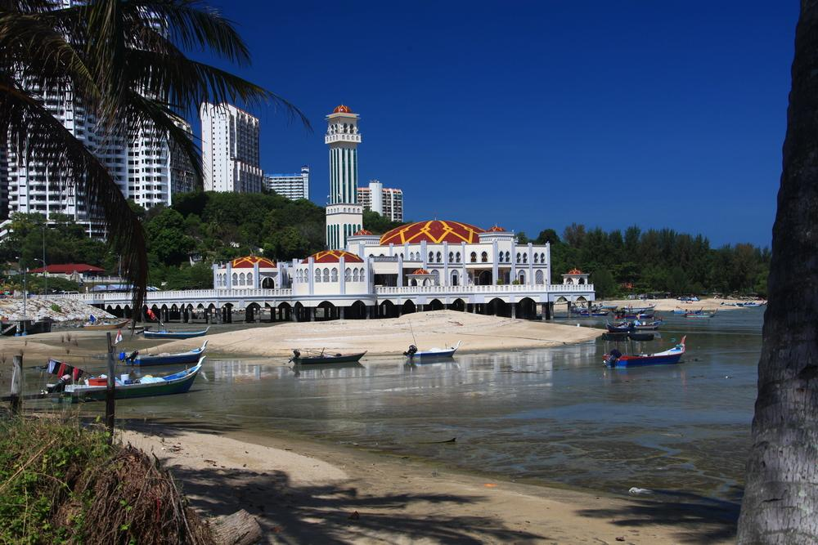
The Floating Mosque - Penang

Slide 18
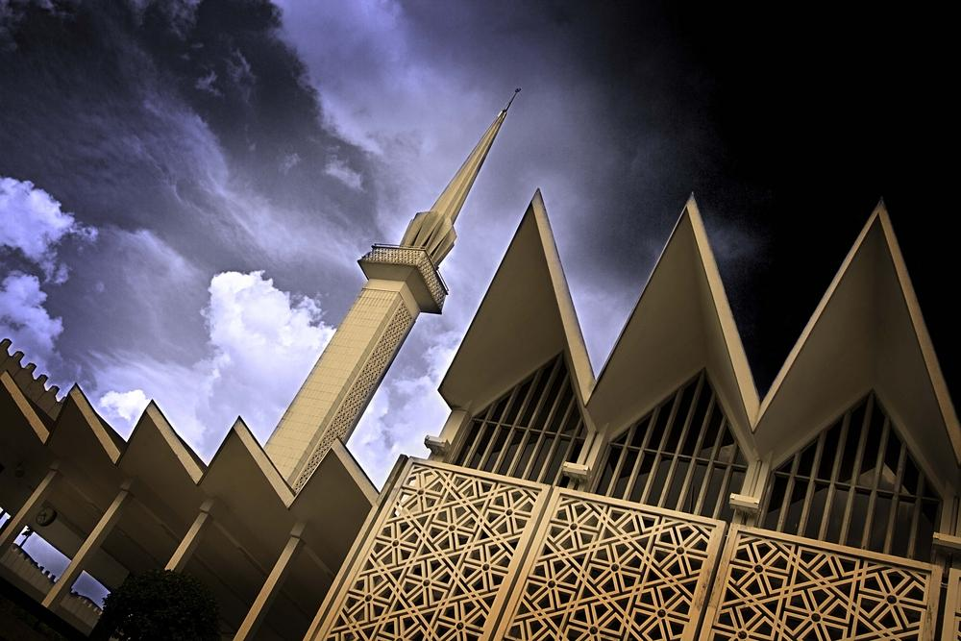
National Mosque(Masjid Negara) – Kuala Lumpur

Slide 19
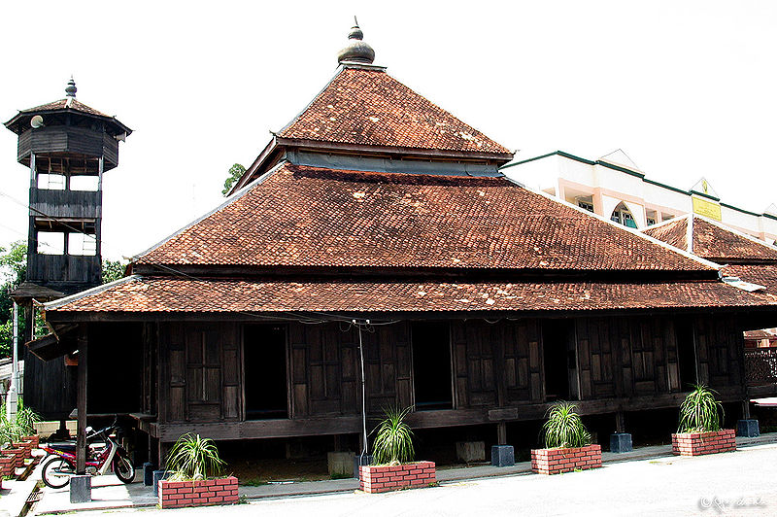
Kampung Laut Mosque

Slide 20
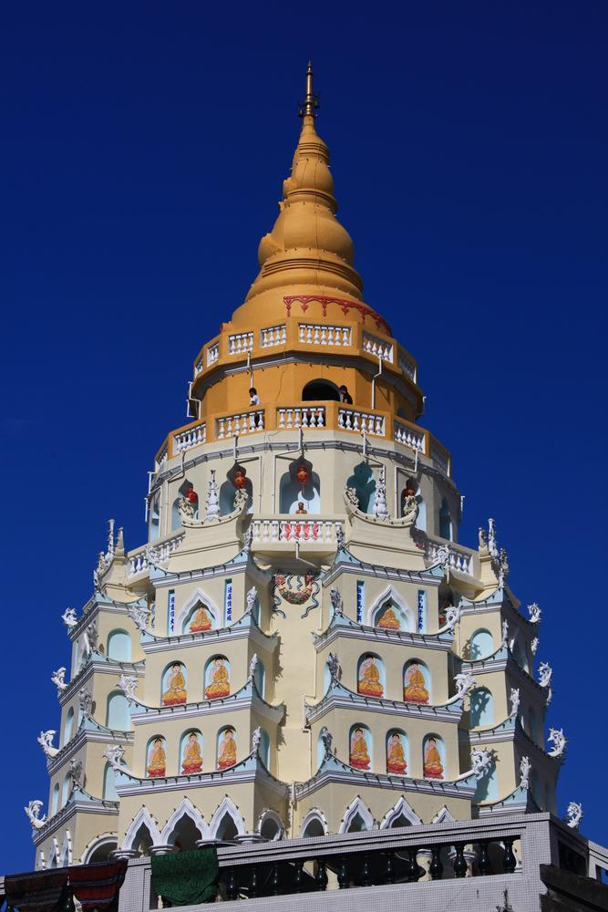
Buddhism in Malaysia

Slide 21
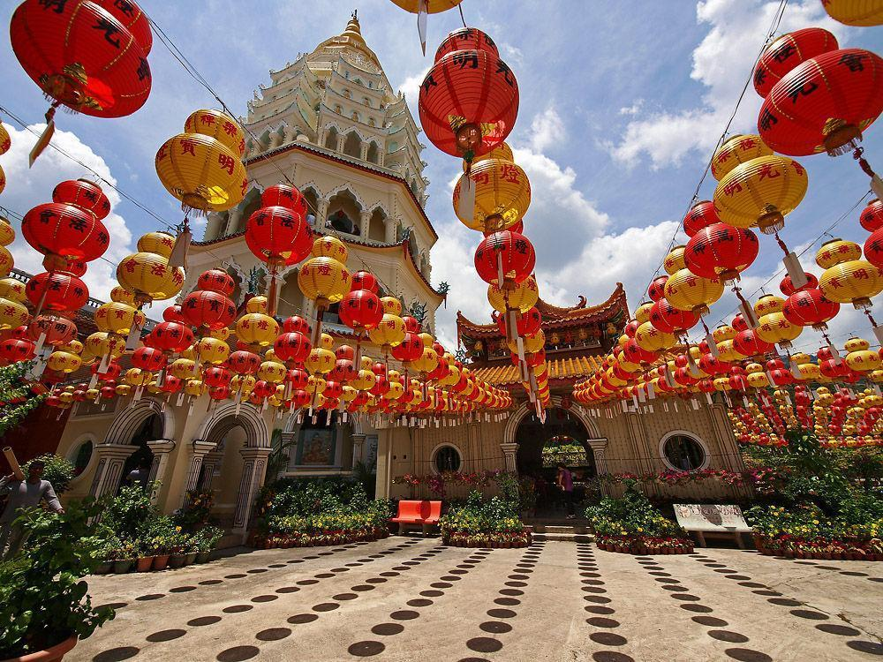

Slide 22
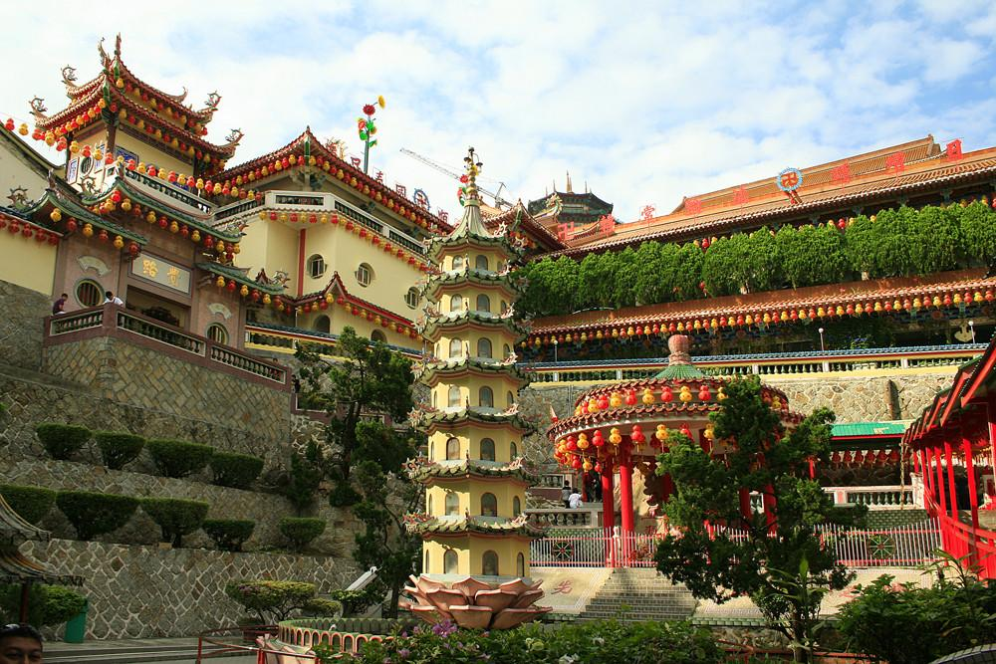

Slide 23
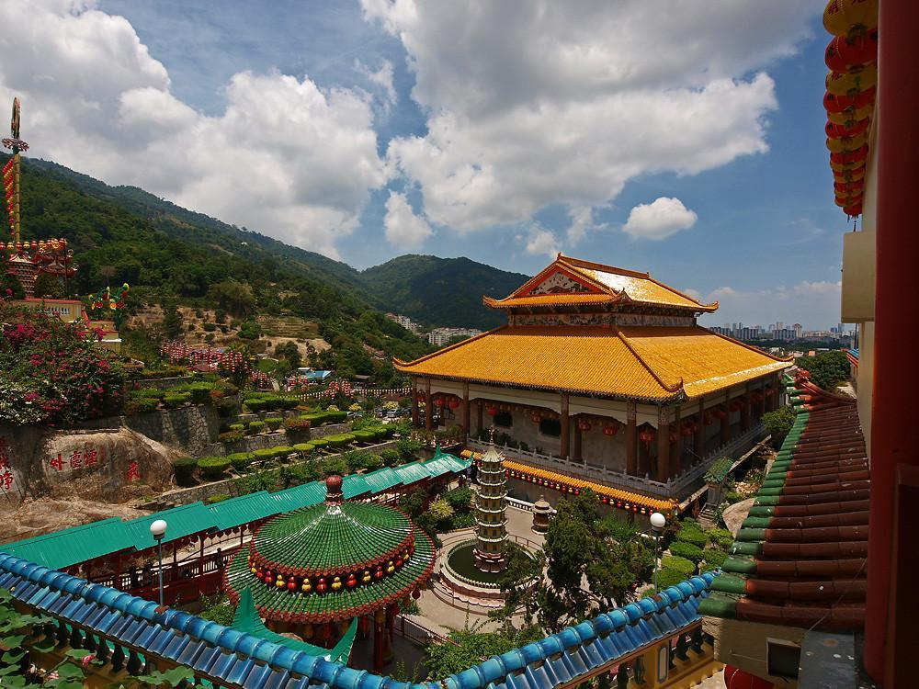

Slide 24
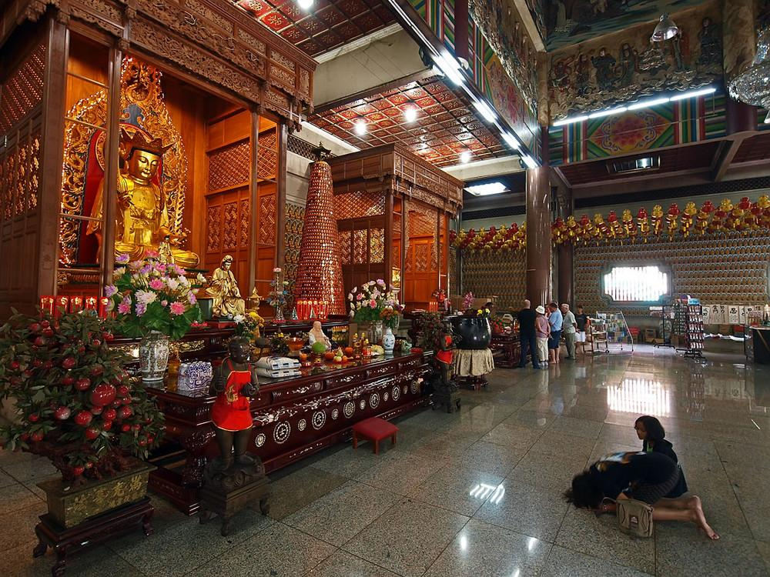

Slide 25
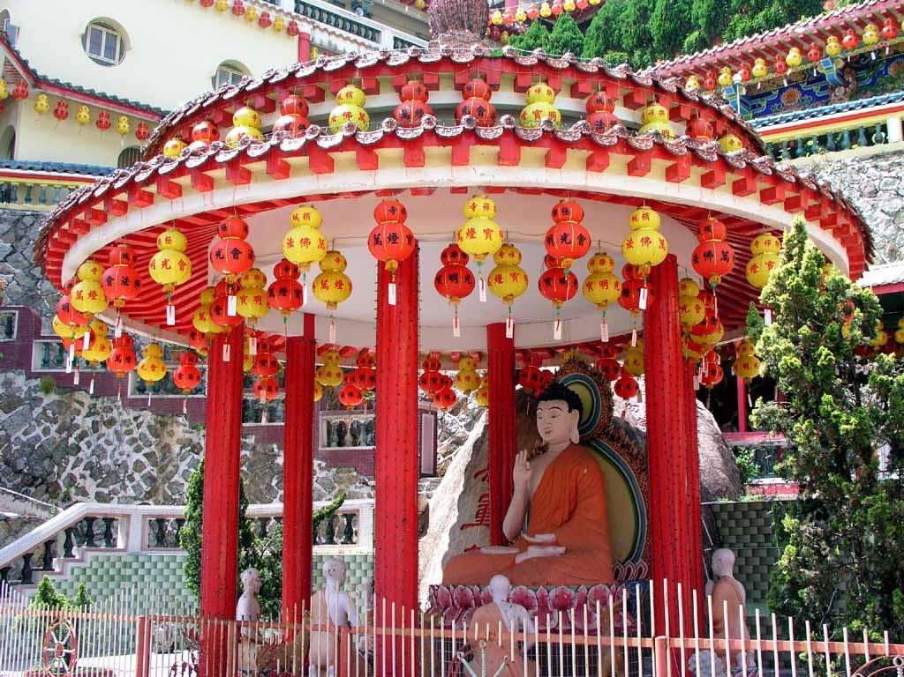

Slide 26
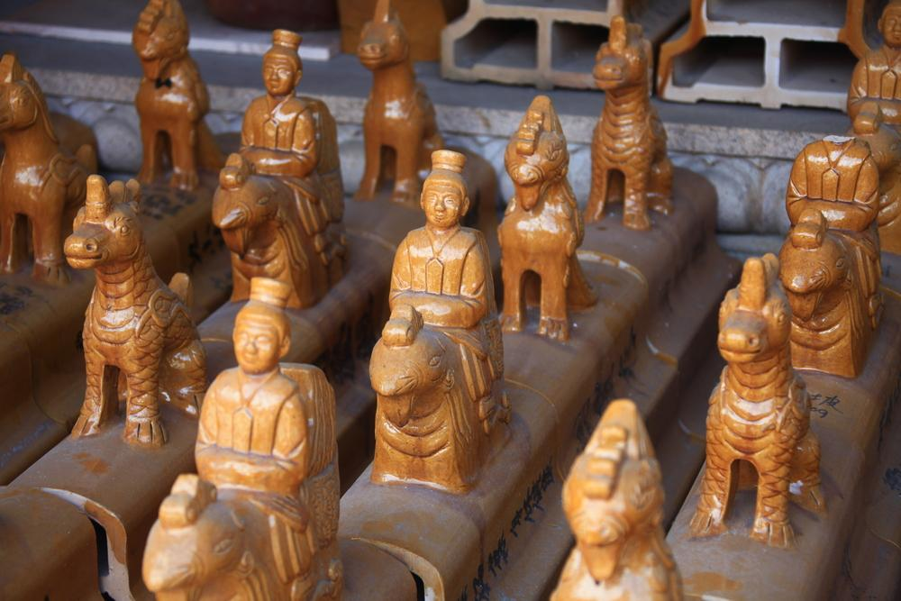

Slide 27
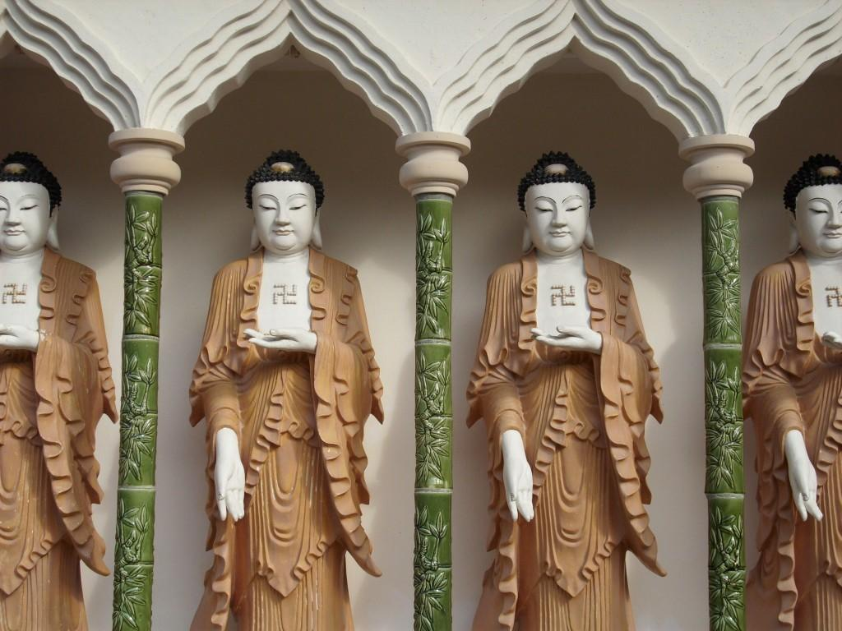

Slide 28
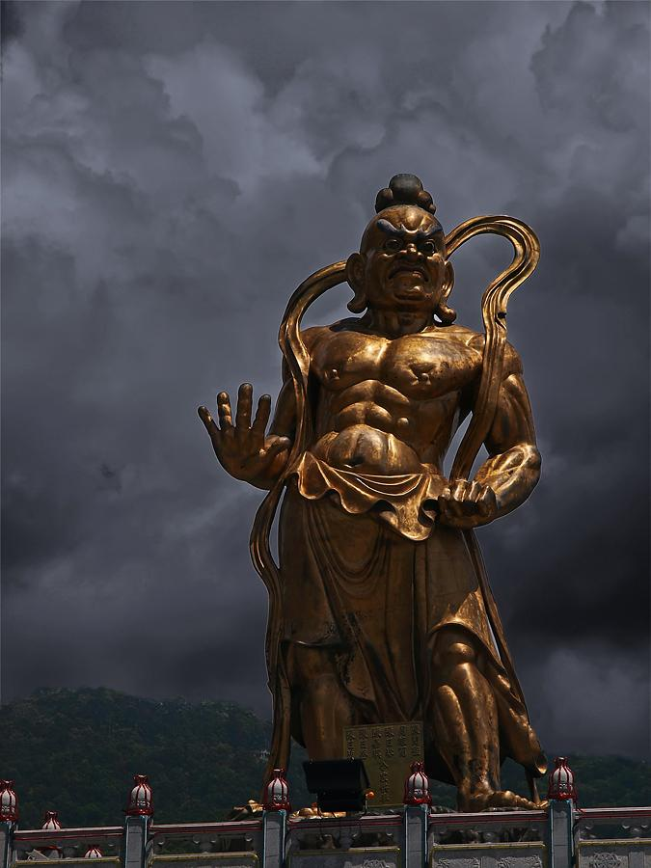

Slide 29
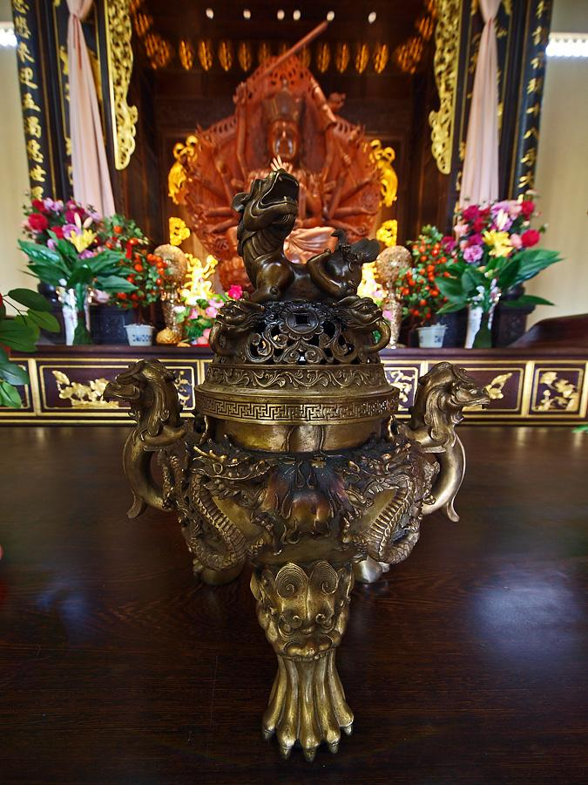

Slide 30
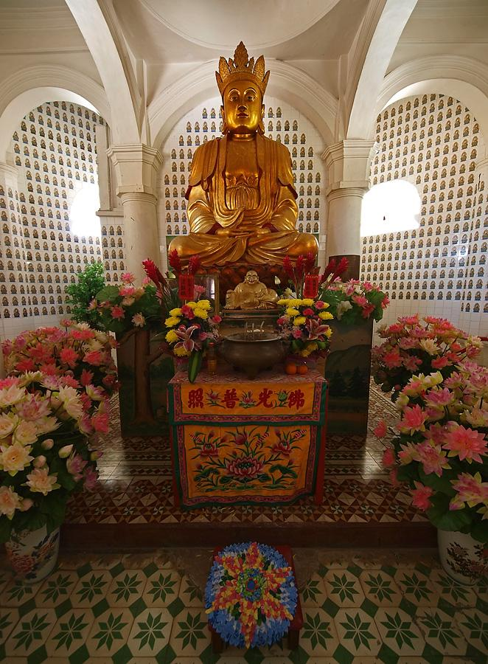

Slide 31
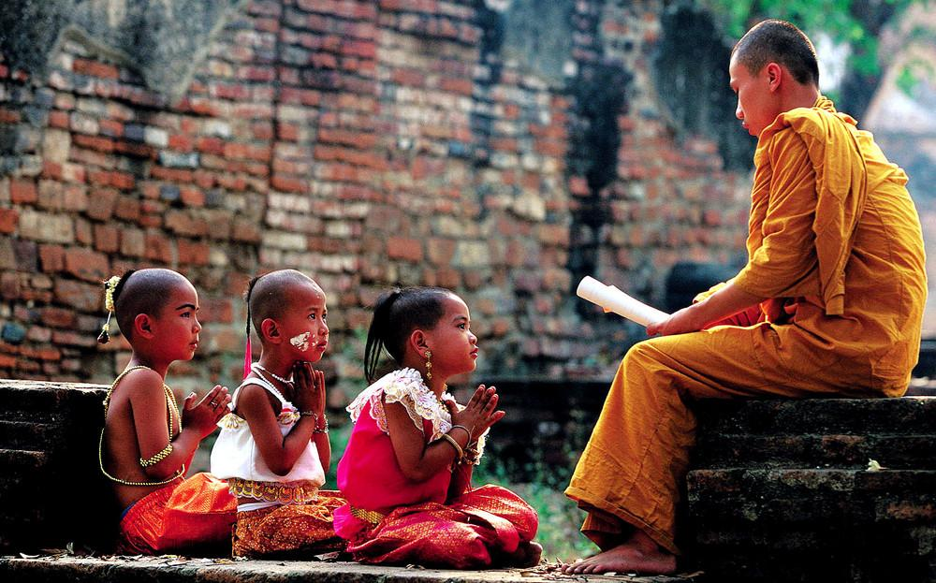

Slide 32
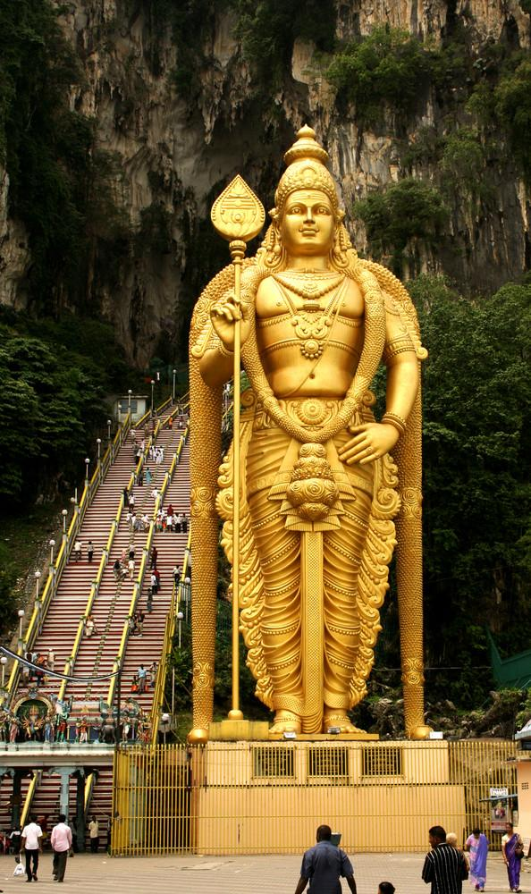
Hinduism in Malaysia

Slide 33
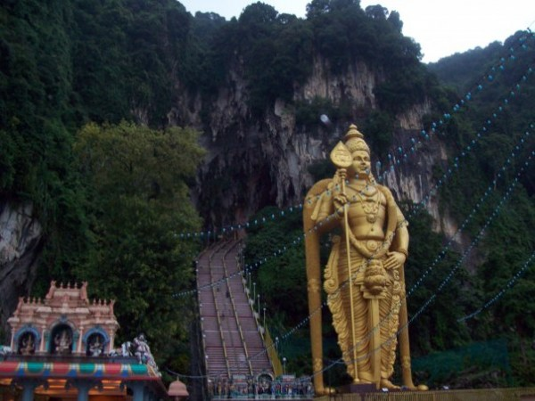
Batu Caves – Malaysia

Slide 34
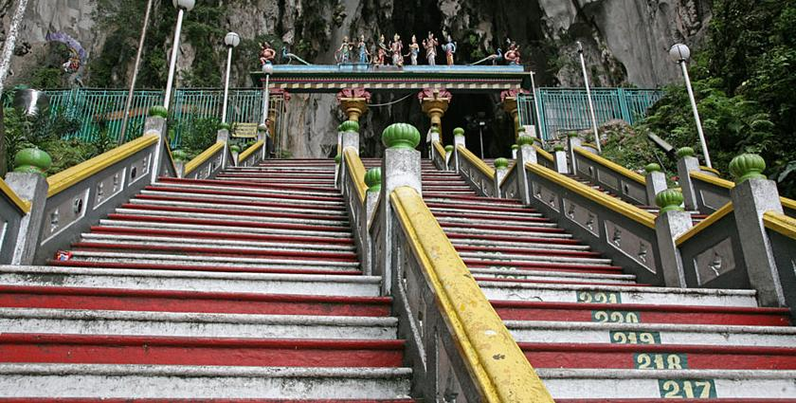

Slide 35
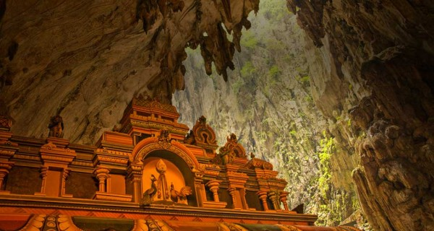

Slide 36
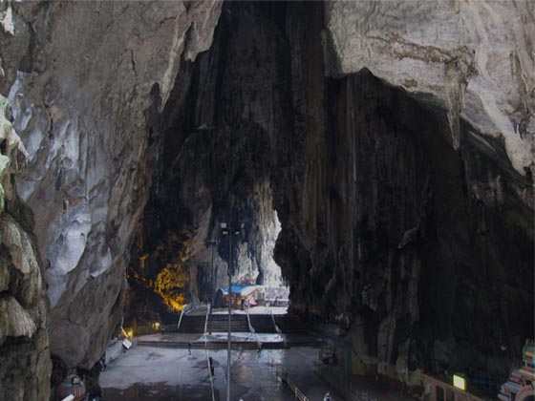

Slide 37
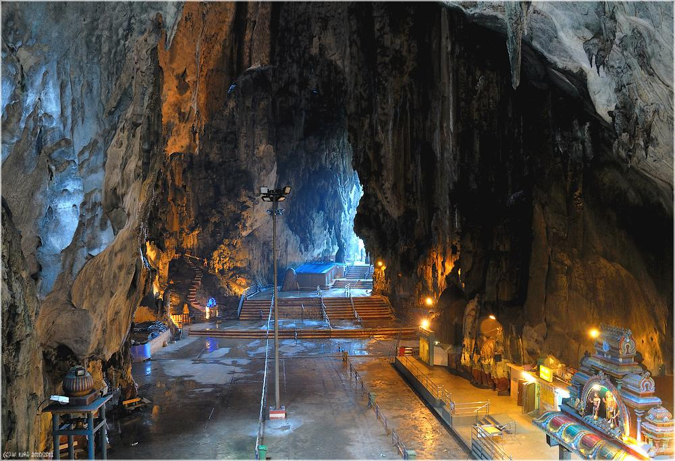

Slide 38
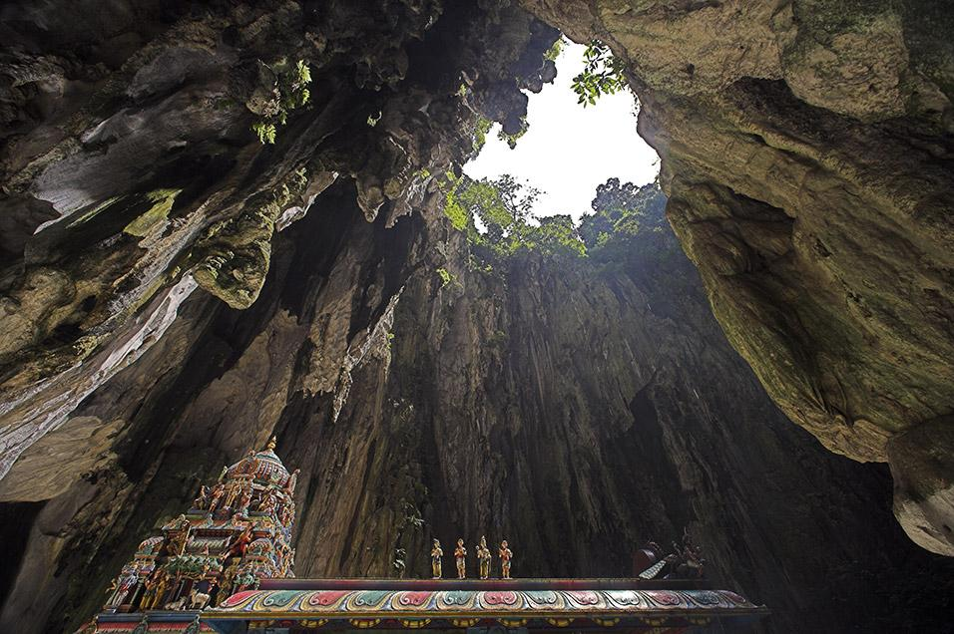

Slide 39
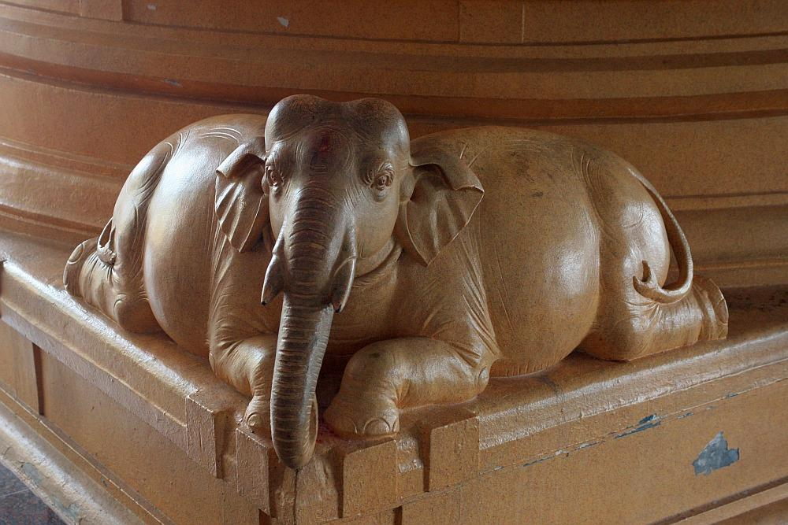

Slide 40
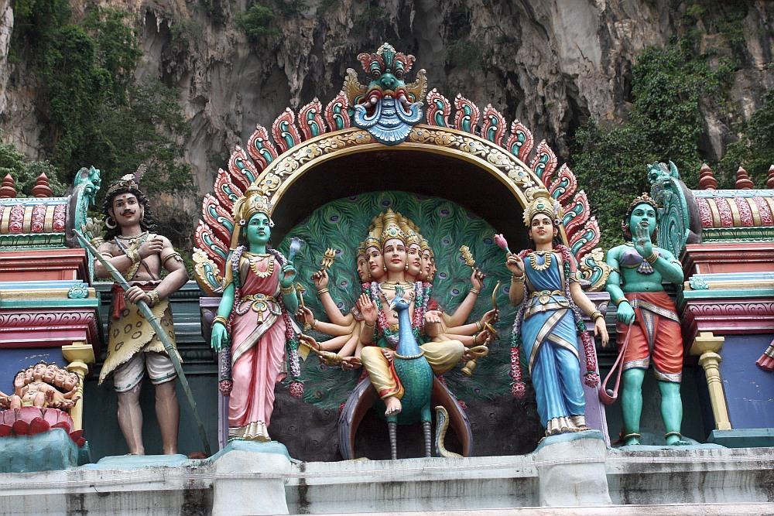

Slide 41
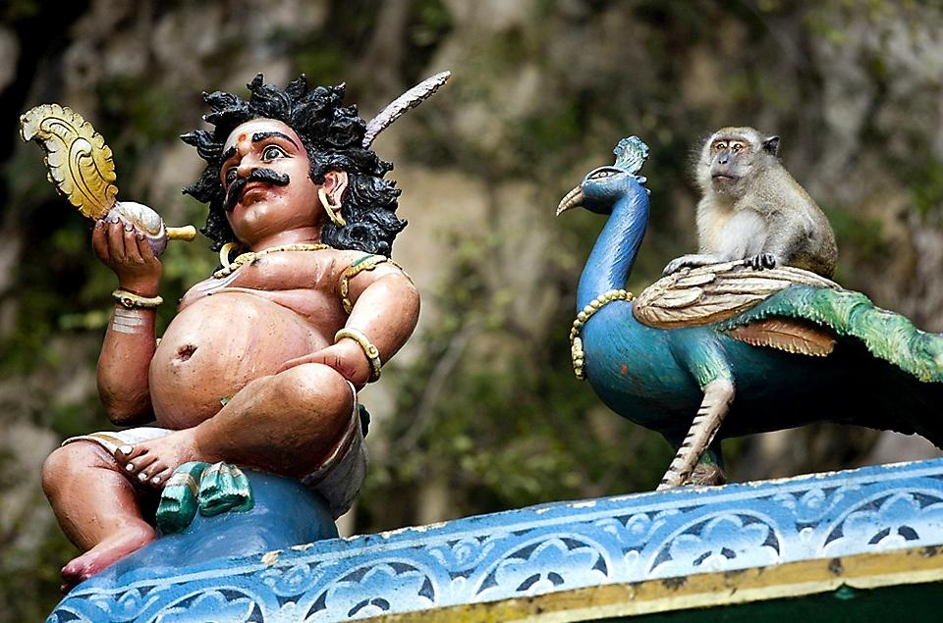

Slide 42
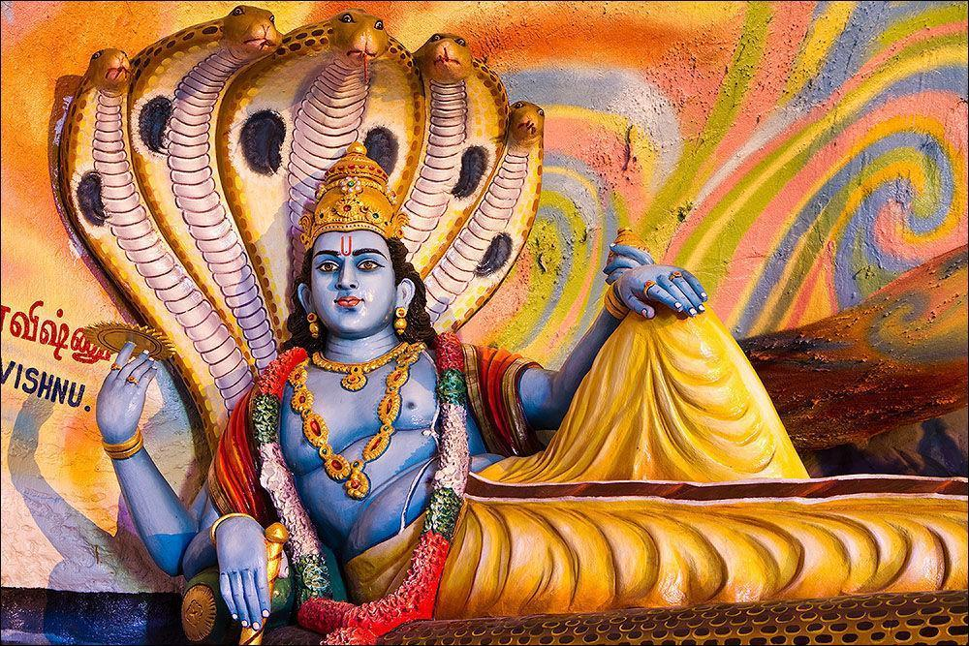

Slide 43
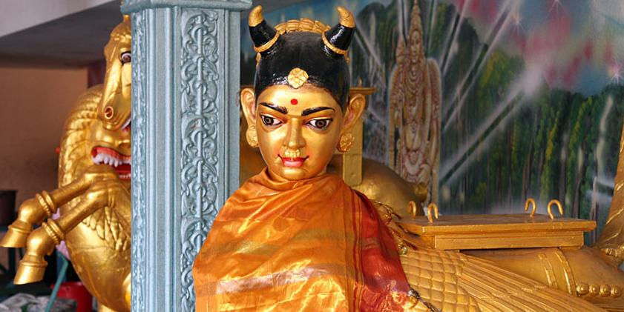

Slide 44
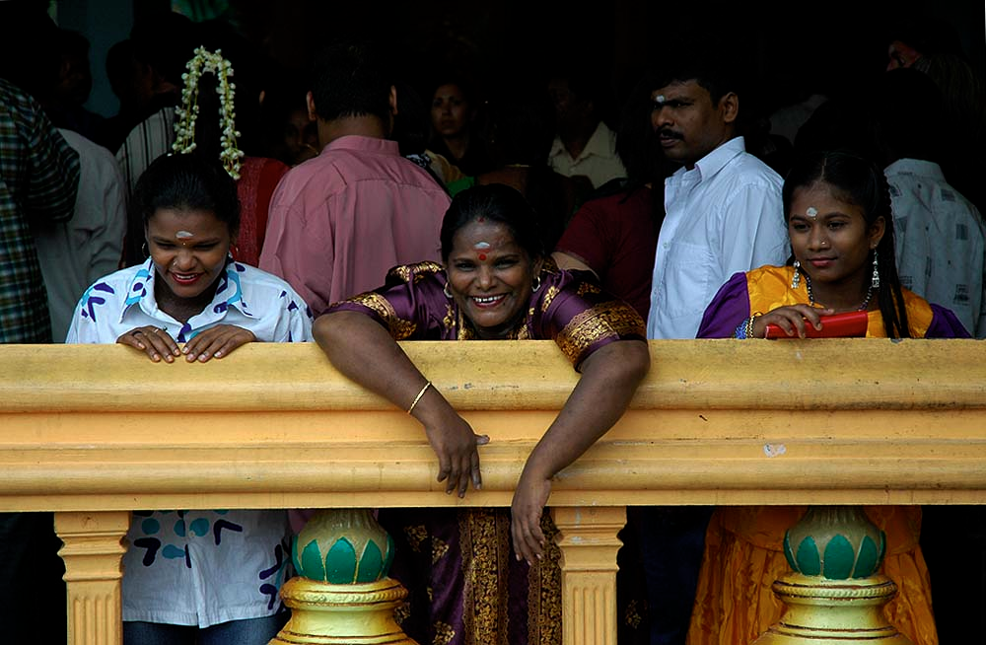

Slide 45
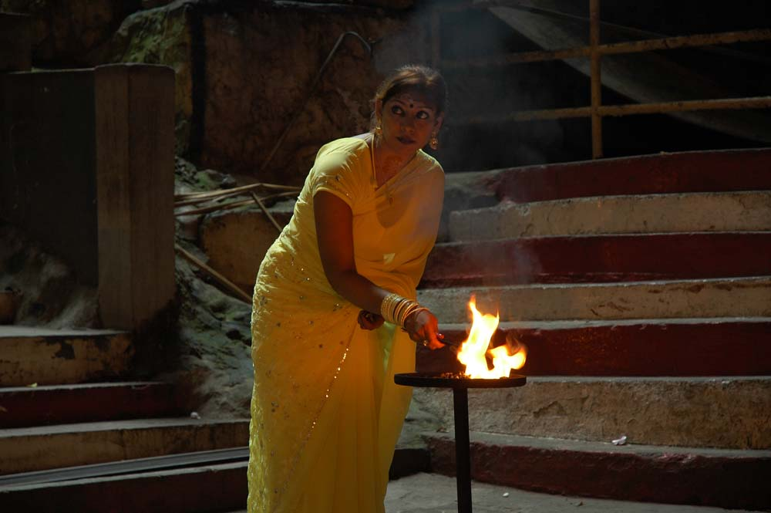

Slide 46
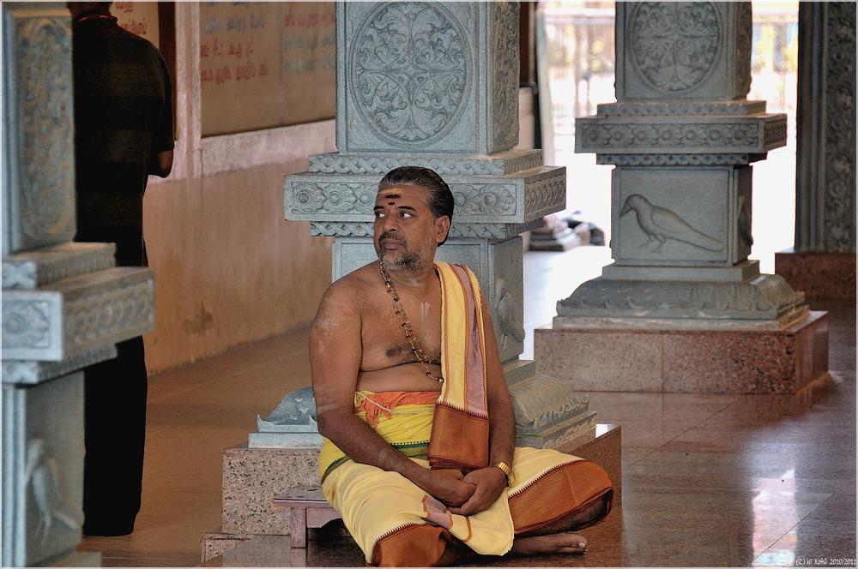

Slide 47
THAIPUSAM
Thaipusam is a Hindu festival celebrated mostly by the Tamil community on the full moon in the Tamil month of Thai (January/February). It is celebrated not only in countries where the Tamil community constitutes a majority, but also in countries where Tamil communities are smaller, such as Singapore and Malaysia. The festival commemorates the occasion when Parvati gave Murugan a vel "spear" so he could vanquish the evil demon Soorapadam.

Slide 48
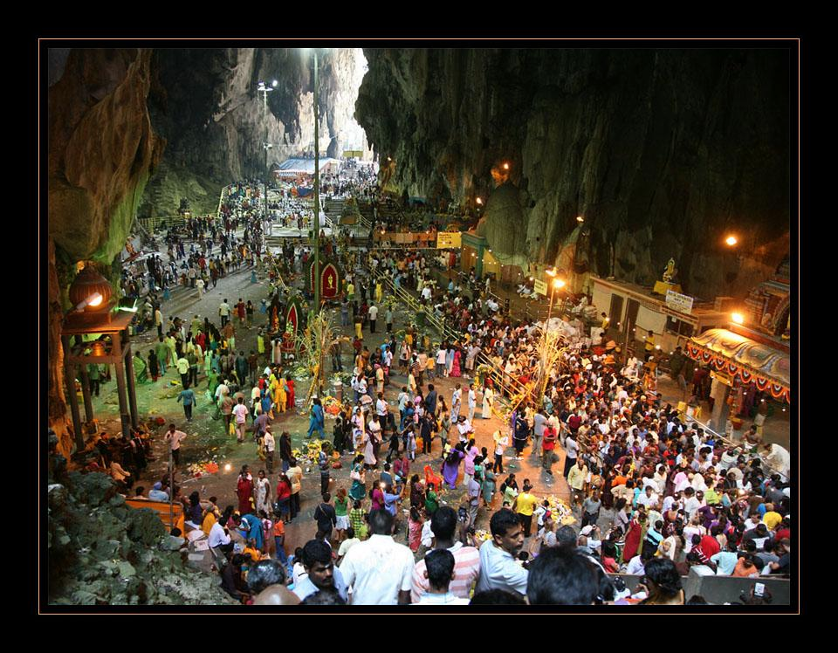

Slide 49
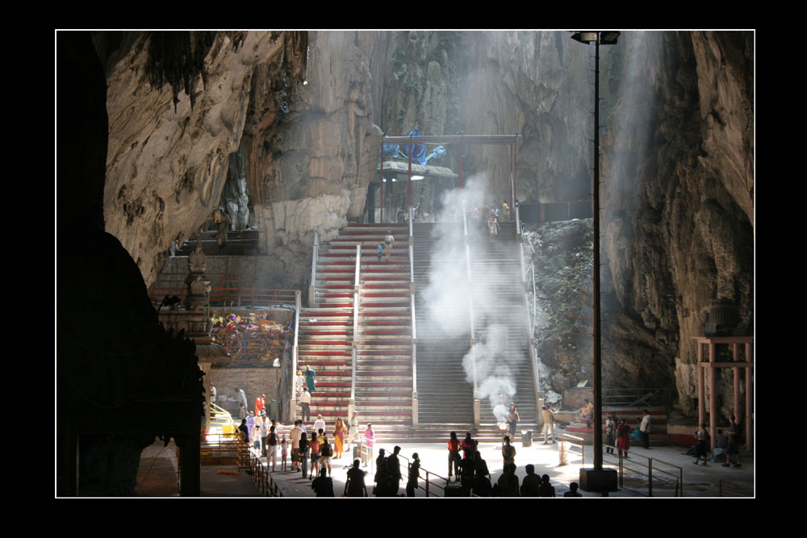

Slide 50
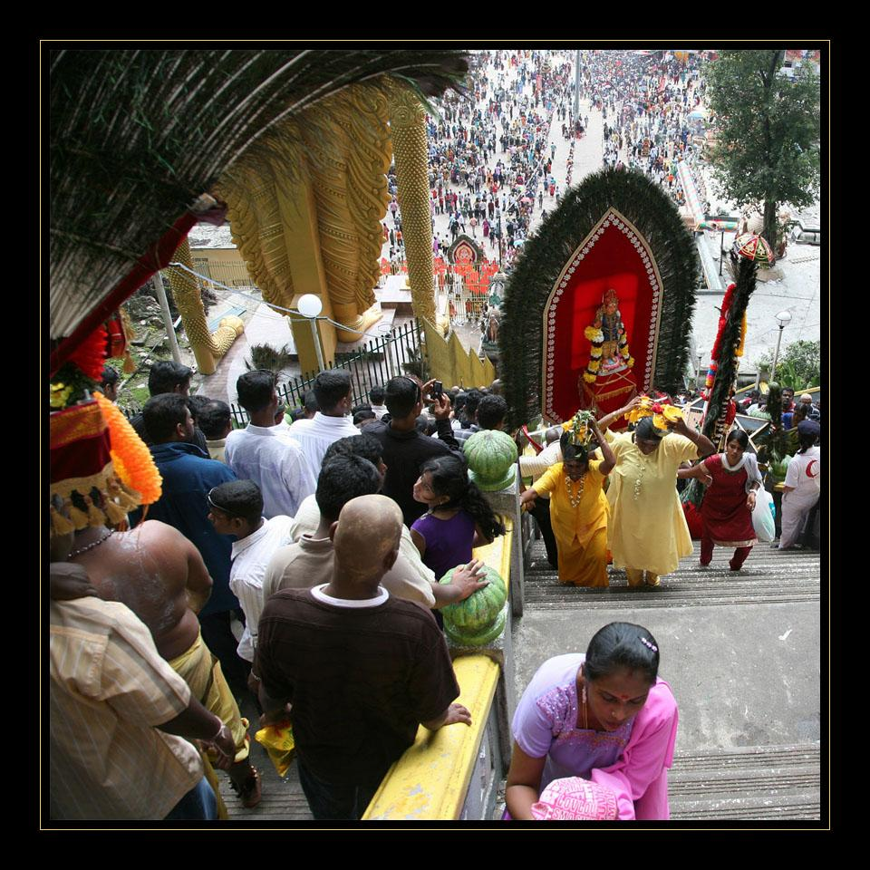

Slide 51
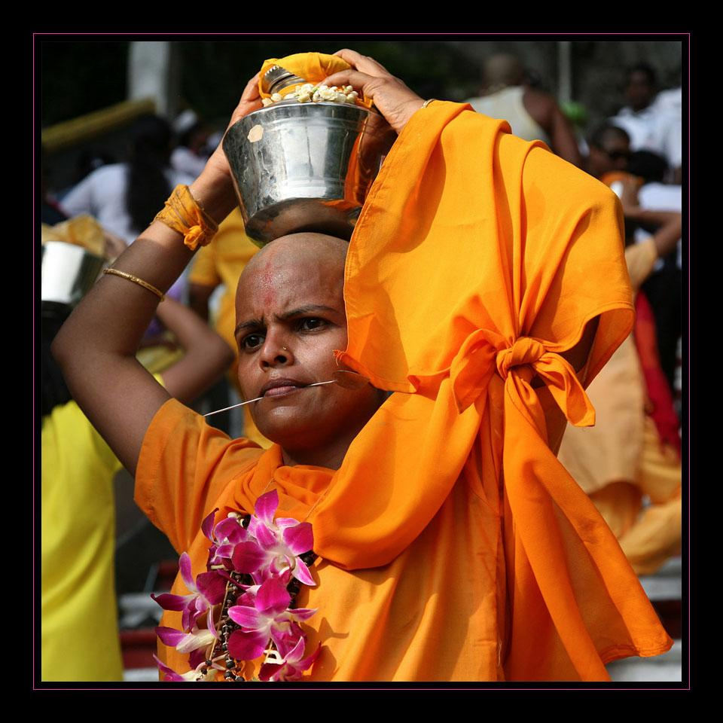

Slide 56
Flora & fauna
Looking down on a rainforest from above.

Slide 57
Taman Negara - National Park

Slide 59
Breadfruit

Slide 77
Ethnic Groups
Ethnic groups: Malay 50.4%, Chinese 23.7%, indigenous 11%, Indian 7.1%, others 7.8% (2004 est.)

Slide 78
Chinese Presence

Slide 81
Bhangra folk dance performed by Punjabi men

Slide 82
Malay Drummers

Slide 83
Chinese and Indian Drummers

Slide 84
Malay Cultural Dance

Slide 85
Malay woman and girl

Slide 86
Portuguese-Eurasian Descended from Portuguese settlers of the 16th century, Melakan Portuguese-Eurasian's traditional attire reflect their heritage. Dominated by the colours black and red, men wear jackets and trousers with waist sashes whilst ladies wear broad front-layered skirts.

Slide 87
Sarawak With its diverse ethnic groups, Malaysia's largest state, Sarawak, has a plethora of unique tribal costumes. Using a variety of designs and native motifs, common materials for the Orang Ulu or upriver tribes are hand-loomed cloths, tree bark fabrics, feathers and beads.

Slide 88
Orang Asli Traditionally living in the deep jungles of Malaysia, the Orang Asli of Peninsular Malaysia wore clothing made from natural materials such as tree barks like the terap, and grass skirts. Ornaments include skillfully woven headbands with intricate patterns that are made from leaf fronds.

Slide 89
Indian (Tamil ancestry)

Slide 90
A Variety of Ethnic Foods

