Slide 1
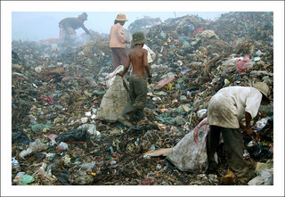
An Eye Opener

Slide 2
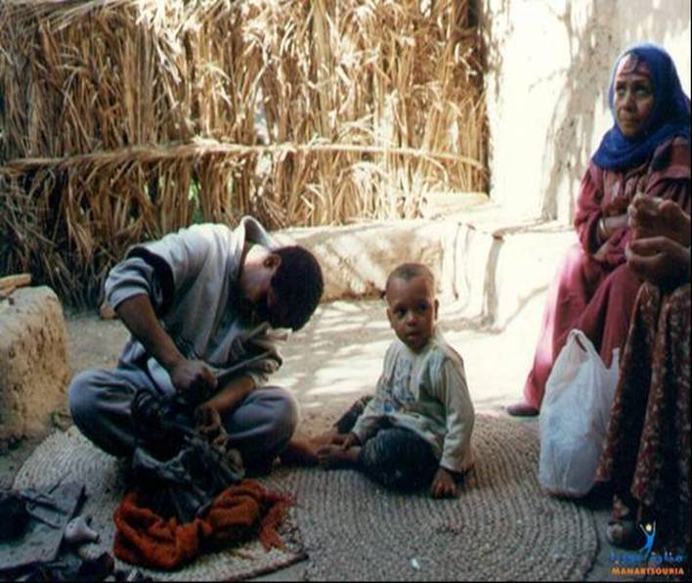
They are not aware about the advanced world. Sitting on the grass mat, living an isolated life….

Slide 3
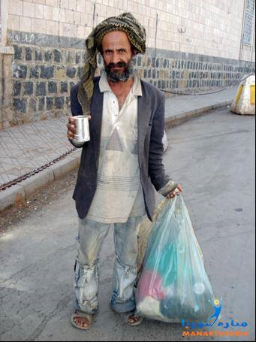
All day he has to pick garbage for his survival…..

Slide 4
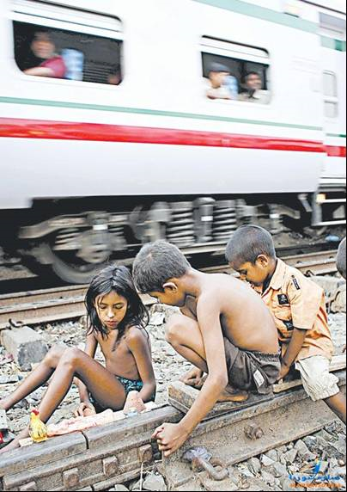
Care for child safety during play!!!

Slide 5
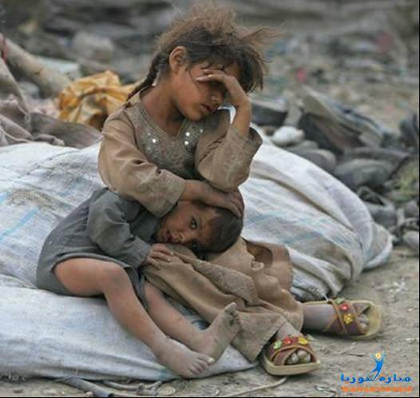
No home to protect them from the winter….

Slide 6
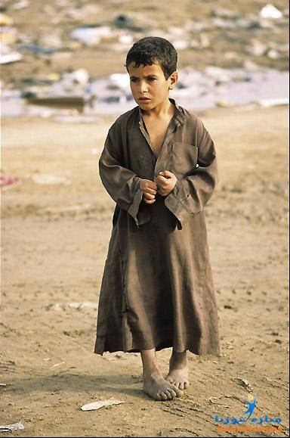
All that belongs to me is my body. Can’t afford a pair of shoes….

Slide 7
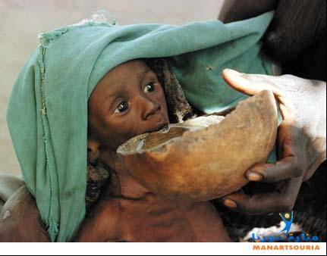
Nido milk is good for children’s health, but….

Slide 8
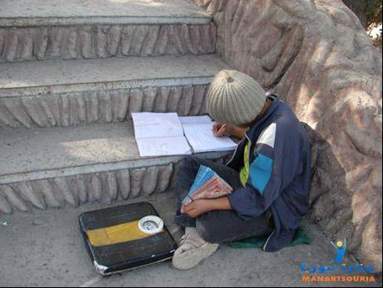
Study, play and work all in one…..

Slide 9
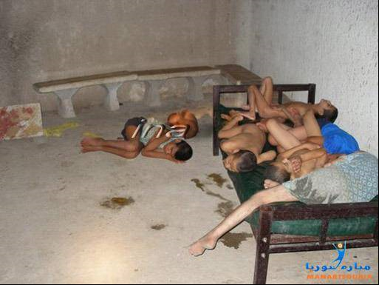
Time to buy a new bedroom set??? How do the orphans sleep....

Slide 10
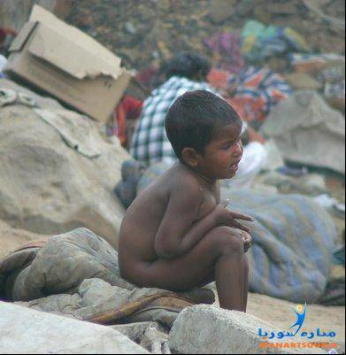
How do you see his future…..

Slide 11
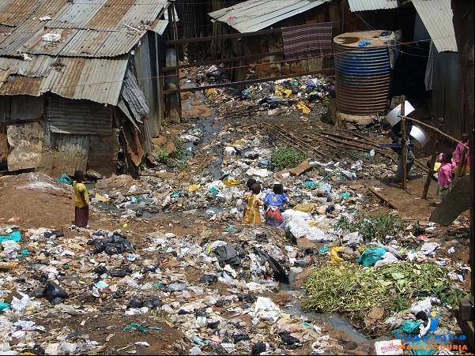
Living on the garbage pile….

Slide 12
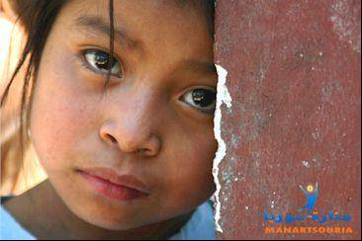
Do you see hope in these eyes!!!!

Slide 13
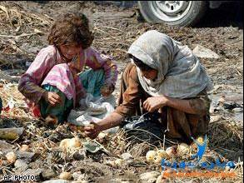
Looking for something they can eat…

Slide 14
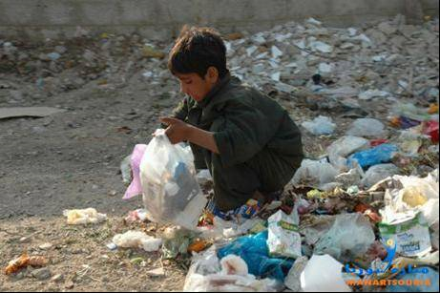
Where is my lunch??

Slide 15
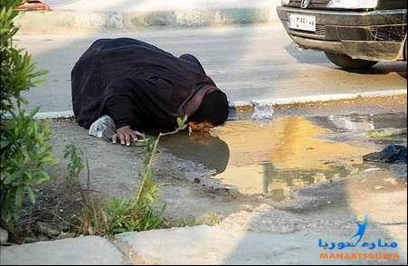
Don’t waste water, some people desperately need it…

Slide 16
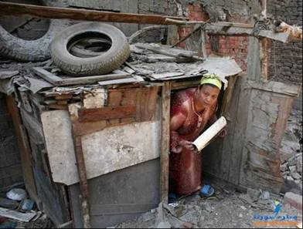
Not happy with your 2 Bedroom Apartment??? This is my home, my world, my universe….

Slide 17
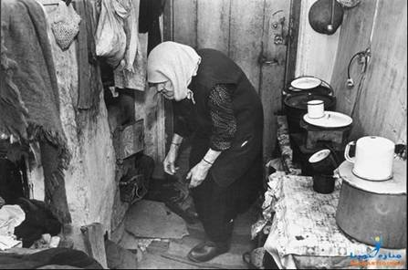

Slide 18
So what do you think about yourself ?
We could have been in one of these pictures, couldn’t we. Of course we don't even wish to think of ourselves being there.
It is the pure chance that we can read this message and not live it.
We mostly keep thinking of what we don't have or what we we think we need to have.

Slide 19
So what?
Now be thankful for the blessings and abundance that has been showered upon us?
AND . . .
Consider how we can reach out to those who deserve to share our blessings simply because they share our inalienable right to human dignity (life, liberty, & the pursuit of happiness.

