Slide 1
FOOD in the Olympics Venue - Beijing
Very interest sidelight – what was available at the food concessions.

Slide 2
Food in Other Countries
An event like the Olympics usually gives visitors from other countries the opportunity to sample the distinctive cuisine of the host country.
Beijing 2008 was no exception.

Slide 3
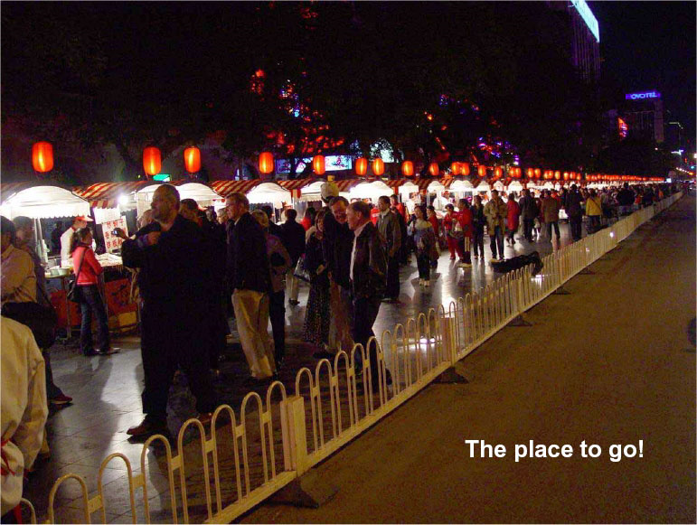

Slide 4
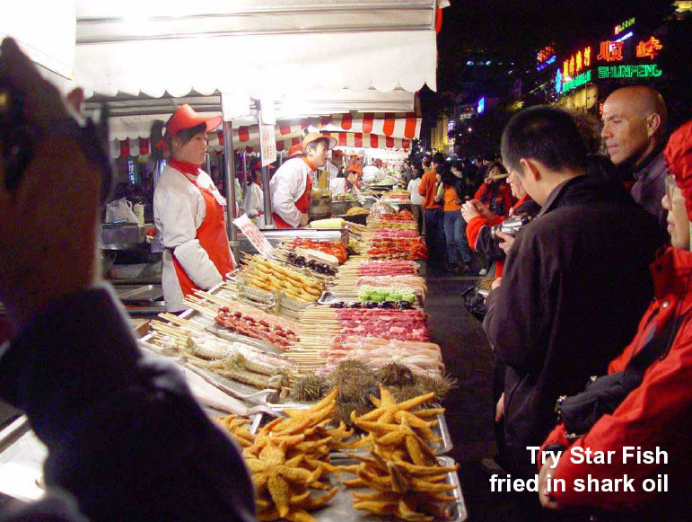

Slide 5
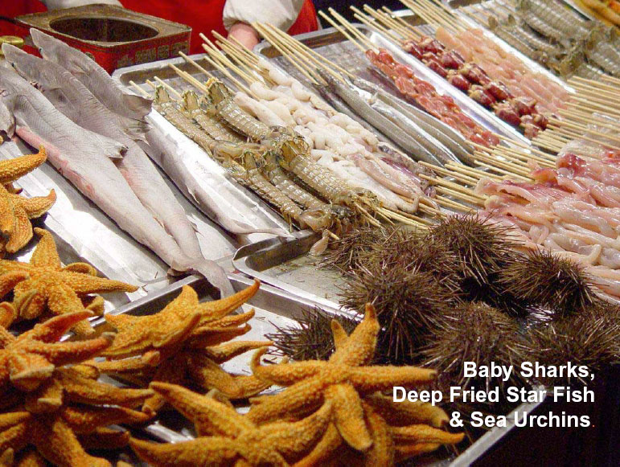

Slide 6
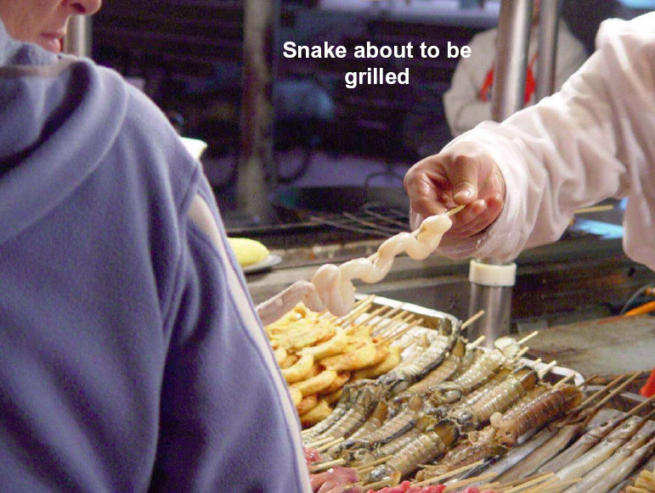

Slide 7
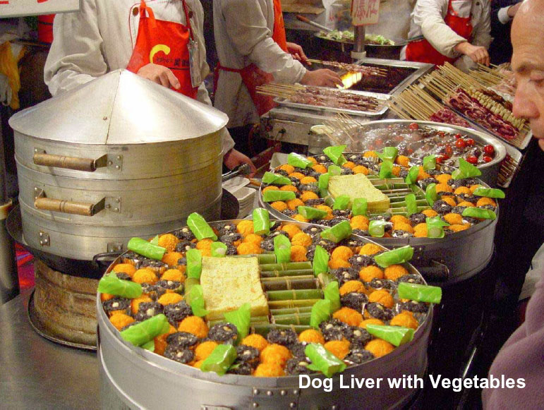

Slide 8
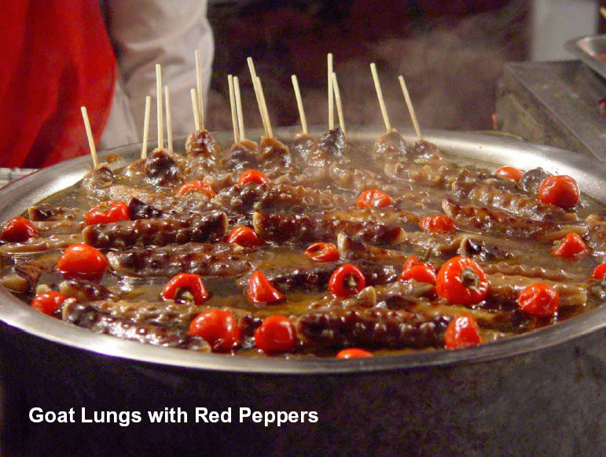

Slide 9
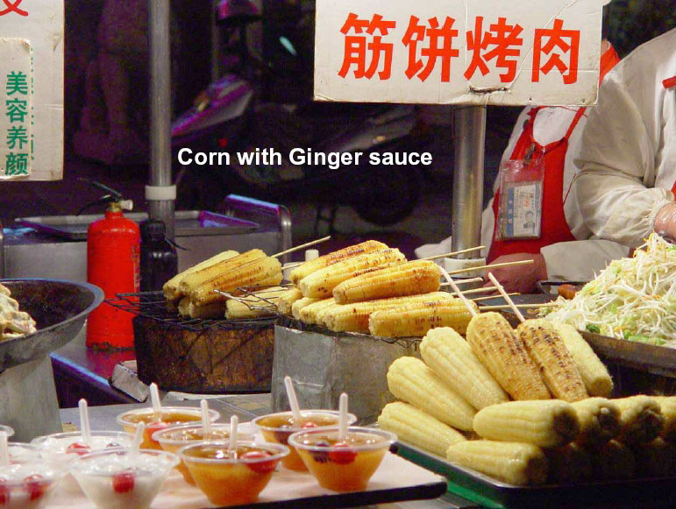

Slide 10
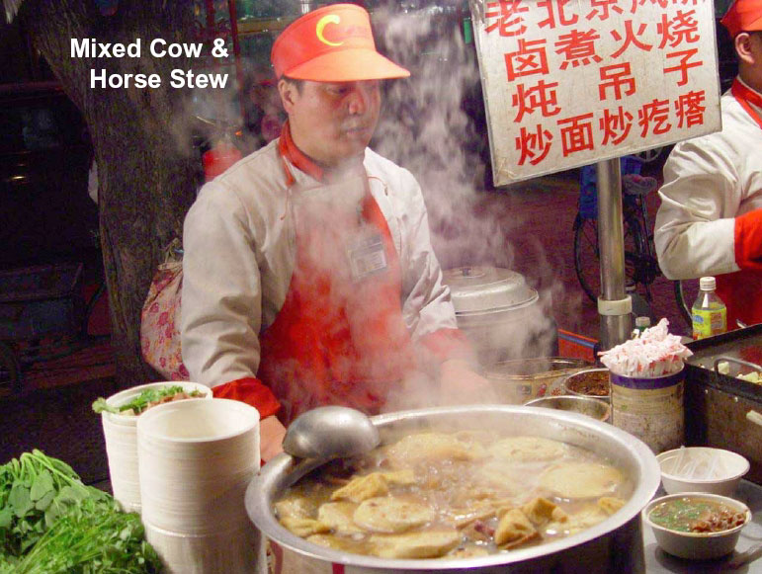

Slide 11
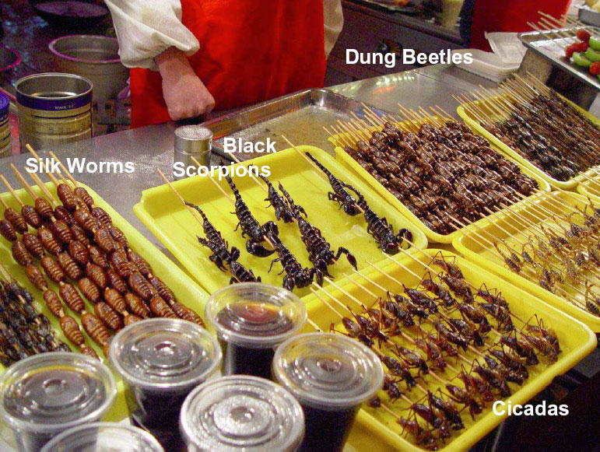

Slide 12
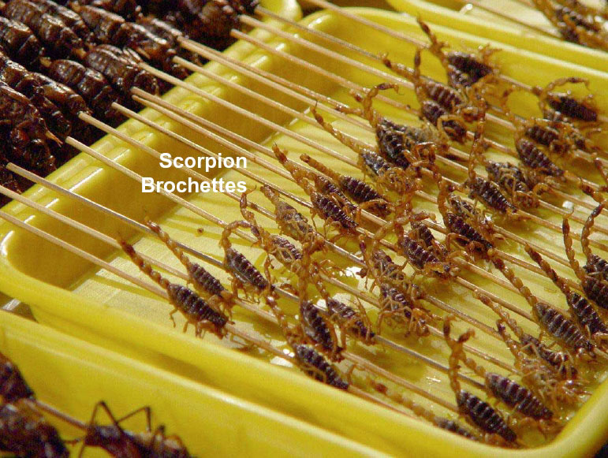

Slide 13
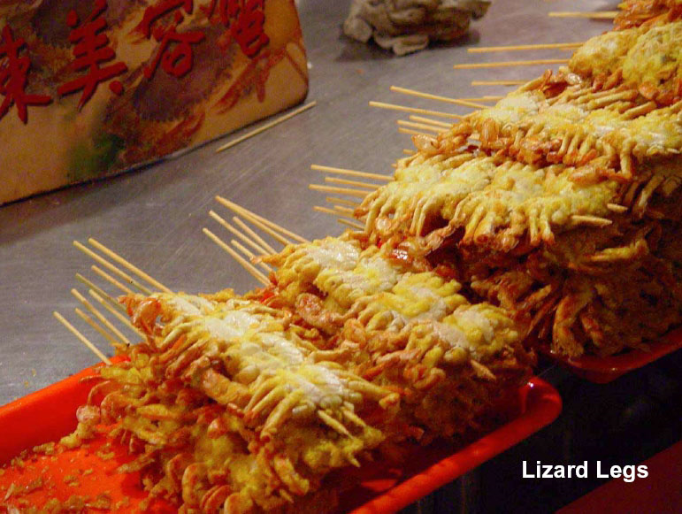

Slide 14
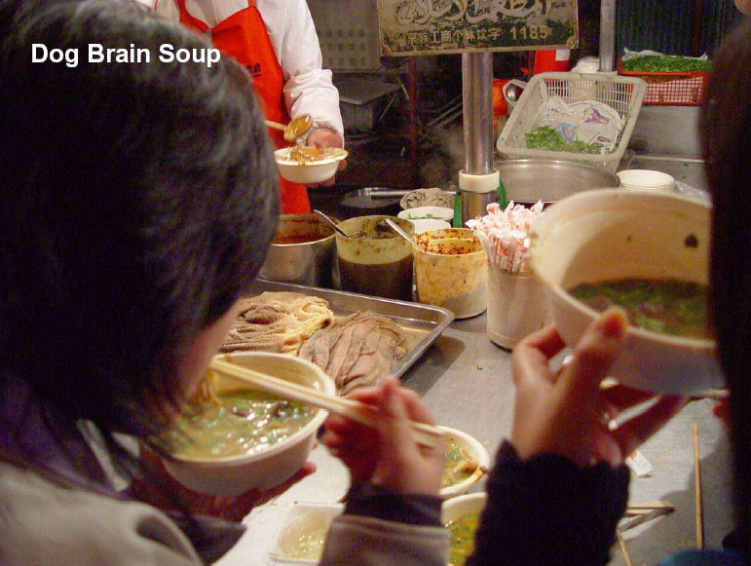

Slide 15
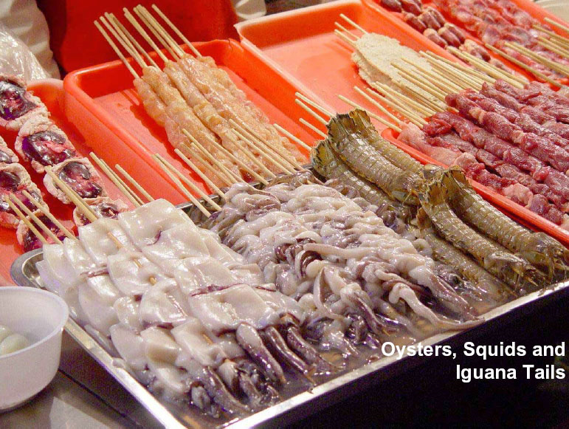

Slide 16
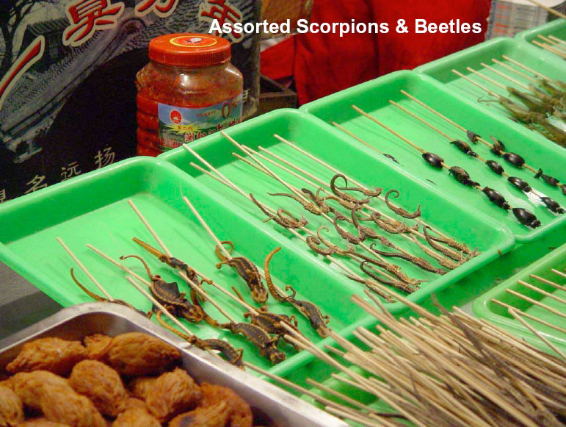

Slide 17
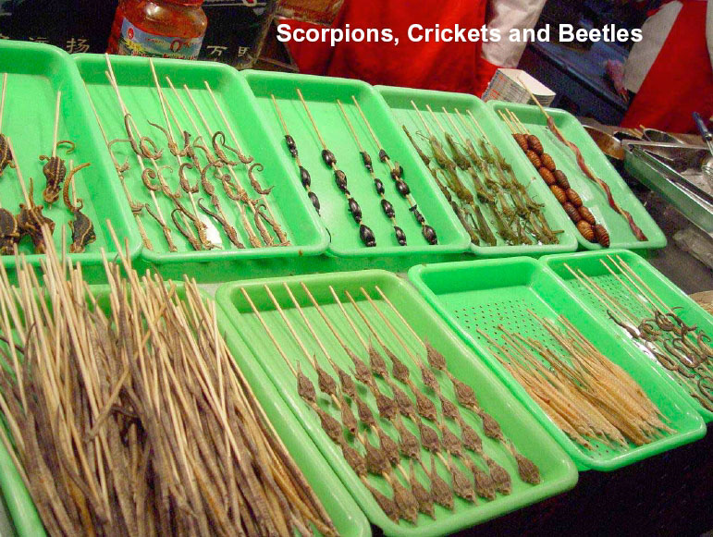

Slide 18
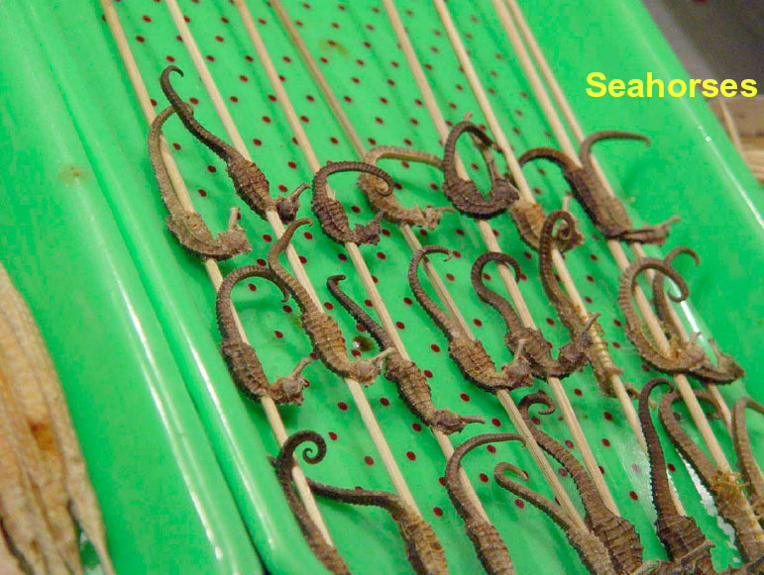

Slide 19
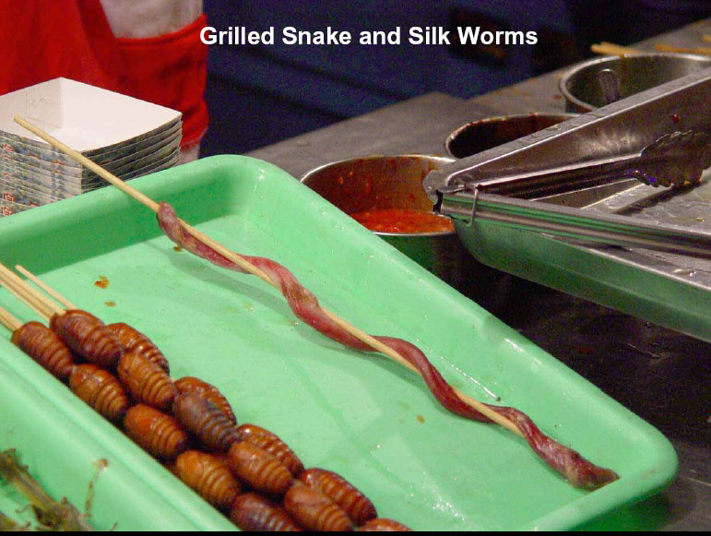

Slide 20
Note from Joe:
I’m pretty open-minded about food and will try most new things; however, some of these choices might go beyond my degree of openness.
I’d love to go to the Olympics somewhere like Rome . . .
Pasta with truffle sauce
Black pasta (with squid ink sauce)
Truffle stuffed ravioli

