Slide 1
Chinese Countryside
Away from the big cities

Slide 2
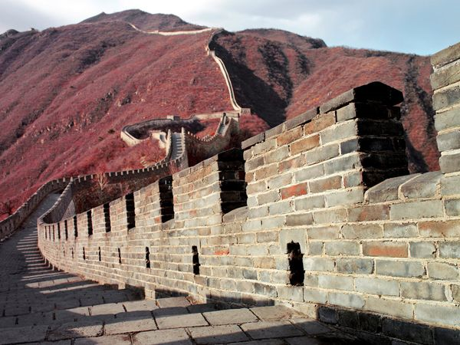
The Great Wall

Slide 3
Grandmother and Baby, Guizhou Province

Slide 4
Brick Factory, Hebei Province

Slide 5
Rice Terraces, Yunnan Province

Slide 6
Narrow Rice Paddies

Slide 7
Buddhist Monk, Tibet

Slide 8
Festival Dance, Tibet

Slide 9
Tibetan Dance, Shangri-La

Slide 10
Chang Tang, Tibet

Slide 11
Farmers, Jiangxi Province

Slide 12
Guanxi provinces in southern China

Slide 13
Southern China

Slide 14
Farm Village

Slide 16
Harvesting Potatoes

Slide 17
Lacking Modern Farm Equipment

Slide 18
Shipton’s Arch, Taklimakan Desert

Slide 19
Giant Panda, Sichuan Province

Slide 20
Red Lanterns, Old Town Lijiang

Slide 24
A winter morning in Daxing

Slide 25
Yu Long River Valley

Slide 26
Mountain Path

Slide 27
Blessing, Guizhou Province

