Slide 1
China Landslide – August 2010

Slide 2
Increasing Death Toll 8/10/2010
The death toll from mudslides in northwest China has surged to 337, as rescuers used diggers and their bare hands in a desperate search for more than 1,100 others still missing
At least three villages were flattened by an avalanche of mud and rocks triggered by heavy rains in a remote area of Gansu province late on Saturday, the latest deadly disaster as China battles its worst flooding in a decade.

Slide 3
BBC News 8/10/2010
702 people confirmed dead and more than 1,000 missing
45,000 people in Zhouqu county evacuated
7,000 soldiers, firefighters and medical staff deployed
300 buildings buried under mud
66% of county without power

Slide 5
Location

Slide 6
Landslide
Landslides are rock, earth, or debris flows on slopes due to gravity. They can occur on any terrain given the right conditions of soil, moisture, and the angle of slope. Integral to the natural process of the earth's surface geology, landslides serve to redistribute soil and sediments in a process that can be in abrupt collapses or in slow gradual slides. Such is the nature of the earth's surface dynamics.

Slide 7
Where?

Slide 8
The weight of heavily saturated soil results in the slippage.

Slide 9
Aerial images show Zhouqu county in north-west China before and after a devastating landslide.

Slide 15
People in Mourning

Slide 16
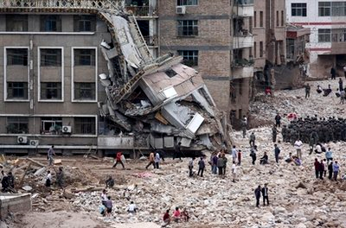

Slide 17
Man rescued – trapped 50 hours

Slide 18
Searching for missing relatives

Slide 19
Remains of collapsed building

Slide 22
Soldiers search for survivors

Slide 23
Trying to avoid the stench of death

Slide 24
View of landslide

Slide 25
Trying to salvage personal belongings

Slide 28
Devastated Citizens

