Slide 1
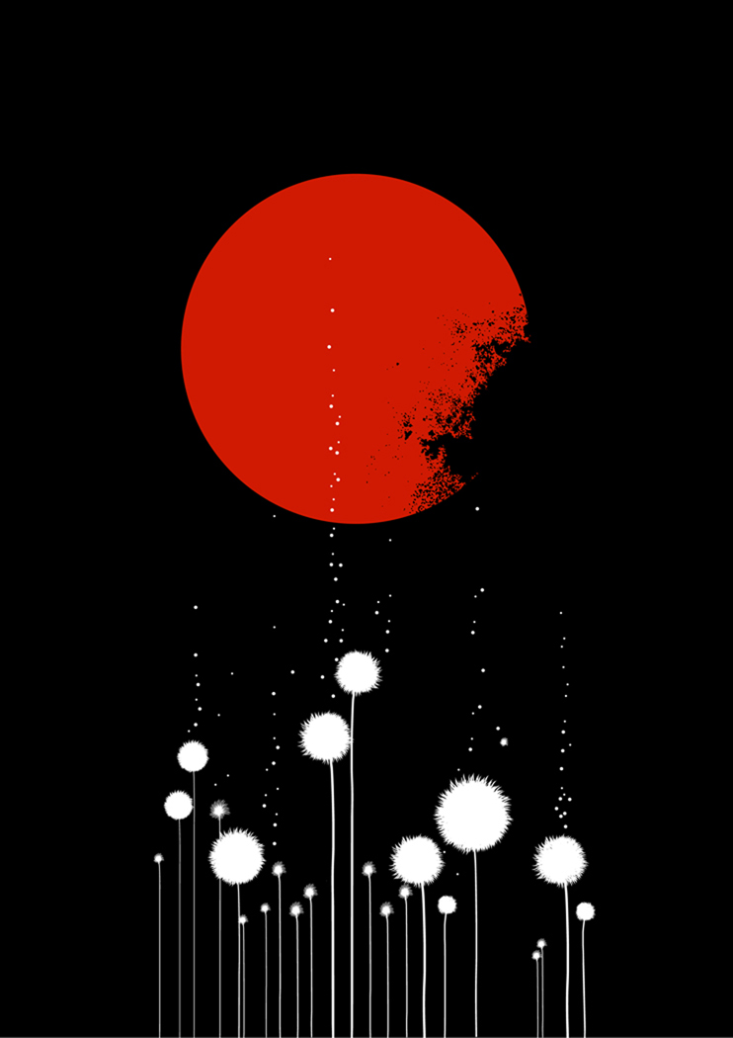
China - Beijing
Capital and Cultural & Industrial Center

Slide 2
Great Wall on the outskirts of Beijing.

Slide 3
Beijing Zoo

Slide 4
Beijing Zoo
Beijing Zoo hosts many species of rare animals including the golden monkey, and others from around the world. The zoo also is a research and conservation center, with a number of programs for the reproduction of rare animals.

Slide 5
"Happy Valley" - an amusement park

Slide 6
Happy Valley
"Happy Valley" is an amusement park (the largest in China) and attraction in Beijing. It consists of 6 thematic sections. The Park was built in 4 years. It more than 40 rides. Currently China has more than 2,000 theme parks, although the boom began just 20 years ago.

Slide 7
Beyhan Park

Slide 8
Here walked emperors. Beyhan Park in Beijing is more than 1000 years old, and served as a place of rest for the rulers of the Five Dynasties. The park opened to the public in 1925. It has a large lake, pavilions, towers, and beautiful landscape.

Slide 9
People buying traditional Chinese shoes on Vanfudzin Street

Slide 10
Vanfudzin Street
Vanfudzin Street is popular among tourists and among the inhabitants of Beijing, for its many beautiful bright stalls with a variety of products and snacks.

Slide 11
The Beijing opera combines literature, music, dance, martial arts and even acrobatics.

Slide 12
Theatre Centre

Slide 13
Theatre Centre
Engineered by the French architect Paul Andrew, Theatre Centre, located near Tiananmen Square, has an opera theater with 2,398 seats, a concert hall with 2019 seats, and theater with 1,035 seats. All these are available in the one location.

Slide 14
The ruins of the palace Qian Yuan

Slide 15
The ruins of the palace Qian Yuan
The ruins of the palace Qian Yuan were also known as the Old Summer Palace. The residence consisted of three independent garden areas and covered a large area of which included about a hundred different landscape attractions. The palace was looted and burned by British and French troops in 1860 CE.

Slide 16
Chinese Muslims gathered for prayers in the mosque Nyudze

Slide 17
Nyudze Mosque
Chinese Muslims are gathered for prayers in the mosque Nyudze in Beijing on the eve of Eid al-Fitr - the day that marks the end Ramadan of the month of fasting. Thousands of people came to this oldest and largest mosque in Beijing, to perform the morning prayer. They had a meal after the fast in tents, and they danced in the street. The mosque was built in 996 CE, and is the spiritual center for more than 10,000 Muslims in the Chinese capital.

Slide 18
The Temple of Heaven and Hall of Prayer for Good Harvest photographed from the complex entrance. The hall is a shishkoobraznoe wooden structure with triple eaves. The blue-tiled roof is visible far outside the palace complex and is a famous example of the Chinese imperial architectural style.

Slide 19
The Temple of Heaven Complex

Slide 20
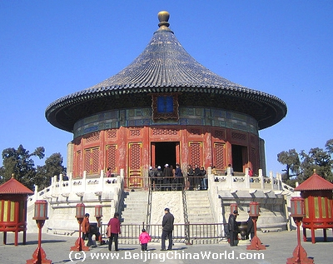
The Entire Complex
The Imperial Vault of Heaven
The Emperor always entered the complex from the South Gate.
For much more detail: http://www.kinabaloo.com/temple_of_heaven.html

Slide 21
The Temple of Heaven

Slide 22
Interior View: The imperial yellow of the wall and the greens and blues of the symmetrical decor above provide a dramatic setting for the intricately carved screen that surrounds the Emperor's throne.

Slide 23
The magnificent ceiling of the Temple of Heaven Hall of Prayer for Good Harvests
For more detailed information and pictures:
http://www.khulsey.com/travel/china_beijing_temple-of-heaven.html

Slide 24
New Year at the Temple of Heaven

Slide 25
New Year
The actor, dressed in imperial yellow costume, rehearsing movement during a ceremony at the Temple of Heaven, marking the Chinese New Year on the lunar calendar.
According to the Chronicle, for more than 500 years the emperors attended the ceremony here.

Slide 26
The statue on The Way of Souls in Ming Cemetery depicts a high-ranking civil servant.

Slide 27
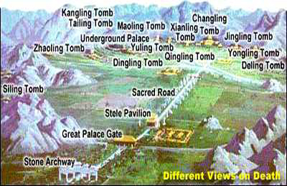
Ming Tombs
The Ming Memorial is where the remains of 13 emperors of the Ming Dynasty are interred. It is classified as a World Heritage monuments by UNESCO.

Slide 28
Along the Sacred Road
For more information: http://www.chineseviolins.com/Show_visit.asp?id=107

Slide 29
Dingling Tomb

Slide 30
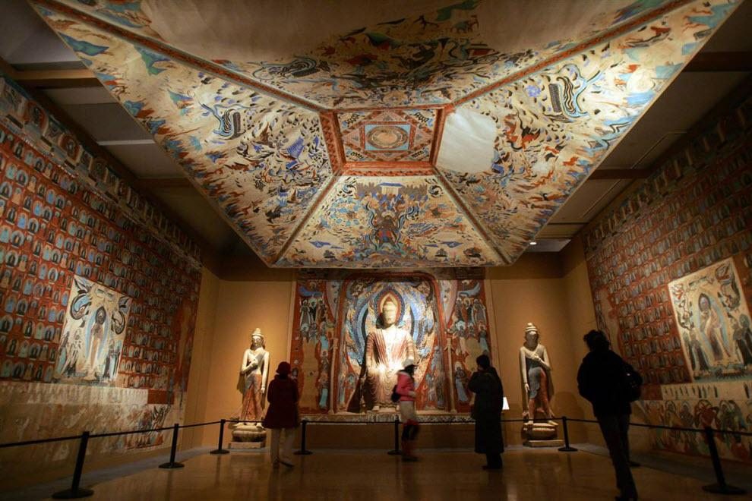
National Art Museum of China

Slide 31
Donhuan Cave Exhibit
Visitors view a copy of the Mogao caves during the exhibition Donhuan in the National Art Museum of China. The exhibition featured the restored sculptures and copies of cave murals, ceramic tile and literary monuments of the cave library Donhuan.
G. Donhuan, located in Gansu Province in northwest China, is remarkable. Inside are painted caves with Buddhist murals and sculptures, dating from between the 5th and 13th centuries CE.

Slide 32
Yonheguna Tibetan Temple

Slide 33
Yonheguna - Lama Temple
Tibetan monk goes to the courtyard of Yonheguna - Lama temple and monastery of the Geluk sect. This is one of the largest and most important monasteries of Tibetan Buddhism in the world. In the temple are five large halls and five courtyards decorated with arches and curved eaves. There are many masterpieces of Buddhist art - murals, statues of gods, demons and Buddhas in this complex

Slide 34
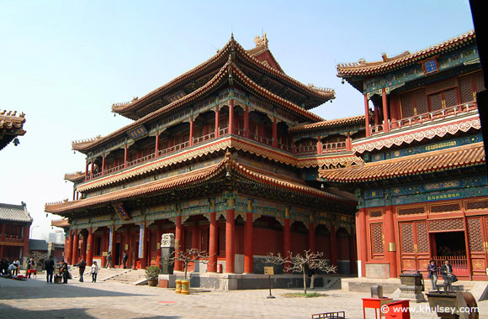
Lama Temple

Slide 35
The Lama Temple complex

Slide 36
A cook prepares a traditional Beijing cuisine in "Hooton".

Slide 37
Those residing in Beijing live in "Hooton" - a traditional street, preserving the city's history and pre-industrial lifestyle. A "Hooton" is formed by the walls of houses. Since the mid 20 th century, these quiet streets are gradually disappearing, as is a new development.

Slide 38
Scene in a Hooton

Slide 39
This photo shows an area of the old buildings in Beijing. This spring, thousands of workers in yellow hard hats took to the streets of old Beijing to renovate old buildings, at least those who remained after the building boom of recent years.

Slide 40
Forbidden City, the famous citadel of Chinese emperors in the heart of Beijing.

Slide 41
The Gate of Heaven of Peace in the Forbidden City.

