Slide 1
China – Ethnic Minorities
55 recognized groups – 8% of China’s population – approximately 100,000,000 people. The Han Chinese make up 92%.

Slide 2
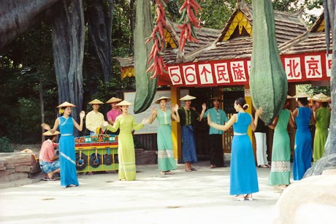
This colorful entrance presents a traditional depiction of ethnic minorities in China as happy providers of exotic culture to the more serious rulers at its center.
National Ethnic Minorities Theme Park

Slide 3
The political importance of the expansive National Ethnic Minorities Theme Park can be seen from its placement directly north of the Forbidden City and the Drum Tower, directly across from the site of the Olympic Village.
The National Ethnic Minorities Theme Park is targeting foreign tourists who do not have time to travel to all of China.
China's 55 official ethnic minorities account for about half of the poorest Chinese, according to state media. They live mostly in underdeveloped western, southern and northern areas. They make up about 100 million, or 8 per cent, of China's 1.3 billion people with China's 56th ethnic group, the Han Chinese, forming the 92-per-cent majority.

Slide 4
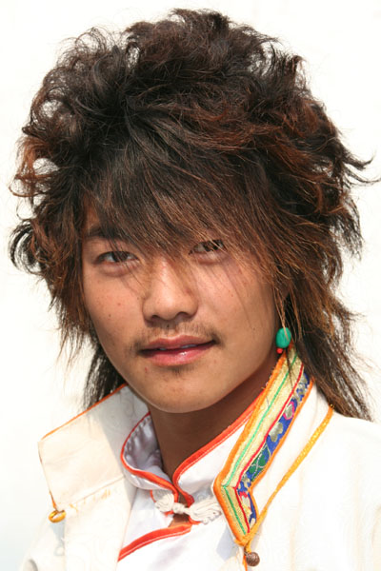
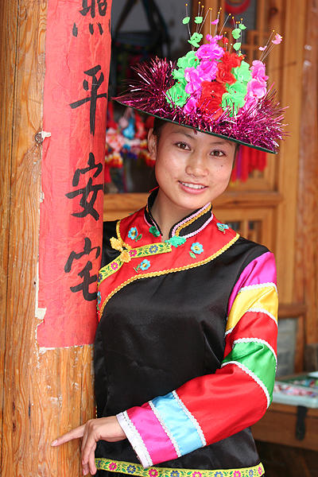

Slide 5
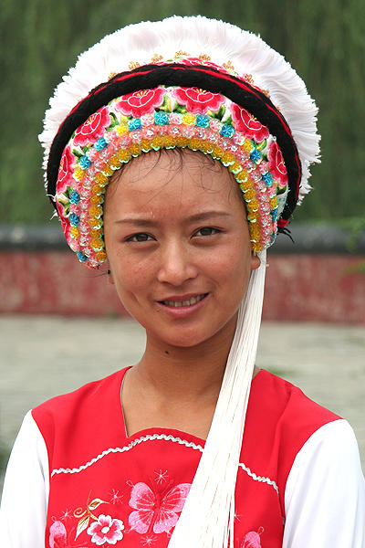
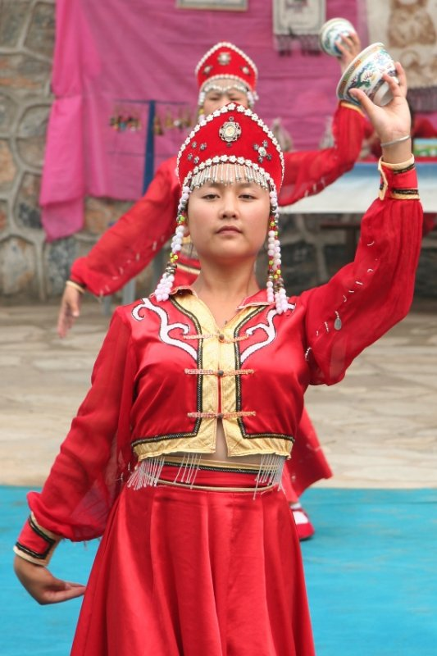

Slide 6
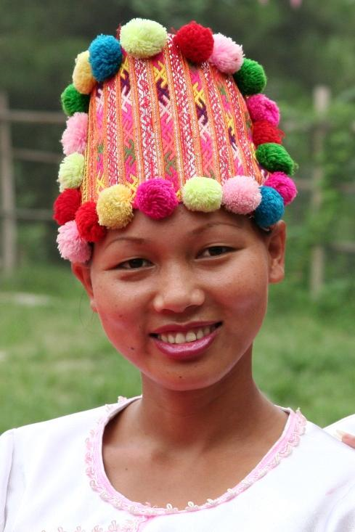
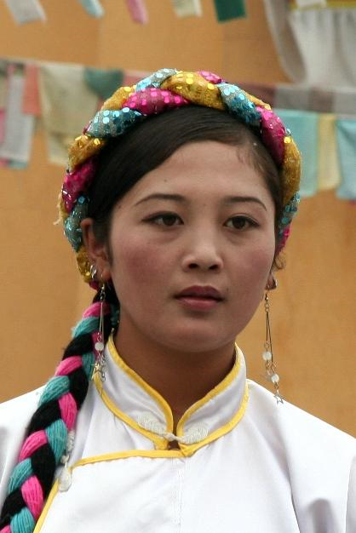

Slide 7
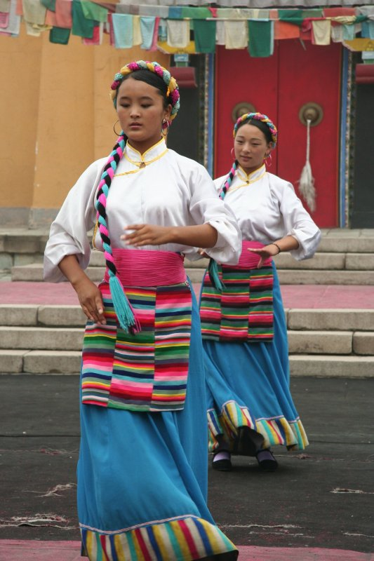
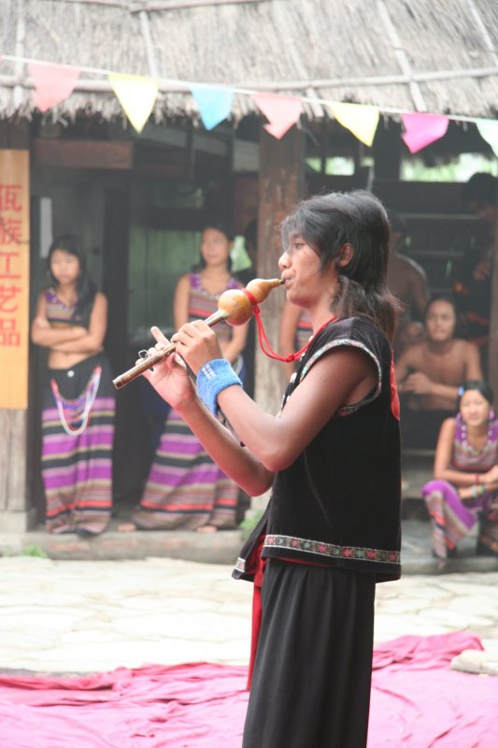

Slide 8
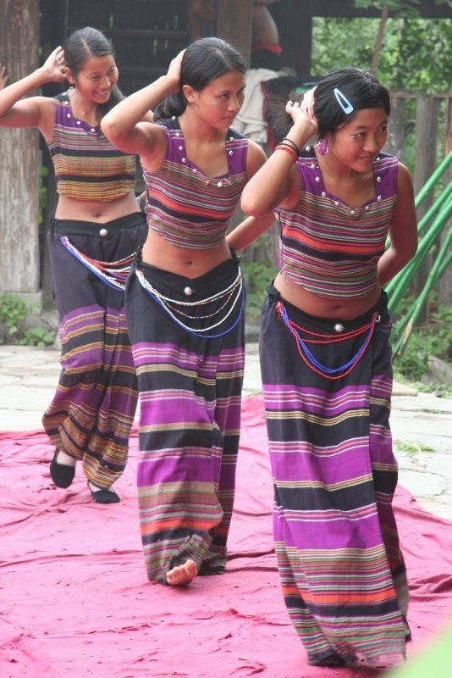

Slide 9
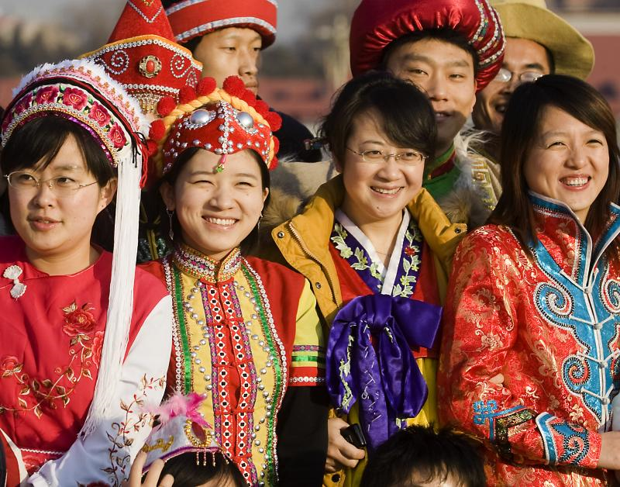

Slide 10
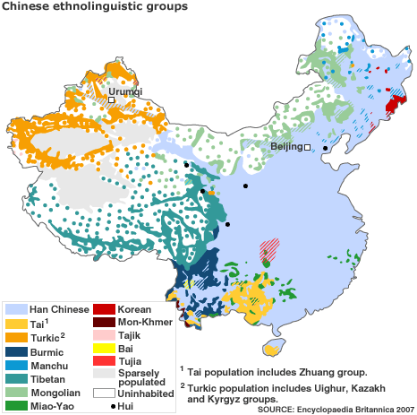

Slide 11
CHINESE ETHNIC MINORITIES
Fifty-five recognized ethnic minorities: Click on the linked title of each group for more information.

Slide 12
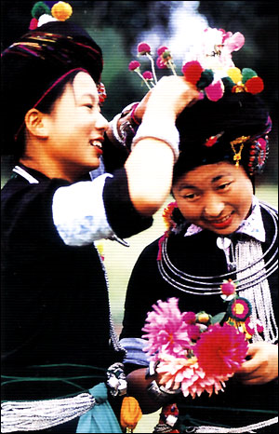
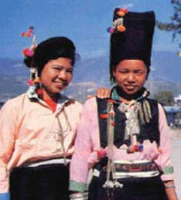
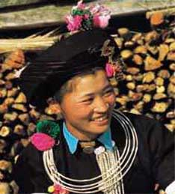
The Achang ethnic minority
Population: 33,936
Major area of distribution: Yunnan
Language: Achang
Religion: Buddhism

Slide 13
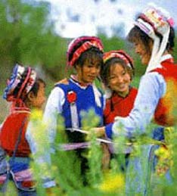
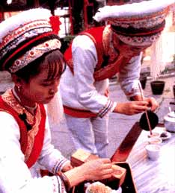
The Bai ethnic minority
Population: 1,858,063
Major area of distribution: Yunnan and Guizhou
Language: Bai
Religion: Buddhism

Slide 14
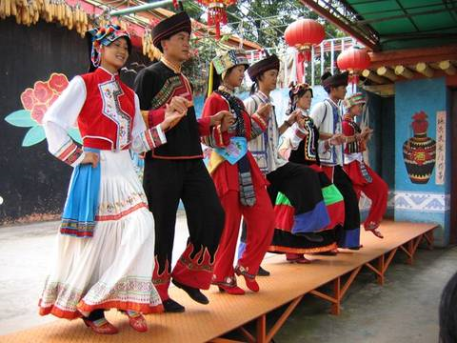
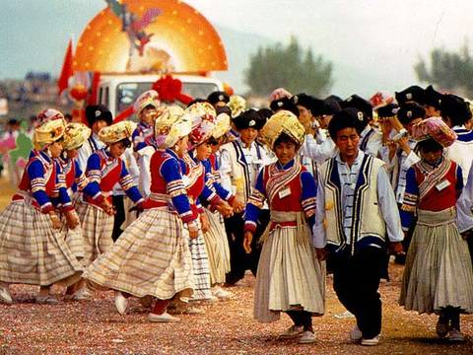

Slide 15
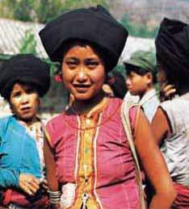
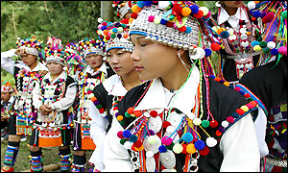
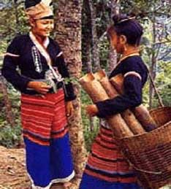
The Blang ethnic minority
Population: 91,882
Major area of distribution: Yunnan
Language: Blang
Religion: Buddhism

Slide 16
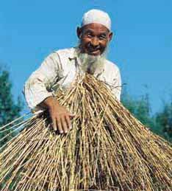
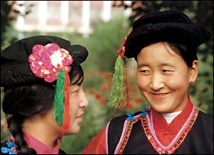
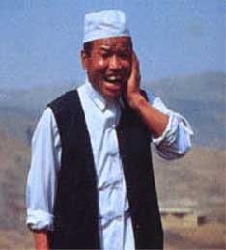
The Bonan ethnic minority
Population: 16,505
Major area of distribution: Gansu
Language: Bonan
Religion: Islam

Slide 17
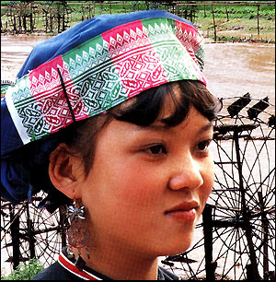
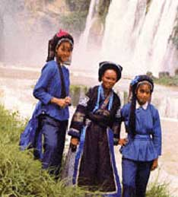
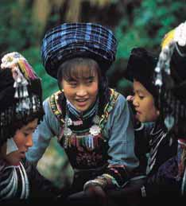
The Bouyei ethnic minority
Population: 2,971,460
Major area of distribution: Guizhou
Language: Bouyei
Religion: Polytheism

Slide 18
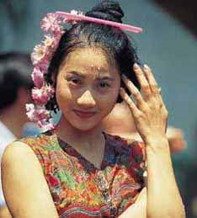
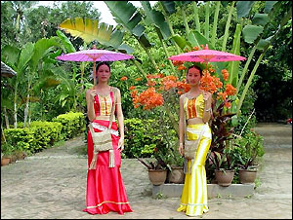
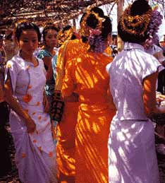
The Dai ethnic minority
Population: 1,158,989
Major area of distribution: Yunnan
Language: Dai
Religion: Buddhism

Slide 19
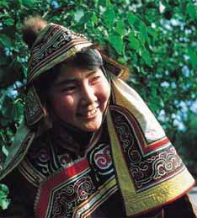
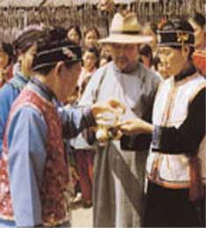
The Daur ethnic minority
Population: 132,394
Major areas of distribution: Inner Mongolia, Heilongjiang and Xinjiang
Language: Daur and Han
Religion: Shamanism

Slide 21
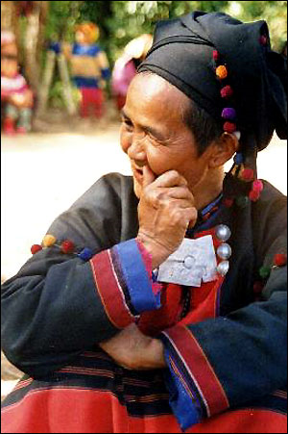
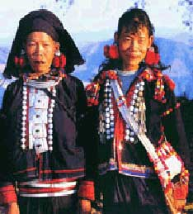
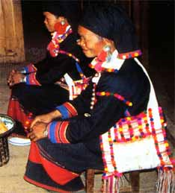
The De'ang ethnic minority
Population: 17,935
Major area of distribution: Yunnan
Language: De'ang
Religion: Buddhism

Slide 22
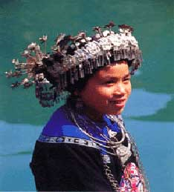
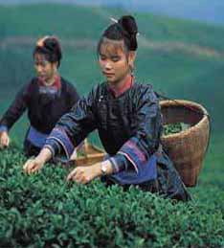
The Dong ethnic minority
Population: 2,960,293
Major area of distribution: Guizhou, Hunan and Guangxi
Language: Dong
Religion: Polytheism

Slide 23
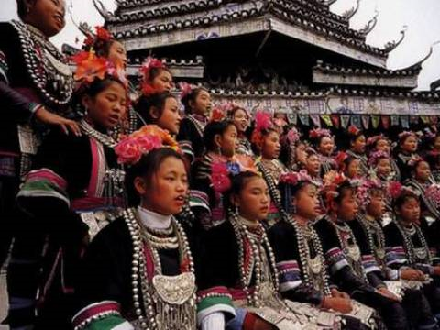
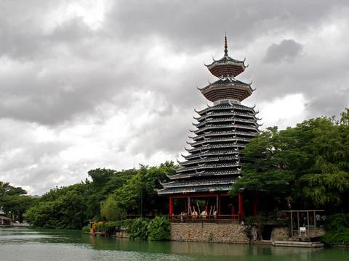
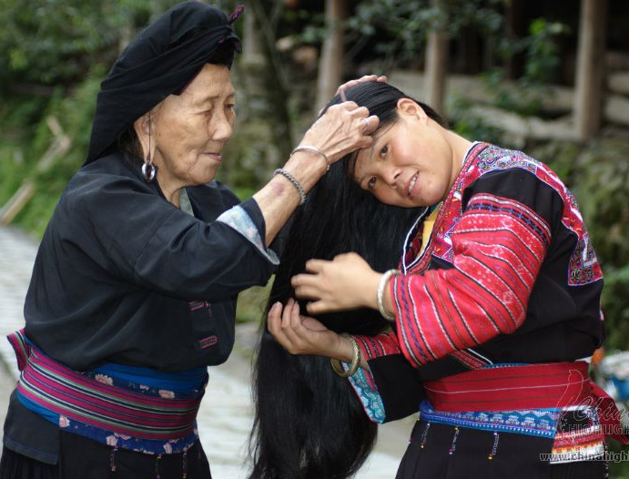

Slide 24
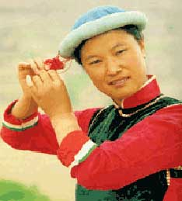
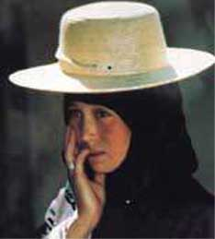
The Dongxiang ethnic minority
Population: 513,805
Major areas of distribution: Gansu and Xinjiang
Language: Dongxiang and Han Chinese
Religion: Islam

Slide 25
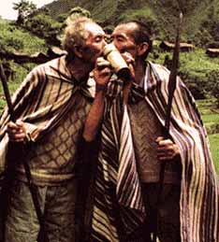
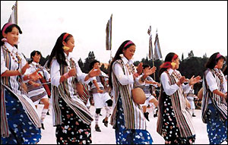
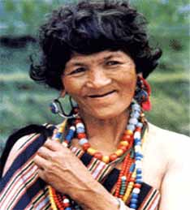
The Drung ethnic minority
Population: 7,426
Major area of distribution: Yunnan
Language: Drung
Religion: Polytheism

Slide 26
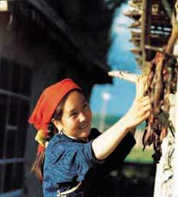
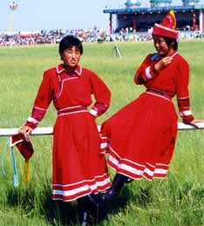
The Ewenki ethnic minority
Population: 30,505
Major areas of distribution: Inner Mongolia & Heilongjiang
Language: Ewenki and Han
Religion: Most Ewenkis are animists while those in the pastoral areas are followers of the Lamaist faith.

Slide 28
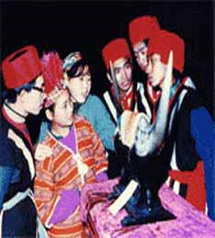
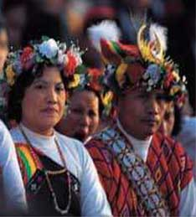
The Gaoshan ethnic minority
Population: 415,000
Major area of distribution: Taiwan and Fujian
Language: Gaoshan people speak 13 languages
Religion: Polytheism

Slide 30
The Gelo ethnic minority
Population: 579,357
Major area of distribution: Guizhou and Guangxi
Language: Gelo
Religion: Polytheism

Slide 32
The Hani ethnic minority
Population: 1,439,673
Major area of distribution: Yunnan
Language: Hani
Religion: Buddhism

Slide 33
The Hezhe ethnic minority
Population: 4,640
Major areas of distribution: Heilongjiang
Language: Hezhe and Han
Religion: originally Shamanism

Slide 34
The Hui ethnic miniroty
Population: 9,816,802
Major areas of distribution: Ningxia, Gansu, Henan, Hebei, Qinghai, Shandong, Yunnan, Xinjiang, Anhui, Liaoning, Heilongjiang, Jilin, Shanxi, Beijing, Tianjin
Language: Han (standard Chinese)
Religion: Islam

Slide 36
The Jing ethnic minority
Population: 22,517
Major area of distribution: Guangxi
Language: Jing
Religion: Buddhism and Taoism

Slide 37
The Jino ethnic minority
Population: 20,899
Major area of distribution: Yunnan
Language: Jino
Religion: Polytheism

Slide 39
The Jingpo ethnic minority
Population: 132,143
Major area of distribution: Yunnan
Language: Jingpo
Religion: Buddhism

Slide 40
The Kazak ethnic minority
Population: 1,250,458
Major areas of distribution: Xinjiang, Gansu and Qinghai
Language: Kazak
Religion: Islam

Slide 42
The Kirgiz ethnic minority
Population: 160,823
Major areas of distribution: Xinjiang and Heilongjiang
Language: Kirgiz
Religion: Islam

Slide 44
The Korean ethnic minority
Population: 1,923,842
Major areas of distribution: Jilin, Liaoning and Heilongjiang
Language: Korean and Han
Region: Buddhism

Slide 46
The Lahu ethnic minority
Population: 453,705
Major area of distribution: Yunnan
Language: Lahu
Religion: Buddhism

Slide 47
The Lhoba ethnic minority
Population: 2,965
Major area of distribution: Tibet
Language: Lhoba
Religion: Lamaism

Slide 48
The Li ethnic minority
Population: 1,247,814
Major area of distribution: Hainan
Language: Li
Religion: Polytheism

Slide 50
The Lisu ethnic minority
Population: 634,912
Major area of distribution: Yunnan and Sichuan
Language: Lisu
Religion: Polytheism

Slide 52
The Manchu ethnic minority
Population: 10,682,263
Major areas of distribution: Virtually scattered over all of China, the largest group, about 46.2 per cent of the total, live in Liaoning Province.
Language: Manchu (in both script and spoken language) and Han (standard Chinese)
Religion: Shamanism

Slide 53
The Maonan ethnic minority
Population: 107,166
Major area of distribution: Guangxi
Language: Maonan
Religion: Taoism, polytheism

Slide 54
The Miao ethnic minority
Population: 8,940,116
Major area of distribution: Guizhou, Hunan, Yunnan, Guangxi, Sichuan, Hainan and Hubei
Language: Miao
Religion: Polytheism

Slide 56
The Moinba ethnic minority
Population: 8,923
Major area of distribution: Tibet
Language: Moinba
Religion: Lamaism

Slide 57
The Mongolian ethnic minority
Population: 5,813,947
Major areas of distribution: Inner Mongolia, Liaoning, Jilin, Heilongjiang, Xinjiang, Henan, Hebei, Gansu, Qinghai, etc.
Language: Mongolian and Han
Religion: Lamaism

Slide 59
The Mulam ethnic minority
Population: 207,352
Major area of distribution: Guangxi
Language: Mulam
Religion: Taoism and Buddhism

Slide 60
The Naxi ethnic minority
Population: 308,839
Major area of distribution: Yunnan and Sichuan
Language: Naxi
Religion: Dongba and Lamaism

Slide 61
Dongba religion of the Naxi people

Slide 62
The Nu ethnic minority
Population: 28,759
Major area of distribution: Yunnan
Language: Nu
Religion: Polytheism

Slide 63
The Oroqen ethnic minority
Population: 8,196
Major areas of Distribution: Inner Mongolia and Heilongjiang
Language: Oroqen and Han
Religion: Shamanism or animism

Slide 65
The Ozbek ethnic minority
Population: 12,370
Major area of distribution: Xinjiang
Language: Osbek
Religion: Islam

Slide 66
The Pumi ethnic minority
Population: 33,600
Major area of distribution: Yunnan
Language: Pumi
Religion: Lamaism and Taoism

Slide 67
The Qiang ethnic minority
Population: 306,072
Major area of distribution: Sichuan
Language: Qiang
Religion: Animism

Slide 69
The Russian ethnic minority
Population: 15,609
Major area of distribution: Xinjiang and Inner Mongolia
Language: Russian
Religion: Orthodox Eastern Church

Slide 71
The Salar ethnic minority
Population: 104,503
Major areas of distribution: Qinghai, Gansu and Xinjiang
Language: Salar
Religion: Islam

Slide 73
The She ethnic minority
Population: 709,592
Major area of distribution: Fujian, Zhejiang, Jiangxi and Guangdong
Language: She
Religion: Ancestor worship

Slide 75
The Shui ethnic minority
Population: 406,902
Major area of distribution: Guizhou and Guangxi
Language: Shui
Religion: Polytheism

Slide 77
The Tajik ethnic minority
Population: 41,028
Major area of distribution: Xinjiang
Language: Tajik
Religion: Islam

Slide 78
The Tartar ethnic minority
Population: 4,890
Major area of distribution: Xinjiang
Language: Tartar
Religion: Islam

Slide 80
The Tibetan ethnic minority
Population: 5,416,021
Major area of distribution: Tibet, Qinghai, Sichuan, Gansu and Yunnan
Language: Tibetan
Religion: Lamaism

Slide 82
The Tu ethnic minority
Population: 241,198
Major areas of distribution: Gansu and Qinghai
Language: Tu and Han
Religion: Lamaism

Slide 84
The tujia ethnic minority
Population: 8,028,133
Major area of distribution: Hubei and Hunan
Language: tujia
Religion: Polytheism

Slide 86
The Uygur ethnic minority
Population: 8,399,393
Major area of distribution: Xinjiang
Language: Uygur
Religion: Islam

Slide 88
The Va ethnic minority
Population: 396,610
Major area of distribution: Yunnan
Language: Va
Religion: Buddhism

Slide 89
The Xibe ethnic minority
Population: 188,824
Major areas of distribution: Xinjiang, Jilin and Liaoning
Language: Xibe
Religion: Polytheism, Shamanism and Buddhism

Slide 91
The Yao ethnic minority
Population: 2,637,421
Major area of distribution: Guangxi, Hunan, Yunnan, Guangdong and Guizhou
Language: Yao and Miao
Religion: Polytheism

Slide 93
The Yi ethnic minority
Population: 7,762,286
Major area of distribution: Sichuan, Yunnan, Guizhou and Guangxi
Language: Yi
Religion: Polytheism

Slide 95
The Yugur ethnic minority
Population: 13,719
Major area of distribution: Gansu
Language: Yugur and Han Chinese
Religion: Lamaism

Slide 96
The Zhuang ethnic minority
Population: 16,178,811
Major area of distribution:
Language: Zhuang
Religion: Polytheism

Slide 98
Additional information:
http://www.orientaltravel.com/people.htm
http://yeschinatour.com/china-guides/

