Slide 1
Antarctica - Blood Falls
Interesting Life Forms

Slide 2
Background
blood-red waterfall pours very slowly out of the Taylor Glacier in Antarctica's McMurdo Dry Valleys. When geologists first discovered the frozen waterfall in 1911, they thought the red color came from algae, but its true nature turned out to be much more spectacular. Roughly two million years ago, the Taylor Glacier sealed beneath it a small body of water which contained an ancient community of microbes. Trapped below a thick layer of ice, they have remained there ever since, isolated inside a natural time capsule.

Slide 4
Evolving independently of the rest of the living world, these microbes exist in a place with no light or free oxygen and little heat, and are essentially the definition of "primordial ooze." The trapped lake has very high salinity and is rich in iron, which gives the waterfall its red color. A fissure in the glacier allows the subglacial lake to flow out, forming the falls without contaminating the ecosystem within.
The existence of the Blood Falls ecosystem shows that life is indeed possible in the most extreme conditions on Earth. Though tempting to make the connection, it does not show, however, whether life could exist on other planets with similar environments and similar bodies of frozen water - notably Mars and Jupiter's moon Europa - as it would have to arise from a completely different chain of events.

Slide 5
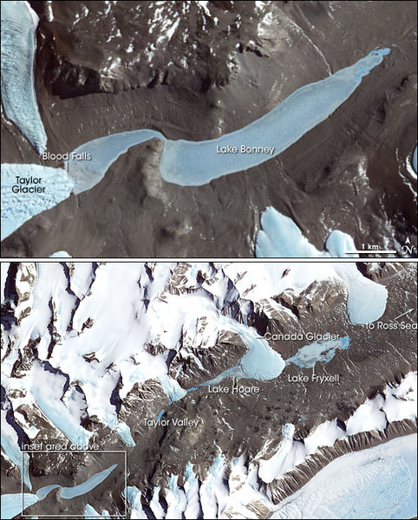

Slide 7
Geochemistry
Poorly soluble hydrous ferric oxides are deposited at the surface of ice after the ferrous ions present in the unfrozen saltwater are oxidized in contact with atmospheric oxygen. The more soluble ferrous ions initially are dissolved in old seawater trapped in an ancient pocket remaining from the Antarctic Ocean when a fjord was isolated by the glacier in its progression during the Miocene period, some 5 million years ago when the sea level was higher than today.

Slide 9
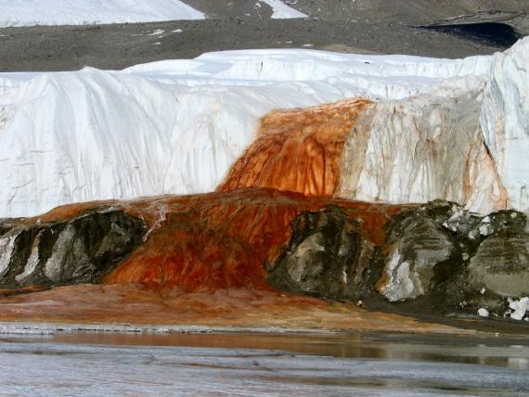

Slide 10
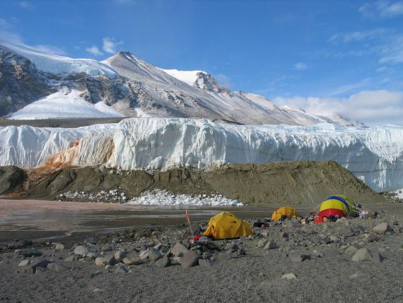

Slide 11
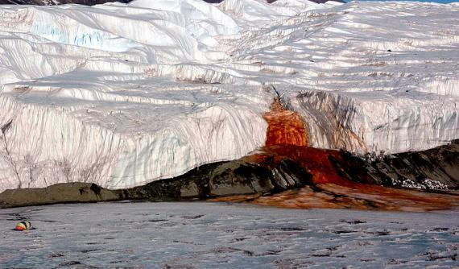

Slide 12
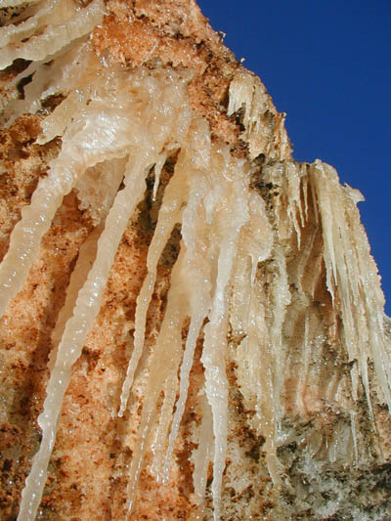
Close up

Slide 13
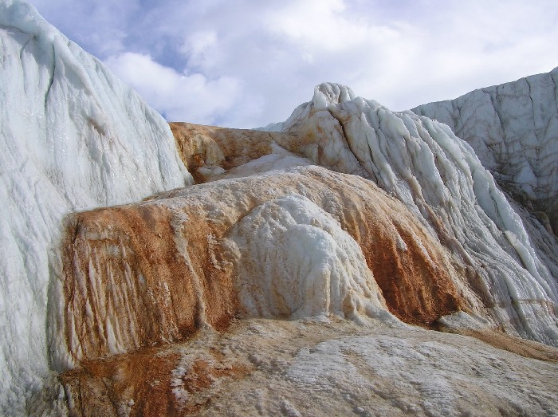

Slide 14
MICROBIAL ECOSYSTEM: Chemical and microbial analyses both indicate that a rare subglacial ecosystem of autotrophic bacteria developed that metabolizes sulfate and ferric ions. According to geomicrobiologist Jill Mikucki at Dartmouth College, water samples from Blood Falls contained at least 17 different types of microbes, and almost no oxygen. An explanation may be that the microbes use sulfate as a catalyst to respire with ferric ions and metabolize the microscopic amounts of organic matter trapped with them. Such a metabolic process had never before been observed in nature. A puzzling observation is the coexistence of Fe2+ and SO42– ions under anoxic conditions. Indeed, no sulfide anions (HS–) are found in the system. This suggests an intricate and poorly-understood interaction between the sulfur and the iron biochemical cycles

