Slide 1
Reflections on North American Regions

Slide 2
Re-regionalizing
We can all probably agree that the borders of the states in the U.S. don’t represent very well the true cultural, linguistic, political, economic, and historic regional differences in the various parts of the country. In many cases these borders are an impediment to sensible regional planning, and do not reflect true regional allegiances. Over the years, a number of people have taken stabs at re-imagining the regions of America, (what I like to call “re-regionalizing”). These plans often include our Canadian neighbors to the north and our Mexican neighbors to the south, while other schemes stop short at the borders.

Slide 3
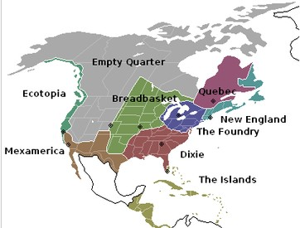
Joel Garreau - the Nine Nations of North America (1981)

Slide 4
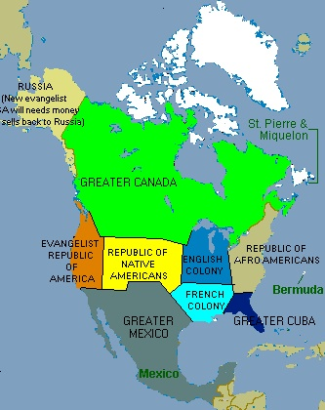
Divided States of America In, United States of America Out - Here we have 10 regions. This map was first published in a conservative Turkish newspaper.

Slide 5
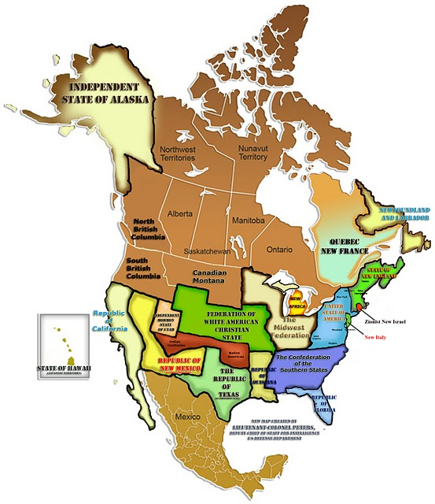
New Map of North America created by Colonel Peters, Deputy Chief of Staff for Intelligence, US Defense Department as a “spoof.”

Slide 6
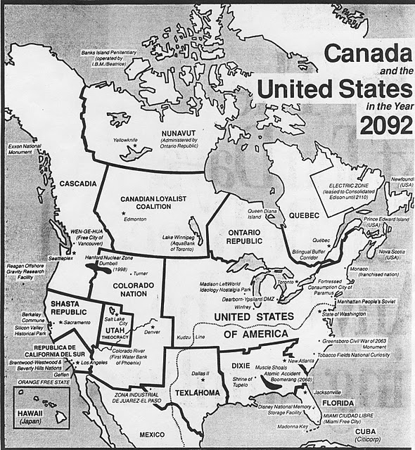
Canada and the United States in the Year 2092, by Douglas Coupland, author of “Shampoo Planet” and “Generation X.” This map, first issued in 1992.

Slide 7
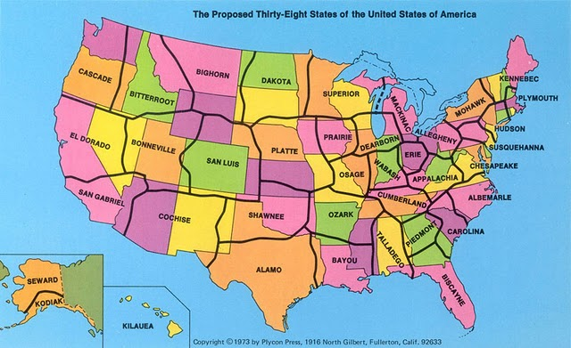
George Etzel Pearcy, a California State University geography professor, re-drew the state borders of the U.S. to end up with 38 states rather than 50. The borders were put in less populated areas, allowing major metropolitan areas to be contained all within one state

Slide 8
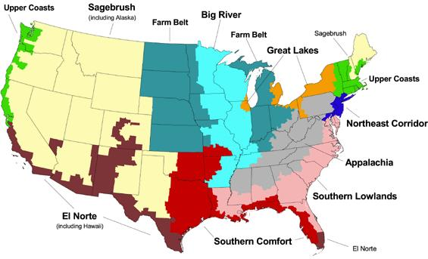
10 U.S. voting regions from the Boston Globe (2004)

Slide 9
And the 10 voting regions revisited, 2008

Slide 10
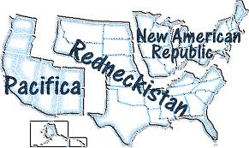

Slide 11
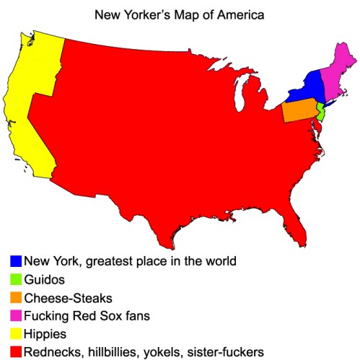

Slide 12
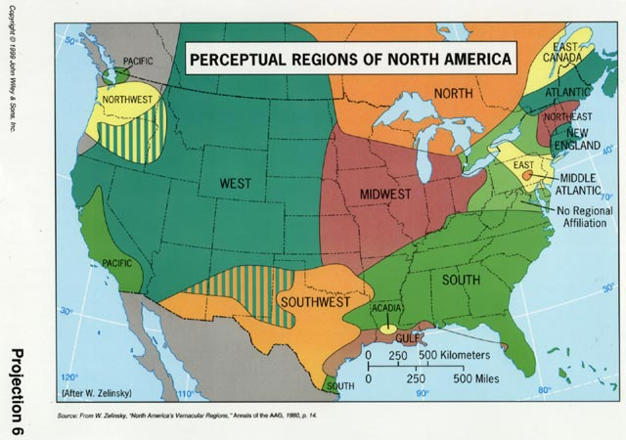

Slide 13
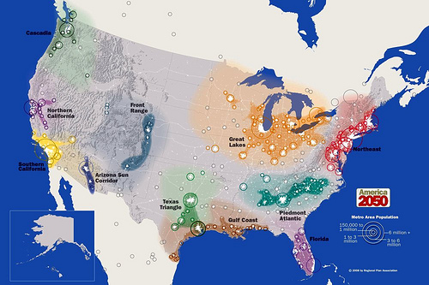

Slide 14
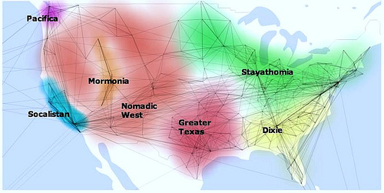

Slide 15
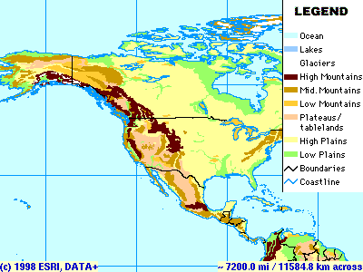
Elevation Regions

Slide 16
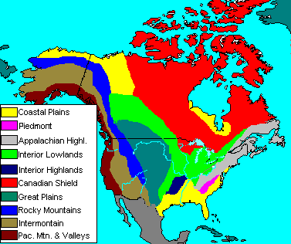

Slide 17
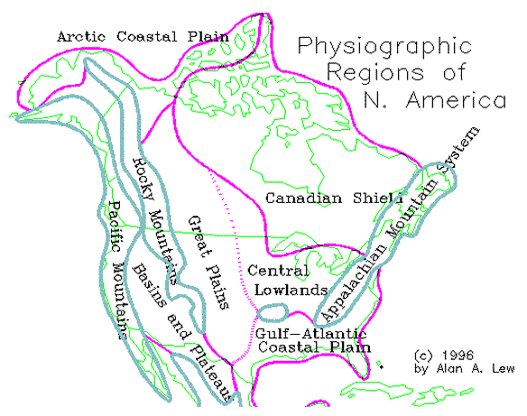

Slide 18
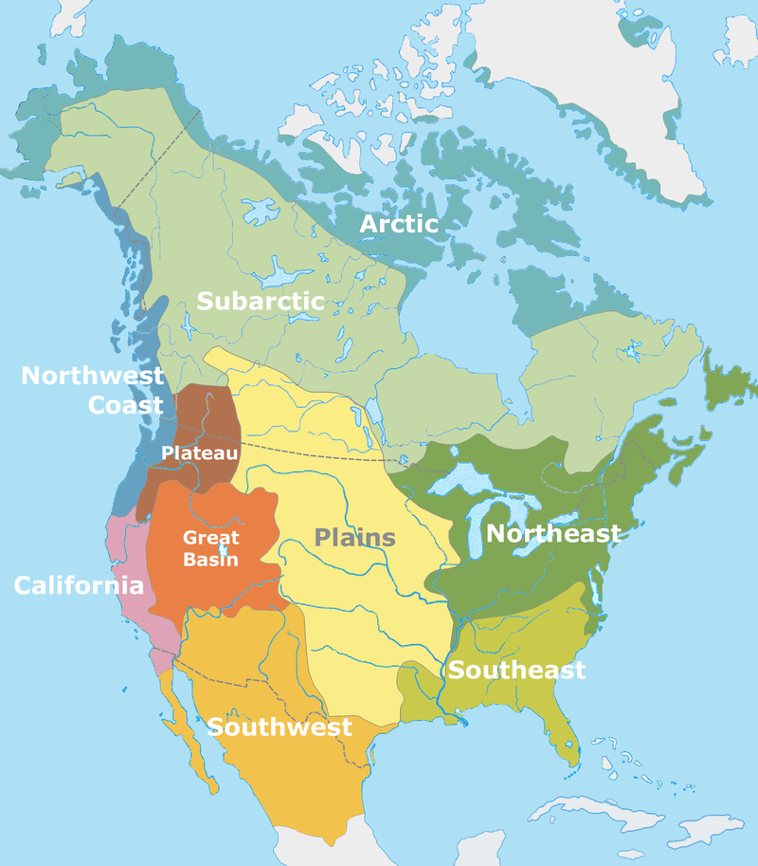
Physical Regions
Primarily based on landforms and climates

Slide 19
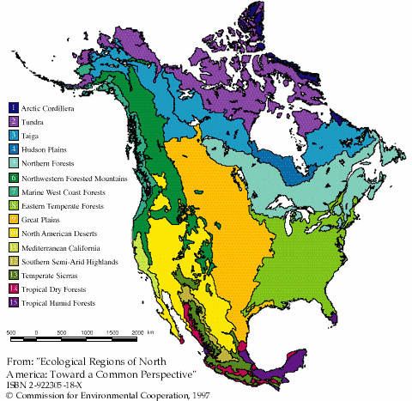

Slide 20
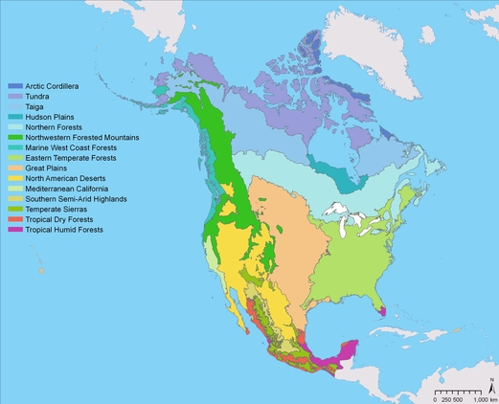
Ecoregions

Slide 21
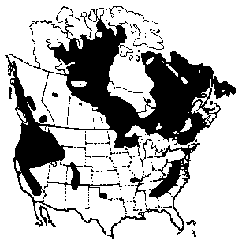
Low soil alkalinity regions

Slide 22
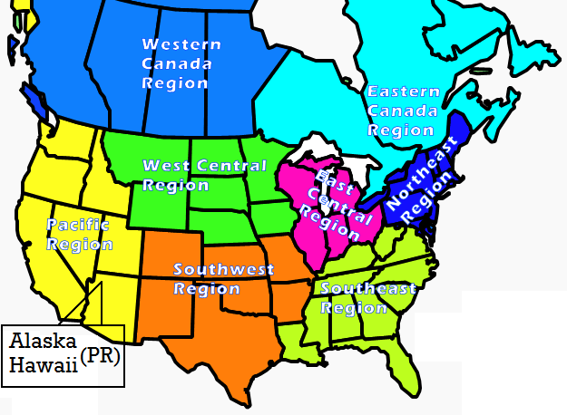

Slide 23
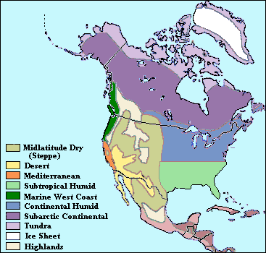
Climate Regions

Slide 24
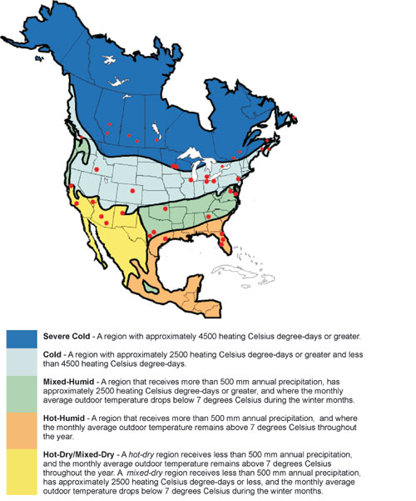
Hygrothermal Regions

Slide 25
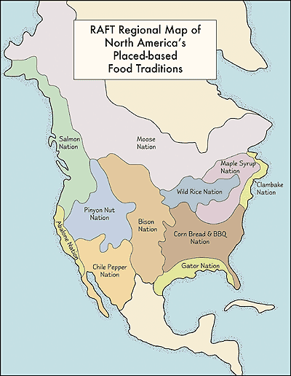

Slide 26
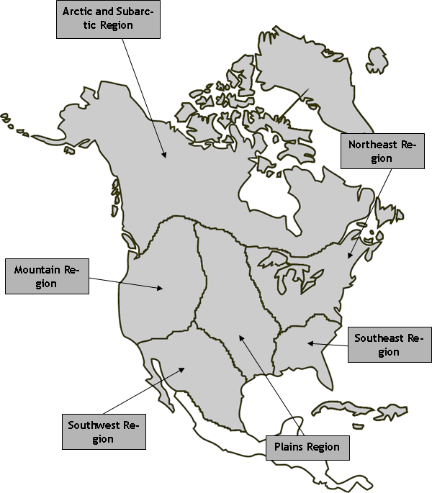
Native American

Slide 27
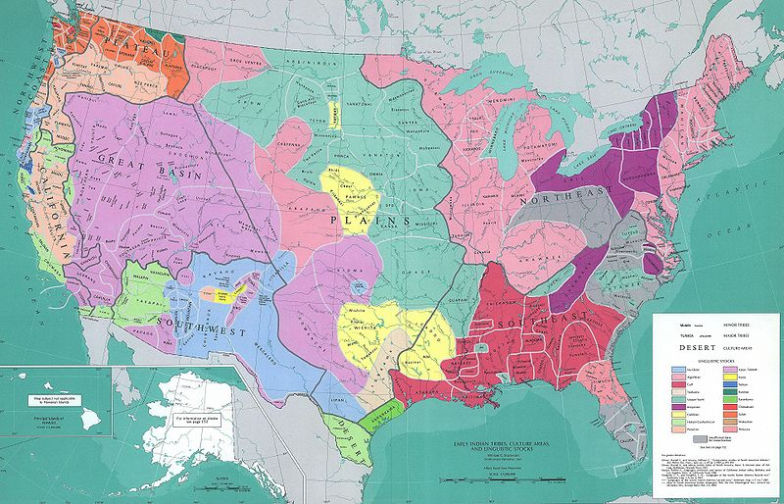
Native American

Slide 28
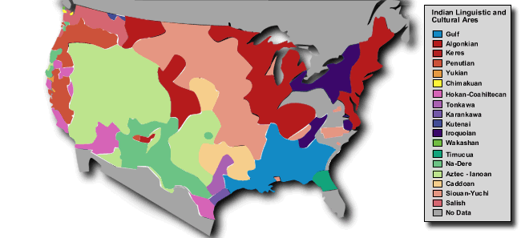

Slide 29
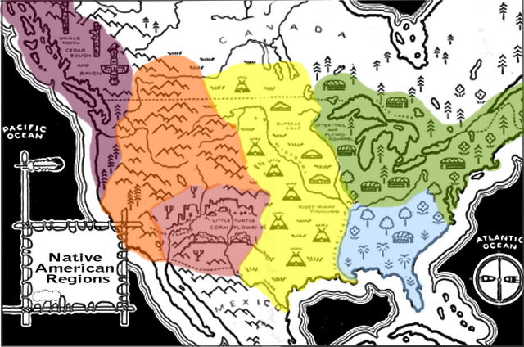
And we will end on this note – the U.S. divided up into the major cultural/tribal regions of the original inhabitants of the continent.

