Slide 1
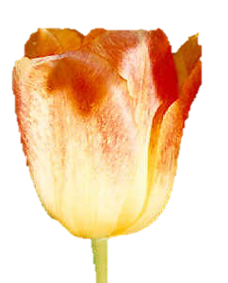
Holland Michigan Tulip Festival

Slide 2
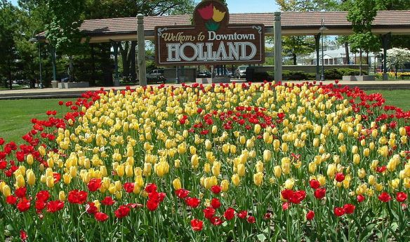

Slide 3
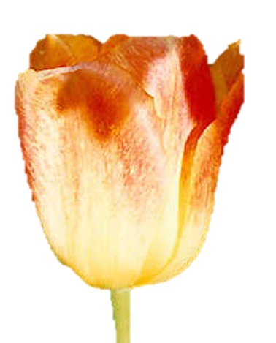
Early in May
Visitors from all over the world come to see millions of tulips planted in parks, gardens and lanes throughout the Holland, Michigan community. Join us for our celebrating Dutch culture with tulips, parades, street scrubbing, carnival, Dutch Dancers, Dutch Marktplaats, concerts, theatre shows, art and craft fair, fireworks, kids events, trolley tours, and so much more!

Slide 4
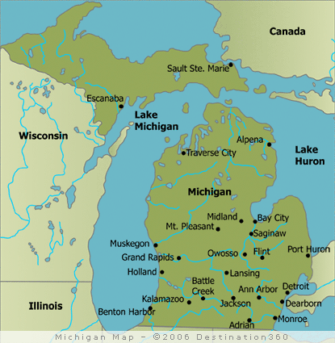

Slide 5
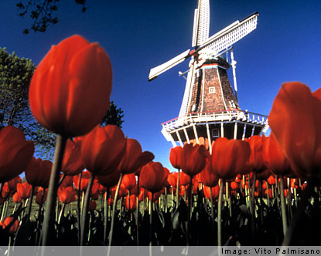

Slide 6
Money Magazine named Holland Michigan one of the top ten places to retire, focusing on its mix of quality health care, cultural atmosphere, and open abundance of green space. The only thing it doesn't have that other desirable places do, is high taxes. Not only ideal for retirees, it offers the perfect place for families and vacationers to retire for a nice respite from the daily grind. Among Michigan's top beachtowns, it offers recreational activities, unique shopping, and year-round festivals and events. You may want to schedule a visit here in May for the Holland Michigan Tulip Festival, drawing off of the town's Dutch influence. During the Holland Michigan Tulip Festival, over six million of the town's signature flower open up to bathe the town in glorious color. The Holland Michigan Tulip Festival, also known as the Tulip Time Festival, is the largest tulip festival in the United States, and Reader's Digest has named it the best small town festival in the country.

Slide 7
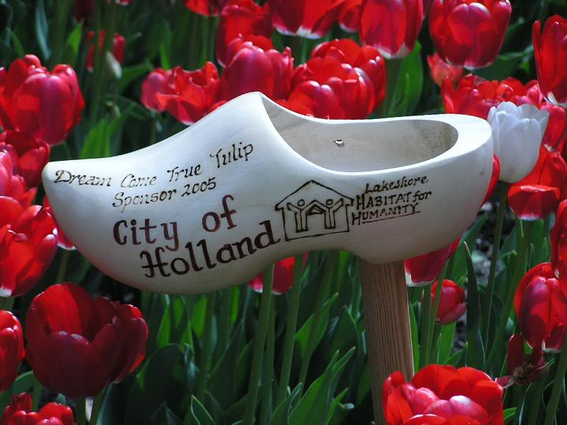

Slide 8
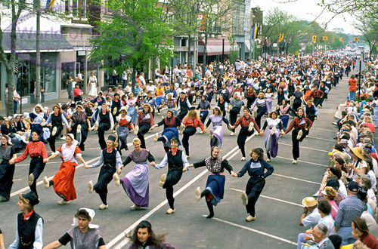

Slide 9
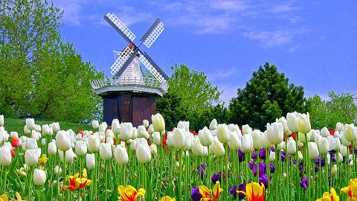

Slide 10
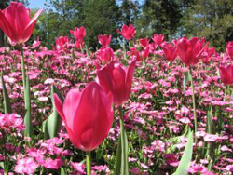
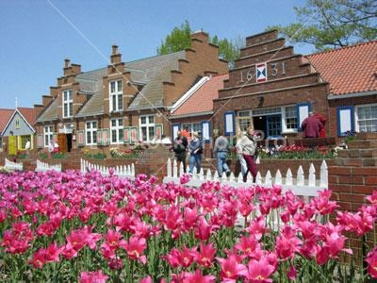
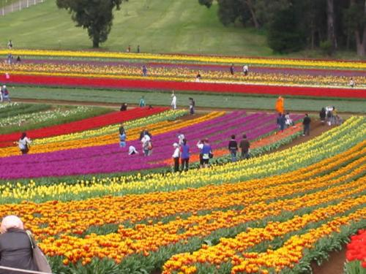
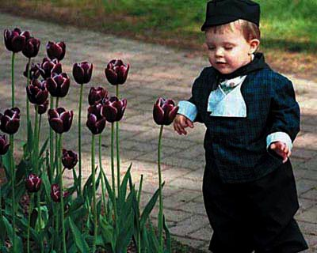

Slide 11
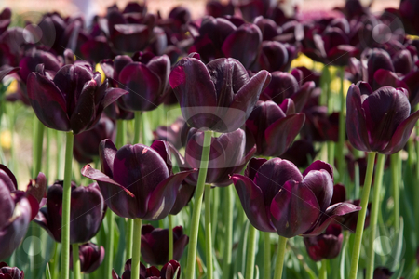

Slide 12
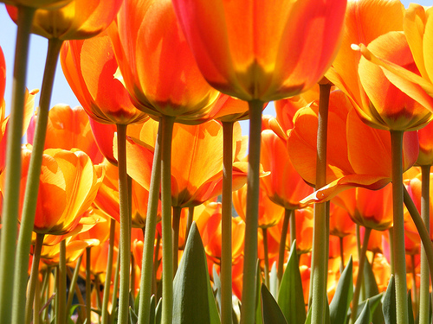

Slide 13
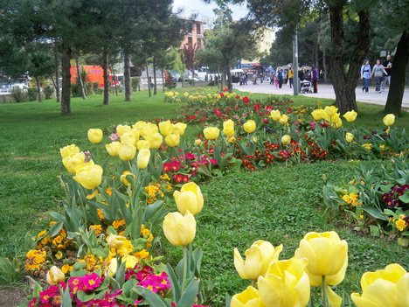

Slide 14
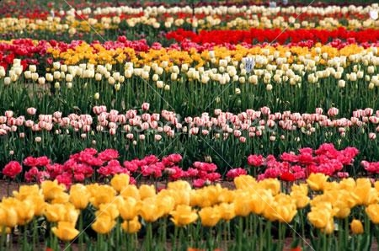

Slide 15
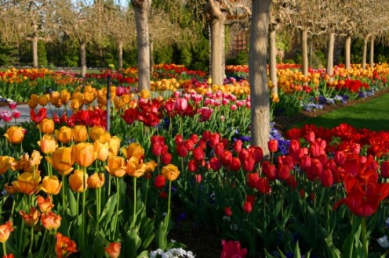

Slide 16
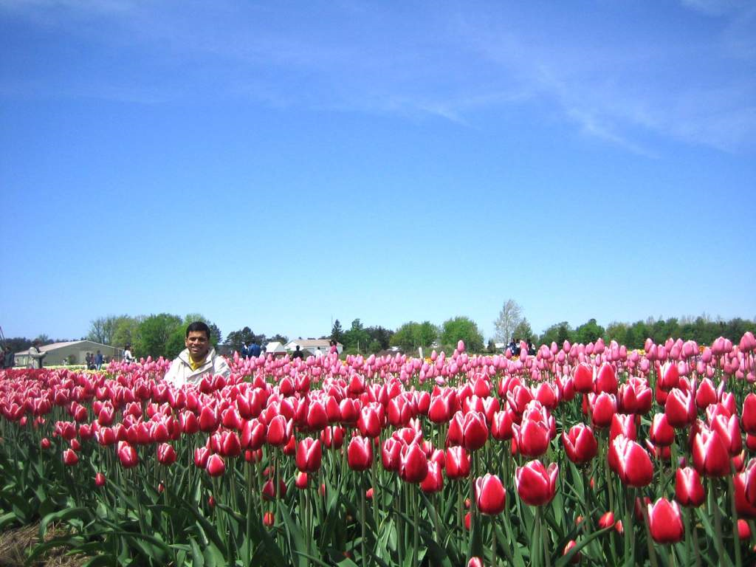

Slide 17
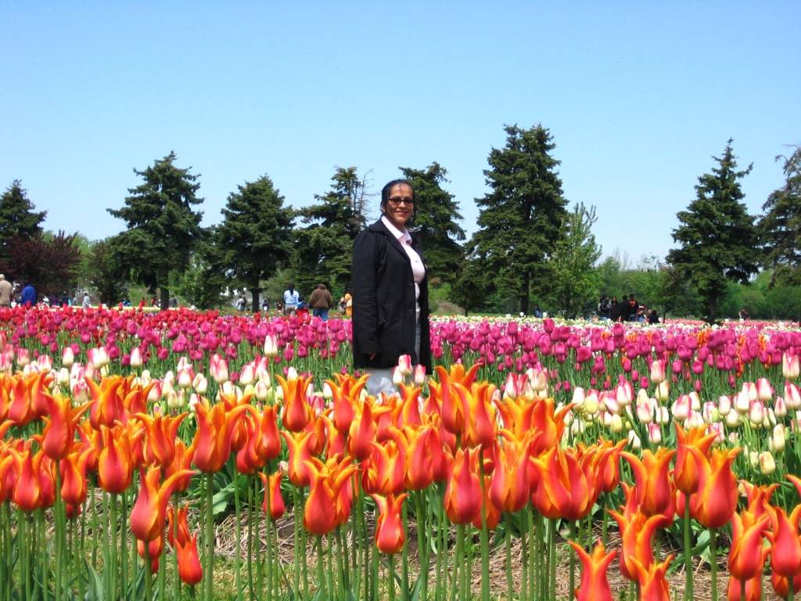

Slide 18
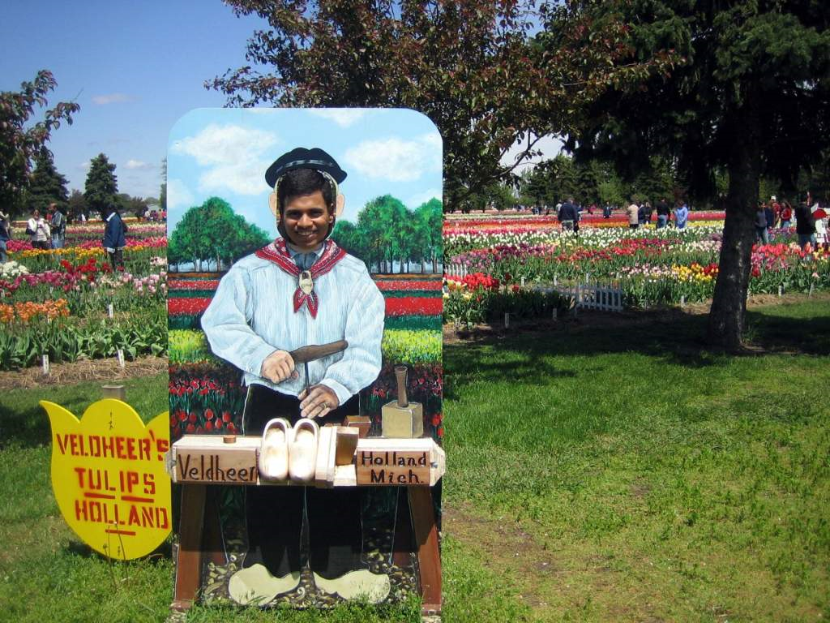

Slide 19
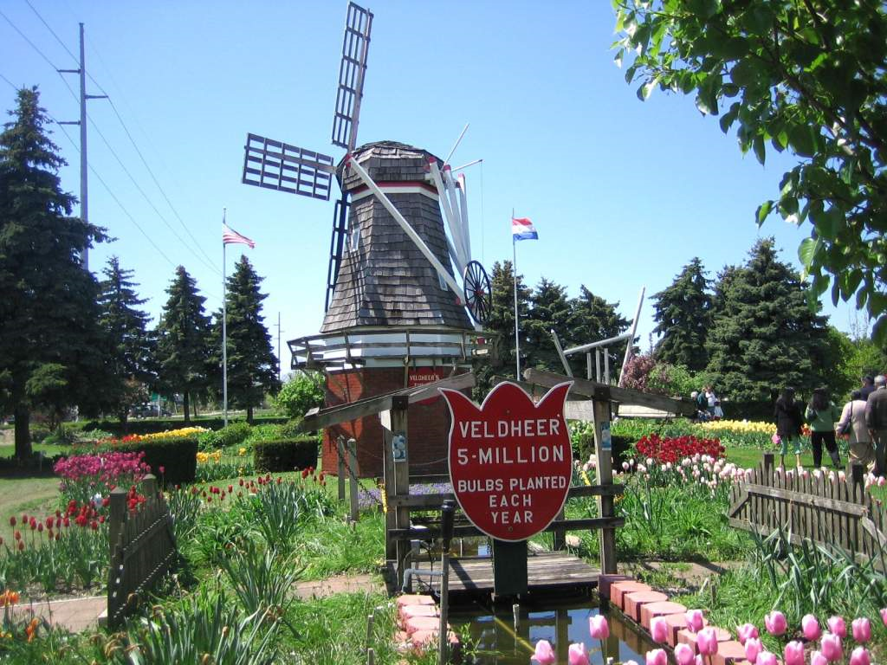

Slide 20
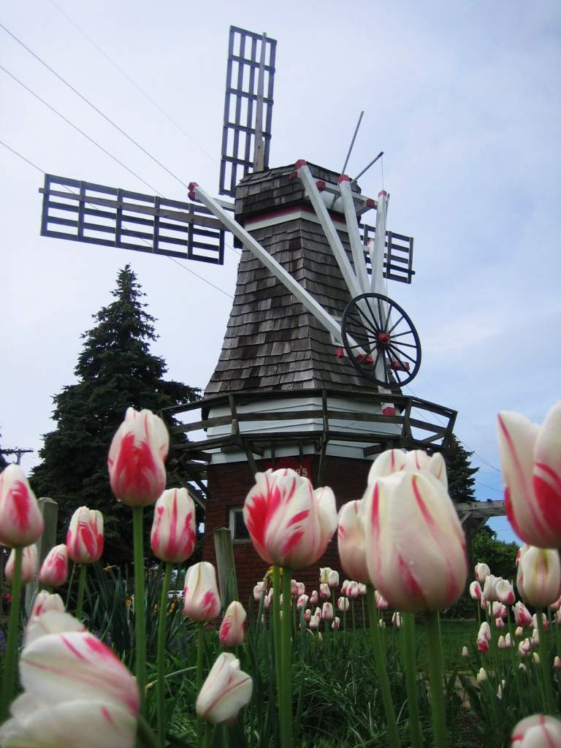

Slide 21
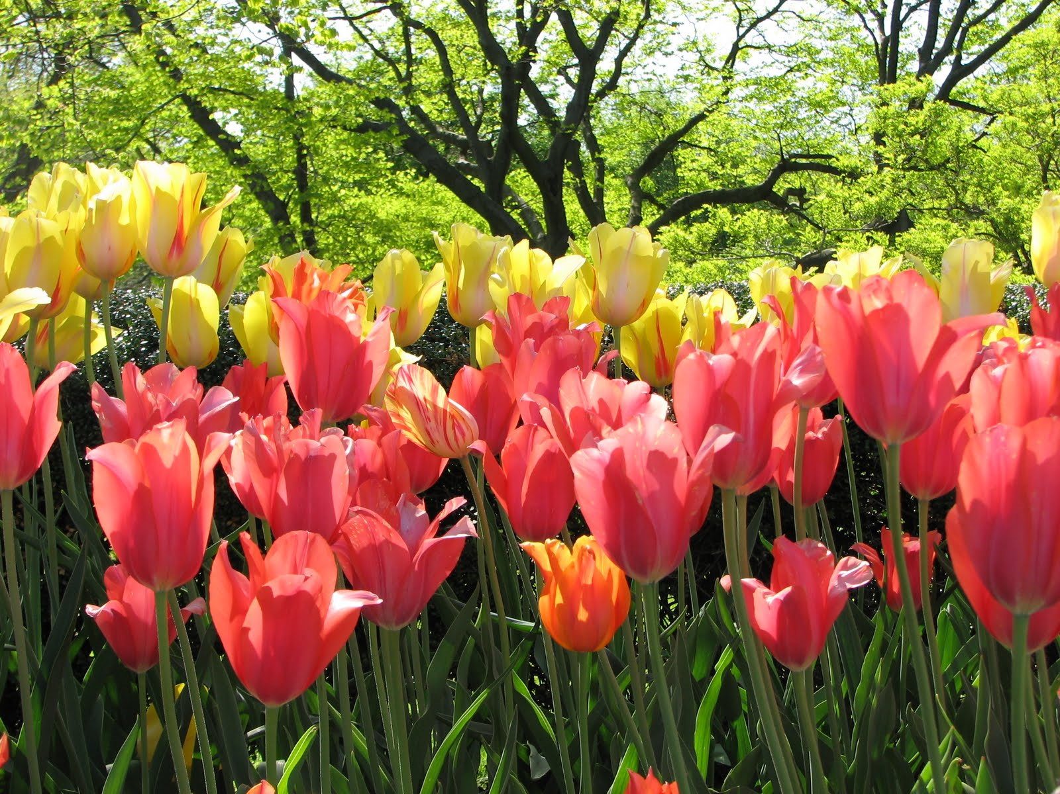

Slide 22
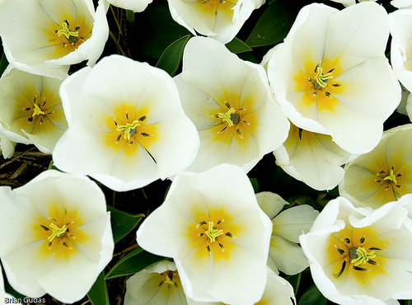

Slide 23
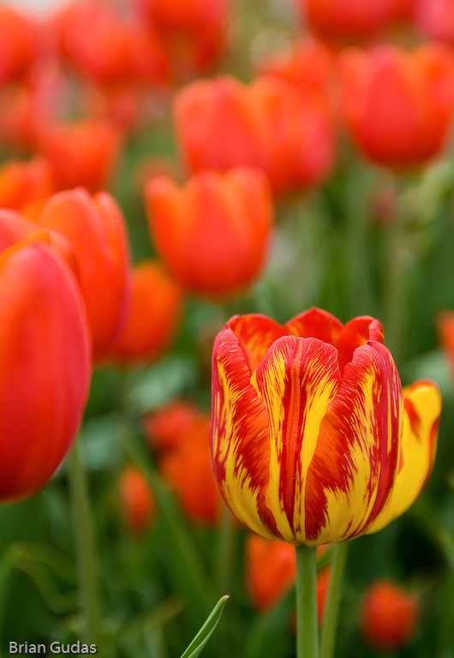

Slide 24
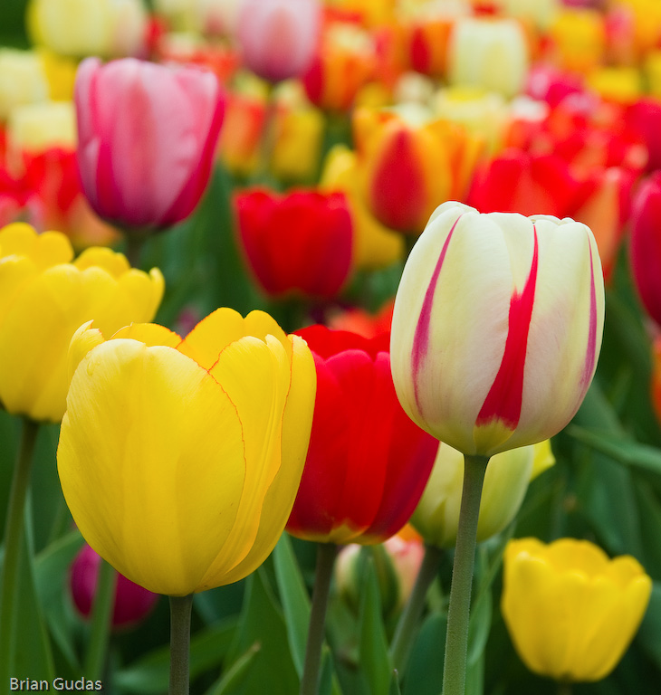

Slide 25
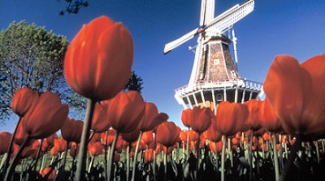

Slide 26
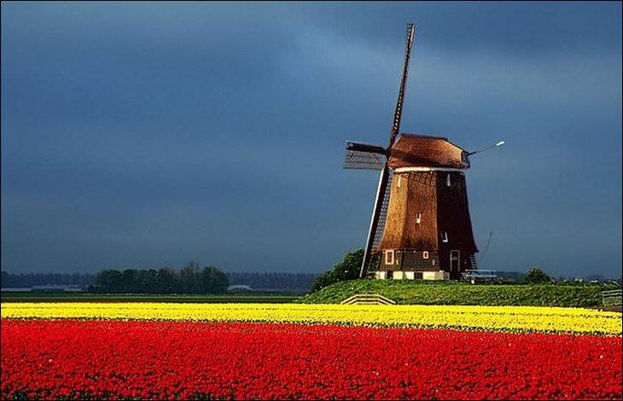

Slide 27
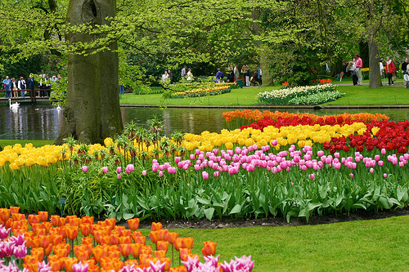

Slide 28
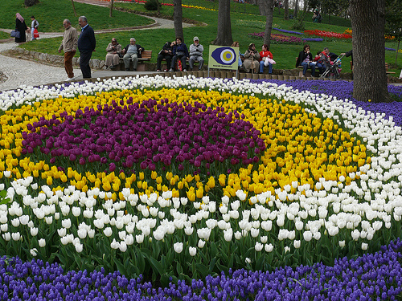

Slide 29
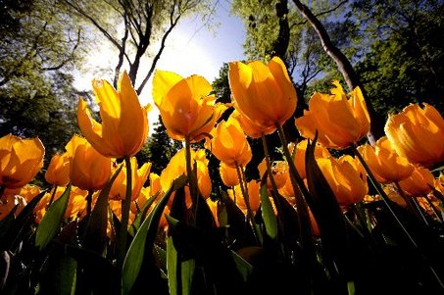

Slide 30
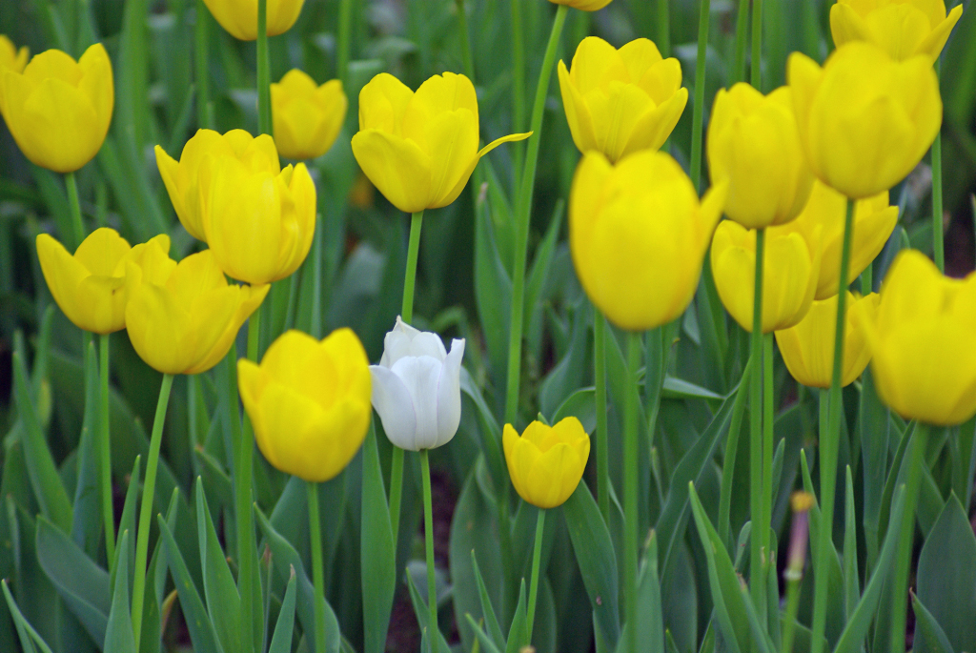

Slide 31
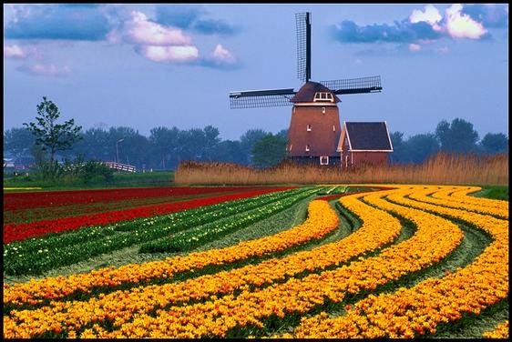

Slide 32
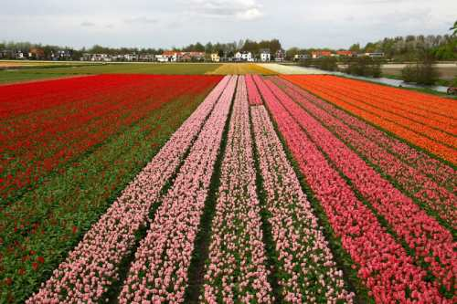

Slide 33
