Slide 1
DALYAN, TURKEY

Slide 2
DALYAN-TURKEY
Dalyan is a town in Muğla Province located between the well-known districts of Marmaris and Fethiye on the south-west coast of Turkey. The town is an independent municipality, within the administrative district of Ortaca. Life in Dalyan revolves around the Dalyan Çayı River which flows past the town. The boats that ply up and down the river, navigating the maze of reeds, are the preferred means of transport to all the local sites.

Slide 3
Mediterranean Climate Rainfall & Temperature Patterns

Slide 4
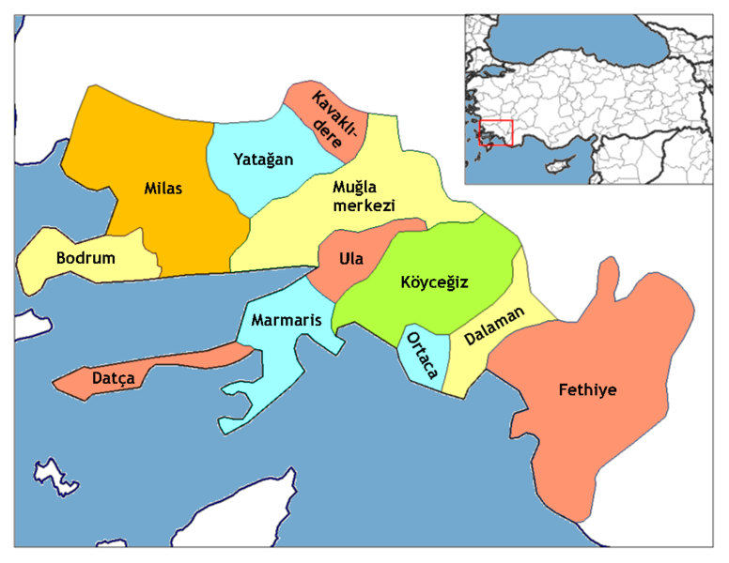

Slide 5
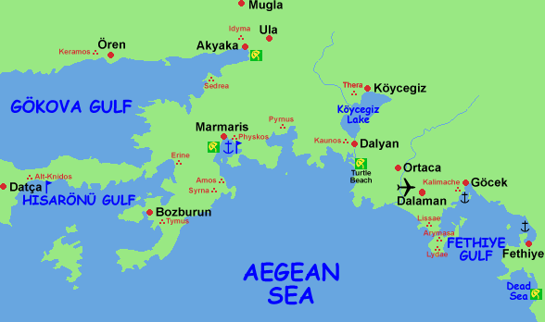

Slide 6
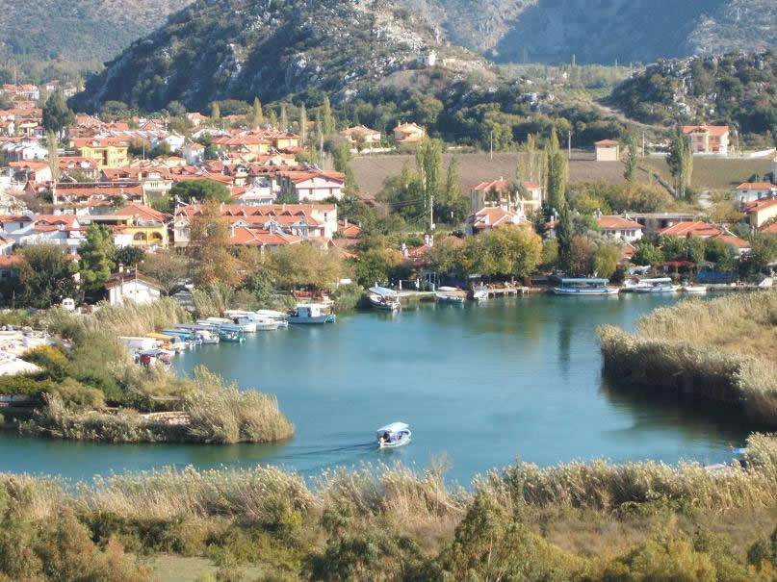

Slide 7
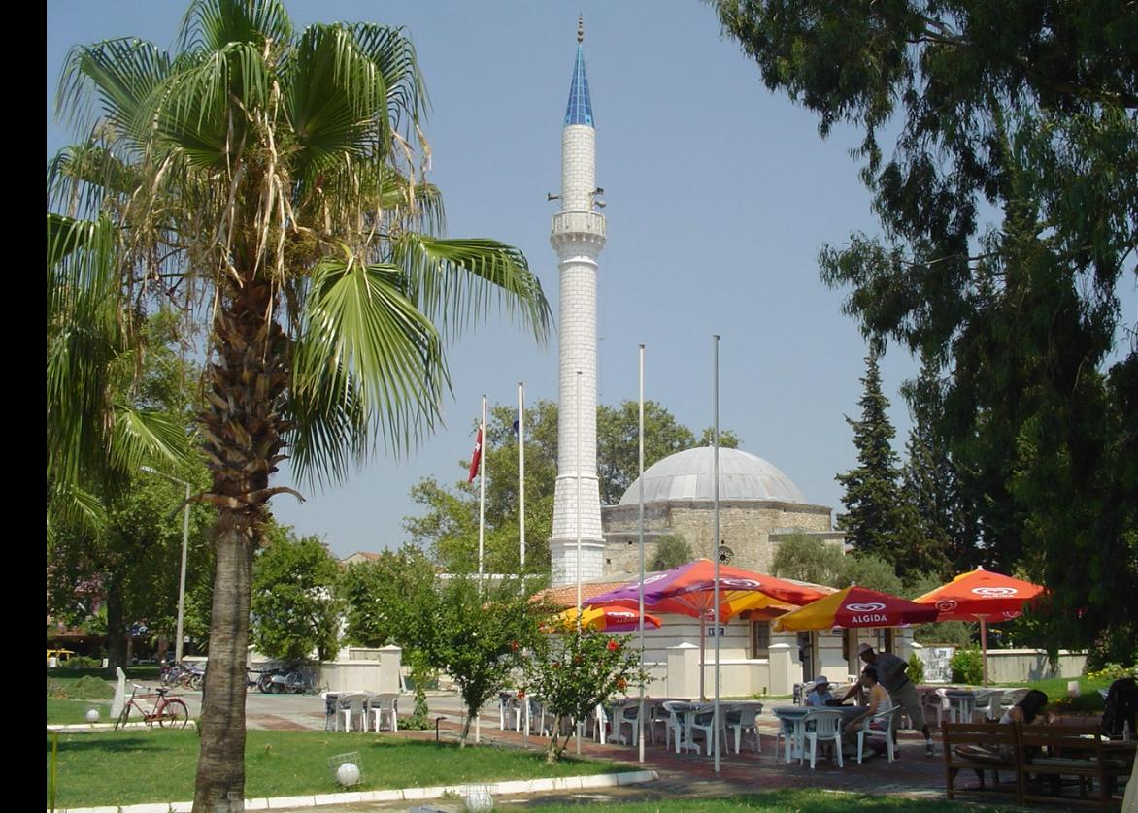

Slide 8
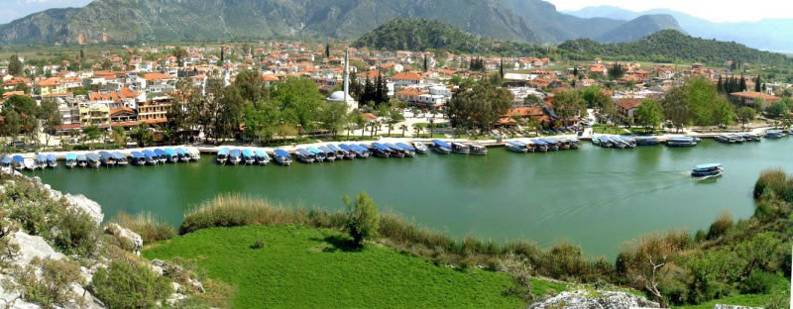

Slide 9
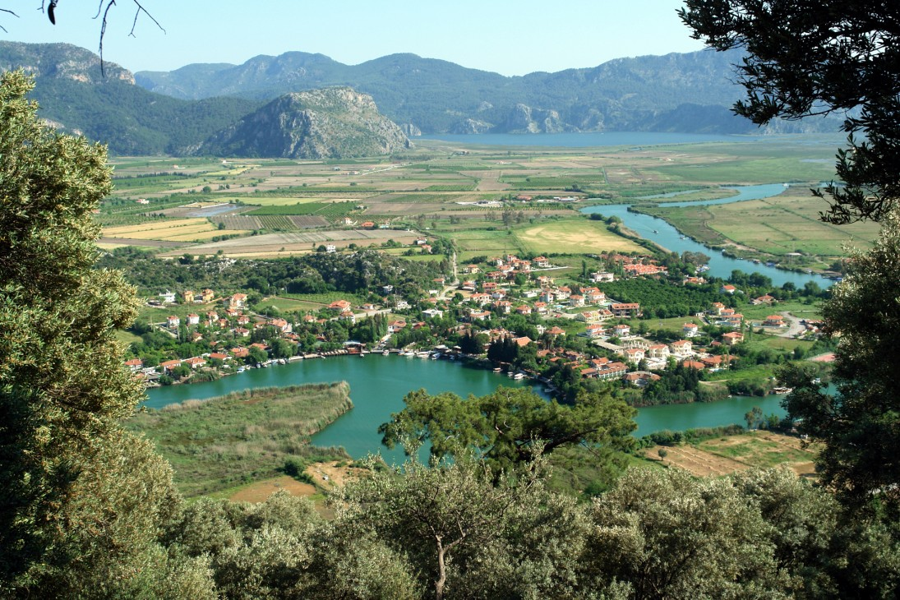

Slide 10
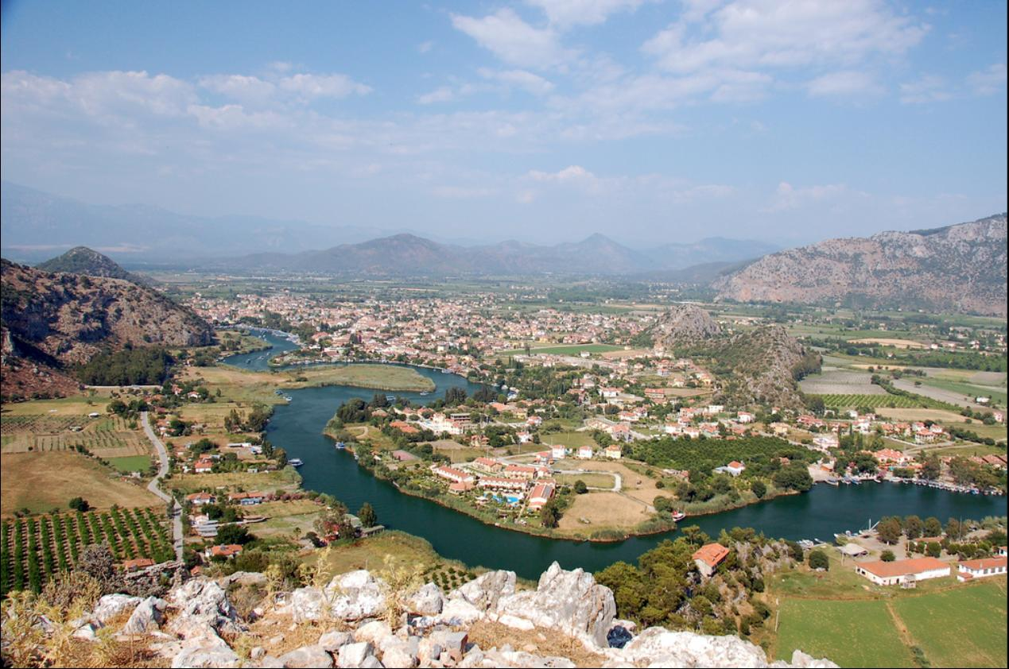

Slide 11
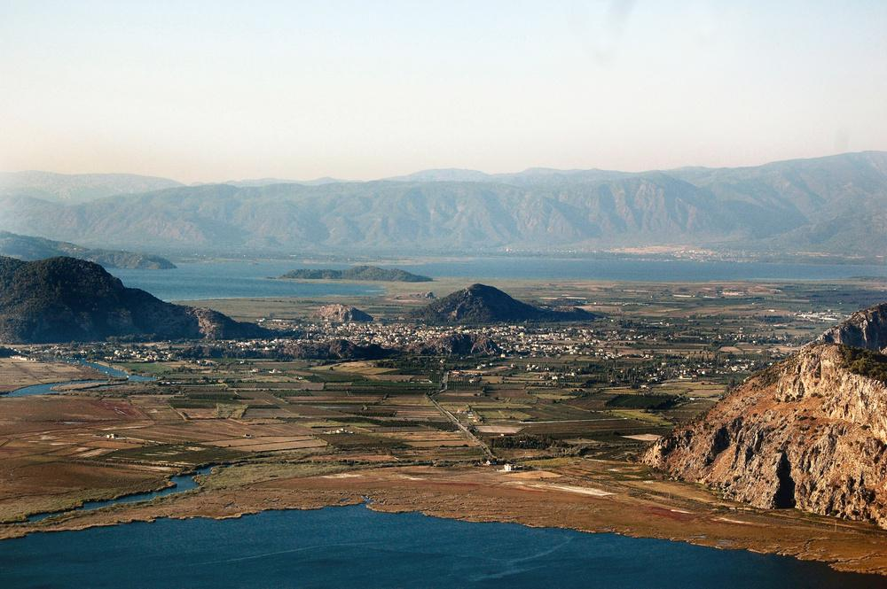
The Dalyan Delta - Turkey, one of the most beautiful areas in the Mediterranean

Slide 12
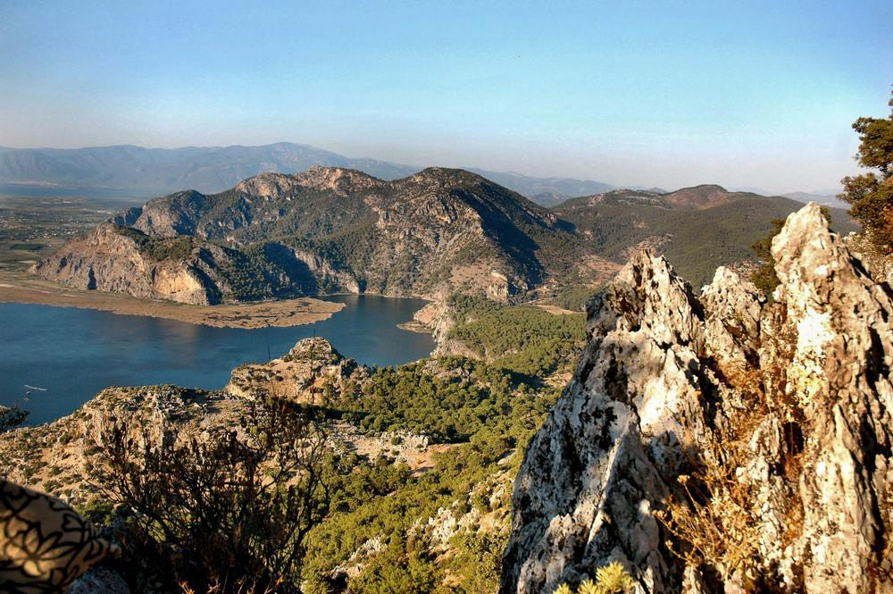

Slide 13
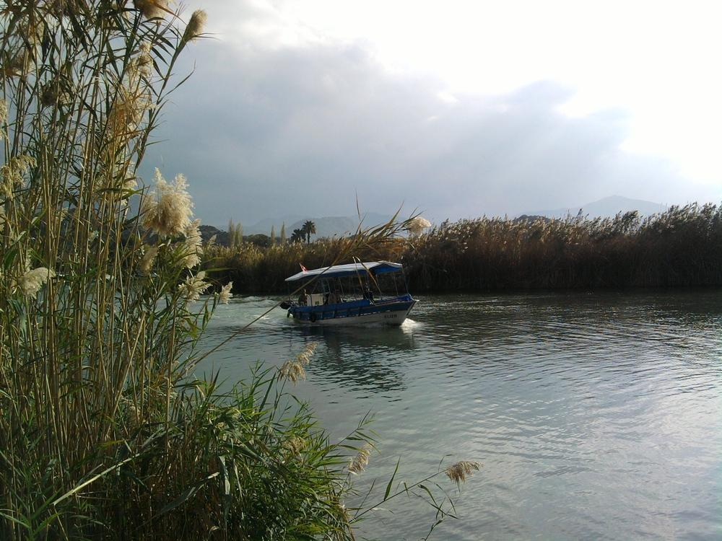
Dalyan River

Slide 14
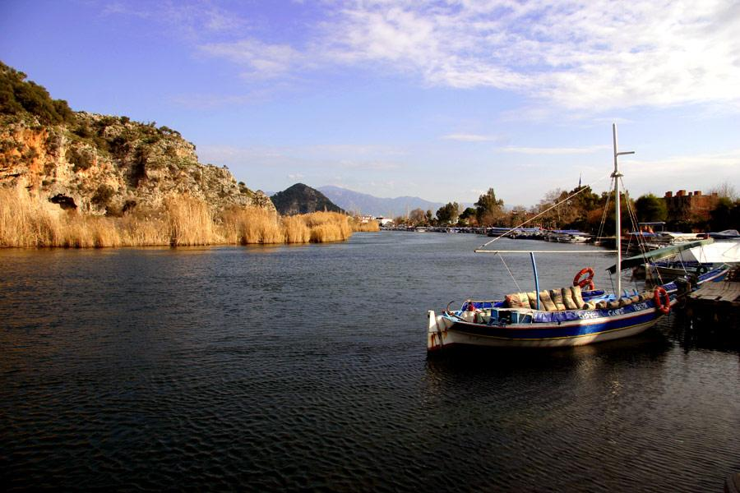
A natural channel separates the Carian ruins of Kaunos Dalyan

Slide 15
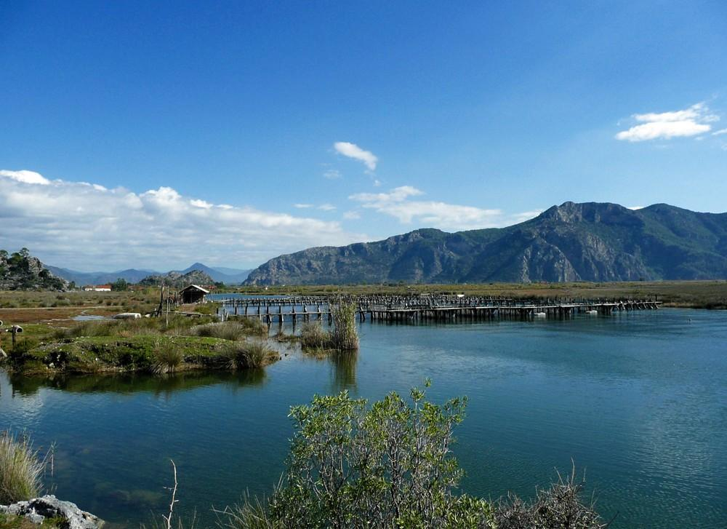

Slide 16
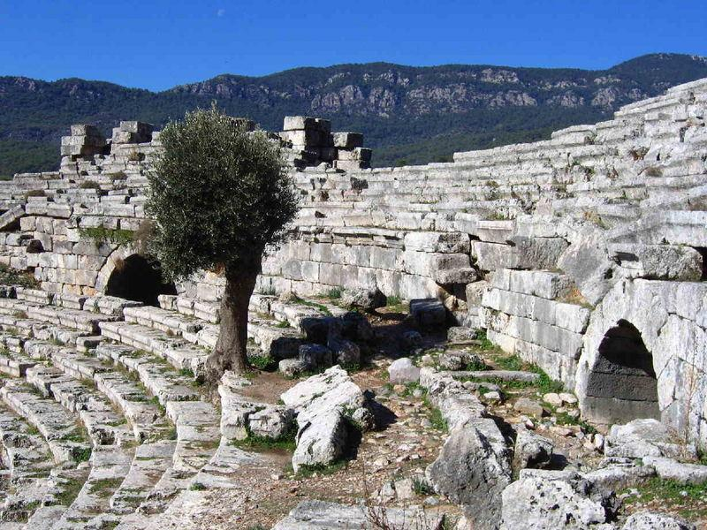
Kaunos theatre

Slide 17
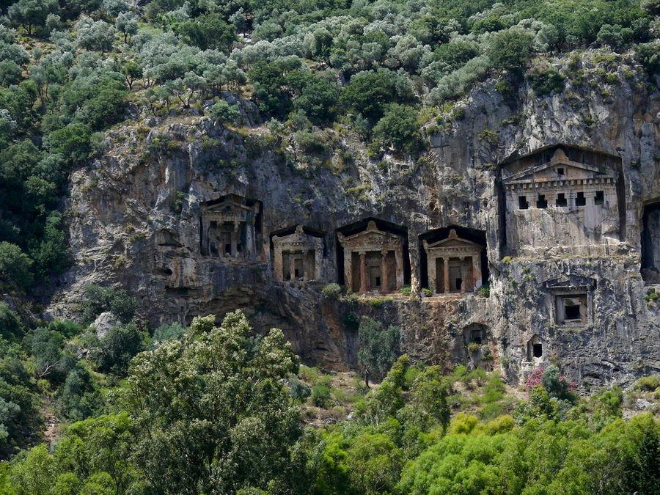
Lycian rock cut tombs of Dalyan

Slide 18
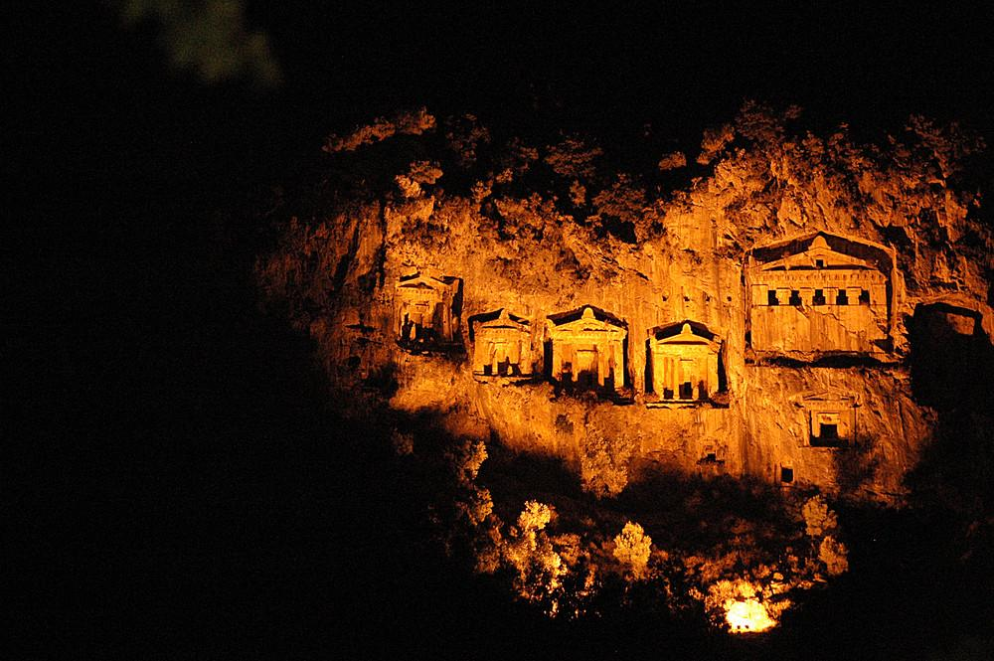

Slide 19
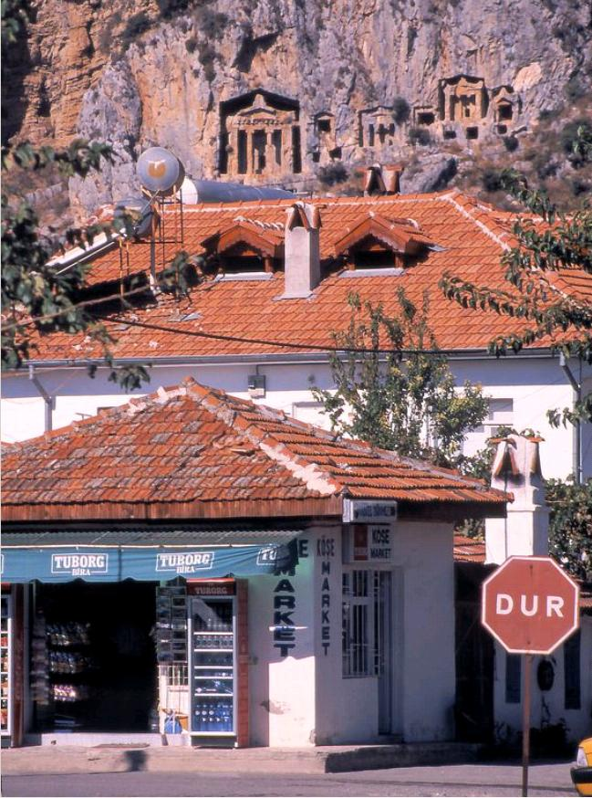

Slide 20
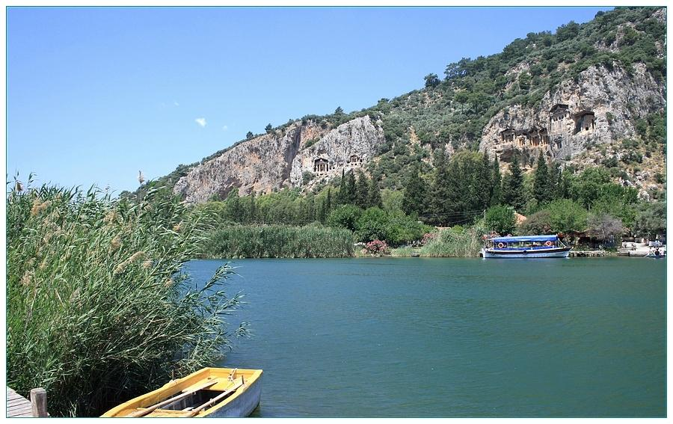
River Dalyan and Lycian rock cut tombs of Dalyan

Slide 21
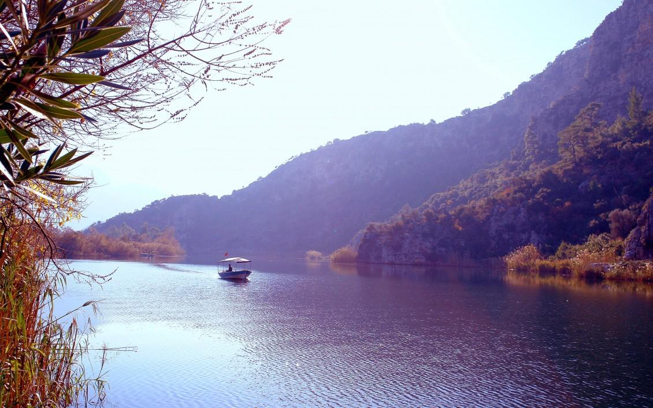

Slide 22
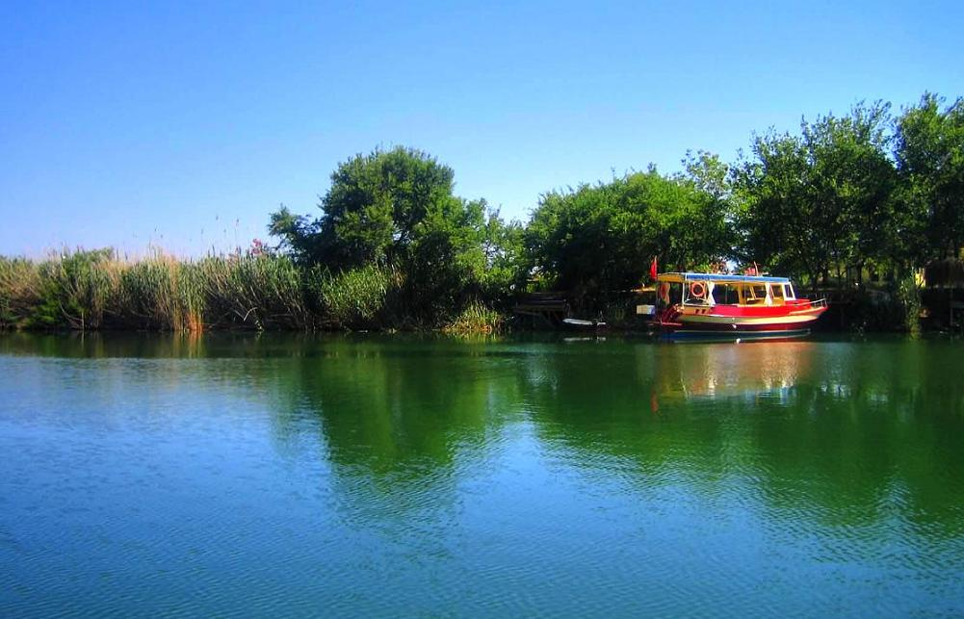

Slide 23
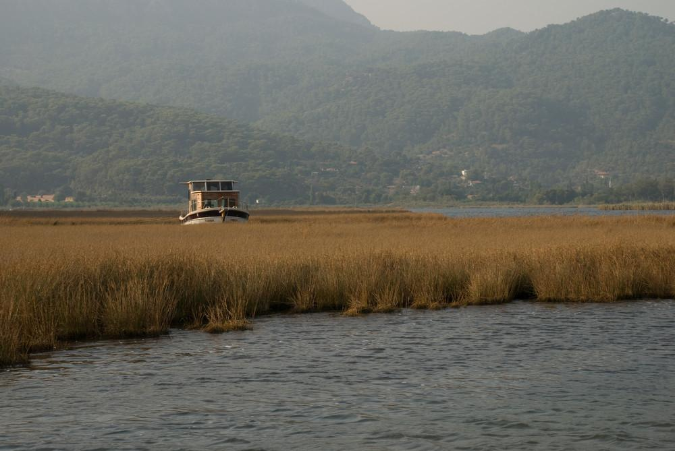
Reed landscape in Dalyan

Slide 24
Iztuzu beach - Dalyan
The beach is a narrow spit of land, which forms a natural barrier between the fresh water delta of the Dalyan river and the Mediteranean. It is one of the main breeding grounds for loggerhead sea turtles (Caretta caretta) in the Mediterranean and is therefore often referred to as "Turtle Beach". The loggerhead turtle (Caretta caretta) is on the IUCN Red list of endangered animals. For this reason the beach has had a protected status since 1988 and is part of the Köyceğiz-Dalyan Special Environmental Protection Area. (see the next slide)

Slide 25
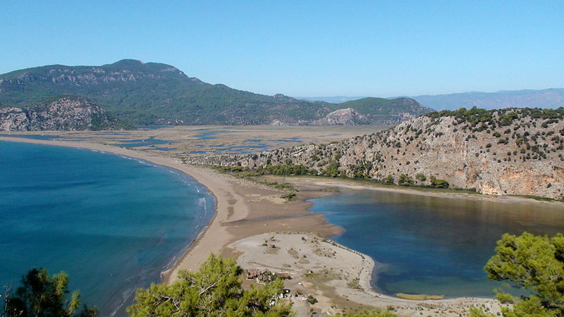

Slide 26
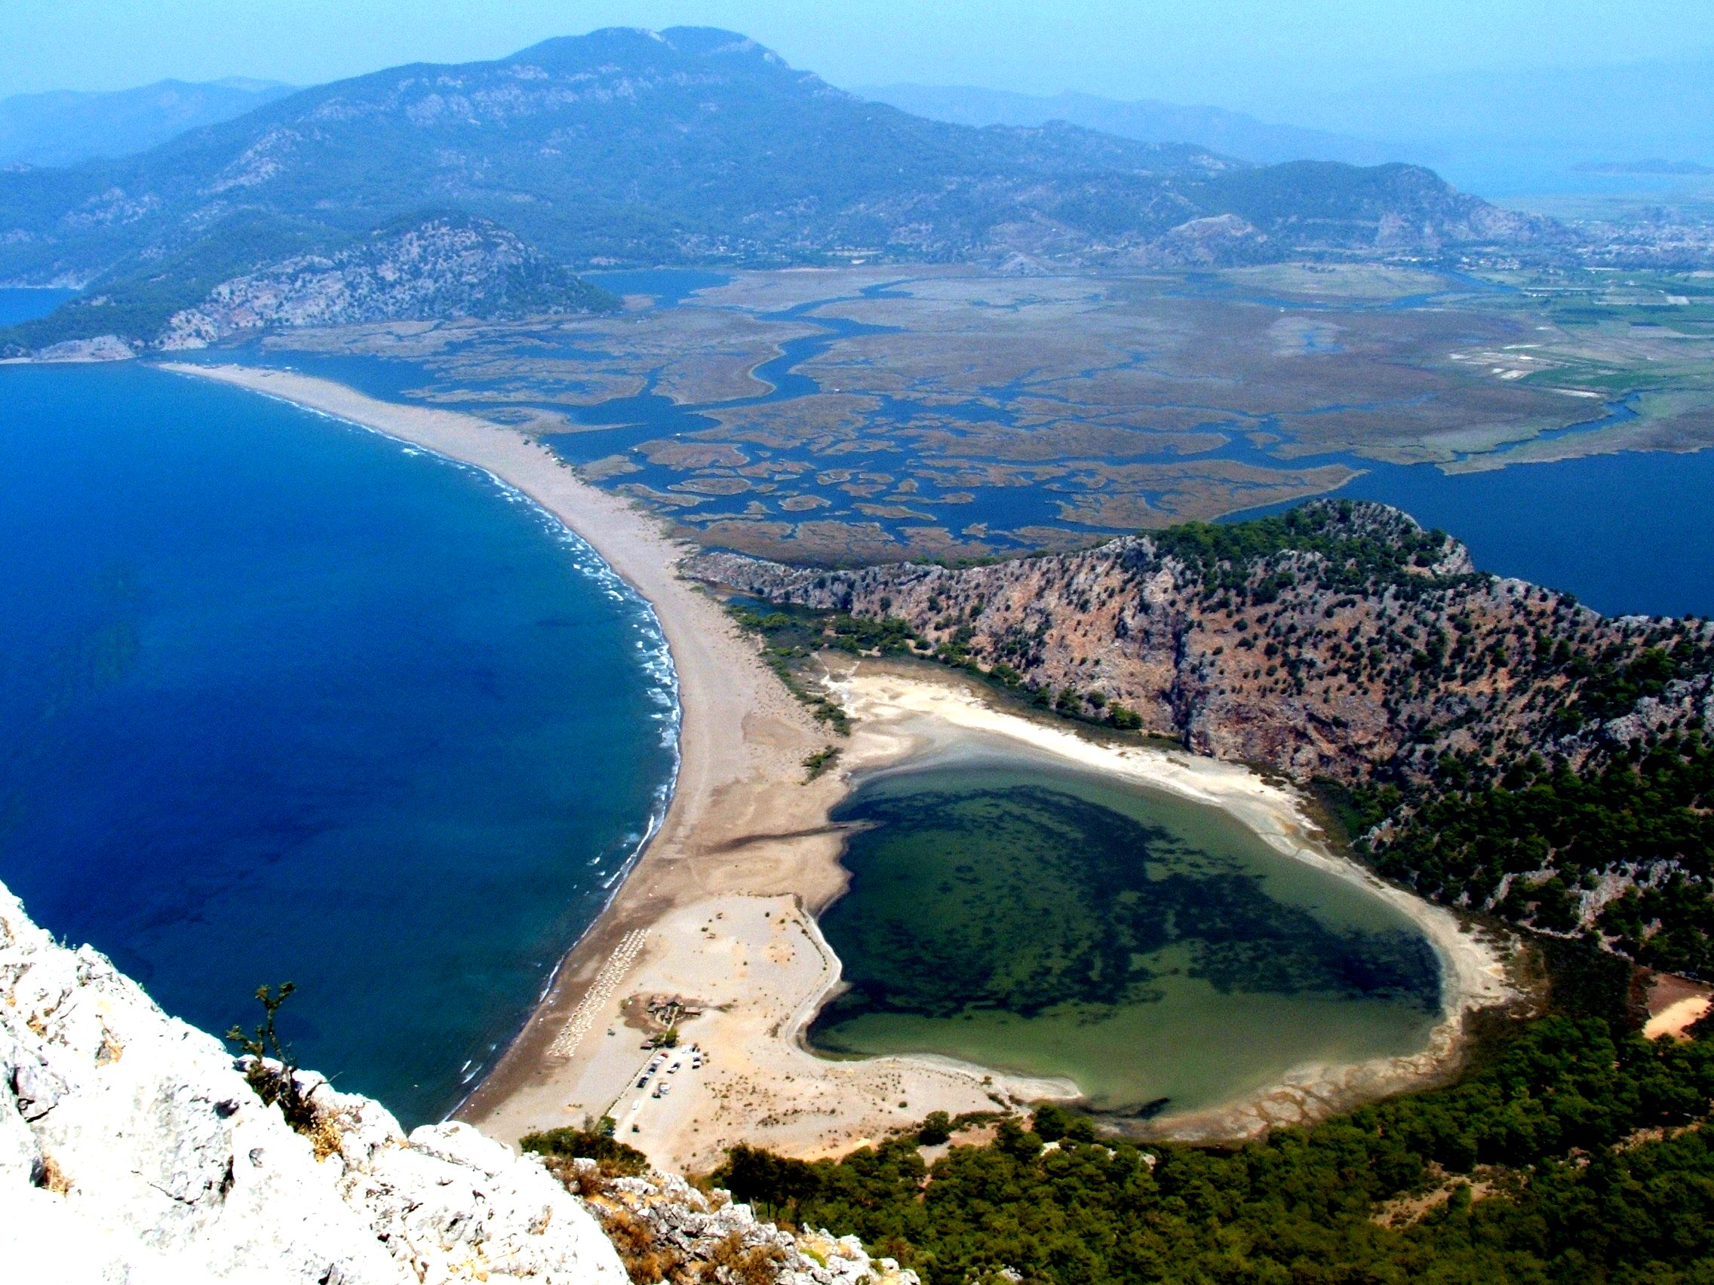

Slide 27
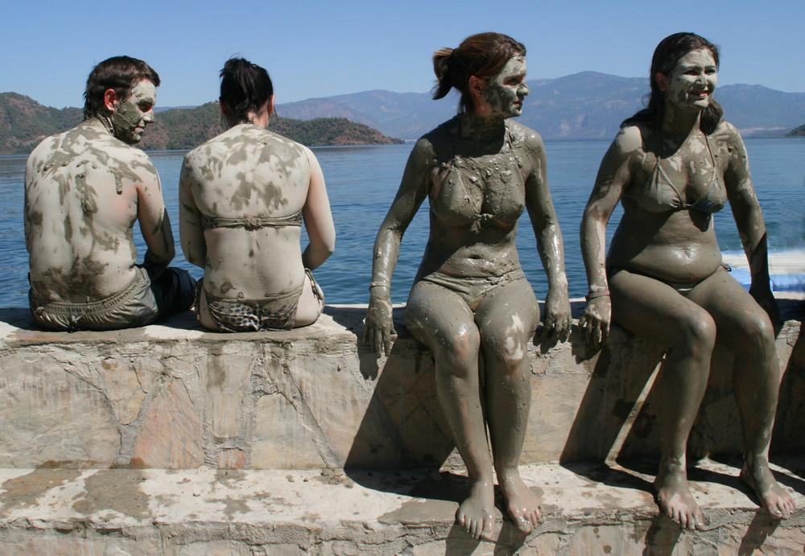
Dalyan mud baths

Slide 28
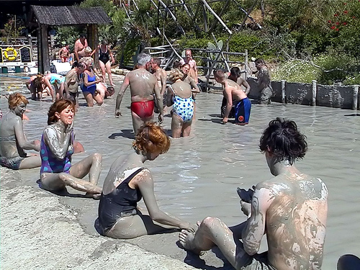

Slide 29
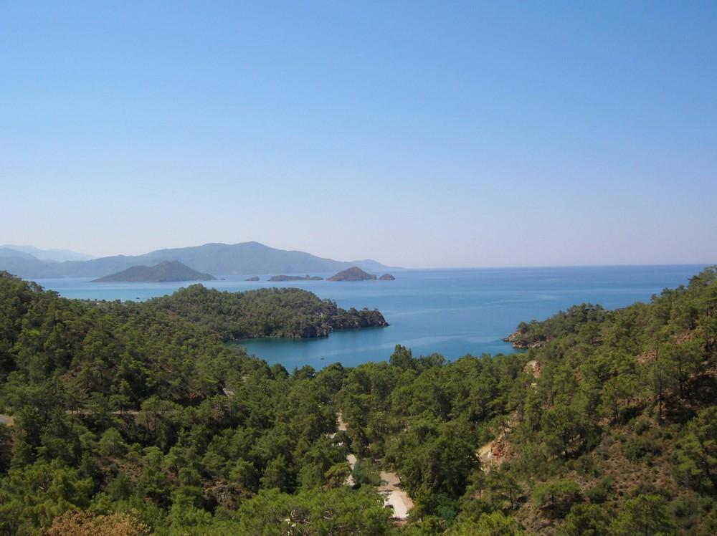
Kashikci Bay

Slide 30
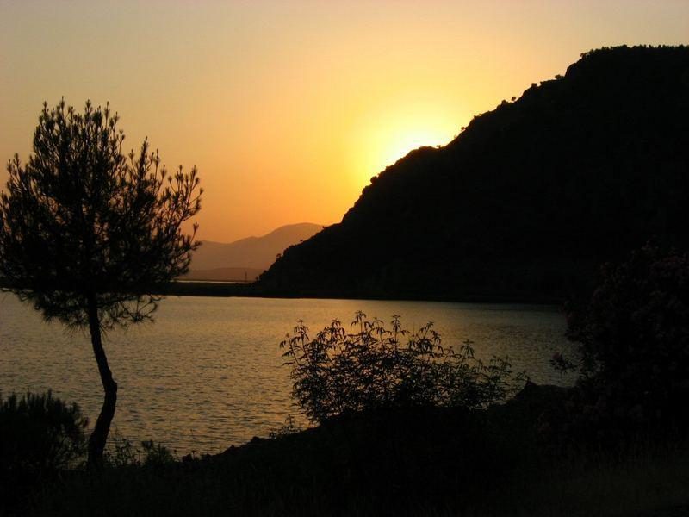
Iztuzu

Slide 31
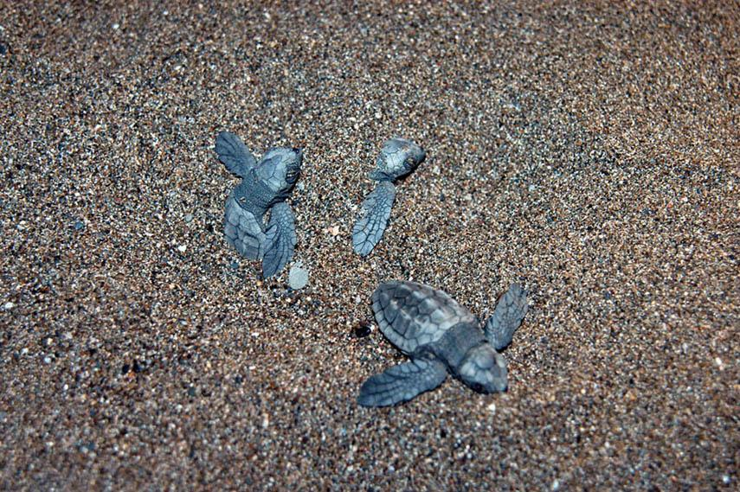
Caretta caretta (hatched tortoises)

Slide 32
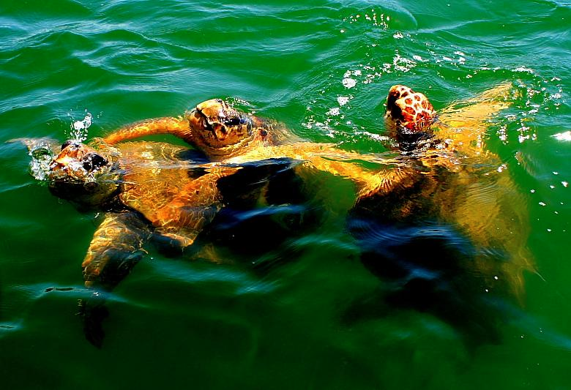
Caretta caretta

Slide 33
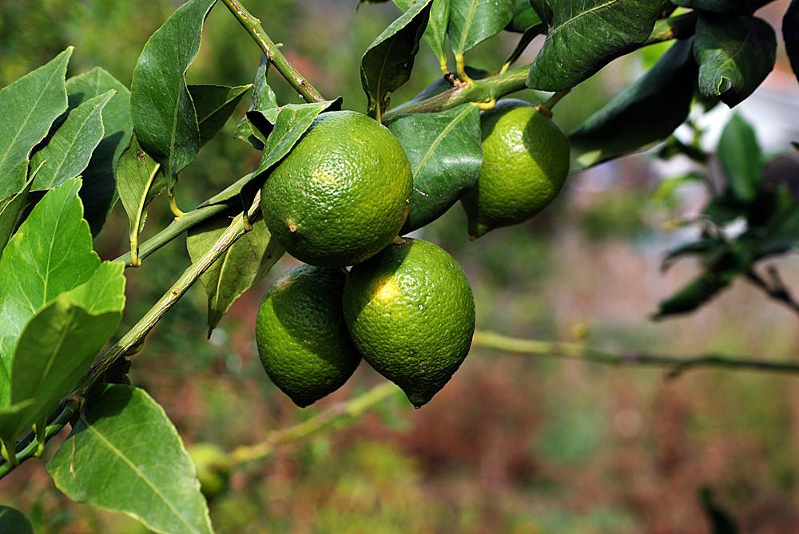

Slide 34
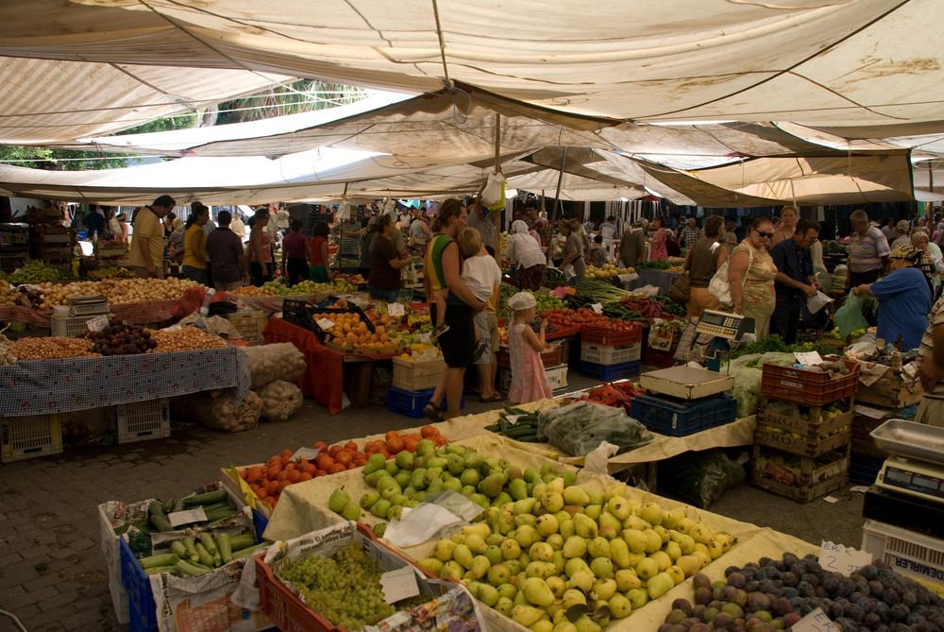

Slide 35
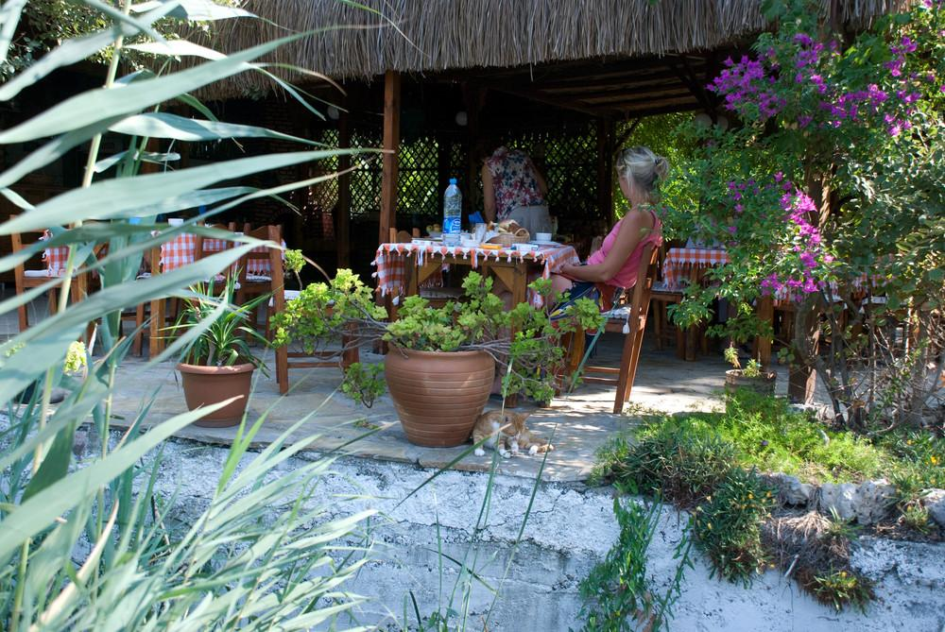

Slide 36
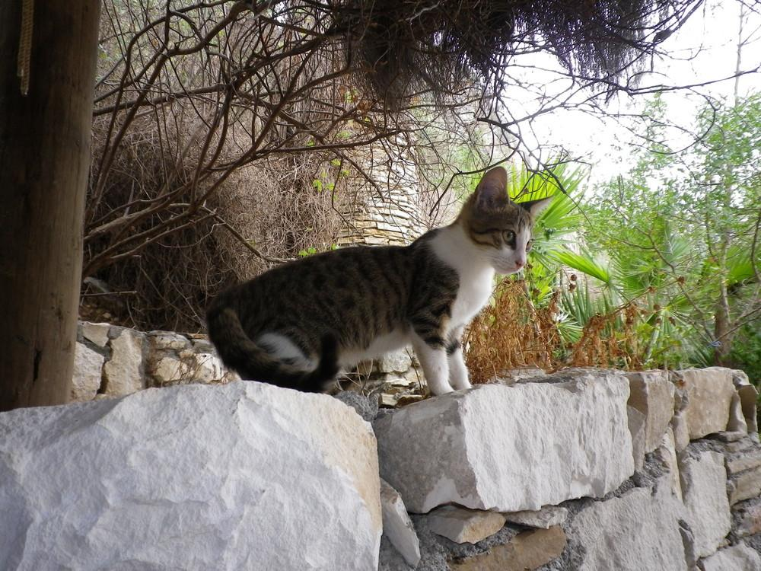

Slide 37
