Slide 1
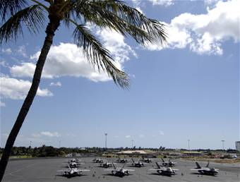
Kingdom of Tonga
Tropical Island State
Notes:
Hawaiian Sky

Slide 2
Background
Tonga - officially the Kingdom of Tonga - an archipelago in the South Pacific Ocean, comprises 169 islands, 36 of them inhabited. The Kingdom stretches over a distance of about 800 kilometres (500 miles) in a north-south line. The islands that constitute the archipelago lie south of Samoa, about one-third of the way from New Zealand to Hawaiʻi. George Tupou V, (born 4 May 1948) is the current King of Tonga. Tonga plans to become a fully functioning constitutional monarchy after legislative reform and a more fully representative election take place in 2010.

Slide 3
Basic Data
Area: 747 sq km
Coastline: 419 km
Climate: tropical; modified by trade winds; warm season (December to May), cool season (May to December)
Terrain: most islands have limestone base formed from uplifted coral formation; others have limestone overlying volcanic base
Natural resources: fish, fertile soil
Population: 122,580 (July 2010 est.)
Population growth rate: 1.282% (2010 est.)
Age structure:
0-14 years: 31.9%
Infant mortality rate: 11.28 deaths/1,000 live births
Life expectancy : 71.03 years
Urban population: 25%
Literacy: (can read and write Tongan and/or English) 98.9%
GDP - per capita (PPP): $4,600 (2009 est.)
GDP - composition by sector:
agriculture: 25%
industry: 17%
services: 57% (FY05/06 est.)
Unemployment rate: 13%
Pop. below poverty line: 24%

Slide 4
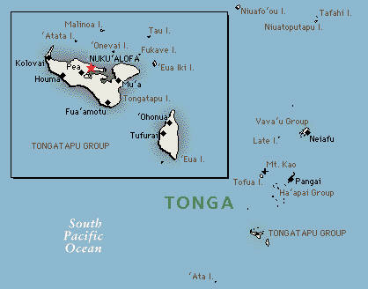

Slide 6
An undersea volcano erupts off the coast of Tonga on March 18, 2009.

Slide 14
Going to School

Slide 15
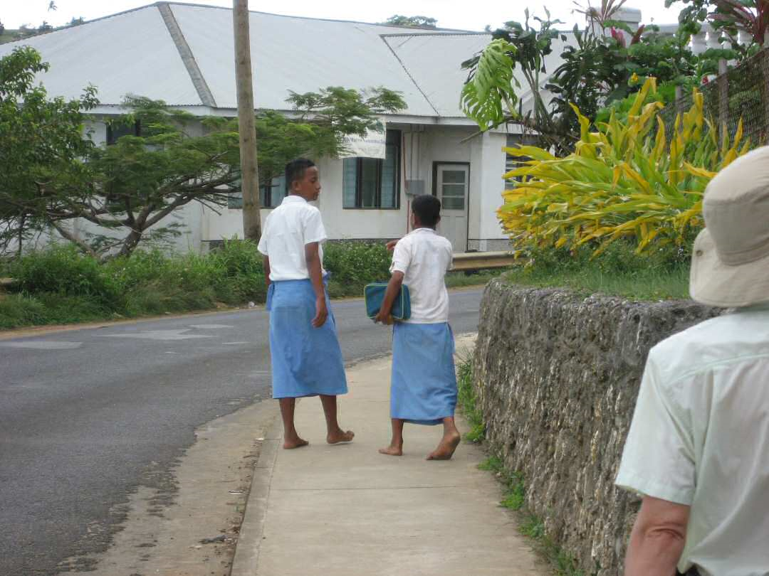
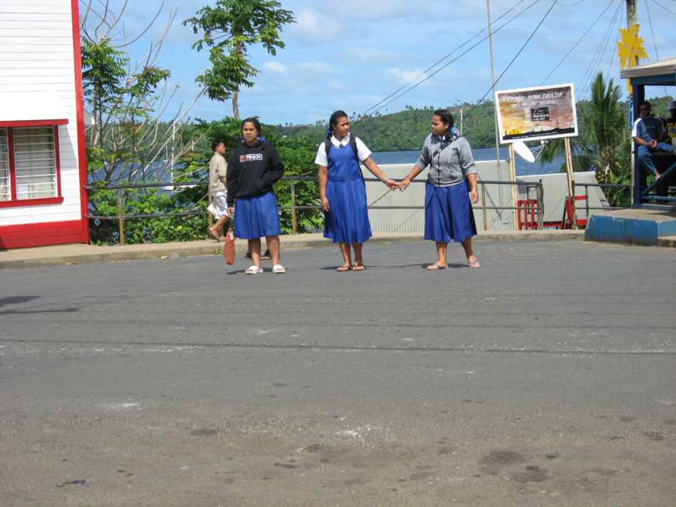
School
School kids all wear uniforms. Boys wear lava-lavas (left) and girls wear jumpers (right).

Slide 17
Tongans don't show affection for the opposite sex in public. But members of the same sex often hold hands or arms, like these boys on the right.

Slide 18
Tongan National Rugby Team

Slide 19
Tonga Royal wedding Capt. M. Tuita and Princess Pilolevu

Slide 20
Traditional Wedding Tatoos

Slide 21
Ha'amonga 'a Maui Trilithon, constructed in the 13th century by the reigning chief. It serves as a sun dial that determines the summer and winter solstice.

Slide 22
Church of Tonga

Slide 24
Coronation of the king

Slide 25
School girls dance at the coronation

Slide 27
Men dance at the coronation

Slide 31
Tongan Economy

Slide 32
Modern Fale - designed in the same shape as a traditional Fale (grass hut), but using modern materials, ie steel and plywood. 90% of the population grow subsistence crops only and live on small farms.

Slide 33
Farm plot

Slide 34
Bananas

Slide 35
Curing Vanilla Bean Pods

Slide 36
Free Range Pork

Slide 37
This sounded difficult -- almost naive -- to us, but Nathan has made it work. His 2.5 acre farm is the largest "greenhouse" plantation in the South Pacific, and the harvests are starting to roll in. Nathan markets his high quality, chemical-free beans overseas.

Slide 38
Tongan Market

Slide 39
Farmer’s Market

Slide 40
Palm Leaf Basket

Slide 41
Making tapa cloth

Slide 42
Fishing boats

Slide 43
Fishermen and clammers work while the tide is low.

Slide 44
Fishermen selling their catch

Slide 45
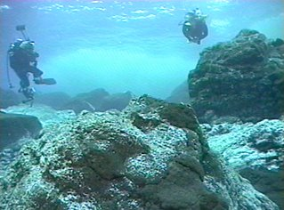
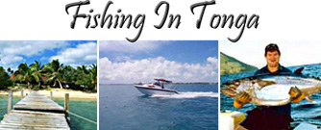
Tourism: Diving, Fishing, Relaxing on the beach

Slide 46
Tourism: Checking out ruins

Slide 47
Tourism: Swallow Cave (Sea Cave)

Slide 48
Value of Money
People here aren't as interested in money as westerners, partly because they can grow or make most of what they need, partly because money doesn't confer social status -- which is mostly determined by family relationships -- and partly because any money you have (and most possessions) belong to your extended family. So if you don't have money, you don't starve, and if you have money, you just have to give it away.

