Slide 1
Thailand – Beer Bottle Temple
Proving Alex Steffen's point that there is no such thing as garbage, just useful stuff in the wrong place.

Slide 2
Buddhist Temple Built from Beer Bottles
Fifty years ago the Heineken Beer company looked at reshaping its beer bottle to be useful as a building block. It never happened, so Buddhist monks from Thailand's Sisaket province took matters into their own hands and collected a million bottles to build the Wat Pa Maha Chedi Kaew temple. It puts every other bottle building we have shown to shame.

Slide 4
Temple of a Million Bottles - Wat Pa Maha Chedi Kaew. Buddhist monks have recycled over one million used bottles to build their temple in Khun Han, Thailand near the Cambodian border. There are 20 buildings in the complex, all of which are made of green Heineken, brown Chang beer, various soft drinks, and Thai Red Bull bottles as a testament to recycling locally found objects.

Slide 5
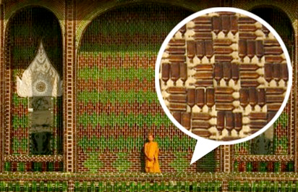
Even the washrooms and the crematorium are built of bottles, a mix of green Heineken and brown local Chang beer. The pattern work is quite intricate

Slide 10
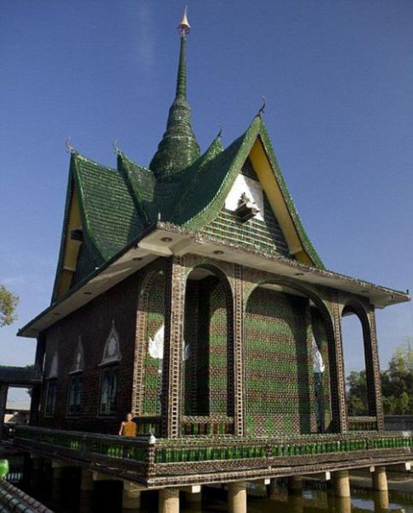

Slide 11
“Artsy” Photo

Slide 16
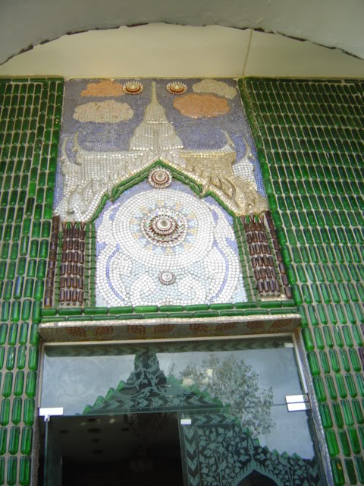

Slide 17
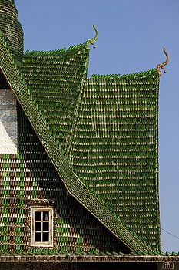
Roof Details

Slide 19
Washroom (restroom)

Slide 20
“Wow!”

Slide 23
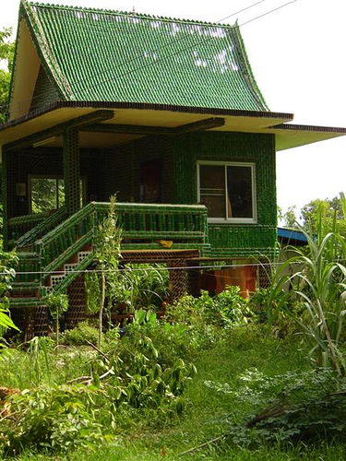

Slide 25
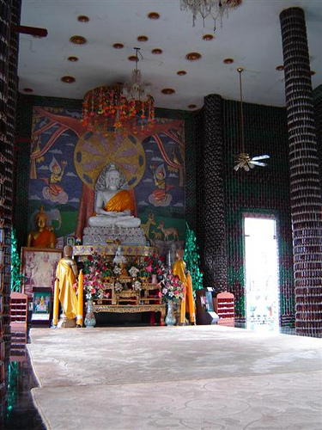

Slide 27
