Slide 1
NEPAL: Dakshinkali, the Bloody Temple

Slide 2
Dakshinkali Temple
Dakshinkali Temple or Dakshin Kali Temple, located 22 km outside Kathmandu, and about 1 km outside the village of Pharping, is one of the main temples of Nepal dedicated to the goddess Kali. Animal sacrifices, particularly of cockerels and uncastrated male goats, are the main way that the goddess is worshipped, and this is especially seen during the Dashain festival.

Slide 6
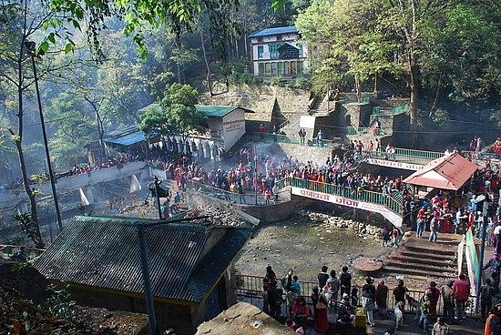

Slide 7
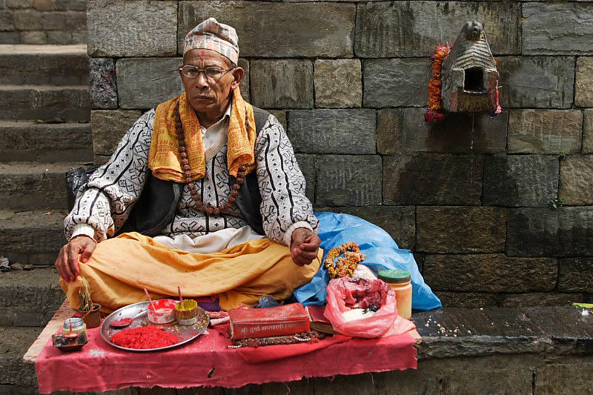
Dakshinkali, the bloody temple is dedicated to the goddess Kali. Twice a week the faithful Nepalese come to make sacrifices of animals and offer food to Kali. After the sacrifices the corpses are butchered and later will be brought home for a feast .

Slide 8
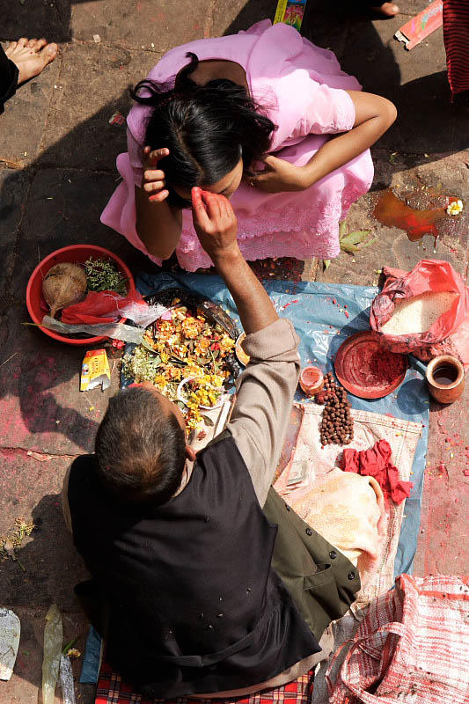

Slide 11
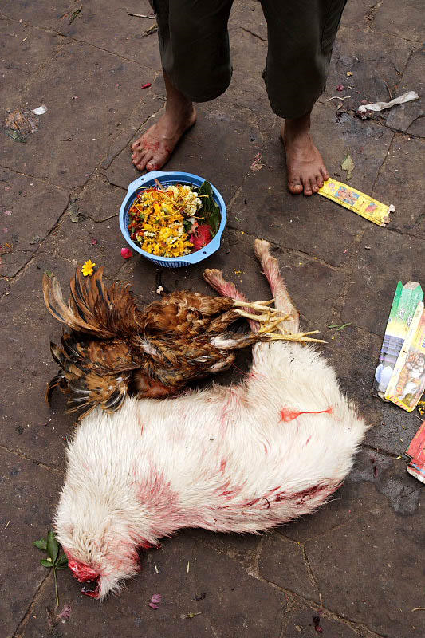

Slide 14
