Slide 1
Luxembourg

Slide 2
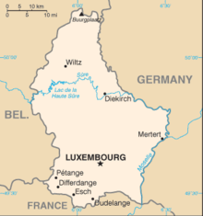
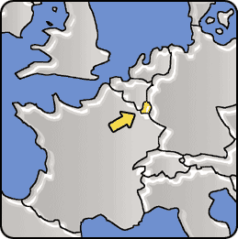
Region: Western Europe
Area total: 2,586.4 km2
Coast line: Landlocked country
Capital: Luxembourg

Slide 3
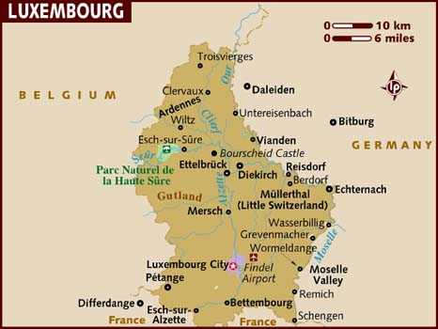

Slide 4
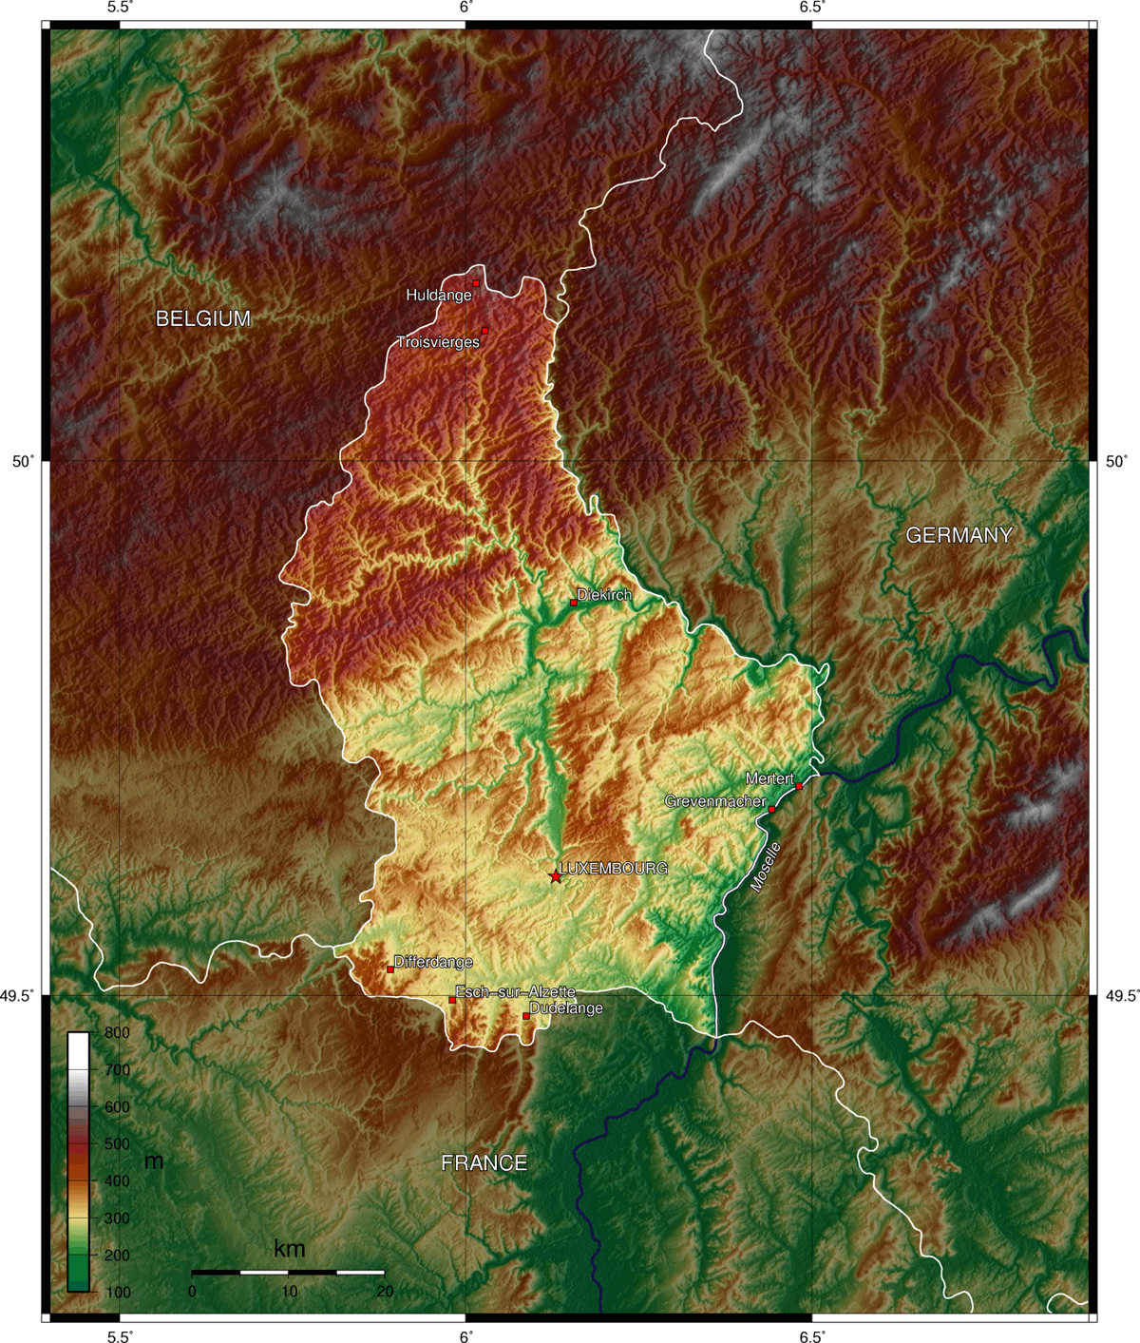
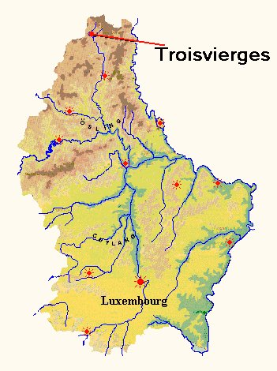
Topography

Slide 5
Background
Luxembourg is a member of the European Union, NATO, OECD, the United Nations, Benelux, and the Western European Union, reflecting the political consensus in favour of economic, political, and military integration. The city of Luxembourg, the capital and largest city, is the seat of several institutions and agencies of the European Union.
Luxembourg culture is a mix of Romance Europe and Germanic Europe, borrowing customs from each of the distinct traditions. Luxembourg is a trilingual country; German, French and Luxembourgish are official languages. Although a secular state, Luxembourg is predominantly Roman Catholic.

Slide 6
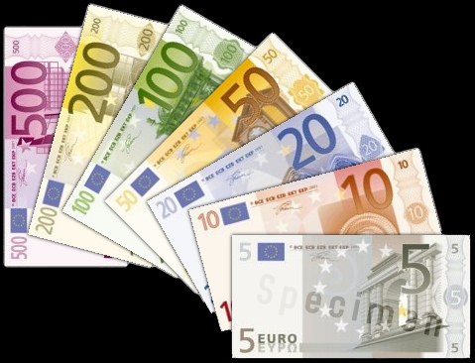
A Member of the Euro-Zone

Slide 7
Luxembourg City Panorama

Slide 8
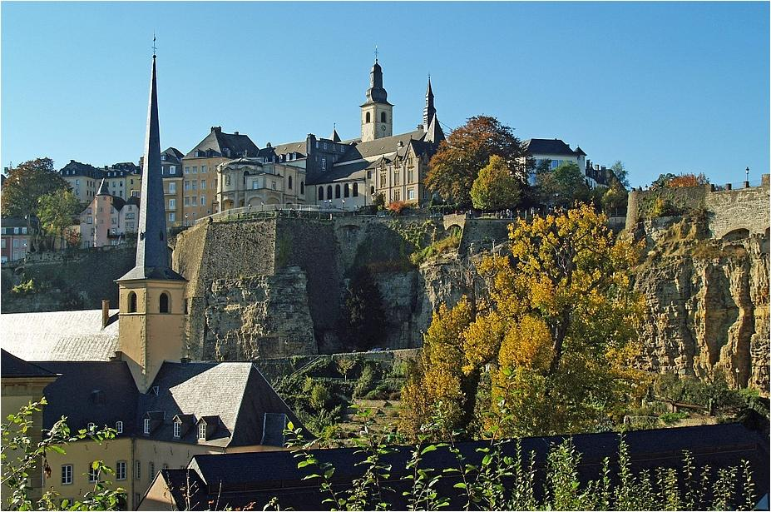
Luxembourg City on the rocks

Slide 9
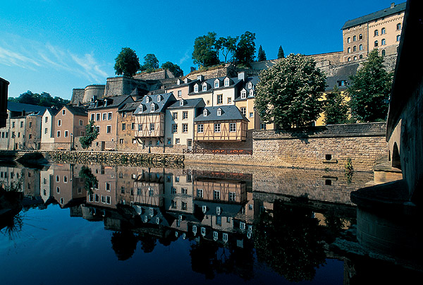

Slide 10
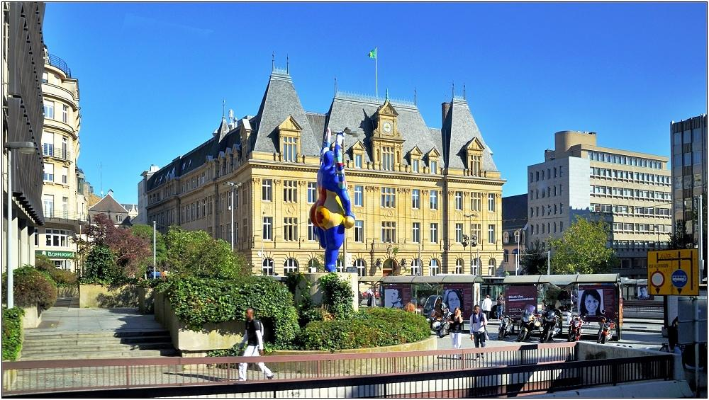

Slide 11
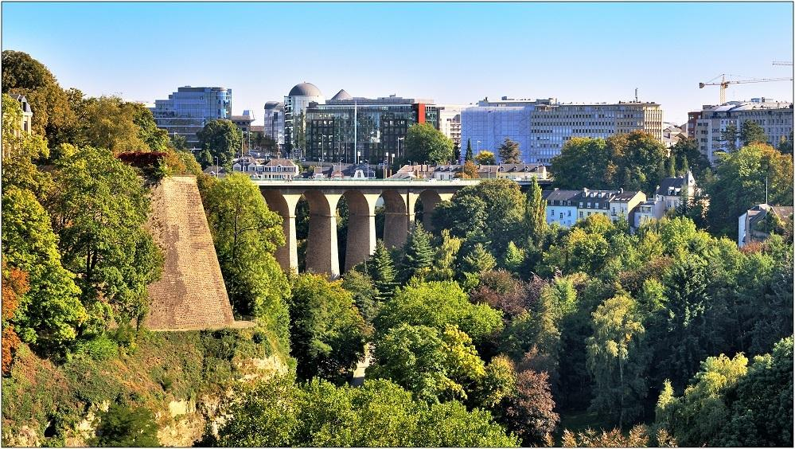

Slide 12
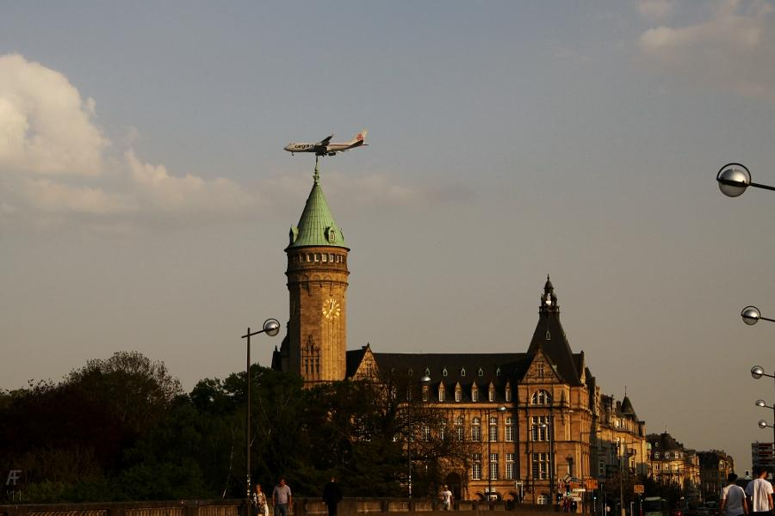

Slide 13
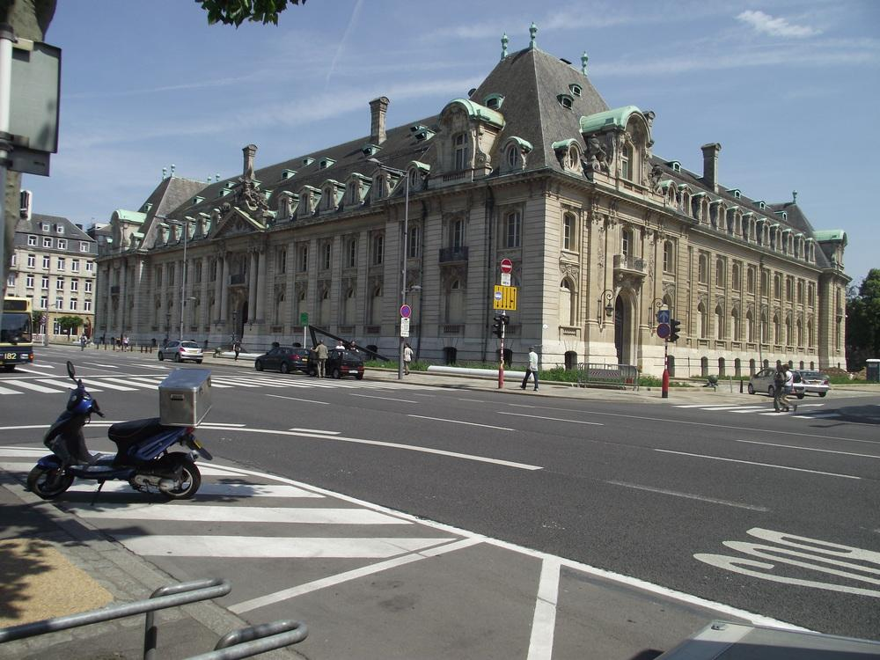

Slide 14
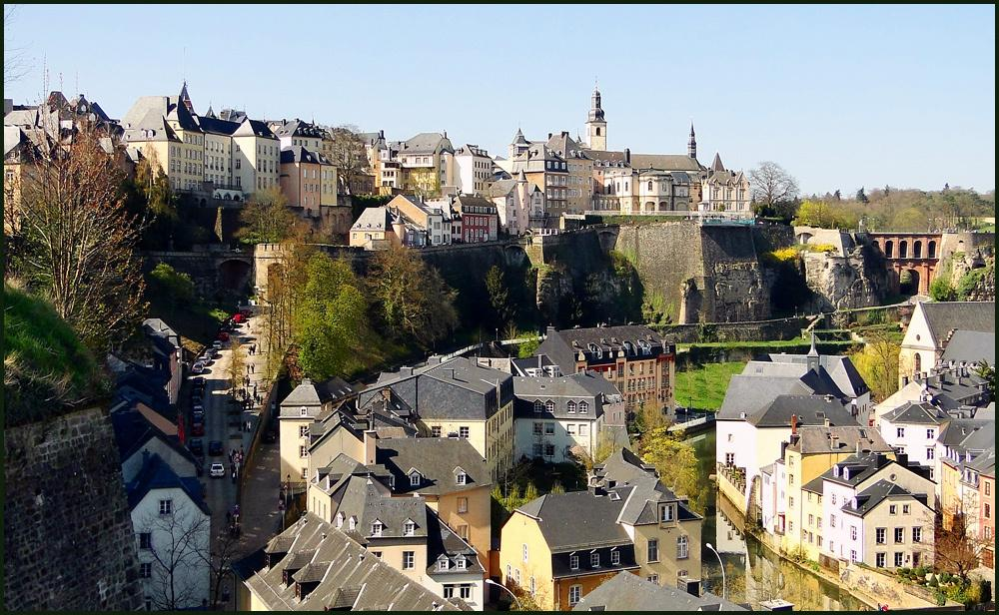

Slide 15
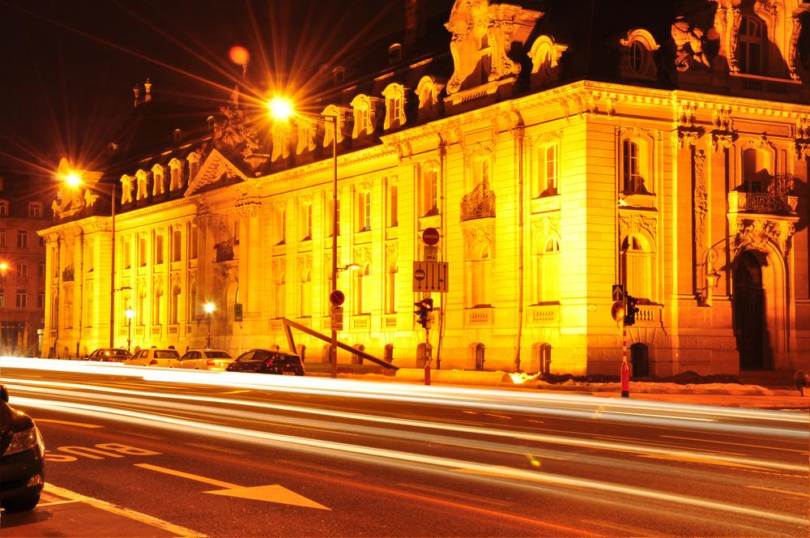

Slide 16
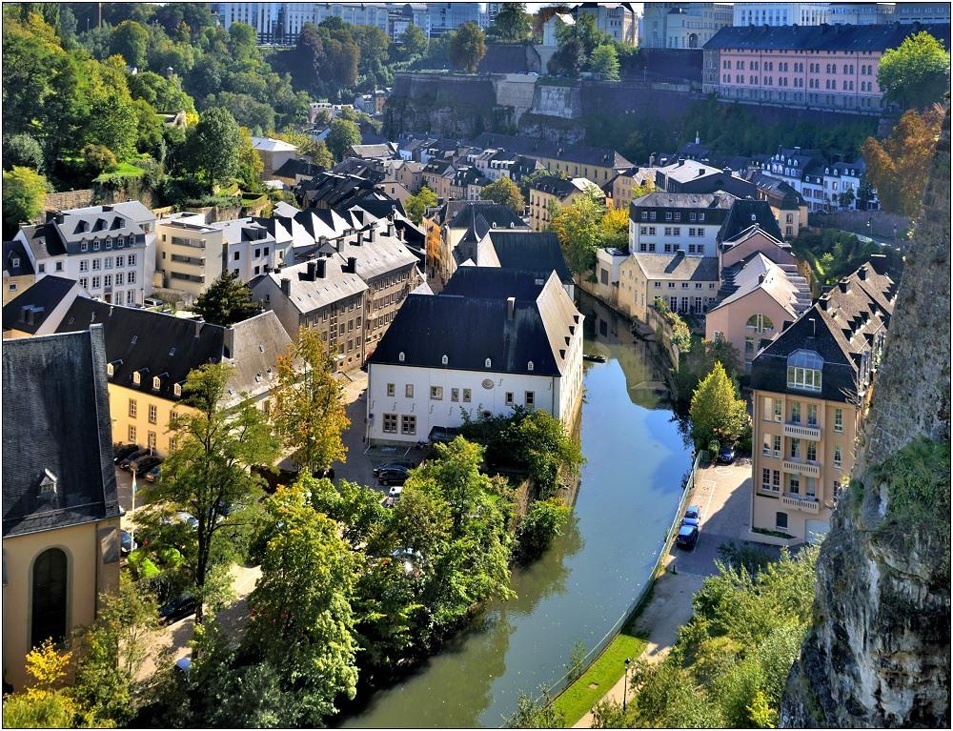

Slide 17
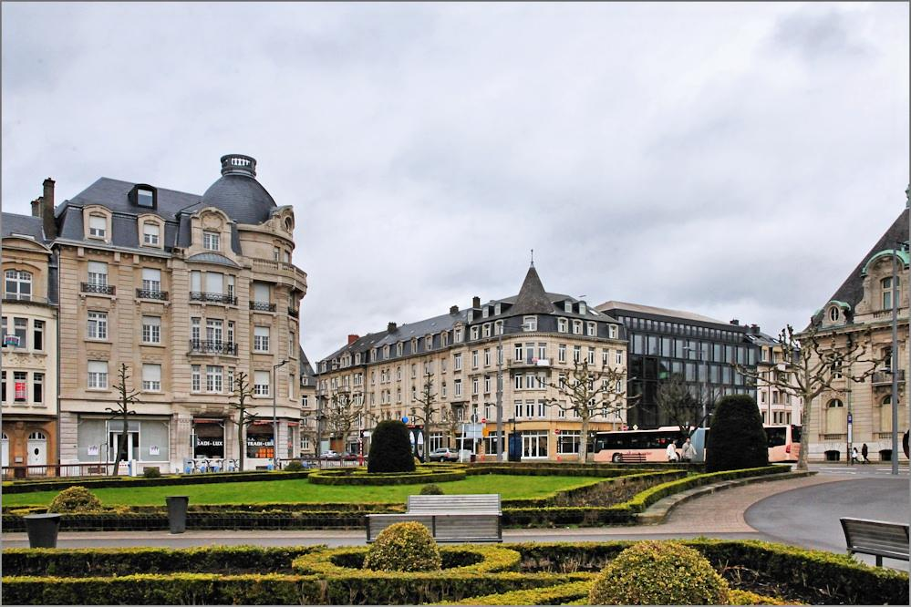

Slide 18
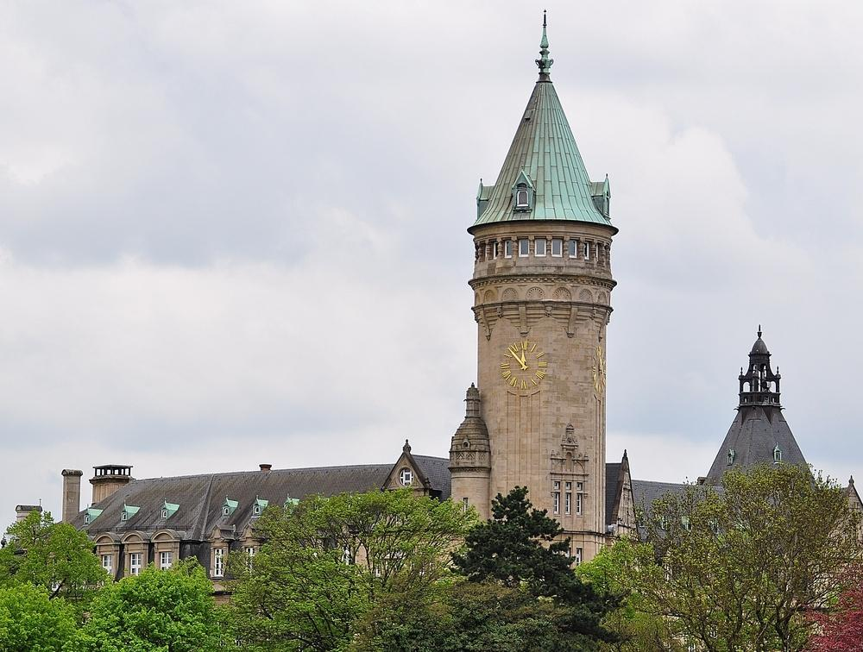

Slide 19
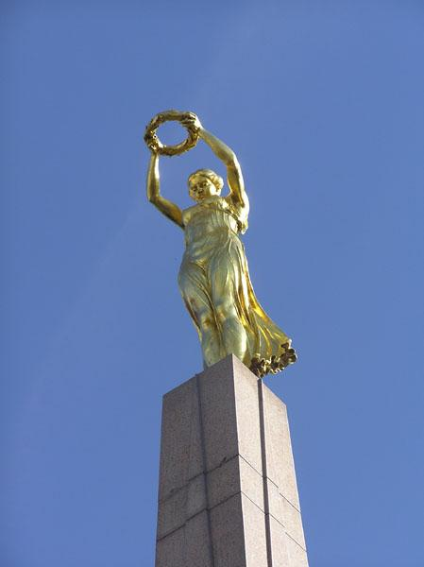
The Golden Lady

Slide 20
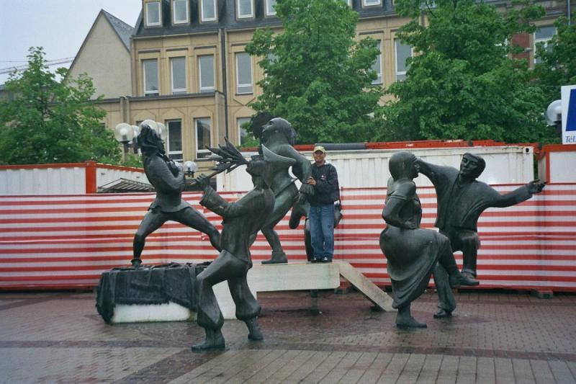
Theater Place

Slide 21
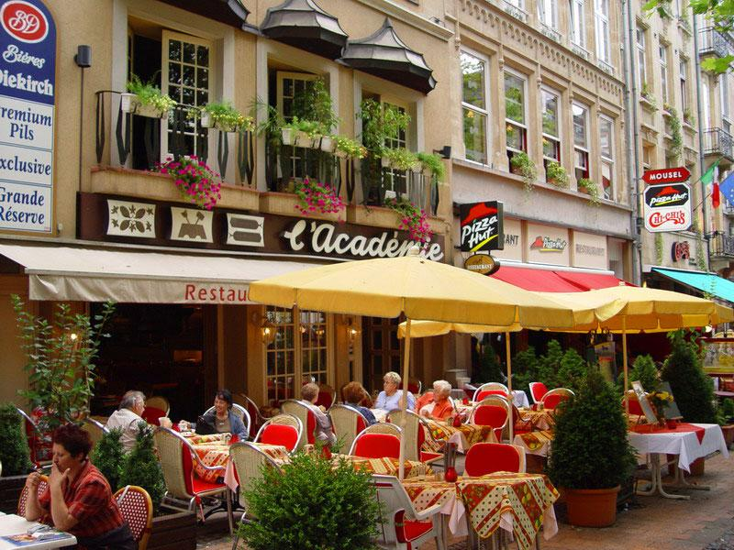

Slide 22
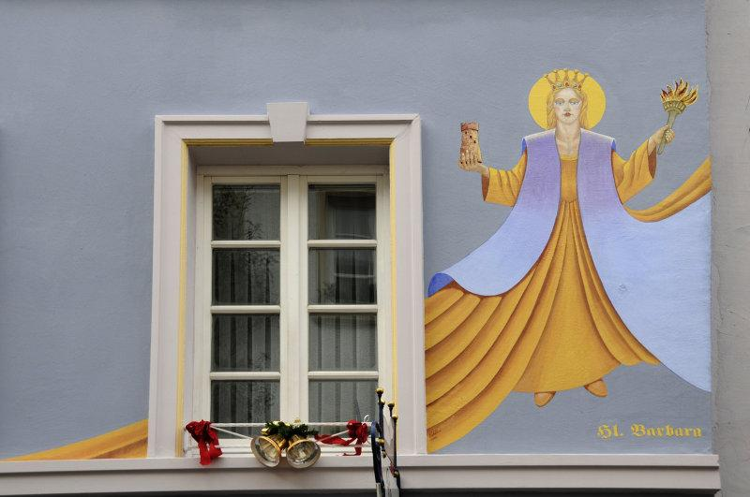

Slide 23
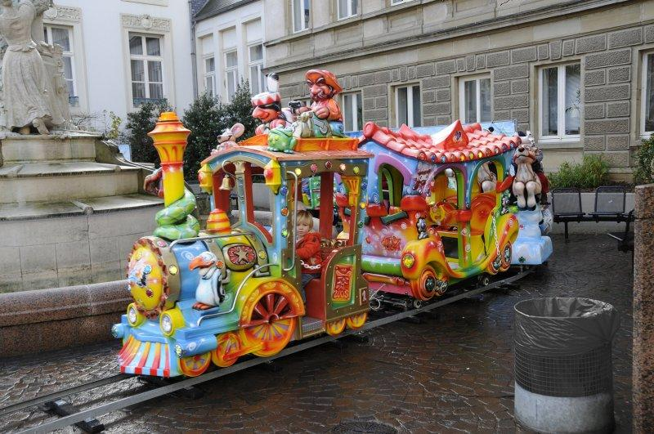

Slide 24
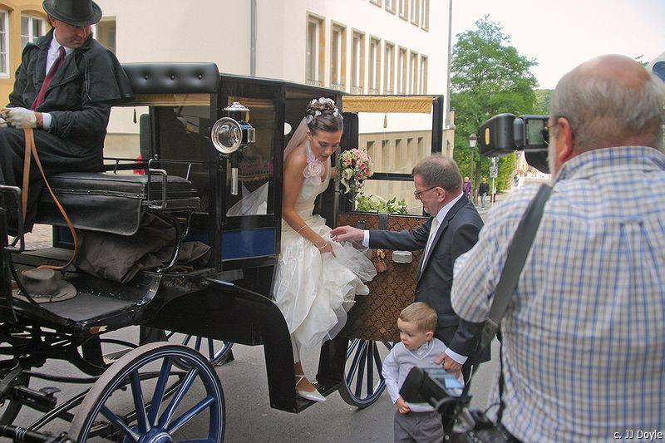

Slide 25
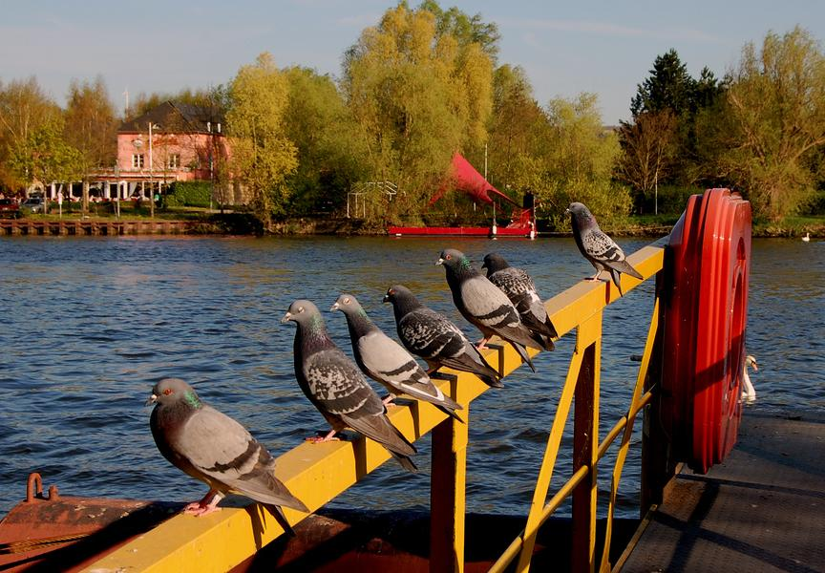

Slide 26
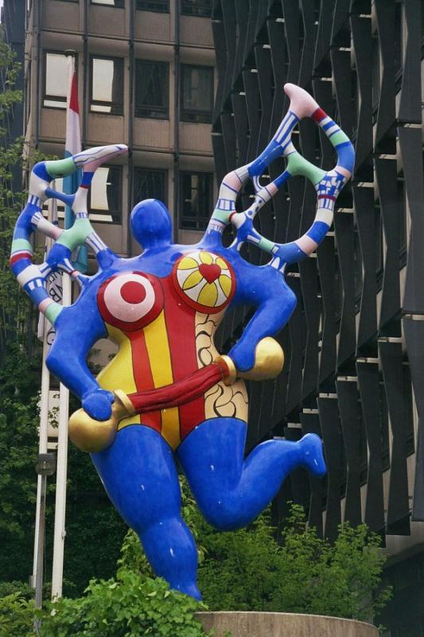

Slide 27
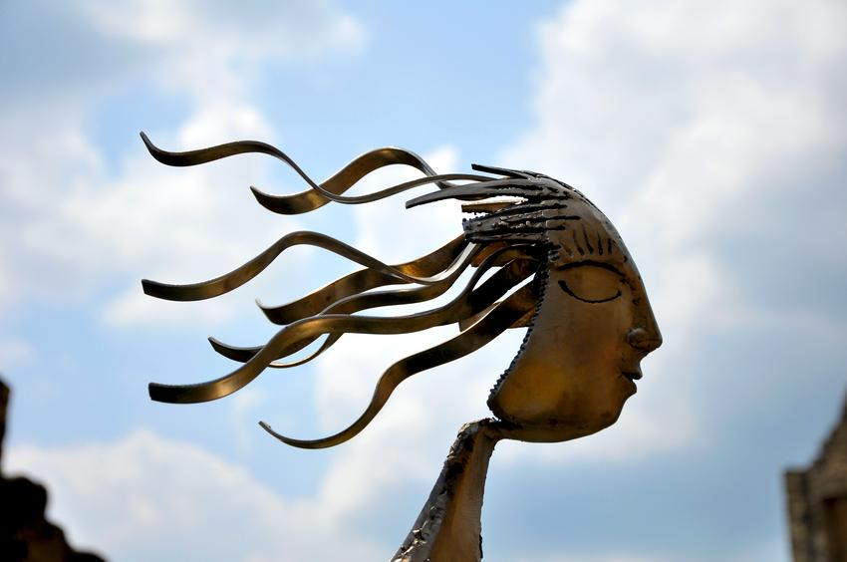

Slide 28
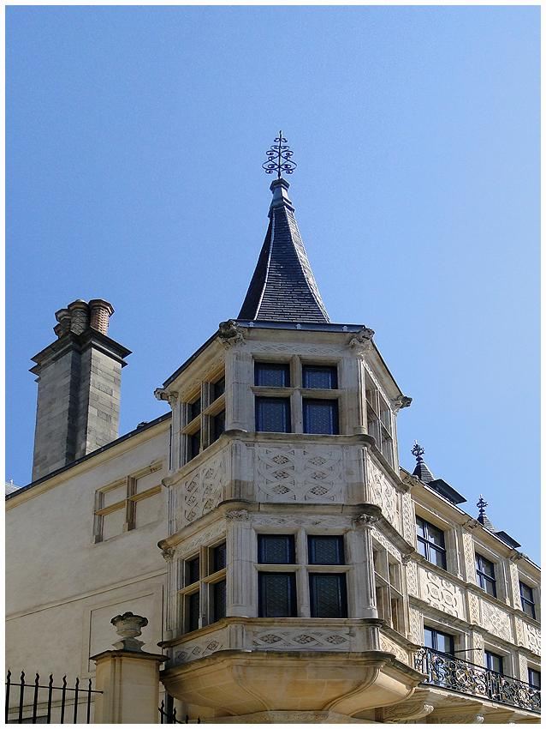
Grand Ducal Palace in Luxembourg City

Slide 29
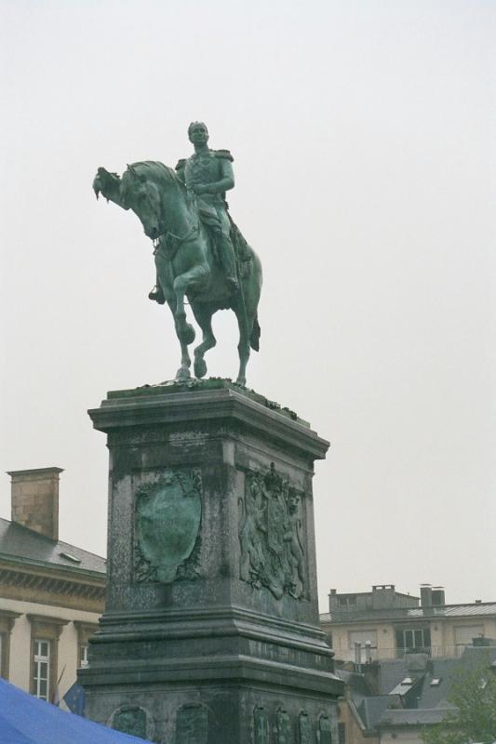
Memorial place

Slide 30
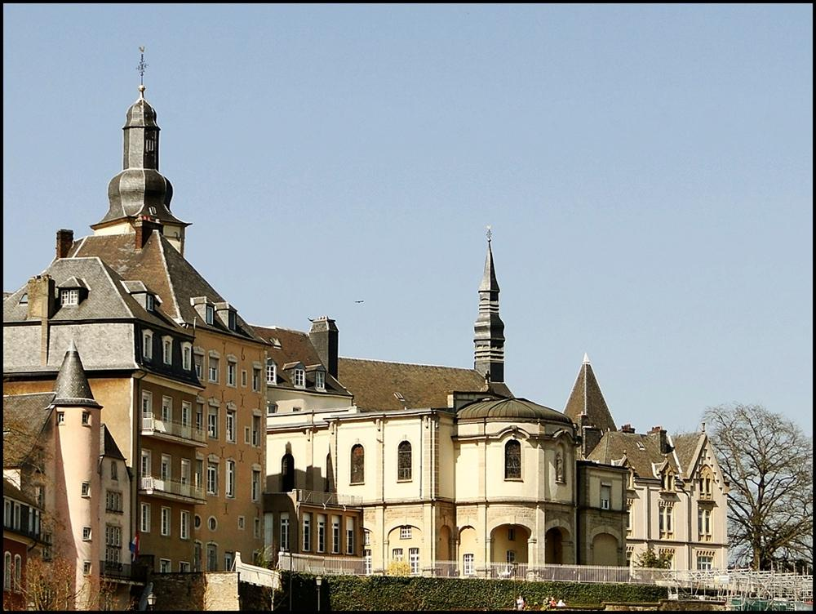

Slide 31
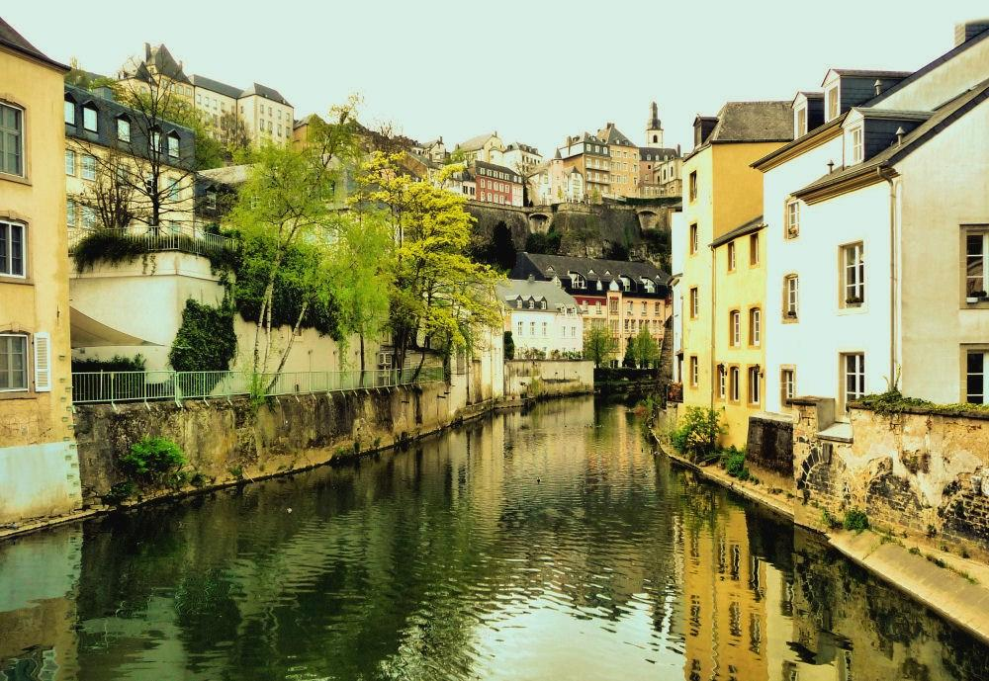

Slide 32
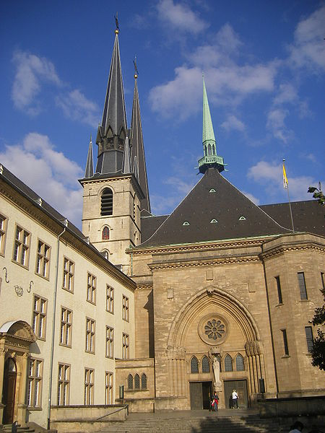
Notre-Dame Cathedral,

Slide 33
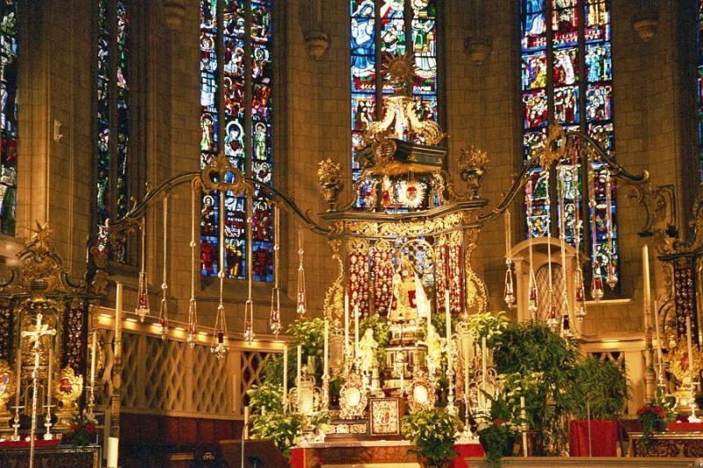
Altar of Notre Dame

Slide 34
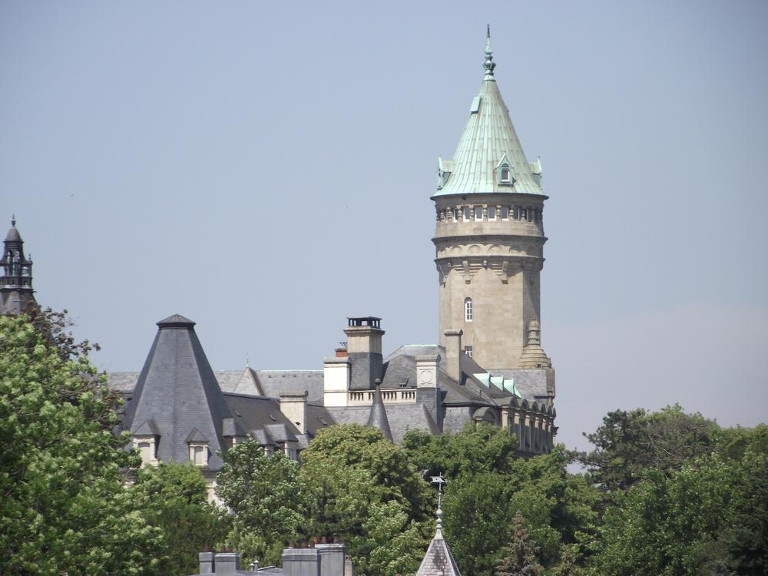
Bank Museum

Slide 35
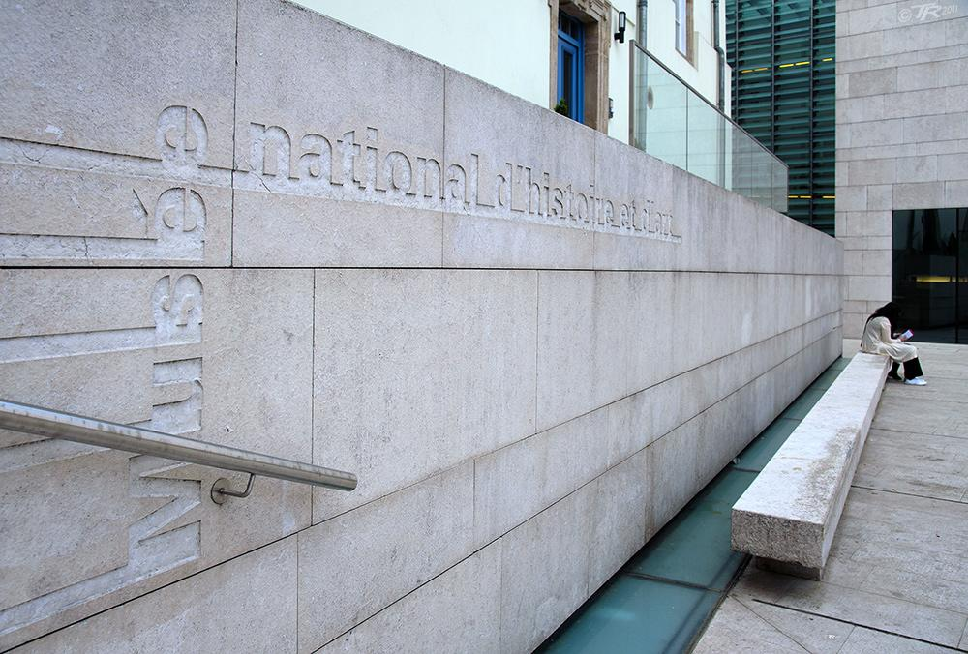
History and Art Museum

Slide 36
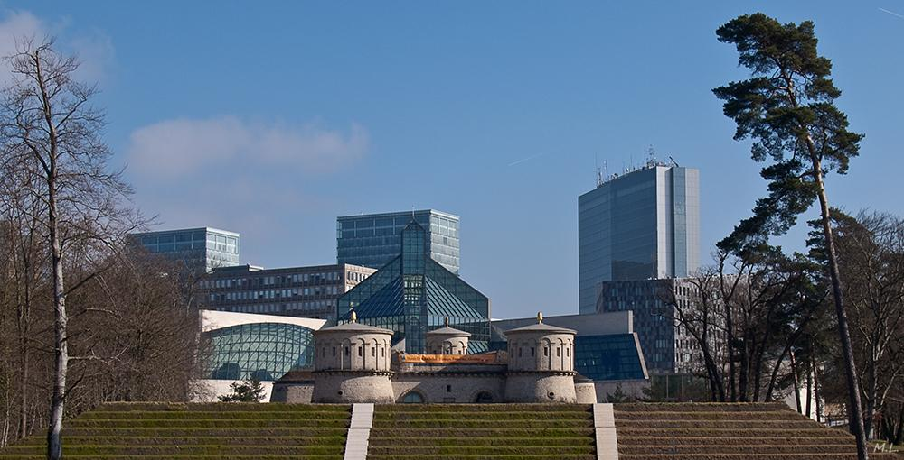
History Meets Modern Times

Slide 37
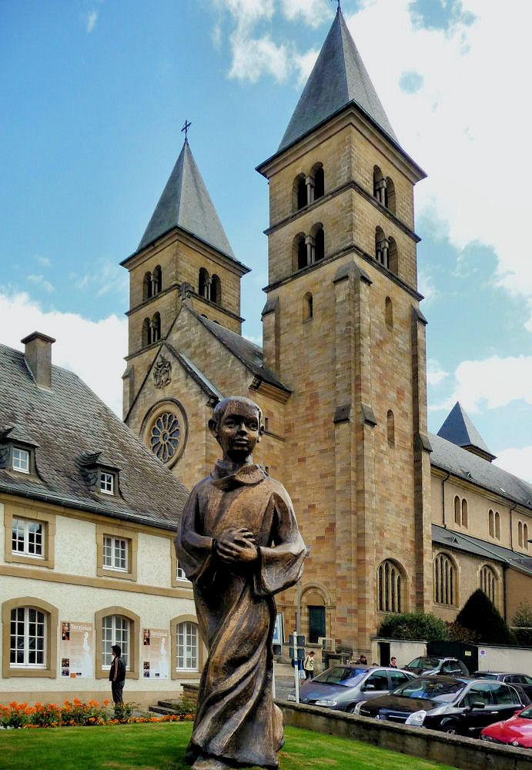

Slide 38
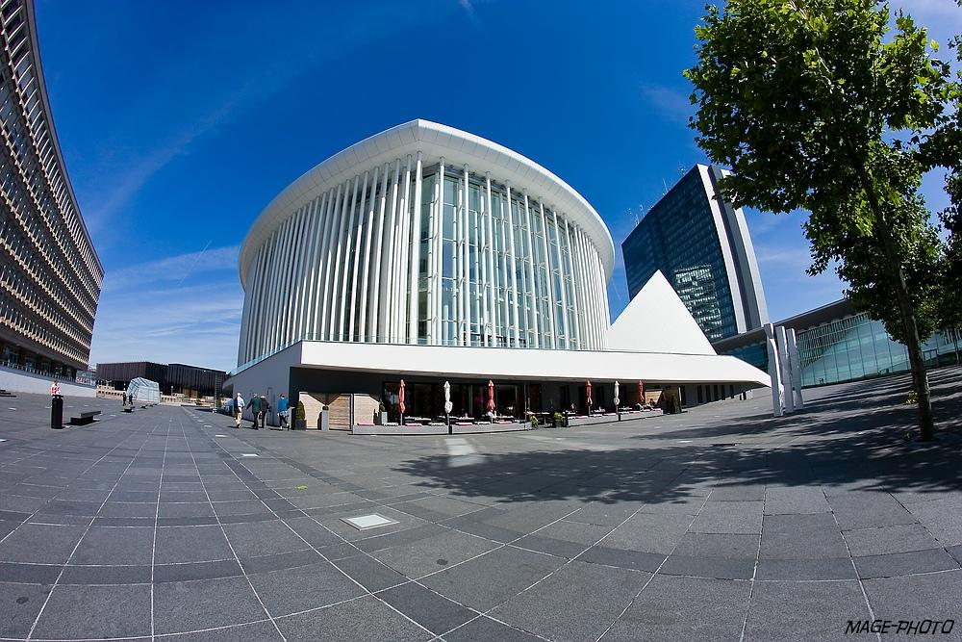
Philarmonie

Slide 39
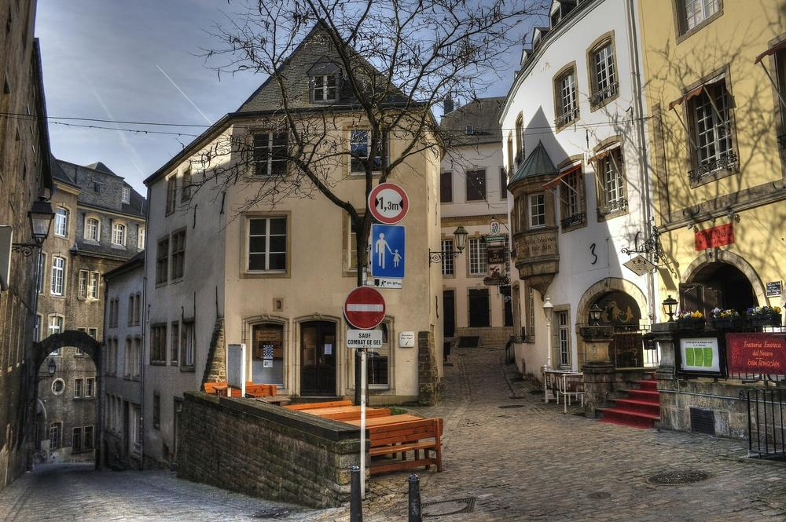
Old Town

Slide 40
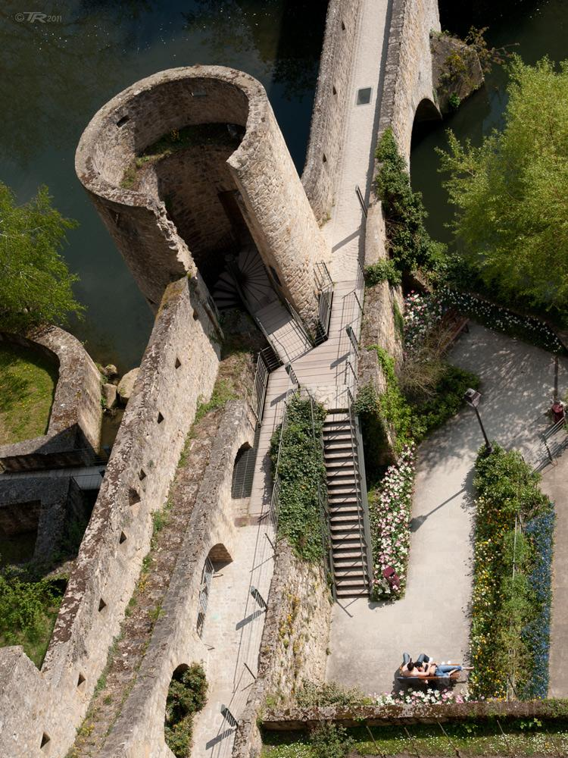
Old walls of Luxembourg City

Slide 41
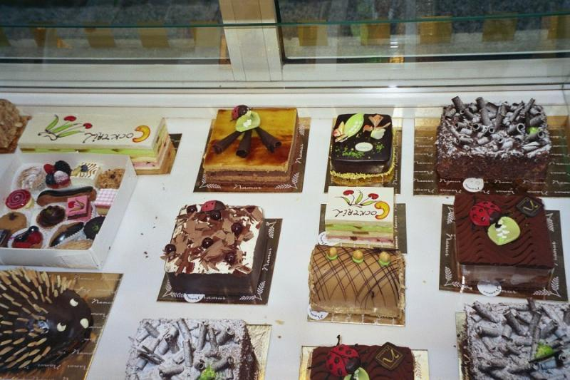
Local Sweets

Slide 42
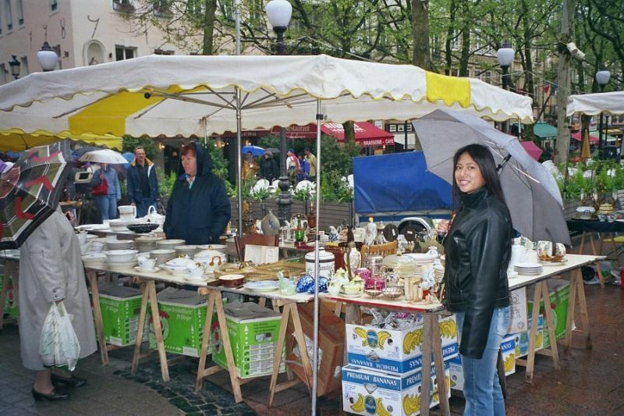
Outdoor Market (flea market?)

Slide 43
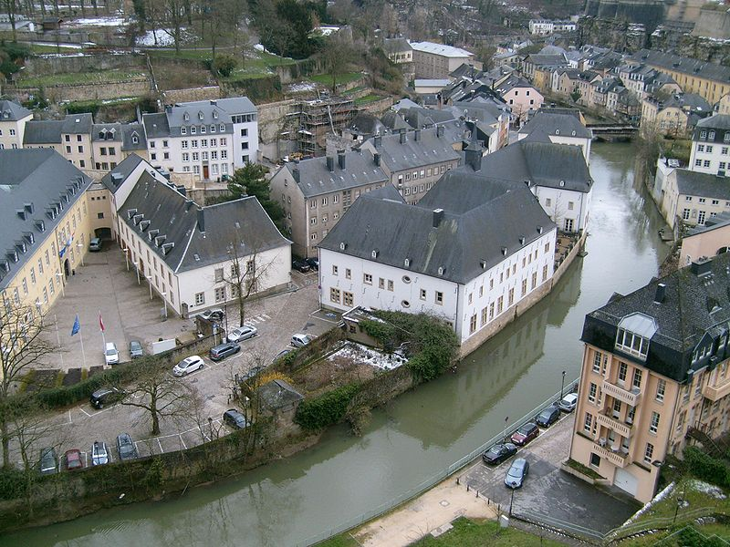
Alzette valley. National Natural History Museum.

Slide 44
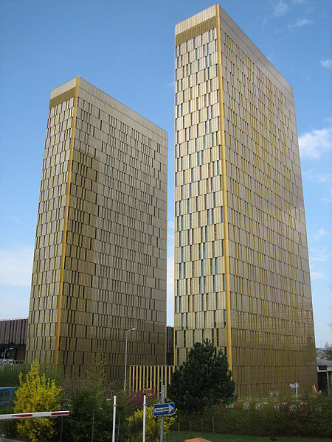
European Court of Justice

Slide 45
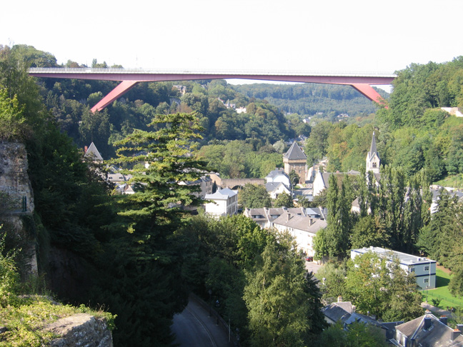
Alzette vally, bridge to Kirchberg.

Slide 47
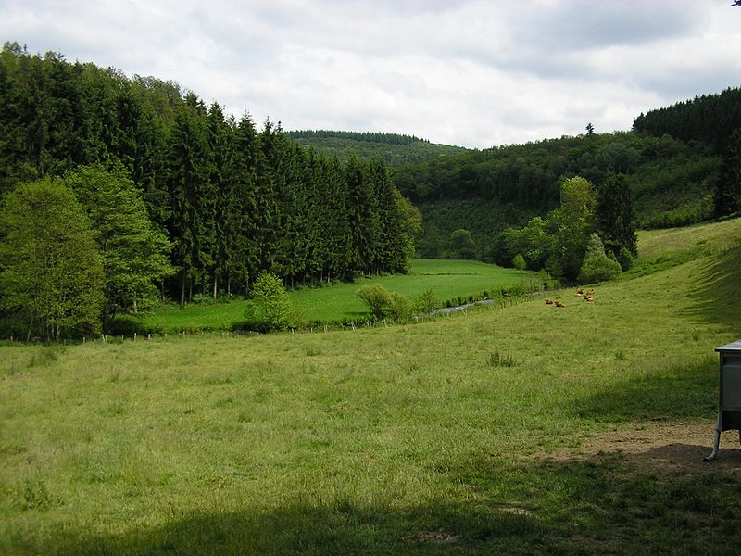
Countryside of Alscheid.

Slide 48
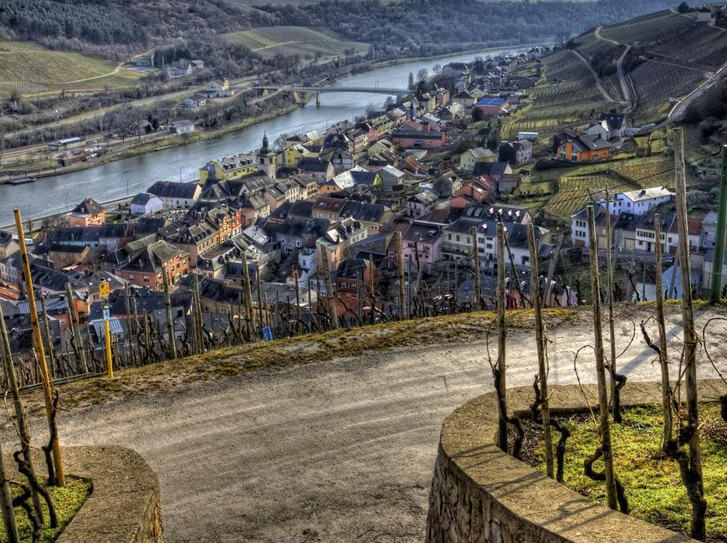
A small wine producing village on the Mosel

Slide 49
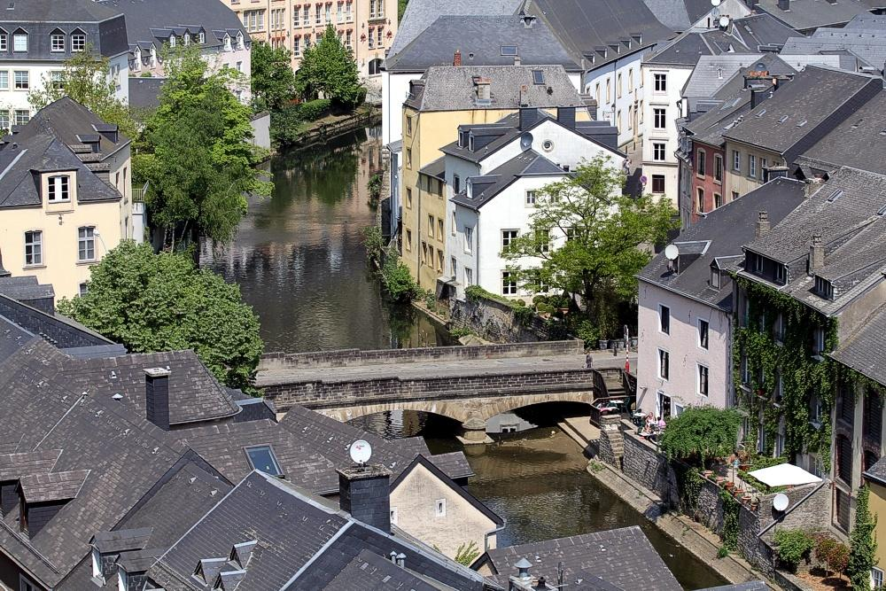
Alzette

Slide 50
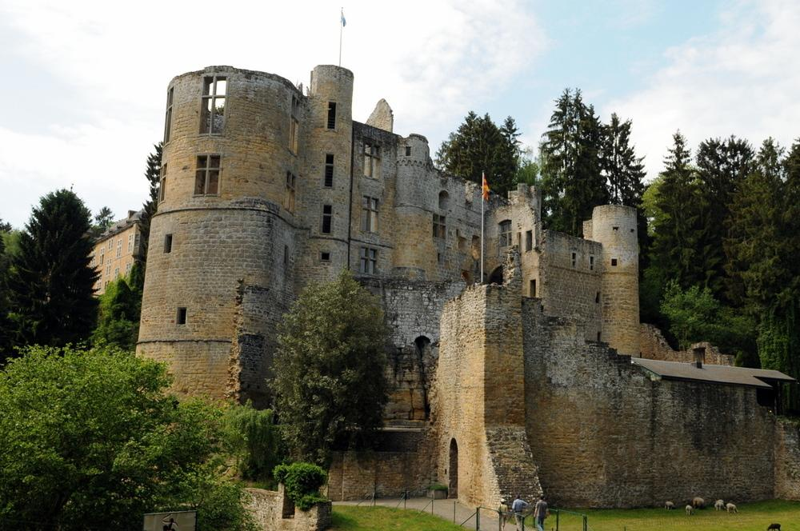
Befort Castle

Slide 51
Casement Dungeon Entry Warning

Slide 52
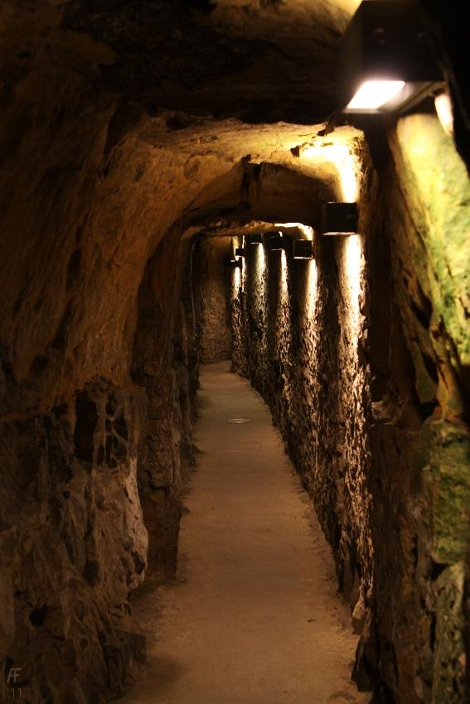
Casement Dungeon

Slide 53
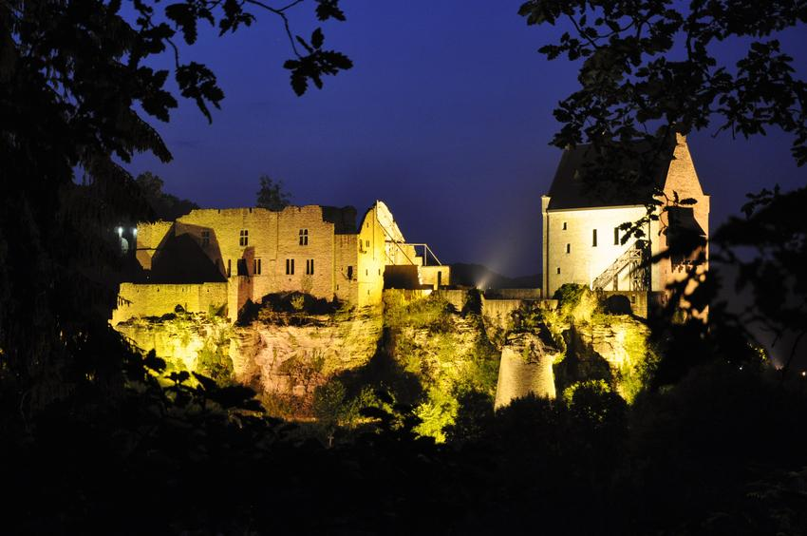
Castle in Larochette

Slide 54
Castle ruins in Luxembourg Useldange

Slide 55
Bourscheid Castle

Slide 56
Befort Castle

Slide 57
Echternach by Night

Slide 58
Echternach City Hall

Slide 60
Neumünster Abbey

