Slide 1
Korea – Heavy Rains in June-July 2011 bring Death and Destruction

Slide 2
North Korea says dozens of people were killed, injured or missing after torrential rain pounded the country between late June and mid-July.
South Korea — Mudslides set off by torrential rain in late July crushed mountainside houses and tourist dwellings in South Korea on Wednesday, July 27, 2011, killing at least 39 people, the police said.

Slide 3
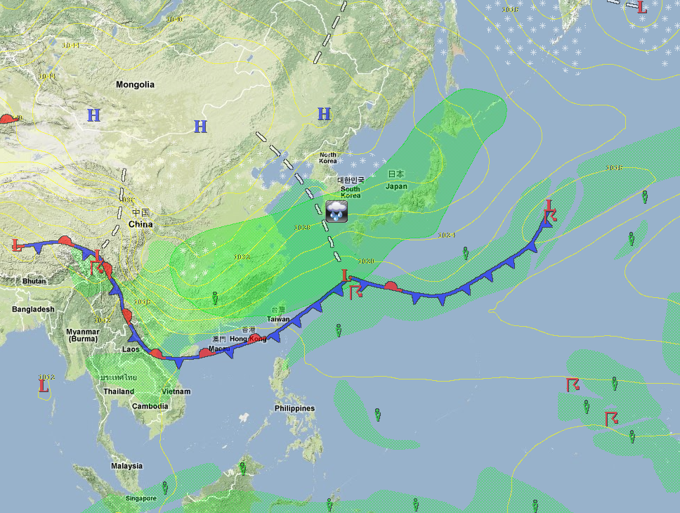

Slide 4
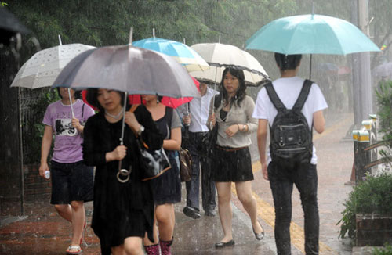

Slide 5
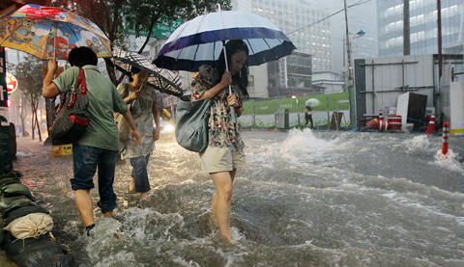

Slide 6
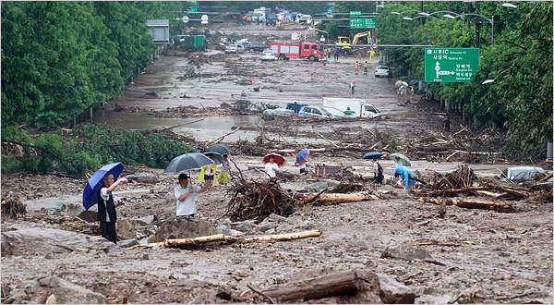
Aftermath of Mudslide in Seoul, South Korea

Slide 7
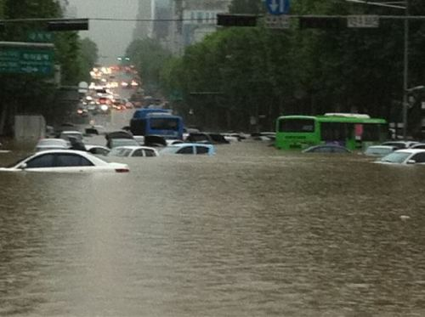

Slide 8
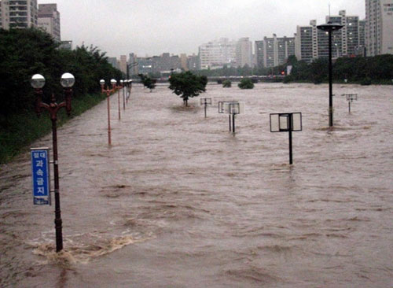

Slide 9
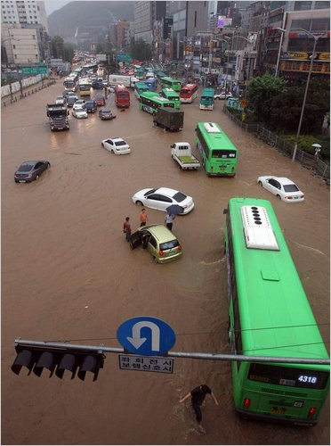
Streets in Seoul, South Korea, were flooded on Wednesday.

Slide 10
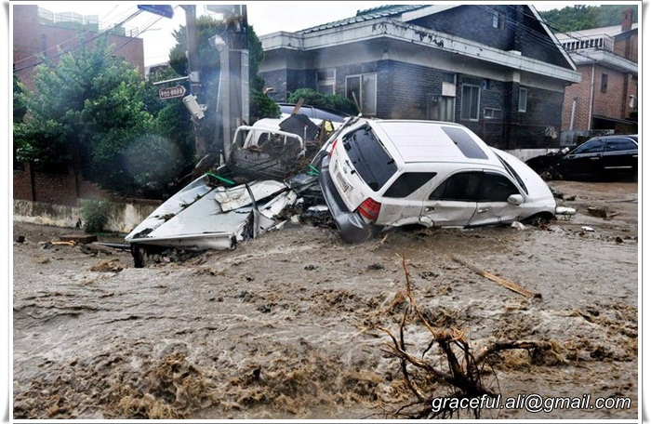

Slide 11
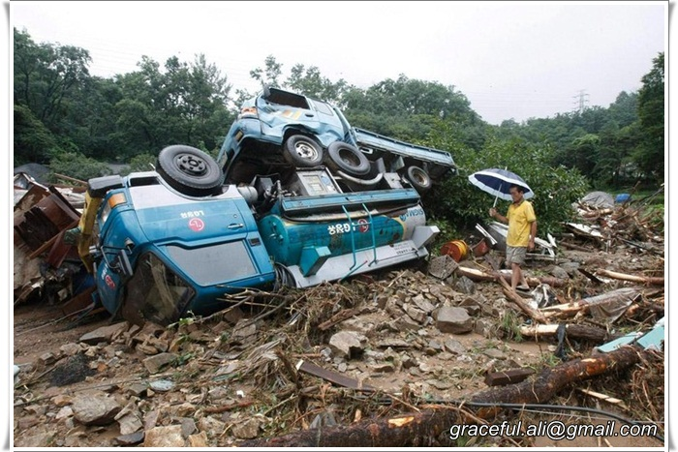

Slide 12
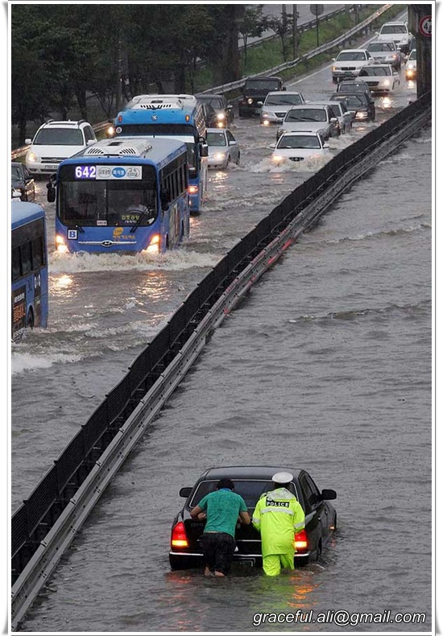

Slide 13
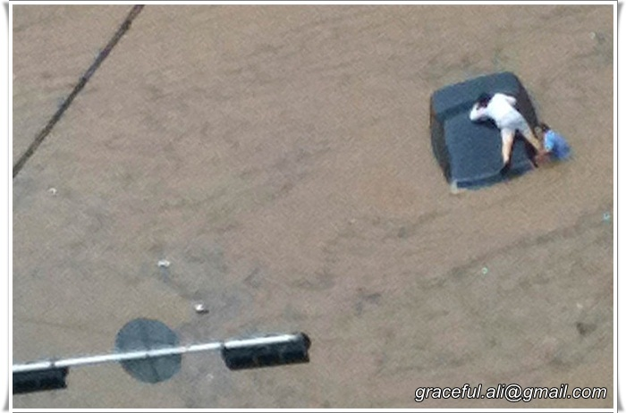

Slide 14
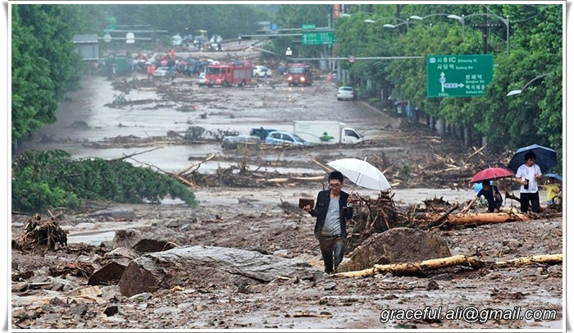

Slide 15
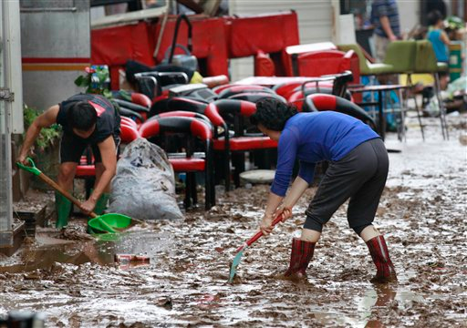

Slide 16
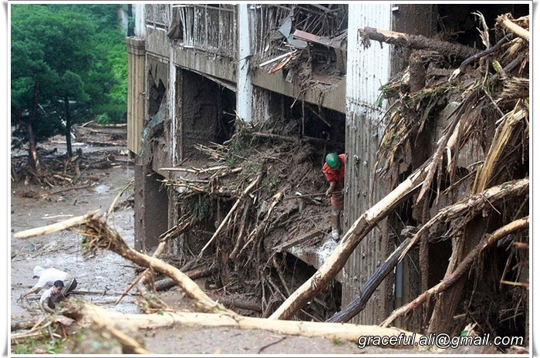

Slide 17
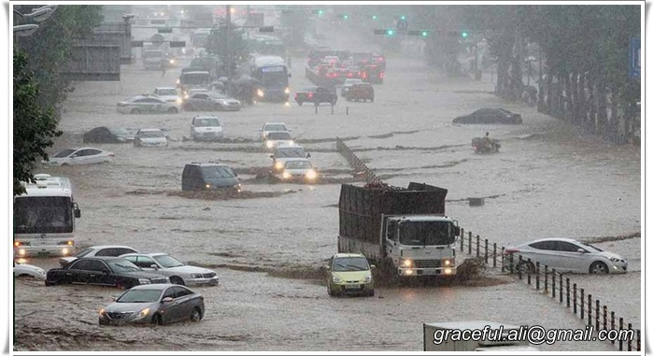

Slide 18
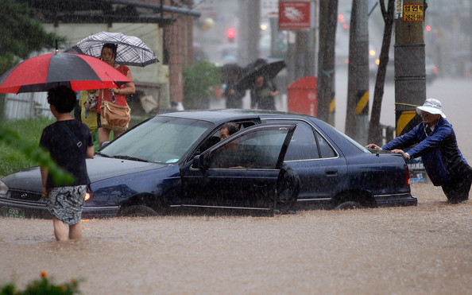

Slide 19
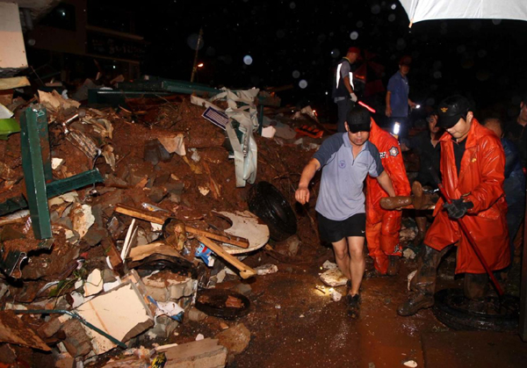

Slide 20
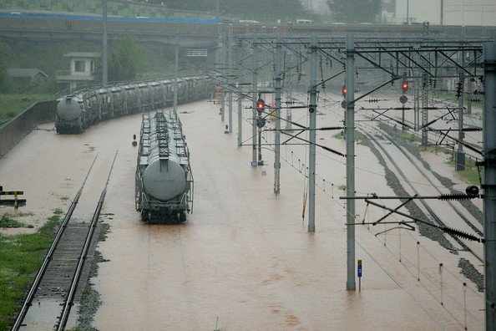

Slide 21
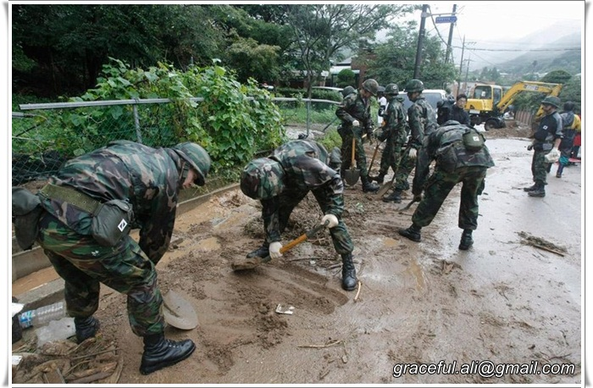

Slide 22
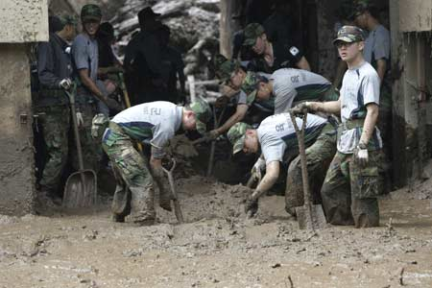

Slide 23
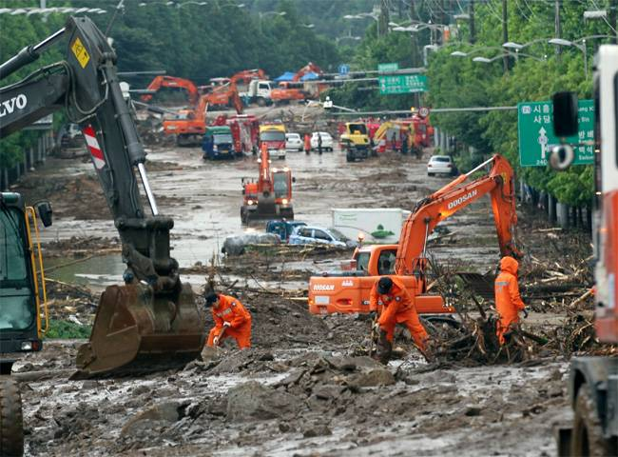

Slide 24
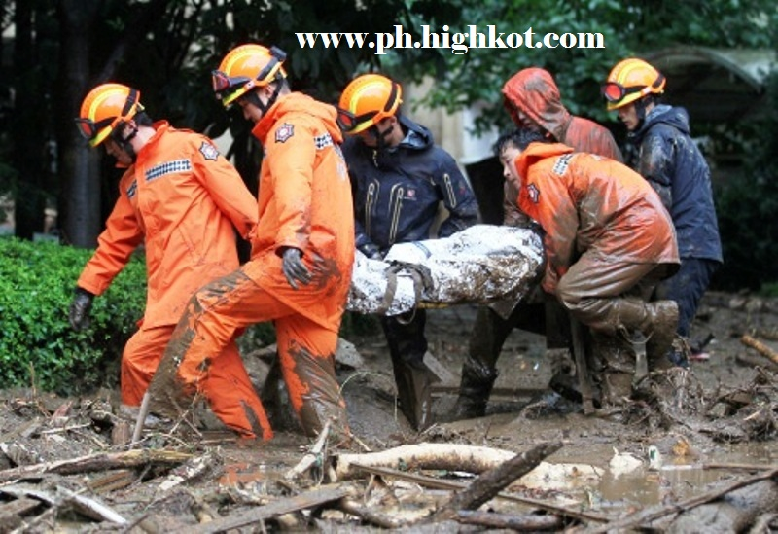

Slide 25
