Slide 1
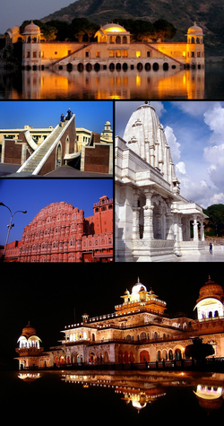
J A I P U R -[RAJASTHAN, INDIA]

Slide 2
Background
Jaipur, also popularly known as the Pink City, is the capital and largest city of the Indian state of Rajasthan. During the British rule in India, Jaipur was the capital of the princely state of Jaipur. Founded on 18 November 1727 by Maharaja Sawai Jai Singh II, the ruler of Amber, the city today has a population of more than 3.2 million.
Jaipur is the first planned city of India, located in the semi-desert lands of Rajasthan. The city which once had been the capital of the royalty now is the capital city of Rajasthan. The very structure of Jaipur resembles the taste of the Rajputs and the Royal families. At present, Jaipur is a major business center with all requisites of a metropolitan city.

Slide 3
Jaipur
The city is remarkable among pre-modern Indian cities for the width and regularity of its streets which are laid out into six sectors separated by broad streets 111 ft wide. The urban quarters are further divided by networks of gridded streets. Five quarters wrap around the east, south, and west sides of a central palace quarter, with a sixth quarter immediately to the east. The Palace quarter encloses a sprawling palace complex, formal gardens, and a small lake. Nahargarh Fort, which was the residence of the King Sawai Jai Singh II, crowns the hill in the northwest corner of the old city. Another noteworthy building is the observatory, Jantar Mantar. Jaipur is a popular tourist destination in Rajasthan and India.

Slide 4
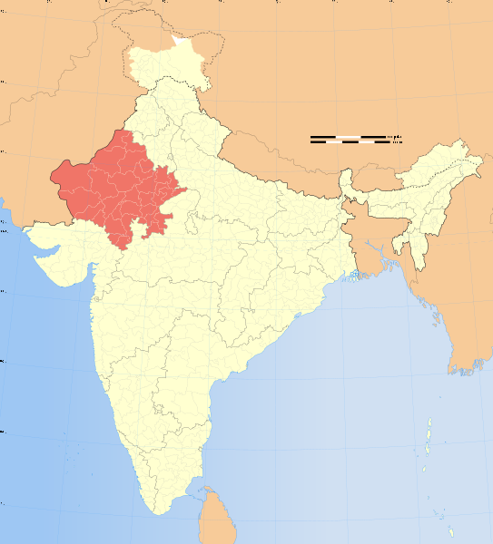
Rajasthan
Jaipur

Slide 5
Jaipur Climograph

Slide 6
Panoramic view of Jaipur from the surrounding hills

Slide 7
Fortification Walls

Slide 8
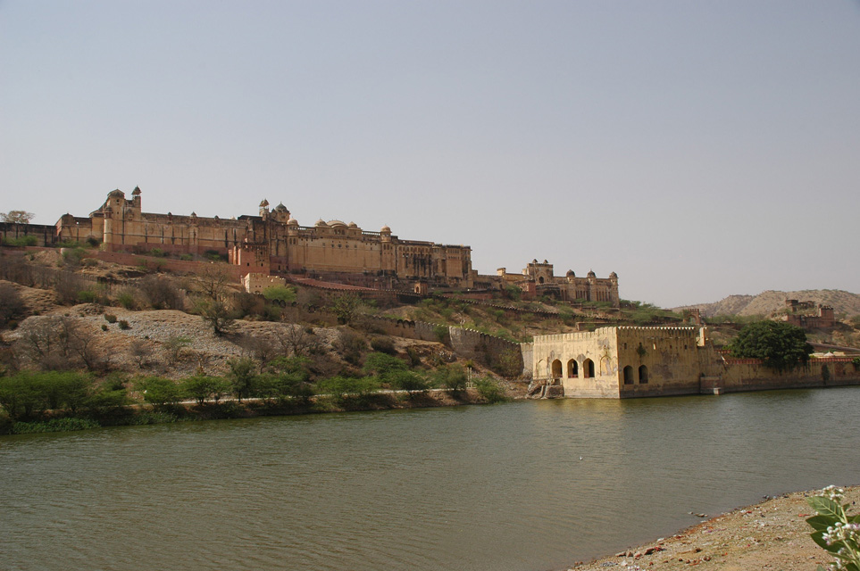
Amber Fort-Palace with superb Rajput architecture

Slide 9
City Gate

Slide 10
The Ganesh Pol of Amber fort. Amber is now part of Jaipur Municipal Corporation

Slide 11
Another view

Slide 12
Amber Fort.

Slide 13
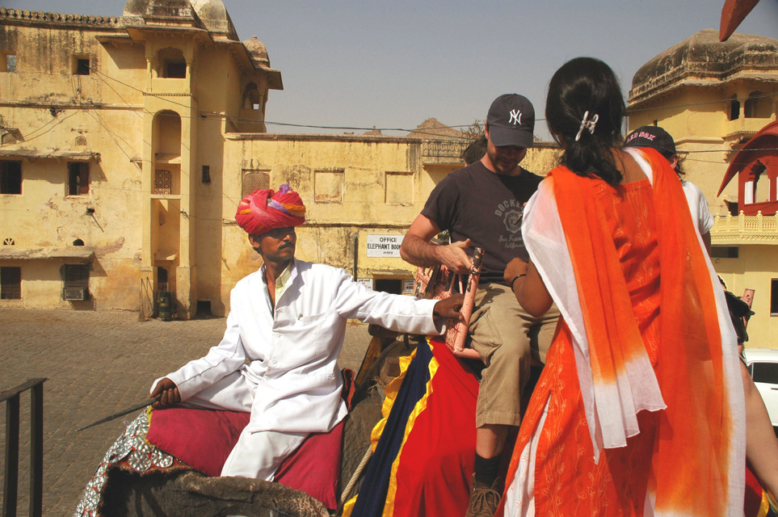
Amber Fort-Palace tourists boarding an elephant

Slide 14
View of Jaipur from Amber Fort

Slide 15
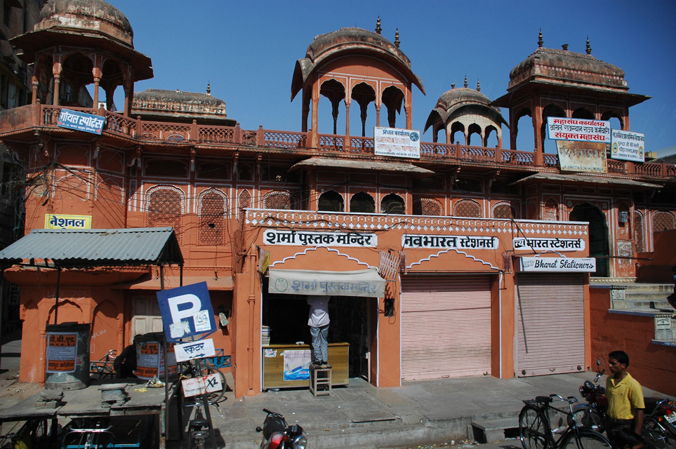
Typical dusky-pink architecture

Slide 16
The Vidhan Sabha is the seat of Rajasthan's Legislative assembly.

Slide 17
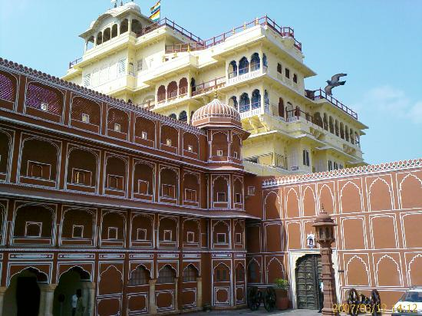
City Palace of Jaipur

Slide 18
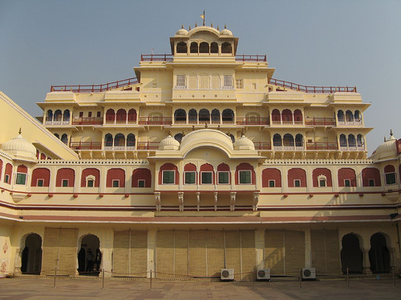
City Palace

Slide 19
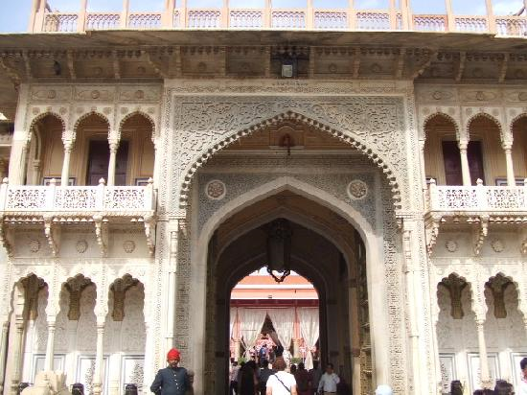
City Palace

Slide 20
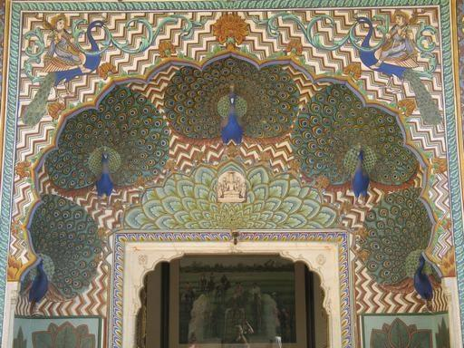
Peacock Gateway, City Complex

Slide 21
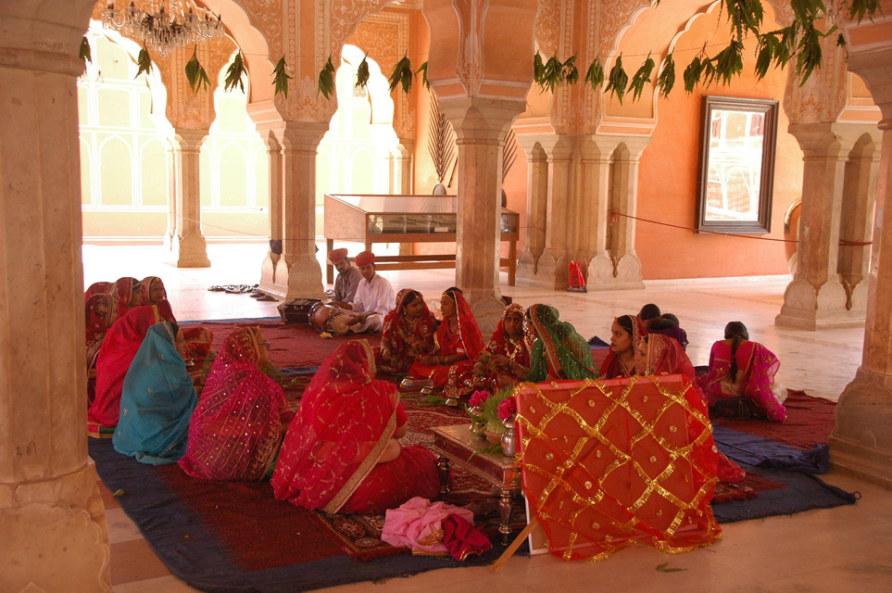
Diwan-i-Kas or Hall of Private Audience in the City Palace Complex

Slide 22
Albert Hall

Slide 23
Albert Hall Museum, Jaipur

Slide 25
Rambagh Palace

Slide 26
Hawa Mahal

Slide 28
Hawa Mahal (Palace of Winds) in Jaipur. From the top

Slide 29
Jal Mahal water palace

Slide 30
Birla Mandir or the Lakshmi-Narayan Temple, situated just below the Moti Dungari is a modern temple built of white marble on top of a hill,

Slide 31
Shri Naryan temple in Jaipur

Slide 32
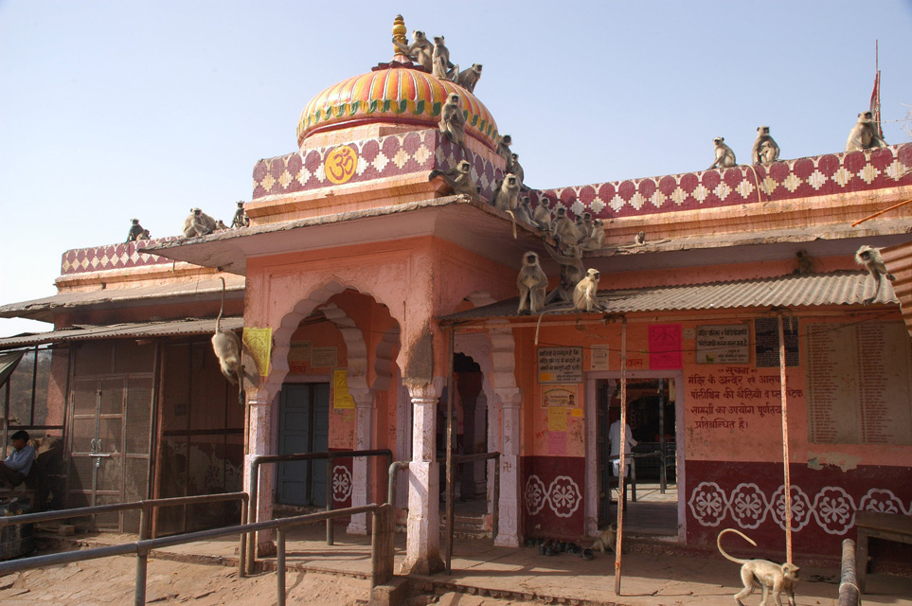
Hindu temple with numerous monkeys inside Ranthambore Fort

Slide 33
Jantar Mantar (Observatory) in Jaipur

Slide 34
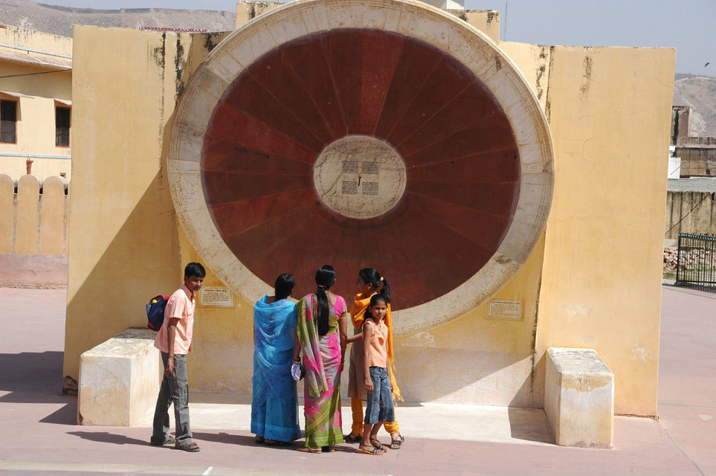
Jantar Mantar Observatory

Slide 35
The observatory is a tourist attraction

Slide 36
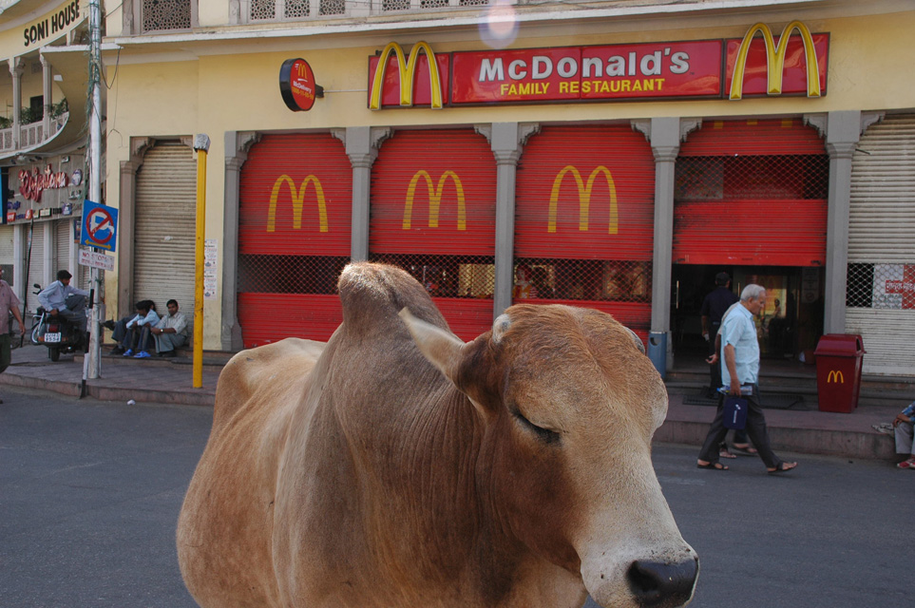
McDonalds with cow at Panch-Batti Circle

Slide 37
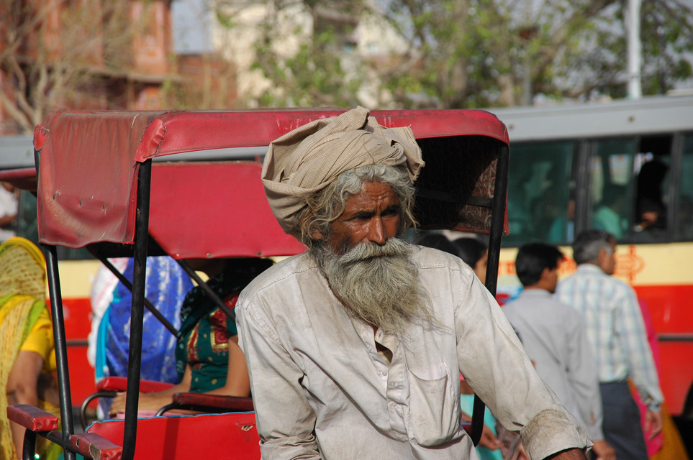
Rickshaw driver at Choti Chaupar Circle

Slide 38
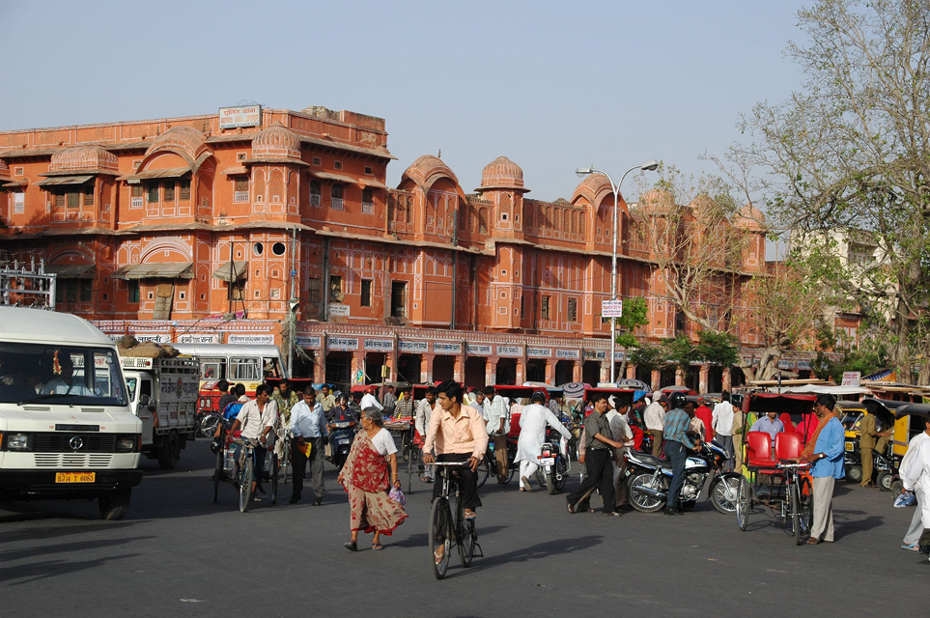
Heavy traffic at Choti Chaupar Circle

Slide 39
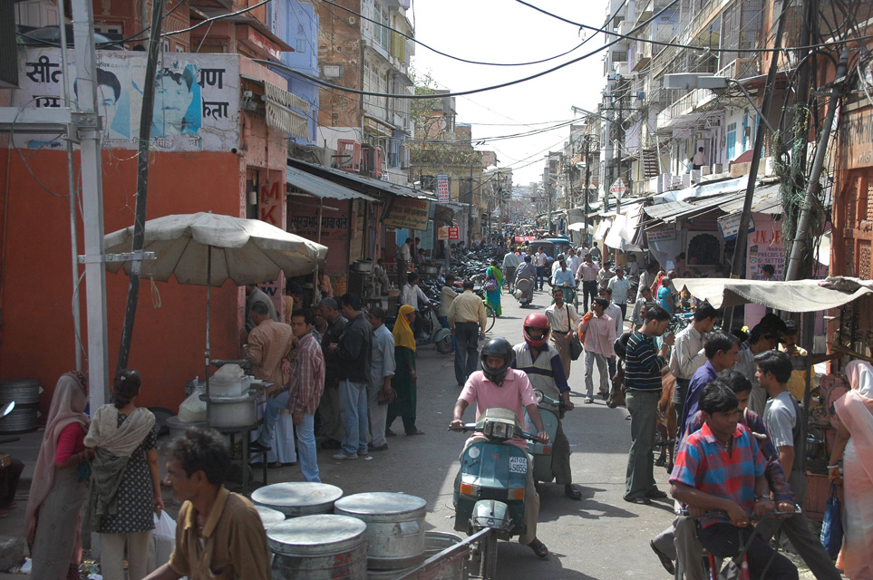
busy street in downtown Jaipur

Slide 40
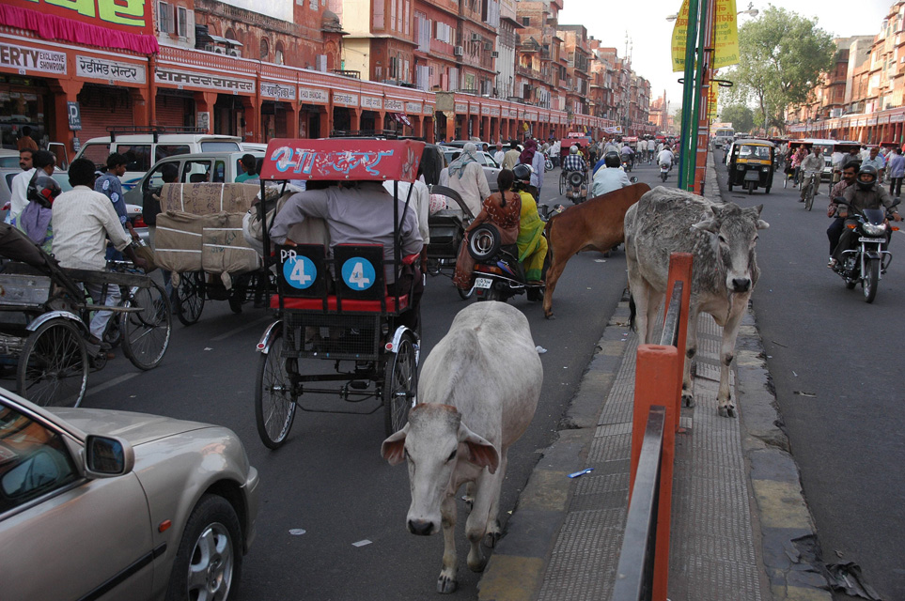
Cows in traffic

Slide 41
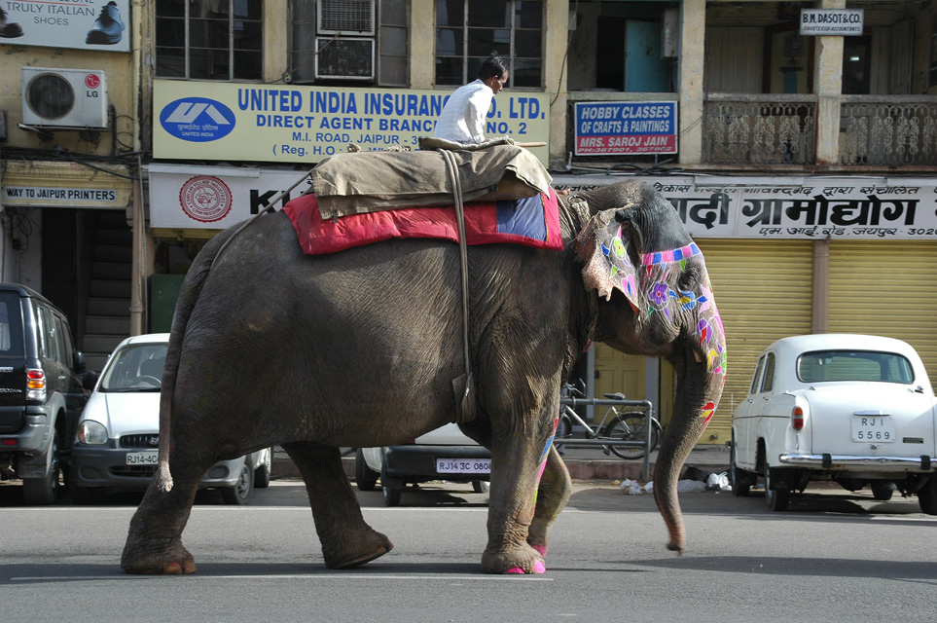
Elephant on a street in the town center

Slide 42
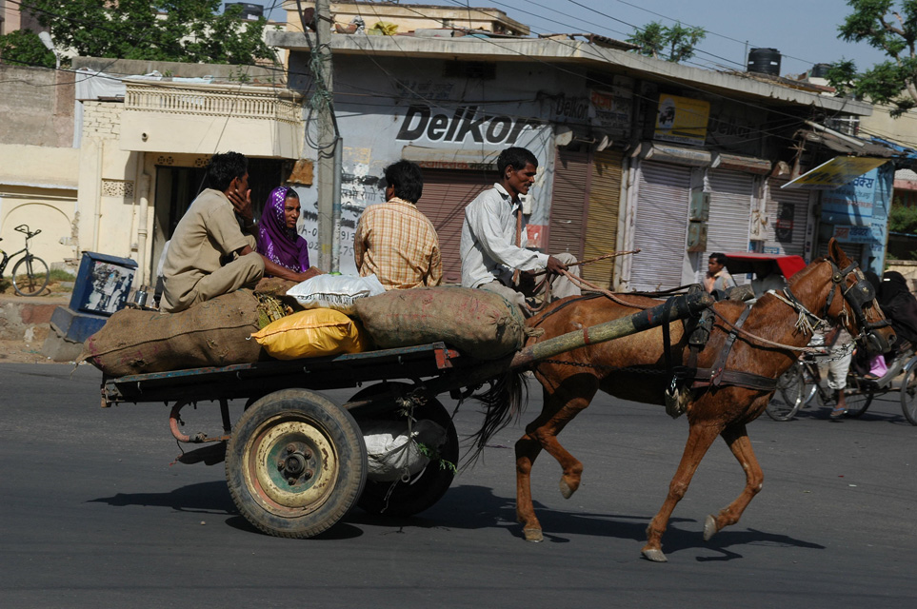
Horse cart in the town center

Slide 43
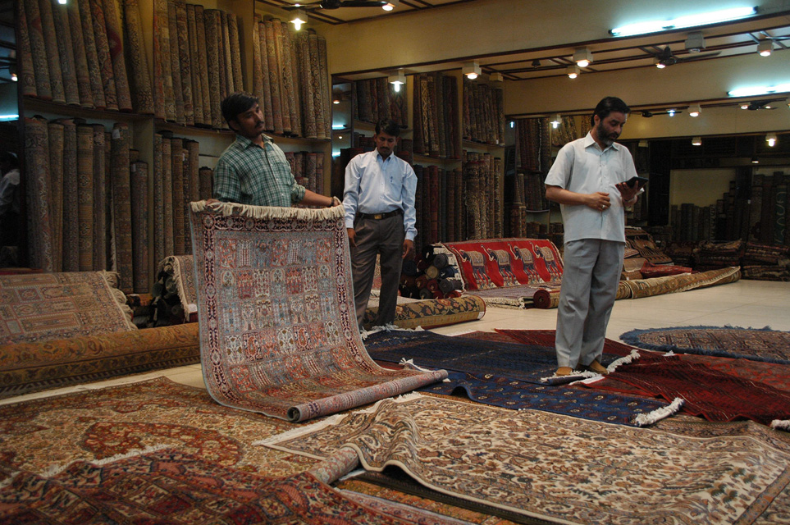
Jaipur - carpet shop

Slide 44
Jaipur market

Slide 45
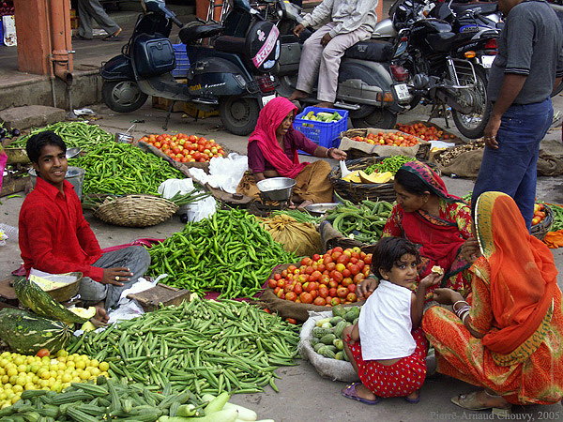
Market - Legumes

Slide 46
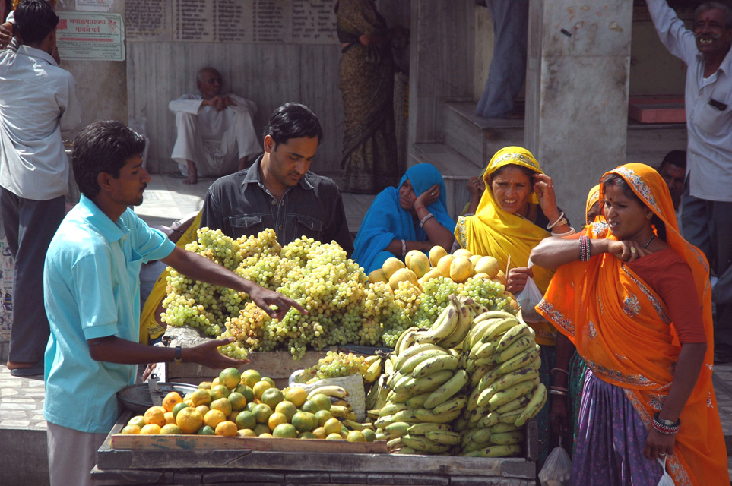
Fruit stall at the market

Slide 47
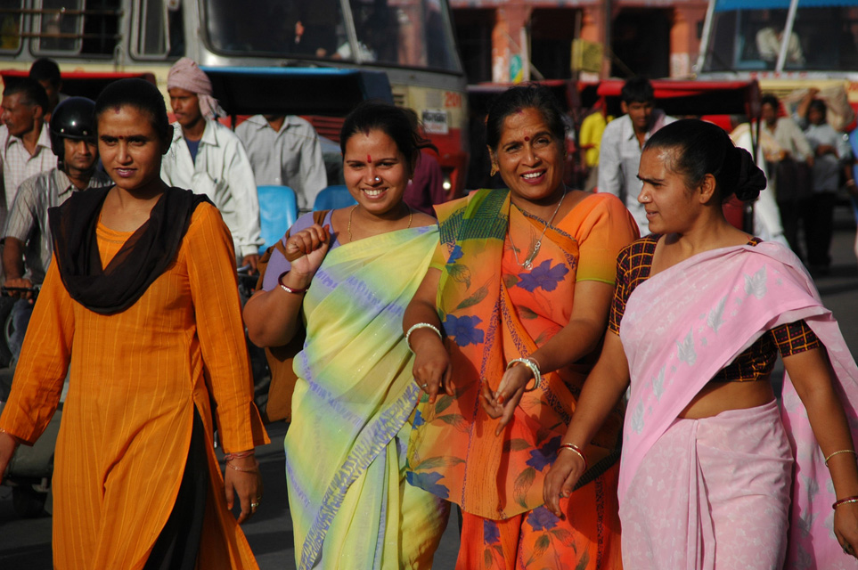
Women in traditional dress

Slide 48
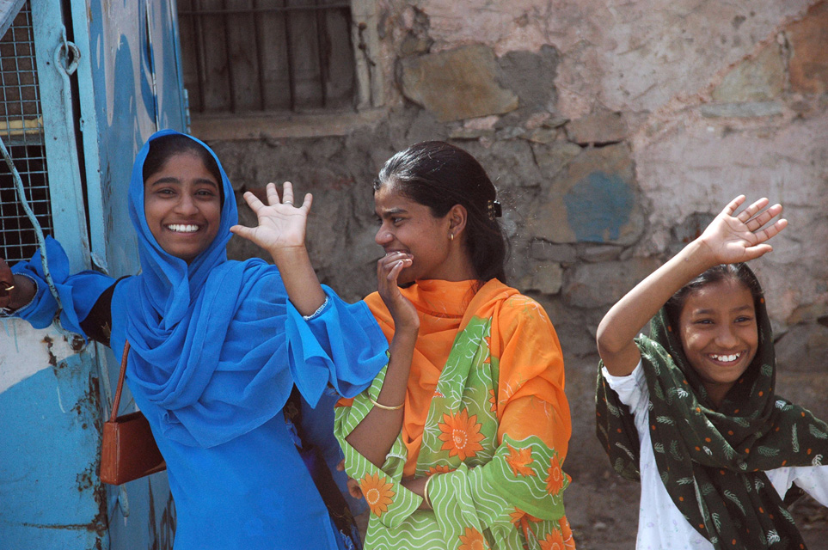
Girls in traditional dress

Slide 49
A view of the Jaipur to Ajmer Road in Rajasthan (India)

Slide 50
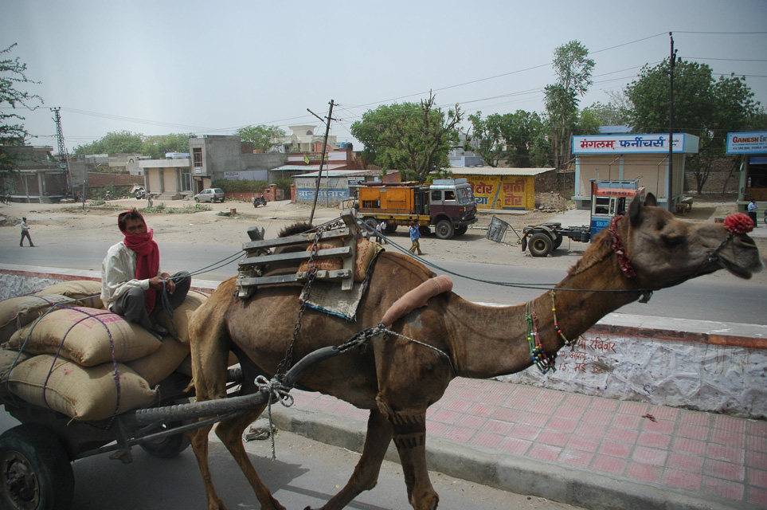
camel cart on the road from Jaipur to Ranthambore National Park

Slide 51
Jaipur Airport

Slide 52
Additional Scenes

